Slide 1

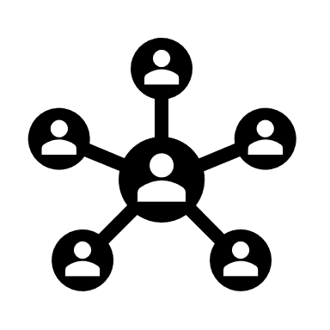





Architecture
HTML, CSS, Material UI
UI Components
S
E
C
U
R
T
I
Y
A
U
D
I
T
Angular.js, D3.js
UI Process Components
Active Directory
Windows Authentication
2 load balancers
Web API
.Net 4.7
MVC 5
REST Web API Layer
Business Service Layer
Business Entities
Entity Framework 6
ORM
Log4net
MS SQL Server 2017
Database
WEB API
ESB
SMTP
Power BI Dashboard
Automated Email Process
Excel File
Local DB
CRM
Third Party Sources

Slide 2
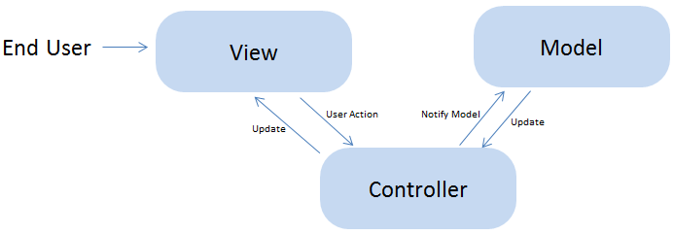
The application follows a 3 tier architecture.
UI Layer
Consists of Upload functionality , datatables , autocomplete boxes and D3. js charts to display small information’s like score , number of engagements done etc.
The manual upload functionality is backed up by strong validation and combinations of different KPIs, so that properly sanitized and expected data as per the predefined template will get ingested in to the database.
Nightly refresh of DB is backed up by SSIS jobs which will ingest third party sources data into local DB using a defined structure of data and its columns.
Business layer
It consists of all business logic and application logic written in Asp.net MVC where model and controllers are defined.
Application is constructed using database first approach.
Dependency Injection has been used to make loosely coupled code.

Slide 3
Entity framework is used for ORM and querying of database using LINQ for creating, updating , modifying and deleting the objects in the DB.
Applications also trigger some Store procedures and Jobs to get the data on the screen.
If there are long running jobs are going on then an email will be sent out to the respective person upon on completion.
Restful API’s has created to GET, POST data in to database triggered from the UI.
ESB’s are used to connect to CRM endpoints to get the data , match and saving of data in the Local DB.
Local DB consists of all CRM data which refresh nightly, so that when a user try to save record it will first search in the DB if it was not there it will go to CRM, by this application is not unnecessarily poking CRM and results in to reduced time while processing a record.
3. Database Layer
It consists of all the objects , tables, Stored procedures , Views , functions and algorithms.
4. Security Layer
In terms of security authentication is happening using windows authentication where data is fetched from active directory.
Authorization is done at application level if a person is not in the DB table then that person has to email admin team to add him/her to get the access of application and on the basis of certain roles one can then further see/access pages, data or functionality.
An admin section is available as a part of application where one can add user, roles , campaign names, scoring model values, threshold, email ids , activities etc.

Slide 4
5. Auditing or tracking
Auditing or tracking is evaluated using log4net.
Errors and description of logging information are rolled and saved in files for further analysis if something fatal had happened.
6. Automated Mail process
On every day at 7:00 am system will trigger an application written in C# which will send emails to all the respective recipients extracted from DB.
Application is scheduled using task scheduler of windows.
Application will automatically fetch data of recipients from local DB, prepare the data to send, prepare the template and send it to the users one by one and logs each and every step in the log file.
SMTP is used for sending emails.
In case of failure or error an email will be send to the developer with the short description of error to check the cause.
7. Deployment process
This process is manual right now, whenever deployment needs to be done a package has to be created and deployed on IIS of 2 load balancers machines.
Versioning is done manually on machines itself by creating a backup of the package when ever there is a need of deployment.
Code check in / out is done using TFS.

