Slide 1
E-COMMERCE SALES ANALYTICS
77%
CASE STUDY
Sales have stalled. The way to grow again is through the customers the business already has.
of revenue comes from repeat customers
…yet 43% of customers bought only once.
Power BI · Python · DAX | 250,000 orders analysed
Notes:
Open with the conclusion. Revenue is flat year on year, and most of it comes from customers who come back. The rest of the deck shows the evidence and what to do about it.

Slide 2
E-COMMERCE SALES ANALYTICS
CASE STUDY
Sales have stalled. The way to grow again is through the customers the business already has.
77%
of revenue comes from repeat customers
…yet 43% of customers bought only once.
Power BI · Python · DAX | 250,000 orders analysed
Notes:
Open with the conclusion. Revenue is flat year on year, and most of it comes from customers who come back. The rest of the deck shows the evidence and what to do about it.

Slide 3




Sales have stalled: Where should we focus?
“
Which products and customers actually bring in the money, are those customers coming back, and where are we losing orders?
Profile & clean
Python: checked keys, gaps and the price arithmetic; removed personal data
Model
Star schema: one sales table linked to customers, products and dates
250K
40K
2K
25
Measure
DAX layer: revenue, AOV, repeat rate, growth, fulfilment
orders
customers
products
months of data
Visualise
Indian online retailer, all values in ₹. 7 categories, 10 states.
6-page Power BI report, one business question per page
Notes:
Frame the business problem in the client's own words, then show the data and the four-step method in one glance. Technical detail lives in the GitHub repo for anyone who wants it.

Slide 4
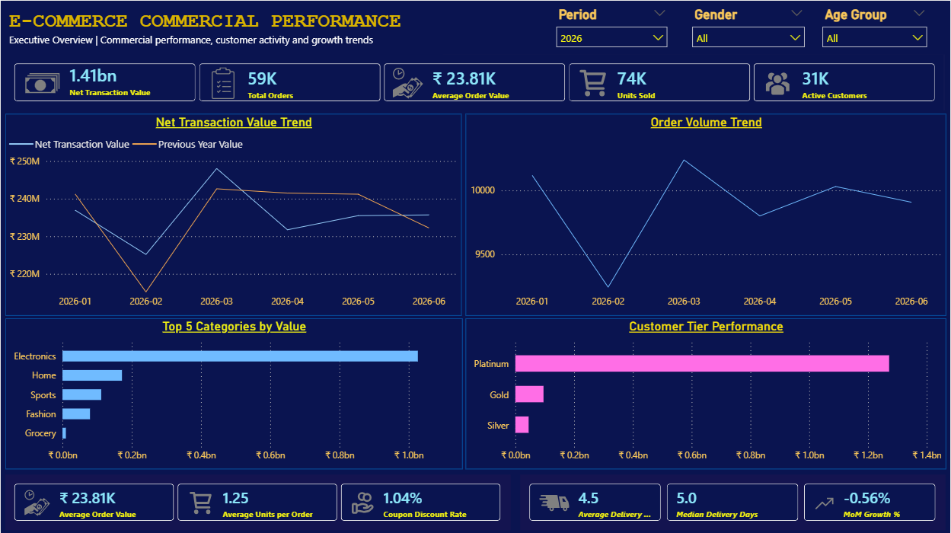
Revenue is flat and relies on a single category
₹1.41bn
Revenue, Jan–Jun 2026: −0.1% vs the same period of 2025
73%
of revenue from Electronics; all top-10 products are electronics
10%
of orders cancelled or returned (₹139M of order value)
Executive Overview page: revenue tracks last year (orange line) almost exactly
Notes:
The business is stable, not growing. Every month sits between ₹215M and ₹248M. Concentration in Electronics is a risk. About one order in ten is lost to cancellation or return.

Slide 5
Platinum and repeat buyers drive the revenue
4.9×
A Platinum customer is worth ₹57.7K, a Silver customer ₹11.8K
2.6×
A repeat buyer is worth ₹62.7K, a one-time buyer ₹23.9K
41%
Silver repeat rate, against 60% for Platinum
Notes:
This is the core of the story. A minority of customer types produces a majority of revenue. Higher tiers spend more, order more and come back more often, so the tier system reflects real behaviour. One-time and lower-tier customers are the untapped upside.

Slide 6




Four ways to restart growth
Win the second purchase
Build a tier ladder
Send first-time buyers a follow-up offer. 13,400 customers bought only once.
Protect Platinum; give Silver and Gold clear rewards for moving up.
Cross-sell beyond Electronics
Cut cancellations and returns
Recommend Home and Sports products to Electronics buyers.
Break the ₹139M lost by product and payment mode to find avoidable causes.
Notes:
Each action ties directly to a finding. Retention and tier progression come first because that is where the value already sits. Cross-selling hedges the reliance on Electronics. Cancellations and returns are the largest leak.

Slide 7



ANALYSIS APPROACH
Clean data model
Power BI dashboard
Prioritised action plan
Validated, documented and free of personal data
Pages built around your business questions
Every recommendation tied to a number
Scope note: the data has no product cost, so findings describe revenue, not profit.
Full project, code and dashboard: github.com/Vin-Okumu/e-commerce-sales-analytics
Have a similar project? I can apply the same approach to your own sales data for actionable insights like these!!
Notes:
Close by turning the case study into an offer: what the client gets if they hire you. Point to the repo for technical reviewers.

