Slide 1

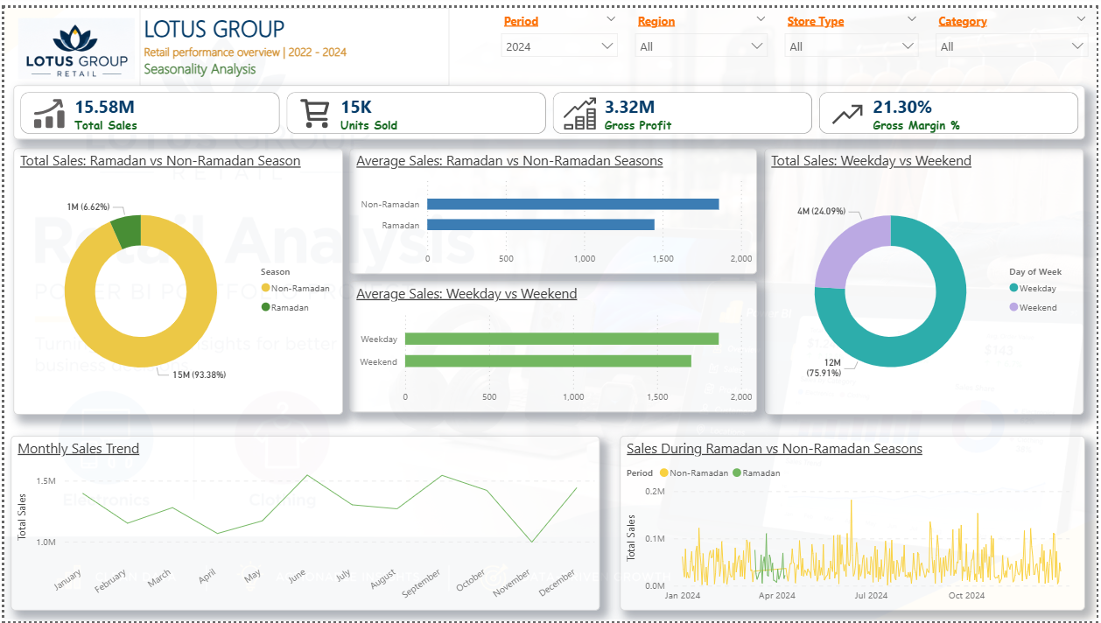
Lotus Group Retail
RETAIL ANALYTICS CASE STUDY
Where does Lotus Group’s profit really comes from
A Power BI analysis of Lotus Group, a 15-store Egyptian retailer: EGP 45.4M in sales and 12,000 orders, 2022–2024
54%
of gross profit comes from clothing, which is only 24% of sales
Vincent Okumu · Power BI & Retail Analytics
Notes:
This is a case study from a retail analytics project. In one line: the business thought electronics was its engine, but clothing quietly earns more than half the profit. The next five slides show how I got there and what it means.

Slide 2


The challenge: Nine messy tables and no single view
9
43K
“We run 15 stores selling clothing and electronics. Our data is spread across nine tables and we don’t fully trust it. We need to see where revenue and profit really come from.”
source tables
rows of data
3 yrs
15
2022 – 2024
stores, 7 regions
Problems found and fixed before any chart was built
50 duplicate customers removed
632 orders with no staff ID kept and tracked
Two order tables merged into one
Inconsistent labels and data types fixed
Notes:
This is the brief as a client would put it. Before building anything, I audited every table. The data had the same problems real client data has: duplicates, missing IDs, split tables and messy labels. Each one was documented and fixed in Power Query, so every number in the report can be traced.

Slide 3
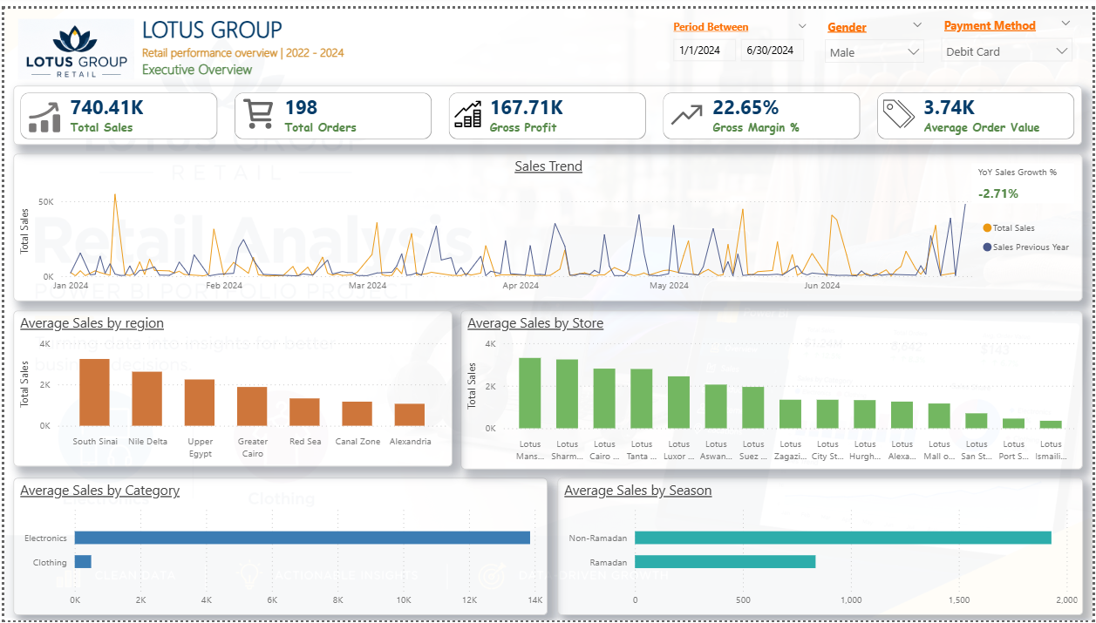
The solution: One trusted model and a 7-page Power BI report
1
Audit
Profiled every table for duplicates, gaps and broken links
2
Clean
Power Query transformations, each step logged
3
Model
Star schema: 5 dimension and 3 fact tables
4
Measure
25 reusable DAX measures, including YoY and Ramadan
5
Report
7 pages: executive, product, store, customer, staff, season, returns
Executive overview, shown filtered to Jan–Jun 2024, male customers and debit-card payments. Every page responds to date, store and customer filters
Notes:
Five steps, in this order on purpose: the dashboard is the last step, not the first. The model is a star schema, so one set of measures works on every page. The report gives each manager their own view.

Slide 4
Clothing earns 54% of the profit from 24% of the sales
47%
gross margin on clothing
13%
gross margin on electronics
So what? Electronics brings people in, but clothing pays the bills. Cutting clothing space to make room for electronics would lower profit.
Notes:
This is the main finding. Electronics is 76% of sales, so it looks like the core of the business. But it earns a 13% margin, against 47% on clothing. Clothing produces EGP 5.2M of gross profit compared with 4.5M from electronics. Discounts are the same in both categories, so the gap comes from pricing and cost.

Slide 5




Four more findings management can act on
37%
of sales come from 3 Cairo flagship stores
59%
of revenue comes from the top 20% of customers
The 7 Small stores average a third of a flagship’s sales, because they get fewer orders, not smaller baskets.
But spend is the same in every loyalty tier, so the programme isn’t identifying them.
−19%
electronics sales per day during Ramadan
37%
of returned value comes from avoidable errors
Clothing sales hold steady (+3%), so Ramadan is a clothing season.
Duplicate orders and wrong items: about EGP 1.5M over three years.
Notes:
Four supporting findings. Each one points to a specific action on the next slide: protect the flagships while growing traffic to small stores; rebuild loyalty around spend; plan promotions around Ramadan; and fix the checkout and fulfilment problems behind returns.

Slide 6
What Lotus Group should do next
1
Grow clothing
2
Raise electronics margin
More floor space and stock, especially in Small stores
Bundle accessories and warranties with big-ticket items
3
Rebuild loyalty around spend
4
Fix checkout and fulfilment
Target the top 20% of customers who drive 59% of revenue
Stop duplicate orders and wrong items, worth about EGP 0.5M a year
I can do the same for your business: clean your data, build a Power BI report your team trusts, and show you where your profit really comes from.
Notes:
Four actions, each tied to a finding. Close with the offer: the same process (audit, clean, model, report, recommend) works on any retail or sales dataset. Full project: github.com/Vin-Okumu/lotus-group-retail-analytics

