Slide 1
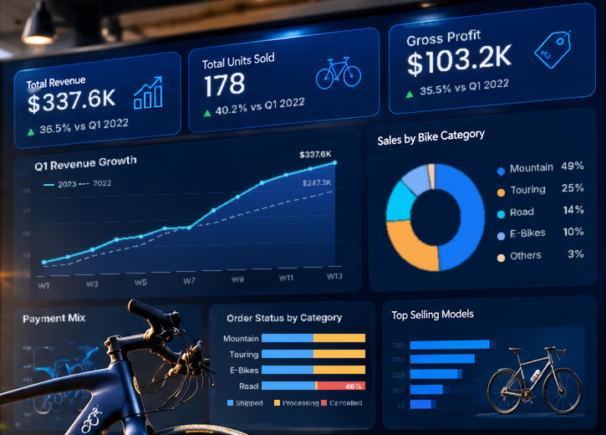
Revenue grew 36%, but one product line is losing $96K a quarter
STARTER BIKE LLC · Q1 SALES ANALYTICS
Power BI analysis of Q1 2022 vs Q1 2023 sales
Prepared by Vincent Okumu, Data Analyst
Notes:
This deck summarises what the Power BI dashboard found in two years of first-quarter sales. Headline: the business is growing fast, but almost all lost revenue comes from cancelled Road Bike orders.

Slide 2




The question, the data and how it was answered
1. Audit & clean
THE BUSINESS QUESTION
Profiled all 15 fields in Excel and Power Query
“Which products make us money, why do orders get cancelled, and how much tax do we owe, without building the report by hand every time?”
2. Model
18 DAX measures: revenue, profit, tax, fulfilment
3. Visualise
245
order lines
4-page interactive Power BI dashboard
2
quarters (Q1 2022, Q1 2023)
4. Recommend
0
missing values
Findings turned into actions with a $ value
Notes:
Starter Bike had two years of first-quarter sales in a spreadsheet and no single view of performance. I audited the data (it was clean: no gaps or duplicates), built the calculations in Power Query and DAX, and designed a four-page dashboard covering sales, products, operations and tax.

Slide 3
Q1 revenue grew 36.5% year on year, led by Mountain Bikes
$337.6K
Q1 2023 revenue, up from $247.3K
$103.2K
gross profit, a steady 31% margin
49%
of revenue from Mountain Bikes alone
Notes:
Revenue rose from $247K to $338K and profit grew at the same pace, so the growth is healthy, not discount-driven. Half of all revenue depends on Mountain Bikes, which is a strength and a concentration risk.

Slide 4
Road Bikes account for 99% of cancelled order value
$96.3K
of the $97.5K in cancelled orders came from Road Bikes
46% of Road Bike orders were cancelled; no other major category lost any.
It also happened in Q1 2022, so it is a recurring problem, not a one-off.
Notes:
This is the key finding. Cancelled orders were worth $97.5K, about 22% of everything ordered, and almost all of it was Road Bikes. Every other major category shipped or was still processing. Because the same pattern appears in 2022, the cause is likely structural: stock, lead times or pricing on Road Bike models.

Slide 5
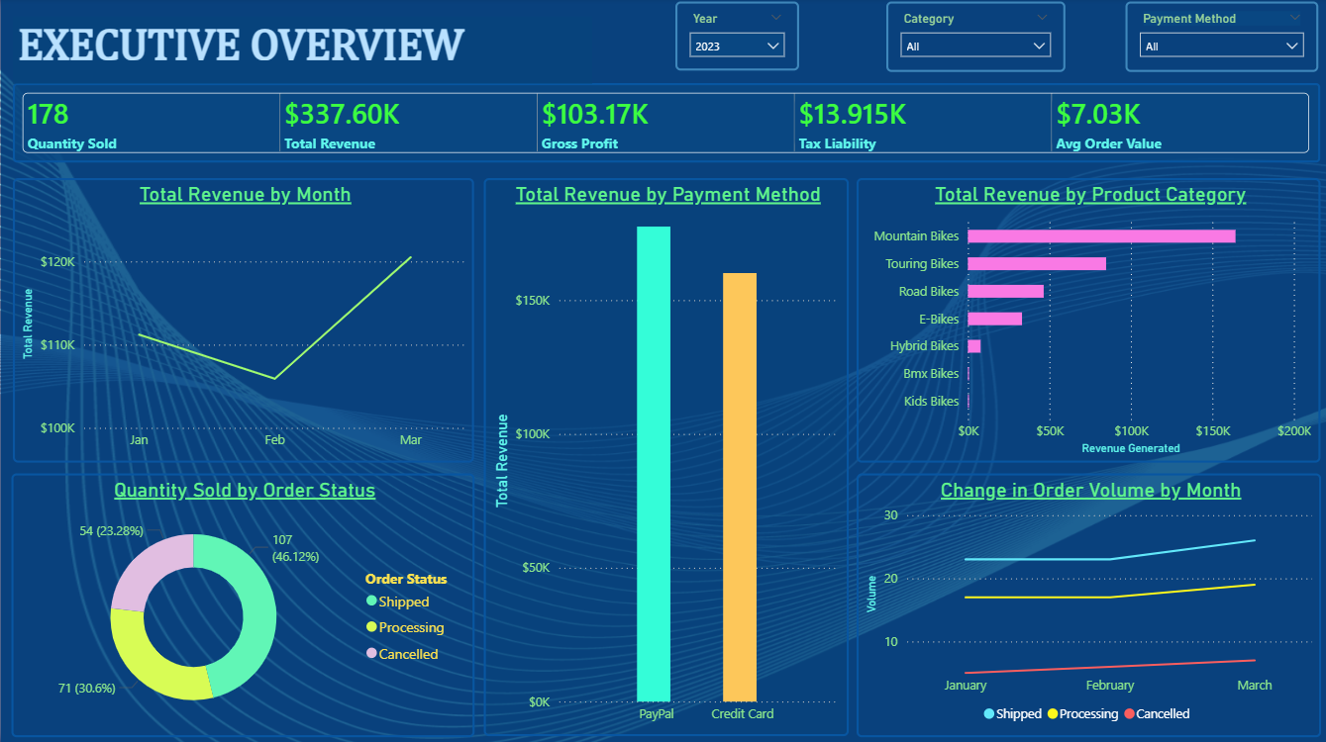



Three actions, starting with Road Bike cancellations
Fix Road Bike cancellations
Check stock, delivery times and pricing. Recovering half adds about $48K a quarter.
Protect the Mountain Bike line
It earns half of revenue; secure stock and supplier terms before Q1.
Grow higher-value PayPal buyers
The dashboard replaces manual reporting and updates as each new quarter is added.
Their orders are 41% larger than card orders; feature PayPal at checkout.
Notes:
Start with the cancellations: it is the biggest and most fixable leak. Then protect the line that carries half the business, and lean into the customers who spend more. The dashboard itself becomes the monthly reporting pack, so these can be tracked going forward.

