Slide 1
Generative Optimisation of Indoor Farm Design
With Genetic Algorithms and Building Performance Simulation
Vincent Kenny
Supervisor – Dr Tom Friedetzky

Slide 2
Motivation
Academic
Environmental
An underexplored domain for generative design.
Provides an objective, performance driven optimisation goal.
Not limited by many of the layout constraints that are present in residential building design.
Decrease in arable land from soil degradation, urbanisation and climate change.
Rising populations
Water scarcity

Slide 3
Objective
To develop a generative design framework, which is capable of creating energy-efficient and profitable solutions tailored to specific environments.

Slide 4
Related Work
Energy Efficient Architecture
Genetic Search Algorithm
Literature is lacking in the vertical farming space, so I looked to an adjacent field, energy efficient architecture, when designing the methodology. Combination of a heuristic search algorithm, with Building Performance Simulation (BPS) has proven efficacy in this domain [1].
Suphavaropas et al. [1] published a 2024 review paper, summarising all work on generative design for energy efficient architecture. They found the following:
Between 4% and 21% efficiency gains
Genetic algorithm was the most common search algorithm used

Slide 5
RELATED Work - BPS
Caldas et al. (2007) [2]
Generation of energy-efficient architecture solutions applying GENE_ARCH; An evolution-based generative design system
Magnier et al. (2009) [3]
Multiobjective optimization of building design using TRNSYS simulations, genetic algorithm, and Artificial Neural Network
Si et al. (2019) [4]
Multi-objective optimization design of a complex building based on an artificial neural network and performance evaluation of algorithms
DOE-2.1
TRNSYS
EnergyPlus

Slide 6
Genetic Algorithm
EnergyPlus Simulation
Search
Evaluation

Slide 7
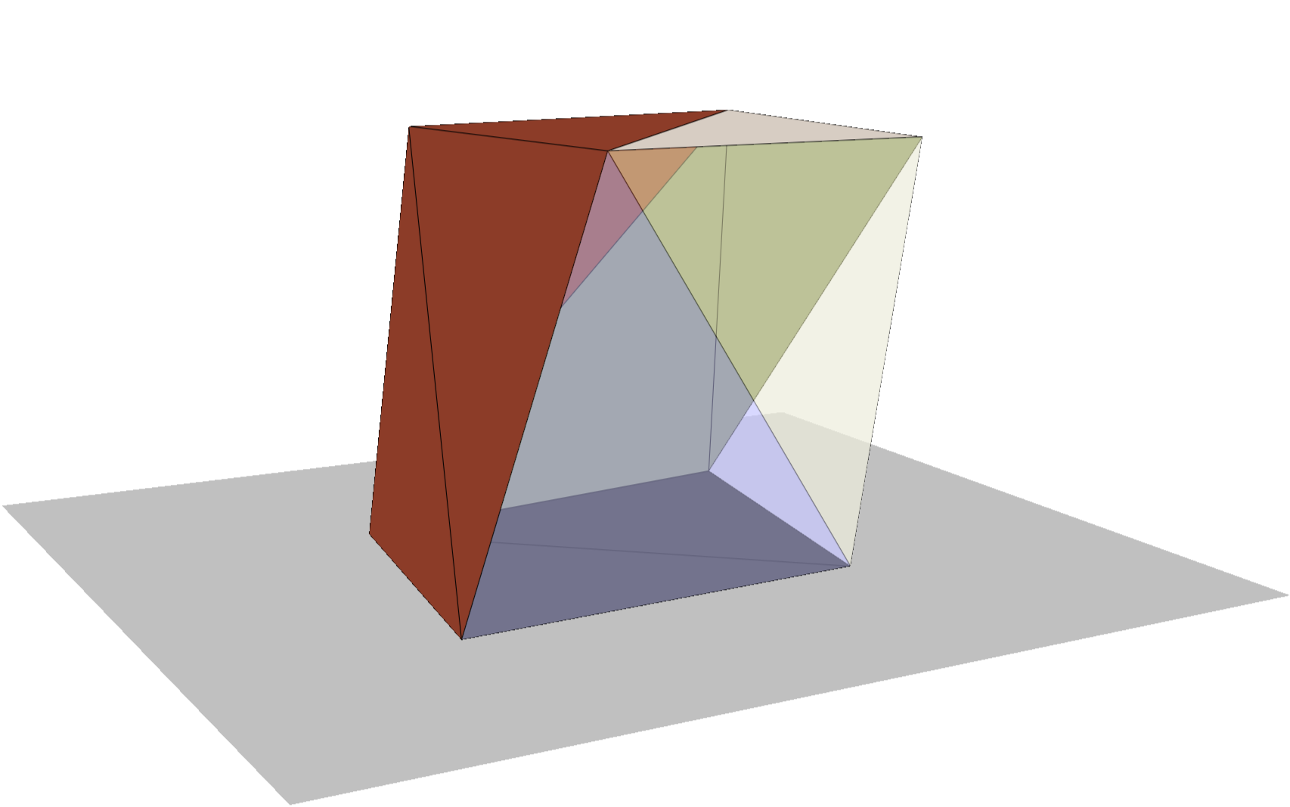
Candidate Representation
Each candidate stores all information necessary for evaluation of its own fitness, this is:
Geometry: Trimesh [6] mesh
Stored as an ordered list of vertices, and a list of faces
(flat floor)
Materials: List of Material objects
(separate sets for floor and non-floor faces)
Setpoints:
-Photosynthetically Active Radiation I_{set} : float
-Temperature T_{set} : float

Slide 8
Validity Constraints
Whole Mesh Constraints
Mesh has no self intersections.
Mesh height is within h_{min} and h_{max}
Mesh footprint is within A_{min} and A_{max}
No face has an area less than 2% of the mean area of all mesh faces.
The mesh is watertight.
Floor Face Constraints
No overlapping coplanar floor faces
No non-floor vertices below the floor height
The sum of floor face areas is greater than 5% of the total mesh surface area

Slide 9
Genetic Operators
Random Initialisation
Crossover
Mutation
Subdivision

Slide 10
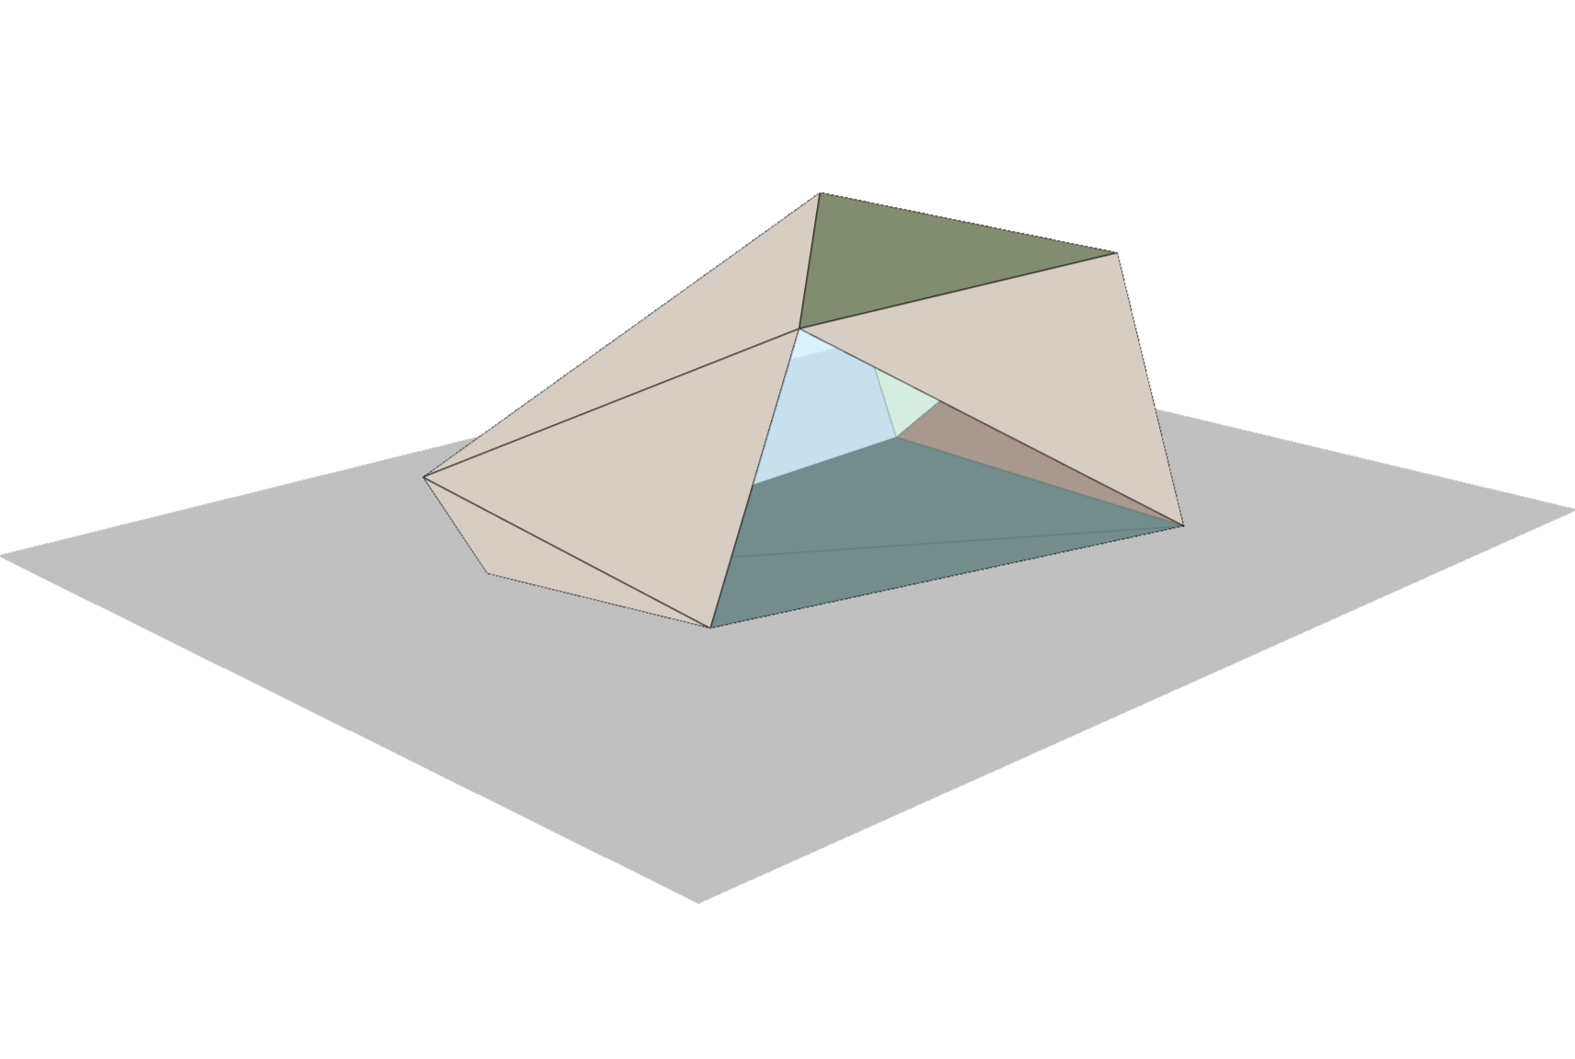
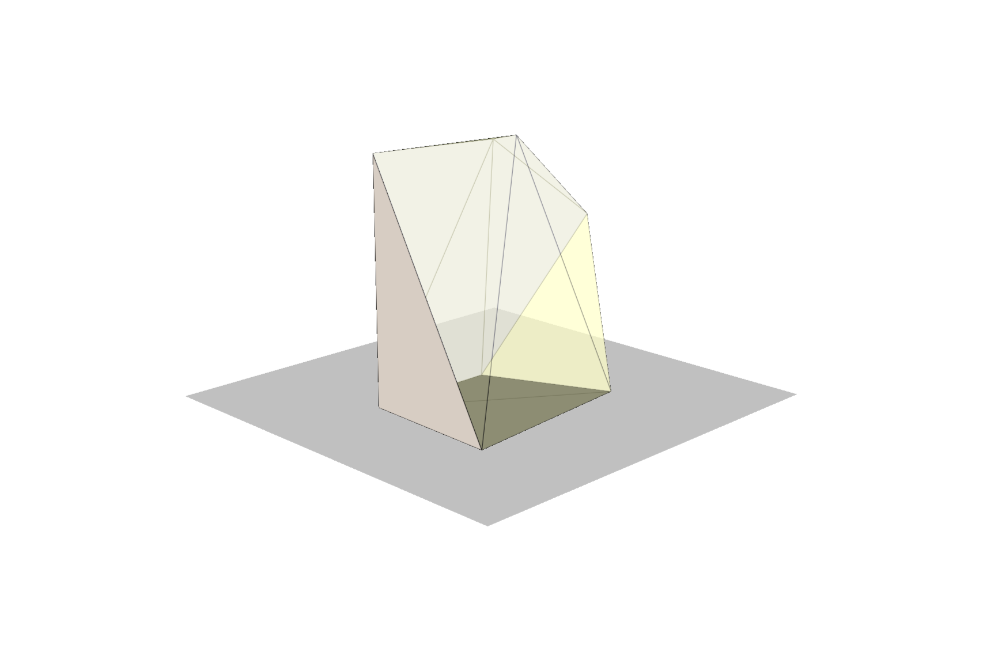
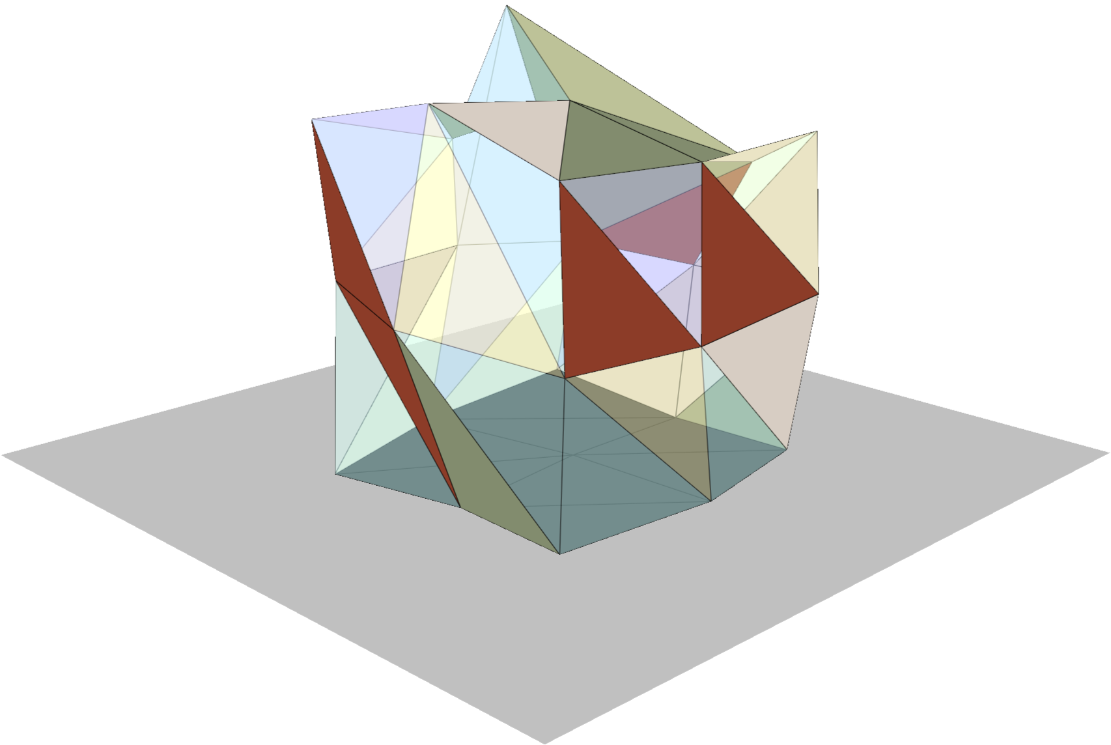
Random Initialisation
Start with a cuboid mesh, with dimensions randomly sampled from the permitted range.
Apply a series of vertex perturbations to introduce variation.
Check each perturbation against the validity constraints
Uniform random selection from the set of available materials at each face.
Uniform random sampling of the temperature and PAR setpoints from the permitted range.

Slide 11
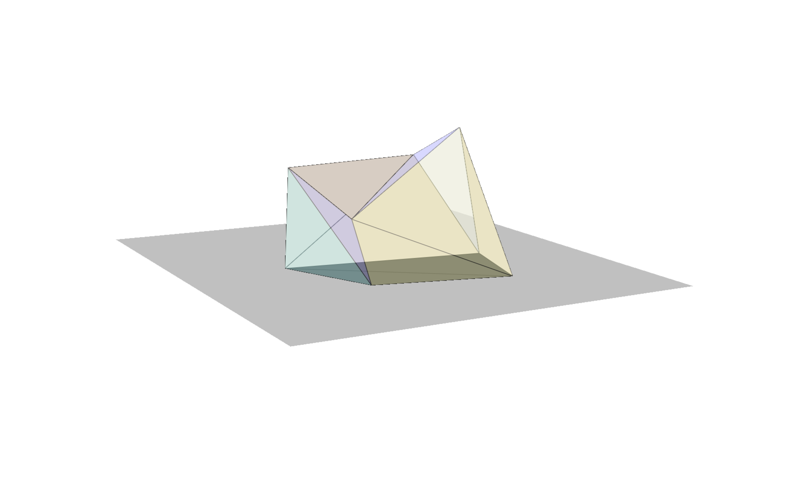
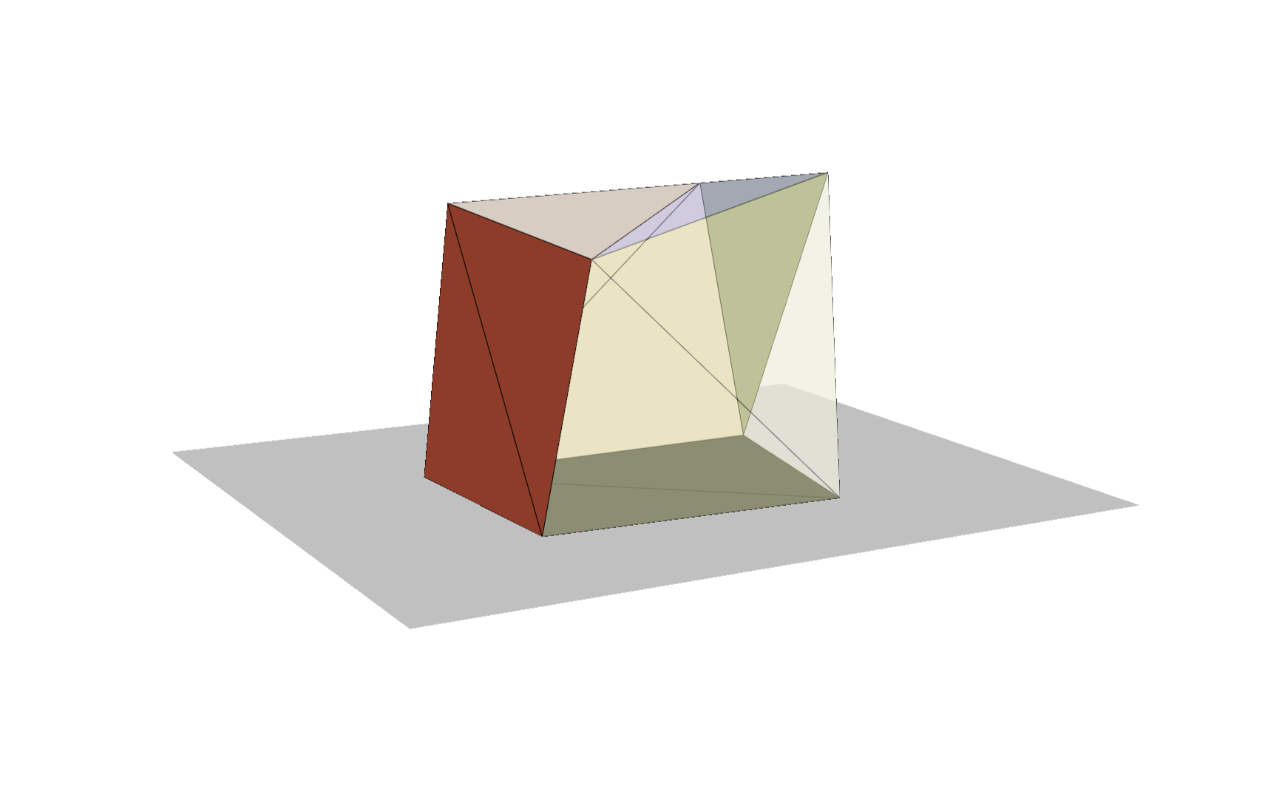
I_{set} = 8.4
T_{set} = 23.0
I_{set} = 1.1
T_{set} = 25.1
Crossover
Vertex interpolation using blending factor alpha (0.2 <= alpha <= 0.8).
Material selection using a binary choice with a blending factor beta (0.2 <= beta <= 0.8).
Setpoint linear interpolation with blending factors gamma₁ and gamma₂
(0.0 <= gamma <= 1.0).
I_{set} = 3.5
T_{set} = 23.8

Slide 12
Mutation
1. Face Mutation
2. Material Mutation
3. Scale Mutation
4. Setpoint Mutation

Slide 13
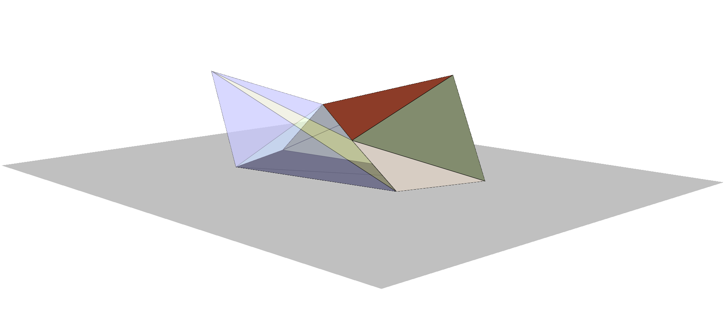
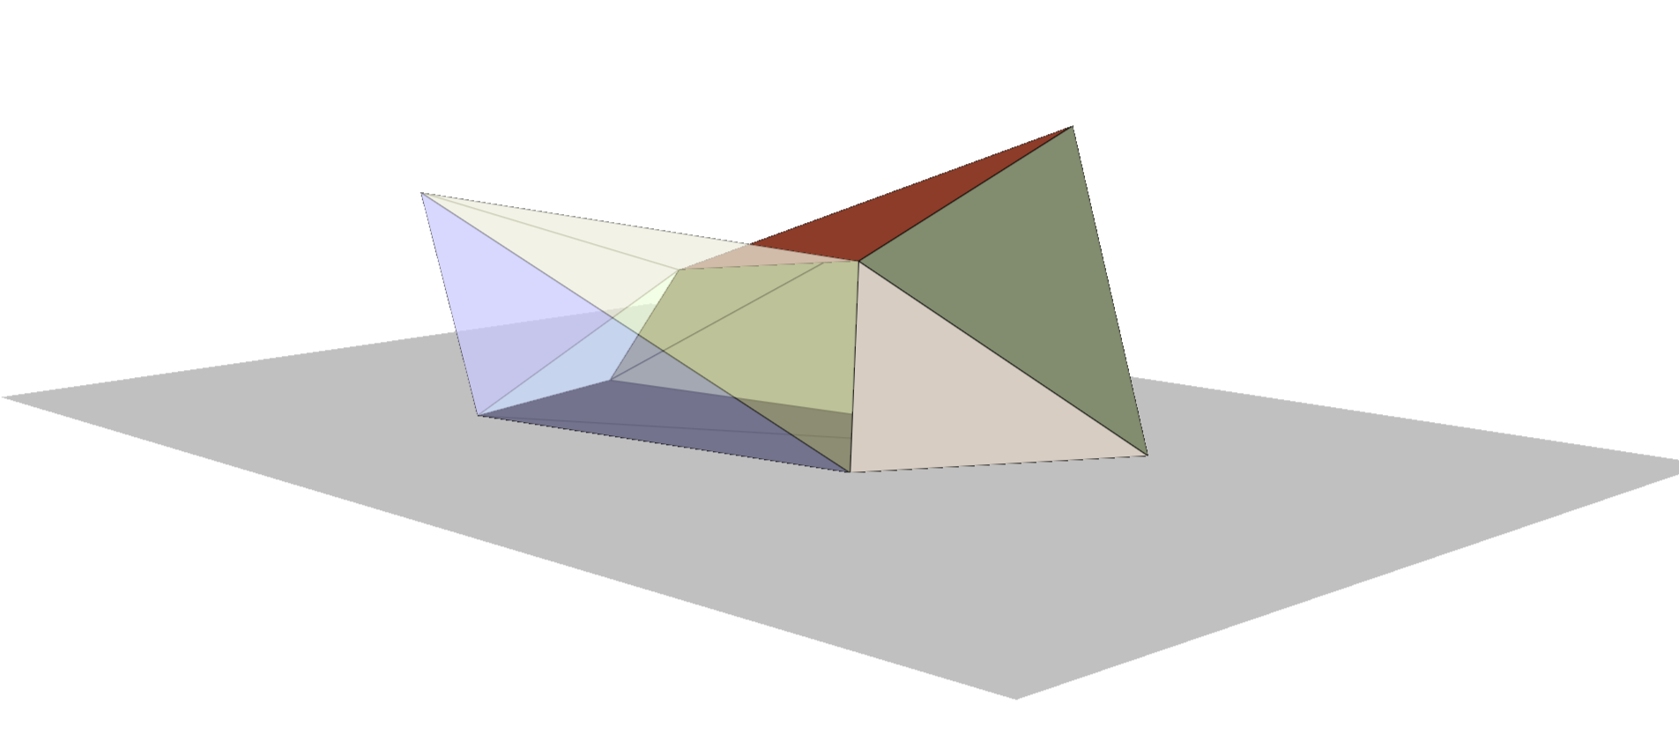
Face Mutation
Occurs with 100% probability.
Up to 3 faces selected.
Up to 3 vertices selected per face
Each vertex is displaced by a vector randomly sampled from between 0 and 10% of the bounding volume in each dimension.

Slide 14
Mutation
Face Mutation
(100%)
2. Material Mutation
3. Scale Mutation
4. Setpoint Mutation

Slide 15
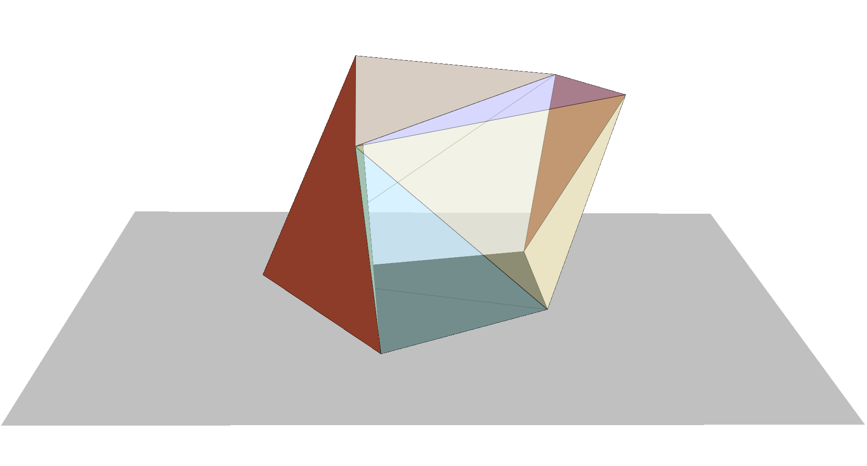
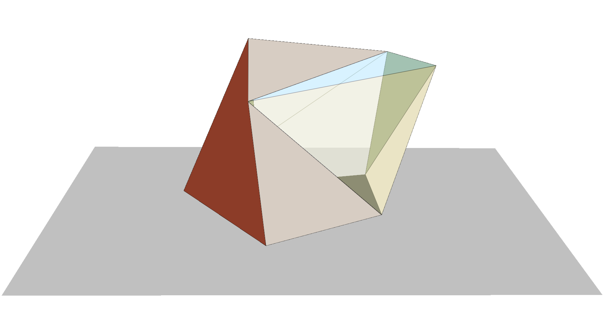
Material Mutation
Occurs with 50% probability.
Up to 3 faces selected.
Each face has its material flipped to another random material in its available set (floor or wall material).

Slide 16
Mutation
Face Mutation
(100%)
2. Material Mutation
(50%)
3. Scale Mutation
4. Setpoint Mutation

Slide 17
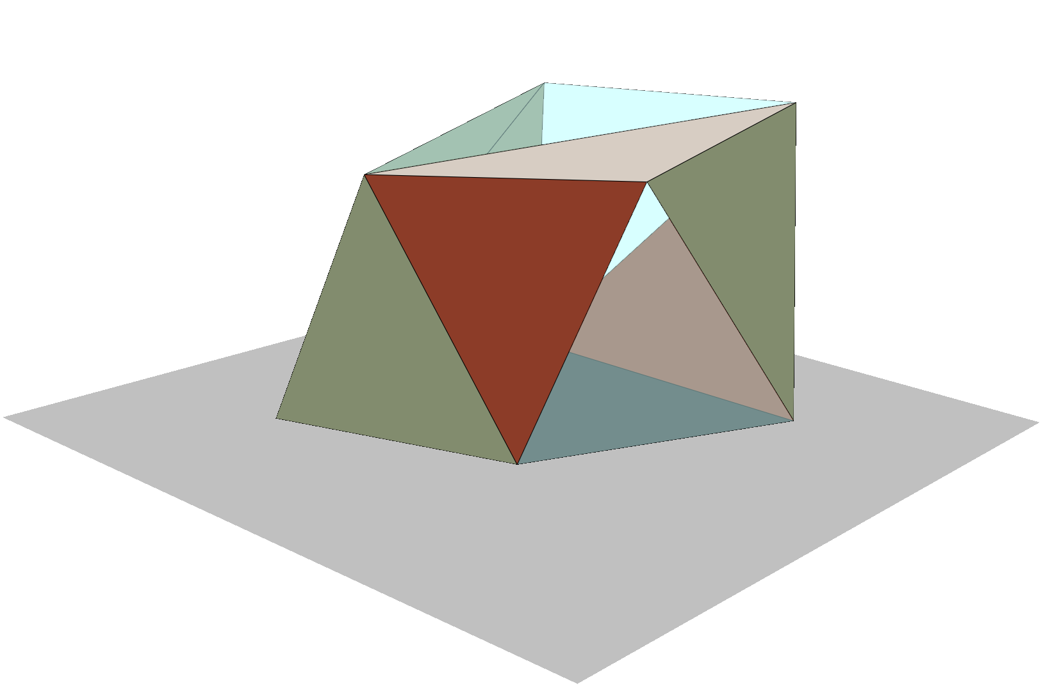
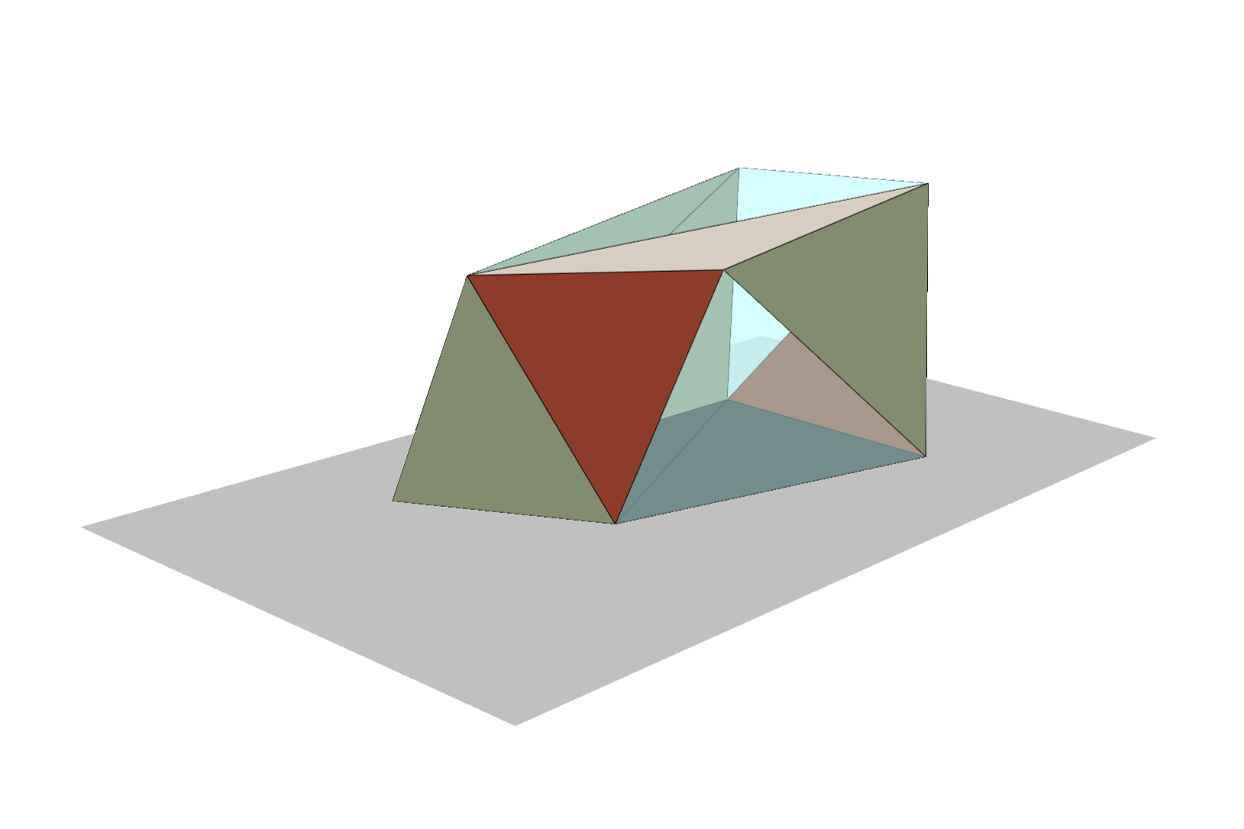
Scale Mutation
Occurs with 10% probability.
The mesh is scaled between 80% and 125% of its original size in each dimension (x, y, z) centred at the origin.

Slide 18
Mutation
Face Mutation
(100%)
2. Material Mutation
(50%)
3. Scale Mutation
(10%)
4. Setpoint Mutation

Slide 19
Setpoint Mutation
Occurs with 20% probability.
Independently mutated by addition of a mutation factor σ, which is drawn from a normal distribution centred at 0.
T′_{set} = T_{set} + N (0, σ_{T} )
I′_{set} = I_{set} + N (0, σ_{I} )

Slide 20
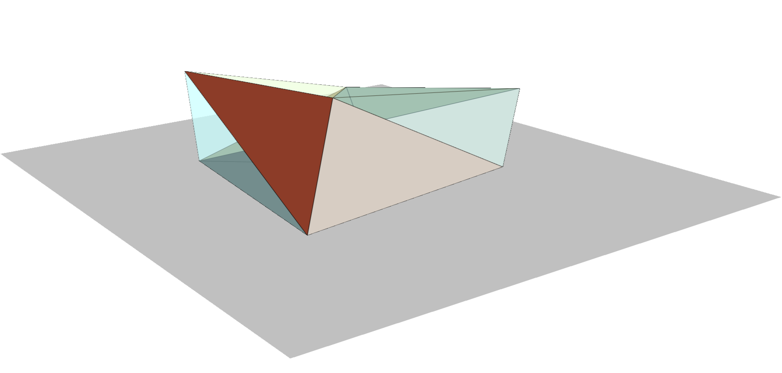
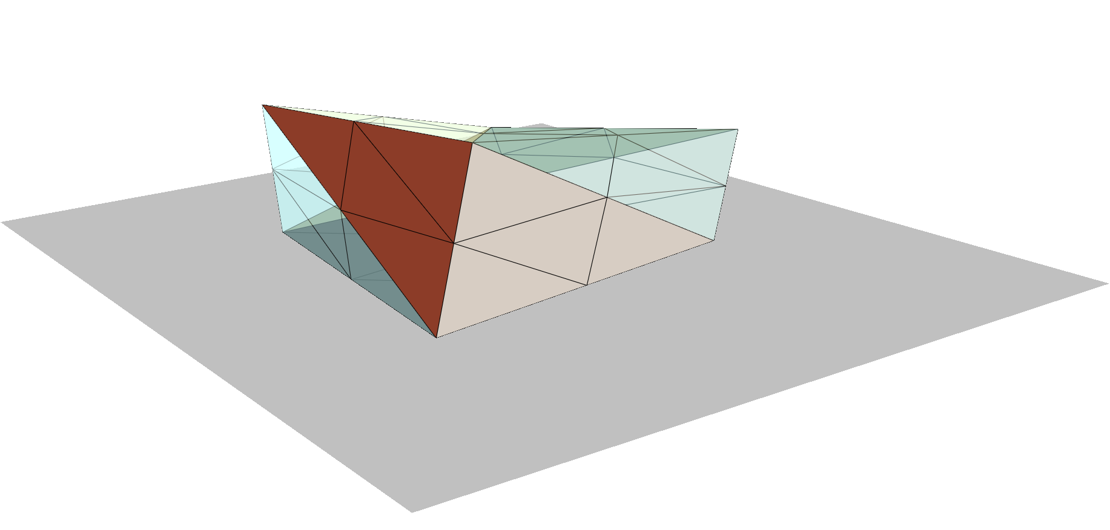
Subdivision
Increase the geometric detail in the mesh
Comes at the cost of increased evaluation time
Triggered at generation 700 out of 1200

Slide 21
Genetic Algorithm
1200 total generations, with subdivision at 700 (30 hours total run time)
50 population size
Distributed over 12 CPU threads (AMD Ryzen 3700x)
Top candidates from each generation survive unaltered
Crossover creates the children for the next generation, with random mutation
Remaining slots populated by random candidates
Proportion of each is variable, and outlined in full detail in the paper

Slide 22
Candidate Evaluation Pipeline
Heating + Cooling Loads
Lighting Load
SIMPLE Crop Model – Expected Yield

Slide 23
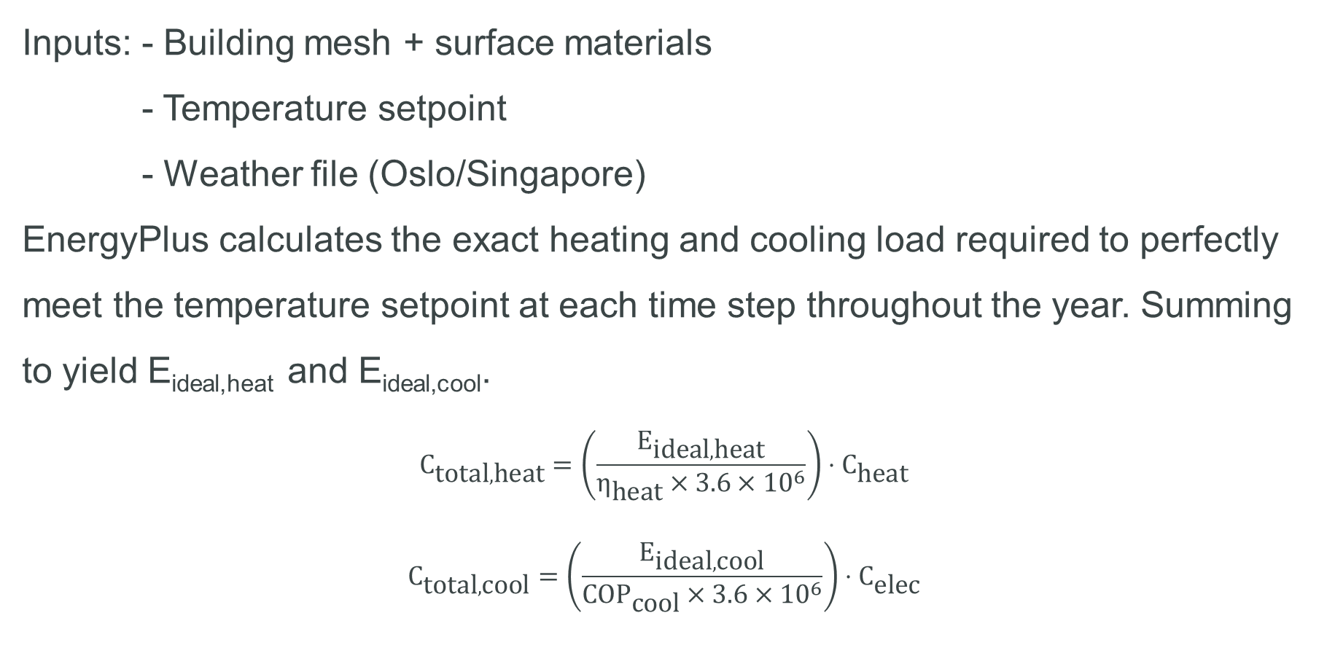
Thermal Loads
Inputs: - Building mesh + surface materials
- Temperature setpoint
- Weather file (Oslo/Singapore)
EnergyPlus calculates the exact heating and cooling load required to perfectly meet the temperature setpoint at each time step throughout the year. Summing to yield E_{ideal,heat} and E_{ideal,cool}.
$$C_{\text{total},\text{heat}}=\left(\frac{E_{\text{ideal},\text{heat}}}{η_{\text{heat}}×3.6×{10}^{6}}\right)⋅C_{\text{heat}}$$
$$C_{\text{tot}\text{al},\text{cool}}=\left(\frac{E_{\text{ideal},\text{cool}}}{{COP}_{\text{cool}}×3.6×{10}^{6}}\right)⋅C_{\text{elec}}$$

Slide 24
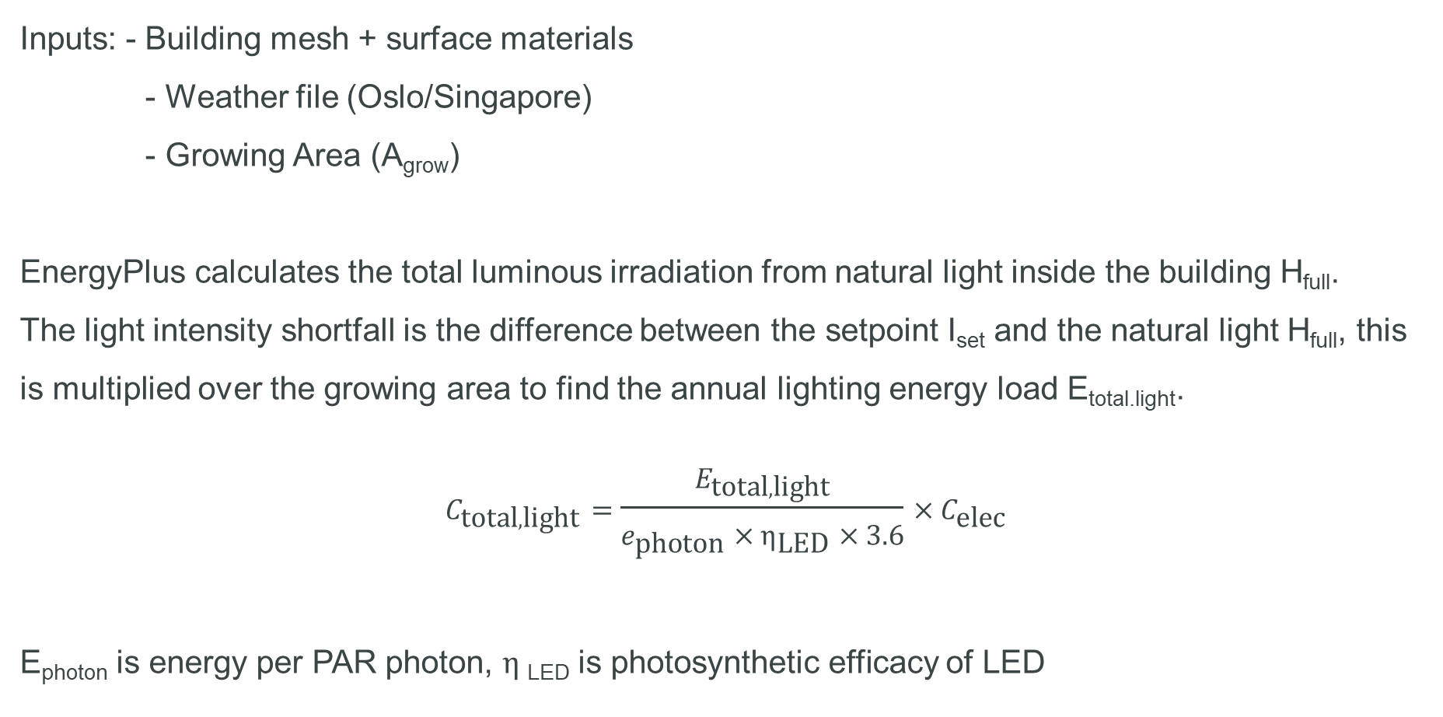
Lighting Load
Inputs: - Building mesh + surface materials
- Weather file (Oslo/Singapore)
- Growing Area (A_{grow})
EnergyPlus calculates the total luminous irradiation from natural light inside the building H_{full}.
The light intensity shortfall is the difference between the setpoint I_{set} and the natural light H_{full}, this is multiplied over the growing area to find the annual lighting energy load E_{total.light}.
$$C_{\text{total},\text{light}}=\frac{E_{\text{total},\text{light}}}{e_{\text{photon}}×η_{\text{LED}}×3.6}×C_{\text{elec}}$$
E_{photon} is energy per PAR photon, $η$_{LED} is photosynthetic efficacy of LED

Slide 25
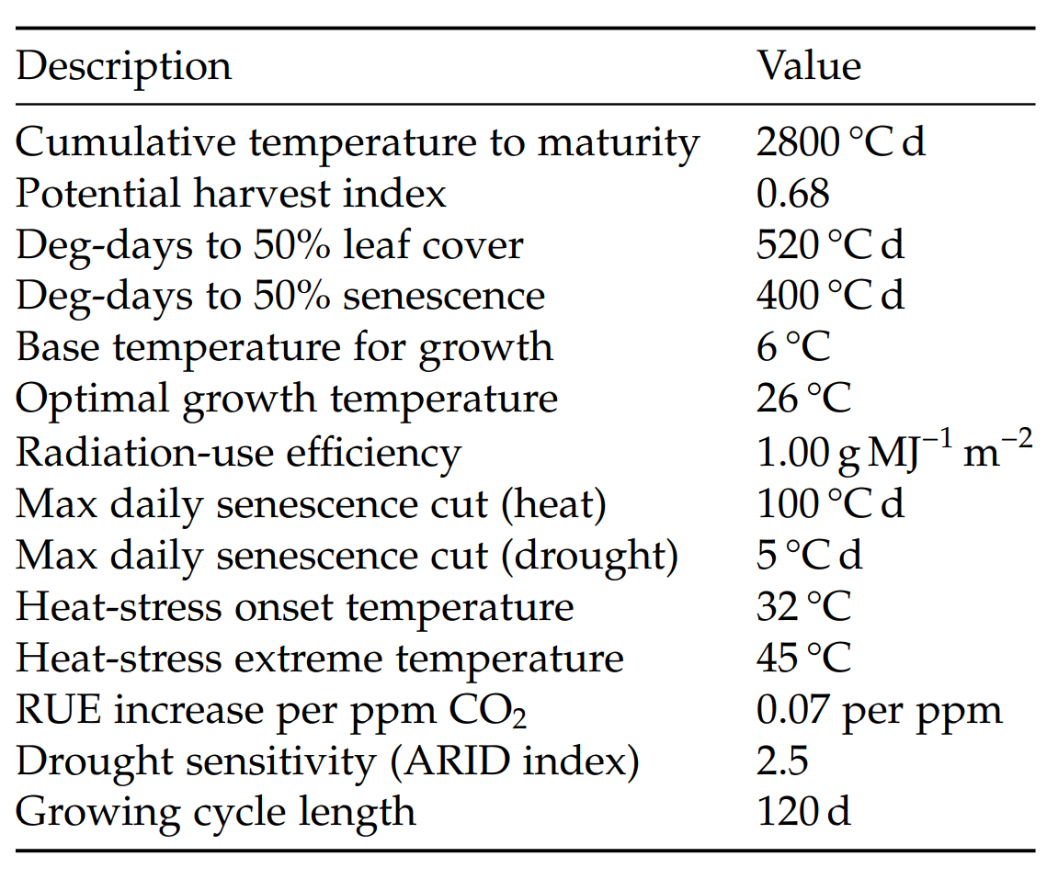
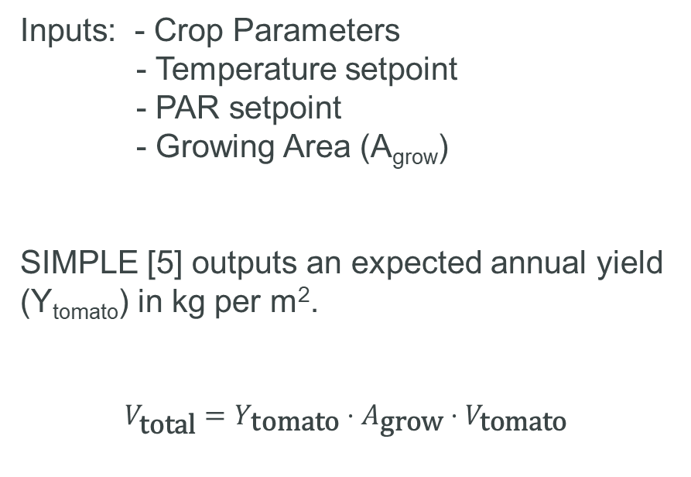
SIMPLE Crop Model
Tomato Parameters Used
Inputs: - Crop Parameters
- Temperature setpoint
- PAR setpoint
- Growing Area (A_{grow})
SIMPLE [5] outputs an expected annual yield (Y_{tomato}) in kg per m².
$$V_{\text{total}}=Y_{\text{tomato}}⋅A_{\text{grow}}⋅V_{\text{tomato}}$$

Slide 26
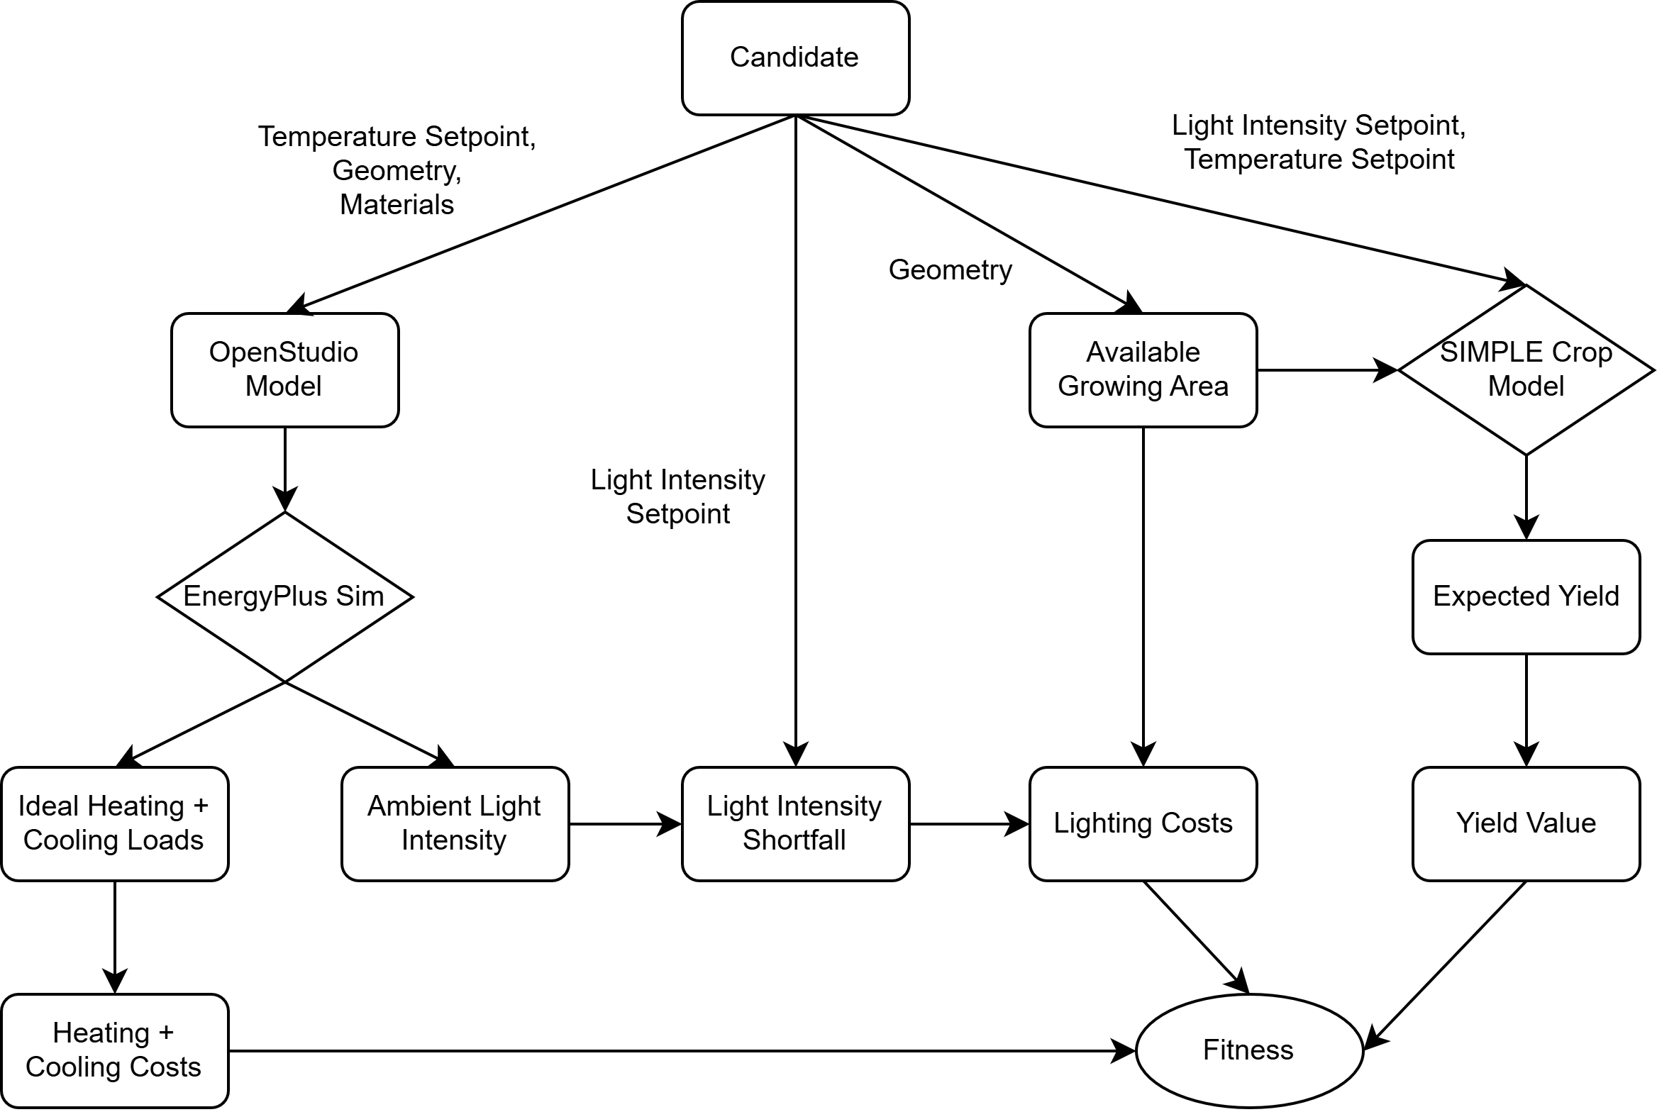

Slide 27



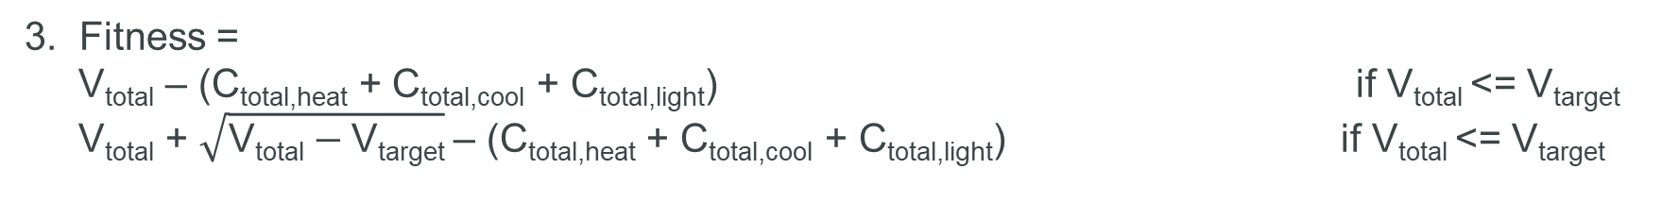
Fitness Function
1. Fitness = V_{total} – (C_{total,heat} + C_{total,cool} + C_{total,light})
2. Fitness = V_{total} / (C_{total,heat} + C_{total,cool} + C_{total,light})
3. Fitness =
V_{total} – (C_{total,heat} + C_{total,cool} + C_{total,light}) if V_{total} <= V_{target}
V_{total} + $\sqrt{\text{V}\text{total}−\text{V}\text{target}}$– (C_{total,heat} + C_{total,cool} + C_{total,light}) if V_{total} <= V_{target}
4. Fitness = 350 $\sqrt{\text{V}\text{total}}$ – (C_{total,heat} + C_{total,cool} + C_{total,light})
(350 is a variable value which controls the optimal yield tradeoff point)

Slide 28
Results
Final Design – Oslo
Final Design – Singapore
Design Comparison

Slide 29
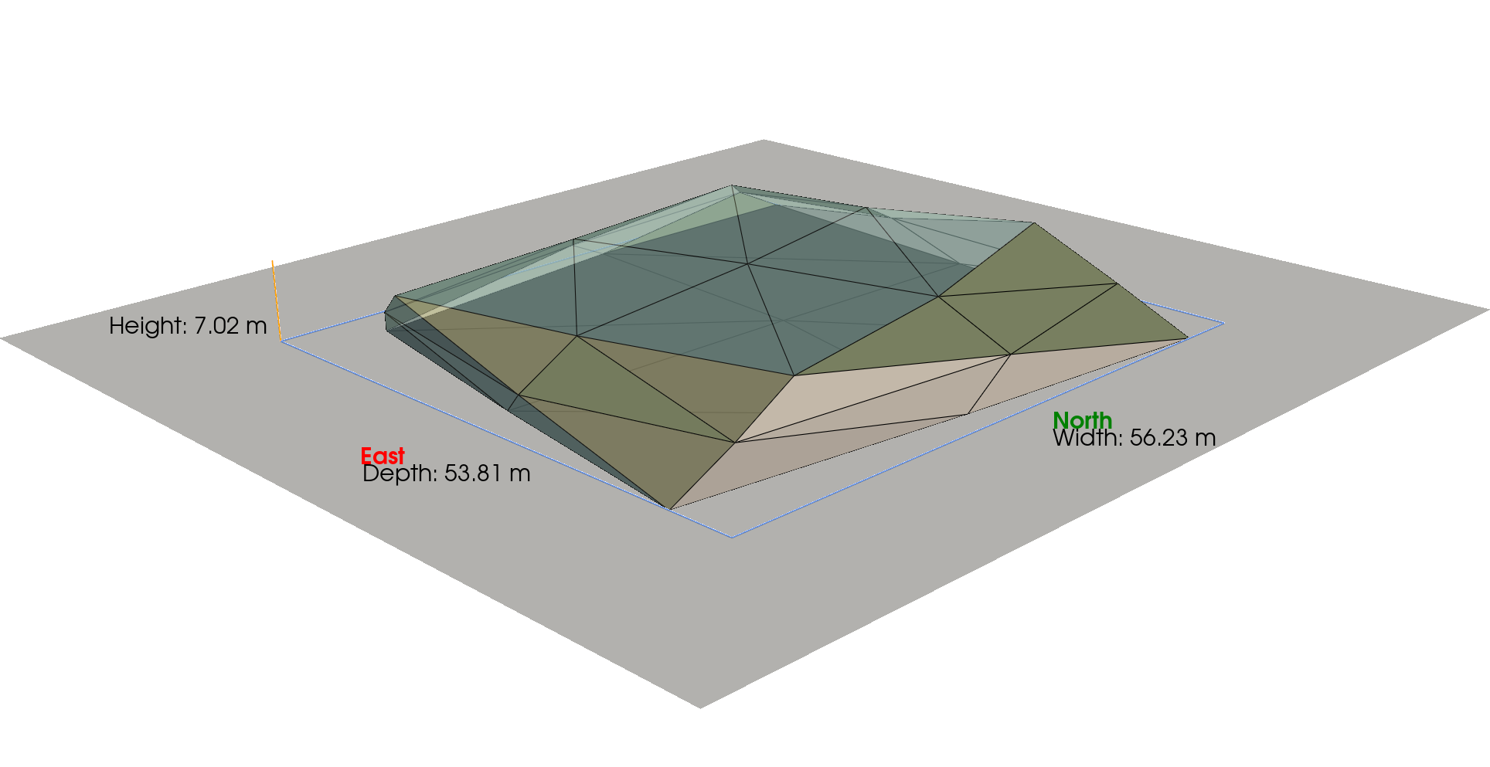
Oslo

Slide 30
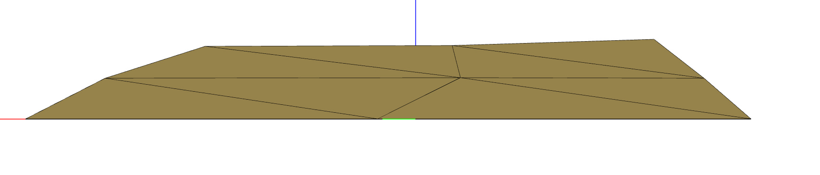
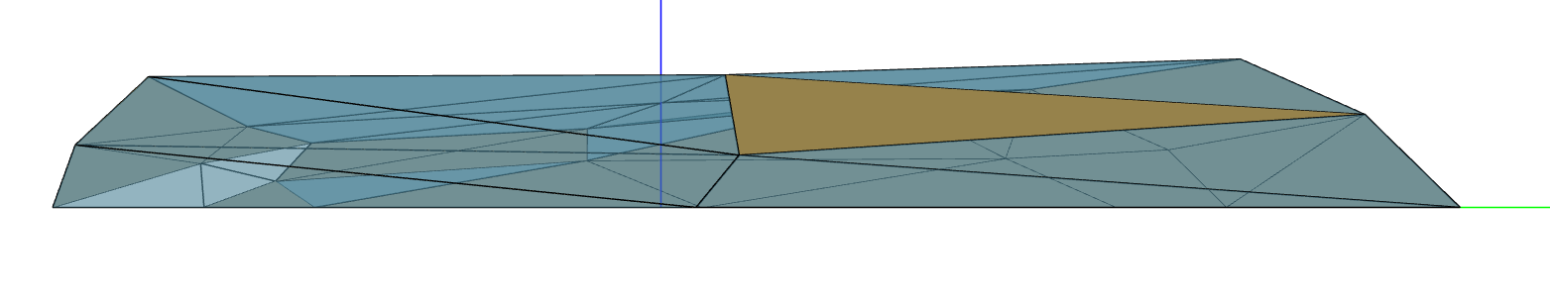
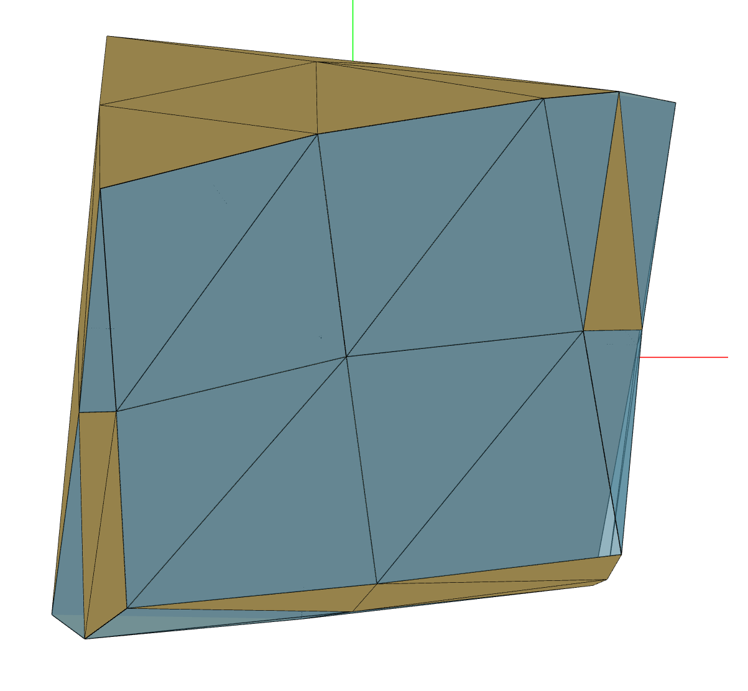
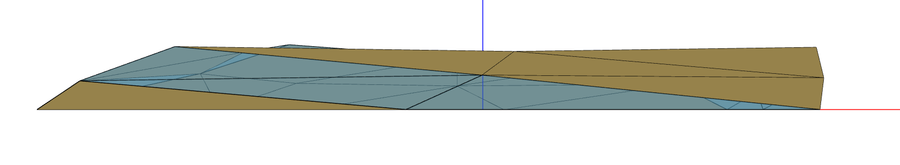
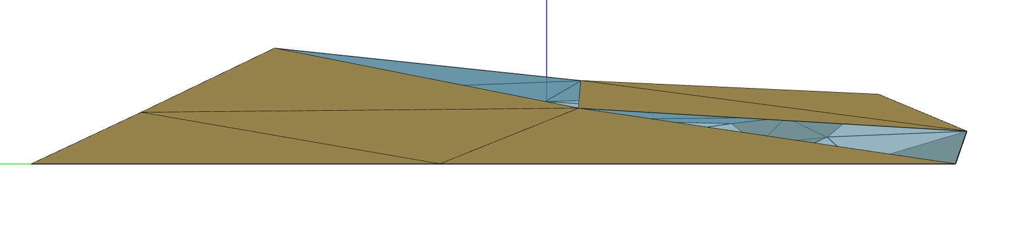
Oslo
North Side
Annual Figures:
Yield*: 13,900,000 kg
Thermal Load: 1,290,000 kwh
Lighting Load: 4,060,000 kwh
Fitness: 1,440,000
East Side
South Side
Plan View
West Side

Slide 31
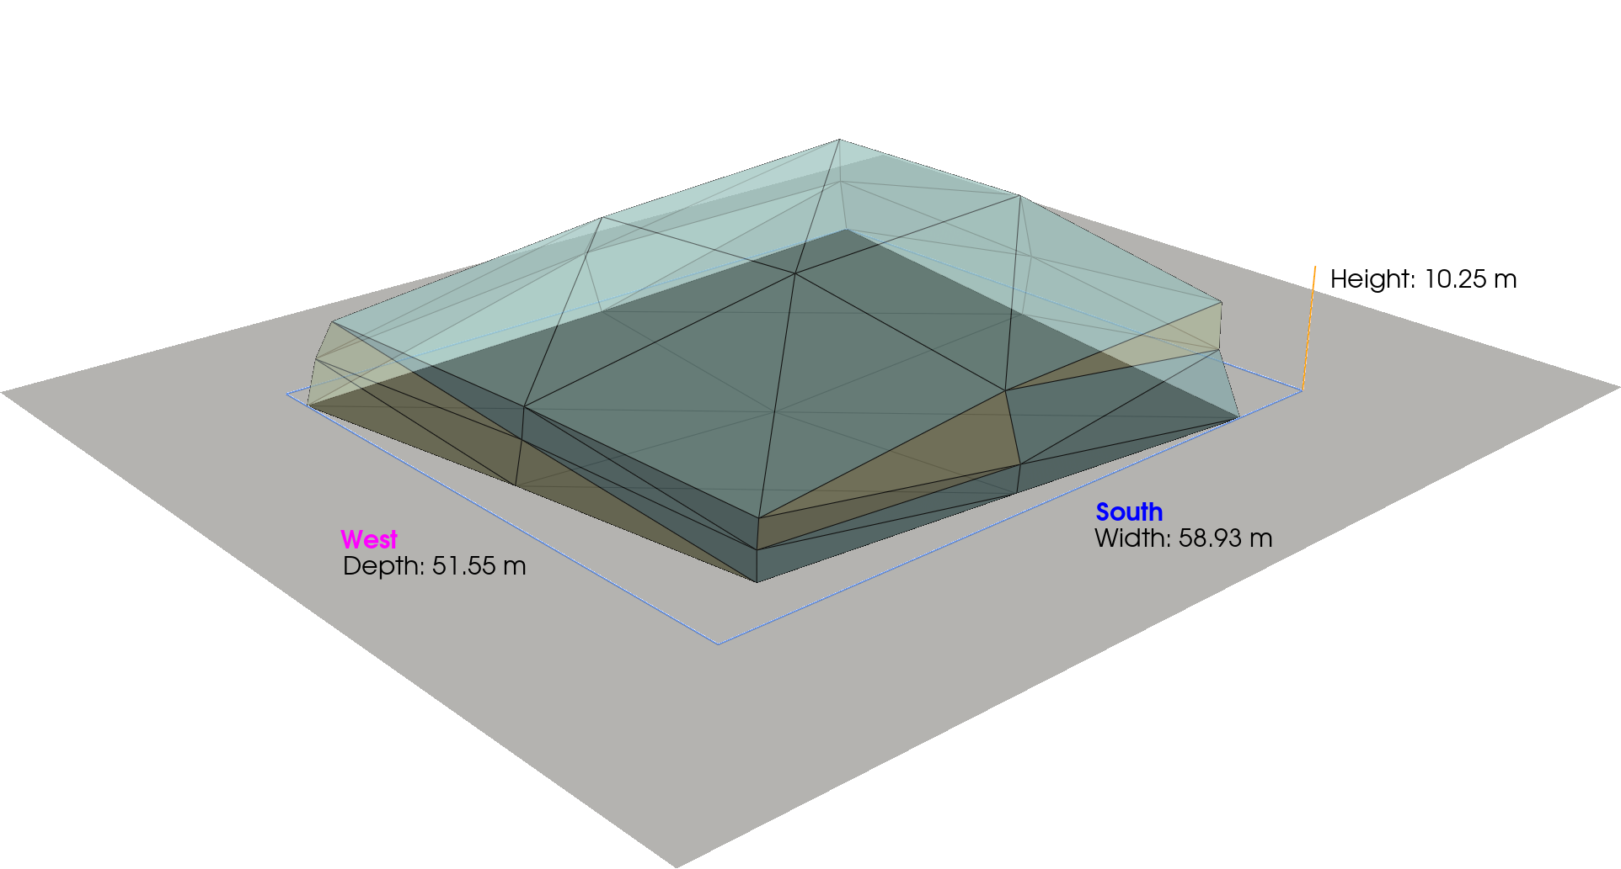
Singapore

Slide 32
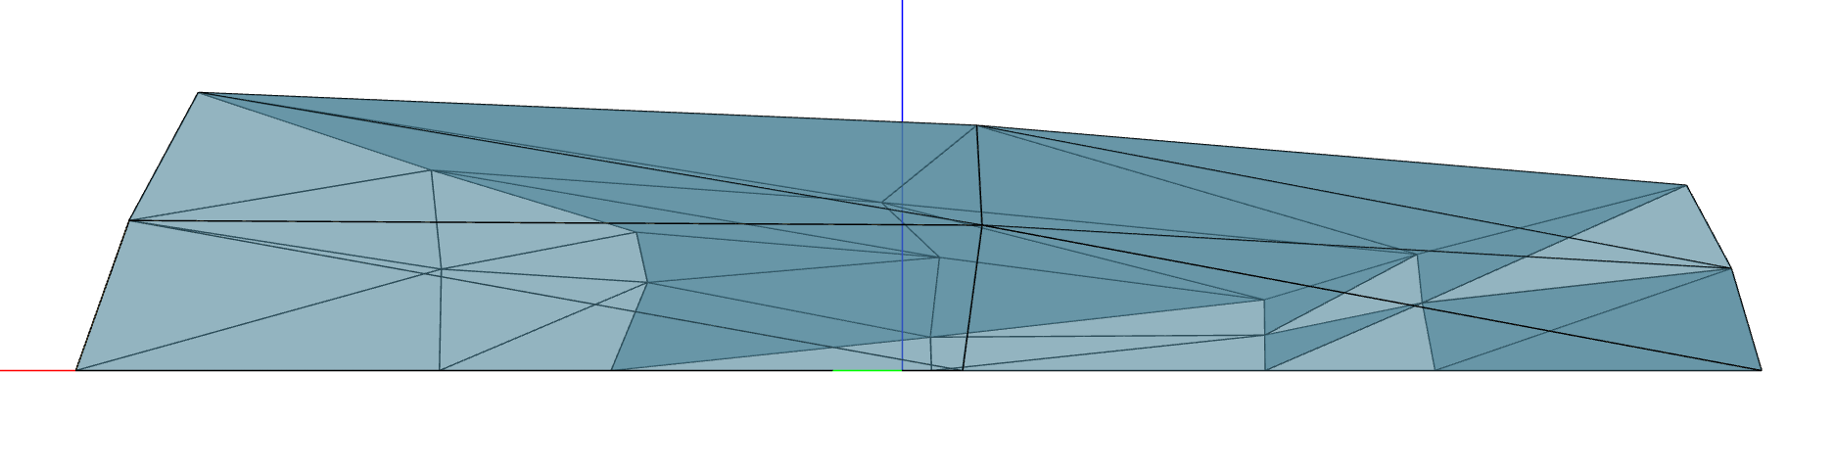
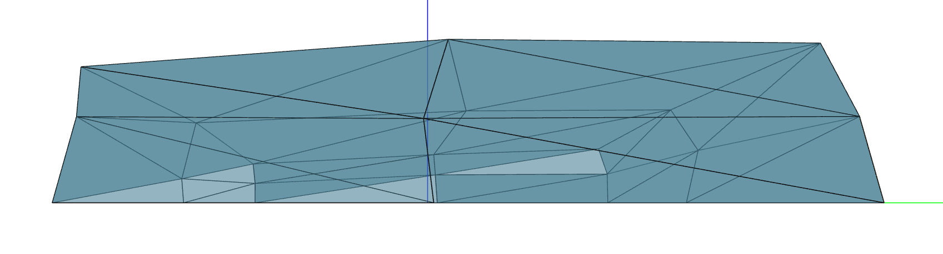
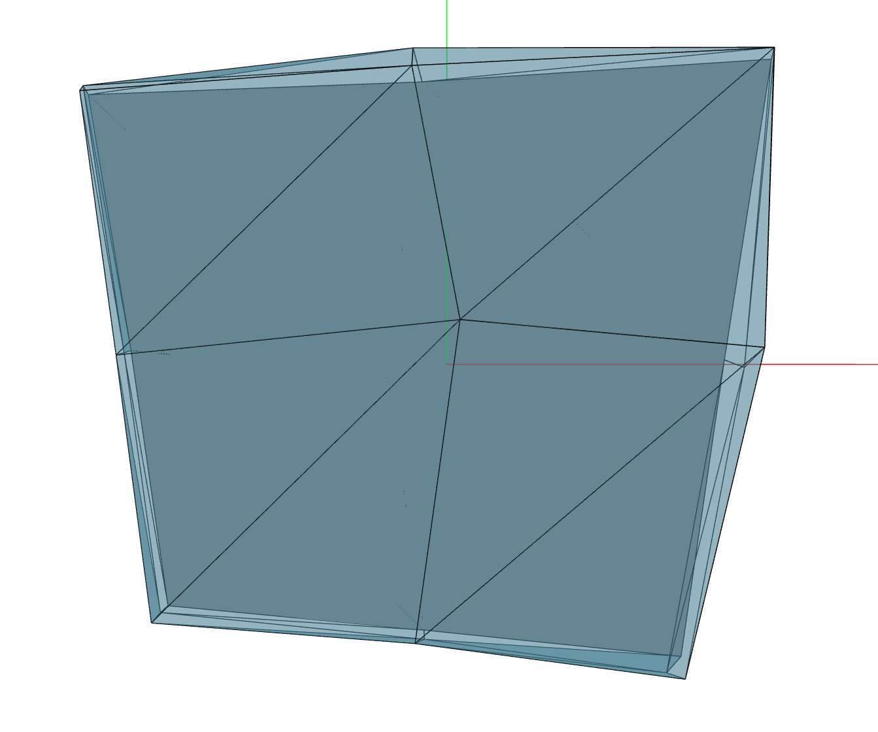
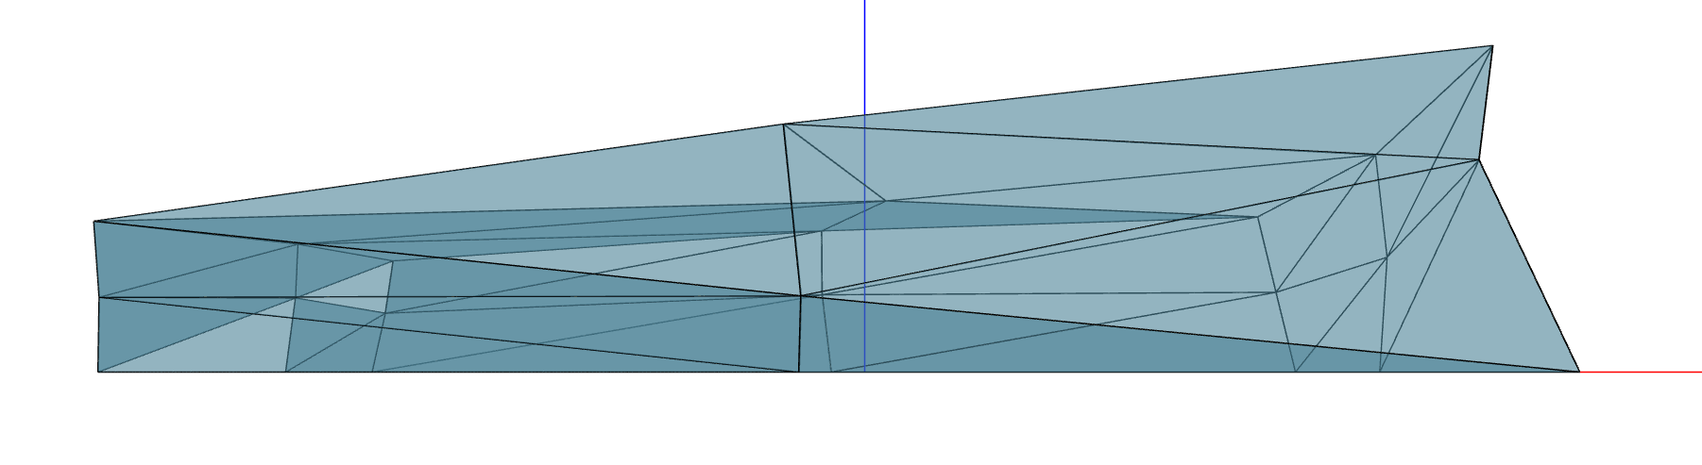
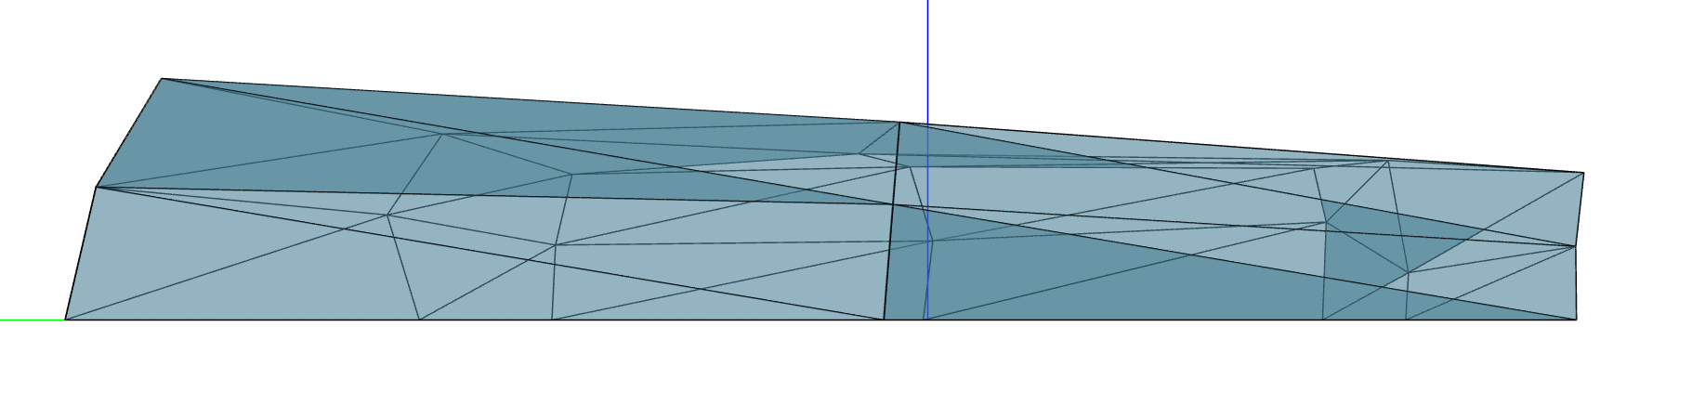
Singapore
North Side
Annual Figures:
Yield*: 13,700,000 kg
Thermal Load: 256,000 kwh
Lighting Load: 2,190,000 kwh
Fitness: 2,040,000
East Side
South Side
Plan View
West Side

Slide 33
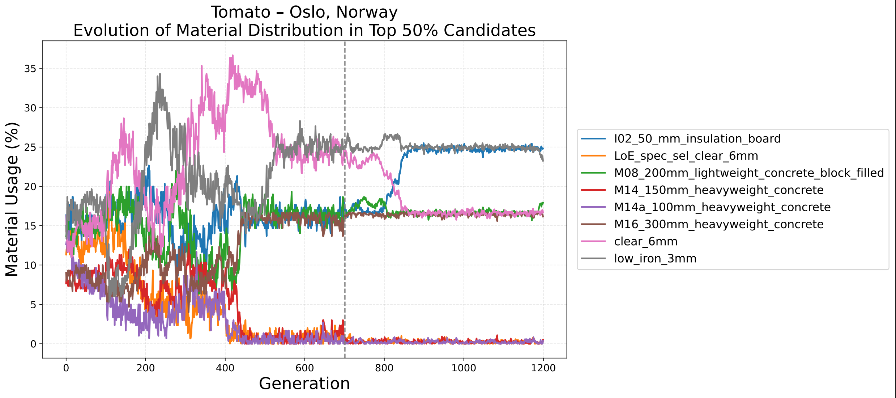
Graphs

Slide 34
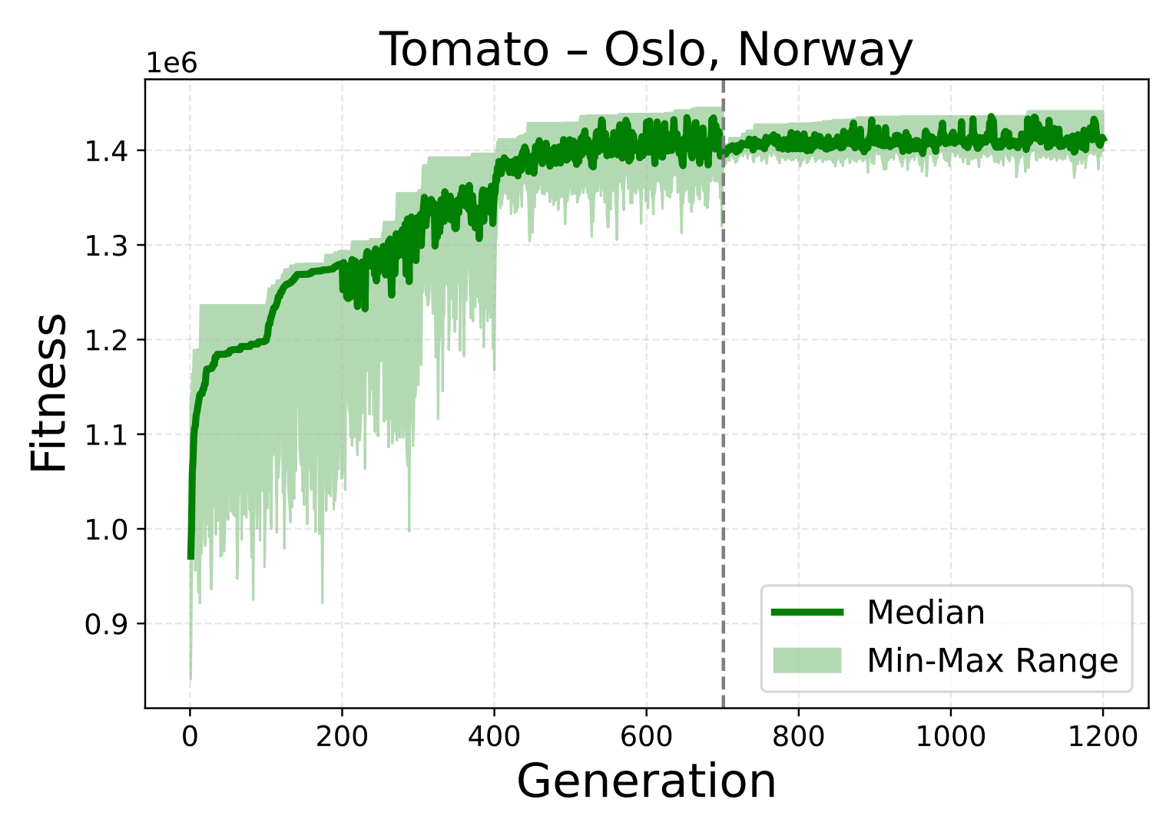
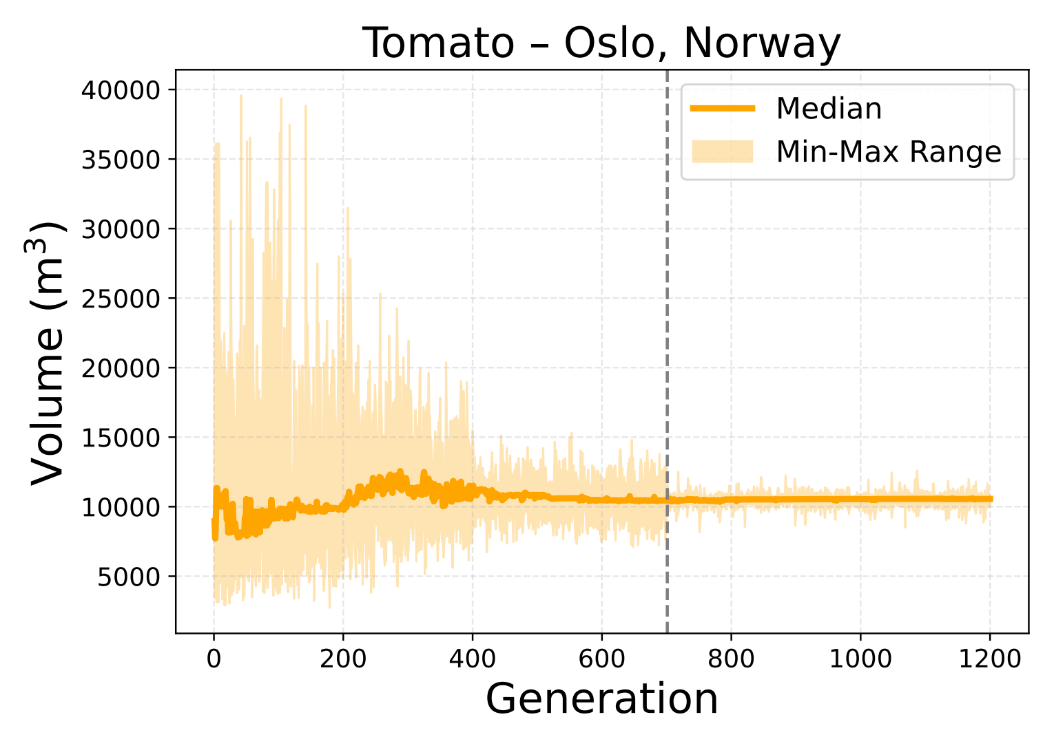
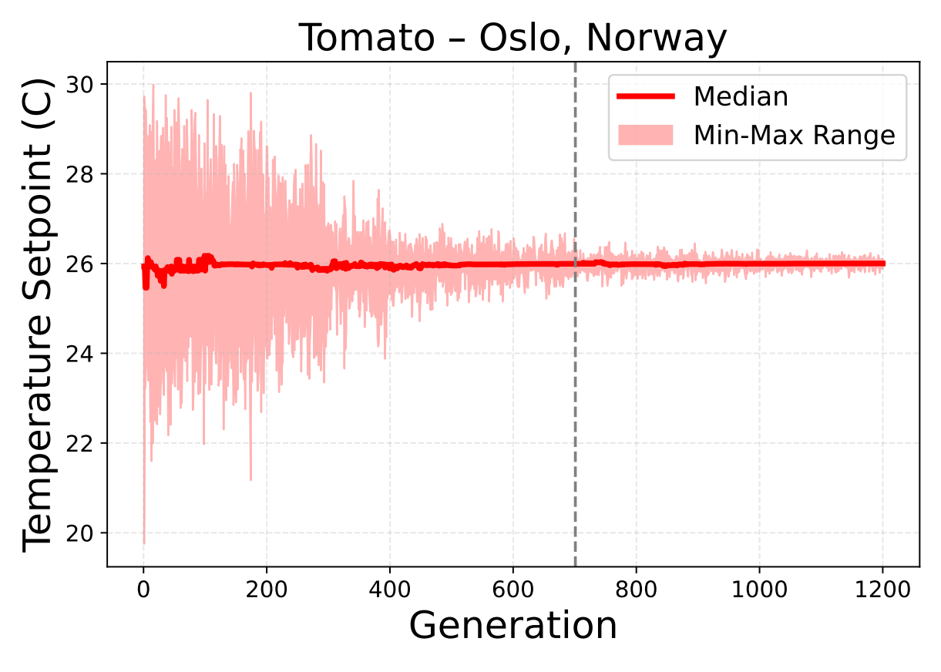
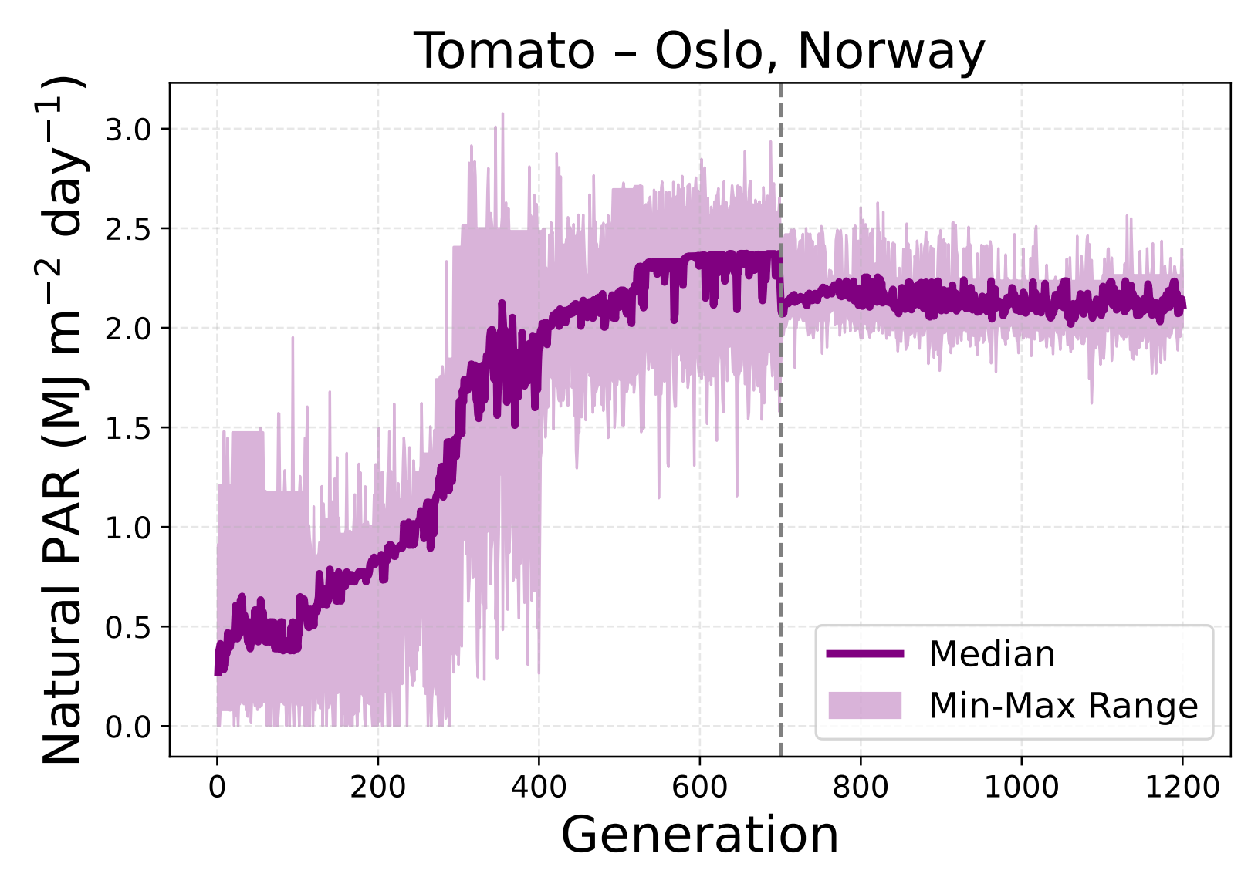
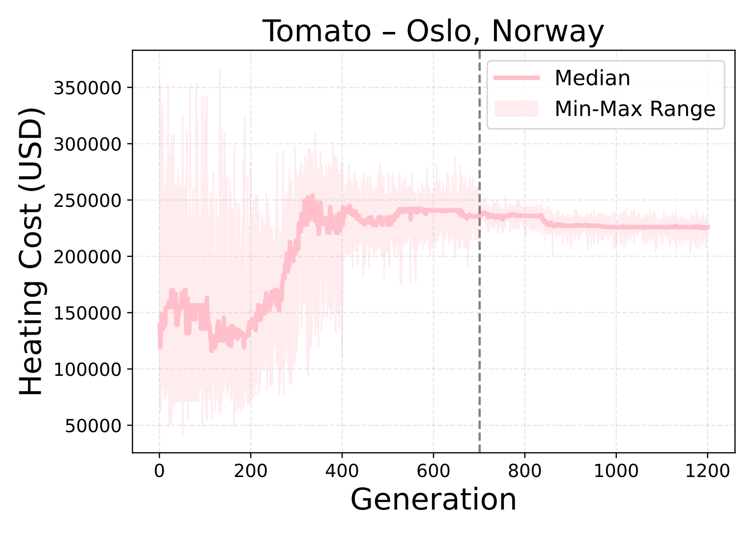
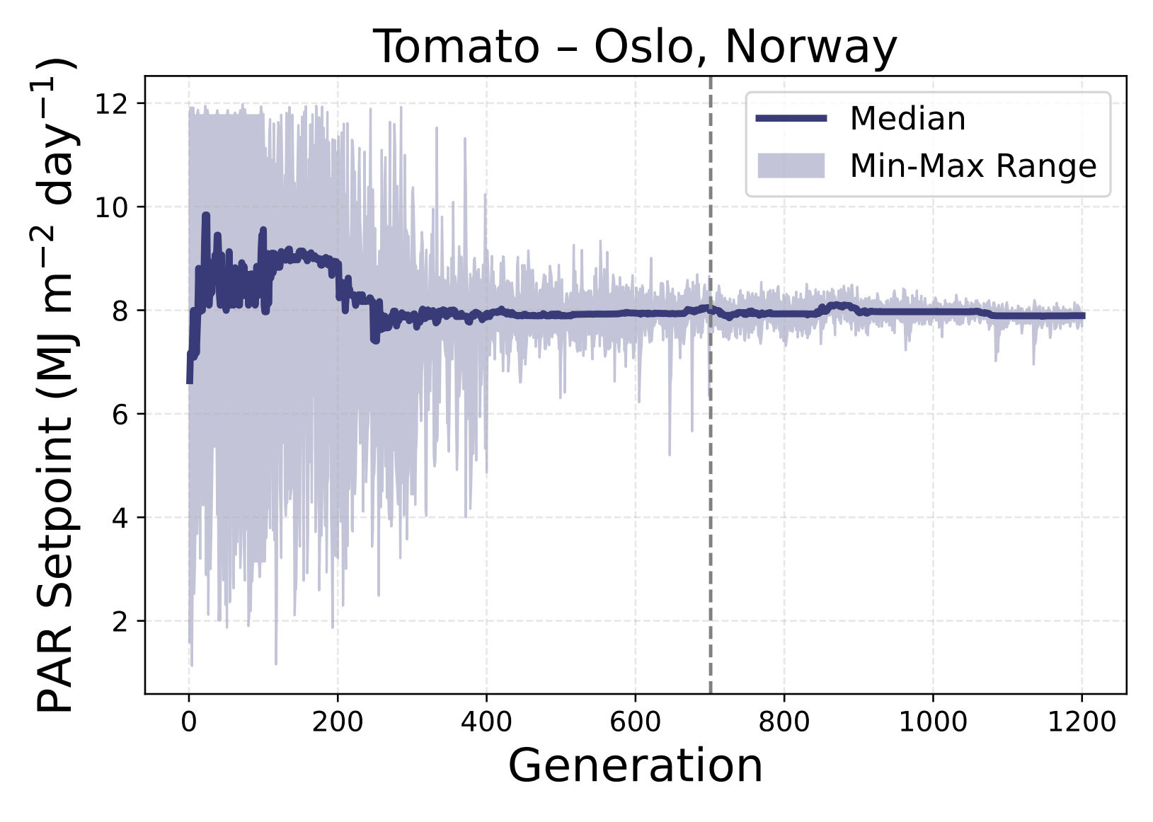
Graphs

Slide 35
Comparison
Annual Metrics | Oslo | Singapore
Dimensions (m) Width-Depth-Height | 56x54x7 | 59x52x10
Available Growing Area (m²) | 3870 | 6570
Temp Setpoint (°C) | 26 | 26
Heating Cost (USD) | 227,000 | 25,000
Cooling Cost (USD) | 5,160 | 26,900
Ambient PAR Intensity (MJ m⁻² d ⁻¹) | 2.26 | 2.81
PAR Setpoint (MJ m⁻² d ⁻¹) | 7.89 | 4.60
Lighting Cost (USD) | 934,000 | 504,000
Yield Value* (USD) | 55,500,000 | 54,900,000
Fitness | 1,440,000 | 2,040,000

Slide 36
Evaluation
Deliverables
Further Work

Slide 37
deliverables
Basic
Basic single objective genetic design algorithm (GA)
Encoding for building geometry + materials
Heuristic fitness function
Intermediate
EnergyPlus for heating loads
EnergyPlus for lighting loads
Combine GA with EnergyPlus for evaluation
Parallelisation of candidate evaluation
Advanced
Neural network fitness approximation
Integration with SIMPLE crop model [7]
Analysis for multiple crops / climates

Slide 38
Further Work
Materials
Multi-layer compositions
Daylighting
Radiance for daylighting using an accurate ray tracing approach
Longer run time but more accurate results that split-flux
Fitness Evaluation
Multi-objective optimisation
Genetic Algorithm
‘Shrink-wrap’ crossover
Explicit diversity preservation

Slide 39
Thank You
Vincent Kenny
Supervisor – Dr Tom Friedetzky

Slide 40
References
[1] P. Suphavarophas, R. Wongmahasiri, N. Keonil, and S. Bunyarittikit, “A systematic review of applications of generative design methods for energy
[2] Caldas, L., 2008. Generation of energy-efficient architecture solutions applying GENE_ARCH: An evolution-based generative design system. Advanced Engineering Informatics, 22(1), pp.59-70.
[3] Magnier, L. and Haghighat, F., 2010. Multiobjective optimization of building design using TRNSYS simulations, genetic algorithm, and Artificial Neural Network. Building and Environment, 45(3), pp.739-746.
[4] Si, B., Wang, J., Yao, X., Shi, X., Jin, X. and Zhou, X., 2019. Multi-objective optimization design of a complex building based on an artificial neural network and performance evaluation of algorithms. Advanced Engineering Informatics, 40, pp.93-109.
[5] C. Zhao, B. Liu, L. Xiao, G. Hoogenboom, K. J. Boote, B. T. Kassie, W. Pavan, V. Shelia, K. S. Kim, I. M. Hernandez-Ochoa et al., “A simple crop model,” European Journal of Agronomy, vol. 104, pp. 97–106, 2019.
[6] M. Dawson-Haggerty and contributors, “Trimesh,” 2019. [Online].
Available: https://github.com/mikedh/trimesh

