Slide 1



MavenMarket_Report
View in Power BI
Last data refresh:
10/8/2022 3:33:45 PM UTC
Downloaded at:
10/9/2022 6:46:08 AM UTC

Slide 2
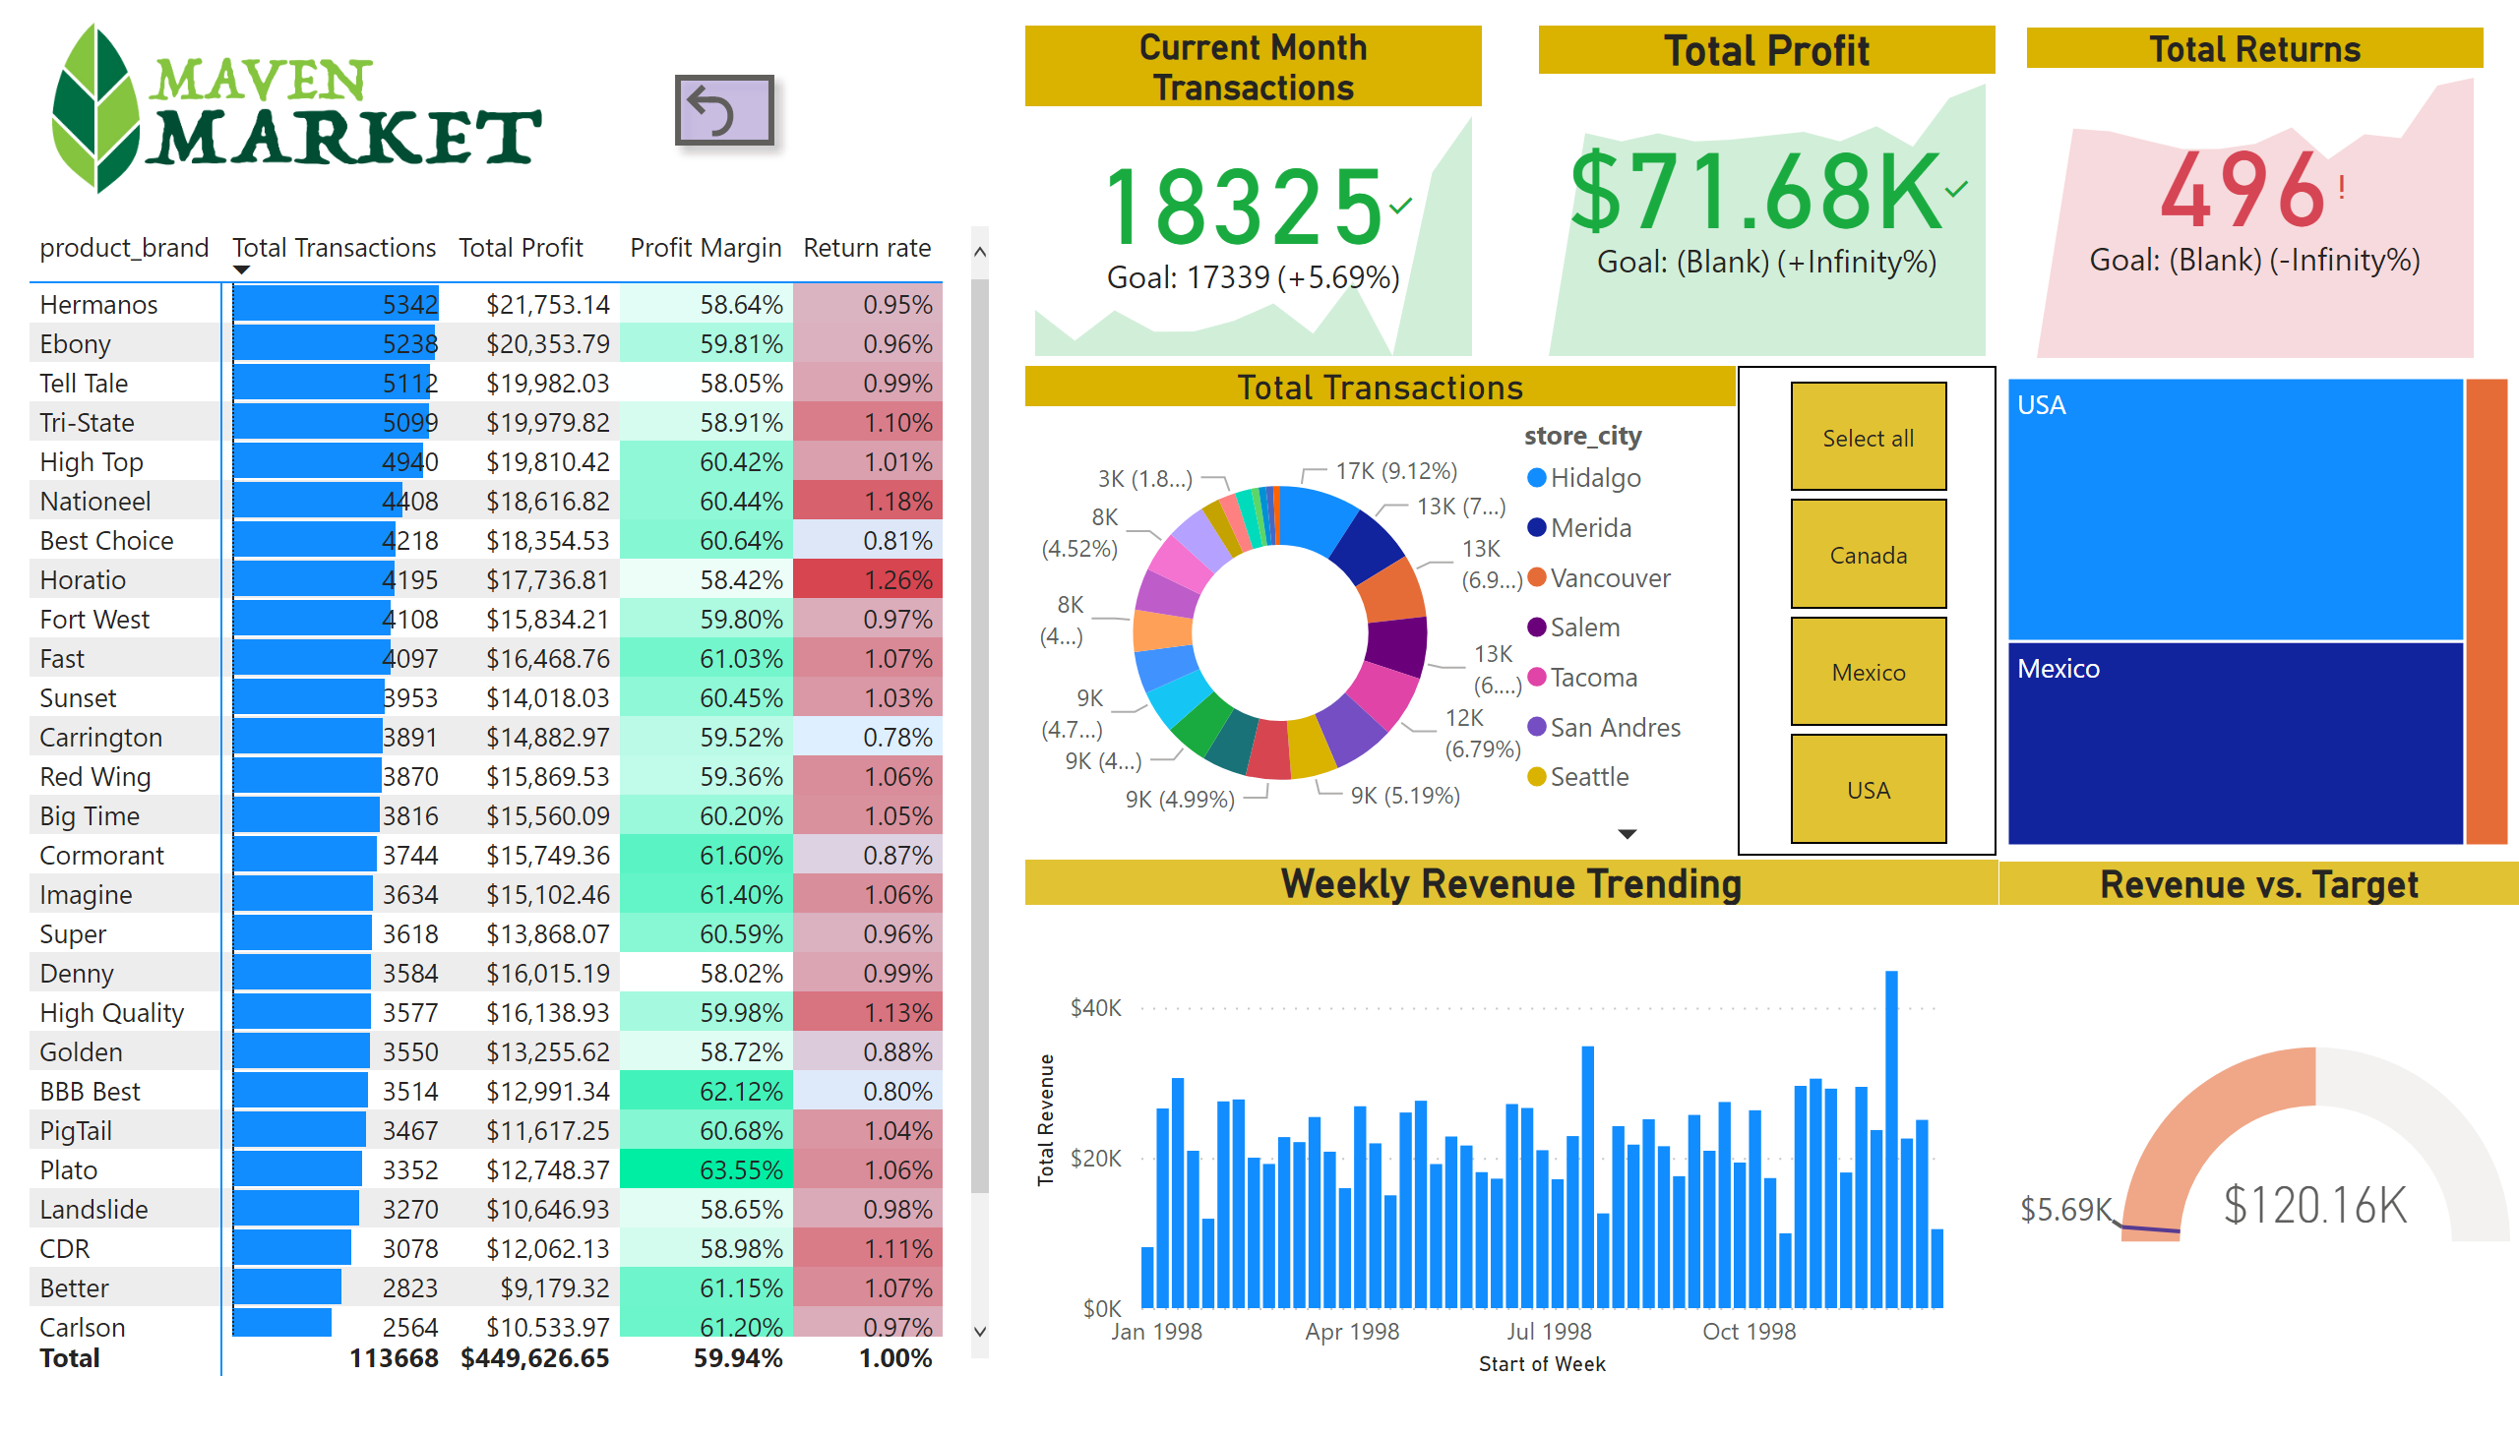
Topline Performance
Notes:
image
No alt text provided
pivotTable
No alt text provided
Current Month Transactions
No alt text provided
Total Profit
No alt text provided
Total Returns
No alt text provided
Total Transactions
No alt text provided
slicer
No alt text provided
treemap
No alt text provided
Weekly Revenue Trending
No alt text provided
Revenue vs. Target
No alt text provided
actionButton
No alt text provided

Slide 3

Notes
Notes:
textbox
No alt text provided
actionButton
No alt text provided
textbox
No alt text provided

