Slide 1
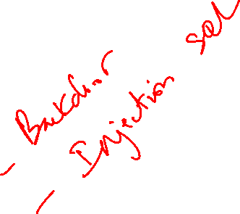
Thực hành Spring Security với JDBC

Slide 2
Tạo table Users
CREATE TABLE users (
username VARCHAR(50) PRIMARY KEY,
password VARCHAR(100) NOT NULL,
enabled TINYINT NOT NULL
);

Slide 3
Tạo table authorities
CREATE TABLE authorities (
username VARCHAR(50) NOT NULL,
authority VARCHAR(50) NOT NULL,
UNIQUE KEY (username, authority),
CONSTRAINT fk_username FOREIGN KEY (username) REFERENCES users (username)
);

Slide 4
Dependency mysql

Slide 5
