Slide 1
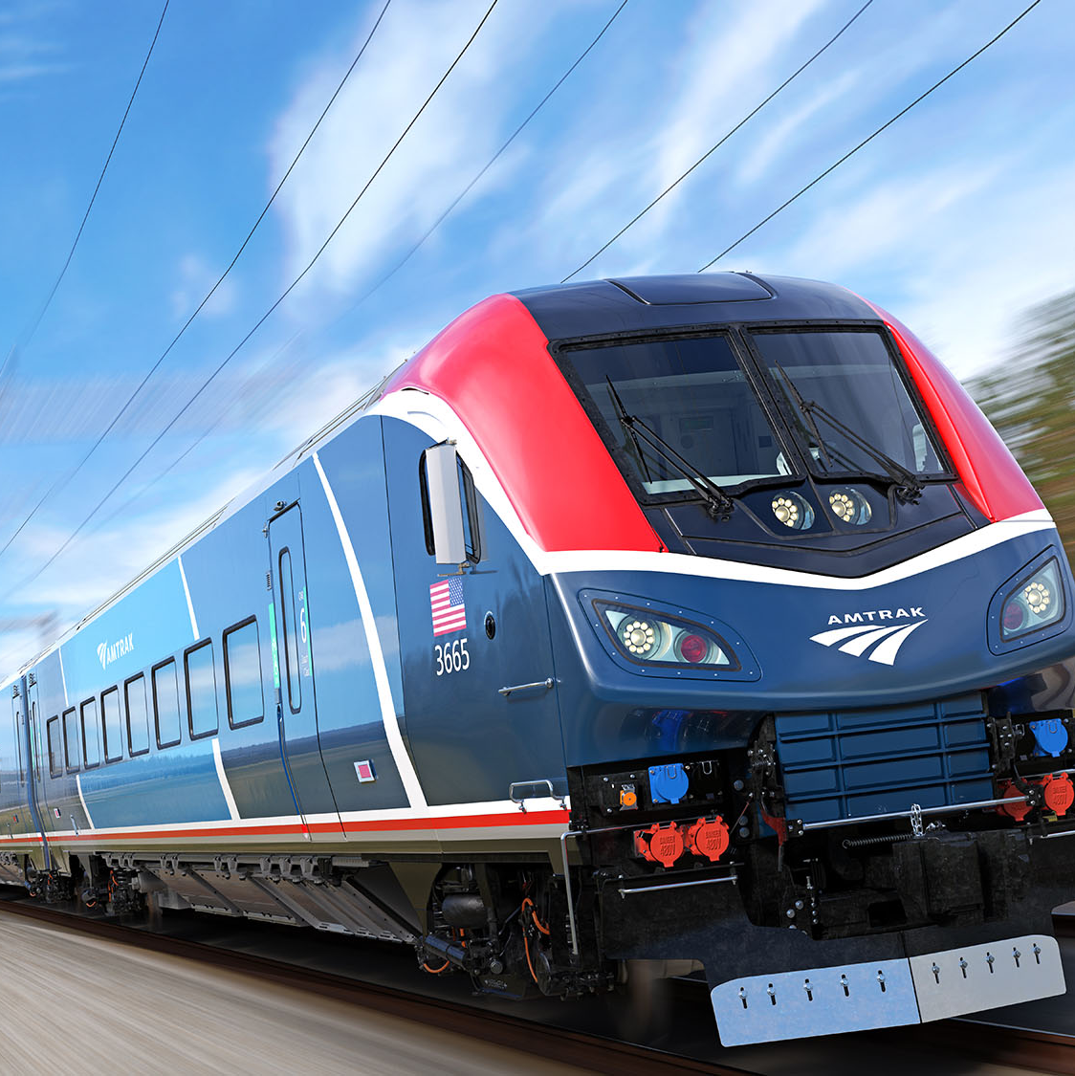
VAMP (Vaulted Amtrak Metrics and Performance)
12/04/2024
Aishwarya Chamakuri,
Manish Gangapuram,
Pavan prithvi Madduri,
Vinay Chanamallu

Slide 2
Data Sources
Amtrak Data: https://umd.instructure.com/courses/1368423/modules/items/13221176
Goals Set By Amtrak: https://www.amtrak.com/content/dam/projects/dotcom/english/public/documents/corporate/businessplanning/Amtrak-Five-Year-Service-Plans-FY18-FY23.pdf
Users/clients
Research and Academic Institutions: Purpose: Conduct transportation studies, focusing on public transit efficiency and workforce correlations. Benefit: Enables targeted studies for sustainable transportation development.
Amtrak Management and Leadership: Purpose: Use the insights for strategic decision-making to meet service goals and improve ridership. Benefit: Align internal strategies with operational outcomes and improve financial sustainability.

Slide 3
Mission Statement
To analyze service performance metrics and demand fluctuations to improve resource allocation, operational efficiency, and on-time service reliability.

Slide 4
Mission Objectives
Identify high-traffic stations and analyze demand fluctuations.
Compare states' ridership goals with actual FY23 performance.
Highlight states achieving top 10 OTP (On-Time Performance) improvements with minimal procurement costs.
Evaluate the top 10 states with the highest employee-to-ridership impact.

Slide 5
Business Terms
Service Performance Metrics: Measures ridership, OTP, and procurement efficiency.
Demand Fluctuations: Focus on high-traffic stations and resource realignment.
High-Traffic Stations: Priority targets for maintaining service quality.
Ridership Goals vs Actuals: Insight into performance alignment.
Employee-to-Ridership Impact: Efficiency evaluation of staffing against passenger needs.
Procurement Costs: Importance of cost management in boosting OTP.

Slide 6
Potential trends
Prioritized high-traffic stations significantly influence demand.
Resource allocation and OTP improvements drive ridership success.
Strategic resource use demonstrates operational efficiency.

Slide 7
Sample Data
Station: Includes details like station codes, cities, and state names.
Budget: Details on financial allocations over fiscal years.
OTP: On-time performance data by state and route.
Guest Rewards: Year-over-year state-wise loyalty metrics.
Ridership: Passenger data segmented by station and year.
Procurement: Financial spending data by state.
Employment: Staffing levels and associated costs.
Goals Year On Year: Goals set by Amtrak for year 2023.

Slide 8
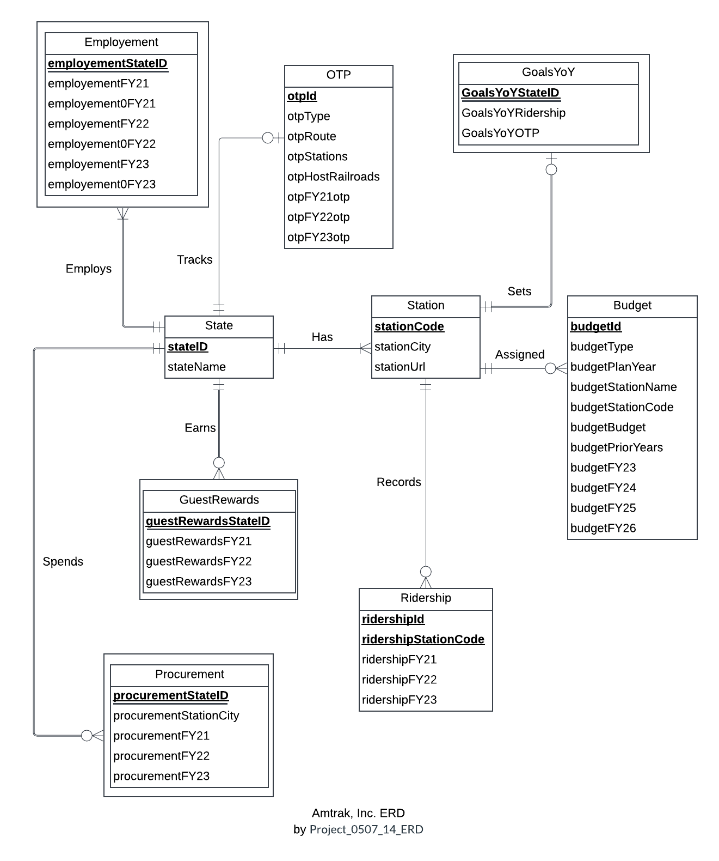
Entity Relationship Diagram

Slide 9
Relational schema
State(stateID, stateName)
Station(stationCode, stationCity, stationStateID, stationUrl)
Budget(budgetId, budgetType, budgetPlanYear, budgetStationCode, budgetStationName, budgetBudget, budgetPriorYears, budgetFY23, budgetFY24, budgetFY25, budgetFY26)
OTP(otpId, otpStateID, otpType, otpRoute, otpStations, otpHostRailroads, otpFY21otp, otpFY22otp, otpFY23otp)
GuestRewards(guestRewardsStateID, guestRewardsFY21, guestRewardsFY22, guestRewardsFY23)
Ridership(ridershipId, ridershipStationCode, ridershipStateID, ridershipFY21, ridershipFY22, ridershipFY23)
Procurement(procurementStateId, procurementStationCity, procurementFY21, procurementFY22, procurementFY23)
Employment(employmentStateID, employmentFY21, employment0FY21, employmentFY22, employment0FY22, employmentFY23, employment0FY23)
GoalsYoY(GoalsYoYStateID, GoalsYoYRidership, GoalsYoYOTP)

Slide 10
Physical Database Design
-- Create Station Table
CREATE TABLE Station_T (
stationCode CHAR(3) NOT NULL,
stationCity VARCHAR(100),
stationUrl VARCHAR(100),
stationStateID CHAR(3),
CONSTRAINT pk_Station PRIMARY KEY (stationCode, stationCity),
CONSTRAINT fk_ Station_StateID FOREIGN KEY (stationStateID)
REFERENCES State_T (stateID)
ON DELETE CASCADE ON UPDATE CASCADE
);

Slide 11
Business transactions

Slide 12
B1.States with the Highest Employee-to-Ridership Impact
-- Identify whether changes in employees over the years led to changes in ridership
SELECT e.employmentStateID AS StateID, s.stateName AS StateName, (e.employmentFY23 - e.employmentFY21) AS EmployeeChange,
(SUM(r.ridershipFY23) - SUM(r.ridershipFY21)) AS RidershipChange,
CASE
WHEN (e.employmentFY23 - e.employmentFY21) > 0 AND (SUM(r.ridershipFY23) - SUM(r.ridershipFY21)) > 0 THEN 'Positive Correlation’
WHEN (e.employmentFY23 - e.employmentFY21) < 0 AND (SUM(r.ridershipFY23) - SUM(r.ridershipFY21)) < 0 THEN 'Positive Correlation'
WHEN (e.employmentFY23 - e.employmentFY21) * (SUM(r.ridershipFY23) - SUM(r.ridershipFY21)) < 0 THEN 'Negative Correlation'
ELSE 'No Significant Change’
END AS Correlation
FROM Employment_T e JOIN Ridership_T r ON e.employmentStateID = r.ridershipStateID JOIN
State_T s ON e.employmentStateID = s.stateID
GROUP BY e.employmentStateID, s.stateName, e.employmentFY23, e.employmentFY21
HAVING (SUM(r.ridershipFY23) - SUM(r.ridershipFY21)) IS NOT NULL
ORDER BY ABS(SUM(r.ridershipFY23) - SUM(r.ridershipFY21)) DESC, ABS(e.employmentFY23 - e.employmentFY21) DESC;

Slide 13
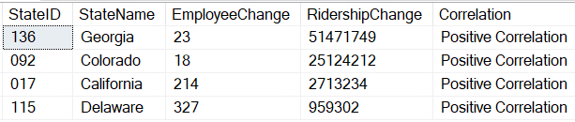
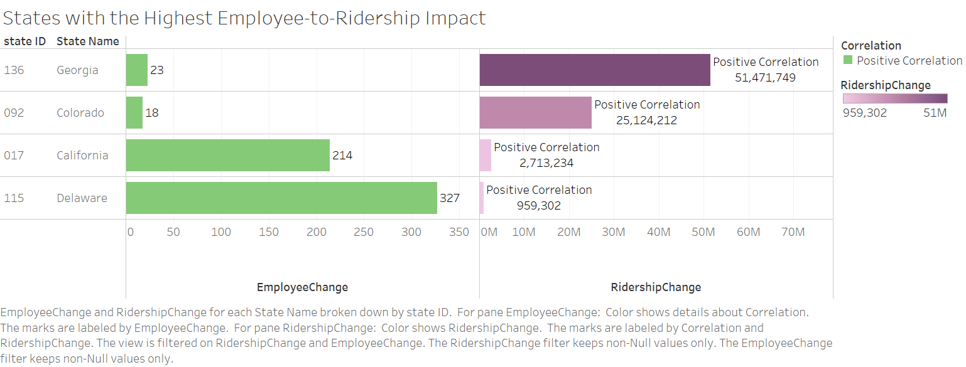
Identify whether changes in employees over the years led to changes in ridership

Slide 14
Findings and Insights:
Employee-to-Ridership Correlation:
States such as Georgia, Colorado, California, and Delaware exhibit a positive correlation between changes
in employee numbers and ridership figures.
Notable ridership changes in states like California (214) and Delaware (327) suggest that increases in ridership drive corresponding changes in staffing, highlighting the impact of operational demand on employee levels.

Slide 15
B2. To identify states that are meeting/not meeting/exceeding ridership goals compared to actual performance for FY23
-- To identify states that are meeting/not meeting/exceeding ridership goals compared to actual performance for FY23 SELECT g.GoalsYoYStateID AS StateID,
s.stateName AS StateName,
g.GoalsYoYRidership AS GoalFY23Ridership,
SUM(r.ridershipFY23) AS ActualFY23Ridership,
CASE
WHEN SUM(r.ridershipFY23) < g.GoalsYoYRidership THEN 'Not Meeting'
WHEN SUM(r.ridershipFY23) = g.GoalsYoYRidership THEN 'Meeting'
WHEN SUM(r.ridershipFY23) > g.GoalsYoYRidership THEN 'Exceeding'
END AS PerformanceStatus
FROM GoalsYoY_T g JOIN State_T s ON g.GoalsYoYStateID = s.stateID
JOIN
Ridership_T r ON r.ridershipStateID = g.GoalsYoYStateID
GROUP BY g.GoalsYoYStateID, s.stateName, g.GoalsYoYRidership;

Slide 16
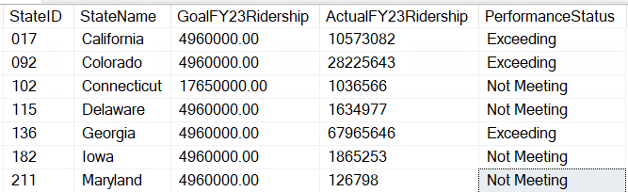
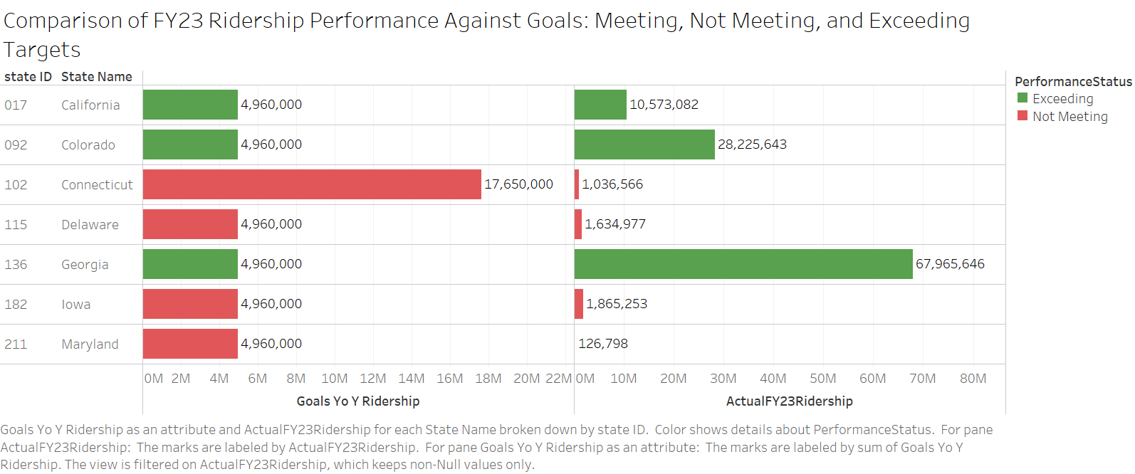
To identify states that are meeting/not meeting/exceeding ridership goals compared to actual performance for FY23

Slide 17
Findings and Insights:
YoY Growth Performance :
• Overall ridership growth from FY22 to FY23: 28.2%, reflecting strong operational improvements.
• States like California and Georgia demonstrate the impact of population density and efficient transit networks on growth.
Challenges :
• Despite ~30% YoY growth, states did not meet ridership goals due to:
Variations in population density.
2. Migration trends affecting demand.
Model Contributions :
• Establishes a baseline for minimum expected YoY growth.
• Acts as a framework for aligning strategic goals and ridership milestones.
Analysis Value :
• Provides YoY growth data for all states.
• Serves as a benchmark for setting realistic FY24 goals and developing a 5-year roadmap.

Slide 18
Conclusion:
Our analysis of Amtrak's performance metrics and demand fluctuations has highlighted critical insights that can drive strategic improvements:
Optimized Resource Allocation: Effective management of employees and resources plays a pivotal role in increasing ridership and improving on-time performance (OTP).
Targeted Interventions: Underperforming states can leverage strategies adopted by top-performing states to bridge operational gaps and meet ridership goals.
Data-Driven Decisions: Prioritizing high-traffic stations and aligning procurement costs with OTP improvements fosters financial sustainability and enhances service reliability.
By implementing these strategies, Amtrak can improve its operational efficiency, meet service goals, and strengthen its position as a leader in sustainable public transit. The findings underscore the importance of using performance data to address challenges and capitalize on opportunities for growth.

Slide 19
THANK YOU

