Slide 1

Take Home Assignment-CATT Lab
Ch Vinay

Slide 2
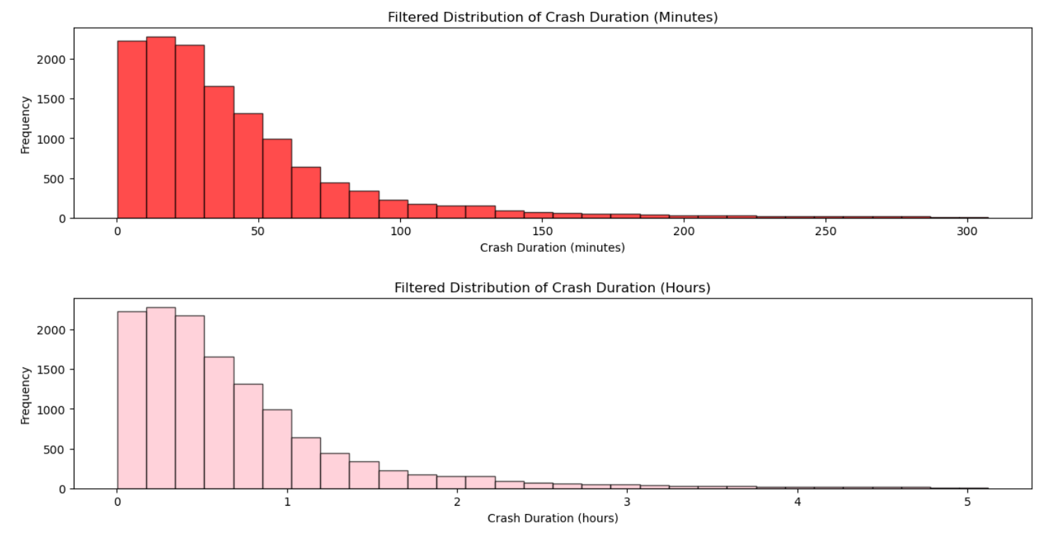
Distribution of crash duration
Calculated the crash duration in minutes and hours by subtracting the start time from the end time for each crash event.
A boxplot revealed the presence of outliers, indicating some crashes lasted significantly longer than others.
After removing outliers (beyond the 99th percentile), we plotted the filtered crash duration distribution in both minutes and hours.
The histograms show a positively skewed distribution, indicating that most crashes are short-duration (under 50 minutes), with a small number of long-duration crashes.
This positive skewness highlights that while most crashes are cleared quickly, long-duration crashes, though rare, can cause significant disruptions.

Slide 3
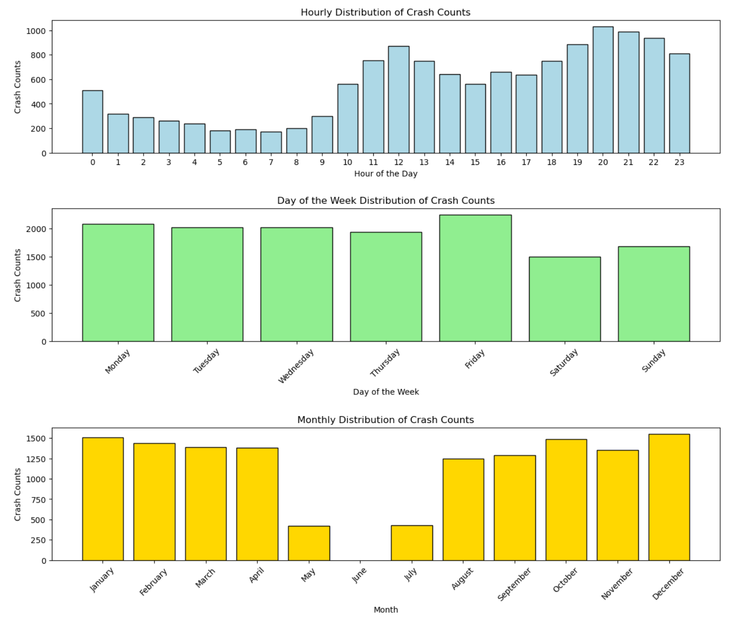
Temporal Distribution of crash counts at the hourly, day of the week, and monthly levels
Hourly Trend: Crash counts increase steadily from morning (6 AM) and peak during evening hours (6 PM to 9 PM), indicating higher risks during rush hours. The lowest crash counts are observed late at night and early morning (12 AM to 6 AM).
Day of the Week Trend: Crash counts are consistently high from Monday to Friday, with a noticeable dip on weekends (Saturday and Sunday).
Monthly Trend: The first quarter of the year (January to March) shows the highest crash counts, followed by a dip during summer (May to July). The counts rise again during September to December, possibly due to seasonal factors and holiday travel.

Slide 4
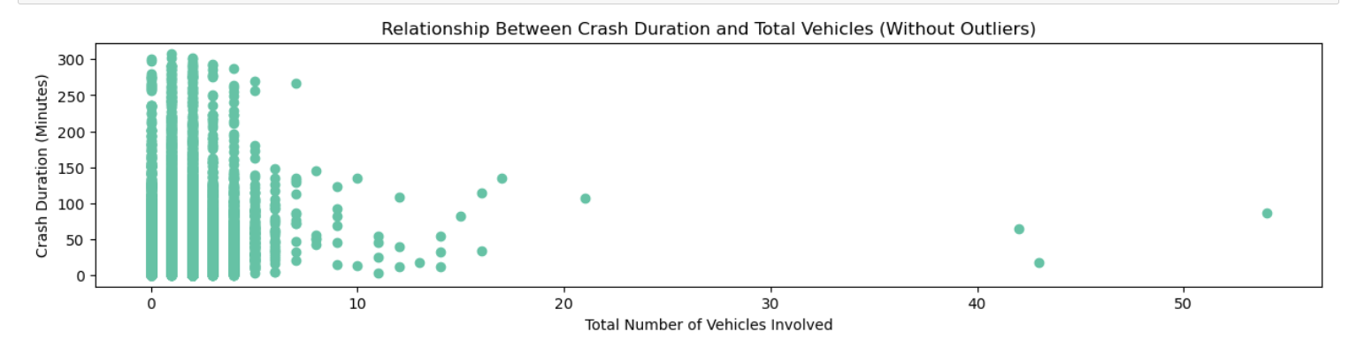
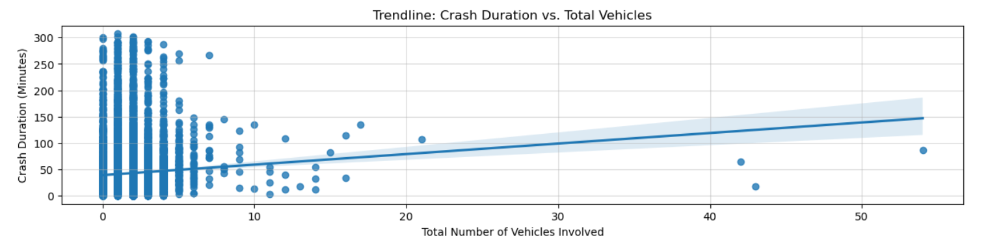
Visualization to show the relationship between crash duration and the total number of vehicles involved in the crash
The scatter plot shows that most crashes involve fewer than 10 vehicles and last under 60 minutes, indicating that short-duration crashes are more common.
A positive correlation is observed between crash duration and the number of vehicles involved, suggesting that as more vehicles are part of a crash, the time to clear the crash increases.
Multi-vehicle crashes tend to have longer durations due to the complexity of managing multiple vehicles and coordinating emergency services.
Crashes involving a higher number of vehicles show more variability in duration, highlighting the challenges in handling larger incidents.

Slide 5
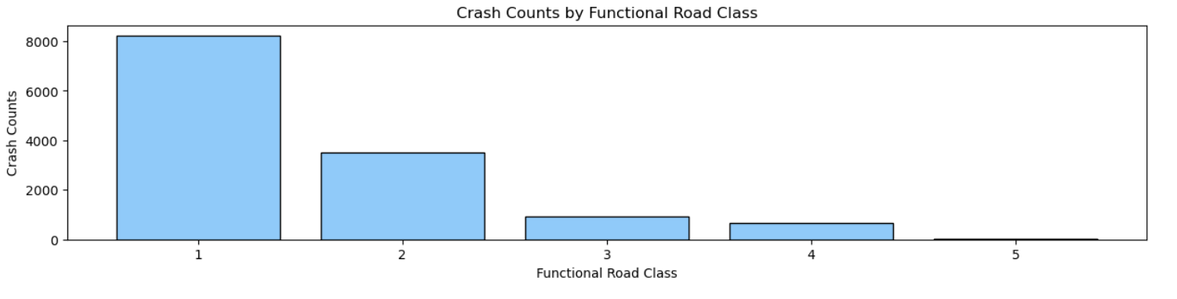
Visualize the crash count based on the segment functional road class
The highest number of crashes is observed on Class 1 roads, which typically represent interstate highways. These roads handle the highest traffic volumes and speeds, increasing the likelihood of crashes.
There is a clear decreasing trend in crash counts as the road class number increases. This indicates that higher-class roads (Class 1 and Class 2) experience significantly more crashes compared to lower-class roads.
Class 1 and Class 2 roads combined account for the majority of crash incidents. These road types include interstates and principal arterials, which are more prone to crashes due to high speeds and traffic density.
Road classes 3, 4, and 5 show much lower crash counts. These roads usually handle local traffic with lower speeds and are less congested, which likely contributes to the reduced number of incidents.
The data highlights the need for safety interventions on highway segments and major arterial roads (Classes 1 and 2). These roads experience higher risk factors such as speeding, congestion, and driver fatigue.

Slide 6
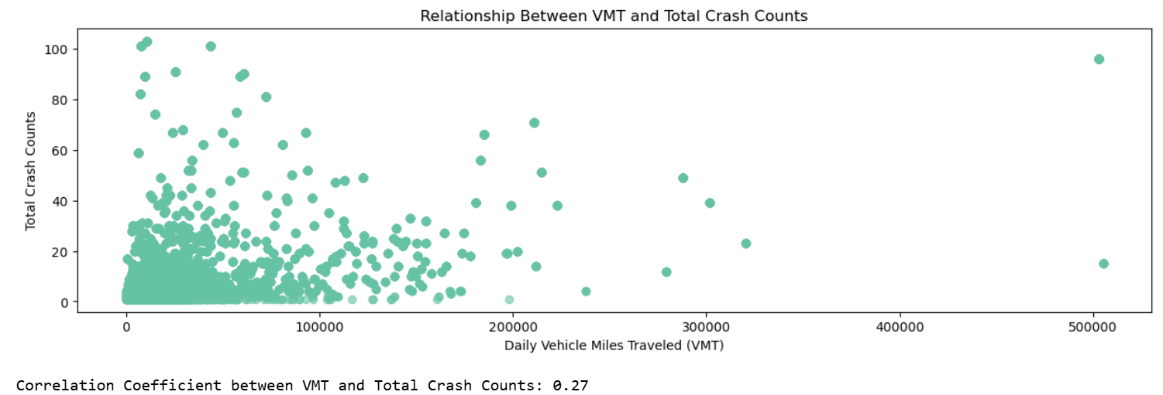
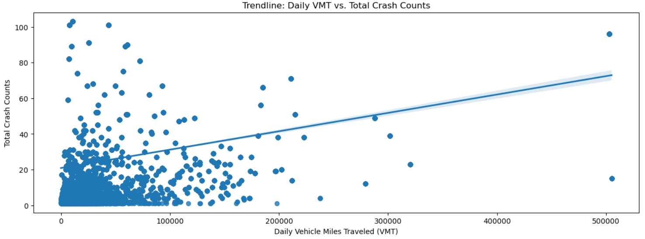
Pattern between the segments' daily VMT (vehicle mile traveled) and their total crash counts
There is a positive relationship between the daily Vehicle Miles Traveled (VMT) and total crash counts. As VMT increases, the number of crashes also tends to increase.
The calculated correlation coefficient between VMT and total crashes is approximately 0.27, indicating a weak to moderate positive linear relationship.
The regression trendline in the scatterplot confirms the upward trend, showing that segments with higher VMT generally experience more crashes.
The majority of crash counts occur at lower VMT values, suggesting that crashes are more frequent on segments with moderate daily travel rather than extremely high VMT.
The results indicate that while higher VMT is associated with more crashes, additional factors such as road type, traffic management, and driver behavior likely influence crash frequencies. This suggests that VMT alone does not fully explain crash risk.

Slide 7

Linear Regression and a Random Forest model to estimate crash duration
Data Preprocessing:
Feature Selection: Selected relevant features from the dataset, including crash characteristics like speed_at_crash, vehicle_count, total_lanes, etc.
Handling Missing Values: Filled missing values in the dataset using mean imputation to ensure a complete training dataset.
Train-Test Split: Split the dataset into training (70%) and testing (30%) sets for model evaluation.

Slide 8
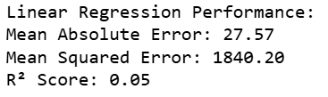
Linear Regression Model:
Achieved a Mean Absolute Error (MAE) of 27.57 minutes, a Mean Squared Error (MSE) of 1840.20, and an R² score of 0.05.
The R² score indicates that the model explains only 5% of the variance in crash duration, which suggests that Linear Regression is not suitable for this dataset due to the complexity of the relationships between features.

Slide 9
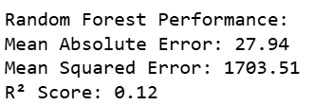
Random Forest Model:
Achieved a slightly better performance than Linear Regression with an MAE of 27.94 minutes, an MSE of 1703.51, and an R² score of 0.12.
The R² score of 0.12 indicates that the Random Forest model captures more variance in crash duration compared to Linear Regression but is still not highly predictive.

Slide 10
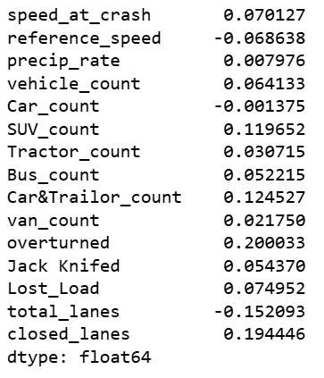
Feature Selection Using Correlation:
Analyzed the correlation between features and the target variable (crash_duration_minutes) to identify important predictors.
Removed low-correlation features and selected more impactful ones, including SUV_count, Car&Trailer_count, overturned, total_lanes, and closed_lanes.

Slide 11
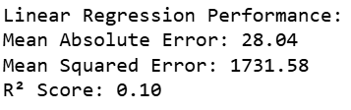
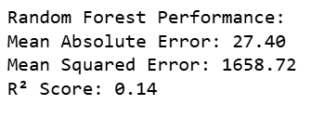
Results After Making Changes to X:
Performance was low, with R² scores of 0.10 and 0.14 for Linear Regression and Random Forest, respectively, indicating that the models were not explaining much variance in the crash duration.

Slide 12
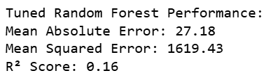
Hyperparameter Tuning:
Applied GridSearchCV for Random Forest hyperparameter tuning with parameters like n_estimators, max_depth, min_samples_split, and min_samples_leaf.
The best-tuned model slightly improved the R² score to 0.16, but the improvement was marginal.

Slide 13
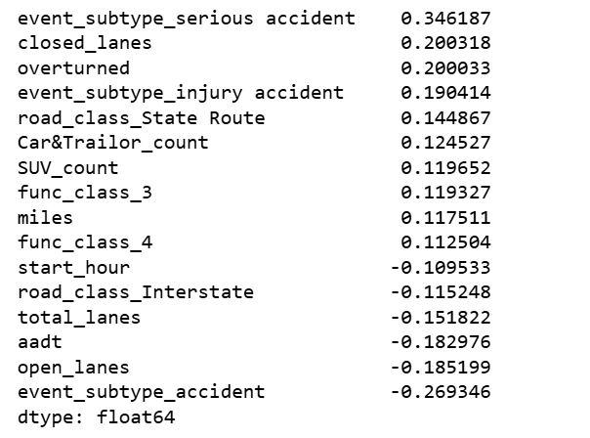
Categorical Feature Handling:
Identified categorical variables such as event_subtype, precipitation_flag, road_condition, start_day_of_week, and func_class.
Performed one-hot encoding to convert categorical features into numerical format for better model performance.
Post-encoding, the dataset expanded to 83 columns, capturing more nuanced information about road conditions, precipitation, and crash context.
Rechecked the correlation to validate the impact of encoded features on crash duration.

Slide 14
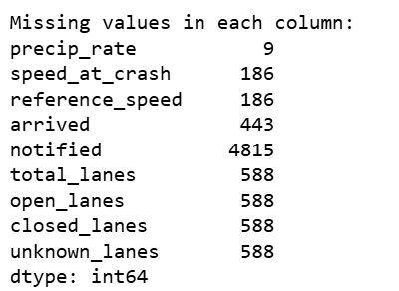

NA fixtures:
Identified missing values across multiple columns and quantified the extent of missing data in the dataset.
Applied mean imputation for numerical columns and mode imputation for categorical columns to handle missing values.
Verified successful imputation, ensuring zero missing values in the dataset for a cleaner and more complete analysis.

Slide 15
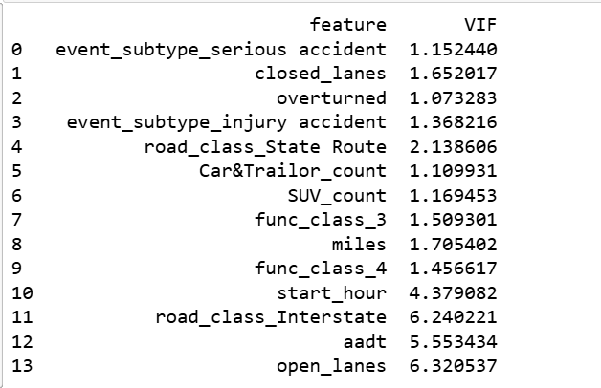
Feature Selection and Multicollinearity Handling:
Calculated Variance Inflation Factor (VIF) to detect multicollinearity in the dataset.Dropped features with high VIF values to reduce redundancy and improve model performance.
Recomputed VIF to ensure the remaining features had acceptable multicollinearity levels.
Trained Linear Regression and Random Forest Regressor models with the updated feature set.

Slide 16
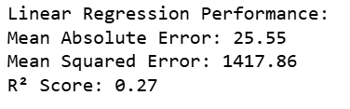
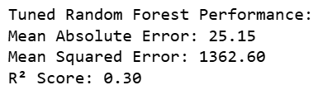
Did LR & RFR with Hyper-parameter Tuning again!
The final model was trained using a mix of numerical and categorical features, including SUV_count, closed_lanes, road_class, and various event_subtype and direction variables.
Categorical features were one-hot encoded to convert them into numerical format, ensuring the model could handle non-linear relationships.
After adjusting the feature set, the Linear Regression model improved significantly with an R² score of 0.27, indicating that the new features helped capture more variance in crash duration.
The tuned Random Forest model achieved an R² score of 0.30, with a Mean Absolute Error (MAE) of 25.15 minutes. This indicates a steady improvement in accuracy compared to the initial models, though there is still room for further enhancements.

Slide 17
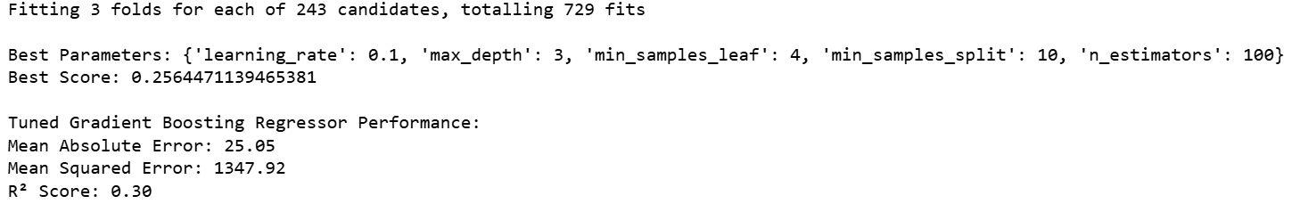
Gradient Boosting Regressor (GBR) with Hyperparameter Tuning:
Gradient Boosting Regressor (GBR) was introduced to improve the model's performance after Random Forest yielded low results.
Hyperparameter tuning was performed using GridSearchCV to identify the best parameters like n_estimators, max_depth, learning_rate, min_samples_split, and min_samples_leaf.
The best parameters found were: learning_rate: 0.1 max_depth: 3 n_estimators: 100 min_samples_split: 10 min_samples_leaf: 4
The tuned GBR model improved the R² score to 0.30, indicating a better performance than previous models.
The Mean Absolute Error (MAE) and Mean Squared Error (MSE) were also reduced, showing that GBR effectively minimizes prediction errors.

Slide 18
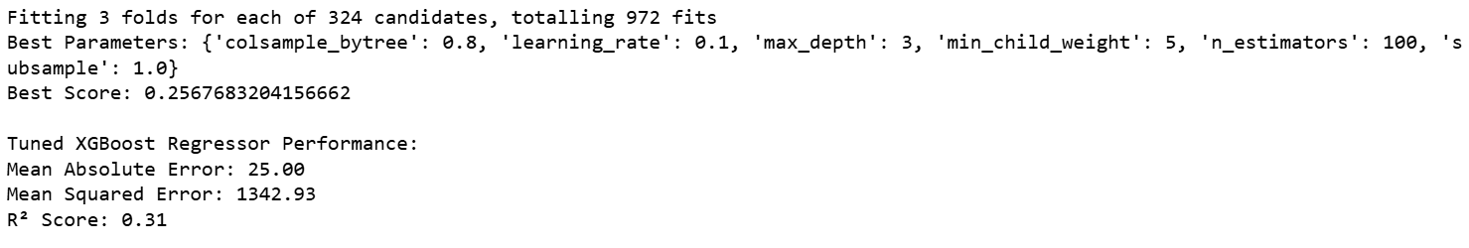
XGBoost Regressor with Hyperparameter Tuning:
XGBoost was introduced as an improvement over previous models due to its efficiency and performance on structured/tabular data.
Hyperparameter tuning was performed using GridSearchCV, optimizing parameters such as n_estimators, max_depth, learning_rate, min_child_weight, subsample, and colsample_bytree.
The best parameters identified were: colsample_bytree: 0.8 learning_rate: 0.1 max_depth: 3 min_child_weight: 5 n_estimators: 100 subsample: 1.0
The tuned XGBoost model achieved an R² score of 0.31, showing a slight improvement over the Gradient Boosting model. The Mean Absolute Error (MAE) and Mean Squared Error (MSE) were further reduced, indicating better predictive accuracy for crash duration.

Slide 19
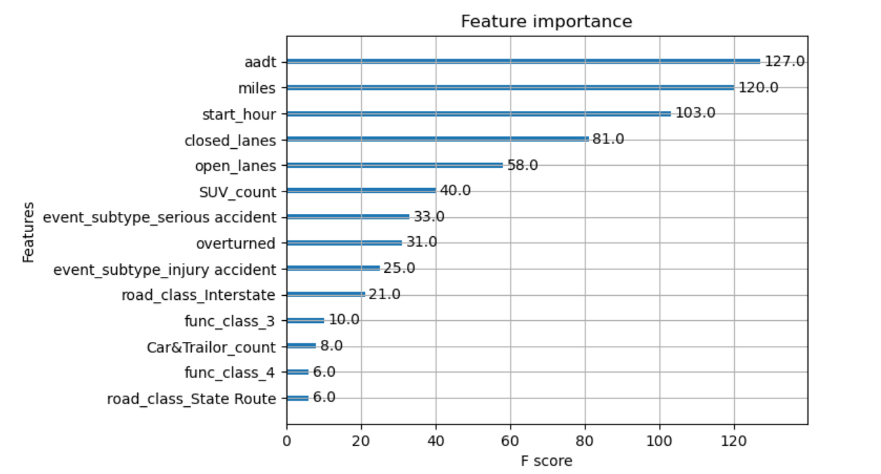
Feature Importance Analysis Using XGBoost:
The AADT (Annual Average Daily Traffic) was identified as the most critical feature influencing crash duration, suggesting that higher traffic volume significantly increases the time required to clear crashes. This implies that crash management strategies should focus more on high-traffic areas.
Miles (Segment Length) and Start Hour also play substantial roles in predicting crash durations. Longer road segments likely experience extended crash durations due to the complexity of managing incidents over larger areas, while the time of day impacts both traffic flow and the availability of emergency services.
The number of Closed Lanes and Open Lanes are key operational factors affecting crash duration, indicating that lane closures during crashes directly increase clearance time. Similarly, SUV Count suggests that vehicle type can impact crash management, with larger vehicles potentially requiring more time to remove from the scene.
Crash severity-related features, such as Overturned Vehicles and Serious Accident subtypes, show moderate importance. These features highlight the significance of crash severity in prolonging clearance times.crashes.
Finally, road class types and functional classes have relatively lower importance, implying that while roadway characteristics contribute to crash duration, they are less influential than traffic volume and crash-specific factors.

Slide 20
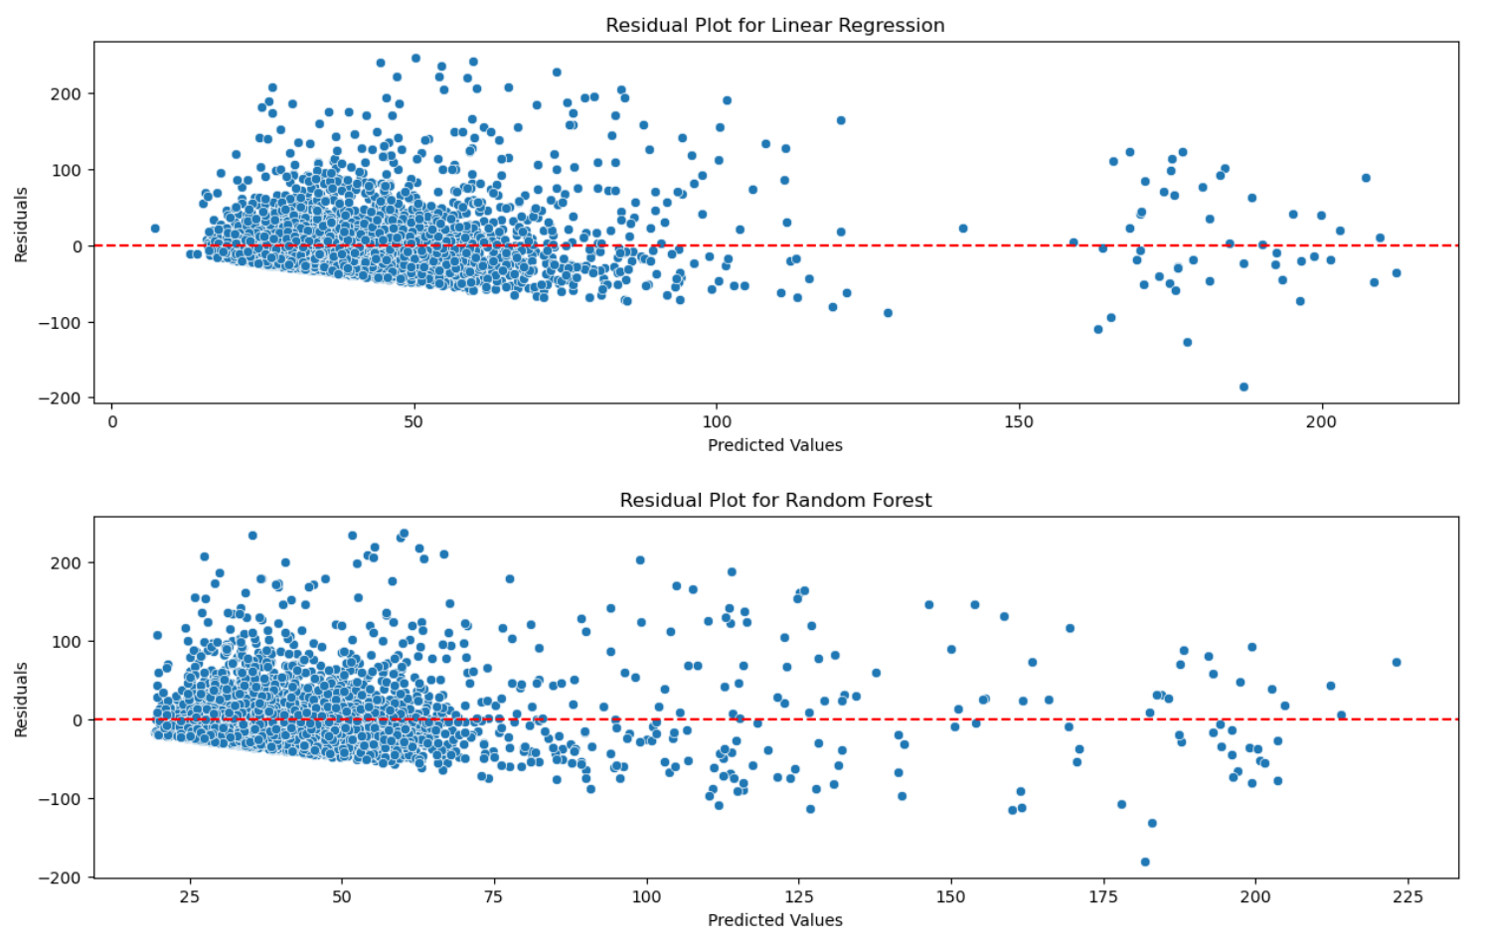
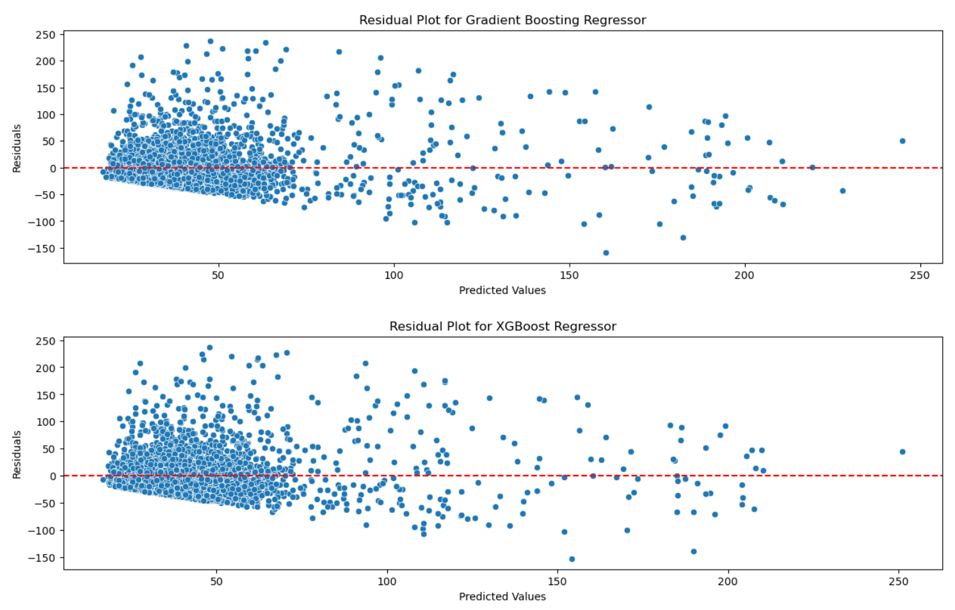
Residual Plots:

Slide 21
Summary on Residual Plots:
Linear Regression Residual Plot: Shows a wide spread of residuals across predicted values. The residuals are not evenly distributed around the zero line, indicating possible issues with the model's assumptions or fit.
Random Forest Residual Plot: The spread of residuals reduces slightly compared to Linear Regression. Still shows a pattern, indicating the model may not fully capture the variance in crash durations.
Gradient Boosting Regressor Residual Plot: The residuals show a more concentrated spread around the zero-line compared to previous models. A slight improvement in prediction accuracy is observed.
XGBoost Residual Plot: Residuals are more balanced and centered around the zero line. Indicates that XGBoost provides the most accurate predictions among the tested models.
Overall Observation: All models show residuals with a wide range, indicating further feature engineering or more complex models might be needed. XGBoost shows the best balance in residual distribution, suggesting it's the most effective model in this scenario.

Slide 22
Speed Ratio Distribution for non-crash time intervals vs. crash time intervals:
Data Filtering: Filtered out segments with more than 75 crashes per year to focus on high-risk segments.
Time Interval Marking: Converted measurement_tstamp to datetime format and rounded to 5-minute intervals for both high_crash_speeds and high_crash_events. Marked time intervals as crash intervals for each segment by checking if the timestamps fall between crash start and end times.
Merging and Calculating Speed Ratio: Merged the reference_speed from high_crash_events into high_crash_speeds. Calculated the speed ratio as speed / reference_speed.
Histogram Plots: Plotted histograms of speed ratio distribution during crash intervals and non-crash intervals. Crash intervals showed a peak around a speed ratio of 1, indicating crashes occur near reference speeds. Non-crash intervals had a more varied speed ratio distribution with higher frequency in the 0.75 to 1.0 range.

Slide 23
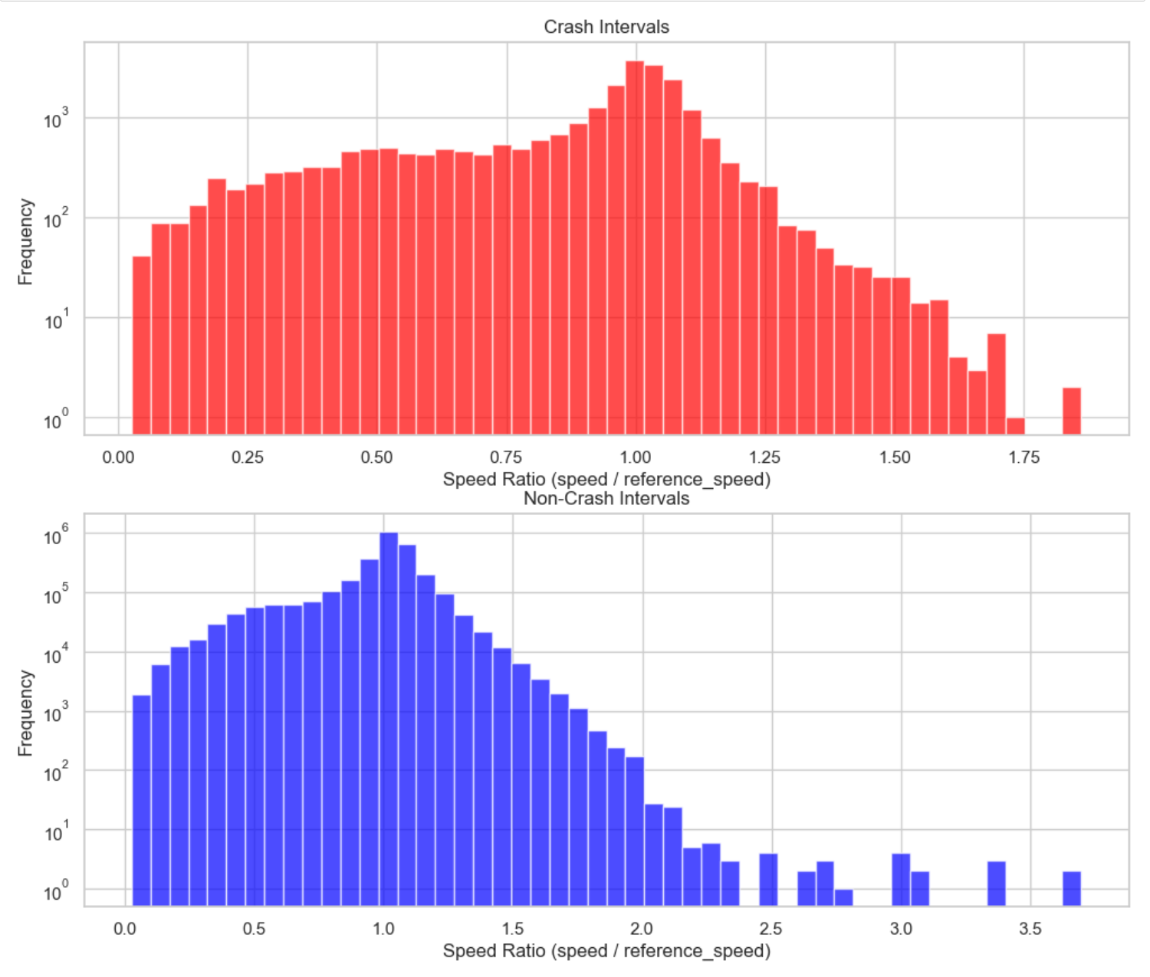
Crash Interval vs Non-Crash Interval Plots:

Slide 24
Summary on the plot:
Crash Intervals Distribution (Red Plot)
The distribution of speed ratios during crash intervals shows a peak around 1.0, indicating that most crashes occur when vehicles are traveling near their reference speed (expected or average speed for that segment).
There is a drop-off at higher speed ratios (above 1.25), suggesting that vehicles traveling significantly faster than the reference speed are less likely to be in crashes during the observed intervals.
The logarithmic y-axis scale indicates that lower speed ratios (< 0.75) also have notable crash occurrences, implying that vehicles traveling below the reference speed might still be prone to crashes, possibly due to road conditions or sudden deceleration.
Non-Crash Intervals Distribution (Blue Plot)
The distribution for non-crash intervals shows a more symmetrical pattern, with the highest frequency around a speed ratio of 0.75 to 1.0, indicating that normal traffic typically flows close to the reference speed.
There is greater variability in speed ratios during non-crash intervals compared to crash intervals, with some vehicles traveling significantly faster (above 2.0) or slower (below 0.5) than the reference speed without resulting in crashes.
The tail on the right side indicates that higher speed ratios (> 1.5) are more commonly observed in non-crash intervals, suggesting that vehicles exceeding the reference speed are not necessarily at higher crash risk unless certain conditions apply.

