Slide 1

Credit Card Fraud Detection
Group 23: Vincenzo Coppola, Prachi Sanghvi
04/24/2022

Slide 2








Agenda
Introduction to the Problem
Understanding the Data
The Data Mining process
Performance Evaluation
Overview
Conclusion

Slide 3

Overview
How was the project approached?
The Big 4:
Data Acquisition – Determine topic of interest and find useful data for prediction
Data Pre-Processing – Data Verification, Dimensionality Reduction, Feature Selection
Data Modelling – Assist in understanding pre-processing needs and important features
Prediction and Evaluation – Test several models evaluating performance / effectiveness
GOALS:
Correctly classify Fraud among the original dataset and verify with 2nd set
Achieve >75% Total / Fraud classification accuracy w/ minimal information required

Slide 4
Introduction to the problem
Introduction to the Problem
Understanding the Data
The Data Mining process
Performance Evaluation
Overview
Conclusion

Slide 5

Raise your hand if you have ever used a credit card!

Slide 6







Introduction to the Problem
Fortunately for you, financial institutions have you covered
For them it’s not so good…and here’s the problem
2013 – Yahoo has 3 billion records exposed (largest ever)
2017 – Equifax has 143 million records exposed
2019 – Facebook, Capital One, FA Financial combined 1.5 billion
2012
2022
2016 – AdultFriendFinder has 412 million records compromised
2018 – Marriot has 500 million records exposed

Slide 7
Introduction to the Problem
Problems:
All types of organizations are hurt from fraud – it can cost them billions of dollars
Credit Card Fraud Reports have constantly been on the rise
Technological capabilities Global Pandemic Point of Sale Transactions
Reports of Fraud
Mitigations:
Consumers: Monitor credit card locations, keep cards secure, shop in person when possible
Companies: Put advanced detection in place…This is where Data Mining can help

Slide 8
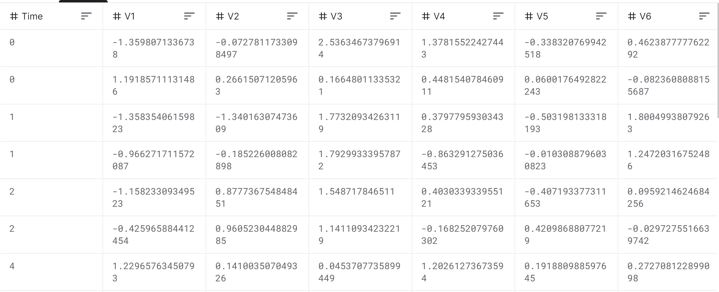
Introduction to the Problem
The Problem: Picking the dataset to base model on…
Most Financial datasets have PCA pre performed to create statement confidentiality

Slide 9
Understanding the Data
Introduction to the Problem
Understanding the Data
The Data Mining process
Performance Evaluation
Overview
Conclusion

Slide 10
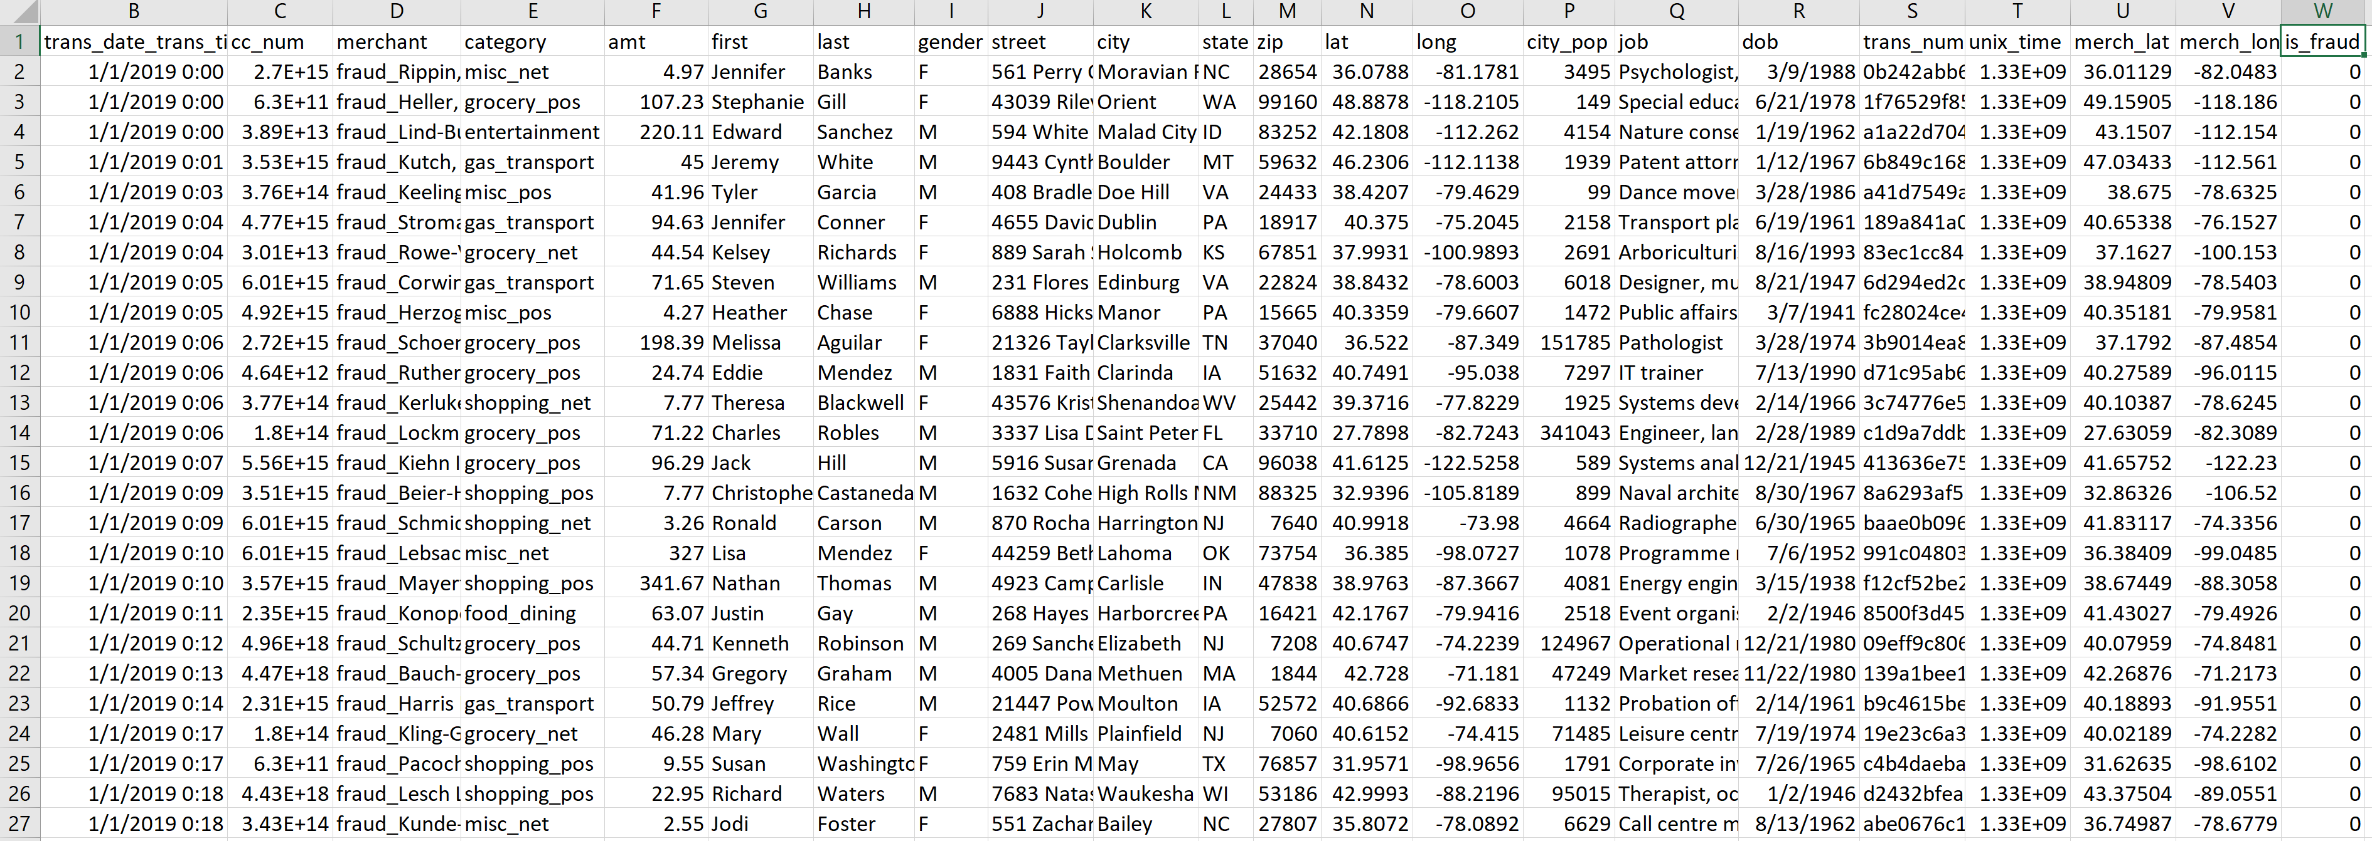
What is the Data?
The Solution: Utilize generated simulation data (python, shell, batch) developed over 1 year

Slide 11
Understanding the Data
Sources: 2 datasets
FraudTrain.csv – 23 columns, 1048575 Records
FraudTest.csv – 23 columns, 555718 Records
Attributes:
Features – Transaction (date | time | number), amount, credit card number, name (first | last), address (street | city | state | latitude | longitude | zip), date of birth, job title,
merchant (name | longitude | latitude)
Classes – is_fraud (0 – Not Fraud, 1 – Fraud)

Slide 12
The Data Mining Process
Introduction to the Problem
Understanding the Data
The Data Mining process
Performance Evaluation
Overview
Conclusion

Slide 13
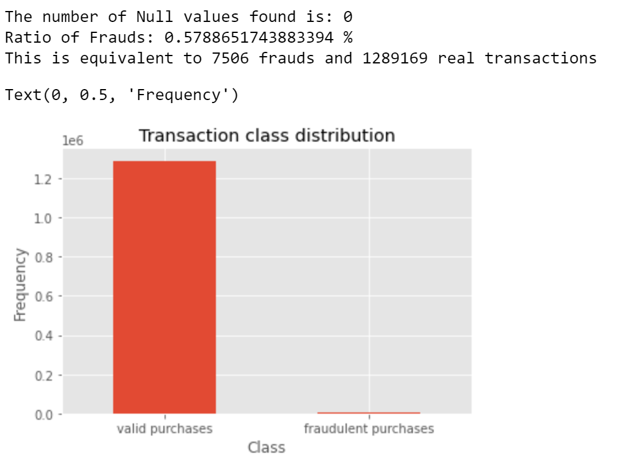
Data Pre-Processing
Data Validation
Null Handling – To indicate missing / unknown values in the dataset
Data Distribution – Determine ratios of the two classes

Slide 14
Data Pre-Processing
Data Wrangling
Custom Column Creation – Created a column which gave time between transactions for each card
.groupby( ), .str.split( ), .diff( ), .fillna( )
Label Encoding – To replace categorical values with numeric values

Slide 15
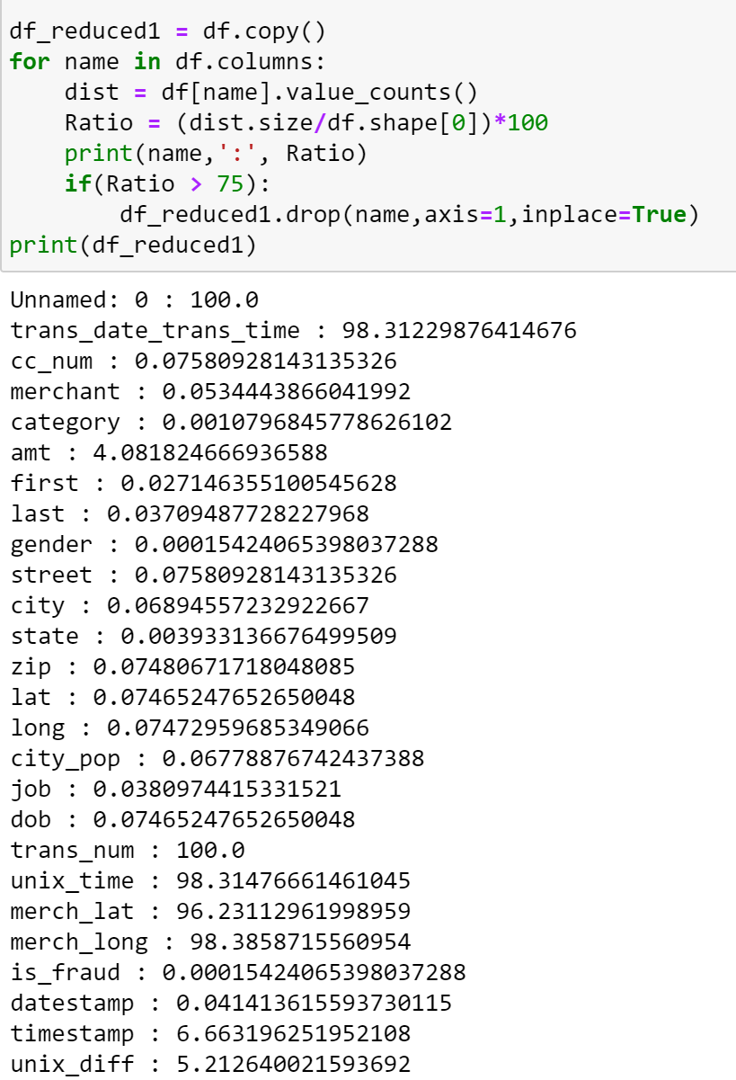
Data Pre-Processing
Dimension Reduction
Unique Values – Find ratios of unique values for each attribute to remove substantially variant columns
Results – Remove index, transaction time, merchant long/lat

Slide 16
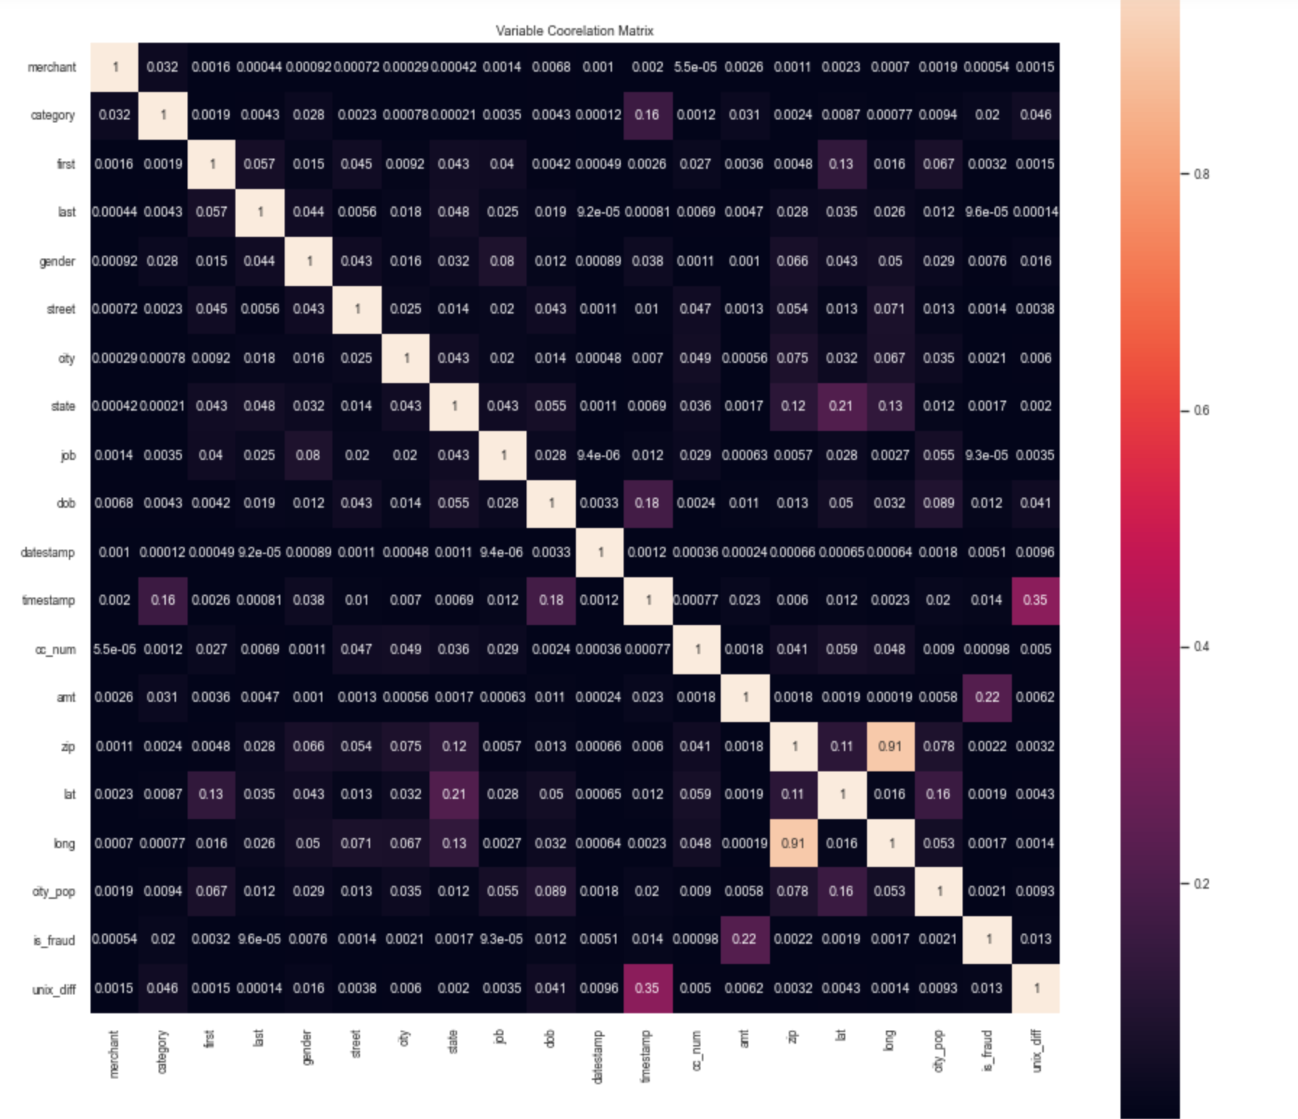
Data Pre-Processing
Dimension Reduction
Correlation – Matrix made to remove one of overly correlated variables (>0.9 correlation)
Results: Longitude removed, used Zip instead

Slide 17
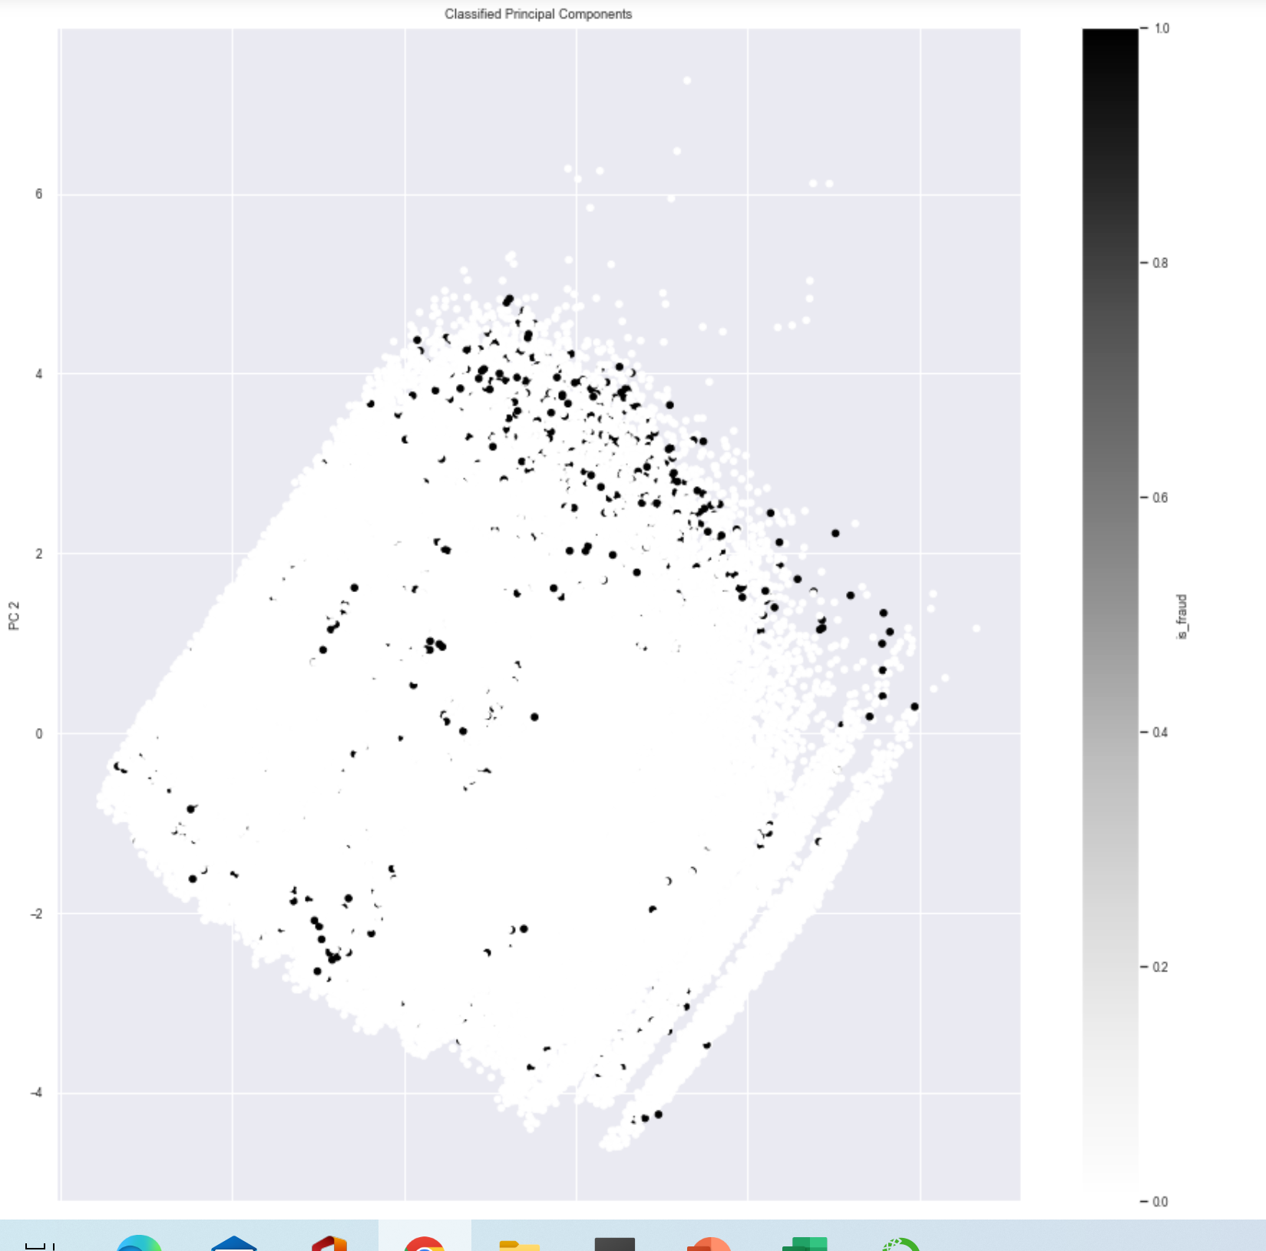
Data Pre-Processing
Dimension Reduction
PCA – Performed PCA as a means of reducing attributes and retaining info
Results: PCA did not assist in reducing dimensions
<10% of information retained per component

Slide 18
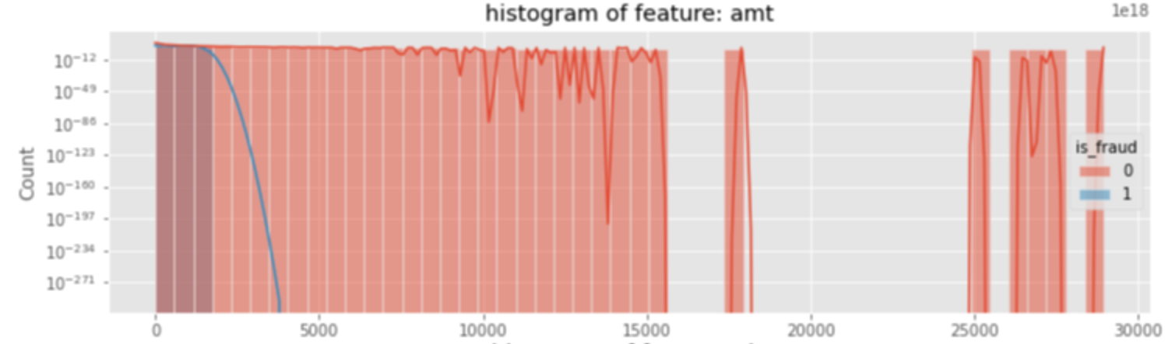
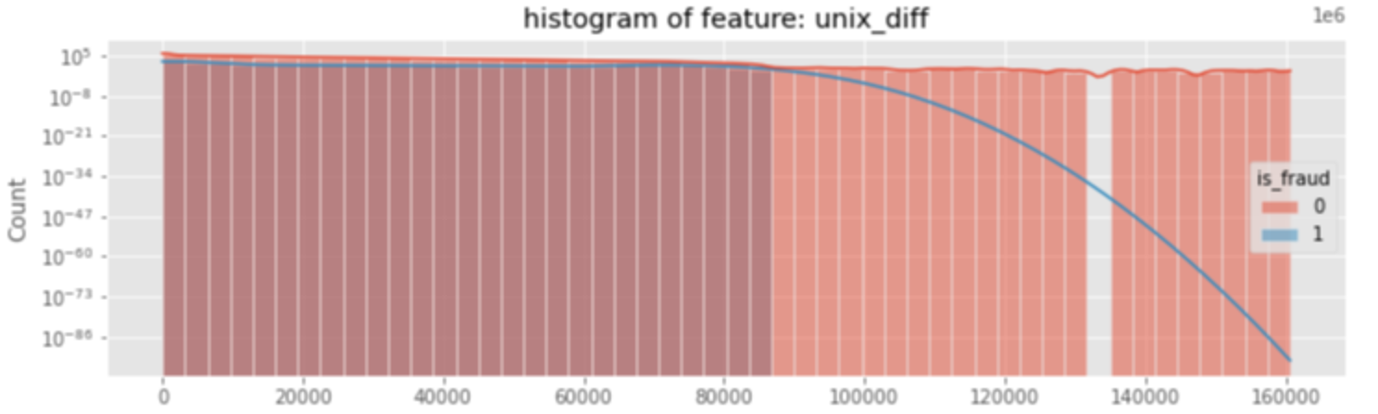
Data Modelling
Diving into the data distribution –
Feature Histograms based on class to see extreme differences
Results- UNIX_Diff and AMT appear to have largest variance in class distribution

Slide 19
Model Exploration
Metrics –
Test Train Split: Due to major bias in data (99.43% of records = not fraud), test_train_split 80% / 20% was not be viable
Null accuracy: Because of 99.43% being not fraud Accuracy (all predicted not fraud = 99.43%)
Accuracy vs Sensitivity: Knowing accuracy is not a good metric to measure, we prioritized Sensitivity (How well the model classifies fraud)
Missing Fraud is much worse than misclassifying real transactions as Fraud

Slide 20
Original Dataset
7506 Fraud(1) = 0.57%
1289169 Real(0) = 99.43%
½ of Fraud (3753)
½ of Fraud (3753)
Equal Number of Real (3753)
# Real to retain 99.43% (644585)
Train Dataset
Balance
3753 Fraud
3753 Real
Valid Dataset
Original Ratio
3753 Fraud
644585 Real

Slide 21
Model Exploration
Models used to classify –
Logistic Regression – Pros: Improved Sensitivity, (Time / iteration = ~1.7 s)
Cons: Linear Probabilistic Limitations
KNN Neighbors – Pros: Improved Sensitivity
Cons: Extremely inefficient (Time / iter = ~2 min), must choose K
Naïve Bayes – Pros: Improved Sensitivity and Accuracy, (Time / iter = ~1.55 s)
Cons: Requires all features of same statistical relevance
Decision Tree – Pros: Optimal Sensitivity / AUC, Time Efficient (Time / iter = ~1.55 s)
Cons: Potential for Overfitting, must prune

Slide 22
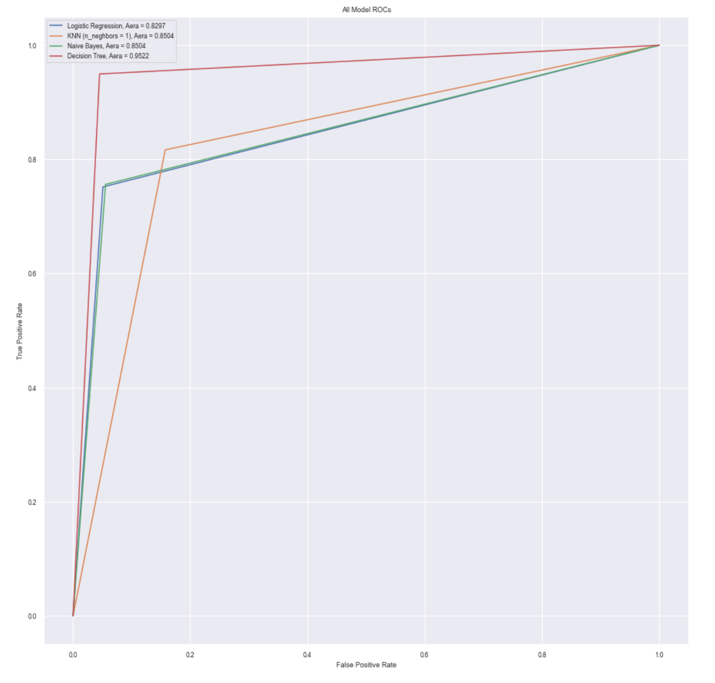
Decision Tree is Far and away the best

Slide 23
Performance Evaluation
Introduction to the Problem
Understanding the Data
The Data Mining process
Performance Evaluation
Overview
Conclusion

Slide 24
Performance Evaluation
Initial Results
Accuracy – 95%
Sensitivity – 95%
Optimizing the Model
Remove remaining low impact Features
Cost Complexity Analysis

Slide 25
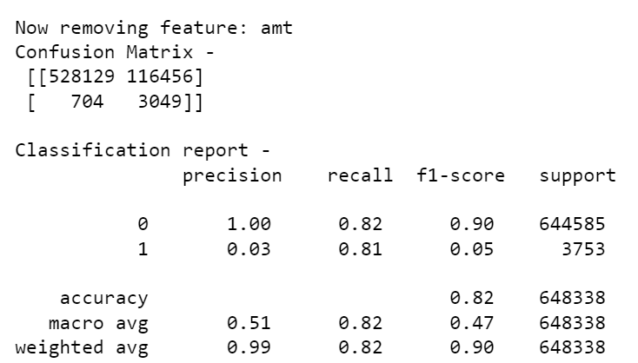
Performance Evaluation
Optimizing the Model
Remove remaining low impact Features
Iterate through columns, remove to see if model is impacted
Results: reduced to only 6 attributes

Slide 26
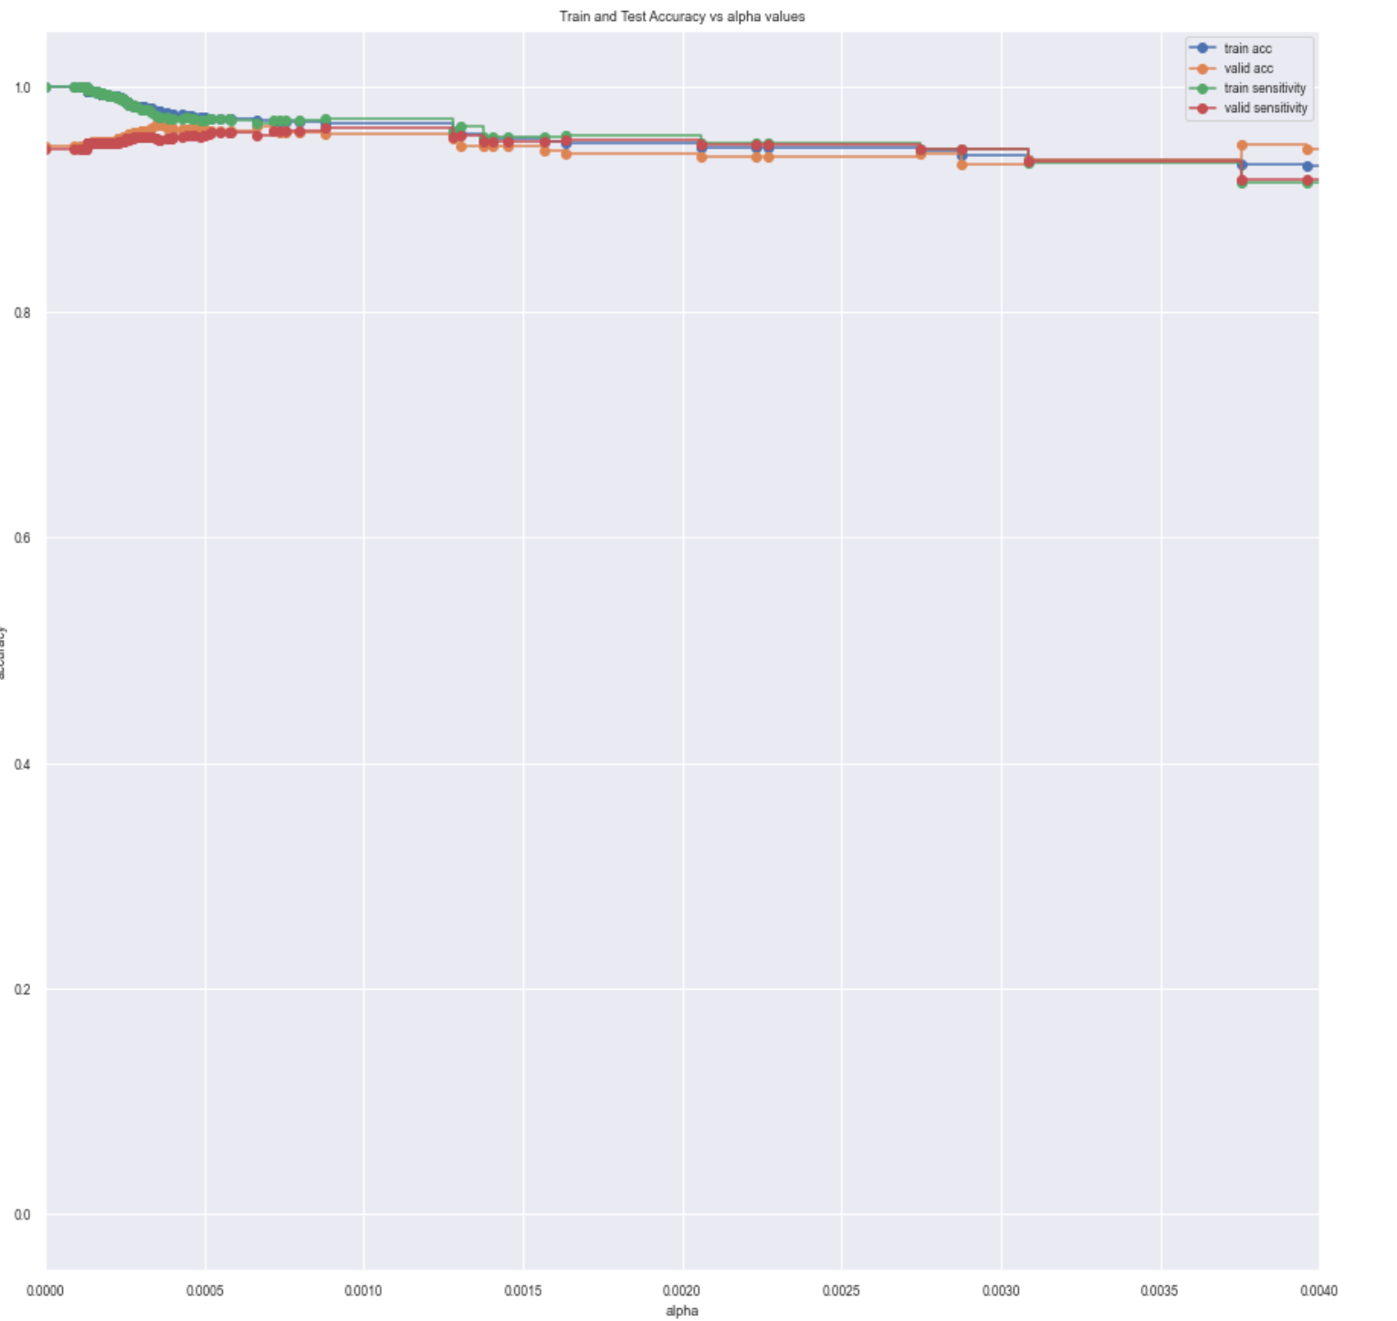
Performance Evaluation
Optimizing the Model
Cost Complexity Analysis
Results: potential overfitting (ccp_alpha = 0)
ccp_alpha = 0.0010, 0.98 Sensitivity
0.94 Accuracy
ccp_alpha = 0.0004, 0.96 Sensitivity
0.96 Accuracy
Improved Precision /Accuracy
Optimal Sensitivity

Slide 27
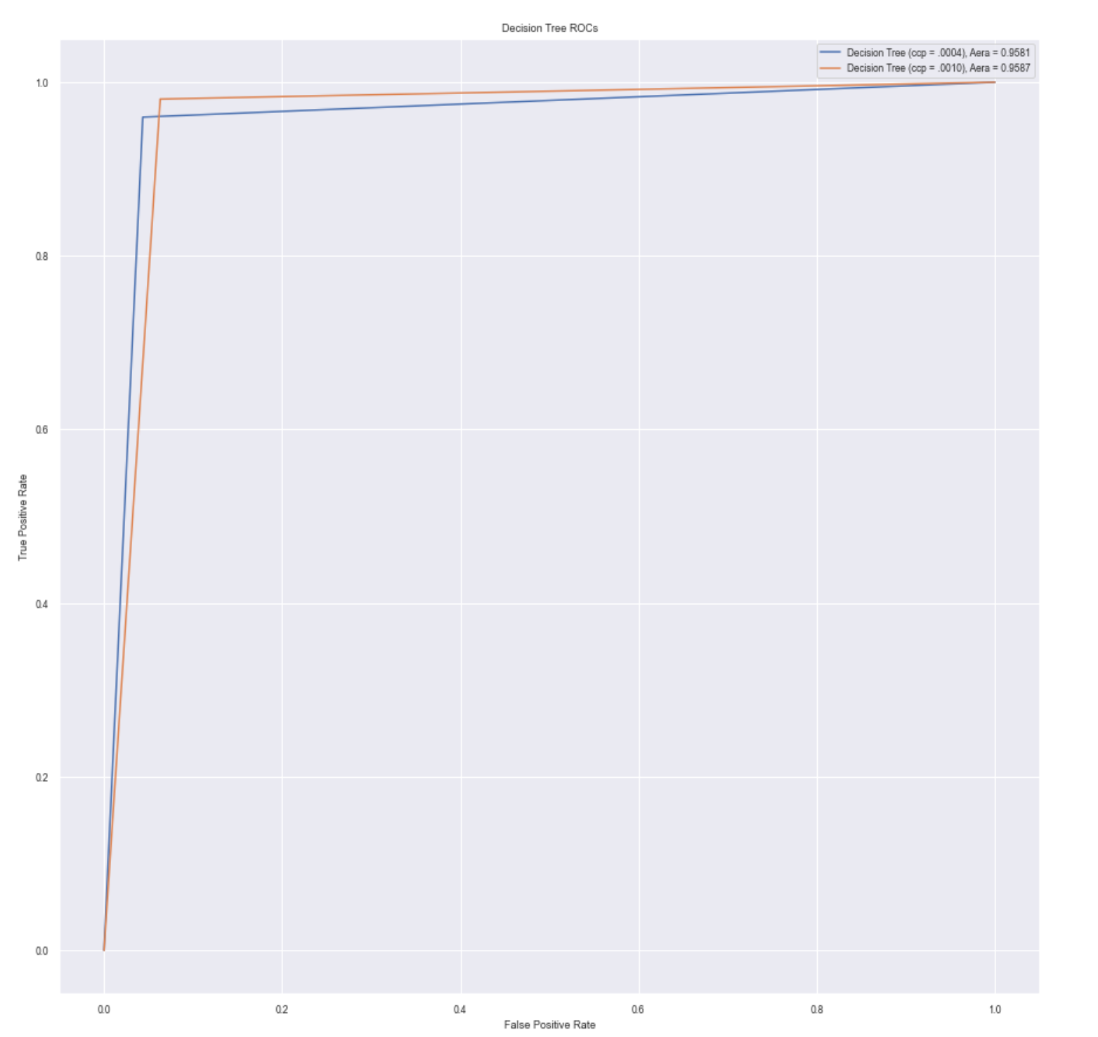

Slide 28
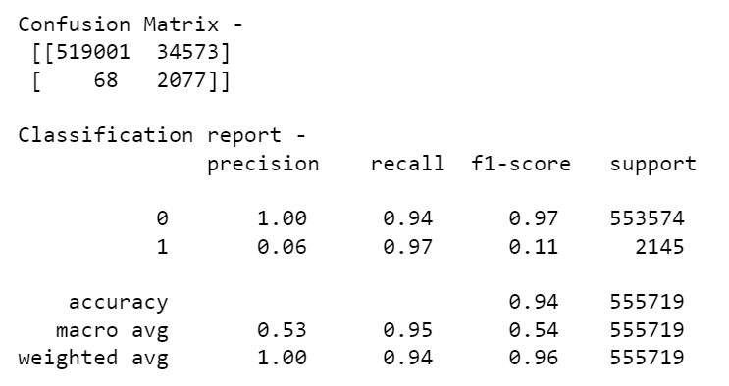
Performance Evaluation
THE FINAL TEST!!
Utilized second simulated dataset and cleaned to match train/valid sets

Slide 29
Conclusion
Introduction to the Problem
Understanding the Data
The Data Mining process
Performance Evaluation
Overview
Conclusion

Slide 30

Conclusion
To Conclude…
Credit Card Fraud is a major issue especially in the USA, but good detection can limit missed cases
No model is perfect and there is a need to prioritize
Catching fraud but potentially inconveniencing customers
V.S.
Missing fraud cases and losing money
Moving Forward
Try other models such as RandomForest and SVM
Work to minimize False Positives

Slide 31
THANK YOU!
Questions?
Sources:
https://www.kaggle.com/datasets/kartik2112/fraud-detection
https://github.com/namebrandon/Sparkov_Data_Generation
https://www.kaggle.com/datasets/mlg-ulb/creditcardfraud
https://shiftprocessing.com/credit-card-fraud-statistics/#:~:text=Losses%20of%20%2424.26%20Billion%20in,continues%20to%20climb%20over%20time

