Slide 1



network based intrusion detection system in Iot devices
Course: SCS_3253_024 Machine Learning
By Team 7
Bhavnil Patel, Dhairya Sheth, Vinay Pandit
Git Link : https://github.Com/vingpan/machine_learning_3252_project
Link to Notebook: https://github.com/VinGPan/Machine_Learning_3252_project/blob/master/project.ipynb

Slide 2
CONTENTS
Introduction
Data Description & EDA
Time-Series View of Data
Problem Statement
Model Search Framework
Results
Conclusion

Slide 3
INTRODUCTION
Background: A system that detects cyber attacks can prevent any harm caused by them.
Objective: build ML models that identifies 3 types of attacks:
Distributed denial of service (DDOS) attack- attacker attempts to make a machine or network resource unavailable for its users.
Port Scan Attack- attacker attempts to identify exploitable vulnerabilities on targeted systems
Man In the Middle Attack- attacker attempts to secretly alter the communications between two parties who believe that they are directly communicating with each other.
Build both detection & prediction models.

Slide 4

Novel ideas & contributions
We are the first to build an end-to-end ML model on the Kaggle dataset https://www.kaggle.com/speedwall10/iot-device-network-logs. At the time of writing this report, there are NO publicly available kernels to detect/predict using this dataset
We have developed Model Search Framework. For a dataset (X, y) this validates 120 model pipelines.
We have explored the possibility of utilizing a time-series analysis APIs provided by PyEEG, an open-source library originally developed to analyse EEG signals.

Slide 5
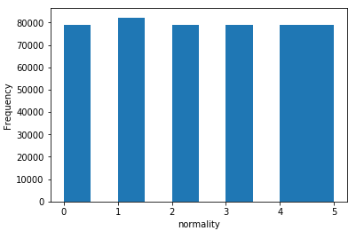
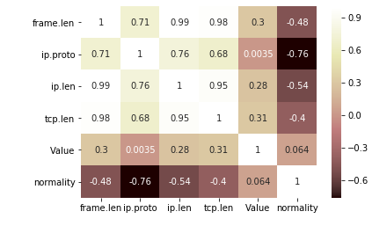
DATA Description
Data source https://www.kaggle.com/speedwall10/iot-device-network-logs
'Normality’ is the categorical target variable with values
0-Normal
1-Wrong Setup
2-DDOS attack
3-Data type probing
4-Scan Attack
5-Man In the Middle Attack
No class imbalance
Over 400K Samples
frame.number : Index of the frame | ip.proto : Frame protocol type
frame.time : Time Stamp of the frame | ip.len : Frame IP length
frame.len : Frame length | tcp.len : Frame TCP length
eth.src : Descriptor of frame originator | tcp.srcport : TCP port of frame originator
eth.dst : Descriptor of frame destination | tcp.srcport : TCP port of frame destination
ip.src : IP address of frame originator | Value : Transmission Value
ip.dst : IP address of frame destination | normality : Transaction Type: Normal, Attack or Probe
frame.len, ip.proto, ip.len & tcp.len have reasonable correlation with target

Slide 6
TIME-SERIES VIEW OF DATA
Goal - get useful patterns for frame.len, ip.proto and other predictor values over time PRIOR to an attack by rearranging (sort) the data using frame.time
New terms - 1. history which is # time-frames used for prediction.
2. lead which is # time-frames immediately before the attack (or normal).
Example - to predict future 'normality' 100 time-frames in advance we say, lead = 100. To analyze 600 time-frames of data to make this prediction we say, history = 600.
History
Lead
Target
Rows 0-599 used for prediction
Rows 599-699 NOT used for prediction
Predict target of Row 700

Slide 7
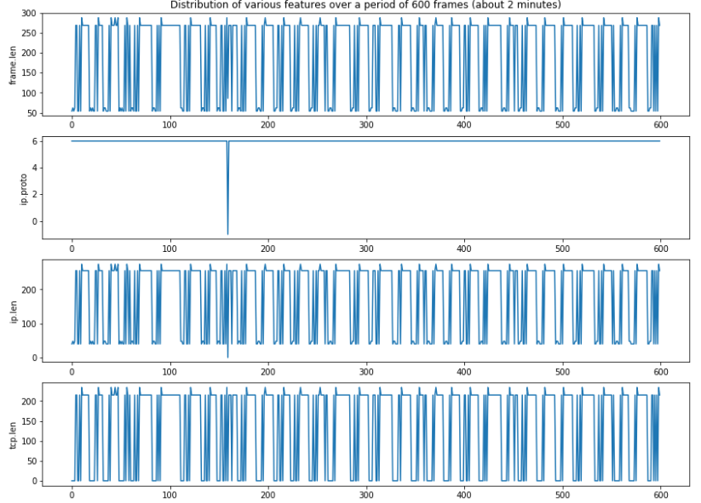
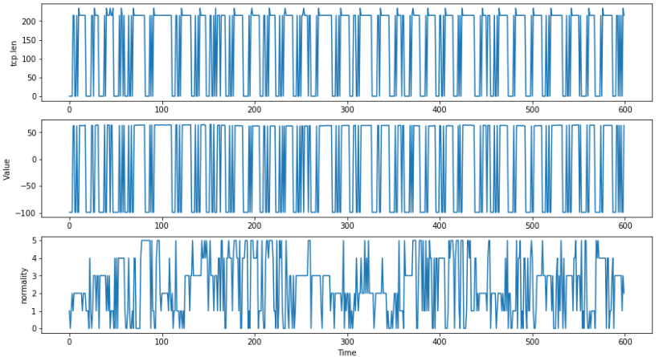
A single sample of TIME-SERIES dataset
Inference: Most variables have systematic patterns over time except ip.proto

Slide 8
PROBLEM STATEMENT
Model to build |  | Details
Attack Detection |  | Objective- identify whether the current frame is an instance of attack or not. Use 'frame.len', 'ip.proto', 'ip.len', 'tcp.len', 'Value’ features to predict the 'normality'.
Predict Future Attacks using Time-Series Analysis | Predict Near Future Attacks history = 5 & lead=10 | Combine features for every 5 frames, skip the next 10 time-frames and predict for the 16th time-frame.
 | Predict Far Future Attacks history = 5 & lead = 100 | Combine features for every 5 frames, skip the next 100 time-frames and predict for the 106th time-frame.
 | Predict Far Future Attacks history = 100 & lead = 10 | Combine features for every 100 frames, skip the next 10 time-frames and predict for the 111th time-frame. Perform feature engineering using PyEEG
 | Predict Far Future Attacks history = 100 & lead = 100 | Combine features for every 100 frames, skip the next 100 time-frames and predict for the 201th time-frame. Perform feature engineering using PyEEG

Slide 9
Model search framework
This framework is a collection of model pipelines generated in combinatorial fashion.
Given a dataset (X, y) this validates 120 different model pipelines and stores their results. This also uses GridsearchCV used for hyperparams search for each pipeline. Models to be generated can be controlled via experiment yml file
Generates following pipelines
Preprocessing
Min-Max transform
Standard normal transform
No Preprocessing
Dimensionality reduction
PCA
Kernel PCA
Locally Linear Embedding
ISO Map
No Dimensionality Reduction
Dimensionality reduction
Logistic Regression
Naive Bayes
kNN
Random Forest
SVC
XGBoost
AdaBoost
Gradient Boosting
Framework code is in our github at https://github.com/VinGPan/Machine_Learning_3252_project/blob/master/src/s04_build_models.py

Slide 10
FEATURE ENGINEERING
Though it is beneficial to consider longer historical values while predicting the future Normality/attack values, increasing the history will also increase the dimensionality of the data
Hence, use an open-source library called PyEEG for Feature Extraction from time-series data
Below list of PyEEG features are used
Power Spectral Analysis: Measure of signal's power content versus frequency
Entropy and Information: Entropy quantifies how "informative" or "surprising" the entire random variable is
Fractal Dimension: A fractal dimension is an index for characterizing fractal patterns. Fractals are self-similar structures but with different scales.
Hurst Exponent: a measure of long-term memory of time series
Detrended Fluctuation Analysis: a method for determining the statistical self-affinity of a signal.

Slide 11
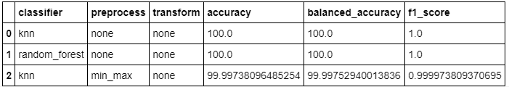
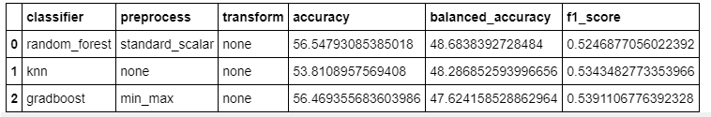
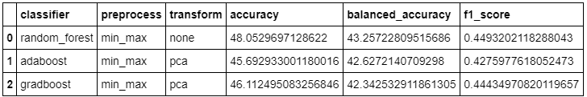
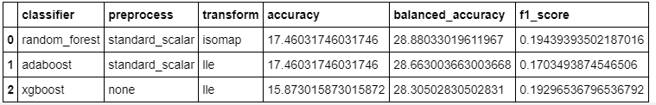
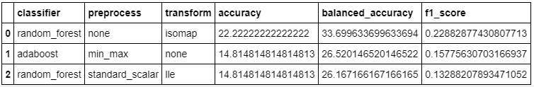
Validation RESULTS-top 3 classifiers
Attack Detection
Predict Near Future Attacks
history = 5 & lead=10
Predict Far Future Attacks
history = 5 & lead = 100
Predict Far Future Attacks
history = 100 & lead = 10
Predict Far Future Attacks
history = 100 & lead = 100

Slide 12
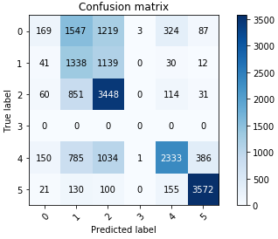
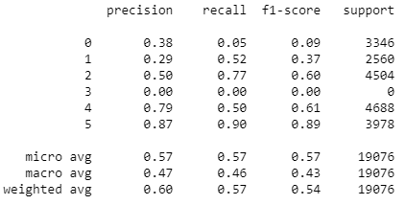
TEST RESULTS on the Best Model
Attack Detection Model - Test accuracy = 100.0% & F1 = 1.0
Predict Near Future Attacks
with history = 5 & lead=10 - Test accuracy = 56.9%, balanced accuracy = 54.7%, F1 = 0.54
Seen promising F1 score for actual attacks.
DDOS (Distributed denial of service) attack => F1 Score = 0.6
Scan Attack => F1 Score = 0.61
Man In the Middle Attack => F1 Score = 0.89

Slide 13
CONCLUSION
Developed ML model which can predict and detect attacks.
Developed a Model Search mechanism which exhaustively searched for optimal model among several possible classification approaches.
Our model detected the attacks with 100% accuracy
Our best attack predictor model based on Random Forest can detect “Man In the Middle Attack” approx. 2 seconds in advance, with promising F1 score of 0.89.
Explored the usage of PyEEG library for this problem.

Slide 14
THANK YOU

