Slide 1
Airbnb Listings Analysis
Vinay PaNDIT

Slide 2
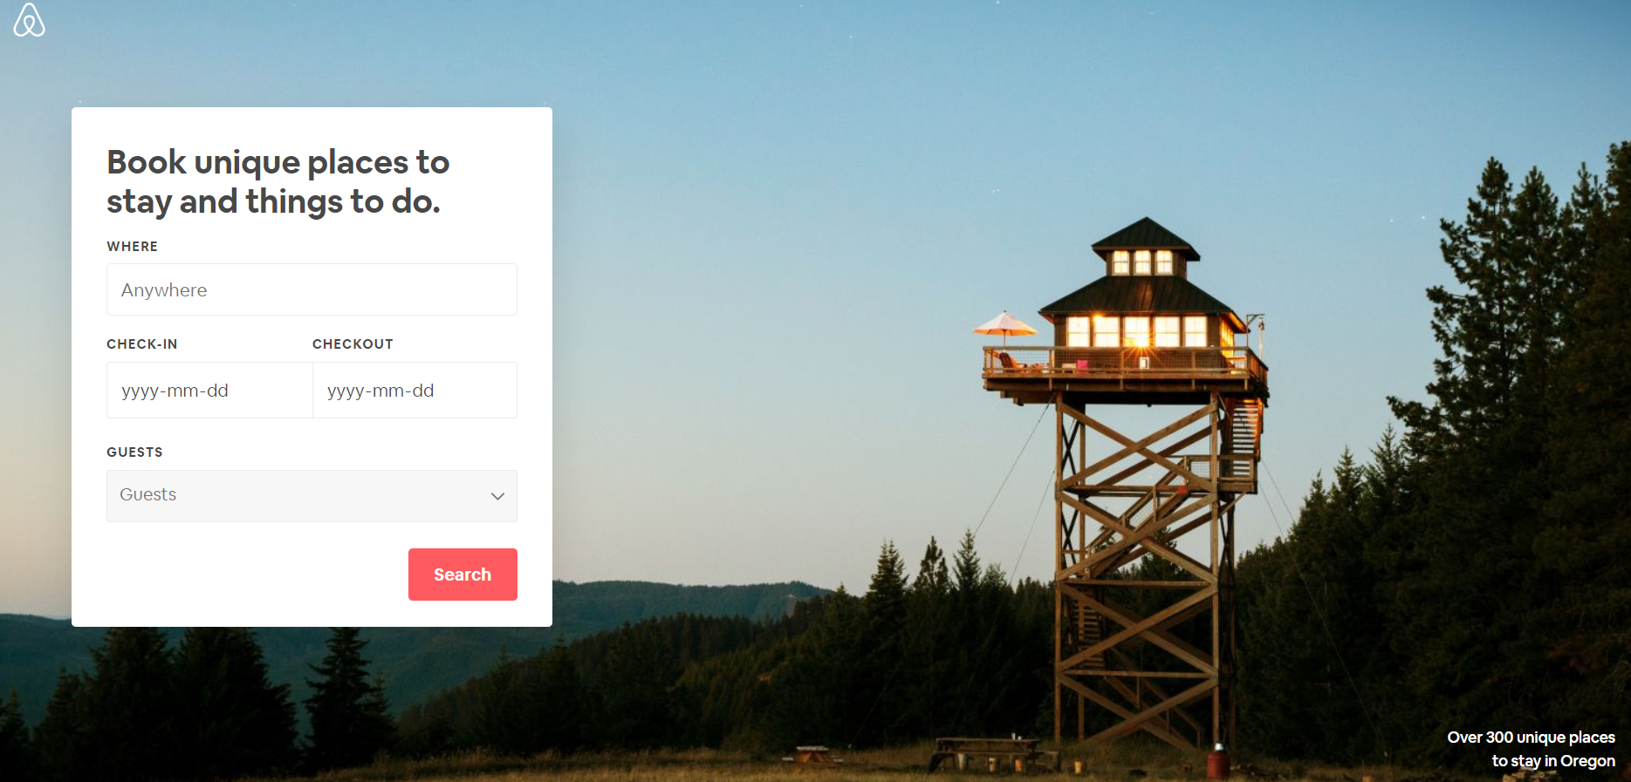


Introduction
Lease or rent variety of short-term housing options
Available in 34,000+ cities across 190+ countries
How are the listings distributed geographically?
What different types of listings are available and how are they priced?
Are the listings really for short duration?
How much rent can I expect for my property in Toronto?

Slide 3
Data
Data is available for free at http://insideairbnb.com/
The data has been provided in tabular form spread over multiple .csv files : listings.csv, calendar.csv, reviews.csv, neighbourhoods.csv etc.
listings.csv : 21900 x 106
calendar.csv : 8 Million x 7
Demographics
Details
Descriptions
Date
Availability
Price
…
City
Zip
Latitude
Longitude
…
Property Type
Room type
# Bedrooms
Amenities provided …
Ad Title
Summary
Accessibility
…
Neighbourhood
Host Info
Price
For every entry in listings table
X
For every day for one year starting from 2019-Sept-14
Area
Description
…
Host Since
Description
# Properties Listed
…
Daily
Weekly
Charge per extra people
…

Slide 4
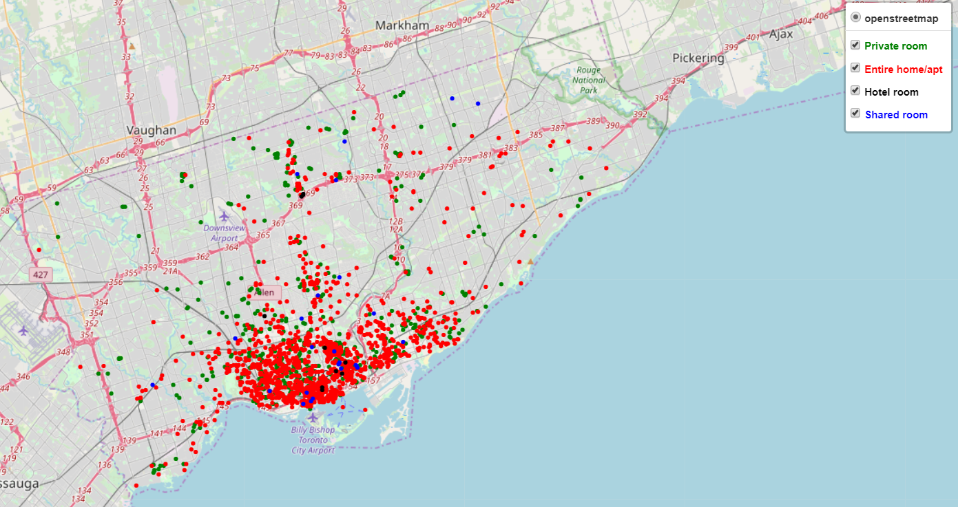
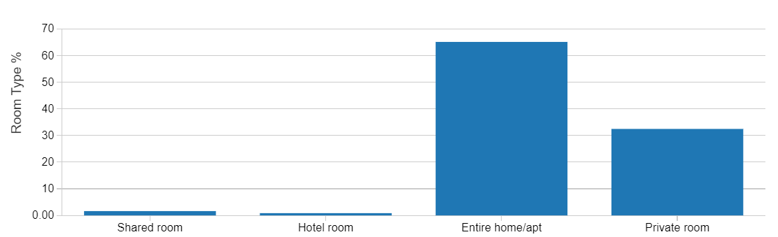
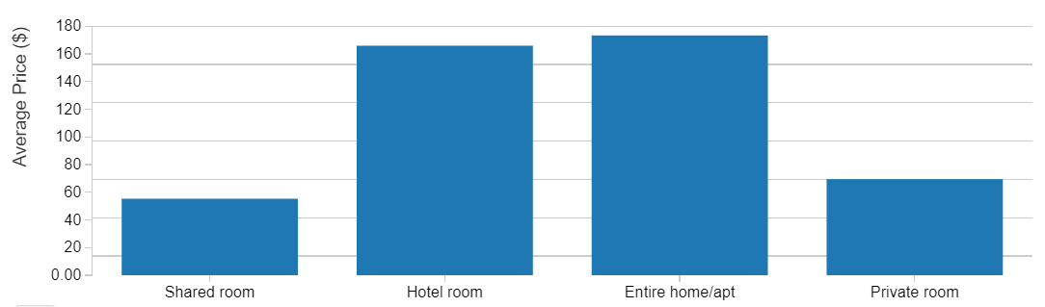
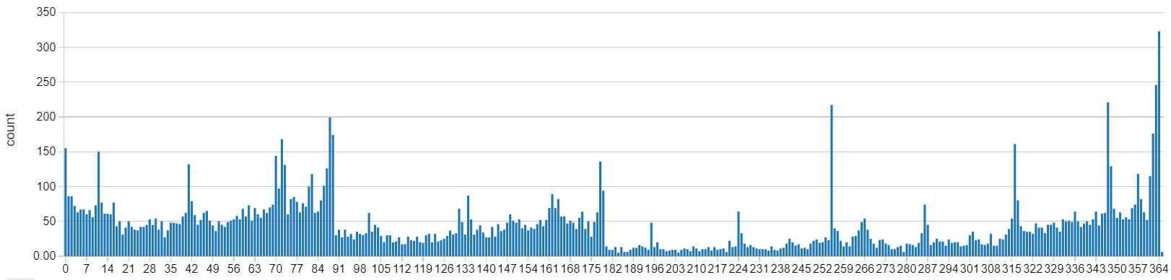
Exploratory Data Analysis
65%
$ 173
Toronto Court Ruling on 18-Nov-2019 :
Maximum Up to 180 nights a year allowed
$ 70
28 % of listing are available for more than 6 months
Estimated Avg Income: $2,136 per month

Slide 5
Price Prediction – Random Forest Regressor
Remove Outliers
Min price $15 (≈ mean – 1 * std). max price $375 (≈ mean + 2 * std)
Nan Values
Binary fields like host_has_profile_pic, host_identity_verified to “false”
Numeric fields like cleaning_fee, reviews_per_month to 0
Drop rows for fields like # beds , # bedrooms
Add New feature
Count number of verbal descriptive fields provided. Treat null as not provided
Count number of binary fields like host_is_superhost, host_identity_verified set to 1
Use latitude-longitude provided to compute distance from a Toronto mid point
Categorical
Convert to categorical columns property_type, cancellation_policy to numbers
Grid Search & CV
Tune for Max depth, Number of trees and Minimum instance per node
On Test Set : R2 = 0.57
Mean Absolute Error = $33

Slide 6
Conclusion
Majority of the listings are in downtown area
Renting entire home or apartment is more common compared to renting a private room
Listings are priced high at about $173 per night on an average
Listing are not quite short-term rentals. About 28 % of listing are available for more than 6 months in an year
Random Forest Regressor based price predictor: R2 of 0.57 with Mean Absolute Error of $33

Slide 7
thanks

