Slide 1

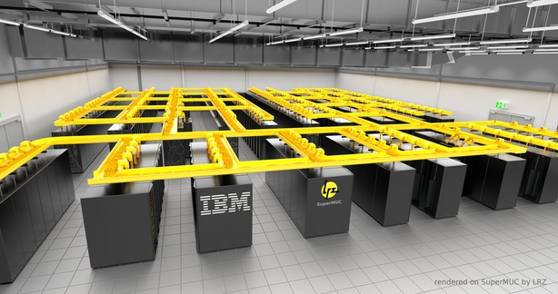

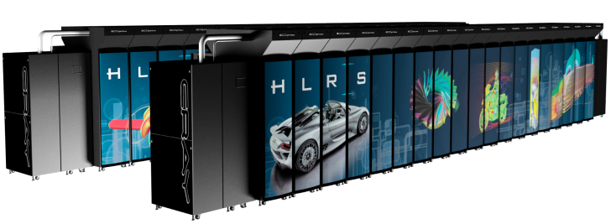


FloatingPoint Arithmetic for Scientists: Precision, Accuracy, Efficiency
Vincenzo Innocente
CERN, June 2026

Slide 2
Definitions

Slide 3
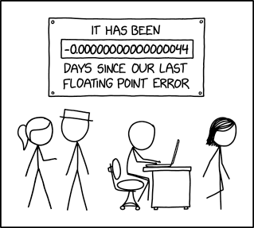
What is a Floating Point? https://en.wikipedia.org/wiki/Floating-point_arithmetic
Science is based on Measurements
The result of a Measurement is a Rational Number
M_{H} = 125.04 ± 0.12 GeV = 2.2290ᐧ10⁻²⁵ ± 2.1ᐧ10⁻²⁸ kg
“Floating Point” is a way to represent Rational Numbers by a fixed number of digits (precision) multiplied by a “base” with an exponent
A form of “Scientific Notation”
31ᐧ10⁻¹ is a FP in base 10 with “precision” 2 (# significant digits) printed in decimal
FP are usually “normalized” : the first digit is always not zero
1.10010010000111111011011 is a FP in base 2 with precision 24 printed in binary
normalized is a 1 followed by a string of 23bits. Easier to read if printed in hexadecimal: 1.921fb6ᐧ2⁺¹ . NB in hex last digit is always even

Slide 4
Some Trivial properties of FP
Each FP has a previous and a next
Previous of 31ᐧ10⁻¹ is 30ᐧ10⁻¹, next is 32ᐧ10⁻¹
Previous of 1.921fb6ᐧ2⁺¹ is 1.921fb4ᐧ2⁺¹, next is 1.921fb8ᐧ2⁺¹
The difference between two consecutive FP is called ULP (unit in last place)
For each value of the exponent there is a finite number of FP
10 ᐧ10e - 99 ᐧ10e
1.000000ᐧ2e - 1.ffffffᐧ2e
(called “binade”)

Slide 5
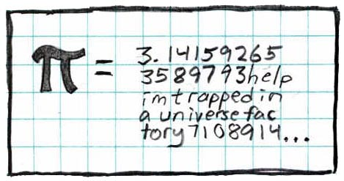
Precision and Rounding
The result of a measurement is 3.1415 and its accuracy, say, 0.1.
This result needs to be rounded. Default is to round to “nearest”
3.1415 -> 3.1 (3.1515 -> 3.2)
31ᐧ10⁻¹ represents all numbers in the interval [30.5ᐧ10⁻¹, 31.5ᐧ10⁻¹]
1.921fb6ᐧ2⁺¹ represents all numbers in the interval [1.921fb5ᐧ2⁺¹,1.921fb7ᐧ2⁺¹]
nextafter(pi,-inf)
nextafter(pi,inf)
ULP
π
1.921fb4ᐧ2⁺¹
3.14159274
1.921fb8ᐧ2⁺¹
1.921fb5ᐧ2⁺¹
1.921fb7ᐧ2⁺¹
1.921fb6ᐧ2⁺¹ ⁽0x1.921fb6p+1)

Slide 6
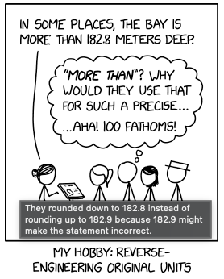
Rounding Algorithms
The standard defines five rounding algorithms.
The first two round to a nearest value; the others are called directed roundings:
Roundings to nearest
Round to nearest, ties to even – rounds to the nearest value; if the number falls midway it is rounded to the nearest value with an even (zero) least significant bit, which occurs 50% of the time; this is the default algorithm for binary floating-point and the recommended default for decimal
Round to nearest, ties away from zero – rounds to the nearest value; if the number falls midway it is rounded to the nearest value above (for positive numbers) or below (for negative numbers)
Directed roundings
Round toward 0 – directed rounding towards zero (also known as truncation).
Round toward +∞ – directed rounding towards positive infinity (also known as rounding up or ceiling).
Round toward −∞ – directed rounding towards negative infinity (also known as rounding down or floor).
A ”function” is correctly rounded if the result corresponds to the rounded true value
A “function” is faithfully rounded if the result corresponds to one of the two FP closest to the true value

Slide 7
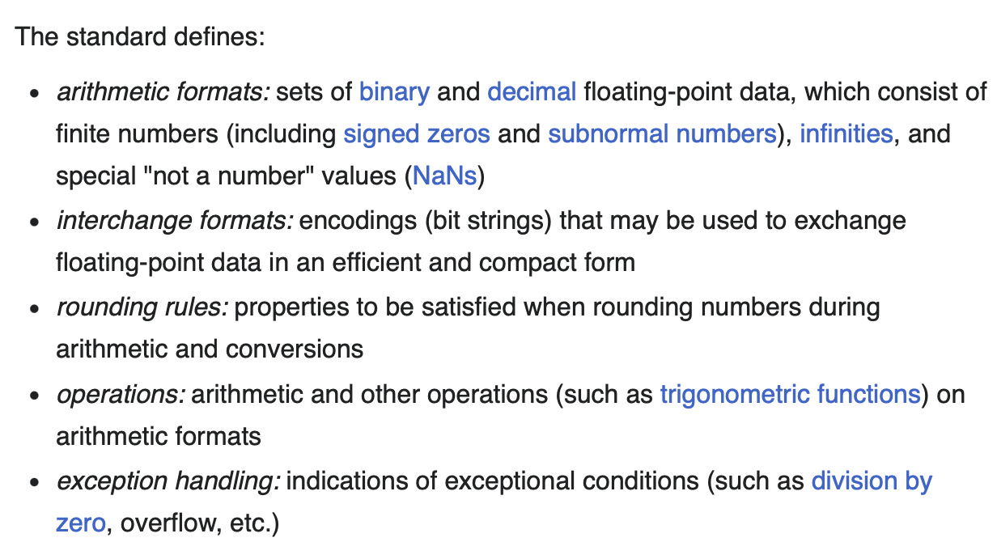
FP on a Computer
FP are well suited to perform arithmetic on a computer
Since 1985 FP representations and operations are standardized in IEEE754 (https://en.wikipedia.org/wiki/IEEE_754)

Slide 8
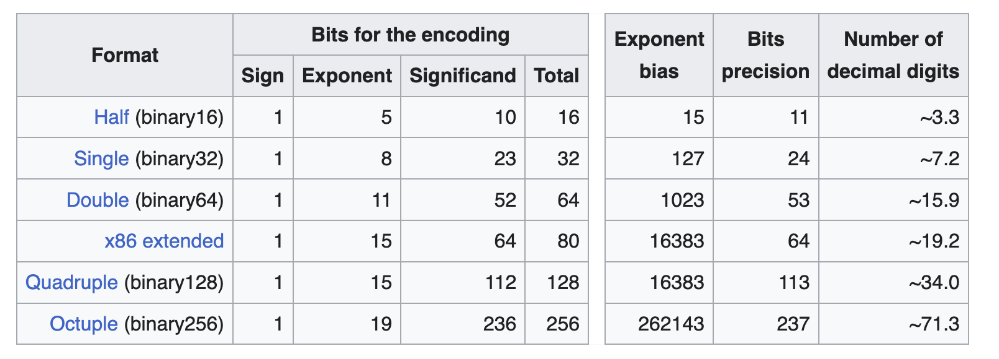

FP binary representations in IEEE754
Implicit 1

Slide 9
IEEE 754 representation of single precision FP
Implicit 1
Exponent | significand zero | significand non-zero | Equation
00_{H} | zero, −0 | subnormal numbers | (-1)^{signbits}×2⁻¹²⁶× 0.significandbits
01_{H}, ..., FE_{H} | normalized value | normalized value | (-1^{signbits}×2^{exponentbits-127}× 1.significandbits
FF_{H} | ±infinity | NaN (quiet,signalling)

Slide 10
examples
sign exponent significant
0.00000000e+00 0x0p+0 00000000000000000000000000000000
5.00000000e-01 0x1p-1 00111111000000000000000000000000
1.00000000e+00 0x1p+0 00111111100000000000000000000000
1.50000000e+00 0x1.8p+0 00111111110000000000000000000000
2.00000000e+00 0x1p+1 01000000000000000000000000000000
2.50000000e+00 0x1.4p+1 01000000001000000000000000000000
3.00000000e+00 0x1.8p+1 01000000010000000000000000000000
8.00000000e+00 0x1p+3 01000001000000000000000000000000
3.14159274e+00 0x1.921fb6p+1 01000000010010010000111111011011
1.00000001e-01 0x1.99999ap-4 00111101110011001100110011001101
1.17549435e-38 0x1p-126 00000000100000000000000000000000
3.40282347e+38 0x1.fffffep+127 01111111011111111111111111111111
nan nan 11111111110000000000000000000000
-inf -inf 11111111100000000000000000000000
2.93873588e-39 0x1p-128 00000000001000000000000000000000

Slide 11
C++ interlude
#include<iostream>
#include<iomanip>
#include<cmath>
#include<limits>
// std style
template<typename T>
void print(T x) {
std::cout << std::hexfloat << x <<' ’ // exact binary representation
<< std::scientific << std::setprecision(8) << x << ' ’ // 8 decimal digits
<< std::defaultfloat << x << std::endl; // 6 decimal digits for float
}
// integer representation // https://godbolt.org/z/96778d4GW
#include<cstring>
#include<bitset>
int f2i(float x) { int i; memcpy(&i,&x,sizeof(float)); return i;} // compiler will optimize
// use bitset to print in binary (bit by bit)
int ix = f2i(x);
std::cout << std::bitset<32>(ix)) << std::endl; ; // bit by bit
int e = ((ix >> 23) & 255) - 127; //exponent
ix &= 0x7FFFFF; //mantissa (aka significand) (w/o leading “1”)

Slide 12
Limits
Everything you want to know about an arithmetic type is in
std::numeric_limits<T>
see http://www.cplusplus.com/reference/limits/numeric_limits/
#include <iostream> // std::cout
#include <limits> // std::numeric_limits
int main () {
std::cout << std::boolalpha;
std::cout << "Minimum value: " << std::numeric_limits<float>::min() << '\n';
std::cout << "Maximum value: " << std::numeric_limits<float>::max() << '\n';
std::cout << "Is signed: " << std::numeric_limits<float>::is_signed << '\n';
std::cout << "significand bits: " << std::numeric_limits<float>::digits << '\n';
std::cout << "precision: " << std::numeric_limits<float>::epsilon() << '\n';
std::cout << "has infinity: " << std::numeric_limits<float>::has_infinity << '\n';
return 0;
}

Slide 13
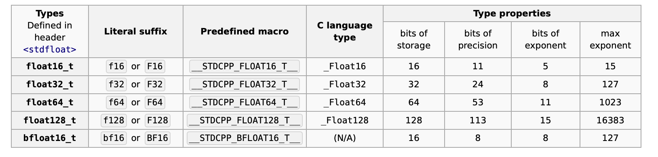
Fixed width floating-point types (since C++23) https://en.cppreference.com/w/cpp/types/floating-point.html

Slide 14
Python interlude
Python intrinsic “float” is actually double precision
float.hex() and float.fromhex() allows to convert to/from exadecimal string
numpy defines float16, float32, float64 (and float128 on x86_64)
https://numpy.org/doc/2.3/reference/arrays.scalars.html - floating-point-types
decimal is a module providing FP in base 10 of arbitrary precision
https://docs.python.org/3/library/decimal.html

Slide 15
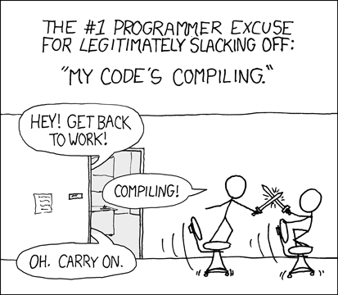
EXERCISES
Either in Python or C++
For C++ one can use godbolt (https://godbolt.org/z/d1e18j3jK )
For Python either a python3 shell on your PC, or a jupyter notebook or the browser shell in https://numpy.org/

Slide 16
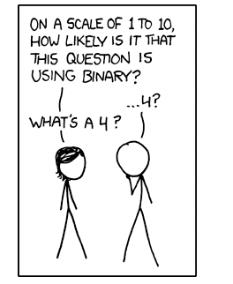
Count the number of FP in a binade
Verify that it is the same for two different binades
Compute the ULP for some FPs
How it depends on the binade?
Convert some number (0.1, e, pi, 31.5, …) between various representations (including decimal)
See what happens and explain it

Slide 17
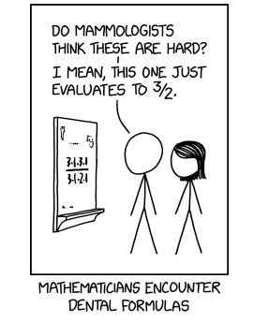
Arithmetic

Slide 18
FP Arithmetic
There are two basic operations: sum and multiplication
a+b and a×b symbolize the exact sum and multiplication between a and b
a⊕b and a⊗b symbolize the rounded sum and multiplication between FPs a and b
a+b and a*b are the corresponding operations in code
We will use decimal precision 2 for all examples to allow mental arithmetic in a finite time
42+3.7 = …
42⊕3.7 = …
42⊕3.3 = … , 42⊕3.5 = … , 43⊕3.5 = … 42⊕3.3⊕3.4 = … , 3.4⊕3.3⊕42 = … 42⊕3.3⊕ -45 = …
(use python decimal to verify results)
FP Arithmetic is not associative and can lead to loss of precision up to catastrophic cancellations
x + ε – x ≠ ε (can easily be 0 or ∞ )

Slide 19
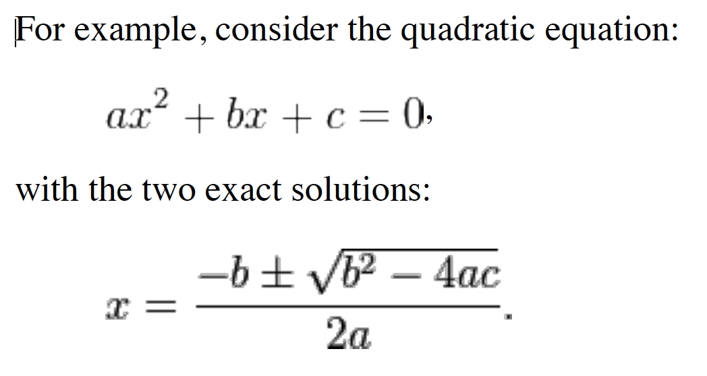
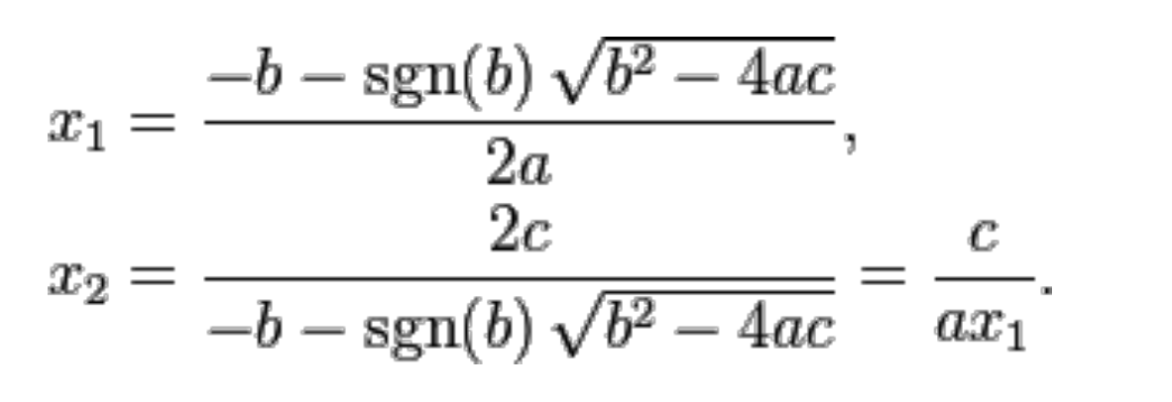
Classical example of loss of precision due to cancellation
Well know better solution
Two sources of cancellation
https://en.wikipedia.org/wiki/Loss_of_significance

Slide 20
A first theorem
The difference of two number of the same binade is precise
99-11 = 88, 42-37 = 5
0x1.921fb6p+1 - 0x1.001e72p+1 = 0x1.240288p+0
If 2b>a>b/2>0 then a⊖b = a-b (is precise) (https://en.wikipedia.org/wiki/Sterbenz_lemma)
12-7.4 = 4.6 (precise)
18-7.4= 10.6 => 18⊖7.4 = 11 (not precise)
0x1.333334p-2 ⊖ 0x1.99999ap-3 = 0x1.99999ap-4 (precise)
0x1.333334p-2 ⊖ 0x1.99999ap-4 = 0x1.99999cp-3 (not precise)

Slide 21
Augmented Arithmetic
If a>b>0 => a+b < 2a
c = a⊕b
t = c⊖a is exact
e = b⊖t is exact
a+b = c+e
e is the error of a⊕b
This algorithm is known as “fastTwoSum” and (with small modifications) proposed as AugmentedSum in next IEEE754 revision
A similar algorithm exists for multiplication as well

Slide 22
Example of augmented sum https://godbolt.org/z/nq5Po1Gdz
42⊕3.7 = 46
46⊖42 = 4
3.7⊖4 = -0.3
46-0.3 = 42+3.7 (q.e.d.)
In short: asum(42,3.7) = 46,-0.3
42⊕3.3⊕3.4 = 48 while 42+3.3+3.4 = 48.7
asum(42,3.3) = 45,0.3
asum(45 ,3.4) = 48,0.4
asum(48,0.3+0.4) = 49, -0.3

Slide 23
Does it help for catastrophic cancellation?
42⊕3.3⊕ -45 = 0 while 42+3.3-45 = 0.3
Catastrophic cancellation
asum(42,3.3) = 45,0.3
asum(45 ,-45) = 0.0,0.0
asum(0.0,0.3+0.0) = 0.3, 0.0

Slide 24
Compensating algorithms
Kahan summation
https://en.wikipedia.org/wiki/Kahan_summation_algorithm
with excruciating details https://arxiv.org/html/2602.19452v1 - LST2
T kahanSum(T const * input, size_t n) {
T sum = input[0];
T t = 0.0;
for (size_t i = 1; i<n; ++i) {
auto y = input[i] – t;
auto s = sum + y
t = (s - sum) – y;
sum = s;
}
return sum;
Improved algorithms exist:
differently handling of various magnitude ranges (“big”, “medium”, “tiny”)
(partial) sorting
pairwise recursion
optimization for parallelism

Slide 25
FMA: Fused Multiple Add
Also known as MAC (multiply accumulate) instruction on AMD
fma(a,b,c) computes the correctly rounded result of a*b+c
It improves speed and precision in many computation such as linear algebra
No standard on how to “contract” expression (depends on compiler)
a*b+c*d , a+b*c+d , x*=a;x+=b , etc
It clearly introduces asymmetries
for instance a*b+c*d ≠ c*d+a*b
Kahan comes to the rescue again with this algorithm
T kahanDet(T a, T b, T c, T d) { // a*d-b*c
using std::fma;
auto w = b*c;
auto e = fma(-b, c, w); // error on w: (w,-e) = augmentedMultiply(b,c)
auto f = fma(a, d, -w);
return (f+e);
}

Slide 26
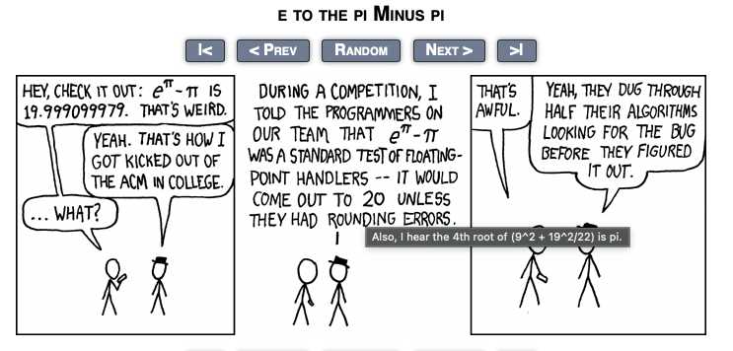
EXERCISES
Either in Python or C++
For C++ one can use godbolt (https://godbolt.org/z/d1e18j3jK )
For Python either a python3 shell on your PC, or a jupyter notebook or the browser shell in https://numpy.org/

Slide 27
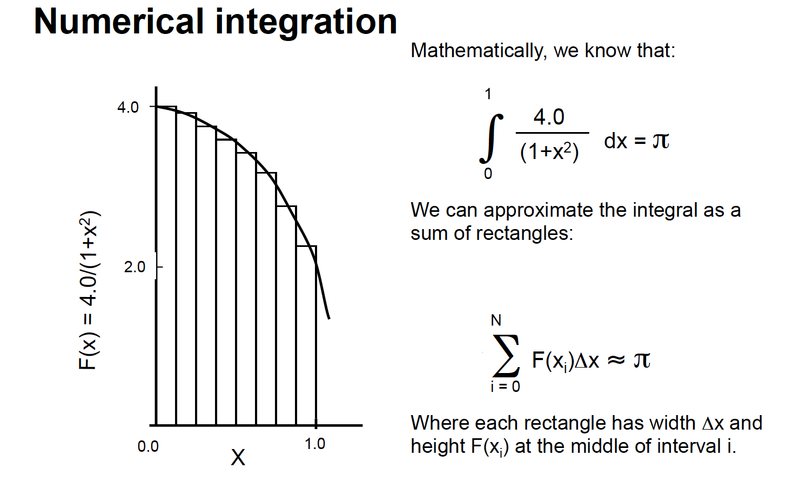
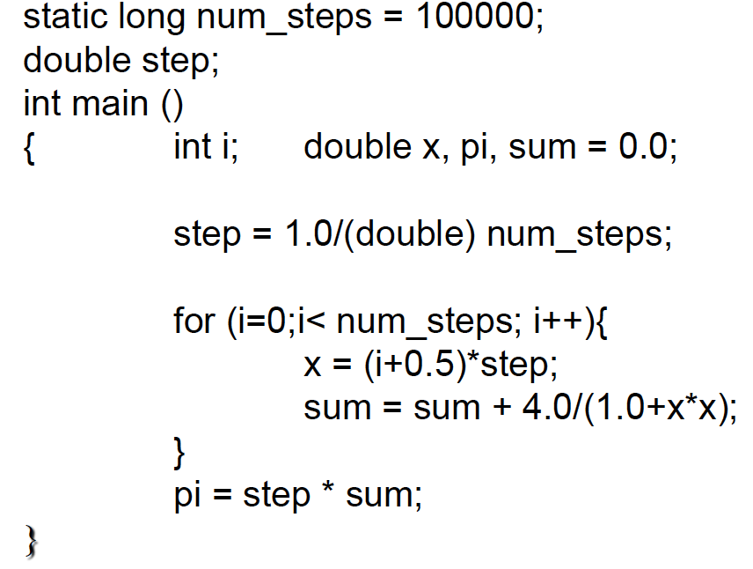
Sum T(0.1) 10000 times in binary32, binary64, decimal2, decimal5
Google for “patriot failure”
Sum 10⁹ positive random numbers (in range 10^{-n}, 10^{+n} )
Typical in unbinned log-likehood
Compute the average age of all humans on earth
Compute π as the integral of 4/(1+x²) between 0 and 1 (use float, double, simd, int, mixed)
(credit: Tim Mattson)
https://godbolt.org/z/h6bEa8GY1

Slide 28
Solve the equation x² – 2bx +1 = 0 using the “high-school” formula
What is the smallest value of b (single precision) for which one of the solution becomes 0?
What is instead the correct result? (use only single precision computations)

Slide 29
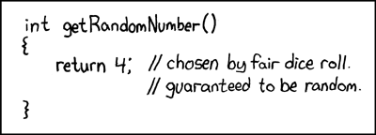
Random Number interlude
0 -5.96046e-08 1.19209e-07 -1.19209e-07 1.19209e-07 -1.19209e-07 1.19209e-07 1.19209e-07 -1.78814e-07 2.38419e-07 -2.38419e-07 -3.57628e-07 3.57628e-07 3.57628e-07 -4.17233e-07 -4.17233e-07 -4.17233e-07 4.76837e-07 4.76837e-07 4.76837e-07 5.96046e-07 -5.96046e-07 -6.55651e-07 7.15256e-07 -7.15256e-07 -7.7486e-07 8.34465e-07 8.34465e-07 -8.34465e-07 8.34465e-07 -8.9407e-07 -9.53674e-07 -9.53674e-07 -9.53674e-07 9.53674e-07 1.07288e-06 1.07288e-06 1.19209e-06 1.19209e-06 1.19209e-06
1 -1 1 1 1 -1 1 1 1 1 -1 -1 -1 -1 -1 1 1 0.999999 0.999999 -0.999999 -0.999999 -0.999999 -0.999999 -0.999999 0.999999 0.999999 0.999999 0.999999 -0.999999 -0.999999 -0.999999 0.999999 0.999999 -0.999999 -0.999999 -0.999999 0.999999 0.999999 0.999999 -0.999999
0x0p+0 -0x1p-24 0x1p-23 -0x1p-23 0x1p-23 -0x1p-23 0x1p-23 0x1p-23 -0x1.8p-23 0x1p-22 -0x1p-22 -0x1.8p-22 0x1.8p-22 0x1.8p-22 -0x1.cp-22 -0x1.cp-22 -0x1.cp-22 0x1p-21 0x1p-21 0x1p-21 0x1.4p-21 -0x1.4p-21 -0x1.6p-21 0x1.8p-21 -0x1.8p-21 -0x1.ap-21 0x1.cp-21 0x1.cp-21 -0x1.cp-21 0x1.cp-21 -0x1.ep-21 -0x1p-20 -0x1p-20 -0x1p-20 0x1p-20 0x1.2p-20 0x1.2p-20 0x1.4p-20 0x1.4p-20 0x1.4p-20
0x1p+0 -0x1p+0 0x1p+0 0x1p+0 0x1p+0 -0x1.fffffep-1 0x1.fffffcp-1 0x1.fffffcp-1 0x1.fffff8p-1 0x1.fffff4p-1 -0x1.fffff4p-1 -0x1.fffff2p-1 -0x1.fffff2p-1 -0x1.fffffp-1 -0x1.fffffp-1 0x1.fffffp-1 0x1.fffffp-1 0x1.ffffecp-1 0x1.ffffecp-1 -0x1.ffffeap-1 -0x1.ffffeap-1 -0x1.ffffeap-1 -0x1.ffffeap-1 -0x1.ffffeap-1 0x1.ffffe8p-1 0x1.ffffe8p-1 0x1.ffffe8p-1 0x1.ffffe8p-1 -0x1.ffffe6p-1 -0x1.ffffe6p-1 -0x1.ffffe6p-1 0x1.ffffe4p-1 0x1.ffffe4p-1 -0x1.ffffe2p-1 -0x1.ffffe2p-1 -0x1.ffffep-1 0x1.ffffep-1 0x1.ffffep-1 0x1.ffffep-1 -0x1.ffffep-1
#include <iostream>
#include <iomanip>
#include <random>
#include <algorithm>
#include <cmath>
int main()
{
std::random_device rd; // to obtain a seed for the random number engine
std::mt19937 gen(rd()); // Standard mersenne_twister_engine seeded with rd()
std::uniform_real_distribution<float> dis(-1.0, 1.0);
size_t N = 40*1000*1000;
float * x = new float[N];
for (int n = 0; n < N; ++n) {
// Use dis to transform the random unsigned int generated by gen into a
// float in [-1, 1). Each call to dis(gen) generates a new random float.
x[n] = dis(gen);
}
// sort in absolute value
std::sort(x,x+N,[](float a, float b) { return std::abs(a) < std::abs(b);});
// print first and last 40
for (int i=0; i<40; ++i) std::cout << x[i] << ' ‘; std::cout << '\n';
for (int i=0; i<40; ++i) std::cout << x[N-1-i] << ' ‘; std::cout << '\n’; std::cout << '\n';
std::cout << std::hexfloat;
for (int i=0; i<40; ++i) std::cout << x[i] << ' ‘; std::cout << '\n’;
for (int i=0; i<40; ++i) std::cout << x[N-1-i] << ' ‘; std::cout << '\n';
delete [] x;
return 0;
}

Slide 30
Uniform vs canonical (for a detailed discussion see among others https://github.com/DiscreteLogarithm/canonical-random-float/tree/master)
Uniform in range [a,b)
Throw 32 coins: interpret as a positive integer N
Compute r = float(N)/float(2³²)*(b-a) –a
Canonical
Throw 23 coins: set significand of r to them
Throw one more coin: if 1 set exponent of r to -1: uniform in [0.5,1) prob. 1/2
If 0 :Throw one more coin: if 1 set exponent of r to -2: uniform in [0.25,0.5) prob. 1/4
If 0: Throw one more coin: if 1 set exponent of r to -3: uniform in [0.125,0.25) prob. 1/8
If 0: Throw one more coin: if 1 set exponent of r to -4: uniform in [0.0625,0.125) prob. 1/16
If 0: ….
If symmetric interval around 0 needed : use last coin to choose sign

Slide 31
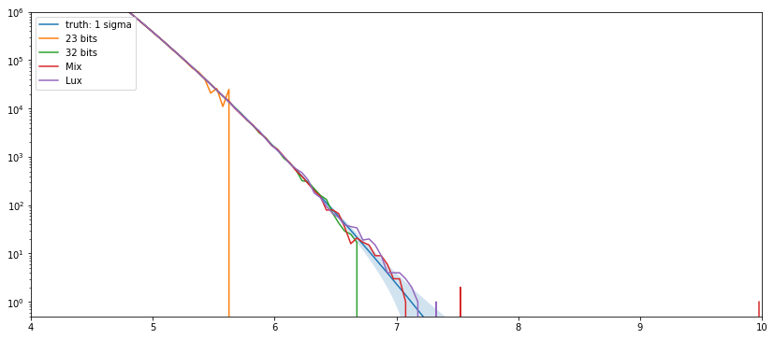
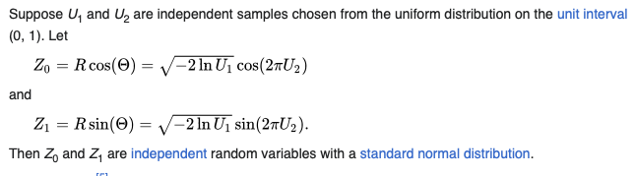
Gaussian Tail
Generated 256*10⁹ Normal distributed using Box-Muller
Mix: 23 bits for U2, 41 bits for U1
Lux: all-possible floats for both
Box-Muller Algorithm
sqrt(-2log(2⁻²³)) ~ 5.6
sqrt(-2log(2⁻³²)) ~ 6.6

Slide 32
Elementary Functions

Slide 33
Elementary functions
IEEE754 defines a set of “additional operations” (aka elementary functions)
exp, log, power of various forms
trig, hyperbolic and their inverse (arc)
They are “required” to be correctly rounded
C and C++ std define some more special functions
https://en.cppreference.com/cpp/numeric/math
https://en.wikipedia.org/wiki/C_mathematical_functions
Each vendor/compiler provides its own implementation
A comparison of their accuracy is compiled by B.Gladman et al.
https://members.loria.fr/PZimmermann/papers/accuracy.pdf
The most accurate implementation to date is from the “core-math” project
https://core-math.gitlabpages.inria.fr/

Slide 34
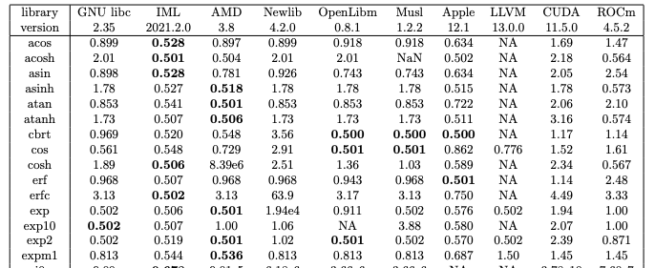
Library functions
Maximal error (in bits) for single precision functions as implemented in various math library
https://members.loria.fr/PZimmermann/papers/accuracy.pdf

Slide 35
Evaluating a function for a recent review see https://dl.acm.org/doi/pdf/10.1145/3747840
Five steps
Handling special values, under/over-flows and invalid
Standard specify them all!
Range Reduction
Approximation
If required:
precision test and handling of “Table Maker’s Dilemma”
Back to full range

Slide 36
Range reduction
exp, log, pow
exploit fp representation: x = 1.mᐧ2^{n}
For log(x): x = yᐧ2^{z}, with y in [0.75,1.5) . log(x) = zᐧlog(2)+log(y)
For exp(x): x = kᐧlog(2)+y, with y in [-log(2)/2;log(2)/2). exp(x) = 2^{k} ᐧexp(y)
x^{y} = e^{yᐧlog(x)}
sin,cos,tan,atan(2)
Reduce to [0, π/4) (trivial for f(πᐧx) known as sinpi,cospi etc, tricky for sin(x) etc)
use trig identities to go back
asin,acos, hyperbolic
approximate it in “ad-hoc” intervals (make sure continuity at edges)

Slide 37
Approximation
Since 1964 the reference for function approximation is the Abramowitz and Stegun
Today replaced by the digital library https://dlmf.nist.gov/
Elementary functions are usually approximated either by
shift-and-add algorithms (CORDIC https://en.wikipedia.org/wiki/CORDIC)
Today limited to FPGA
a polynomial
Chebyshev approximation satisfying the ”superior” norm (max in an interval)
a rational function (ratio of two polynomials)
Pade’ approximation
an iterative method such as Newton-Raphson
See also the short paper by J.M.Muller https://hal.science/hal-02517784v1/file/approxfunctions.pdf

Slide 38
1/x, √(x),1/√(x) aka rcp(x),sqrt(x),rsqrt(x)
Few fast-converging Newton-Raphson iterations
Starting point is an approximation of f(1.m)
The major contribution of game industry to CS is the discovery of the “magic” fast 1/√x algorithm in quake3
float rsqrt(float x){
union {float f;int i;} tmp;
tmp.f = x;
tmp.i = 0x5f3759df - (tmp.i >> 1);
float y = tmp.f; // approximate
return y * (1.5f - 0.5f * x * y * y); // NR
}
Real x86_64 code for 1/√x
_mm_store_ss( &y, _mm_rsqrt_ss( _mm_load_ss( &x ) ) );
return y * (1.5f - 0.5f * x * y * y); // One round of Newton's method
Real x86_64 code for 1/x
_mm_store_ss( &y,_mm_rcp_ss( _mm_load_ss( &x ) ) );
return (y+y) – x*y*y; // One round of Newton's method
https://en.wikipedia.org/wiki/Fast_inverse_square_root

Slide 39
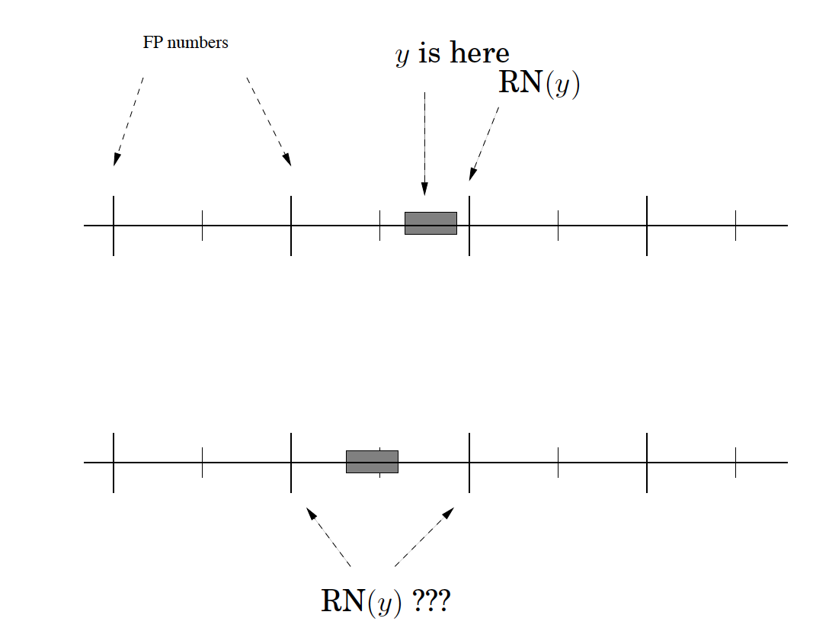
Table Maker’s Dilemma
to guarantee a given precision one needs to evaluate the error of the approximation “y = f(x)”
From first principle
Or on the fly as seen before
The function need to be computed with at least one more digit (the round digit)
In Round2Near: if the error interval includes the middle point an even more precise evaluation is required
the round digit may be followed by a sequel of 0’s or 1’s (or 9’s) and the TMD solution may be very expensive
Examples :
sin(0.40225342) = 0x1.90e382fffff7bp-2 sin(0.47485355) = 0x1.d42e63000000bp-2

Slide 40
EXERCISES
Either in Python or C++
For C++ one can use godbolt (https://godbolt.org/z/d1e18j3jK )
For Python either a python3 shell on your PC, or a jupyter notebook or the browser shell in https://numpy.org/

Slide 41
Polynomials
Approximate sin(x) in [0, π/4) with polynomials of increasing order
Taylor
Chebyshev
Pade
Plot the absolute and relative error w/r/t a high precision result
Use python mpmath module https://mpmath.readthedocs.io/en/latest/calculus/approximation.html
or sage, or mathematica…

Slide 42
Test rsqrt precision in the interval [0.5, 4)
use “quake magic” and/or x86_64 intrinsics plus multiple NR iterations
Try to reach faithful (or even correct) rounding.
Compute sin(0x1.e64002p-2) using Taylor expansion:
How many terms are needed to reach faithful rounding in single precision?
How many more terms to reach correct rounding (in single precision)?
Use double precision to compute, then round to single

Slide 43
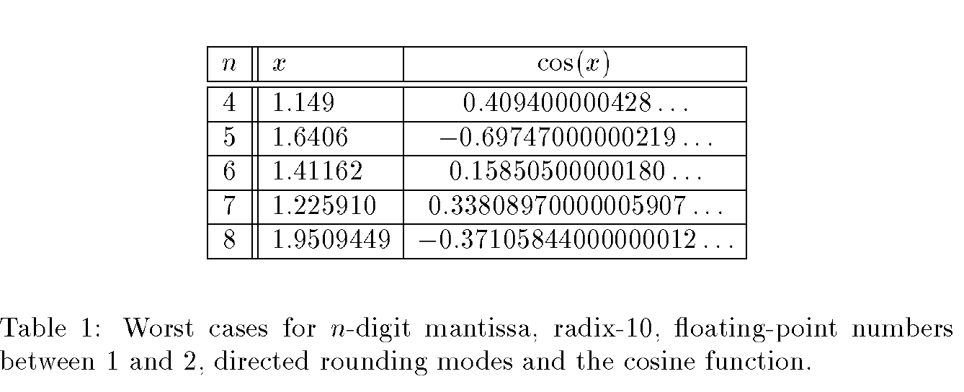
TMD in decimal
Use cos(x) approximation in decimal (taylor) see https://docs.python.org/3/library/decimal.html - recipes
to “solve” TMD above (mind: direct rounding!)

Slide 44
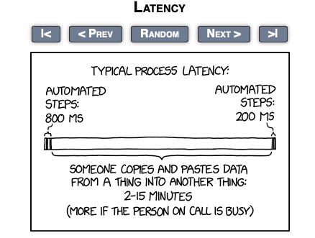
Precision, Accuracy, Speed

Slide 45
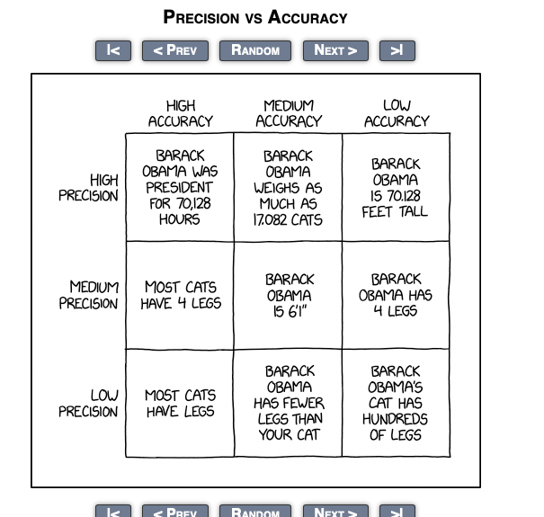
Definitions
Precision
Numerical precision (in bits)
For an instrument (ruler!) typically “half a tick”
Comes from specs
Accuracy
The error w/r/t the truth
Can be evaluated comparing with a “refence” or a different algorithm
In science “comparing different experiments”
Target Accuracy
The acceptable tolerance w/r/t the above
Evaluated, for instance, w/r/t know error on the truth

Slide 46
Cost of operations (in cpu cycles on x86_64) https://www.agner.org/optimize/instruction_tables.pdf (icelake & zen5)
 |  | latency |  | inv throughput
op | instruction | s | d | s | d
+,- | ADD,SUB | 3-4 | 3-4 | 0.5 | 0.5
==, <, > | COMISS CMP.. | 2,3 | 2,3 | 0.5-1 | 0.5-1
f=d, d=f ,i=f, f=i | CVT.. | 3-7 | 3-7 | 0.5-1 | 0.5-1
|,&,^ | AND, OR … | 1-2 | 1-2 | 0.25-0.5 | 0.25-0.5
* | MUL | 5-4 | 5-4 | 0.5 | 0.5
a*b+c | FMA | 4 | 4 | 0.5 | 0.5
/,sqrt | DIV, SQRT | 11-20 | 13-29 | 3-12 | 4-24
1.f/ , 1.f/sqrt | RCP, RSQRT | 4-5 |  | 0.5-1
= | MOV | 1,3,… | 1,3,… | 0.25,1,…. | 0.25,1,…
+ jump “overhead”
(mispredicted branches)
(does not vectorize on intel?)
➔350 from main memory

Slide 47
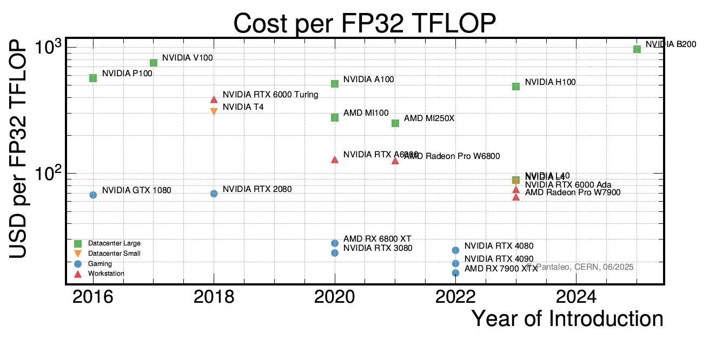
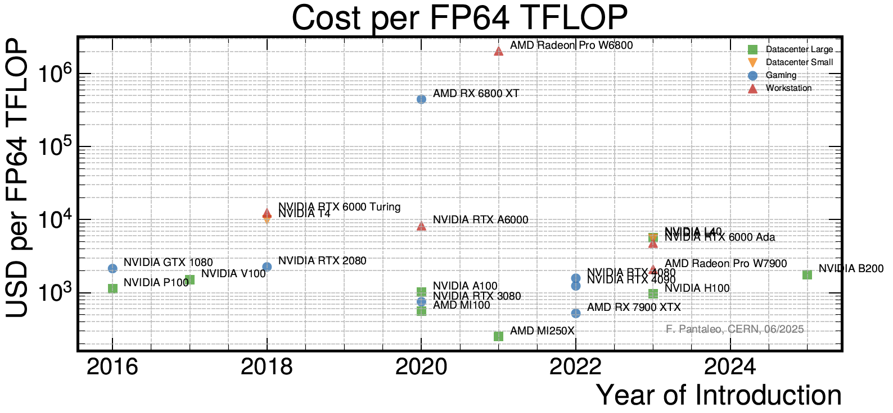
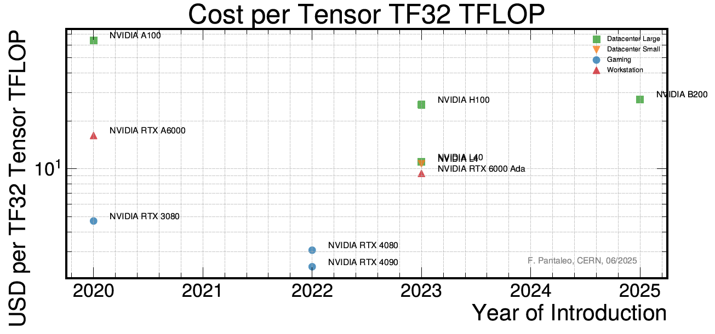
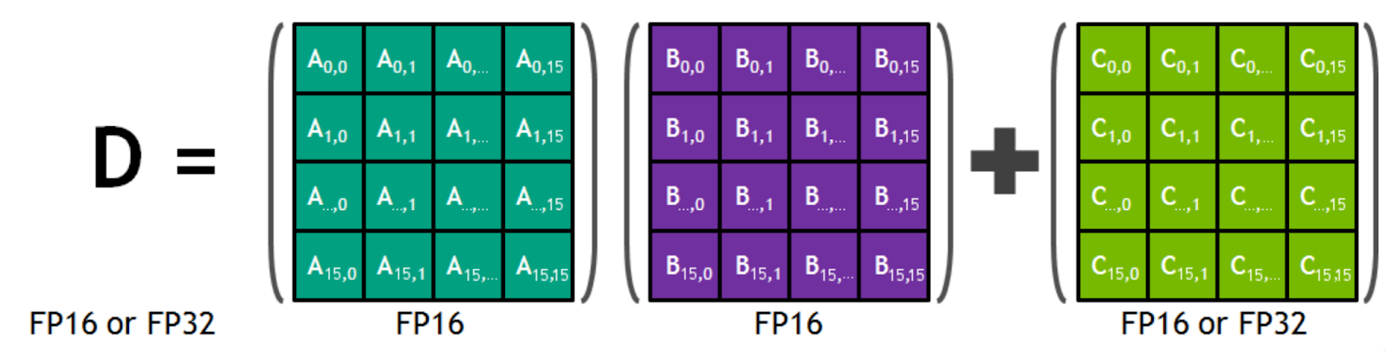
GPU landscape: FP64 is 32 times slower than FP32 on affordable GPU
min rank for tensor is 16 (not 4)!

Slide 48
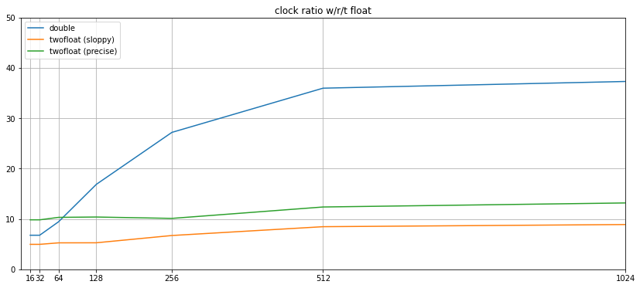
GPU (T4) performance Brute-force inversion of 5x5 Pos-Def Matrix using Cholesky decomposition 33 + , 29 - , 126 * , 5 / , no sqrt (compiler optimization and fma will contract some)

Slide 49
float vs double: summary
In the old days: X87
Double faster than float!
X86_64 (and ARM, PPC, RISC)
Scalar: float and double same speed (but div, sqrt, memory bandwidth)
Vector: float twice faster than double
GPU: gaming and “Data Center”
Float 64 times faster than double
GPU: HPC
Float twice faster than double
GPU: AI
Optimized for low-precision tensor operations (GEMM can profit )

Slide 50
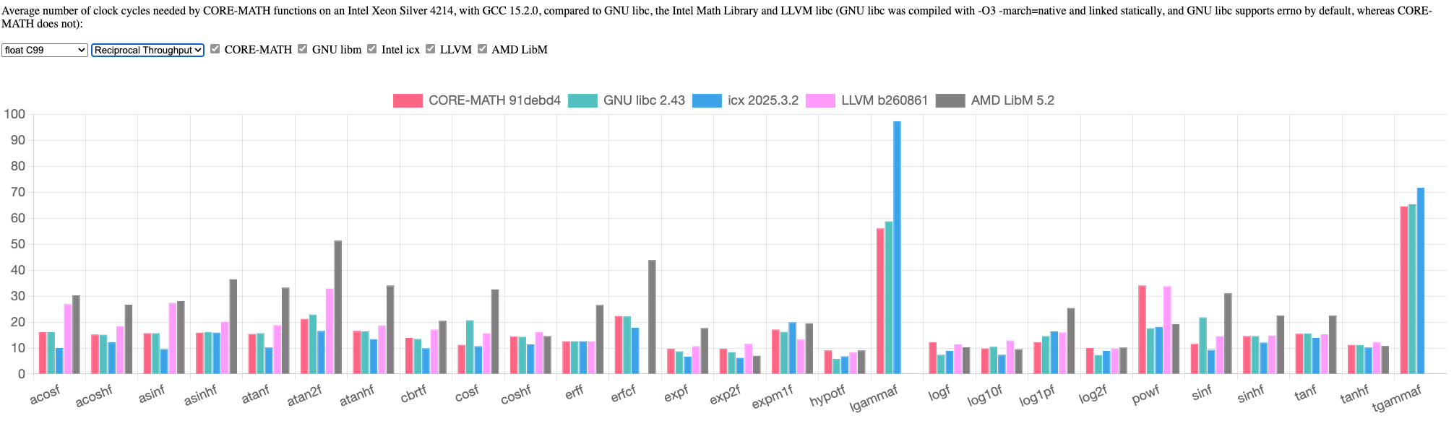
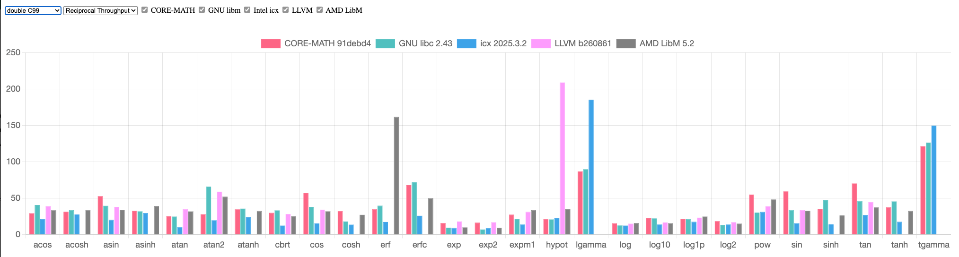
Elementary functions 1/throughput (in cycles) (origin https://core-math.gitlabpages.inria.fr/)

Slide 51
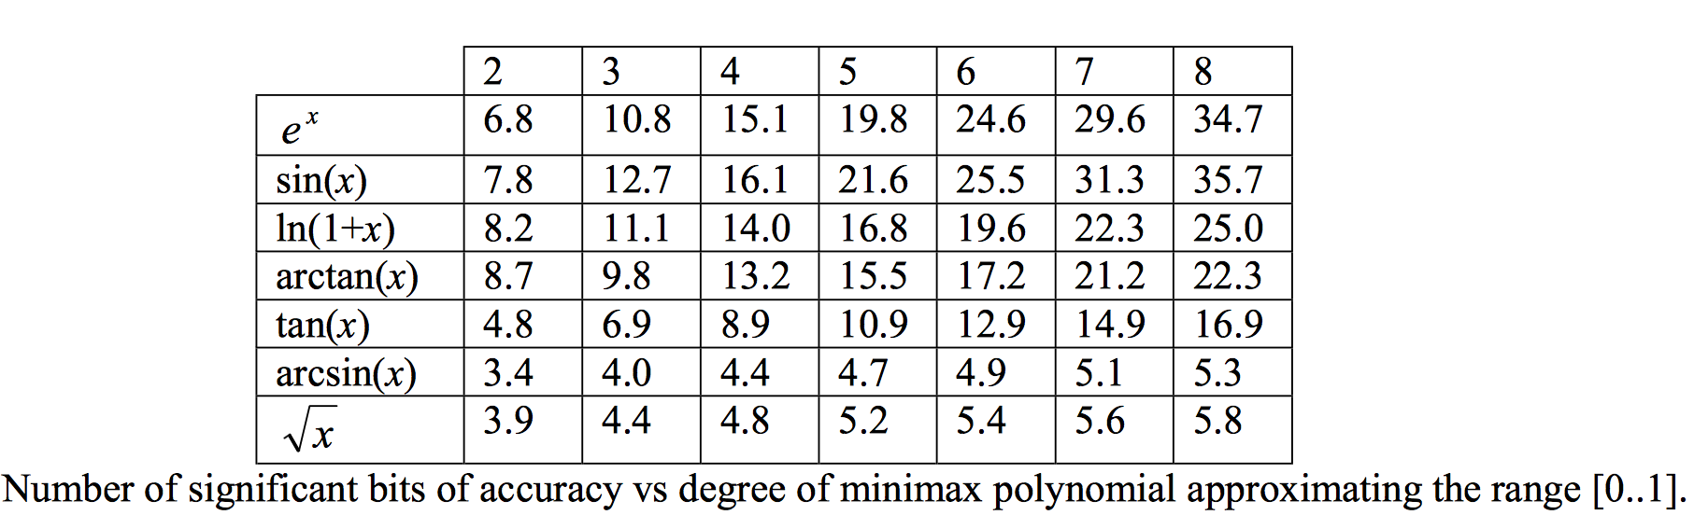
Precision vs Speed for elementary functions
Log
24 bit precision needs 8th degree polynomial
16 bit precision needs 5th degree polynomial
7 bit precision needs 2th degree polynomial

Slide 52
Example: multiple scattering formula
double ms(double radLen, double m2, double p2) {
constexpr double amscon = 1.8496e-4; // (13.6MeV)**2
double e2 = p2 + m2;
double beta2 = p2/e2;
double fact = 1 + 0.038*log(radLen); fact *=fact;
double a = fact/(beta2*p2);
return amscon*radLen*a;
}
Already an
approximation
Material density,
thickness, track angle
Known at percent?
float msf(float radLen, float m2, float p2) {
constexpr float amscon = 1.8496e-4; // (13.6MeV)**2
float e2 = p2 + m2;
float fact = 1.f + 0.038f*unsafe_logf<2>(radLen); fact /= p2;
fact *=fact;
float a = e2*fact;
return amscon*radLen*a;
}
2nd order polynomial

Slide 53
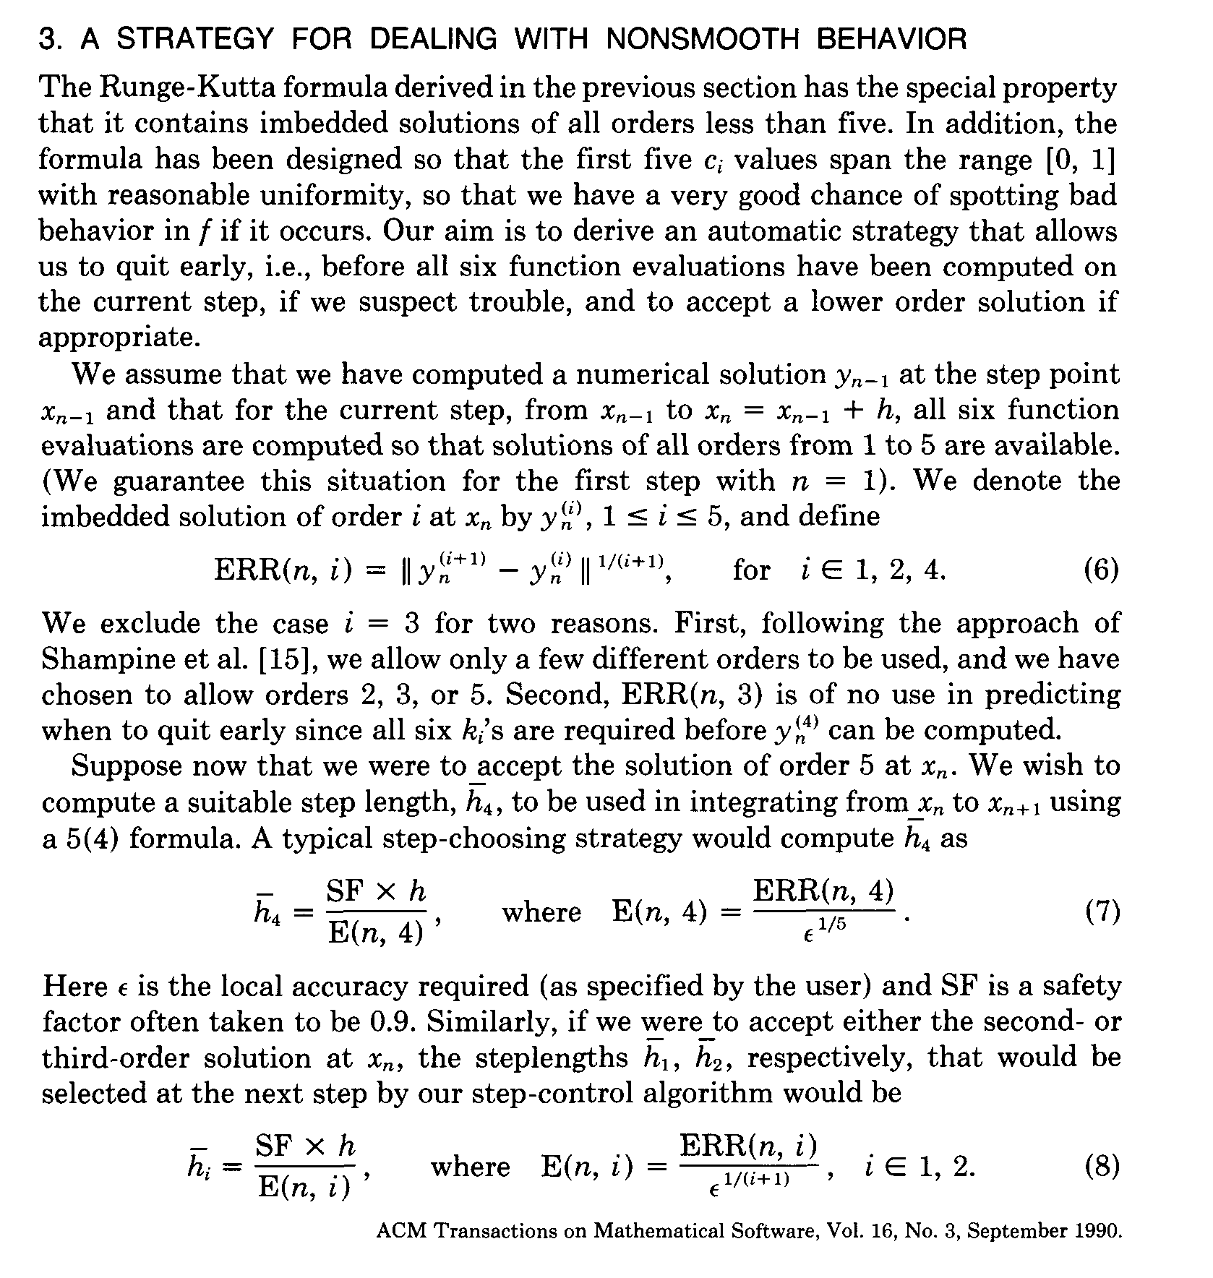
Cash-Karp Runge-Kutta Step
0.9*step/pow(err/eps,0.2)

Slide 54
Code pitfalls and opportunity for optimization

Slide 55
Language and compiler “rules”
In essentially any language default FP arith is in double
Any other precision needs to be explicitly stated
One element in double and the whole expression will be evaluated in double
Promotion to double can be turn in a warning using “-Wdouble-promotion”
C and C++ compilers (gcc, clang) by default will never reorder or transform expressions if the result may change
FMA is (currently) an exception
C is a language born in the late `70
even C++ does not (potentially) break old code

Slide 56
Compiler option affecting FP Arith https://gcc.gnu.org/wiki/FloatingPointMath https://clang.llvm.org/docs/UsersManual.html - controlling-floating-point-behavior
-fno-math-errno
Assume user ignore libc error flag
-fno-trapping-math
Assume user ignore IEEE754 exceptions
-fno-signed-zeros
Assume user do not distinguish sign of zeroes
-ffinite-math-only
Assume code does not emit NaNs and Infs
-fassociative-math
Allows free reordering of expressions
-freciprocal-math
Allows transformation of divisions
-ffast-math
All above and more

Slide 57
Controlling fma (contraction)
gcc (and clang) flags
-ffp-contract=off (default is “fast”)
https://stackoverflow.com/questions/43352510/difference-in-gcc-ffp-contract-options
cuda (nvcc) flags
-fmad=false (default is “true”)
https://docs.nvidia.com/cuda/floating-point/index.html
fma function itself will in any case honored and will use the hardware instruction if supported

Slide 58
Inspecting generated code
objdump -S -r -C --no-show-raw-insn –w kernel.o | less
(on MacOS: otool -t -v -V –X kernel.o | c++filt | less)
Or use http://gcc.godbolt.org
kernel(float, float, float):
mulss %xmm0,%xmm2
mulss %xmm0,%xmm1
addss %xmm2,%xmm1
movaps %xmm1,%xmm0
ret
c++ -S kernel.cc; less kernel.s
-O2
float
kernel(float a, float x, float y) {
return a*x + a*y;
}
kernel(float, float, float):
addss %xmm2,%xmm1
mulss %xmm0,%xmm1
movaps %xmm1,%xmm0
ret
-O2,-ffast-math

Slide 59
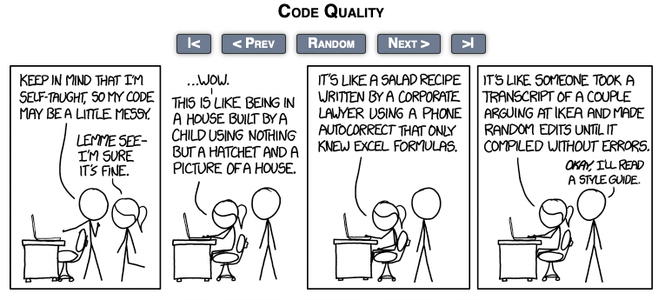
Formula Translation: what was the author’s intention?
// Energy loss and variance according to Bethe and Heitler, see also
// Comp. Phys. Comm. 79 (1994) 157.
//
double p = mom.mag(); // sqrt(mom.x()*mom.x()+mom.y()*mom.y()+mom.z()*mom.z())
double normalisedPath = fabs(p/mom.z())*radLen;
double z = exp(-normalisedPath);
double varz = (exp(-normalisedPath*log(3.)/log(2.))- exp(-2*normalisedPath));
double pt = mom.perp(); // sqrt(mom.x()*mom.x()+mom.y()*mom.y())
double j = a_i*(d_x * mom.x() + d_y * mom.y())/(pt*pt);
double r_x = d_x - 2* mom.x()*(d_x*mom.x()+d_y*mom.y())/(pt*pt);
double r_y = d_y - 2* mom.y()*(d_x*mom.x()+d_y*mom.y())/(pt*pt);
double s = 1/(pt*pt*sqrt(1 - j*j));

Slide 60
EXERCISES
In C++
use godbolt ( https://godbolt.org/z/5TWjsKqha )
change compiler options for various compilers and see what happens
Try to optimize some code and see if it really improves

Slide 62
Anecdotes
Floating point “disasters”
http://ta.twi.tudelft.nl/users/vuik/wi211/disasters.html
https://www.iro.umontreal.ca/~mignotte/IFT2425/Disasters.html
https://slate.com/technology/2019/10/round-floor-software-errors-stock-market-battlefield.html
https://medium.com/@sohail_saifii/the-floating-point-standard-thats-silently-breaking-financial-software-7f7e93430dbb
https://pavpanchekha.com/blog/casio-mathjs.html

Slide 63
References
What Every Computer Scientist Should Know About Floating-Point Arithmetic (1991) https://dl.acm.org/doi/pdf/10.1145/103162.103163
Handbook of Floating-Point Arithmetic(2018) https://link.springer.com/book/10.1007/978-3-319-76526-6
Elementary Functions (2016) https://link.springer.com/book/10.1007/978-1-4899-7983-4
Floating-point arithmetic (2023) https://www.cambridge.org/core/journals/acta-numerica/article/floatingpoint-arithmetic/287C4D5F6D4A43FBEEB1ABED2A405AAF
Low Precision (2025) https://www.siam.org/publications/siam-news/articles/mixed-precision-computing-high-accuracy-with-low-precision/
Bleeding edge
IEEE Arith Conference: https://arith2026.org/archive.html
FPTalks: https://fptalks.org/
NGT Workshop: https://indico.cern.ch/event/1538409/

Slide 64
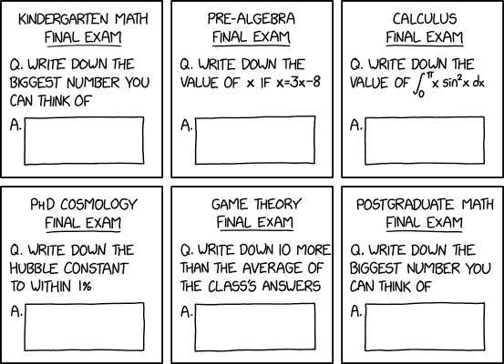
Self Assessment
How many significand bits does have a single precision FP number?
How many single precision binary FP numbers exist between 2 and 3?
Round 137.5 to 3 digits using default rounding
Is the result of 137.5 - 82.4 precise?
If MAX is the largest representable single precision FP number: what’s the result of MAX + 0.1 - MAX ? And of Max + Max/1024 –Max ?
What is the result of 2.0 < NaN when compiled with –ffinite-math-only?
What’s the difference between sin(x) and sinpi(x)?
When the “Table Maker Dilemma” occur?
What is faster: a fma instruction or a division?
How many fma instructions a modern processor can execute while a similar one is computing a single precision ”exp” functions?

Slide 65
“additional” material

Slide 66
What precision is good enough?
bits | decimal | relative error
8 | 2.3 | 3.9E-3 | uint8 ( byte)
12 | 3.3 | 5.0E-4 | float16 (half)
16 | 4.8 | 1.5E-5 | uint16 (short)
24 | 7.2 | 1.2E-7 | float32 (float)
32 | 9.5 | 2.3E-10 | uint32 (int)
53 | 16 | 1.1E-16 | float64 (double)
64 | 19 | 5.4E-20 | uint64 (long long)
113 | 34 | 1.9E-34 | float128 (quad)

Slide 67
Example: detector of size 1 m and resolution 10 micron (required accuracy: ~1micron?)
x_{t},y_{t}
three measurement planes
Is single precision enough to represent
geometric elements?
Measurements?
computed trajectory?
Is enough to perform computation?
h = 500mm
x_{m},y_{m}
s
x₀,y₀
Trajectory: circle with radius r
s is the sagita, h the half-chord
r = (s²+h²) /2s ~ h²/2s
h² = 2sr - s²
x₀ = r + x_{m}
x_{b},y_{b}

Slide 68
Circle equation and solutions
(x-x₀)² +(y-y₀)²= r²
Compute x_{t} (x for y=h)
x = x₀ - (r^{2 –} h²)^{1/2} ~ 0 (zero)
Alternative formulation equivalent to change of
coordinate centered at x_{m} ,y_{m}
(x-x_{m})² + (y-y_{m})² -2ar(x-x_{m}) -2br(y-y_{m}) = 0
In our simplified case a=1, b=0, y_{m} =0
(x-x_{m})² - 2(x-x_{m})r + h² = 0
x = x_{m} + r - (r^{2 –} h²)^{1/2} ~ x_{m} (naïve: cancellation!!)
x = x_{m} + h² / (r + (r^{2 –} h²)^{1/2} ) ~ x_{m} + h² / 2r (optimal)
A correct choice of algorithm can allow to use a reduced precision to obtain the same accuracy
Faster
Smaller memory footprint

Slide 69
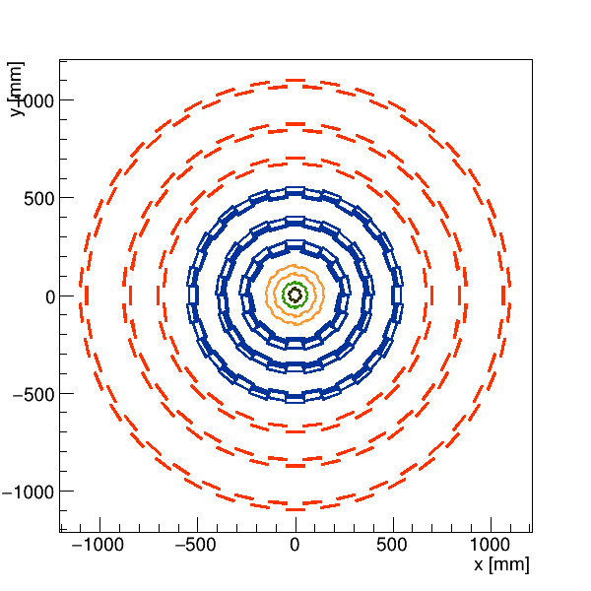
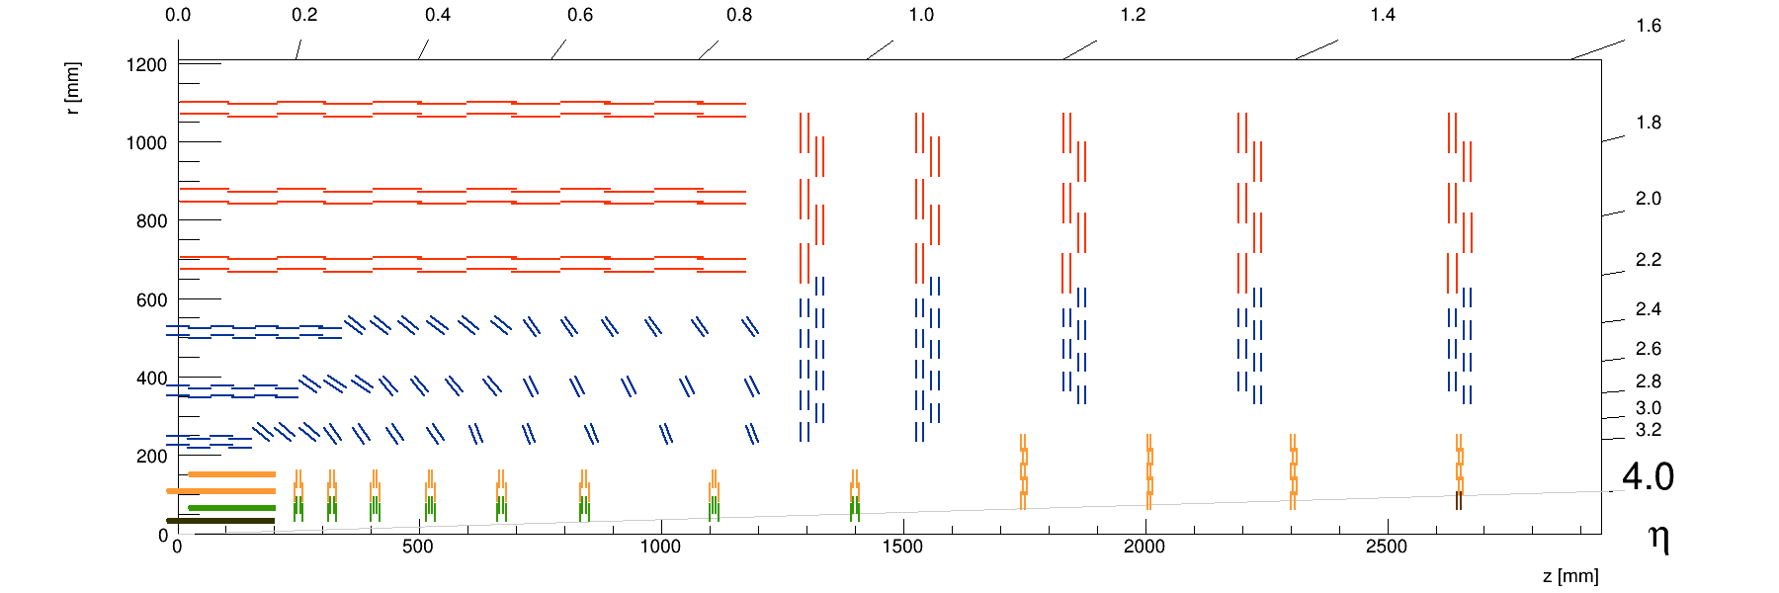
Example: CMS tracker https://cms-tklayout.web.cern.ch/cmssw/OT806_IT742/info.html
Ultimate single hit spatial resolution: (alignment error to be added)
IT: σ_{x}~3μ σ_{z}~10μ at r<15cm |z|<20cm
OT: σ_{x}~20μ σ_{z}~425μ at r<120cm |z|<130cm
In both cases 19 bits (absolute: ie integer) are enough as precision

Slide 70
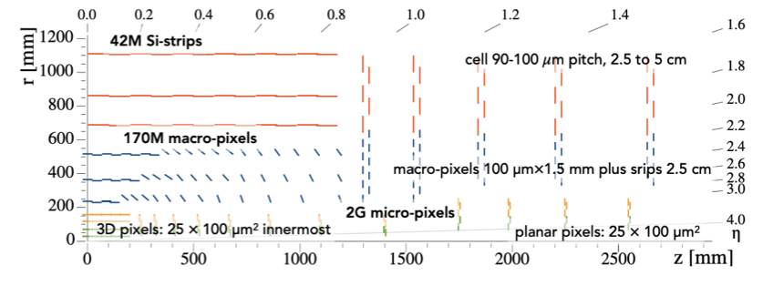
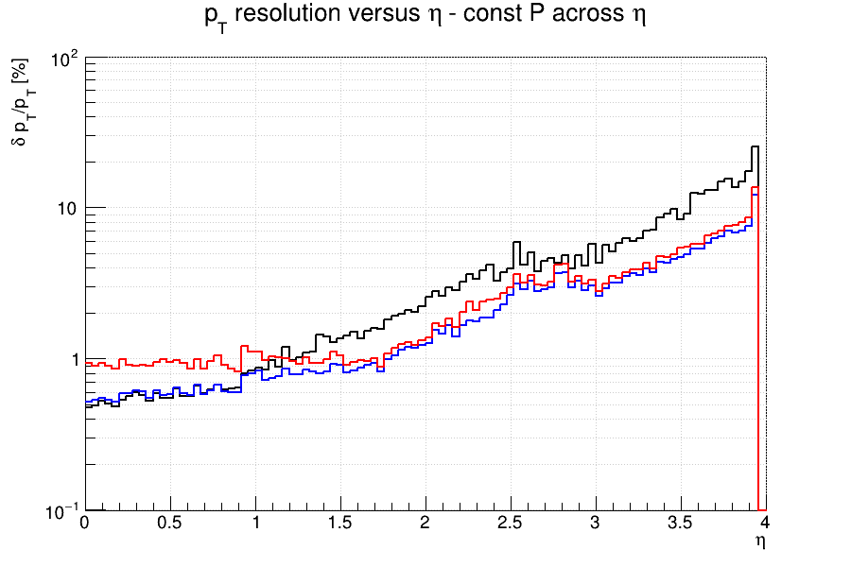
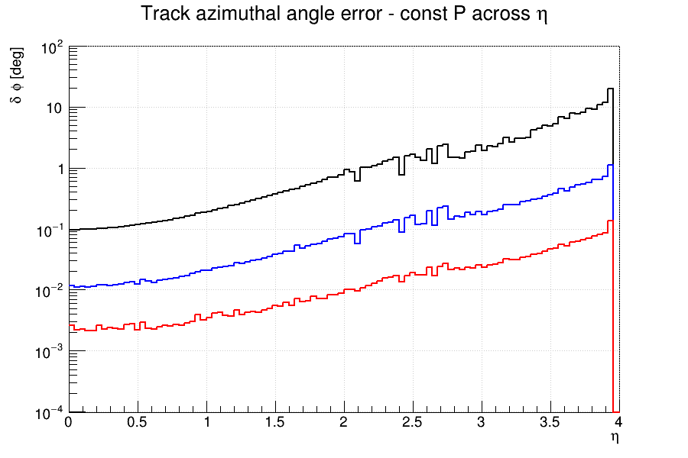
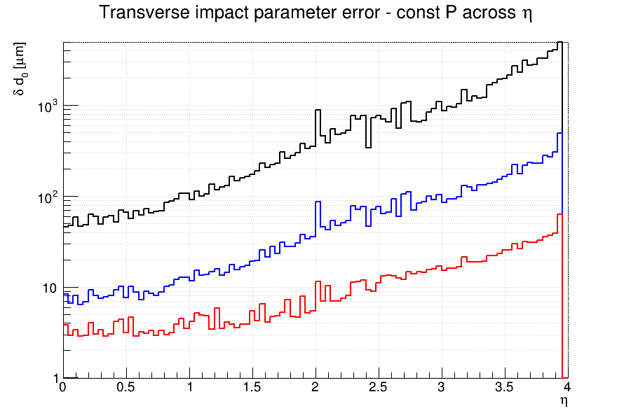
Ultimate track resolution
1Gev
10GeV
100GeV
10 bits (relative) 18 bits absolute 14 bits absolute (inside beam pipe)

Slide 71
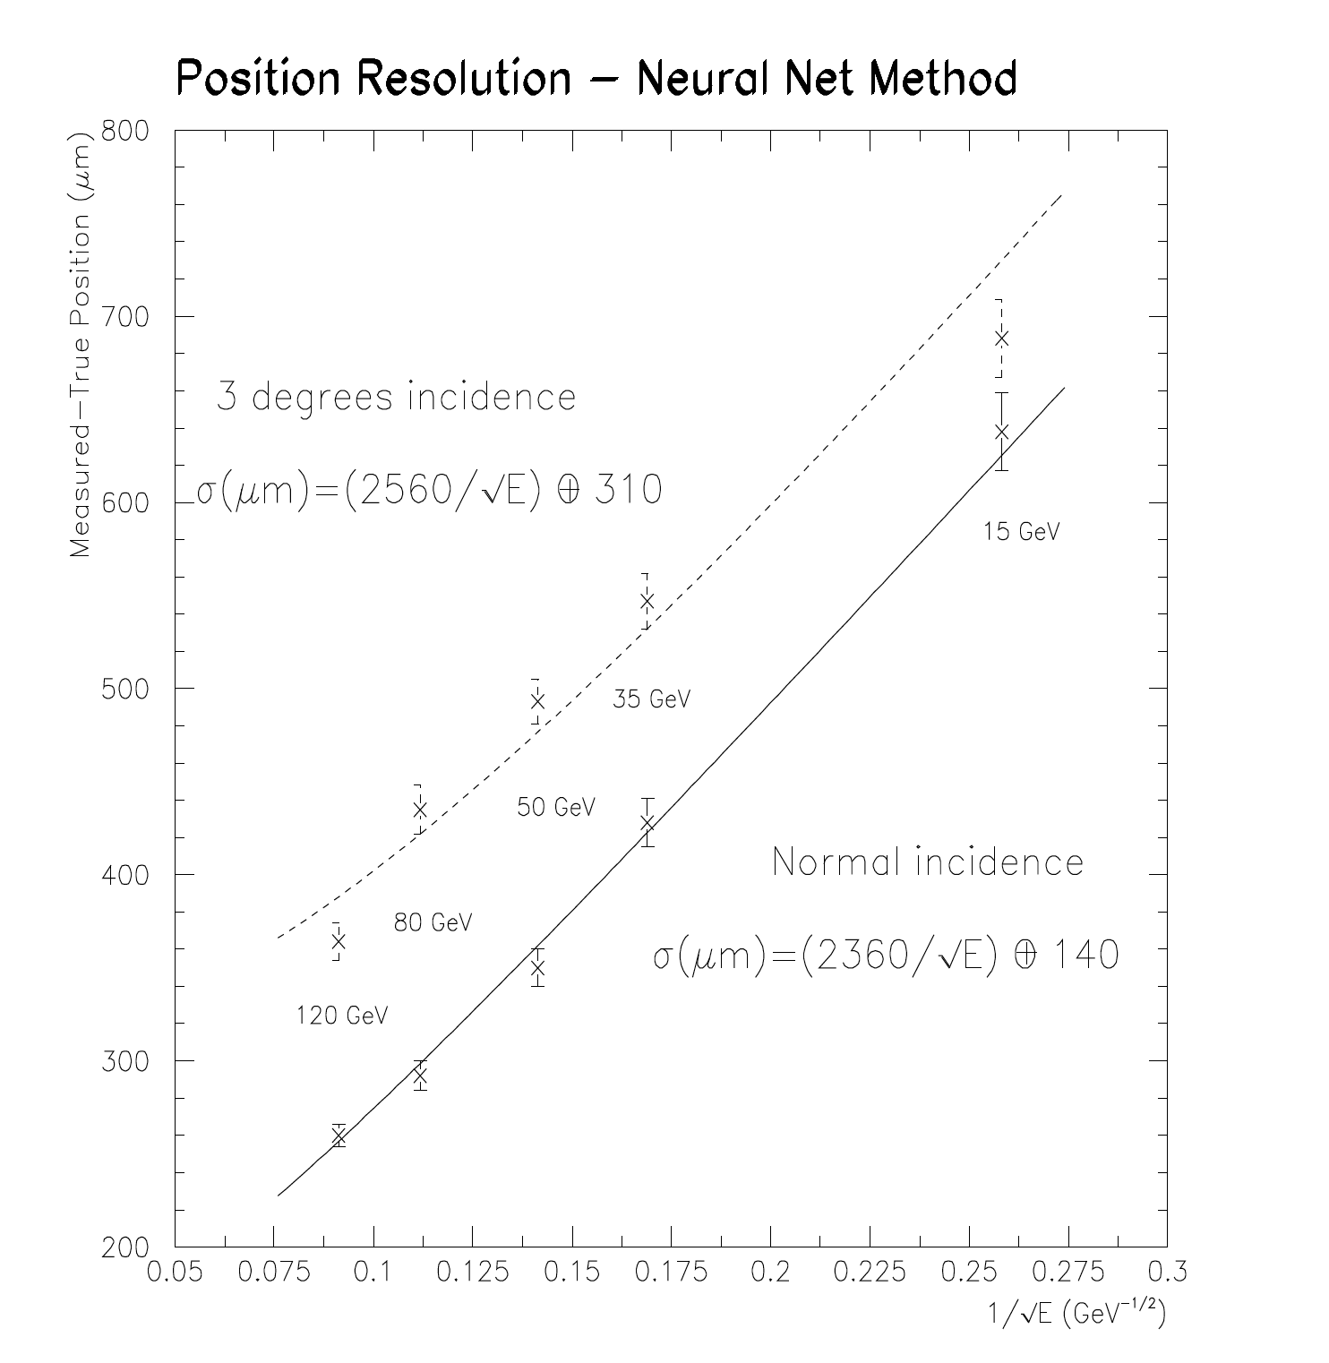
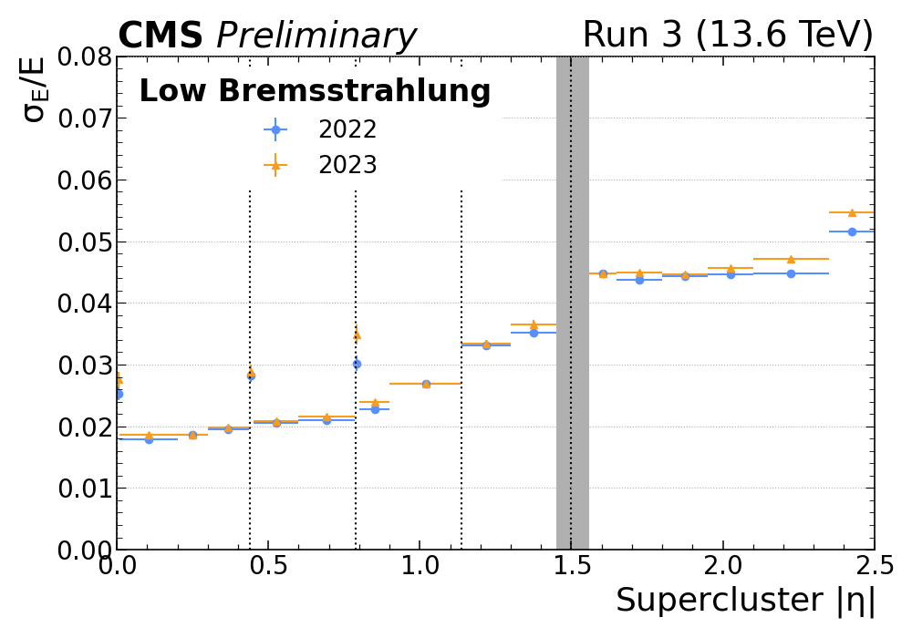
Example: CMS Electromagnetic Calorimiter
Energy Resolution
8 bits relative
16 bits absolute

Slide 72
Example: cut in pt, phi, eta
inline float pt2(float x, float y) {return x*x+y*y;}
inline float pt(float x, float y) {return std::sqrt(pt2(x,y));}
inline float phi(float x, float y) {return std::atan2(y,x);}
inline eta(float x, float y, float z) { float t(z/pt(x,y)); return ::asinhf(t);}
inline float dot(float x1, float y1, float x2, float y2) {return x1*x2+y1*y2;}
Inline float dphi(float p1,float p2) {
auto dp=std::abs(p1-p2); if (dp>float(M_PI)) dp-=float(2*M_PI);
return std::abs(dp);
};
if (pt(x[i],y[i])>ptcut) …
if (dphi(phi(x[i],y[i]),phi(x[j],y[j]))<phicut) ….
Exercise in ptcut.cpp

