Slide 1

JMS & ActiveMQ
265ced1609a17cf1a5979880a2ad364653895ae8
An unexpected journey
Sébastien Chenevotot,
Andrea Marziali
Notes:
Cover example with photo
Insert new photo: Delete photo on slide, click on Insert photo-icon on slide and Insert new photo. Use Crop Tool under Picture Tools to pan and zoom
To update the text, just click on the text

Slide 2
Document control
265ced1609a17cf1a5979880a2ad364653895ae8
Security level
Company | Amadeus IT Group SA
Department | Airport IT
Author | Sébastien Chenevotot
Reviewed by | Reviewer Name |  | Date | DD / MM / YYYY
Approved by | Approver Name |  | Date | DD / MM / YYYY
Version | Date | Change | Comment | By

Slide 3
Agenda
265ced1609a17cf1a5979880a2ad364653895ae8
JMS Basics
Enterprise Patterns
What is ActiveMQ ?
ActiveMQ settings
Network of brokers
Monitoring
Troubleshooting
MB UI
1
2
3
4
5
6
7
8

Slide 4
1
265ced1609a17cf1a5979880a2ad364653895ae8
JMS reminders
Notes:
The divider slides can be in blue, light blue, cherry and gray. All colours are available in this template.

Slide 5
Introduction to JMS
265ced1609a17cf1a5979880a2ad364653895ae8
General concepts
JMS is:
An API
It is vendor-agnostic
JMS offers:
General API (Connection, manual read/write)
Point-to-point API
Publish-and-subscribe API
ActiveMQ is:
A JMS 1.2 compliant message broker.

Slide 6
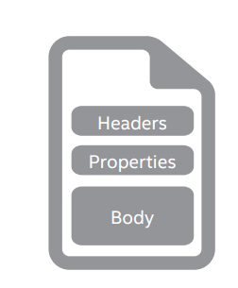
JMS Basics
265ced1609a17cf1a5979880a2ad364653895ae8
Anatomy of a message
Headers:
Contains metadata for internal use
The broker owns them
Predefined list
Properties:
Application driven metadata
Body:
Contains message content.
Can hold different types of media:
Text
Binary
Object
Stream

Slide 7
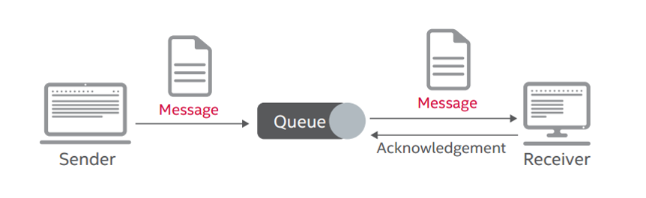
JMS Basics
265ced1609a17cf1a5979880a2ad364653895ae8
Point to point messaging
Uses a queue as channel
Messages flow according to FIFO model
Allows load balancing
Guaranteed Delivery / Retention
Supports synchronous operations (Request/Reply)

Slide 8
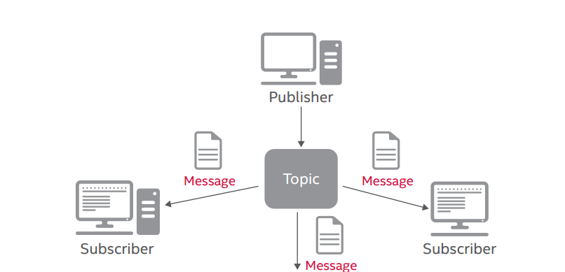
JMS Basics
265ced1609a17cf1a5979880a2ad364653895ae8
Publish-subscribe messaging
Uses a topic as channel
Messages are broadcasted without retention
Consumers should follow producer rate
No Guaranteed Delivery
Useful when multiple applications are interested in same message

Slide 9
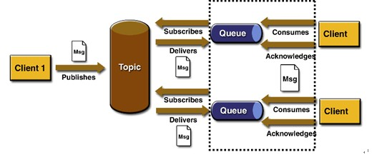
JMS Basics
265ced1609a17cf1a5979880a2ad364653895ae8
Virtual Topics – ActiveMQ specific
Publisher uses a topic as channel
Each subscriber has its own derived queue
Allows load balancing on a topic
Consumer queue is on the form clustered.app_name.topic_name

Slide 10
Enterprise Patterns
265ced1609a17cf1a5979880a2ad364653895ae8
Message Selectors
Selectors allow to do filtering on subscriptions
Filtering is done by the broker itself
Uses a subset of SQL92 conditional expressions
Filtering should match a JMS property or header
Examples:
apt_customer_id = ‘AITA-FMG’
apt_customer_id = ‘AITA-FMG’ OR apt_customer_id=‘TEST’

Slide 11
Enterprise Patterns
265ced1609a17cf1a5979880a2ad364653895ae8
Acknowledgement
A publisher or a subscriber informs the broker a message send/receive is successful.
Three majors modes:
Automatic: simplest mode. Messages are automatically acknowledged in background by the JMS provider when the message is received.
Client: the application must acknowledge manually each message receipt/send. Rollback is possible.
Transacted: the application creates a transacted session on the broker. Thus it can either commit either rollback.
Session transactions are mostly used when several resources are involved in the transaction (e.g. JMS and Database).
Client acknowledgement is rather to be preferred in case the application wants to rely on guaranteed delivery.

Slide 12
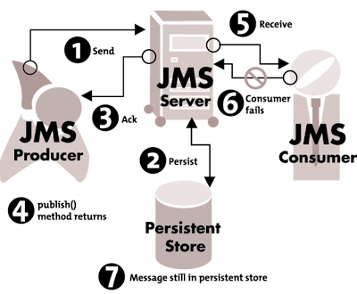
Enterprise Patterns
265ced1609a17cf1a5979880a2ad364653895ae8
Redelivery
When a message is rolled back the broker allows retrying the delivery a configurable number of times.
After the max retries, the message is discarded

Slide 13
Enterprise Patterns
265ced1609a17cf1a5979880a2ad364653895ae8
Message Expiration
Persistent messages have a time to live (TTL)
A message is discarded after its expiration (trashed)
TTL can vary depending on:
Destination type (queues or virtual topics)
Functional use case (long/short live messages)
By default:
Queues: 2h (operational messages, AODB sync)
Virtual topics: 15 minutes

Slide 14
Enterprise Patterns
265ced1609a17cf1a5979880a2ad364653895ae8
Connection / Session Pooling
Enterprise Application should pool resources because
Open/Close each time connections is costly
Open/Close sessions can cause poor performances on broker side.
Create/Destroy consumers/producers can cause high network traffic if broker nodes are networked.

Slide 15
2
265ced1609a17cf1a5979880a2ad364653895ae8
ActiveMQ
Notes:
The divider slides can be in blue, light blue, cherry and gray. All colours are available in this template.

Slide 16

ActiveMQ
265ced1609a17cf1a5979880a2ad364653895ae8
What is ActiveMQ ?
“Apache ActiveMQ ™ is the most popular and powerful open source messaging and Integration Patterns server.”
It is a “message broker”
It receives messages from producers
It forwards messages from consumers
“C’est la version la plou stable jamais créée !”

Slide 17
ActiveMQ
265ced1609a17cf1a5979880a2ad364653895ae8
What is ActiveMQ ?
Many APIs/protocols supported
JMS (of course !)
Stomp (for UIs)
REST
And also
Camel
Can be extended with plugins
Guaranteed delivery !

Slide 18
ActiveMQ
265ced1609a17cf1a5979880a2ad364653895ae8
Deployment
ActiveMQ version
5.11.0
5.13.4 is already out
Deployment
as an EAR
using Spring and activemq-core.xml

Slide 19
ActiveMQ
265ced1609a17cf1a5979880a2ad364653895ae8
Settings - Persistence
Persistence storage
Necessary for guaranteed delivery
Managed by KahaDB
File based persistence database
Fast persistence
Recommended implementation

Slide 20
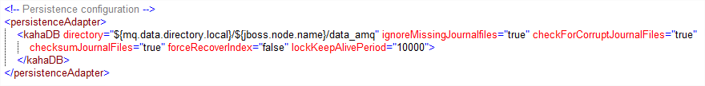
ActiveMQ
265ced1609a17cf1a5979880a2ad364653895ae8
Settings - Persistence
KahaDB files are hosted on a NAS
Configuration

Slide 21
ActiveMQ
265ced1609a17cf1a5979880a2ad364653895ae8
Settings - Connector
Usage of openwire connector
Huge list of parameters on ActiveMQ documentation
Configuration
soTimeout/soWriteTimeout: socket timeout
maxInactivityDuration: time after which the connection is closed by the broker if no data was received
enableStatusMonitor: monitor connections to determine if they are blocked
rebalanceClusterClients: automatically rebalance clients across the cluster on changes of topology
updateClusterClients: update client connections (if they use the failover:// transport) of changes to the broker cluster
updateClusterClientsOnRemove: update clients if a broker is removed from the cluster

Slide 22
ActiveMQ
265ced1609a17cf1a5979880a2ad364653895ae8
Settings - Plugins
What is a plugin ?
An object which implements org.apache.activemq.broker.BrokerPlugin
It gives the possibility to add a filter (ie, an interceptor) which can modify the logic of most events:
Message delivered to the broker
Message consumed
Client connected
And more !

Slide 23
ActiveMQ
265ced1609a17cf1a5979880a2ad364653895ae8
Settings – Plugins (1)
DestinationAliasPlugin | Alias for a destination. Used in queue name migration.
MasterSlaveMonitorPlugin | Log a message when the broker becomes a master broker. Used in Active/passive setup.
BrokerStatisticPrinterPlugin | Stats for sentinel.
TimeToLiveLimiterPlugin | Overrides the expiration date of the message when enqueued in the message.
ForceQueueMessagePersistencePlugin | Forces all messages incoming in a queue to be persisted.
QueueBrowseDenyPlugin | Denies the browsing of a queue.
PerHostConnectionLimiterBrokerPlugin | Limits the number of JMS connections per hostname. 200 in INT/QA, 100 everywhere else.

Slide 24
ActiveMQ
265ced1609a17cf1a5979880a2ad364653895ae8
Settings - Plugins (2)
BrokerHealthTracingPlugin | Log dangerous events (fast producer, destination full…)
MessageTracingPlugin | Log about connection added and removed, messages dispatched and expired
SlowConsumerTransactionMonitor | Aborts the transaction if it exceeds 10s.
CamelContextBrokerAwarePlugin | Enables camel context. Used by IB and history but should be migrated to virtual topics.
SubQueueSelectorTmpCacheBrokerPlugin | Possibility to create selector aware virtual topics and route the messages to the derived queue even if there are no consumers

Slide 25

ActiveMQ
265ced1609a17cf1a5979880a2ad364653895ae8
Settings - Destinations
Destination declaration
Topics (and virtual topics !)
Queues
How to add a new destination ?
Simply add your new destination to the existing list
Don’t forget to update the maven site (see link later on)

Slide 26
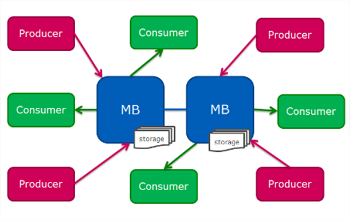
ActiveMQ
265ced1609a17cf1a5979880a2ad364653895ae8
Network of brokers
The MB nodes are connected and forward the messages to the appropriate MB node
The MB nodes discovery rely on multicast communication
The clients are automatically balanced. This is managed by the failover protocol.

Slide 27
ActiveMQ
265ced1609a17cf1a5979880a2ad364653895ae8
Network of brokers - Demo
Let’s demo 2 scenarios:
Network of brokers: a normal flow
Virtual topics
Notes:
Scenario 1:
Network of brokers
1) Start 2 MB nodes in network
In jboss directory
start "local_mb1" mvn org.codehaus.cargo:cargo-maven2-plugin:run -Pstart-on-jboss -Dmq.broker.name=local_mb1 -Dmq.network.discovery.uri=static:(tcp://localhost:62616)
start "local_mb2" mvn org.codehaus.cargo:cargo-maven2-plugin:run -Pstart-on-jboss -Dmq.broker.name=local_mb2 -Dmq.network.discovery.uri=static:(tcp://localhost:61616) -Dport.offset=1000 -Dmq.openwire.listen.port=62616 -Ddebug.port=9787"
2) Show the destination topic.ext.navcon.fum.update.V1. It has no consumers.
3) Run a consumer on topic.ext.navcon.fum.update.V1 on node 2. No consumer on node 1.
Show the destination topic.ext.navcon.fum.update.V1 on node 2.
http://localhost:9080/mb/admin/jmx/operations?tab=activemq&nid=root-org.apache.activemq-Broker-local_mb2-Topic-topic.ext.navcon.fum.update.V1
It has one consumer a "direct" consumer.
Show the destination topic.ext.navcon.fum.update.V1 on node 1.
http://localhost:9080/mb/admin/jmx/operations?tab=activemq&nid=root-org.apache.activemq-Broker-local_mb2-Topic-topic.ext.navcon.fum.update.V1
It has one consumer a "network" consumer.
4) Send a message on topic.ext.navcon.fum.update.V1 on node 1.
Show the console
1 msg is received on node 2.
Scenario 2:
Virtual topics
1) Remove the consumer on the topic on node 2
2) Add a queue consumer on clustered.seb.topic.ext.navcon.fum.update.V1 on node 1
3) Add another consumer on clustered.seb.topic.ext.navcon.fum.update.V1 on node 2
4) Send many messages on topic.ext.navcon.fum.update.V1 on node 1.
Show the console

Slide 28
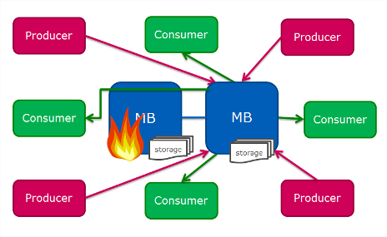
ActiveMQ
265ced1609a17cf1a5979880a2ad364653895ae8
Network of brokers - outage
In case of outage (or load)
The failover protocol will automatically rebalance the clients to the other node
The clients may be rebalanced after the end of the outage
The consumption of the messages stored in the node in outage will be resumed

Slide 29
ActiveMQ
265ced1609a17cf1a5979880a2ad364653895ae8
Monitoring/admin - Hawtio
Hawtio
is a web console to administrate JMX beans
relies on Jolokia (which provides the REST API to access JMX beans)
provides an ActiveMQ plugin
is deployed in our ActiveMQ EAR
is secured (you need to login with your windows account)
is available on http://host:port/mb/admin
The ActiveMQ plugin
Lists the destinations, consumers and producers
Allows administrative operations (clearing a destination)
Demo:
http://nceaptint16.nce.amadeus.net:9081/mb/admin/

Slide 30
ActiveMQ
265ced1609a17cf1a5979880a2ad364653895ae8
Monitoring/admin - Hawtio
How to update the list of people authorized ?
Ask PRS to update the property hawtio.roles (ex: 11564765)
How to connect to a remote Jolokia with a local Hawtio ?
Magic bullet “Hawaii”:
mvn org.apache.maven.plugins:maven-dependency-plugin:2.8:copy -Dmdep.useBaseVersion=true -Dartifact=com.amadeus.apt.as.hawaii:hawaii-app:LATEST:pom -DoutputDirectory=./ -Dmdep.stripVersion=true && mvn -f hawaii-app.pom package tomee:run
Open http://localhost:8080/hawaii/#/jvm/connect
Go in the Discovery tab and open the instance of your choice
May be very slow to open
Trick: Set Preferences > Jolokia > Max collection size to 3000

Slide 31
ActiveMQ
265ced1609a17cf1a5979880a2ad364653895ae8
Monitoring/admin - Sentinel
Metrics (per destination) available in Sentinel
AET: average enqueue time
average of the duration of all message from their enqueue time to their dispatch
DIR: dispatching ratio
ratio (in percent) of the number of dispatched messages over the number of enqueued messages. Dispatched messages are not necessarily dequeued (because they may not be acknowledged).
DTS: dequeue TPS
number of messages dequeued per second
ETS: enqueue TPS
number of messages enqueued per second
MEC: message count
number of messages currently in the queue
MPU: memory percent usage
memory usage of the destination (in percents)

Slide 32
ActiveMQ
265ced1609a17cf1a5979880a2ad364653895ae8
Monitoring/admin - Sentinel
Global metrics
BROKER_CONNECTION_COUNT
Number of JMS connections
BROKER_STORE_USAGE
Usage (in percent) of the store
BROKER_TEMP_USAGE
Usage (in percent) of the memory

Slide 33
ActiveMQ
265ced1609a17cf1a5979880a2ad364653895ae8
Documentation
Maven site
http://apt.nce.amadeus.net/mvn-sites/messagebroker/2.1.23/
Source available in Git: src/site/
Build it with site-deploy.bat. It will be deployed on your local machine in D:\remote\projusers\aptmdw\mvn-sites\messagebroker
Deploy it on any linux machine in /remote/projusers/aptmdw/mvn-sites/messagebroker/VERSION
Don’t forget to chmod –R g+w
ActiveMQ documentation
http://activemq.apache.org/

Slide 34
ActiveMQ
265ced1609a17cf1a5979880a2ad364653895ae8
Troubleshooting – usual issues
Take a look at the wiki and the mvn site:
http://rndwww.nce.amadeus.net/wiki/apt/index.php/MB_Troubleshooting_Guide
http://apt.nce.amadeus.net/mvn-sites/messagebroker/2.1.23/troubleshooting.html
KahaDB NAS vs local
KahaDB files are stored on the NAS. Before, they were on the local disk, but the performances were dramatically slow.
Wait, a NAS faster than a local disk ?
Apparently, yes. The NAS probably acknowledges write operations before they are done
The local disk was using a very old file system

Slide 35
ActiveMQ
265ced1609a17cf1a5979880a2ad364653895ae8
Troubleshooting – usual issues
Old kahaDB files
ActiveMQ should not keep “old” kahaDB files (ie, more than 1 day or 2)
If it happens, it means that some messages are not considered as garbage-collectable by ActiveMQ
It probably means a consumer didn’t acknowledge a message
Timer already canceled (ex: 11611514)
Only the tip of the iceberg
It means an exception occurred in a plugin (can be several weeks before!) and has broken the ActiveMQ scheduler
Find the root cause and fix it ☺

Slide 36
ActiveMQ
265ced1609a17cf1a5979880a2ad364653895ae8
Troubleshooting – usual issues
Persistent store is Full (ie full KahaDB)
A consumer stopped consuming
A producer flooded a destination
Solution
Fix the consumer and/or the producer
Check if they can consume all the messages
Clear the KahaDB (it means messages will be lost !)
via the console
With rm (don’t forget to stop/start the node)
JMS dequeuer
Simple Java/Spring tool to check if you can dequeue a destination
Useful for debugging
https://rndwww.nce.amadeus.net/confluence/display/APTAODB/JMS+dequeuer

Slide 37
ActiveMQ
265ced1609a17cf1a5979880a2ad364653895ae8
Work in progress
Merge MB UI/MB
Merge DF_MB/MB
APT Framework 2.0
Implemented in 2.2.0
Need significant testing
TCP keepalive
In some special situations, the clients are not considered as disconnected, which means they won’t be able to dequeue any message
Upgrade to new ActiveMQ version 5.13.4 ?
Today: 5.11.0
Good to know: there are some non regression tests !

Slide 38
ActiveMQ – MB UI
265ced1609a17cf1a5979880a2ad364653895ae8
Goals - documentation
Provide messaging
From backend (SGA) to UI clients
From UI clients to UI clients
Avoid having all clients polling for messages
http://rndwww.nce.amadeus.net/wiki/apt/index.php/UI_Message_Broker

Slide 39
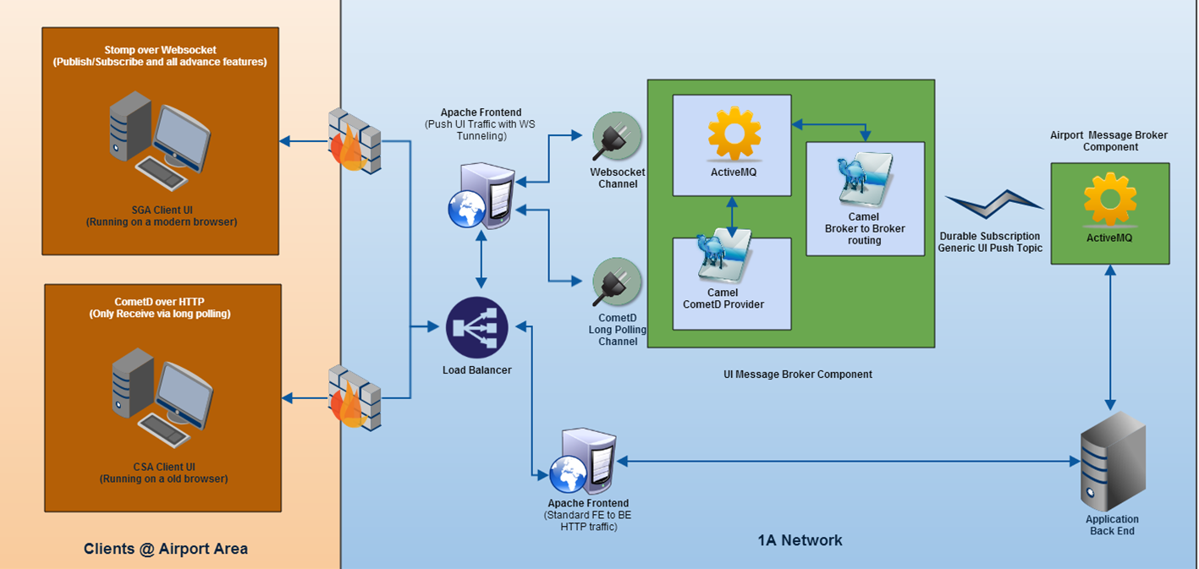
ActiveMQ – MB UI
265ced1609a17cf1a5979880a2ad364653895ae8
Topology

Slide 40
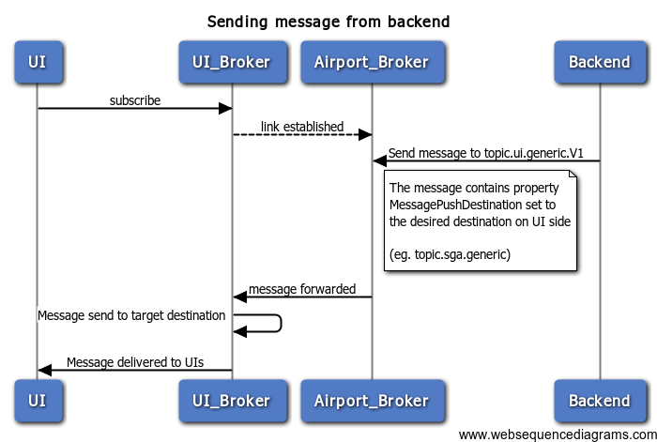
ActiveMQ – MB UI
265ced1609a17cf1a5979880a2ad364653895ae8
Typical flow
Backend sent a message to queue topic.ui.push.generic.V1 on the “classic” Message Broker. The message contains a property MessagePushDestination set to topic.XXX
The UI Broker will receive the message and forward it to its destination called topic.XXX.V1.
UIs that subscribed to topic.XXX.V1' will receive the message.

Slide 41
265ced1609a17cf1a5979880a2ad364653895ae8
So long, and thanks for all the fish
You can follow us on:
AmadeusITGroup
amadeus.com/blog
amadeus.com

