Slide 1
Digital-ANALOG VARIATIONAL QUANTUM EIGENSOLVER
Vinamr Jain
Qiskit For the Biscuit

Slide 2
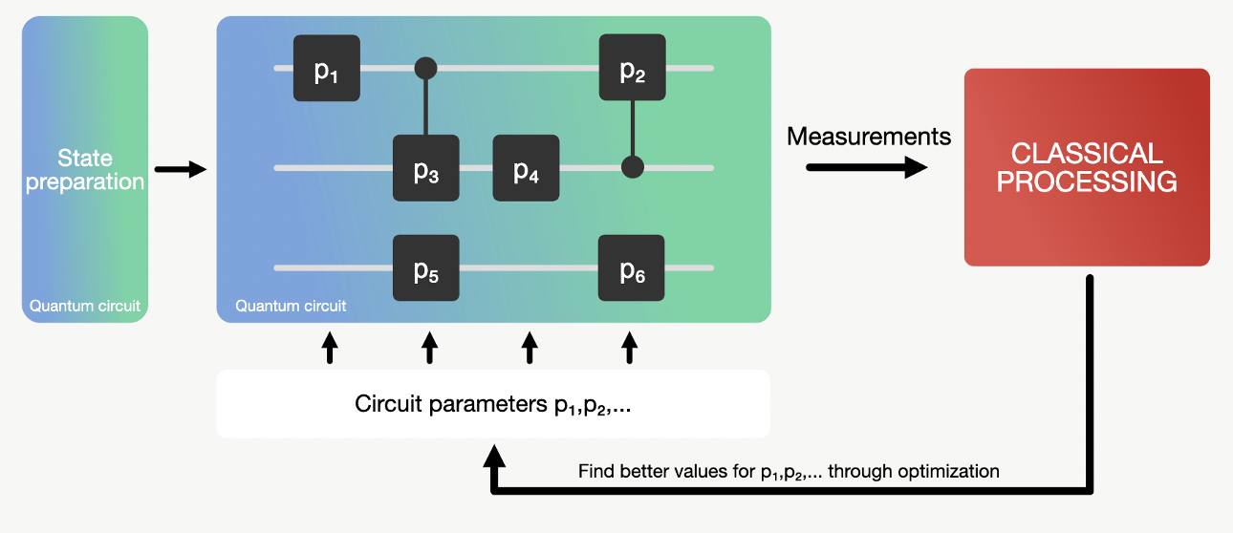
Motivation
Digital-Analog Quantum Computing (DAQC) allows us to reduce the number of gates needed to perform quantum algorithms. It combines digital single qubit gates with analog multi-qubit blocks. VQE is one of the algorithms, where DAQC has the potential to be “more hardware efficient” and thus allow for better ground state energy estimation than purely digital quantum computing in the NISQ era.
Why Use analog gates?
To perform quantum simulations, we use a controllable quantum system whose effective dynamics is similar to the one of the desired model.
Reduce the number of gates needed to perform quantum algorithms, in the current spirit of near-term intermediate-scale quantum computation (NISQ).
For our use case, we will explore DAQC from the perspective of VQEs, A versatile tool with varied applications like blah blah blah

Slide 3
FOR the case of h2 (n = 2)
Digital-Analog Approach-
Reference value: -1.85728
VQE on Aer qasm simulator (no noise): -1.85332
VQE on Aer qasm simulator (with noise): -1.12066
VQE on Aer qasm simulator (with noise and measurement error mitigation): -1.86029
Reference value: -1.85728
VQE on Aer qasm simulator (no noise): -1.85803
VQE on Aer qasm simulator (with noise): -1.78265
VQE on Aer qasm simulator (with noise and measurement error mitigation): -1.86086
It seems that the DAQC approach works just fine at a smaller scale (here n = 2) qubits. The results are better than those obtained through Digital gates and multi qubit gates.
Notice that the DAQC Approach works significantly better for the noisy case and can be attributed to the fact that gate noise was significantly reduced for this case (No multi-qubit gates). However, one needs to take into account the fact that the analog gates in practice are far from ideal and hence, that aspect was not addressed in this simulation

Slide 4
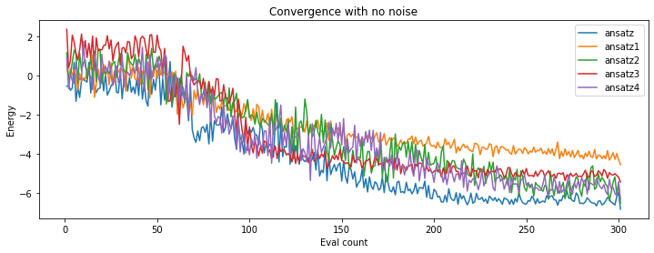

Digital VQE for the Heisenberg case
N=5 HERE
A few Observations and Conclusions
- The ansatz which works for a smaller case may not scale well
- The form of entanglement highly affects the capability of finding the true ground state
- Increasing the no. of layers/no. of gates generally but not necessarily mean you'll get a better approximation for the ground state
- The same ansatz works differently for different forms of problem Hamiltonians, hence there are problem inspired ansatzes which leverage on the inherent symmetries of the problem and even choose an appropriate initial state, but without any initial knowledge of the Hamiltonian, our goal would be to develop hardware efficient and versatile ansatzes
VQE on Aer qasm simulator (no noise): -7.20312
Delta from reference energy value is 0.50842
The Digital Ansatz used in DAQC_VQE_Heisenberg_(rough).ipynb gives a good approximation of the ground state energy (Better than all in CNOT approaches) which comprises of RXX gates with Rx Rz rotation gates
Here ansatz corresponds to 2 layers of Rx Rz gates clubbed with CNOTS in linear entanglement
Reference value: -7.71155
VQE on Aer qasm simulator (no noise): -6.83398
VQE on Aer qasm simulator (with noise): -5.67383
VQE on Aer qasm simulator (with noise and measurement error mitigation): -6.94336

Slide 5
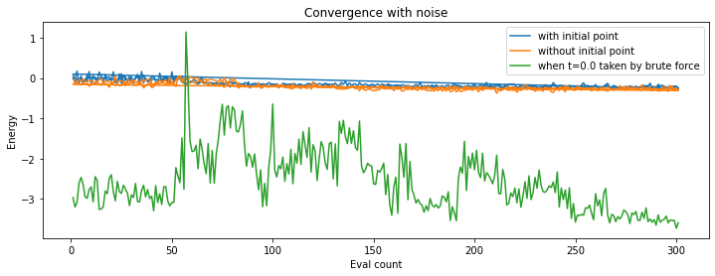
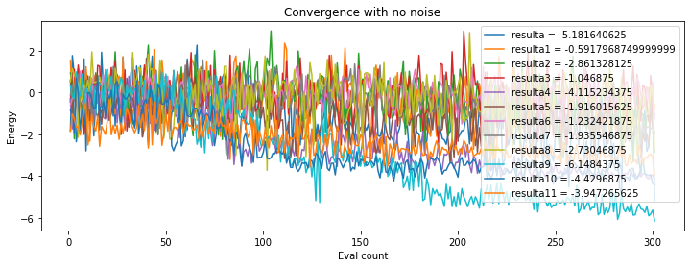
DAQC VQE for HEISENBERG HAMILTONIAN n=5
Ansatzes which produce good results at small scale, may not work for larger scale. Converse is not true.
One possible reason why More "Complex" ansatzes fail to produce results which are closer to actual ones is because those ansatzes are "Stronger" in the sense that they gradient is "steeper" and hence often gets stuck in barren plateaus
As opposed to what one would initially think that increasing the number of layers/gates (more parameters) would lead to a higher coverage of the Hilbert space, it seems like although that may be true, but that would also imply the higher probability of getting stuck in a local minima. Specialized Initial states/ Problem specific ansatz analysis may be one way of tackling the same.
In our case the winner ansatz was the simplest to construct with simple $Z_{j}Z_{j+1}$ terms in the analog gate in which the h_coefficients were not parameterized and the same time was used for multiple occurrences of the analog gate
DAQC seems to be at par with Digital VQE for the noiseless case, however for the noisy case, it seems to be performing poorly. The reason for this can be-
The loss of degree of freedom since time could not be parameterized for the noisy system within the framework (for n>2).
Reference value: -7.71155
VQE on Aer qasm simulator (no noise): -6.14844
VQE on Aer qasm simulator (with noise): -3.59375
VQE on Aer qasm simulator (with noise and measurement error mitigation): -4.18555

Slide 6
Scope for IMPROVEMENT
Redefine the Qiskit framework for Creating Hamiltonian gates so as to facilitate parameterization, so that a greater insight can be deduced about analog systems
Scope to work to play around with other Hamiltonians/SYSTEMS (like H2 (4 qubit case)/ T-Ising) using the same Heuristics as in Heisenberg model
A lot of experimentation, but need proper analysis of the ansatzes built
In depth noise analysis
Formal treatment of algorithms built
Scalability and efficiency

