Slide 1
Approximate Bayesian Computation Sequential Monte Carlo
A Statistical Analysis by
Pagella Filippo, Poggi Marco & Venturini Giulio

Slide 2

The Bayesian Choice
Two possible approaches for parameter estimation:
Frequentist: θ fixed but unknown
Bayesian: θ is a random variable
In the Bayesian approach we want to estimate the posterior of θ, using the Bayes’ Formula:
Likelihood is often computationally intractable

Slide 3
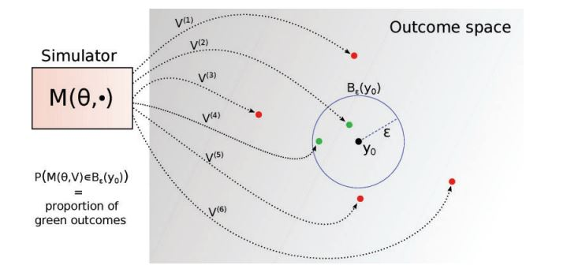
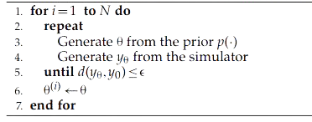
Approximate Bayesian Computation
In ABC methods, the evaluation of the likelihood is replaced by a simulation-based procedure
The simplest ABC algorithm is the ABC Rejection sampler:

Slide 4
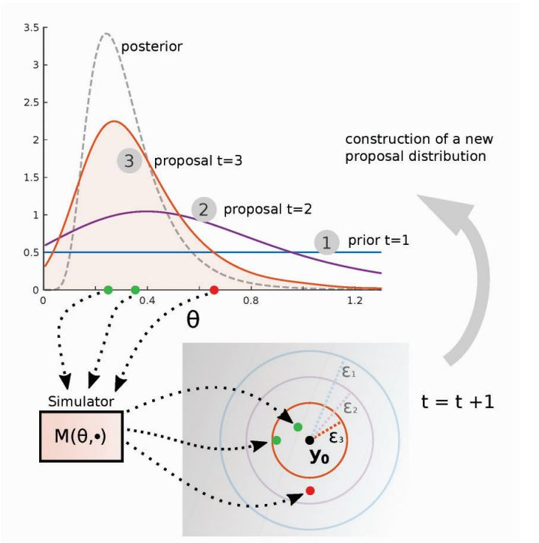
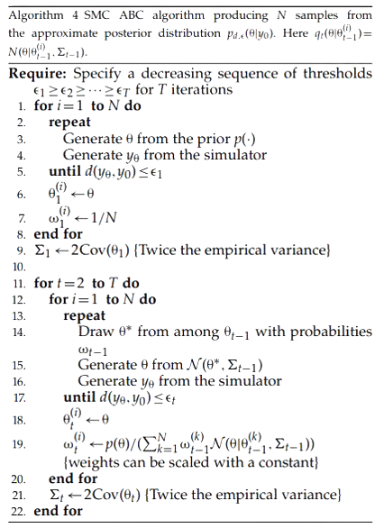
Sequential Monte Carlo

Slide 5
An Explicative Example:
Gaussian Mixture

Slide 6
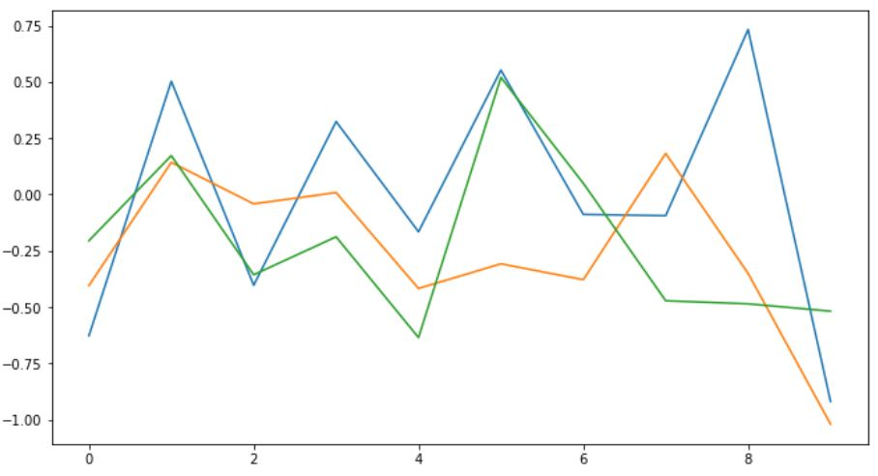
Defining the Model
Prior:
θ ∼ Unif(−10, 10)
Model:
f(θ∣x) = 0.5 N(θ, 1) + 0.5 N(θ, 1/100)
Goal:
To approximate the posterior distribution of θ, starting from an observation based on θ_true = 0

Slide 7
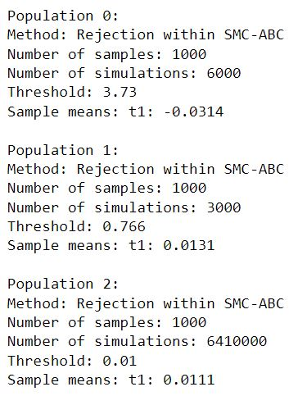
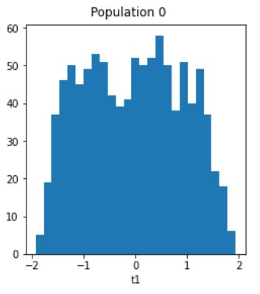
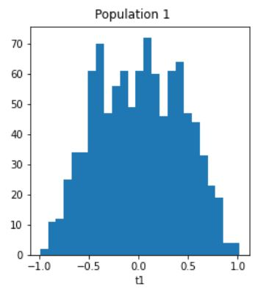
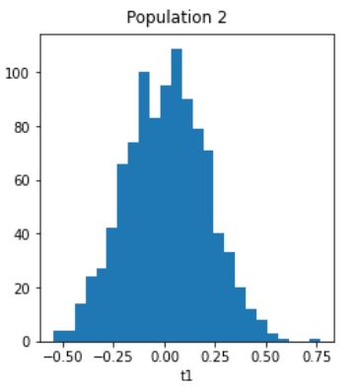
Sequential Monte Carlo

Slide 8
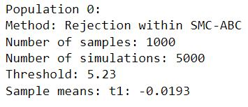
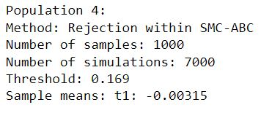
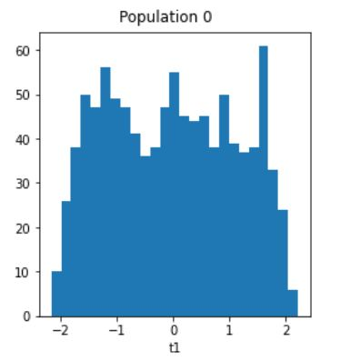
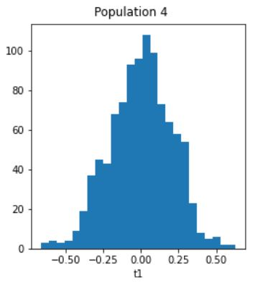
SMC with Adaptive Threshold

Slide 9
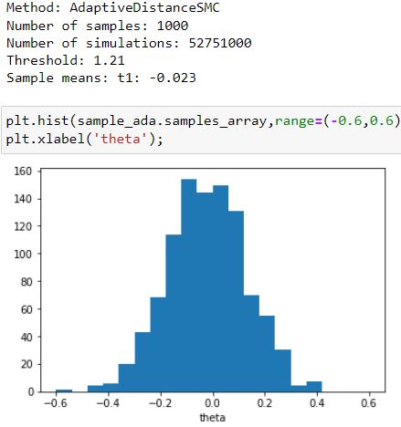
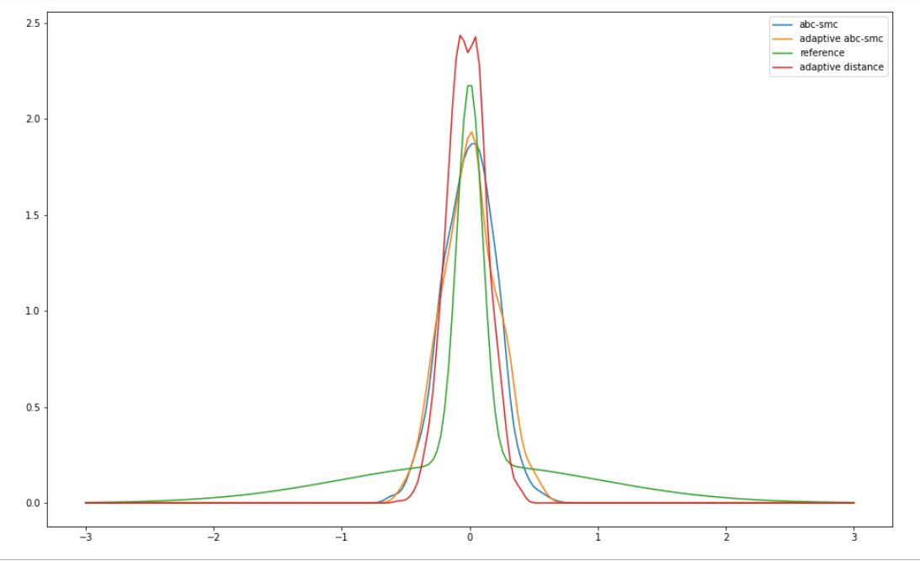
SMC with Adaptive Distance

Slide 10
A Differential Case:
The Simple Pendulum

Slide 11
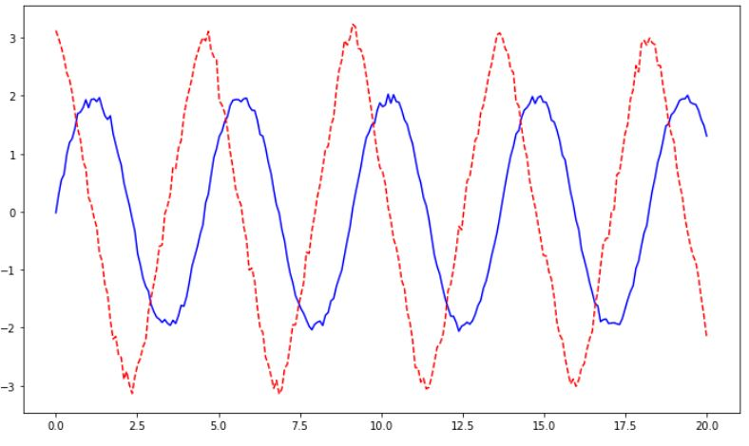
Defining the Model
Prior:
l ∼ Unif(0, 7)
Model:
θ’’ + g/l*sin(θ) = 0
g = 9.81 m/s^2
Goal:
To approximate the posterior distribution of l, starting from an observation based on θ_0 = 0, θ’_0 = 3 and l_true = 3

Slide 12
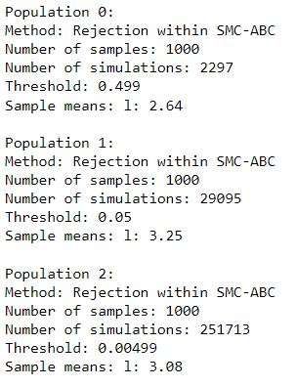
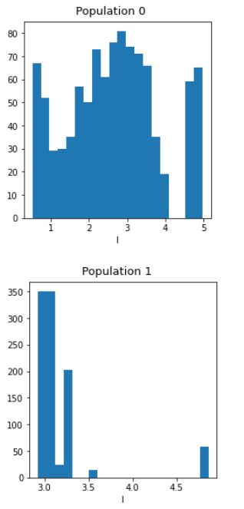
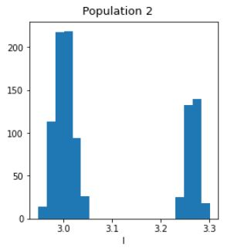
Sequential Monte Carlo based on θ’

Slide 13
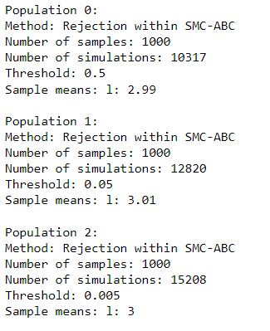
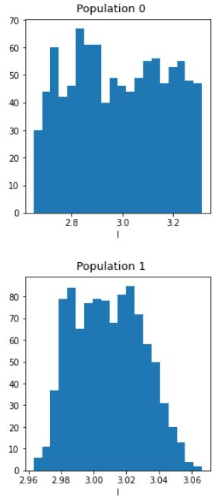
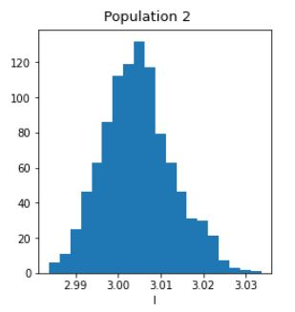
Sequential Monte Carlo based on θ

Slide 14
References
Toni T., Welch D., Strelkowa N., Ipsen A., Stumpf M.P. 2009. Approximate Bayesian computation scheme for parameter inference and model selection in dynamical systems. J. Roy. Soc. Interf. 6:187–202.
Lintusaari J., Gutmann M.U., Kaski S., Corander J. 2016. On the identifiability of transmission dynamic models for infectious diseases. Genetics 202(3):911–918
Sisson, S. A., Fan, Y. & Tanaka, M. M. 2007 Sequential Monte Carlo without likelihoods. Proc. Natl Acad. Sci. USA 104, 1760–1765.
Marin J.-M., Pudlo P., Robert C., Ryder R. 2012. Approximate Bayesian computational methods. Stat. Comput. 22:1167–1180.
Beaumont M.A., Cornuet J.P., Marin J.M., and Robert C.P., Adaptive approximate bayesian computation, Biometrika 96 (2009), no. 4, 983.
Bonassi F.V., You L., and West M., Bayesian learning from marginal data in bionetwork models, Department of Statistical Science, Duke University: Discussion Paper 11-07 (2011).

