Slide 1
Q1
INSIGHTS
To remove the duplicates from the row we have to select the requires column and click on remove duplicates option.
We can see the remove duplicates in data tab and go to data tools.
And now duplicates get deleted.
As we can see there are no duplicates in the data set according to video_id.
To remove missing or null values I want to fill it up with mean of the data.
FORMULA
=IF('Q1'!H2=0,AVERAGE('Q1'!$H$2:$H$593),'Q1'!H2)
=IF(I2=0,AVERAGE($I$2:$I$593),I2)
likes | dislikes
15665 | 414
2001.03 | 439.5912
2004.422 | 439.5912
8374 | 2668
1996.998 | 439.5912
2000.4 | 439.5912
280 | 210
2006.761 | 439.5912
2010.197 | 439.5912
2013.645 | 439.5912
2017.105 | 439.5912
2020.577 | 439.5912
2024.06 | 439.5912
2027.556 | 439.5912
2031.064 | 439.5912
2034.584 | 439.5912
2038.116 | 439.5912

Slide 2
Q2
INSIGHTS
Now to get difference between the trending date and the publish date.
So we have to directly separate trending from publish date.
And then to get average we have directly apply the average function to difference of dates.
average
2.221284
FORMULA
=B2-A2(DIFFERENCE OF DATES)
=AVERAGE(C2:C593)

Slide 3
Q3
category_id | Average of views | Average of likes | Average of comment_count
2 | 1500201 | 27351 | 0
1 | 1198848.292 | 3872.916667 | 0
28 | 862396.75 | 13399.75 | 0
17 | 847732.6667 | 838.6666667 | 0
10 | 488661.25 | 3059.5 | 0
24 | 469426.5464 | 3614.391753 | 0
25 | 435653.5278 | 1267.027778 | 0
26 | 357043.4615 | 2126.923077 | 0
22 | 235320.9756 | 550.3414634 | 0
29 | 60538.92857 | 1181.02381 | 0
27 | 40741.76724 | 188.4224138 | 0
INSIGHTS
By using pivot table we can easily get total average views.
We can also get the sum of average likes and comments.
We can drag category id into rows and views,comment,likes into values.
We have to change them into average

Slide 4
Q4
category_id
24
27
27
26
27
27
24
22
27
27
27
27
27
27
27
channel name
Entertainment
Education
Education
Howto & Style
Education
Education
Entertainment
People & Blogs
Education
Education
Education
Education
Education
Education
Education
INSIGHTS
We have to take new column as category name.
By taking reference from category sheet and using xlookup we can fill the category names.
FORMULA
=XLOOKUP(E2,Category!$A$2:$A$33,Category!$B$2:$B$33)

Slide 5
Q5
FORMULA : =CONCATENATE(A2,B2) =TEXTJOIN(",",TRUE,A2)
title | channel_title | comment | Concat of title and channel title | text join
‘A Change Is Gonna Come’ for Lifford after he gets a GOLDEN BUZZER! | Auditions | BGT 2018 | Britain's Got Talent | "Engaging and informative presentation!" | ‘A Change Is Gonna Come’ for Lifford after he gets a GOLDEN BUZZER! | Auditions | BGT 2018Britain's Got Talent |  | ‘A Change Is Gonna Come’ for Lifford after he gets a GOLDEN BUZZER! | Auditions | BGT 2018
1 December, 2017 The Hindu Discussion, Data Protection, Child abduction,Padmavati, wild life, FP | only ias | "Great use of visuals to convey your points." | 1 December, 2017 The Hindu Discussion, Data Protection, Child abduction,Padmavati, wild life, FPonly ias |  | 1 December, 2017 The Hindu Discussion, Data Protection, Child abduction,Padmavati, wild life, FP
1 January, 2018 prelim booster news discussion | only ias | "The presentation flowed smoothly from start to finish." | 1 January, 2018 prelim booster news discussiononly ias |  | 1 January, 2018 prelim booster news discussion
1 रात लगाके देखो बालों की लम्बाई इतनी बढ़ेगी बस कटवाते रह जाओगे//Fastest HAIR GROWTH FORMULA | Ayurved Tips in Hindi | "Clear and concise delivery, well done!" | 1 रात लगाके देखो बालों की लम्बाई इतनी बढ़ेगी बस कटवाते रह जाओगे//Fastest HAIR GROWTH FORMULAAyurved Tips in Hindi |  | 1 रात लगाके देखो बालों की लम्बाई इतनी बढ़ेगी बस कटवाते रह जाओगे//Fastest HAIR GROWTH FORMULA
10 February, 2018 The Hindu Discussion, FRBM Act | only ias | "I appreciated the depth of research evident in your slides." | 10 February, 2018 The Hindu Discussion, FRBM Actonly ias |  | 10 February, 2018 The Hindu Discussion, FRBM Act
10 March, 2018 Prelim Booster News Discussion | only ias | "Your presentation style kept me interested throughout." | 10 March, 2018 Prelim Booster News Discussiononly ias |  | 10 March, 2018 Prelim Booster News Discussion
10 రోజుల ముందే శ్రీదేవి చనిపోతుంది తెలుసుకున్న పండితుడు ఏమి చేసాడో తెలుస్తే షాక్ జ్యోతిష్యుడు Sri | Telugu Mix | "The content was well-organized and easy to follow." | 10 రోజుల ముందే శ్రీదేవి చనిపోతుంది తెలుసుకున్న పండితుడు ఏమి చేసాడో తెలుస్తే షాక్ జ్యోతిష్యుడు SriTelugu Mix |  | 10 రోజుల ముందే శ్రీదేవి చనిపోతుంది తెలుసుకున్న పండితుడు ఏమి చేసాడో తెలుస్తే షాక్ జ్యోతిష్యుడు Sri
10రోజుల ముందే శ్రీదేవి చనిపోతుందని ఈ జ్యోతిషుడు ఎందుకు చెప్పాడో తెలిస్తేషాక్ అవుతారు || Sridevi News | We support you | "I liked how you incorporated real-life examples into your presentation." | 10రోజుల ముందే శ్రీదేవి చనిపోతుందని ఈ జ్యోతిషుడు ఎందుకు చెప్పాడో తెలిస్తేషాక్ అవుతారు || Sridevi NewsWe support you |  | 10రోజుల ముందే శ్రీదేవి చనిపోతుందని ఈ జ్యోతిషుడు ఎందుకు చెప్పాడో తెలిస్తేషాక్ అవుతారు || Sridevi News
11 January, 2018 The Hindu Discussion, National Anthem, Rural Distress,Reservation, Reservation | only ias | "Your enthusiasm for the topic was contagious." | 11 January, 2018 The Hindu Discussion, National Anthem, Rural Distress,Reservation, Reservationonly ias |  | 11 January, 2018 The Hindu Discussion, National Anthem, Rural Distress,Reservation, Reservation
12 December, 2017 Prelim Booster Discussion, Mahanadi, CISF, Vyaas, Horn bill, RIC | only ias | "Excellent job in capturing the audience's attention." | 12 December, 2017 Prelim Booster Discussion, Mahanadi, CISF, Vyaas, Horn bill, RIConly ias |  | 12 December, 2017 Prelim Booster Discussion, Mahanadi, CISF, Vyaas, Horn bill, RIC
12 February, 2018 The Hindu Discussion, Maldives, Bangladesh, Health Index, NHPC | only ias | "I found the key takeaways from your presentation very valuable." | 12 February, 2018 The Hindu Discussion, Maldives, Bangladesh, Health Index, NHPConly ias |  | 12 February, 2018 The Hindu Discussion, Maldives, Bangladesh, Health Index, NHPC
12 January, 2018 Prelim Booster News Discussion | only ias | "The visuals were eye-catching and enhanced understanding." | 12 January, 2018 Prelim Booster News Discussiononly ias |  | 12 January, 2018 Prelim Booster News Discussion
12 March, 2018 The Hindu Daily Editorial Discussion | only ias | "Your presentation effectively addressed the audience's questions." | 12 March, 2018 The Hindu Daily Editorial Discussiononly ias |  | 12 March, 2018 The Hindu Daily Editorial Discussion

Slide 6
Q6
INSIGHTS
Take a pivot table and take comments disabled in rows.
Also take them in value.
Clearly we can say videos with comments abled is 96% and comments disabled is 4%
Row Labels | Count of comments_disabled
FALSE | 15715
TRUE | 592

Slide 7
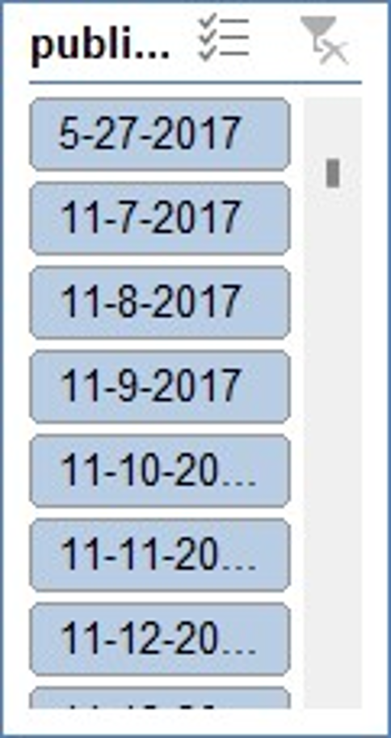
Q7
INSIGHTS
Insert pivot table
Take views,likes,comment count into values and get sum of them.
Insert a slicer
Sum of views | Sum of likes | Sum of comment_count
11146317224 | 235473826 | 24163673

Slide 8
Q8
1
2
video_id | views
6Q0AazVu1Tc | 5423477
Q3jege0p0dQ | 6983042
rucOLpxX6WE | 2769089
45Nkhoa72gY | 3283995
XYviM5xevC8 | 2903560
video_id | views | likes
6Q0AazVu1Tc | 5423477 | 85639
PTQMog9u2Zo | 2682056 | 39322
Q3jege0p0dQ | 6983042 | 177110
gbRijjvIeyk | 1229538 | 51014
XYviM5xevC8 | 2903560 | 64666
INSIGHTS
First top 5 is the video id with respect to views
Second one is wrt likes
Third one is wrt custom sort of views and likes
video_id | views | likes
Q3jege0p0dQ | 6983042 | 177110
6Q0AazVu1Tc | 5423477 | 85639
45Nkhoa72gY | 3283995 | 10595
XYviM5xevC8 | 2903560 | 64666
rucOLpxX6WE | 2769089 | 0
3

Slide 9
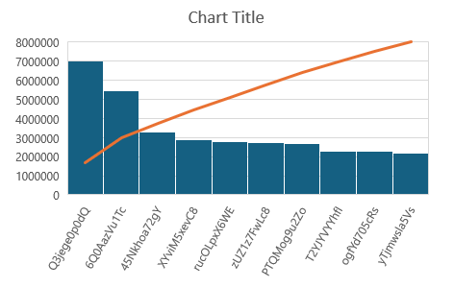
Q9
video_id | publish_date | views
6Q0AazVu1Tc | 5-5-2018 | 5423477
PTQMog9u2Zo | 5-19-2018 | 2682056
ogfYd705cRs | 5-10-2018 | 2281355
T2YJYVYYhfI | 6-3-2018 | 2291019
Q3jege0p0dQ | 4-14-2018 | 6983042
rucOLpxX6WE | 4-11-2018 | 2769089
45Nkhoa72gY | 3-12-2018 | 3283995
XYviM5xevC8 | 1-19-2018 | 2903560
yTjmwsla5Vs | 1-6-2018 | 2164560
zUZ1z7FwLc8 | 11-13-2017 | 2735945
INSIGHTS
I have taken video id,publish date and views
I applied top 10 of views.
And got a visualization based on that

Slide 10
Q10
INSIGHTS
Clearly there is increase in views from 2017 to 2018
Same with the likes
Same as with comments

Slide 11
Q11
Compare sum of likes and views based on dates

Slide 12
Q12
Views based on category id we have to same with revenue

Slide 13
Q13
Insights
Take pivot table and take category id in rows
Comments count in values
We can easily anlyze by seeing the plot

Slide 14
Q14
Insights
We take category id on rows
And take views on values
And we can easily compare

Slide 15
Q15
Insights
Take pivot table
Take likes,dislikes,comments on values
And take category id on rows
Analyse the correlation between the likes,dislikes,comments

Slide 16
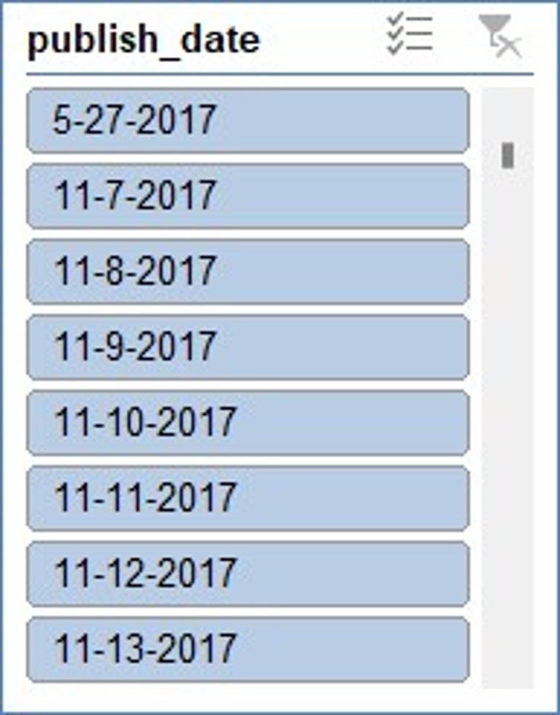
Q16-20

