Slide 1
EXCEL
Vinay varma

Slide 2
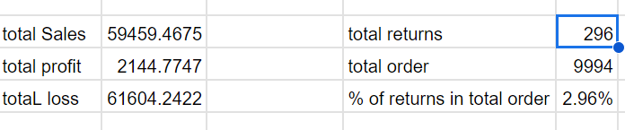
Question 1
Insight:
I have used xlookup to get sales and profit into returns sheet.
And I have calculated the total sales , total profit and loss.
I have calculated total returns , total orders and also percentage of returns.
Inference:
As we can clearly see the return percentage is 2.96% and total returns are 296 .
Total loss is 61604.2422.
Formula:=XLOOKUP(A2,Orders!B:B,Orders!R:R,,0)
=XLOOKUP(A2,Orders!B:B,Orders!U:U,,0),(J6/J5)*100
SUM(B2:B297) SUM(C2:C297)

Slide 3
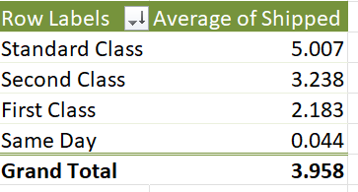

Question 2
Insight:
Create a column named shipped in orders table by subtracting shipping date from order date.
Then create a pivot table .
Drag shipped into values and ship mode into rows and change shipped into average by going into value field settings.
Inference:
Clearly, we get that Standard class have slowest delivery times with average 5
Same day has fastest delivery times with 0.044

Slide 4
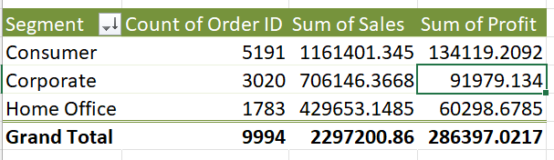
Question 3
Insight:
Create a pivot table from orders sheet.
Take segment into rows
Take order ID, Sales, Profit into Values.
Inference:
We can clearly say that Consumer segment has the highest total profit among all segments .
Corporate segment has the lowest total profit among all segments.

Slide 5
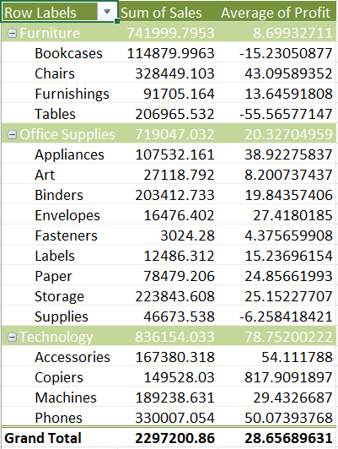
Question 4
Insight:
Create a pivot table from orders table.
Take category and sub-category into Rows.
Take sum of sales, average of profit by using field value settings into values.
Now we will get sum of sales and average of profit.
Inference:
We can now clearly view the average profit margin for each product category and each sub-category in it.

Slide 6
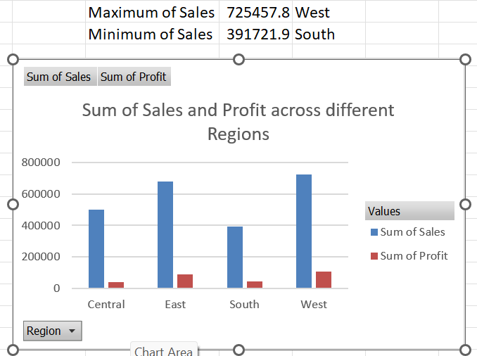
Question 5
Insight:
Create a pivot table from orders table.
Take Region into rows
Take sales and profit into values.
Inference:
Calculate maximum and minimum of sales from pivot table by using max and min functions.
Plot a bar chart to clearly compare sales and profit of various regions.

Slide 7
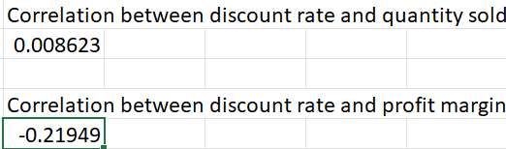
Question 6
Insight:
We should take discount ,quantity , profit
Columns into another sheet.
By using correl function we can know the correlation between discount rate and quantity.
And also correlation between discount rate and profit margin.
Inference:
Clearly there is a positive correlation means one value increases other also increases, between discount and quantity, but the value is very low so that they are not correlated properly.
There is negative correlation between discount and profit if one value increases other decreases.
Formula: =CORREL(B:B,A:A)
=CORREL(B:B,C:C)

Slide 8
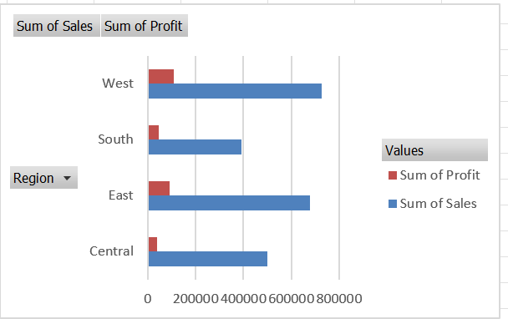
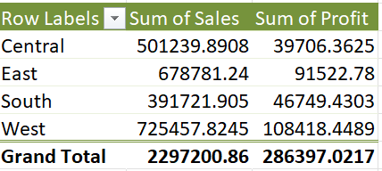
Question 7
Insight:
I have taken a pivot table
I have taken region in rows
I have taken profit and sales in values.
Inference:
We can clearly see the markets changing between different regions.
We can see the market is more in west and east regions
As well the profits are high in west and east compared to other.

Slide 9
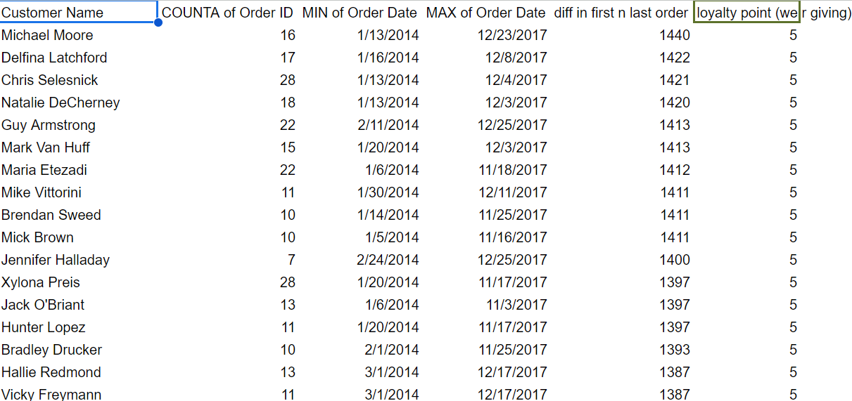
Question 8
Insight:
I have created pivot table.
I have taken customer name into rows.
I have taken order id,order date into values.
Inference:
I have taken max and min of order date in to pivot table.
Difference in first and last order also taken
Also I gave loyalty points.
FORMULA:
=IFS(E2<250,1,E2<500,2,E2<750,3,E2<1000,4,E2>1000,5)

Slide 10
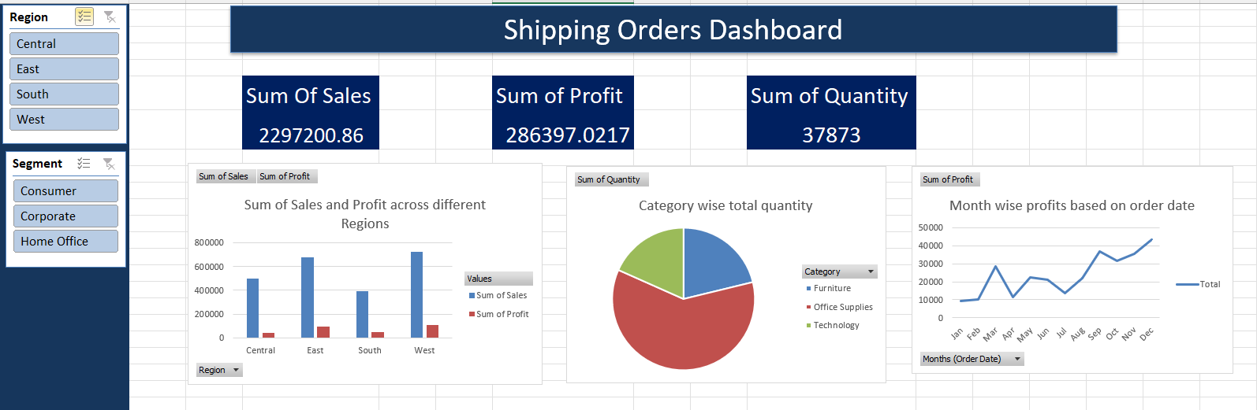
Question 9
I have created a dashboard based on shipping orders .
I have taken sum of sales, profits, quantity.
I Have also taken slicers of region and segments and connected to all the visuals in dashboard.
I have taken 3 charts pie chart, linechart , barchart.

