Slide 1


Data Analysing
Using
Azure Data Factory and Azure Databricks
Azure Data Factory
Azure Databricks

Slide 2
Project Overview:
Ingesting Data From On-premises(Local Computer) to Cloud(ADLS) using Azure Data Factory Pipeline based on Specified Conditions.
Transform the data using Azure Databricks like changing Date format, Remove Row with Error value in url and Convert Country names with their acronyms.
Store the transformed data into Azure SQL Database.
Validate the data on source side(File in Local Computer) and transformed file(File in Azure SQL).

Slide 3
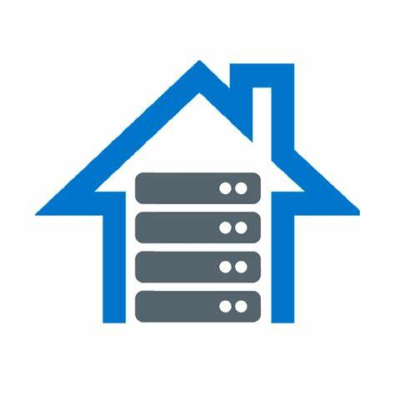
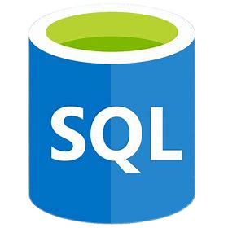

Solution Architecture
Ingest
Store
Transform
Validate
Sources
ADF
Pipeline
Analyse
Data
Self-Hosted IR
Load
Azure Data Factory
Azure SQL Database
Azure Data
Lake Storage
Azure
Databricks
On-Premises

Slide 4
Storage Solution Used In this Project
Azure Data Lake Storage
Azure SQL Database
Ingestion Solution Used In this Project
Azure Data Factory
Transformation Solution Used In this Project
Azure Databricks

Slide 5
Environment-Setup
Azure Subscription
Azure Data Factory
Azure Data Lake Gen2
Azure SQL Database
Azure Databricks Cluster

Slide 6
Thank you

