Slide 1
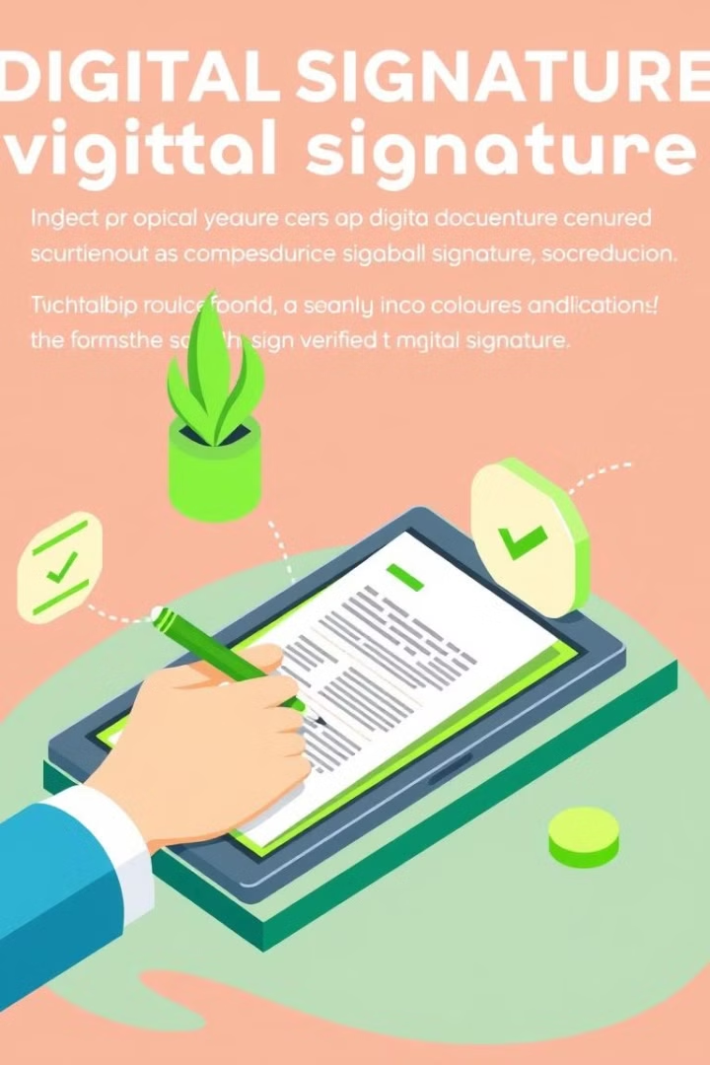
Signature Verification Using MERN and Deep Learning
Presented by Vinay Shankar. A (23BD1A0503, G156)

Slide 2
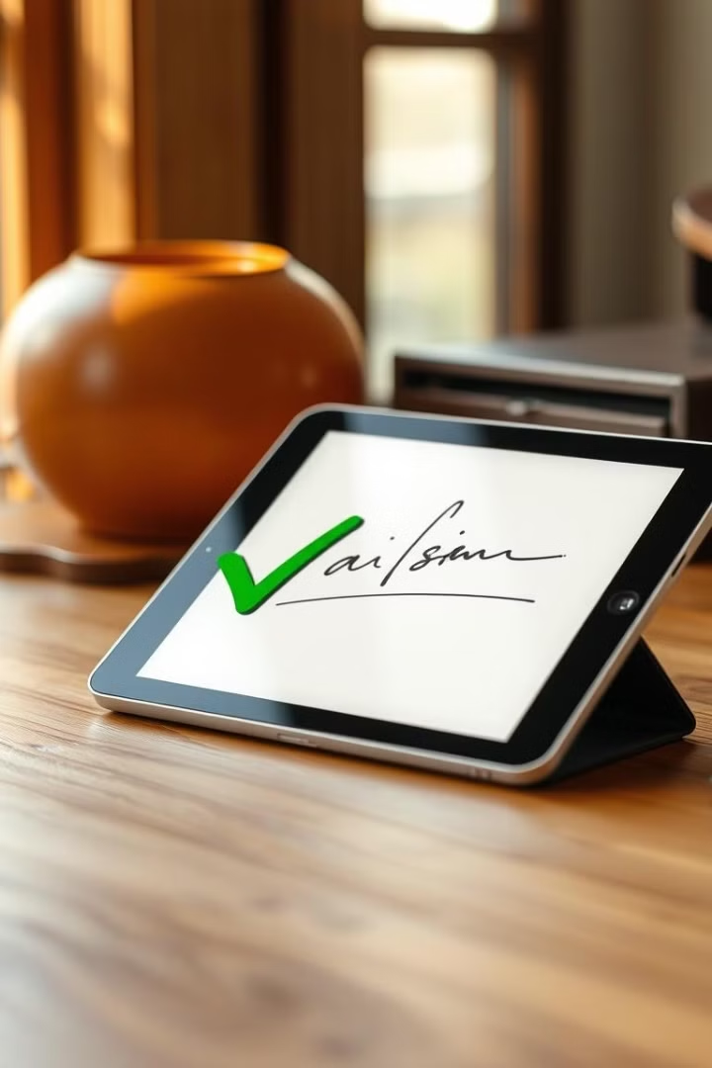
Project Overview
1
Secure Automation
2
MERN Stack Integration
Develop a system that automates signature verification while maintaining high security standards.
Utilize MongoDB, Express.js, React, and Node.js for a full-stack JavaScript solution.
3
Deep Learning Implementation
Leverage convolutional neural networks (CNNs) for accurate signature analysis and authentication.

Slide 3
Tech Stack
Frontend
Backend API
Database
React.js for dynamic UI. Handles file uploads and user interactions.
Node.js with Express.js. Processes requests and interfaces with the deep learning model.
MongoDB for flexible, scalable storage of user profiles and signature data.

Slide 4
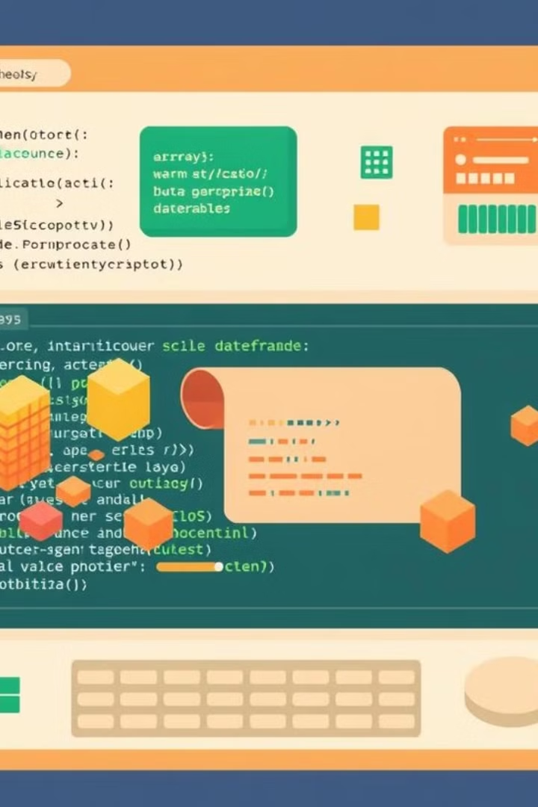
Data Structures
1
Arrays
Store multiple signature images and verification results efficiently. Enable quick access and processing.
2
Objects
Represent user profiles and signature metadata. Facilitate easy data manipulation and storage.
3
Data Frames
Used for analysis and preprocessing of signature data. Enable efficient feature extraction.

Slide 5
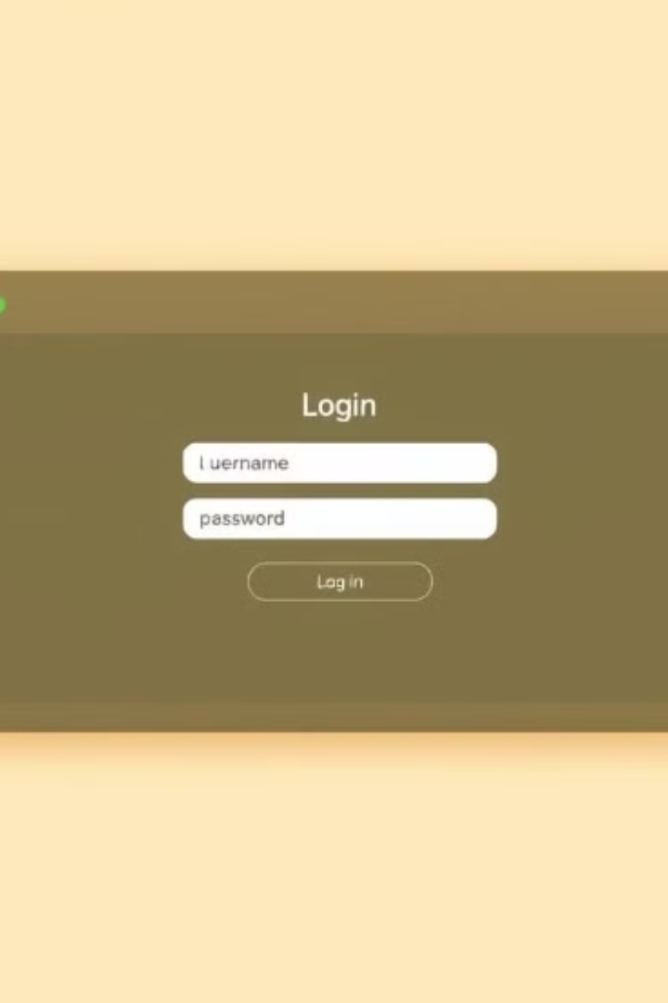
User Interfaces
Login and Authentication
Dashboard
Central hub for managing profiles and signatures. Provides quick access to all system features.
Secure interface with multi-factor authentication. Ensures only authorized users access the system.
Signature Upload
Results Display
User-friendly interface for uploading and managing signature samples. Supports various image formats.
Clear, concise presentation of verification results. Includes detailed analysis and confidence scores.

Slide 6
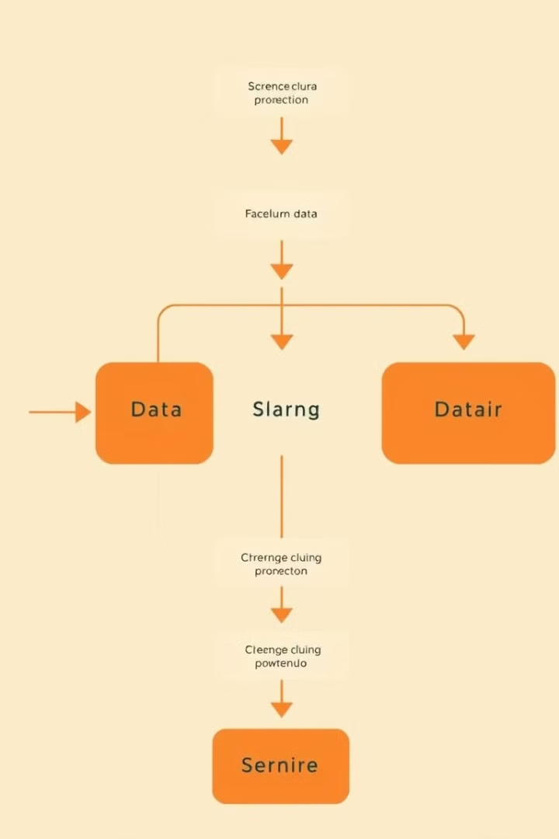

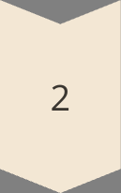
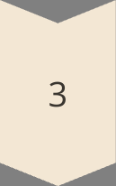
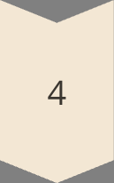
Datasets and Processing
Data Collection
Gather diverse signature samples, including authentic and forged examples. Ensure comprehensive coverage.
Preprocessing
Apply image normalization, noise reduction, and feature extraction techniques. Prepare data for model input.
Augmentation
Generate additional training samples through rotations, scaling, and distortions. Improve model robustness.
Model Training
Train deep learning model on preprocessed dataset. Fine-tune for optimal performance.

Slide 7

Workflow and Screens
1
2
3
4
User Login
Signature Upload
Verification Process
Results Display
Secure authentication process. Users access the system with unique credentials.
Intuitive interface for uploading signature samples. Supports various image formats.
Deep learning model analyzes uploaded signature. Compares against stored reference signatures.
Clear presentation of verification outcome. Includes confidence score and detailed analysis.

Slide 8
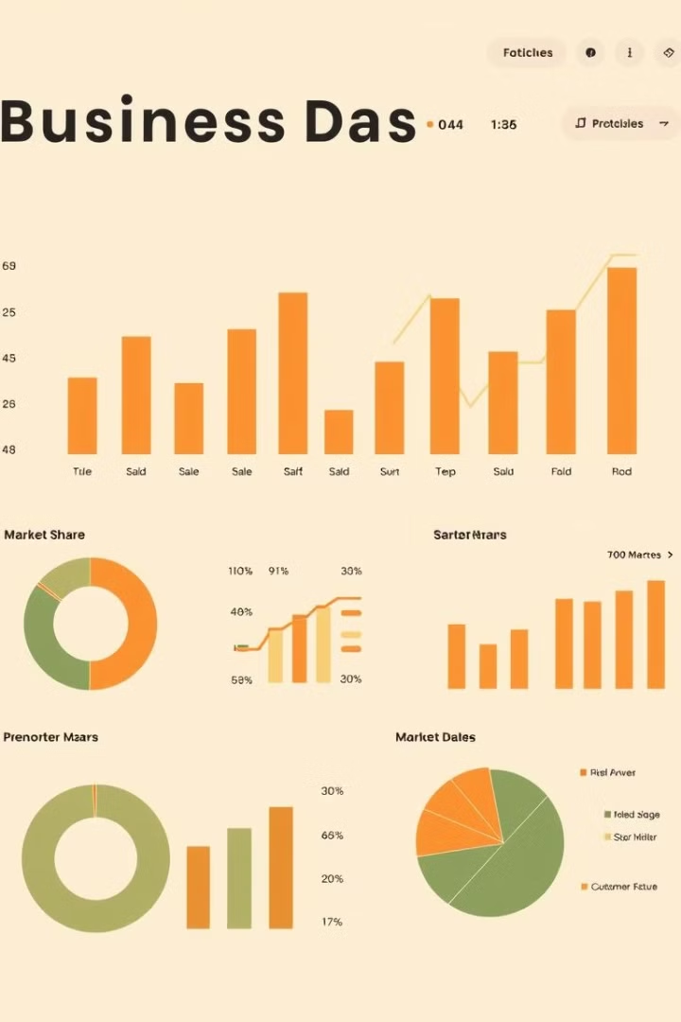



Business Logic and Future Steps
Enhanced Security
Implement advanced encryption and multi-factor authentication. Ensure robust protection of sensitive data.
AI Improvements
Continuously train and update the deep learning model. Incorporate new signature samples for improved accuracy.
Scalability
Optimize system architecture for handling increased user load. Implement load balancing and caching strategies.

