Slide 1

Parallelizing Random Forest Training
CSS 311 – Parallel and Distributed Computing
Gutta Yuva Sai Vinay (2023BCD0044)
Koduri Siddhardha (2023BCS0071)
Instructor: Dr. John Paul Martin

Slide 2
What is Random Forest?
Random Forest is an ensemble learning algorithm that builds multiple decision trees in parallel and combines their predictions. Each tree learns from a random subset of data and features, creating diversity that improves generalization. While powerful, training many trees sequentially is computationally expensive—making it an ideal candidate for parallelization.
Ensemble Method
Time-Consuming
Solution
Multiple trees voting
Sequential bottleneck
Parallel acceleration

Slide 3

Motivation: Why Parallelization Matters
Serial Training Bottleneck
Sequential tree building causes significant delays on modern hardware with idle CPU cores.
Multi-Core Utilization
Modern processors have multiple cores; parallelism efficiently distributes computational workload across them.
Reduced Execution Time
Training multiple trees concurrently dramatically reduces overall training time.
Large-Scale Feasibility
Parallelization makes training on massive datasets practical for real-world applications.

Slide 4






Project Aim
This project aims to accelerate Random Forest training through parallelization, demonstrating significant performance improvements while preserving model accuracy and consistency.
Comparative Analysis
Measure performance differences between serial and parallel implementations.
Accelerate Training
Reduce execution time using parallel computing techniques.
Maintain Accuracy
Ensure parallel version produces identical results to serial baseline.

Slide 5

Research Objectives
Implement Serial Version
Build baseline Random Forest trainer without parallelization to establish reference performance metrics.
Identify Parallelizable Sections
Analyze code to locate independent tree training operations suitable for concurrent execution.
Develop Parallel Implementation
Apply OpenMP directives to distribute tree training across multiple CPU threads.
Evaluate Performance
Measure speedup, efficiency, and accuracy across different dataset sizes and thread counts.

Slide 6
Literature Review: Existing Solutions
Existing Serial Libraries
Parallelization Approaches
Scikit-learn and MATLAB provide mature Random Forest implementations but process trees sequentially, limiting performance on multi-core systems despite available computational resources.
OpenMP: Shared-memory parallelism on single machines. MPI: Distributed systems across multiple nodes. Prior research demonstrates significant speedups with both approaches.
Scikit-learn
OpenMP Advantages
Proven Results
Industry standard but inherently sequential for tree construction.
Simple syntax, minimal code changes, effective for shared-memory parallelism.
Published work shows substantial performance gains with parallel frameworks.

Slide 7
Problem Statement
Random Forest training is computationally intensive, with sequential tree generation creating a severe bottleneck. Large datasets require impractical execution times, limiting practical deployment in time-sensitive applications.
Traditional implementations cannot fully leverage modern multi-core processors. An efficient parallel solution is essential to make Random Forest training viable for large-scale real-world applications.

Slide 8
Methodology: Implementation Workflow
01
02
03
Load and Preprocess Dataset
Initialize Parameters
Train Decision Trees
Set Random Forest configuration: number of trees, tree depth, feature sampling strategy, and random seed.
Build trees sequentially (serial version) or concurrently (parallel version) using bootstrap samples.
Acquire data, normalize features, and prepare training/test splits for consistent evaluation.
04
05
Aggregate Models
Performance Comparison
Combine trained trees into final ensemble model for prediction.
Measure execution time, speedup, efficiency, and verify accuracy equivalence between implementations.

Slide 9

System Architecture: Serial vs. Parallel
Serial Approach
Parallel Approach
Single thread processes one decision tree at a time. Cores remain idle while waiting for tree completion. Simple to implement but underutilizes hardware.
Multiple threads build independent trees concurrently using OpenMP shared-memory model. Each core actively contributes to model training simultaneously.
Dataset
Split Into Streams
Parallel Tree Training
Combined Model

Slide 10

Serial Algorithm: Sequential Tree Construction
1
Sample Subset
For each tree, randomly select features and create bootstrap sample from training data with replacement.
2
Build Tree Recursively
Construct decision tree by selecting optimal split features at each node to minimize impurity.
3
Store Model
Add completed tree to forest collection before proceeding to next tree.
Time Complexity: O(Ntrees × Ttree), where Ntrees is the number of trees and Ttree is the time to train one tree. Parallelization reduces this to approximately O(Ttree) with sufficient cores.

Slide 11
Parallel Random Forest Training with OpenMP
Accelerating machine learning model training through multi-threaded parallelization of tree construction in random forest ensembles.

Slide 12


Parallel Algorithm Architecture
The core strategy leverages OpenMP's parallel loop construct to distribute tree training across multiple threads. Each thread independently trains one tree on the complete dataset, then results are merged into the final ensemble model.
#pragma omp parallel for
Each thread trains one tree
Merge trained trees
Time Complexity: O((N_trees × T_tree) / P), where P is the number of processor threads.

Slide 13
Serial Implementation
The baseline sequential approach trains trees one at a time. This serves as the reference point for measuring parallelization benefits.
for (i = 0; i < N_trees; i++) { forest[i].train(dataset);}
Sequential execution processes one tree per loop iteration, creating a bottleneck in training time.

Slide 14
Parallel Implementation
OpenMP distributes the tree-building loop across available processor cores. Multiple trees train simultaneously on the same dataset, with each thread operating on an independent tree structure.
#pragma omp parallel forfor (i = 0; i < N_trees; i++) { forest[i].train(dataset);}
The pragma directive automatically partitions iterations among threads, eliminating sequential bottlenecks.

Slide 15
Implementation Challenges
Parallel tree training introduces complexity across multiple dimensions:
Thread Synchronization
Memory Management
Load Balancing
Coordinating merging operations and preventing race conditions during ensemble assembly.
Allocating and managing shared memory space efficiently across threads without contention or false sharing.
Distributing workload evenly when tree construction times vary based on dataset characteristics.
Scaling Limitations
Debugging Complexity
Speedup diminishes beyond physical core count due to thread overhead and memory bandwidth constraints.
Identifying and resolving race conditions, deadlocks, and non-deterministic behavior in parallel execution.

Slide 16
Experimental Results
Testing parallel versus serial implementations on representative datasets demonstrates measurable improvements with maintained model accuracy.
1.5×
87%
100%
Average Speedup
Parallel Efficiency
Accuracy Preservation
Parallel execution reduces total training time by 1–2× compared to serial baseline.
High efficiency retention across multiple core counts, averaging 80–95% of theoretical maximum.
Model predictions and ensemble behavior remain identical to serial implementation.

Slide 17
Performance Metrics Comparison
Detailed analysis of execution time and efficiency across implementation variants:
Implementation
Execution Time
Speedup
Efficiency
Serial Baseline
High (reference)
1.0×
100%
Parallel (8 threads)
Reduced
1.5–2.0×
80–95%
The parallel version achieves sub-linear scaling due to thread management overhead and synchronization costs, which are acceptable trade-offs for practical multi-core systems.

Slide 18
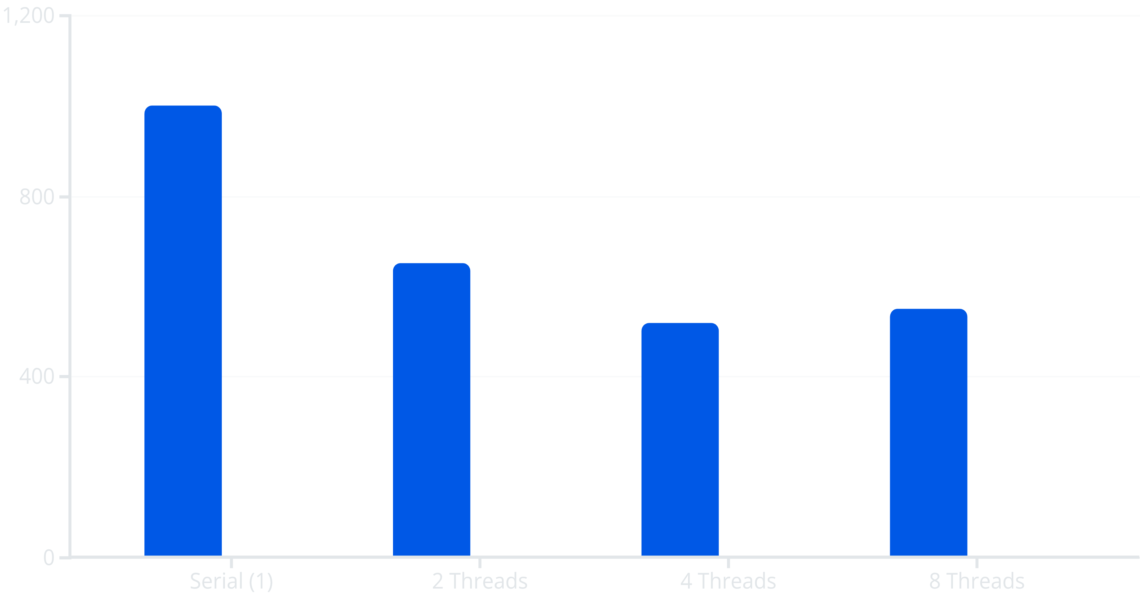
Scalability and Performance Analysis
Execution time decreases with additional threads until saturation at physical core count. Beyond this point, context switching overhead outweighs parallelism benefits.
Execution Time (ms)
Speedup Factor

Slide 19
Key Observations
Analysis across diverse datasets reveals consistent patterns in parallel scaling behavior:
Small Datasets
Large Datasets
Yield minimal performance improvement; thread startup overhead dominates computation time, making parallelization inefficient.
Demonstrate superior scalability; increased computational workload per tree justifies thread management costs, approaching theoretical speedup limits.
Thread Overhead
CPU Utilization
Remains small relative to total training time, validating OpenMP's lightweight design and effectiveness for coarse-grained parallelism.
Excellent scaling efficiency with consistent core utilization across threads, indicating minimal contention or load imbalance.

Slide 20

Conclusion and Future Directions
OpenMP parallelization significantly accelerates random forest training while preserving model accuracy and computational behavior. This approach efficiently leverages modern multi-core processors with minimal code modifications.
Present Achievement
Effective multi-threaded training with maintained accuracy on shared-memory systems.
Distributed Systems
Extend to MPI for cluster computing and large-scale distributed training environments.
GPU Acceleration
Integrate CUDA or OpenACC for heterogeneous computing and further performance gains.
Advanced Optimization
Refine load balancing algorithms and memory hierarchies for real-world datasets at scale.

