Slide 1

MVC Pattern
Object Oriented Software Engineering
Presented By: Vinay P
SRN: PES1PG25CA366

Slide 2
MVC is a software design pattern that separates an application into three distinct layers:
• Model
• View
• Controller
Model View Controller (MVC)

Slide 3
Model: Manages Data and Logic
• Represents application data and business logic.
• Interacts with the database (CRUD operations).
View: Handles User Interface
• Displays data to the user.
• Responsible for rendering the presentation using HTML, CSS, and JavaScript.

Slide 4
Controller: The Mediator
• Acts as an intermediary between Model and View.
• Handles user input.
• Interacts with Model to fetch or update data.
• Passes data to View for display.

Slide 5
Model (Warehouse)
• The Model represents the data and the logic to handle it. Think of it as the warehouse where all the goods (data) are stored.
• It is responsible for managing and updating data. For example:
• What items are available?
• What is the stock quantity?
• Adding or removing items based on demand.
View (Shop or Customer)
• The View is the final interface where the customer (end-user) interacts.
• It could be the shop displaying the products (HTML/CSS) or the person who sees the delivered product.
• The View only presents data and does not process logic.
Controller (Delivery Person)
• The Controller acts as the middleman or mediator.
• Gets the order from the customer (View).
• Fetches the required data from the warehouse (Model).
• Delivers the result back to the customer (View).
MVC Analogy Explanation

Slide 6
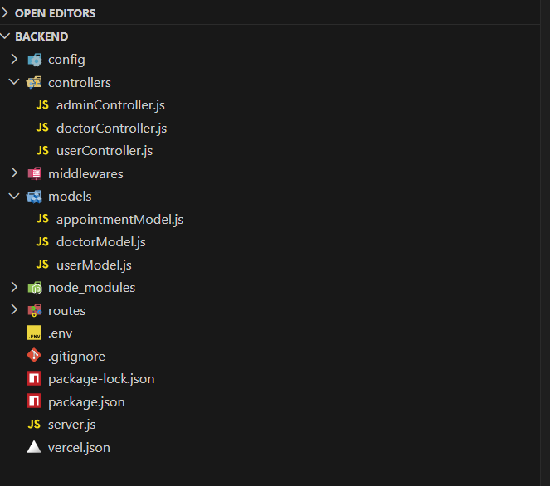
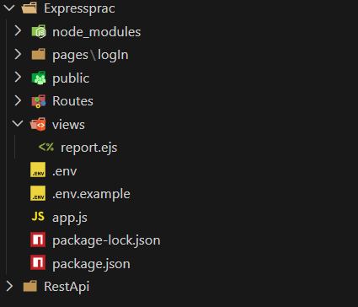
Model, Controller
MVC Application
View

Slide 7
