Slide 1

EFFECTIVE MANAGEMENT FOR BLOCKCHAIN-BASED AGRI-FOOD SUPPLY CHAINS USING DEEP REINFORCEMENT LEARNING
Batch No : 14
Presented by: Project Guide:
Y.YINAY (19BF1A1262) Mrs . N.NALINI, M.Tech
P.C.V.SUBBA REDDY (19BF1A1243) ASSISTANT PROFESSOR
C.BALA KARTHIKEYAN (19BF1A1213)
S.VENKATA GURU PRANAV (19BF1A1256)
DEPARTMENT OF INFORMATION TECHNOLOGY

Slide 2
EFFECTIVE MANAGEMENT FOR BLOCKCHAIN-BASED AGRI-FOOD SUPPLY CHAINS USING DEEP REINFORCEMENT LEARNING

Slide 3
CONTENTS
ABSTRACT
INTRODUCTION
PROBLEM STATEMENT
EXISTING SYSTEM
PROPOSED SYSTEM
SPECIFICATIONS
MODULES
ARCHITECTURE
UML DIAGRAMS
SCREEN LAYOUTS
CONCLUSION

Slide 4
ABSTRACT
In agri-food supply chains (ASCs), consumers pay for agri-food products produced by farmers. During this process, consumers emphasize the importance of agri-food safety while farmers expect to increase their profits. Due to the complexity and dynamics of ASCs, the effective traceability and management for agri-food products face huge challenges. However, most of the existing solutions cannot well meet the requirements of traceability and management in ASCs. To address these challenges, we first design a blockchain-based ASC framework to provide product traceability, which guarantees decentralized security for the agri-food tracing data in ASCs. Next, a Deep Reinforcement learning based Supply Chain Management (DR-SCM) method is proposed to make effective decisions on the production and storage of agri-food products for profit optimization. The extensive simulation experiments are conducted to demonstrate the effectiveness of the proposed blockchain-based framework and the DR-SCM method under different ASC environments. The results show that reliable product traceability is well guaranteed by using the proposed blockchain-based ASC framework. Moreover, the DR-SCM can achieve higher product profits than heuristic and Q-learning methods.

Slide 5
INTRODUCTION
In Agri-Food supply chains there will be two users such as customers who wants to know quality of the product and farmers who wants to maximize their profit by effective management of production details. Blockchain will verify all existing hash codes of all nodes and if block data not alter then all nodes hash code verification will be successful and new transaction will be stored and if verification failed at any node then Blockchain will consider that node as attacked and instruct it to get recovered with genuine blocks. This process is known as proof of work and by using this techniques we can assured customers will get genuine details on product.
Various users may store or view product details in Blockchain such as Seed Providers, Farmers, Processors, Distributors, Retailers and consumers.
In this task traceability face huge challenges, for example all supply and food manufacturing and quality details stored at centralized single server and some malicious users (internal employees) can collect bribes from cheap quality manufacturer to make their product details (fake) as super quality and update centralized server and normal customers will view such fake quality details and trust blindly as there is no one to inform customer about its true quality.

Slide 6
PROBLEM DEFINITION
In this task traceability face huge challenges, for example all supply and food manufacturing and quality details stored at centralized single server and some malicious users(internal employees) can collect bribes from cheap quality manufacturer to make their product details (fake) as super quality and update centralized server and normal customers will view such fake quality details and trust blindly as there is no one to inform customer about its true quality.
Second challenge is how farmers can maximize their profit by efficiently managing their production as there is no one to inform farmers when to sale and when to start production. To overcome from above two challenges author of this paper introduce concept called DR-SCM(Deep Reinforcement learning based Supply Chain Management) which utilizes two different technologies such as Block chain and Deep Reinforcement learning.

Slide 7
EXISTING SYSTEM
The existing Traditional agri-food supply chain management typically involves manual processes, limited use of technology, and a lack of integration between different stages of the supply chain. Some of the commonly used systems in traditional agri-food supply chain management include pen and paper, excel sheets, traditional transportation, phone calls and emails which are very in efficient in tracking of supply chain and make problems more complex.
Overall, traditional agri-food supply chain management systems are characterized by a lack of integration and coordination between different stages of the supply chain, which can lead to inefficiencies, delays, and waste. However, it is important to note that many farmers and small-scale producers still rely on these systems due to limited access to technology and resources.

Slide 8
DISADVANTAGES
Lack of Transparency: The agri-food supply chain is often complex and opaque, making it challenging to track the origin, quality, and safety of food products.
Food Safety Concerns: The agri-food supply chain is prone to food safety issues, such as contamination, spoilage, and adulteration, which can harm public health and reduce consumer trust in the industry.
Labor Exploitation: The agri-food supply chain can involve labor exploitation, including forced labor, child labor, and poor working conditions, particularly in developing countries.
Inefficient Distribution: The agri-food supply chain can suffer from inefficiencies, such as overproduction and waste, due to inadequate distribution and storage systems
Environmental Impact: The agri-food supply chain can have a significant environmental impact due to the use of resources such as water, land, and energy, as well as the production of greenhouse gas emissions.

Slide 9
PROPOSED SYSTEM
We first design a blockchain-based ASC framework to provide product traceability, which guarantees decentralized security for the agri-food tracing data in ASCs. Next, a Deep Reinforcement learning based Supply Chain Management (DR-SCM) method is proposed to make effective decisions on the production and storage of agri-food products for profit optimization. The extensive simulation experiments are conducted to demonstrate the effectiveness of the proposed blockchain-based framework and the DR-SCM method under different ASC environments. The results show that reliable product traceability is well guaranteed by using the proposed blockchain-based ASC framework. Moreover, the DR-SCM can achieve higher product profits than heuristic and Q-learning methods.

Slide 10
ADVANTAGES
Increased efficiency: The project can improve the efficiency of the agri-food supply chain by optimizing the supply chain operations using deep reinforcement learning algorithms. This can result in reduced costs, improved delivery times, and enhanced quality of food products. •
Enhanced transparency and trust: The project can enhance the transparency and trust among the stakeholders in the agri-food supply chain, such as farmers, retailers, and consumers. This can lead to more efficient and reliable transactions, reducing fraud and increasing the accuracy of information.
Reduced waste: The project can help to reduce waste in the food industry by optimizing the supply chain operations and ensuring that the right amount of food products are produced and delivered at the right time. This can help to reduce food waste, which is a significant challenge for the food industry.

Slide 11
MODULES
In this project they have designed above two techniques as simulation so we also implemented this project as simulation and this project consists of following modules
Save ASC Details in Blockchain: using this module we will take product details from users such as farmers, providers, and processors and then store all this details in Blockchain and will Blockchain will store this data as blocks of transaction and for each block it will generate hash code and verified with previous block hash code.
Get ASC Details from Blockchain: using this module all users can read or extract details from Blockchain.
Deep Reinforcement Learning Simulation: using this module we will feed current agriculture stock data to DRL algorithm and then this algorithm will trained itself on available stock and then predict STOCK manufacturing or SALE to farmer.

Slide 12
MODULES
Rewards Graph: for each correct prediction DRL will rewards to its decision and for each wrong prediction DRL will get 0 or penalty deduction and the higher the reward the correct is the prediction. In DRL we will take current stock quantity as STATE and producing or selling STOCK will be action.
Blockchain Computation Graph: using this module we will plot Blockchain hash computation time graph.
Get All Blockchain Products ID: using this module we can get all product ID’s stored in Blockchain.

Slide 13
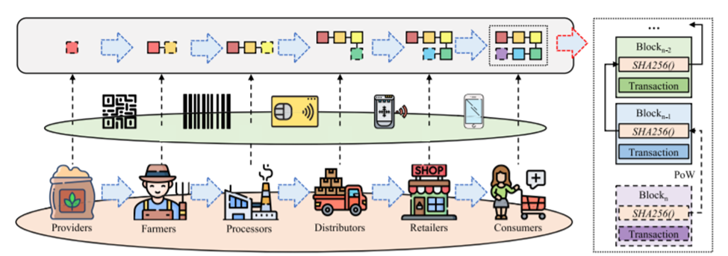
ARCHITECTURE

Slide 14
UML DIAGRAMS

Slide 15
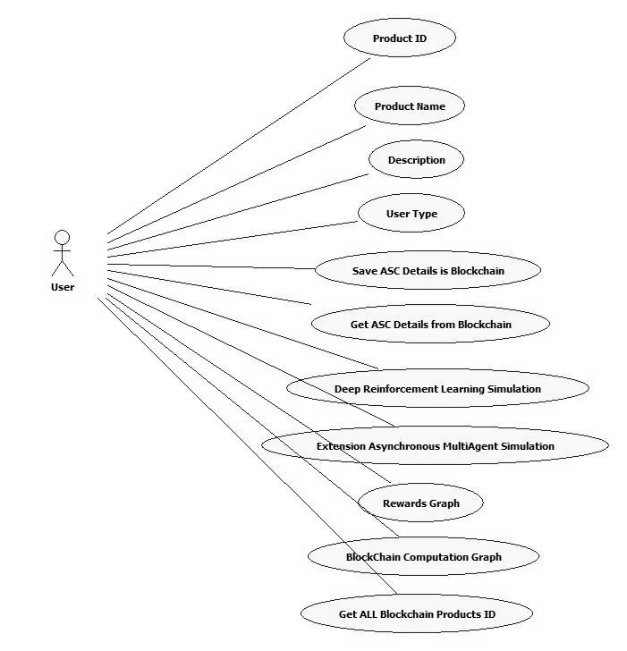
USE CASE DIAGRAM

Slide 16
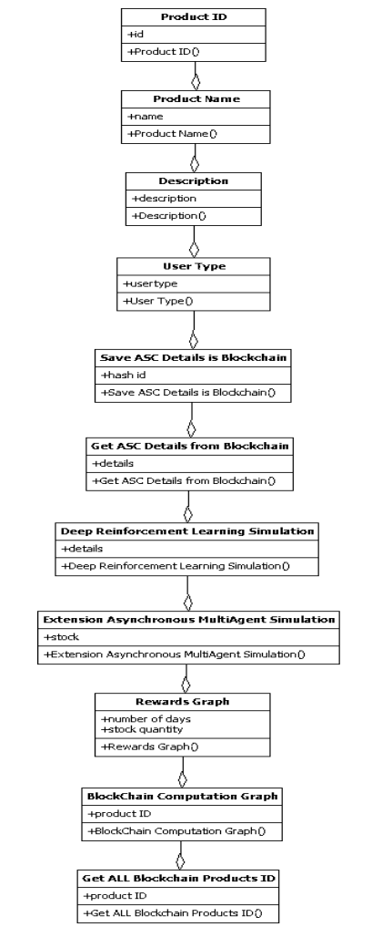
CLASS DIAGRAM

Slide 17
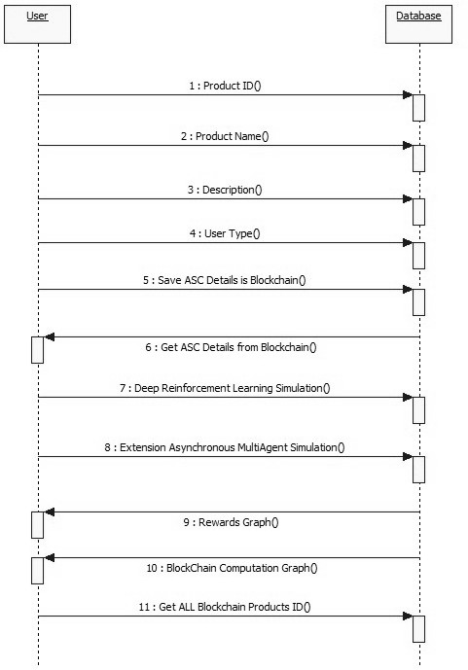
SEQUENCE DIAGRAM

Slide 18
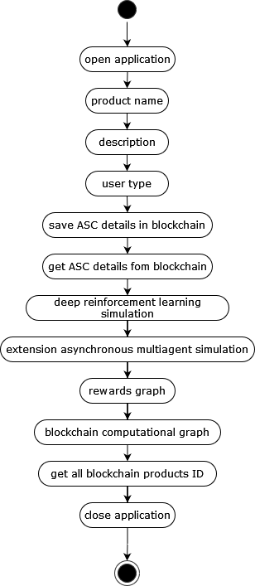
ACTIVITY DIAGRAM

Slide 19
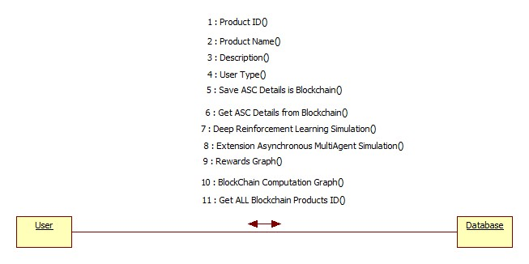
COLLABORATION DIAGRAM

Slide 20
SPECIFICATIONS
HARDWARE REQUIREMENTS:
System : i5 Processor.
Hard Disk : 512 GB.
Input Devices : Keyboard, Mouse, Scanner.
RAM : 4 GB.
SOFTWARE REQUIREMENTS:
Operating system : Windows 10.
Coding Language : Python.
Libraries : Numpy, Matplotlib, keras, Tkinter.
IDE : Jupyter notebook.

Slide 21
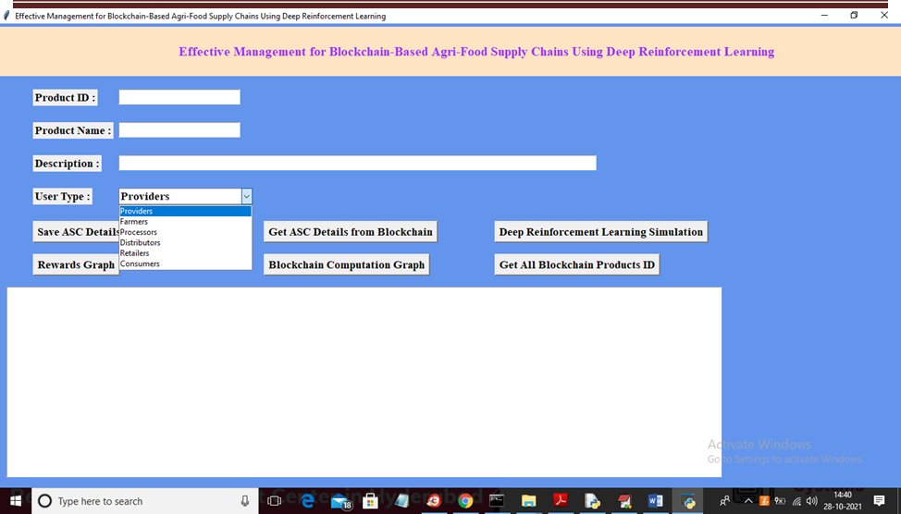
SCREEN LAYOUT

Slide 22
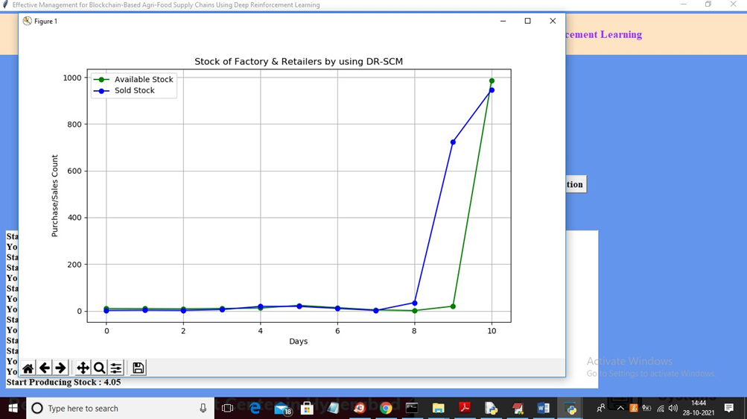

Slide 23
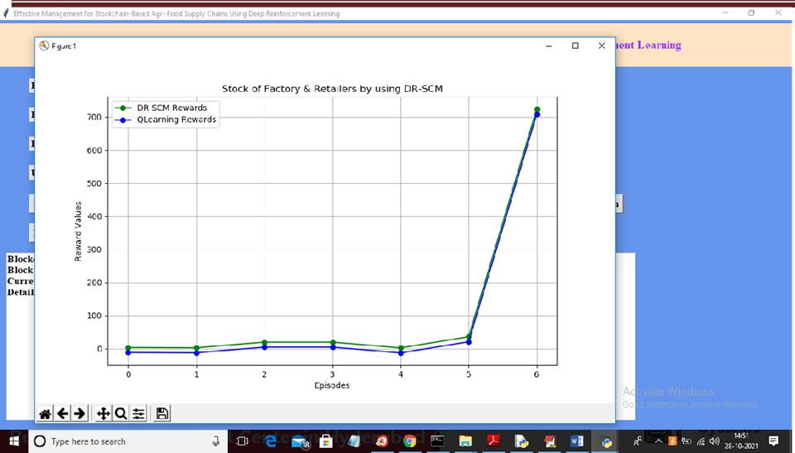

Slide 24
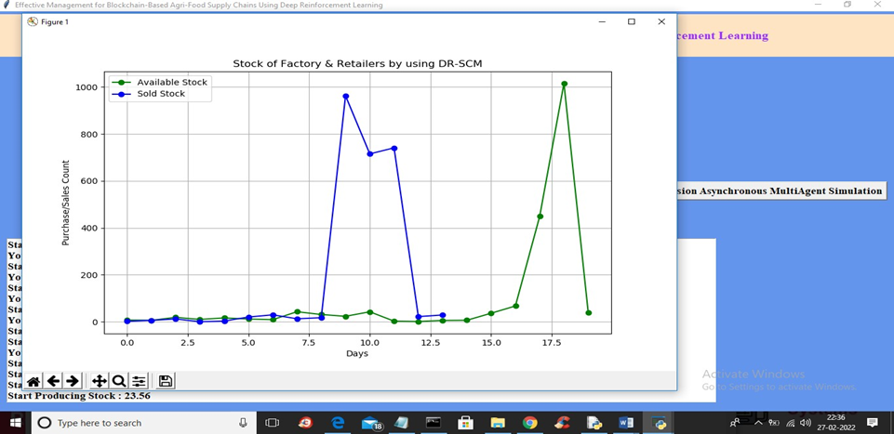

Slide 25
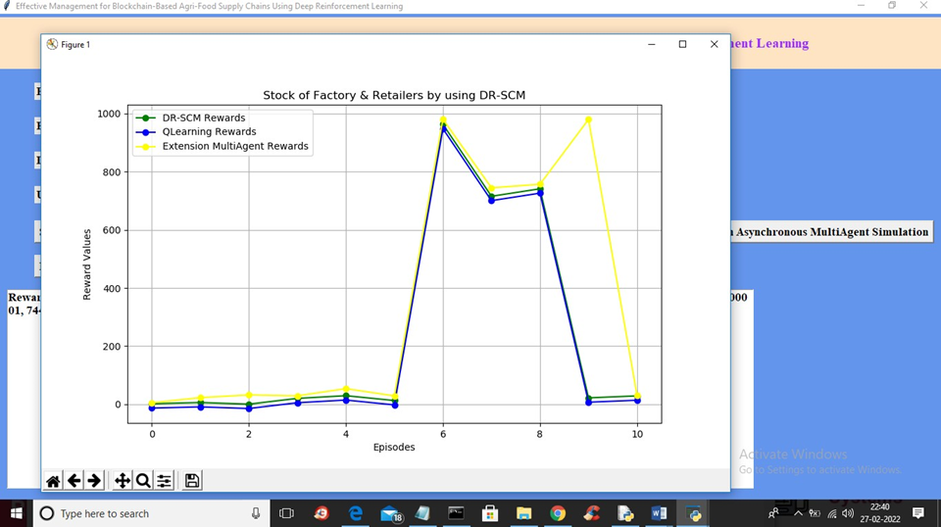

Slide 26
CONCLUSION
The project's objective is to create a blockchain-based framework to ensure agri-food safety and traceability in ASC systems. To optimize product profits in ASCs, a DR-SCM method is proposed to make decisions on agri-food production and storage. Extensive simulation experiments validate the effectiveness of the proposed framework and the DR-SCM method in optimizing ASCs. The DR-SCM method outperforms common heuristic and Q-learning methods in terms of rewards and learning efficiency in various ASC management scenarios. Additionally, it offers higher flexibility in arranging production and storage. In a real-world ASC environment, the DR-SCM method can perform macro-control for the production and storage of agricultural products based on changing consumer demands and costs. By maintaining production availability for retailers in a cost-effective way, the stock of retailers can satisfy consumers' demands effectively. The DQN algorithm's experience replay mechanism facilitates convergence, but the strong relevance of experience data in playback memory can cause low training efficiency in achieving optimal performance.

Slide 27
ANY QUERIES

Slide 28
THANK YOU

