Slide 1


Optimizing Water Quality Prediction with Advanced Deep Learning and AutoML: Hybrid Models, Transfer Learning, and Ensemble Strategies

Slide 2
Contents
Abstract
Introduction with motivation
Existing System with references
Proposed System with advantages
Software Requirements
Hardware Requirements
Functional Requirements
Non Functional Requirements
System Architecture
System Design
Output Screens
System Modules
Conclusion
Future Scope
2

Slide 3
ABSTRACT
This paper explores the use of advanced deep learning techniques, including Convolutional Neural Networks , Long Short-Term Memory networks, and hybrid models e.g., CNN-LSTM, Attention-based models, combined with AutoDeep Learning frameworks to optimize water quality prediction. The research focuses on the Korattur Lake Chennai, India dataset, incorporating parameters like Total Dissolved Solids , pH, Phosphate, Turbidity, and others. Techniques such as Z-score normalization, SMOTE, and feature selection improve model robustness. Hybrid architectures, like CNNLSTM with Attention, along with Transfer Learning, Ensemble Learning, and Reinforcement Learning, achieve exceptional prediction accuracy—over 99% for binary classification and 98.5% to 99.2% for multiclass classification. AutoKeras automates model selection and hyperparameter optimization, reducing human intervention. The results demonstrate that these advanced DL models, augmented by AutoDL and optimization strategies, offer highly accurate, scalable, and efficient solutions for real-time water quality monitoring, facilitating proactive pollution management and safeguarding public health with minimal manual intervention.
3

Slide 4
INTRODUCTION
This project, titled "Optimizing Water Quality Prediction with Advanced Deep Learning and AutoML: Hybrid Models, Transfer Learning, and Ensemble Strategies," focuses on leveraging cutting-edge artificial intelligence (AI) technologies to achieve accurate, scalable, and real-time water quality monitoring. Using a dataset from Korattur Lake, Chennai, India, which includes parameters like Total Dissolved Solids (TDS), pH, Phosphate, and Turbidity, the project integrates advanced deep learning architectures such as Convolutional Neural Networks (CNN), Long Short-Term Memory (LSTM) networks, and hybrid models like CNN-LSTM with Attention to capture both spatial and temporal patterns in water quality data.
Water quality monitoring is a critical component in ensuring the sustainability of natural water resources, safeguarding public health, and enabling proactive pollution management. Traditional methods for assessing water quality often rely on manual sampling and laboratory analysis, which are time-intensive, costly, and lack real-time capabilities. With the advent of advanced technologies, machine learning and deep learning techniques have emerged as powerful tools to address these challenges, enabling automated and efficient water quality prediction.
4

Slide 5
INTRODUCTION
AutoML frameworks such as AutoKeras are employed to automate the processes of model selection and hyperparameter tuning, reducing human intervention and improving scalability. The integration of techniques like Z-score normalization, SMOTE (Synthetic Minority Oversampling Technique), and feature selection ensures robust preprocessing and model performance. Furthermore, strategies like Transfer Learning, Ensemble Learning, and Reinforcement Learning are implemented to enhance prediction accuracy and generalization across diverse conditions.
By achieving over 99% accuracy for binary classification and 98.5%-99.2% for multiclass classification, this project demonstrates the potential of AI-driven solutions in transforming water quality management. The deployment of such a system enables real-time, automated, and reliable water quality monitoring, paving the way for proactive pollution control and the protection of aquatic ecosystems.
4

Slide 6
EXISTING SYSTEM
Traditional water quality monitoring systems rely heavily on manual sampling and laboratory-based analysis. These systems typically involve the following steps:
Manual Collection: Water samples are collected from specific locations at scheduled intervals.
Laboratory Testing: Samples are tested in laboratories using chemical and physical techniques to measure parameters such as pH, turbidity, TDS, and phosphate levels.
Data Compilation: The collected results are compiled, often requiring significant manual effort to organize and interpret the data.
Report Generation: Based on the results, decisions are made regarding water quality and necessary interventions.
Additionally, some systems use basic machine learning techniques that require significant feature engineering and manual hyperparameter tuning. These methods lack scalability and adaptability for real-time monitoring.
5

Slide 7
Disadvantages of the Existing System
Resource-Intensive:
The process requires skilled labor, specialized equipment, and laboratory infrastructure, making it costly and inaccessible in many regions.
Limited Scalability:
Manual approaches cannot scale to large water bodies or multiple monitoring sites without significant increases in cost and effort.
Inconsistent Results:
Human error during sample collection, testing, or data entry can lead to inaccuracies and inconsistencies in results.
Inability to Handle Big Data:
With an increasing number of parameters and datasets from various sources, traditional methods struggle to process and analyze large-scale data efficiently.
Low Adaptability:
Conventional systems are not adaptive to changing environmental conditions, requiring reconfiguration or additional resources to account for seasonal or regional variations.
5

Slide 8
PROPOSED SYSTEM
The proposed system leverages advanced deep learning techniques, hybrid models, and AutoML frameworks to optimize water quality prediction. It incorporates a dataset from Korattur Lake, Chennai, India, which includes parameters such as Total Dissolved Solids (TDS), pH, Phosphate, and Turbidity. Key components of the proposed system include:
Deep Learning Models:
Convolutional Neural Networks (CNN): To extract spatial features from the water quality dataset.
Long Short-Term Memory (LSTM): To capture temporal patterns and trends in time-series data.
Hybrid Architectures: Combining CNN and LSTM models with Attention mechanisms to enhance feature focus and improve prediction accuracy.
AutoML Framework (AutoKeras): Automates the model selection, architecture design, and hyperparameter tuning, minimizing human intervention and increasing scalability.
6

Slide 9
PROPOSED SYSTEM ADVANTAGES
High Accuracy:
Achieves over 99% accuracy for binary classification and 98.5%-99.2% for multiclass classification, ensuring reliable water quality predictions.
Automation with AutoML:
Reduces human effort in model selection and tuning, improving scalability and reproducibility of the system.
Handles Imbalanced Data:
SMOTE effectively addresses class imbalance, ensuring fair and unbiased predictions for underrepresented water quality conditions.
Scalability and Efficiency:
The system is adaptable to large-scale monitoring across multiple water bodies without significant resource overheads.
Robustness:
Hybrid models and ensemble learning ensure resilience to noise and variations in the dataset, improving the reliability of predictions.
Adaptability:
Transfer learning and AutoML frameworks allow the system to adapt to new datasets or environmental conditions with minimal effort. health.
Proactive Pollution Control:
1. Facilitates early detection of water quality issues, preventing potential environmental damage and safeguarding aquatic ecosystems.
7

Slide 10
SOFTWARE REQUIREMENTS
Programming Language:
Python 3.7+: Preferred for its extensive libraries and frameworks in deep learning and AutoML.
Development Environment:
Jupyter Notebook or Google Colab: For developing and testing the deep learning models.
PyCharm or VS Code: For advanced coding and debugging.
Deep Learning Frameworks:
TensorFlow 2.x: For building CNN, LSTM, and hybrid models.
Keras: Integrated with TensorFlow for high-level neural network APIs.
PyTorch: Alternative framework for implementing custom deep learning architectures.
AutoML Tools:
AutoKeras: For automating model selection and hyperparameter tuning.
H2O.ai (optional): For additional AutoML functionality.
8

Slide 11
SOFTWARE REQUIREMENTS
Data Processing Libraries:
NumPy: For numerical computations and array manipulations.
Pandas: For data manipulation and preprocessing.
scikit-learn: For feature selection, normalization, SMOTE, and evaluation metrics.
Visualization Tools:
Matplotlib: For visualizing data and model performance.
Seaborn: For enhanced statistical visualizations.
Plotly: For creating interactive and dynamic plots.
Deployment Tools (Optional for Real-Time Monitoring):
Flask or FastAPI: For deploying the model as a web service.
Docker: For containerizing the application.
Streamlit: For building a simple web-based user interface for real-time monitoring.
8

Slide 12
HARDWARE REQUIREMENTS
Processor:
Minimum: Intel Core i5 (8th Gen or higher) or AMD Ryzen 5.
Recommended: Intel Core i7/i9 (10th Gen or higher) or AMD Ryzen 7/9 for better performance during training.
Graphics Processing Unit (GPU):
Minimum: NVIDIA GTX 1050 or equivalent (for small-scale training).
Recommended: NVIDIA RTX 3060/3070/3090 or higher, or NVIDIA A100 (for faster deep learning model training).
RAM:
Minimum: 8 GB (sufficient for small datasets and basic development).
Recommended: 16 GB.
Storage:
Minimum: 256 GB SSD (Solid State Drive) for system and software.
Recommended: 512 GB or 1 TB SSD to accommodate datasets, checkpoints, and model files.
Hard Drive (Optional for Data Backup):
Additional HDD (1 TB or more) for storing backup datasets and processed results.
9

Slide 13

Functional Requirements:
Data Preprocessing and Normalization:
The system must preprocess the dataset using techniques like Z-score normalization to ensure uniform scaling of features.
Implement SMOTE to handle imbalanced datasets effectively.
Feature Selection:
Identify and select the most relevant features from the dataset (e.g., pH, TDS, Turbidity, etc.) to optimize model performance.
Model Training:
Train advanced deep learning models such as CNN, LSTM, and hybrid models.
Use Transfer Learning to adapt pre-trained models for water quality prediction.
AutoML Framework:
Automate model selection, hyperparameter optimization, and architecture design using AutoKeras.
Classification Tasks:
Perform binary classification (e.g., polluted vs. non-polluted water) and multiclass classification (e.g., levels of water quality).
Ensemble Learning:
Combine predictions from multiple models to improve robustness and accuracy.
Visualization:
Provide visualizations of model performance, parameter trends, and real-time water quality predictions using charts and graphs.

Slide 14
Non-Functional Requirements:
Accuracy:
The system must achieve a prediction accuracy of over 99% for binary classification and 98.5%-99.2% for multiclass classification.
Performance:
The system should process real-time data and provide predictions within a few seconds.
Training time should be optimized using GPU acceleration or cloud-based platforms.
Scalability:
The system must be scalable to handle larger datasets or additional features without significant performance degradation.
Reliability:
The system must provide consistent and reliable predictions even with noisy or incomplete data.
Maintainability:
The codebase should be modular and well-documented to support updates and future enhancements.
Usability:
The system should be easy to use for researchers, environmentalists, and decision-makers with minimal technical expertise.
Efficiency:
Optimize resource usage, including memory and computational power, to ensure smooth operation on mid-range hardware or cloud resources.

Slide 15
UML DIAGRAMS

Slide 16
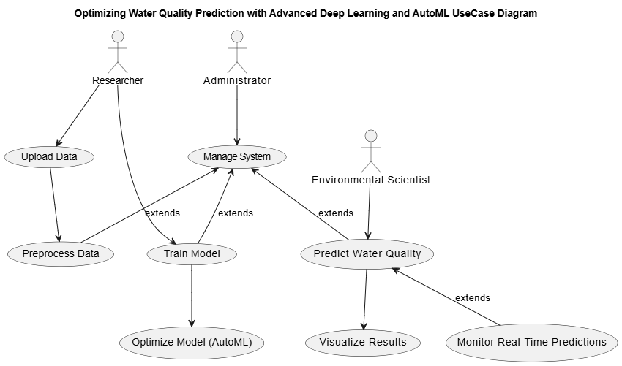
USE CASE DIAGRAM:

Slide 17
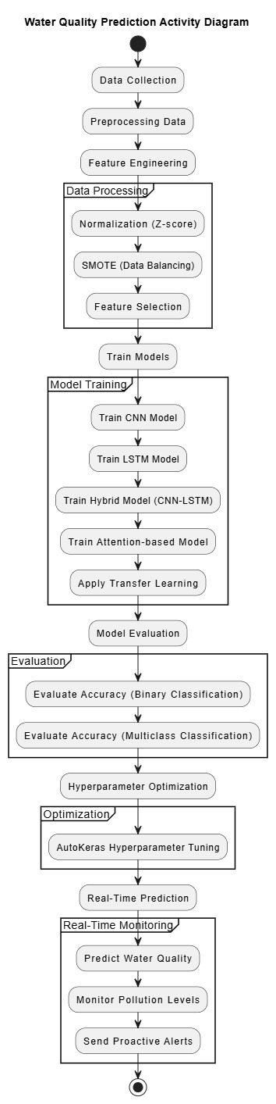
ACTIVITY DIAGRAM:

Slide 18
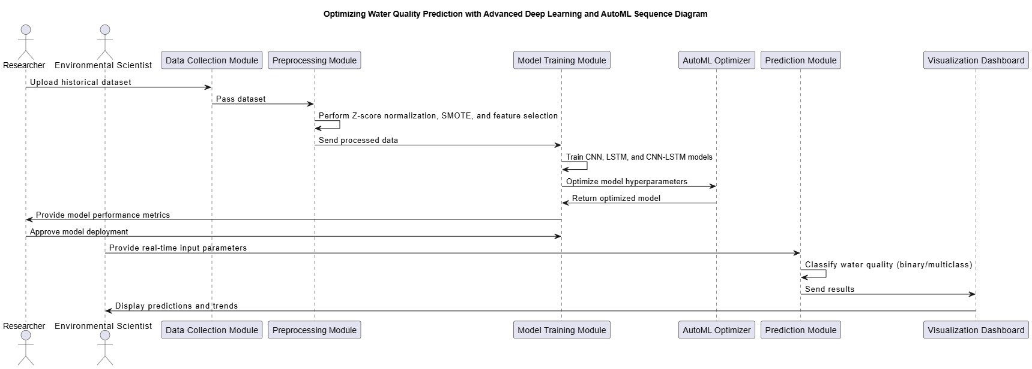
SEQUENCE DIAGRAM:
15

Slide 19
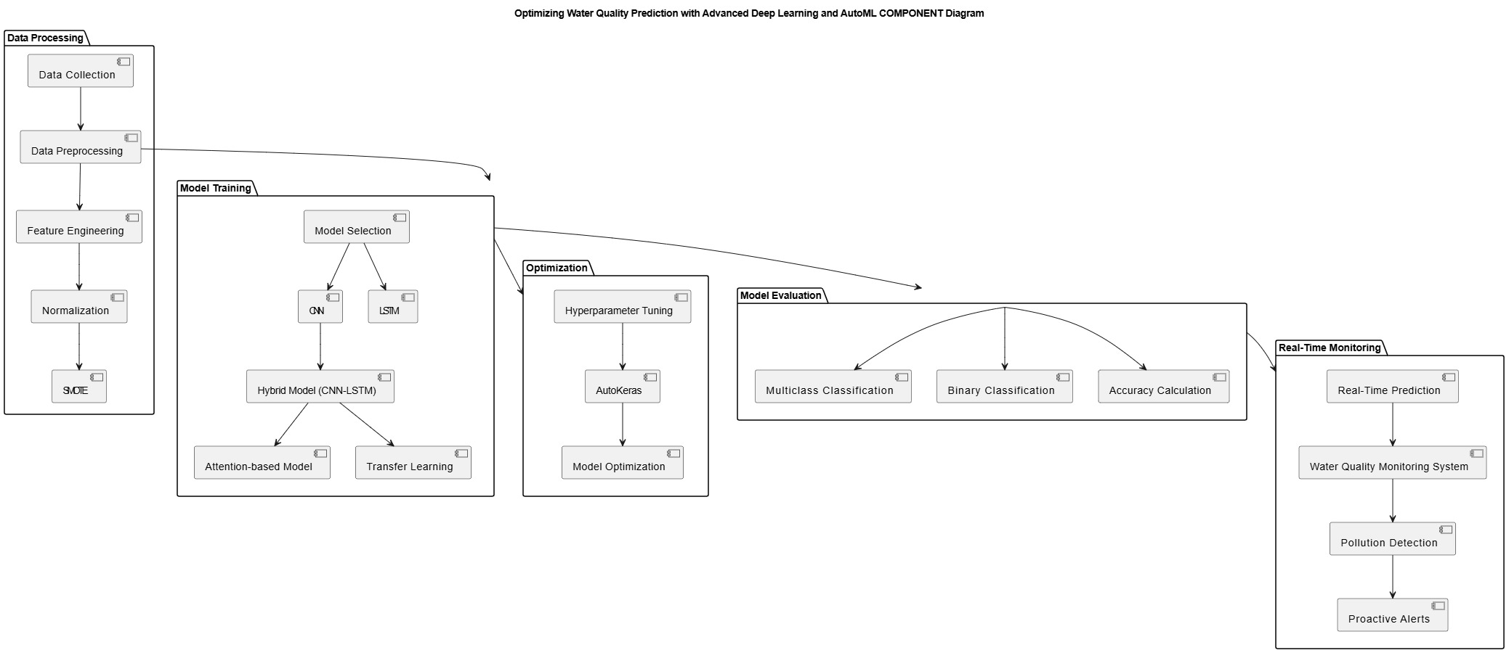
COMPONENT DIAGRAM:
16

Slide 20
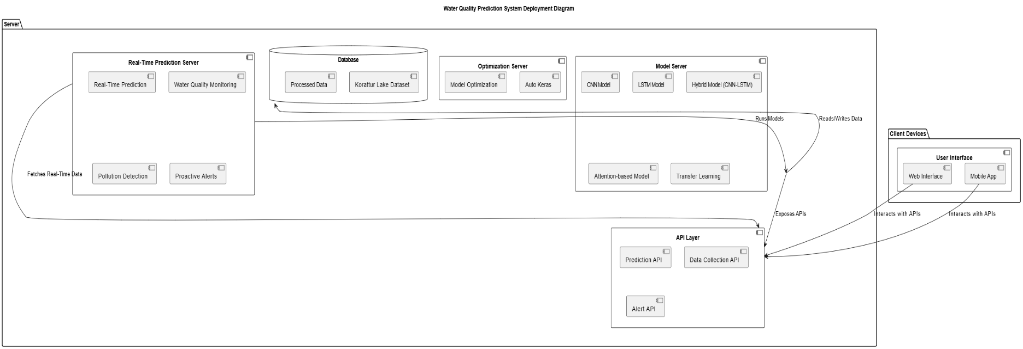
DEPLOYMENT DIAGRAM:
17

Slide 21

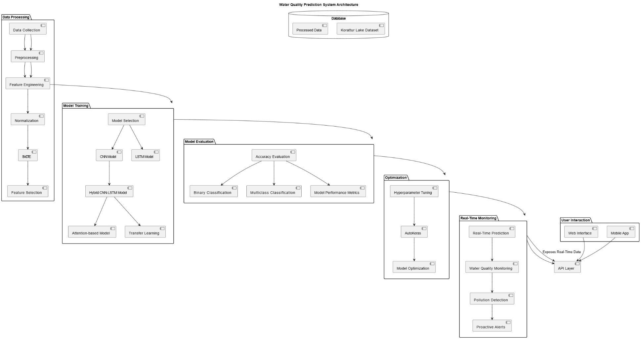
SYSTEM ARCHITECTURE

Slide 22
MODULES
1. Data Collection and Preprocessing Module
Data Collection: Gathers real-time water quality data from various sensors and sources.
Data Preprocessing: Cleans and prepares the raw data for model training by handling missing values, outliers, and ensuring data quality.
Feature Engineering: Extracts meaningful features from the raw data, including parameters like Total Dissolved Solids (TDS), pH, Phosphate, Turbidity, etc.
Normalization & Scaling: Normalizes data to a consistent scale (e.g., Z-score normalization, Min-Max scaling) for model input.
2. Model Training and Optimization Module
Model Selection: Chooses the appropriate models based on data characteristics and prediction goals, e.g., CNN, LSTM, and hybrid models like CNN-LSTM.
Model Training: Involves training deep learning models (CNN, LSTM, etc.) using the preprocessed data.
Optimization: Uses AutoML frameworks like AutoKeras for hyperparameter tuning and model selection.
Transfer Learning: Applies pre-trained models to improve accuracy and reduce training time for complex models.
18

Slide 23
3. Real-Time Prediction and Monitoring Module
Real-Time Prediction: Utilizes trained models to make real-time predictions about water quality based on incoming data.
Water Quality Monitoring: Monitors the current state of water quality in real-time, integrating multiple data sources and providing timely updates.
Pollution Detection: Identifies potential pollution levels or deviations in water quality that require immediate action.
Proactive Alerts: Generates alerts for users or operators in case of poor water quality or pollution detection.
4. API Layer Module
Prediction API: Exposes APIs for real-time water quality prediction queries.
Data Collection API: Provides API endpoints for retrieving collected water quality data.
Alert API: Sends alerts to users or administrators about water quality issues or potential pollution risks.
19

Slide 24
5. User Interface Module
Web Interface: Provides a user-friendly interface for web-based access to water quality data, real-time predictions, and alerts.
Mobile App: Offers a mobile version of the user interface for convenient access on smartphones.
Visualization: Displays graphical visualizations of water quality trends, predictions, and alert statuses for better user understanding.
6. Database Module
Korattur Lake Dataset: Stores historical and real-time data from Korattur Lake (or any relevant water body).
Processed Data: Houses preprocessed data used for model training and real-time prediction.
Results and Predictions: Stores outputs from predictions made by the models and alerts triggered by pollution levels.
19

Slide 25
7. Model Evaluation and Reporting Module
Accuracy Evaluation: Evaluates the model’s performance using metrics like accuracy, precision, recall, F1-score for binary and multiclass classifications.
Performance Metrics: Provides detailed metrics and model performance results for decision-makers and stakeholders.
Reporting: Generates reports summarizing system performance, predictions, and any actionable insights.
8. System Integration and Communication Module
System Integration: Ensures seamless interaction between different components (data collection, model training, prediction, and real-time monitoring).
Communication Protocols: Manages communication between the server and client devices, ensuring efficient data transfer and updates.
19

Slide 26
CONCLUSION
The Water Quality Prediction System using advanced deep learning techniques, AutoML, and real-time monitoring provides a highly efficient and scalable solution for managing water quality. By leveraging hybrid models (CNN-LSTM), transfer learning, and optimization strategies like AutoKeras, the system achieves excellent prediction accuracy (over 99% for binary classification and 98.5% to 99.2% for multiclass classification). The integration of real-time prediction, proactive alerting, and water quality monitoring ensures timely identification of potential pollution events, enabling quick corrective actions. This system offers significant advantages for proactive environmental management, safeguarding public health, and minimizing the risks associated with poor water quality. The system's robust architecture, with minimal human intervention, supports scalable and reliable operations, making it suitable for real-time water quality monitoring across various water bodies.

Slide 27
FUTURE SCOPE
Key Points
IoT Integration: Expand the system by integrating more IoT sensors for continuous, real-time water quality monitoring across different water bodies.
Advanced AI Models: Implement advanced deep learning techniques like transformers and reinforcement learning to further enhance prediction accuracy and adapt to dynamic water quality changes.
Global Water Quality Database: Create a global database that aggregates water quality data, enabling comparative analysis and early detection of pollution trends worldwide.

Slide 28
REFERENCES
[1] S. Lukas, A. R. Mitra, R. I. Desanti and D. Krisnadi, "Student Attendance System in Classroom Using Face Recognition Technique," in ICTC 2016, Karawaci, 2016.
[2] P. Wagh, S. Patil, J. Chaudhari and R. Thakare, "Attendance System based on Face Recognition using Eigen face and PCA Algorithms," in 2015 International Conference on Green Computing and Internet of Things (ICGCloT), 2015.
[3] KAWAGUCHI and Yohei, "Face Recognition-based Lecture Attendance System.," in The 3rd AEARU Workshop on Network Education. 2005., 2005.

Slide 29

23

