Slide 1
WEEK 2 · SESSION 1
ConOps / Requirements
Session 1: From needs to operations: ConOps, scenarios and capabilities
Today: the concept of operations, scenarios and capabilities, then the two levels of requirement
Session 2: writing, checking and tracing requirements; measures; the Lab L2 launch
Your Team Record grows: ConOps, scenarios, capabilities, requirements, measures

Slide 2
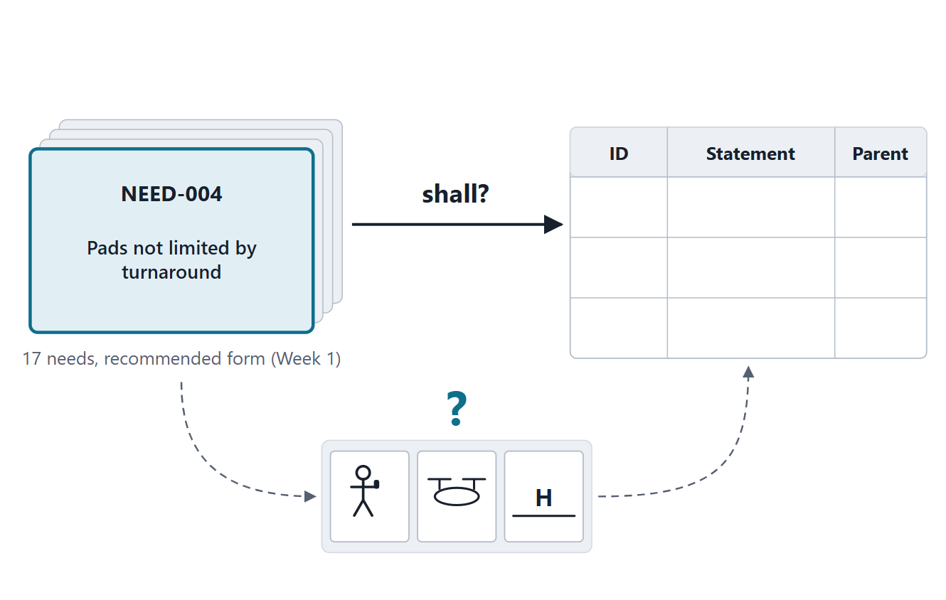
The driving question: can we write requirements now?
SCENARIO (FICTIONAL)
AeroLink has 17 well-formed needs. A team member proposes to write the “shall” statements now.
A · Yes: the needs are complete
B · First describe how the service will be operated
C · First choose the technology
D · Cannot tell yet
Figure. AeroLink ends Week 1 with 17 needs in the recommended form. Can the team go straight to “shall”? (FICTIONAL)

Slide 3
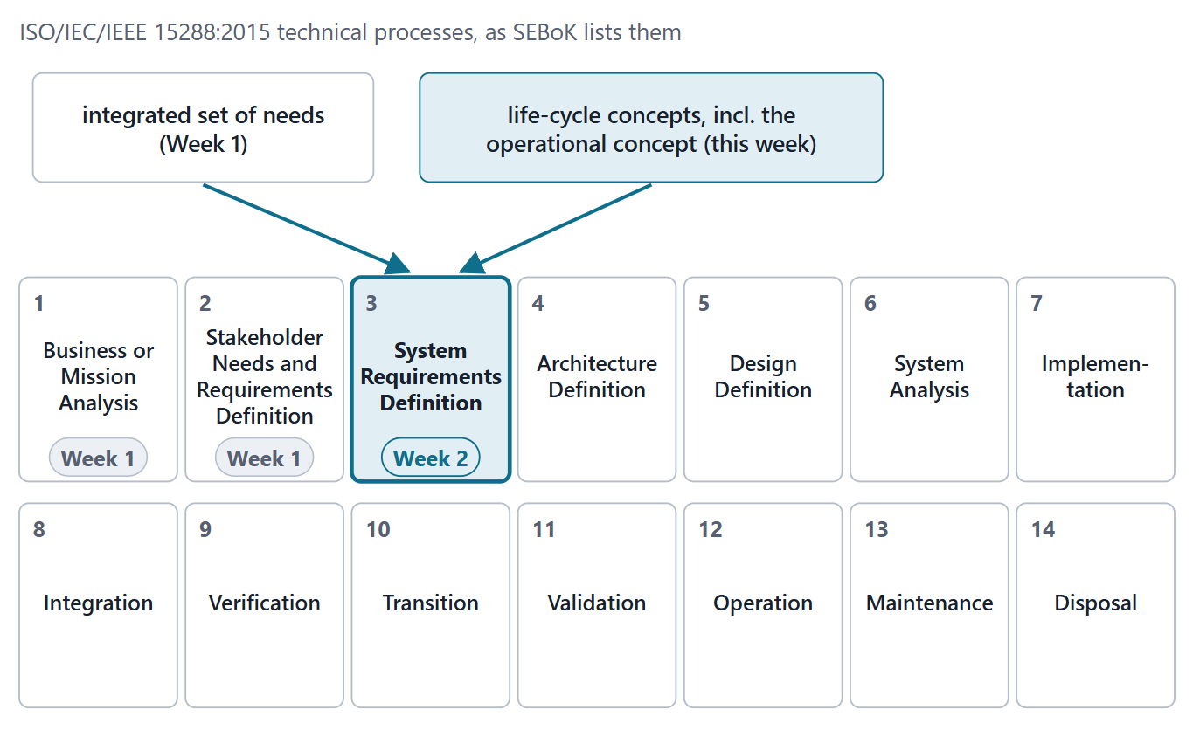
Where Week 2 sits in the process frame
System Requirements Definition: the third technical process
It turns the stakeholder view into a technical, developer view
Inputs: life-cycle concepts and the integrated set of needs
The operational concept is one of those life-cycle concepts
Figure. The ISO/IEC/IEEE 15288:2015 technical processes as SEBoK lists them. Week 2 works in the third, System Requirements Definition, which takes two inputs.
Sources: R98 p.1001; R13 p.557; R13 p.561; R10 p.546

Slide 4
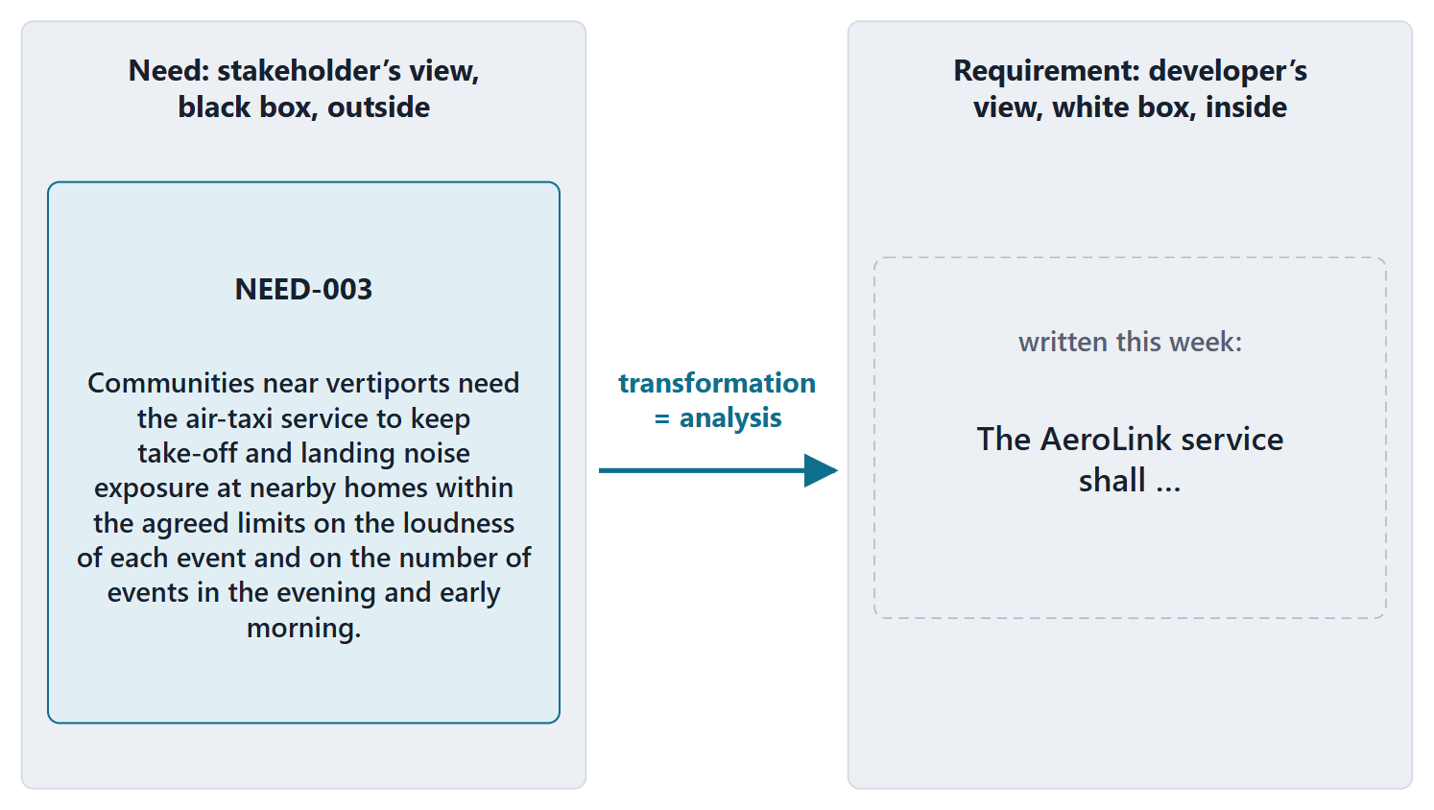
Retrieval: needs are the black box, requirements the white box
Needs: what stakeholders expect, from the outside (black box)
Requirements: what the system must do, from the inside (white box)
CARD QUESTION
“The air-taxi service shall keep pad-edge noise at or below 65 dBA.” Need or requirement? Who is speaking?
Figure. The same concern from two sides: the residents’ need (Week 1) and the requirement this week will write.
Sources: R13 p.558

Slide 5
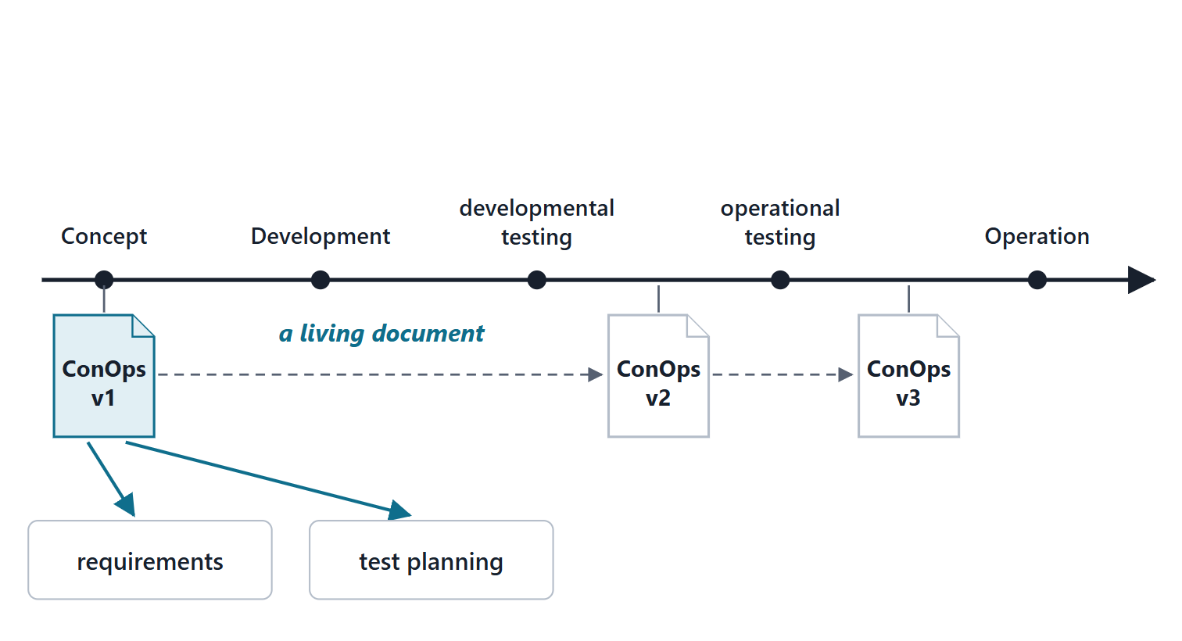
What a ConOps is, and why it comes before requirements
A user-oriented document: the proposed system from the user’s perspective
Operational needs, desires and expectations, without the technical solution
Often a first step toward system requirements
States critical top-level performance objectives, with rationale
Updated after developmental and operational testing
Figure. The ConOps is drafted at concept and revised after developmental and operational testing; it feeds the requirements and the test planning.
Sources: R52 p.298–299

Slide 6
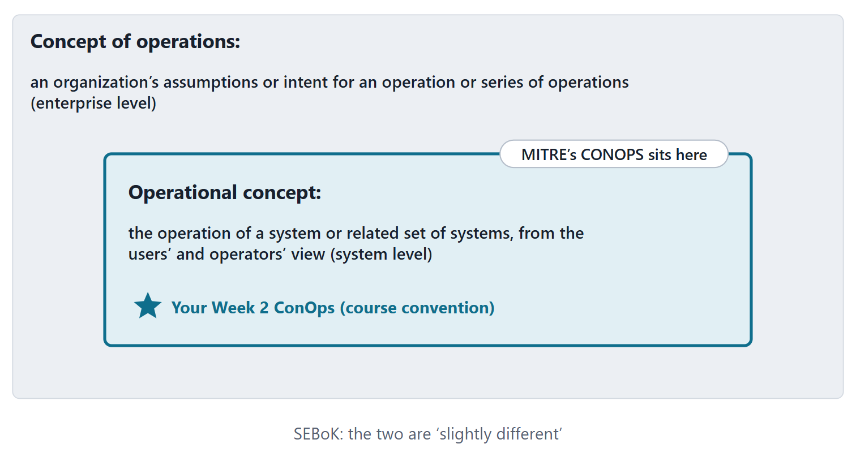
Three names: concept of operations, operational concept, CONOPS
Concept of operations: an organization’s intent for an operation or series of operations
Operational concept: the same, for a system or related set of systems
MITRE’s CONOPS: user-oriented, about a proposed system
Course convention: your ConOps is the operational concept of your system of interest
Figure. Two levels of statement in the SEBoK glossary, and where MITRE’s CONOPS and the team’s Week 2 ConOps sit.
Sources: R39m p.1469; R39g p.1579; R52 p.298

Slide 7
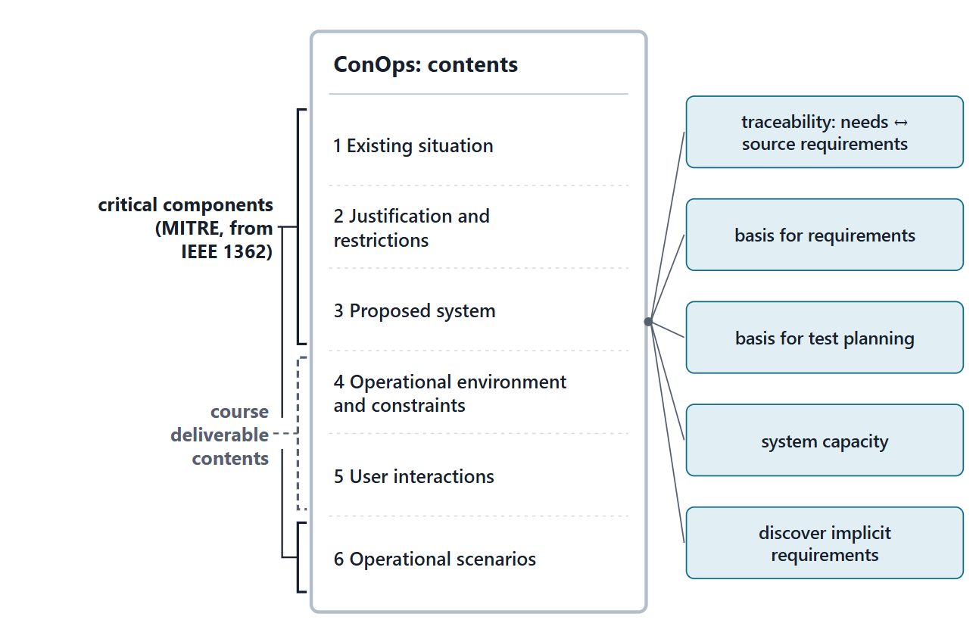
What every ConOps must contain
Critical components (MITRE, from IEEE 1362):
  the existing system; the justification and restrictions
  the proposed system; scenarios in the user’s environment
Objectives: traceability, a basis for requirements and test planning, system capacity, implicit requirements
Course deliverable: mission, environment, scenarios, user interactions, constraints
Figure. A ConOps table of contents. Each part serves an objective MITRE names; parts 4–5 are the course’s additions to the critical components.
Sources: R52 p.300–301

Slide 8
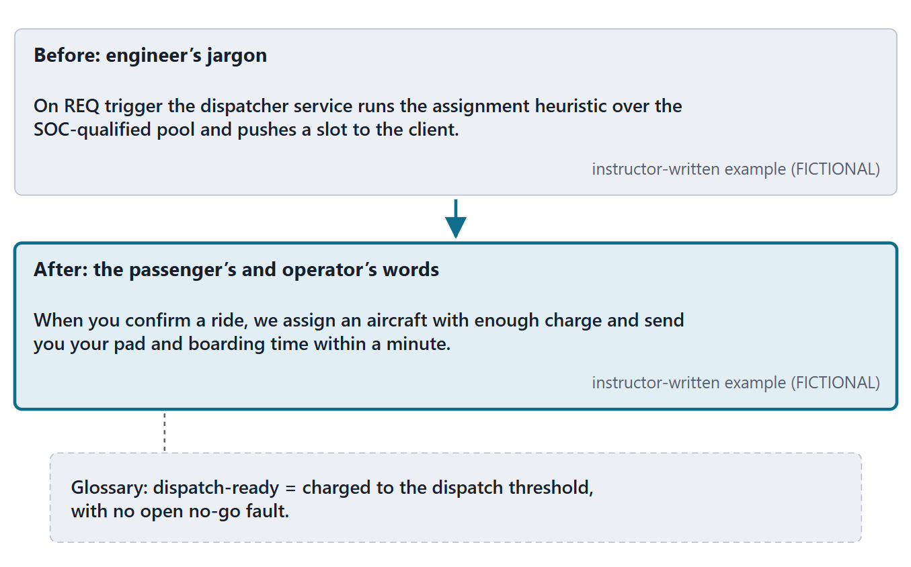
Writing it well: the user’s language, environment, constraints
The user’s perspective and language; a glossary for jargon
Simple, clear and graphic: use cases, storyboards, sequence charts
The operational environment in detail: assumptions, constraints, numbers, capacity
Physical environment, safety, security and privacy
“Highly reliable” is acceptable here; quantifying it comes later
Figure. The same dispatch step in an engineer’s jargon and in the passenger’s and operator’s words, with a glossary entry (instructor-written, FICTIONAL).
Sources: R52 p.302

Slide 9
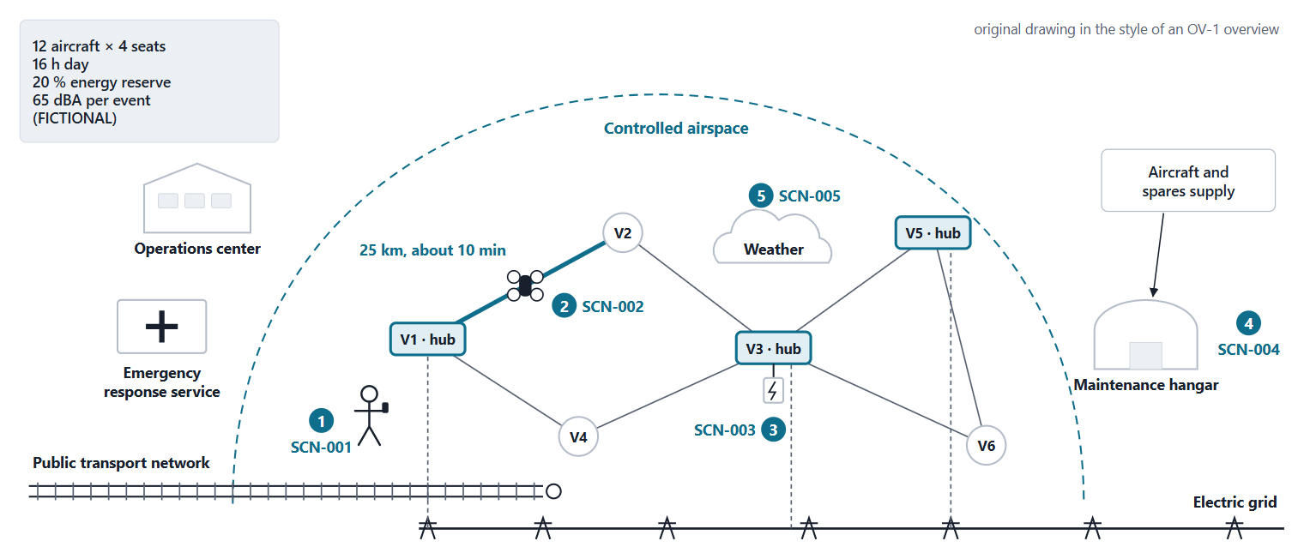
The AeroLink ConOps at a glance
Figure. The AeroLink operational concept as one picture: the network, the operations center, the external systems and where each scenario occurs. Original drawing in the style of an OV-1 overview; all values FICTIONAL.
Sources: R54 p.331

Slide 10
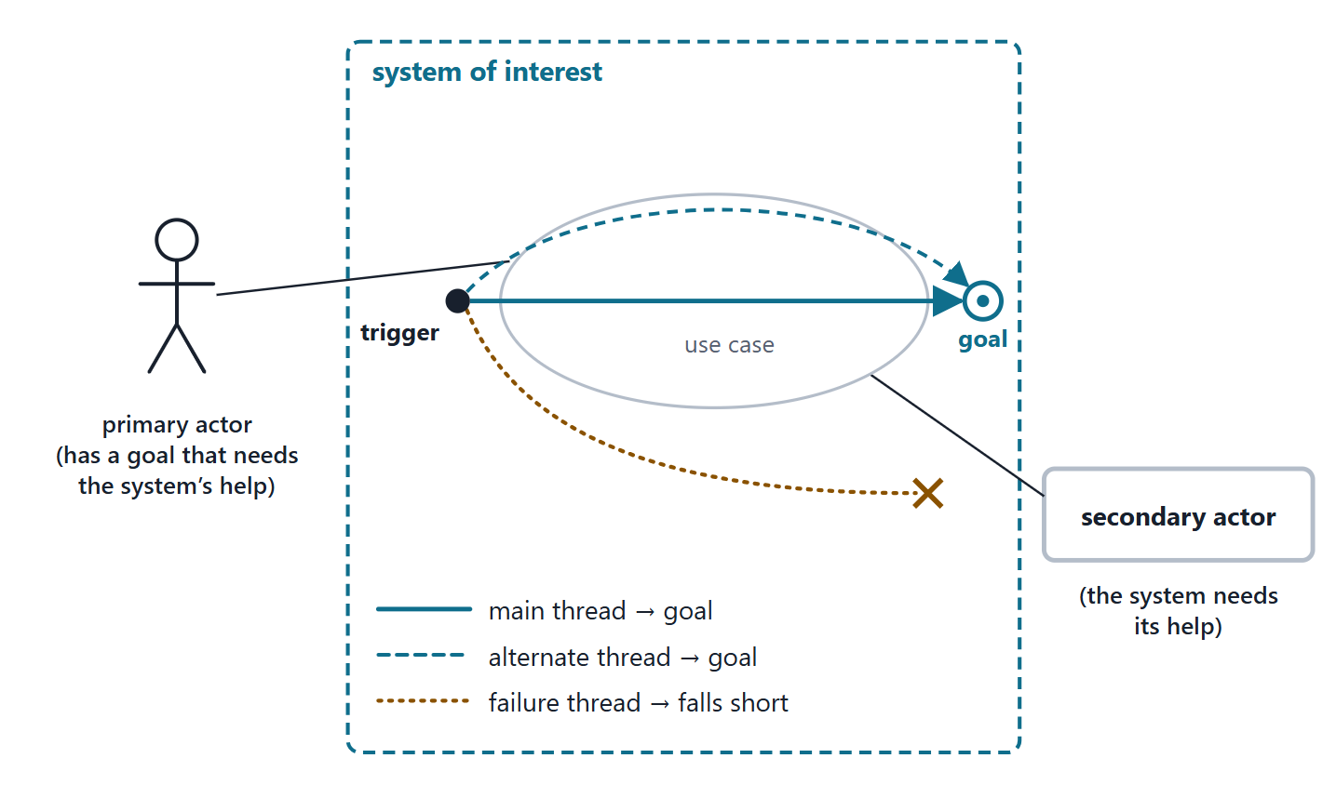
Use cases, actors and threads
Use case: goal-oriented interactions between actors and the system
Actors are outside the system: users, roles, other systems
Primary: has a goal; secondary: the system needs its help
Thread: one path through a use case
OPERATIONAL SCENARIO (SEBOK GLOSSARY)
“Description of an imagined sequence of events that includes the interaction of the product or service with its environment and users …”
R39n · SEBoK v2.14 (2026), "Operational Scenario (glossary)", p.1581
Figure. A use case inside the system boundary, its actors outside, and three threads through it.
Sources: R59 p.452–453; R39o p.1669

Slide 11
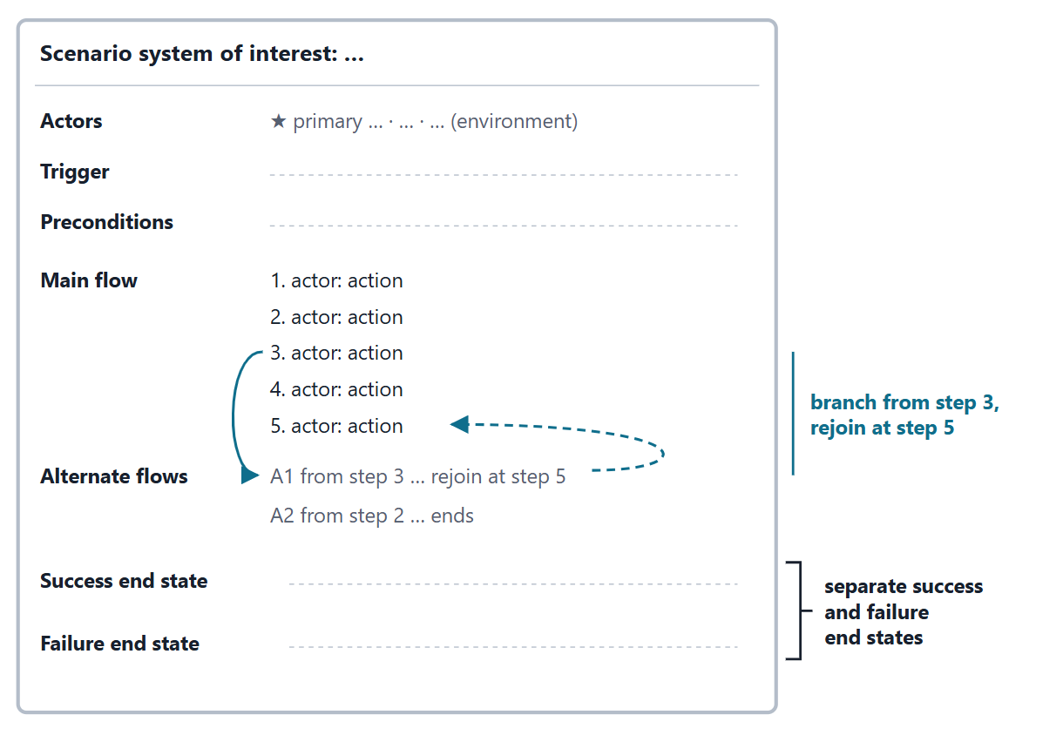
Anatomy of a scenario: the course template
Paths run from a trigger to the goal, or fall short of it
Simple steps in the user’s language: intent, not screens or implementation
Course template: actors, trigger, preconditions, main flow, alternate flows, success end state, failure end state
State the scenario system of interest: it decides who is an actor
Figure. The course scenario template: seven fields under a stated scenario system of interest (course convention, built on MITRE’s description of use cases).
Sources: R59 p.453–454

Slide 12
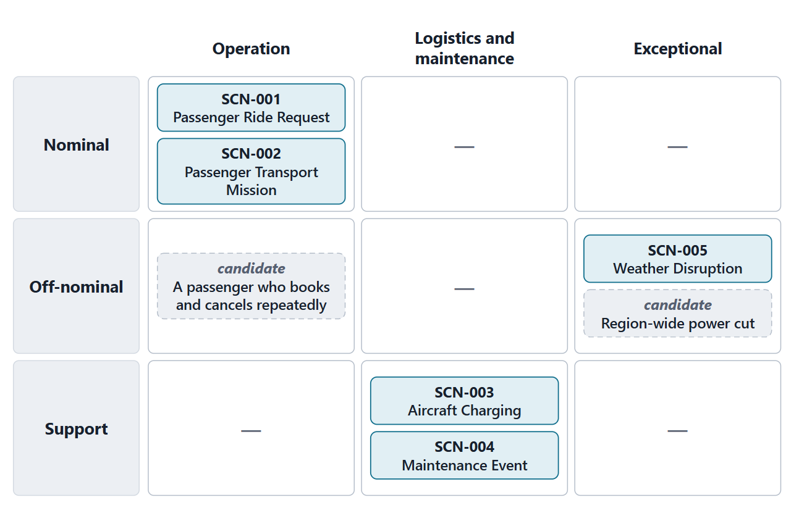
Which scenarios? Coverage and the off-nominal case
Include off-nominal use cases, misuse cases and loss scenarios
Threads cover support, maintenance, training and test, not only operations
Vary the actors, inputs and modes; good actors doing bad things
Enough when stakeholders can think of no more
Course minimum: one nominal, one off-nominal, one support
Figure. A coverage grid for the AeroLink scenarios: kind by part of the life cycle. Dashed cards are candidate scenarios not yet written (instructor synthesis).
Sources: R10 p.546; R11 p.553; R59 p.453; R59 p.455–456

Slide 13
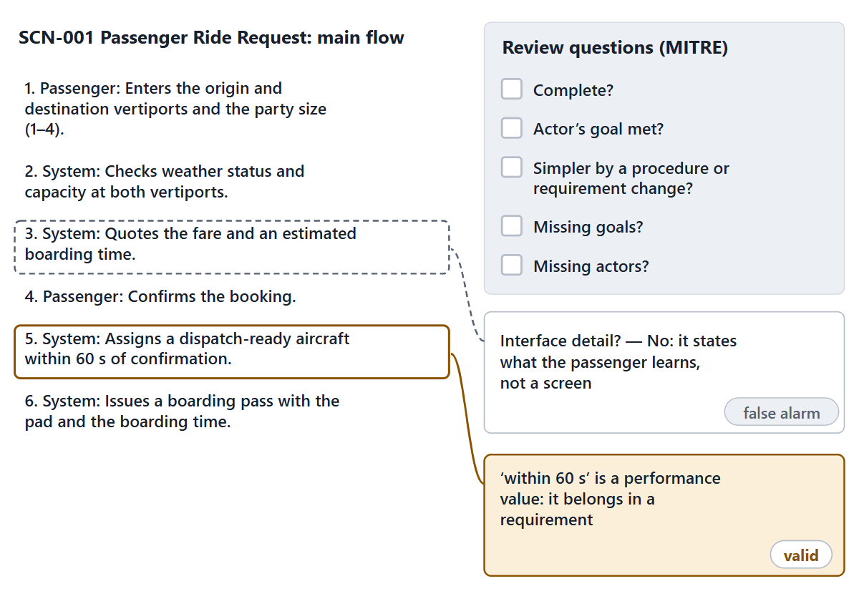
Reviewing a scenario
Complete? Will the actor’s goal be met?
Could a procedure or requirement change simplify it?
Missing goals? Missing actors?
Pitfalls: vague goals, ambiguous scope, interface detail, wishful thinking
Pairs: SCN-001 steps 3 and 5
Figure. SCN-001 under review: MITRE’s questions beside the main flow, and two margin comments, one valid and one a false alarm (FICTIONAL case).
Sources: R59 p.455–456

Slide 14
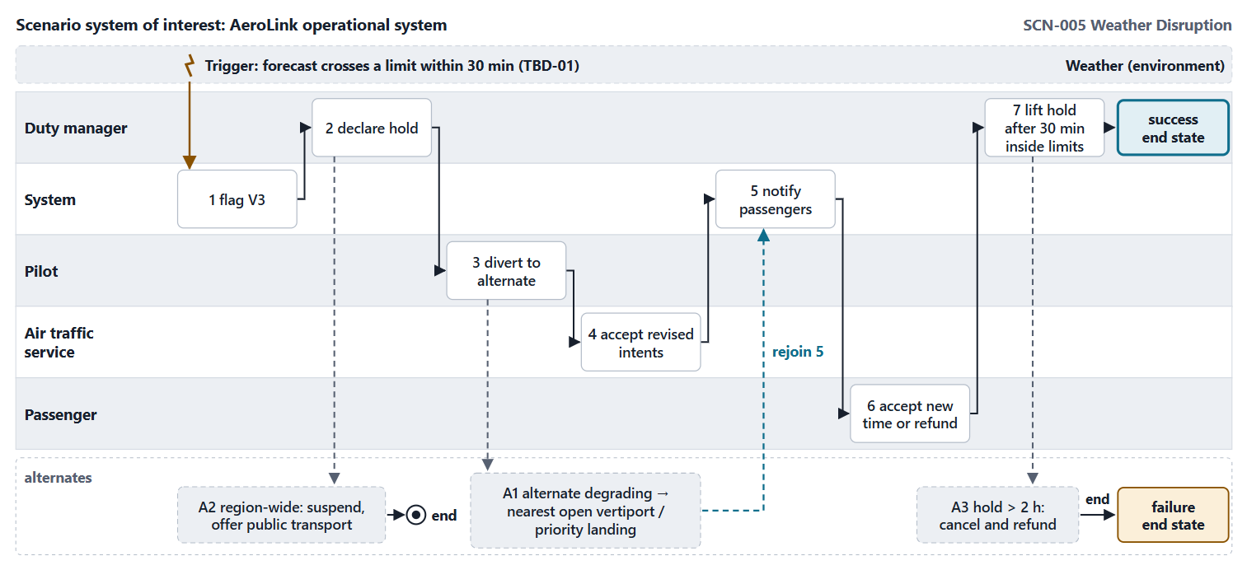
Worked example I: SCN-005 Weather Disruption, step by step
Students propose four fields; the rest is revealed (FICTIONAL)
Figure. SCN-005 Weather Disruption as a swimlane: five lanes, weather as the environment, seven steps and three alternate flows (FICTIONAL).
Sources: R59 p.453–454

Slide 15
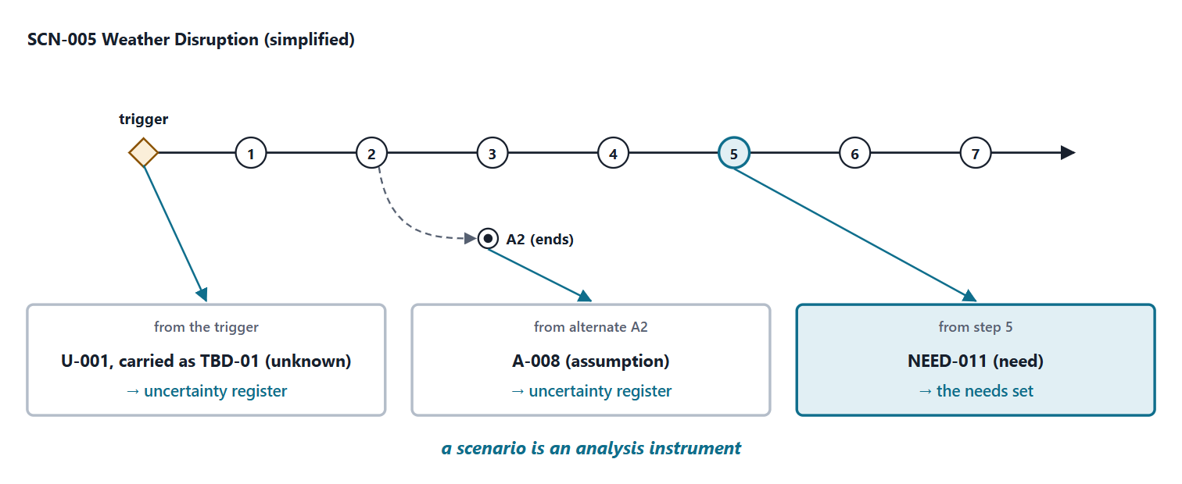
Worked example II: what writing the scenario exposed
KEY POINT
A scenario is an analysis instrument: every discovery goes into the needs set or the uncertainty register.
Figure. Three discoveries from writing SCN-005: a need, an assumption and an unknown, each sent to where it is tracked (FICTIONAL).
Sources: R52 p.301

Slide 16
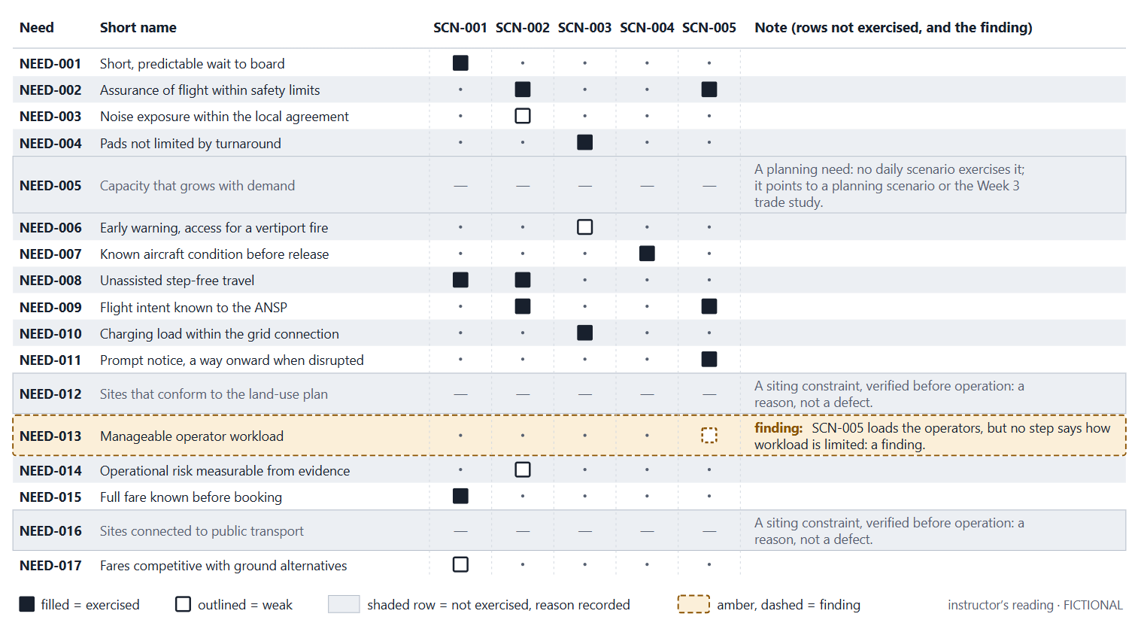
Worked example III: do the scenarios exercise the needs?
Figure. Needs by scenarios, from the instructor’s reading of the reference flows. Filled: exercised; outlined: weakly exercised; shaded rows: not exercised, with a recorded reason; amber: a finding. FICTIONAL.

Slide 17
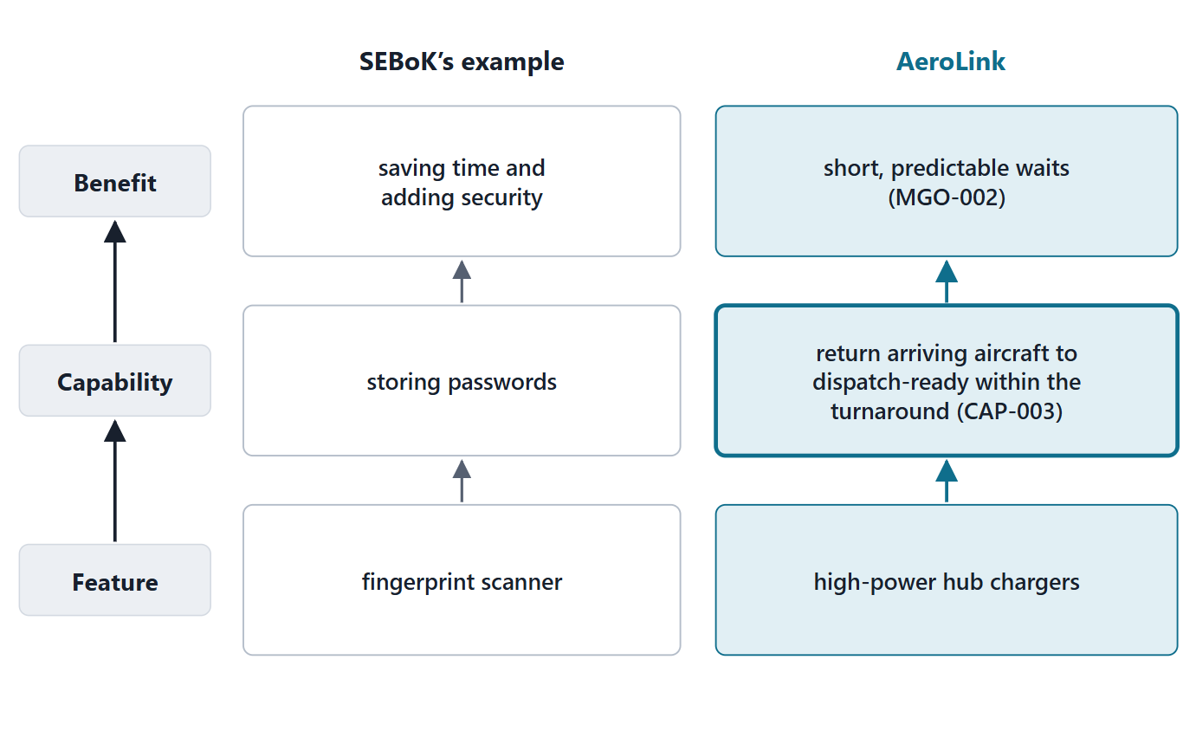
What a capability is
CAPABILITY (SEBOK GLOSSARY)
“An outcome or effect which can be achieved through use of features of a system of interest and which contributes to a desired benefit or goal”
R39p · SEBoK v2.14 (2026), "Capability (glossary)", p.1457
Feature → capability → benefit
Enterprise capabilities exist to meet mission and enterprise needs
Desired minus baseline capability: the capability gap
Figure. Feature, capability, benefit: SEBoK’s illustration and an AeroLink reading.
Sources: R39p p.1457–1458; R12 p.862

Slide 18
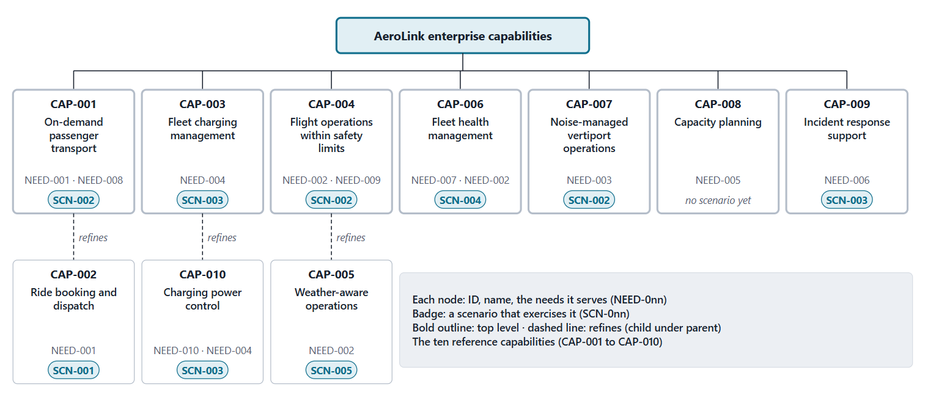
The AeroLink capability tree
Figure. The ten reference capabilities: each traces to needs; three refine a parent; scenario badges show every scenario that exercises each capability (FICTIONAL).

Slide 19
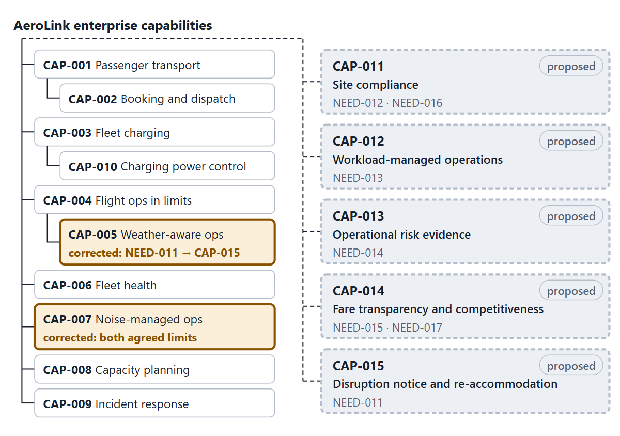
What the tree does not yet cover
The reference capabilities trace to NEED-001 … NEED-010; NEED-011 gets its own: CAP-015
NEED-012 … NEED-017 need capabilities: 4 proposed
CAP-007 covered loudness only; corrected to both agreed limits
Name an ability, not an implementation
Figure. The capability tree after the corrections: CAP-007 corrected to both noise limits; NEED-011 moved from CAP-005 to a proposed CAP-015; and four proposed capabilities for the needs added in Week 1.

Slide 20
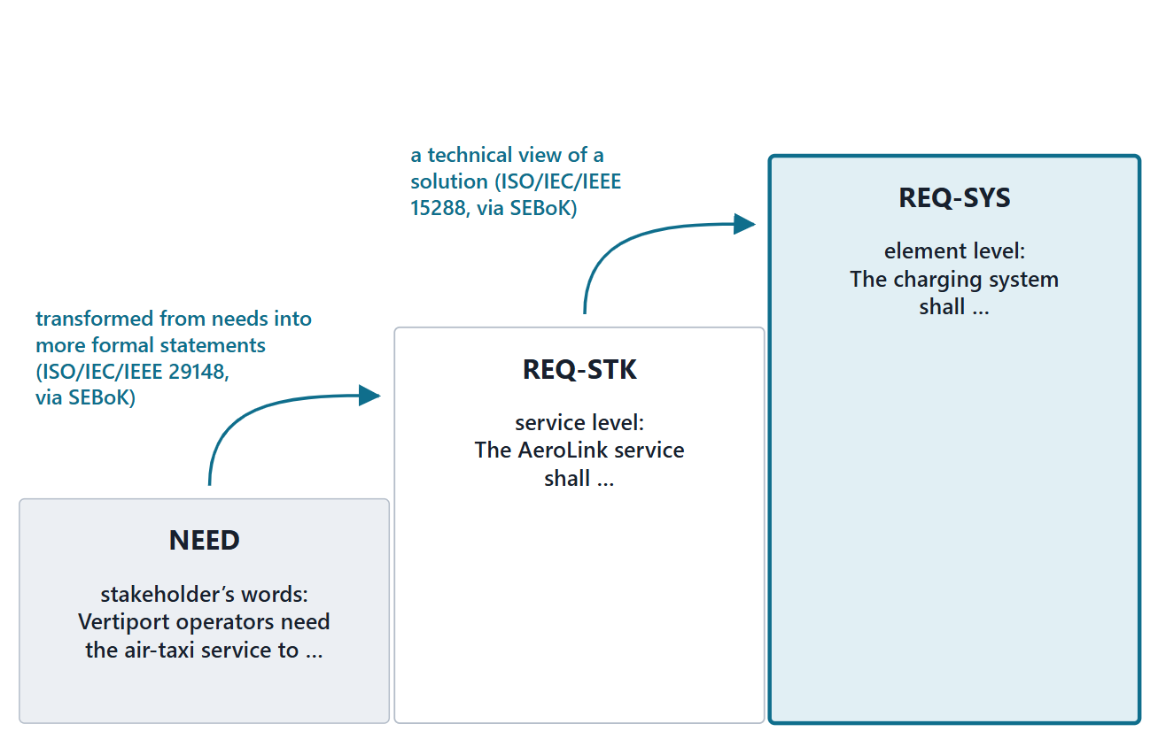
Two levels: stakeholder and system requirements
Stakeholder requirements: needs transformed into more formal statements
System requirements: a technical view of a solution
At the level of the system of interest: what, not how
Course convention: REQ-STK names the service; REQ-SYS names an element or function
Figure. Three tiers: the stakeholder’s words, the service’s obligation, an element’s obligation, each step labeled with its source.
Sources: R39a p.1632; R39l p.1652; R48a p.141; R48b p.142; R13 p.558

Slide 21
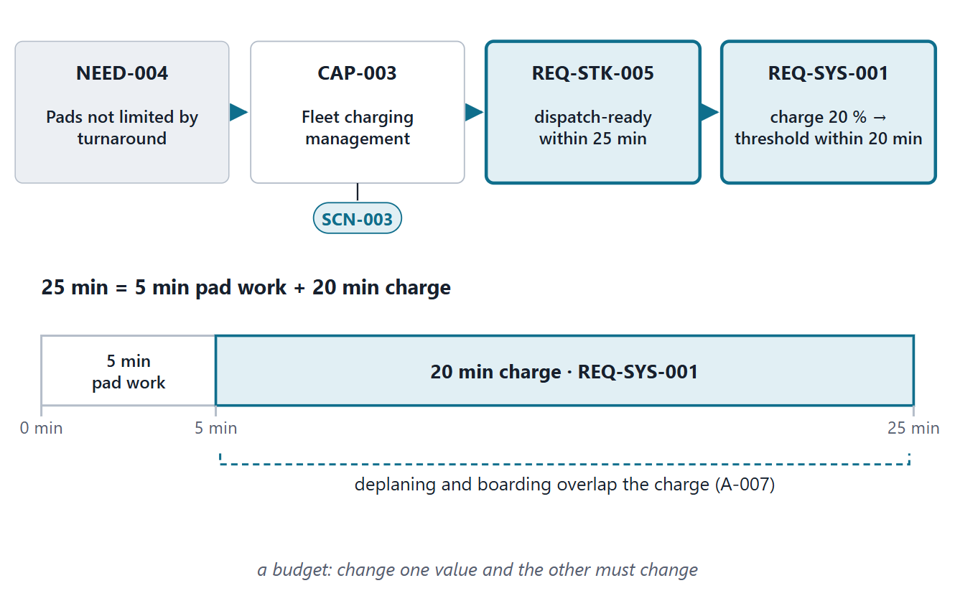
One chain, end to end: NEED-004 to REQ-SYS-001
NEED-004 + CAP-003 + SCN-003 → REQ-STK-005 → REQ-SYS-001
25 min = 5 min pad work + 20 min charge
A budget: change one value and the other must change
The transformation is analysis, not rewording
Figure. From the vertiport operators’ need to a charging-system requirement, with the 25-minute budget that links the two requirement values (FICTIONAL).
Sources: R13 p.558–559; R13 p.562

Slide 22
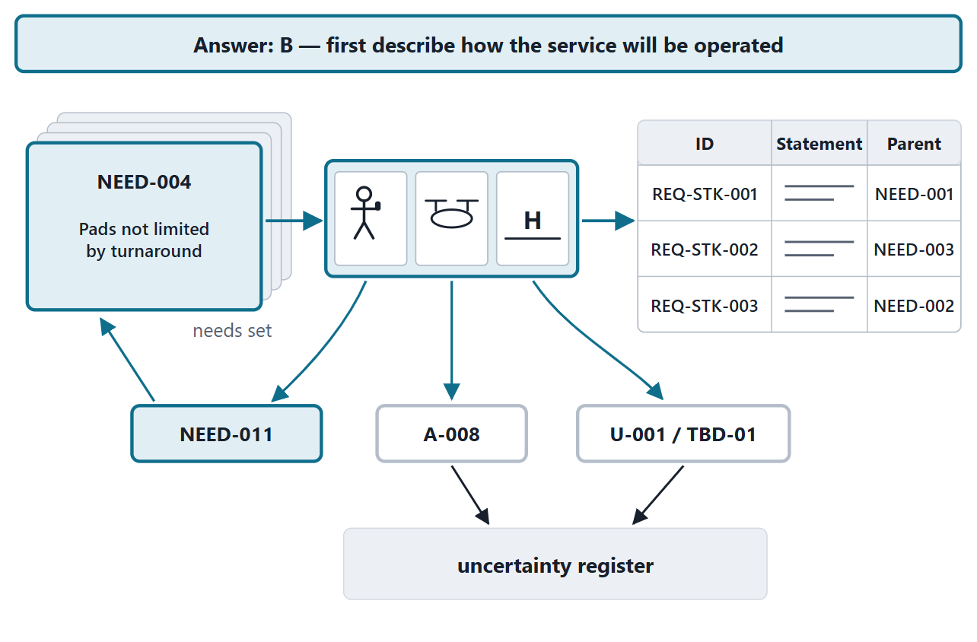
Answering the driving question
Answer: B
SCN-005 exposed a need, an assumption and an unknown
The ConOps fixed the environment the values depend on
The coverage check separated operations from constraints
Figure. The driving question answered: the route from needs to requirements passes through the description of operation, and three discoveries drop out on the way (FICTIONAL).
Sources: R52 p.301

Slide 23
Exit: retrieval and preparation for Session 2
One-minute paper: one off-nominal scenario for your enterprise, and one need it might expose
Before Session 2, each member drafts one candidate scenario:
  trigger, primary actor, failure end state
  its scenario system of interest, in one sentence
Read R13 pp.557–559 and 565–566

Slide 24
References and credits
R10 · SEBoK v2.14 (2026), “Business or Mission Analysis”, p.544, 546
R11 · SEBoK v2.14 (2026), “Stakeholder Needs Definition”, p.553
R12 · SEBoK v2.14 (2026), “Enterprise Capability Management”, p.862
R13 · SEBoK v2.14 (2026), “System Requirements Definition”, p.557–562, 565–566
R39a · SEBoK v2.14 (2026), “Stakeholder (glossary)”, p.1632
R39g · SEBoK v2.14 (2026), “Operational Concept (glossary)”, p.1579
R39l · SEBoK v2.14 (2026), “System Requirement (glossary)”, p.1652
R39m · SEBoK v2.14 (2026), “Concept of Operations (ConOps) (glossary)”, p.1469
R39n · SEBoK v2.14 (2026), “Operational Scenario (glossary)”, p.1581
R39o · SEBoK v2.14 (2026), “Use Case (glossary)”, p.1669
R39p · SEBoK v2.14 (2026), “Capability (glossary)”, p.1457–1458
R48a · OUSD(R&E) Systems Engineering Guidebook (2021/2022), “Stakeholder Requirements Definition Process”, p.141
R48b · OUSD(R&E) Systems Engineering Guidebook (2021/2022), “Requirements Analysis Process”, p.142, 144
R52 · The MITRE Systems Engineering Guide (2014), “Concept of Operations”, p.298–302
R54 · The MITRE Systems Engineering Guide (2014), “Analyzing and Defining Requirements”, p.329–331
R59 · The MITRE Systems Engineering Guide (2014), “Use Cases and Mission Threads”, p.452–456
R98 · SEBoK v2.14 (2026), “Diversity, Equity, and Inclusion”, p.1001
CREDITS AND LICENSES
SEBoK v2.14: “This material is used under a Creative Commons Attribution-NonCommercial ShareAlike 3.0 Unported License from The Trustees of the Stevens Institute of Technology.” (SEBoK, “Bkcase Wiki:Copyright”, PDF p.31). Quotations are short and cited; no SEBoK figure or table is reproduced.
OUSD(R&E) Systems Engineering Guidebook: Distribution Statement A. Approved for public release. Distribution is unlimited.
The MITRE Systems Engineering Guide: © 2014 by The MITRE Corporation. All rights reserved. Approved for public release; distribution unlimited (Case Numbers 10-4072 and 12-1089). Quoted briefly with attribution.
Figures are original drawings for this course; none redraws a figure from the sources.
AeroLink Urban Mobility is a fictional teaching case: every number, name and statement about it is a teaching value.

