Slide 1
Warm-up: three retrieval cards
1 · “Weather limits not yet published”: a risk, an unknown or an issue?
2 · Weather limits were handled by transfer. What did transfer not change?
3 · Margin is the threshold minus what?

Slide 2
Warm-up: the answers
1 · An unknown: information not yet available (a TBD in the requirement)
2 · The consequence for passengers: transfer moves the cost
3 · The worst-case estimate: current estimate plus contingency
Sources: R46 p.127; R61c p.644; R44 p.117

Slide 3
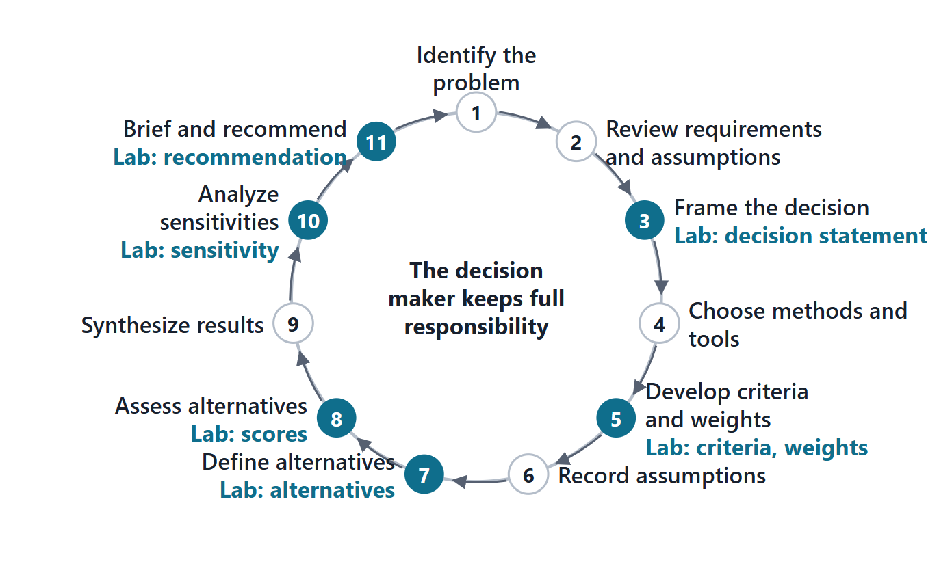
What decision management is for
A structured framework to evaluate alternatives and select the most beneficial course
The trade study is the method most commonly used
One master decision model; value-focused thinking; uncertainty and risk
The decision maker keeps full responsibility
Figure. The decision-analysis steps as a ring, an original drawing from the DoD step list, with the Lab L3 steps mapped onto it.
Sources: R18 p.463; R18 p.464; R43 p.110

Slide 4
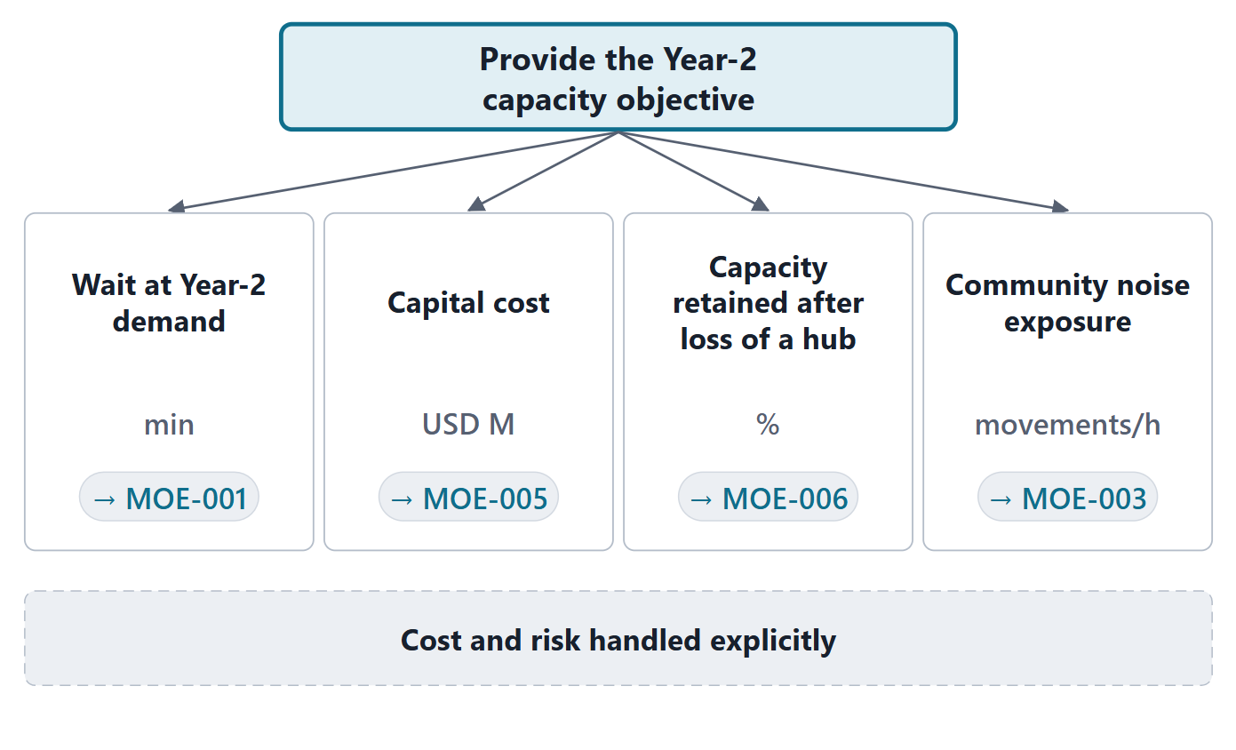
Framing the decision, objectives and measures
State the decision in life-cycle terms
Objectives: essential, controllable, complete, non-redundant
Measures: unambiguous, comprehensive, direct, operational
Course rule: every criterion traces to an MOE
Figure. AeroLink’s objectives hierarchy: the decision at the top, four objectives, each with its measure and the MOE it traces to.
Sources: R18 p.465

Slide 5
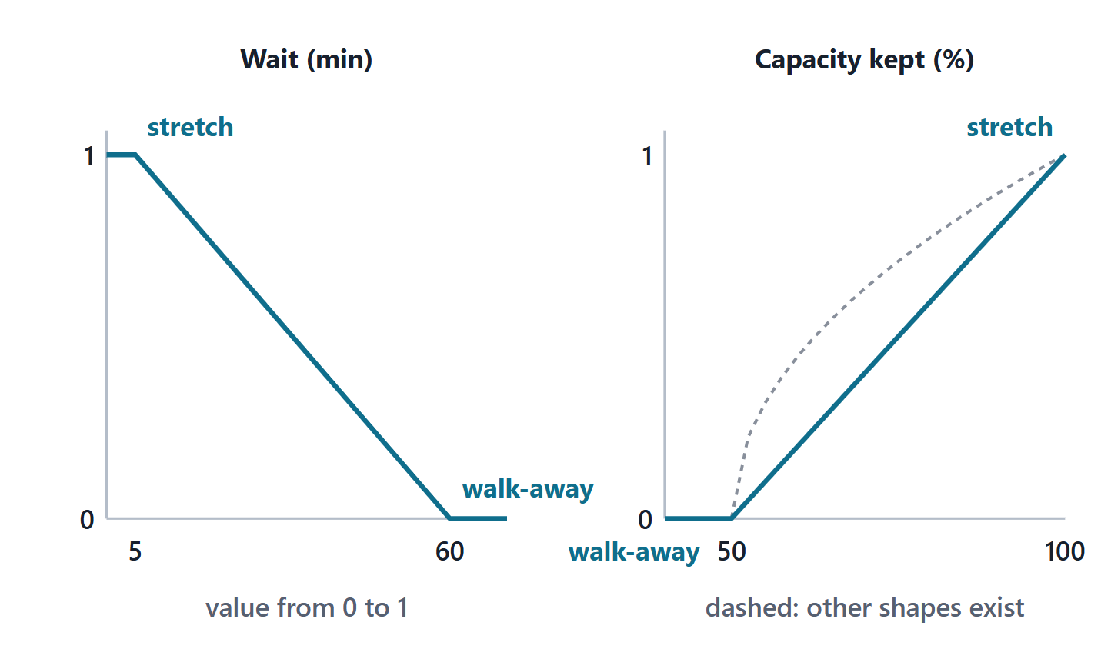
Value functions: from measure space to value space
A value function maps a measure to value
Walk-away point → value 0
Stretch goal → value 1 (or 100)
Document why the curve has its shape
Figure. Two linear value functions from the AeroLink case, with walk-away (value 0) and stretch goal (value 1). Other shapes exist and must be justified.
Sources: R18 p.465; R18 p.466

Slide 6
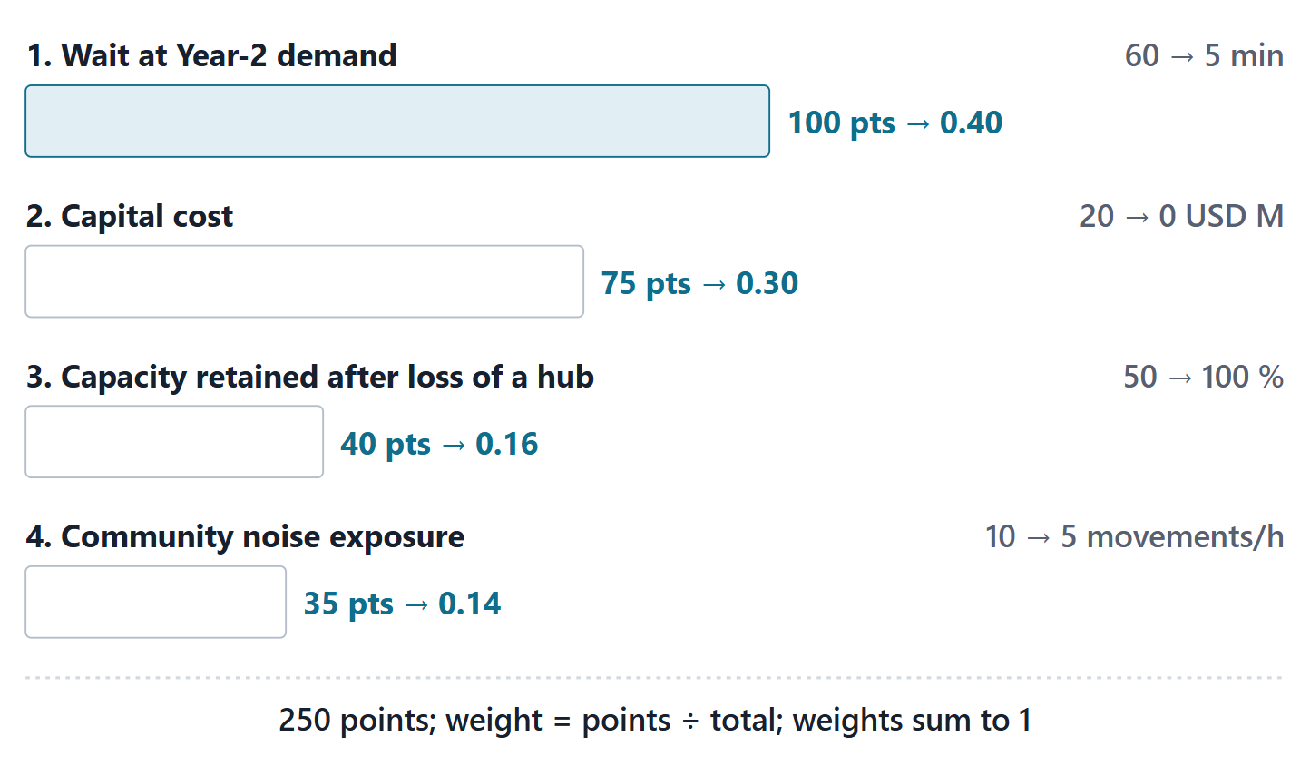
Swing weights: importance and range
Weights depend on importance and range
The top swing gets 100; assess the others against it
Normalize: weight = points ÷ total
AeroLink: 100, 75, 40, 35 → 0.40, 0.30, 0.16, 0.14
Figure. Swing weights for the AeroLink trade: each bar is the swing from walk-away to stretch; ranked swings get points, normalized to sum to one.
Sources: R18 p.466; R18 p.467

Slide 7
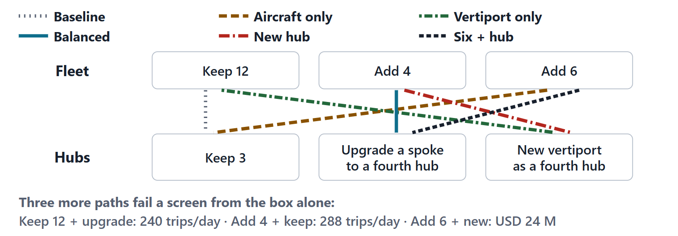
Alternatives and the additive value model
v(x) = Σ wᵢ · vᵢ(xᵢ), Σ wᵢ = 1
xᵢ = the alternative’s score on measure i vᵢ = the value function of measure i wᵢ = the swing weight of measure i
Figure. A morphological box for AeroLink capacity: each alternative is one path through the choices. Nine paths; six are listed alternatives, and the other three fail a screen straight from the box.
Sources: R18 p.467; R18 p.468; R18 p.469

Slide 8
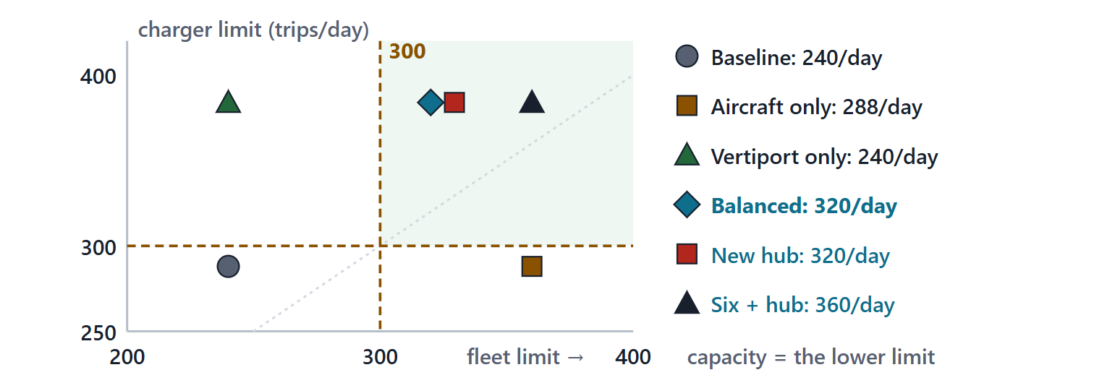
Worked example I: the frame and the capacities
Decide: how to provide 300 trips/day by month 24
Assume: demand 240 trips/day for every alternative
Rule: capacity = min(aircraft × 20, chargers × 48)
Compute: six alternatives, including the baseline
Figure. Each alternative plotted by its fleet limit (aircraft × 20) and charger limit (chargers × 48). Capacity is the lower of the two. (FICTIONAL)
Sources: R18 p.465; R43 p.110

Slide 9
Worked example II: criteria, screens and weights
Criterion | MOE | Walk-away → stretch | Weight
Wait at Year-2 demand | MOE-001 | 60 → 5 min | 0.40
Capital cost | MOE-005 | 20 → 0 USD M | 0.30
Capacity retained after loss of a hub | MOE-006 | 50 → 100 % | 0.16
Community noise exposure | MOE-003 | 10 → 5 movements/h | 0.14
SCREENS, BEFORE ANY WEIGHT
Capacity ≥ 300 trips/day; inside every walk-away; charger control authenticated; no new unauthenticated interface.
Sources: R18 p.465; R18 p.466; R24 p.1208; R24 p.1209; R25 p.1229

Slide 10
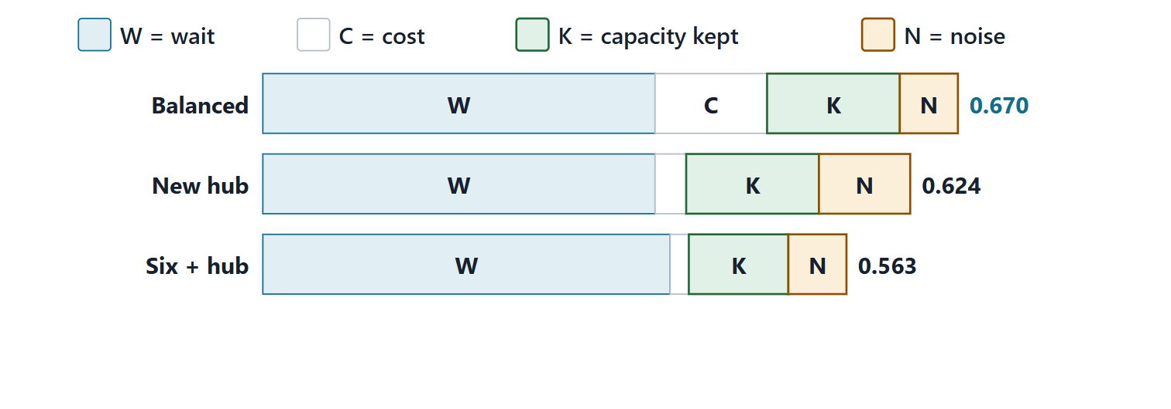
Worked example III: scores, values and totals
Alternative | Wait | Cost | Kept | Noise | Total
Balanced | 8.0 | 12.8 | 90.0 | 8.0 | 0.670
Aircraft plus a new hub vertiport | 8.0 | 18.0 | 90.0 | 6.9 | 0.624
Six aircraft plus hub charging | 6.0 | 18.8 | 80.0 | 8.0 | 0.563
Figure. Value component chart: each bar is an alternative’s total value, split into the weighted value from each criterion. (FICTIONAL)
Sources: R18 p.469; R18 p.470
Value: each score through its function
Sum: weight × value

Slide 11
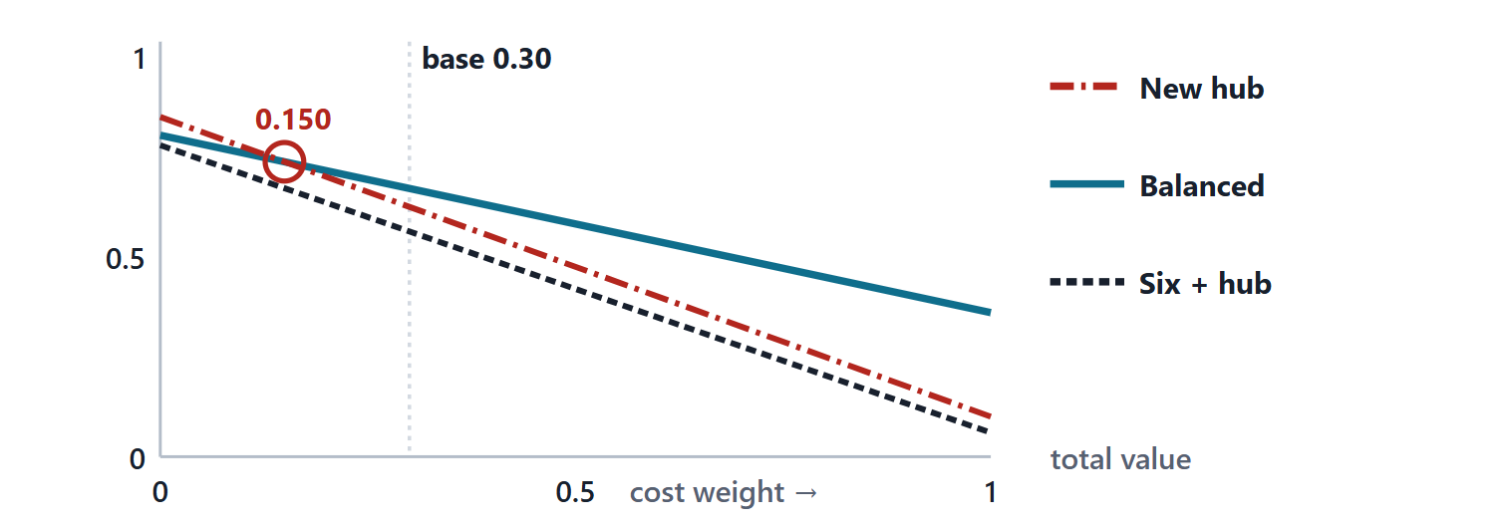
Worked example IV: sensitivity and rank reversal
Vary: one weight; rescale the others to keep Σw = 1
Solve: where two totals are equal
Report: cost ↓ 0.150; noise ↑ 0.284; wait ↑ 0.848; resilience: none
Figure. Line diagram: each feasible alternative’s total value as the cost weight varies from 0 to 1, the others rescaled in proportion. The leader changes at 0.150. (FICTIONAL)
Sources: R18 p.471; R18 p.472

Slide 12
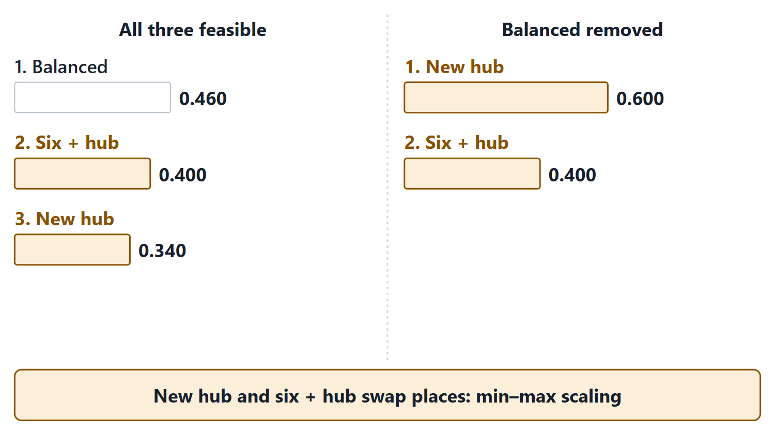
Weighted-sum pitfalls: normalization, compensation, double counting
Normalization: anchor values to walk-away and stretch, not to the set
Compensation: a high score can hide a fatal one; screen first
Double counting: one MOE, one criterion
Range-free “importance” weights break the scale
Figure. With values scaled to the best and worst alternative in the set, removing one alternative reverses the other two. Fixed anchors do not. (FICTIONAL)
Sources: R18 p.465; R18 p.466

Slide 13
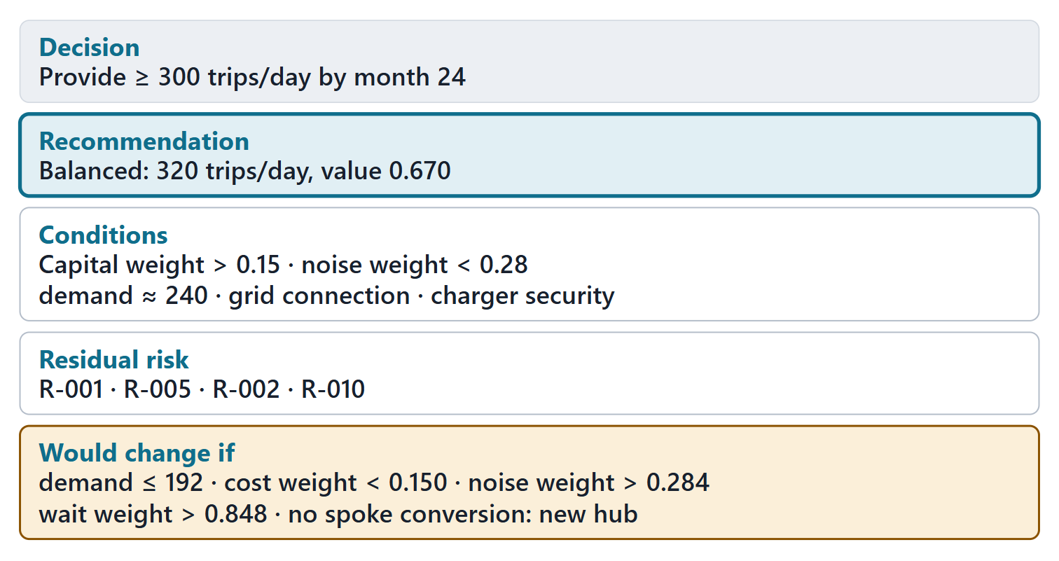
Worked example V: the recommendation, with conditions
Recommend the balanced alternative: 320 ≥ 300 trips/day
Conditions: capital and noise weights, demand, grid connection, charger security
Residual risk: charging lag, grid, battery fade, charger security
Would change if: demand, weights or grid change
Figure. A one-page decision record: decision, recommendation, conditions, residual risk and what would change it. (FICTIONAL)
Sources: R18 p.472; R18 p.473; R43 p.110

Slide 14
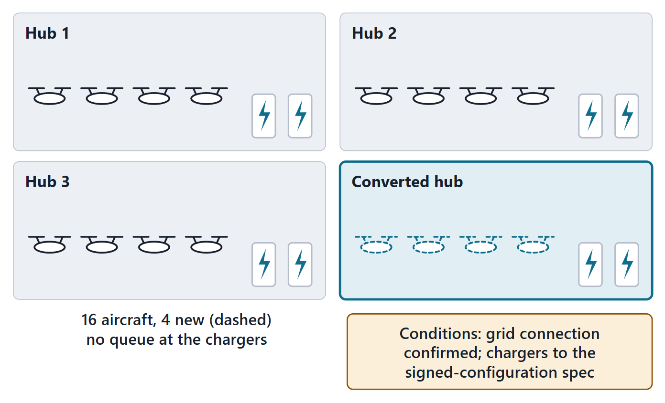
Answering the driving question
B: only with more charging
Six aircraft alone: 288 trips/day, charger-limited
Four aircraft and a fourth hub: 320 trips/day
Charger maturity and grid capacity are conditions
Figure. The Session 1 queue redrawn for the balanced alternative: four aircraft added and a fourth hub’s chargers. (FICTIONAL)
Sources: R18 p.464

Slide 15
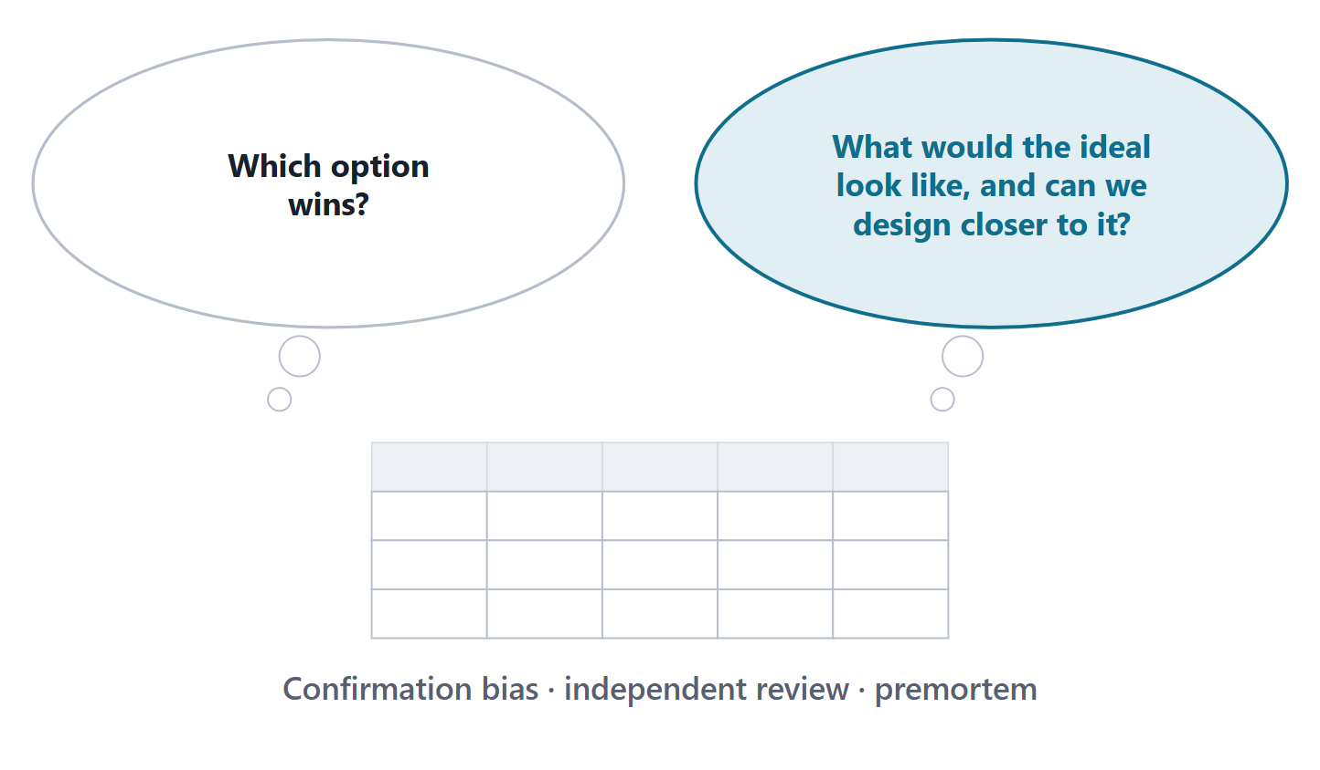
Cognitive bias and value-focused thinking
Mine results to improve alternatives: value-focused thinking
Confirmation bias distorts decisions; self-mitigation rarely works
Mitigate with independent review and a premortem
Course practice: nobody scores their own alternative alone
Figure. Two ways to read a finished trade: which option won, or what would an ideal option look like and can we get closer?
Sources: R18 p.472; R18 p.473; R18 p.474

Slide 16
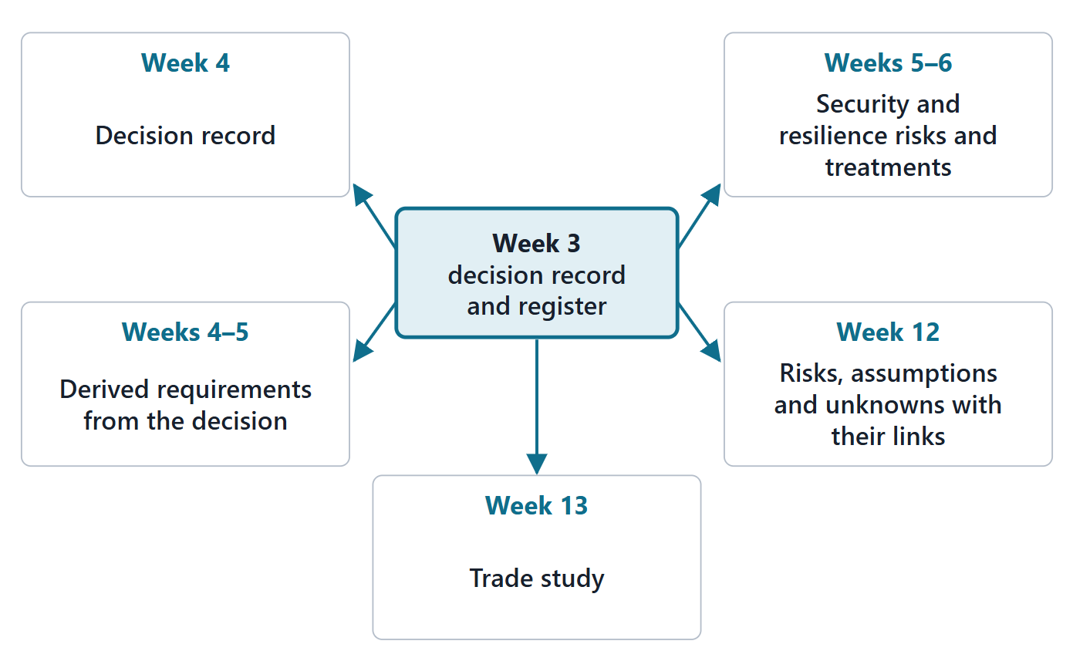
Why these methods: what they feed in Weeks 4–6, 12 and 13
Decision, derived requirements → Weeks 4–5 architecture and interfaces
Security and resilience risks → Weeks 5–6 interfaces and roadmap
Register and TPMs → Week 12 digital thread and V&V
Trade study → Week 13 analysis cases
Figure. The decision record and the register flow into the architecture, the interfaces and the roadmap, then into the model’s digital thread and analysis cases.
Sources: R48 p.146; R78 sl.147; R75 sl.95; R78 sl.152

Slide 17
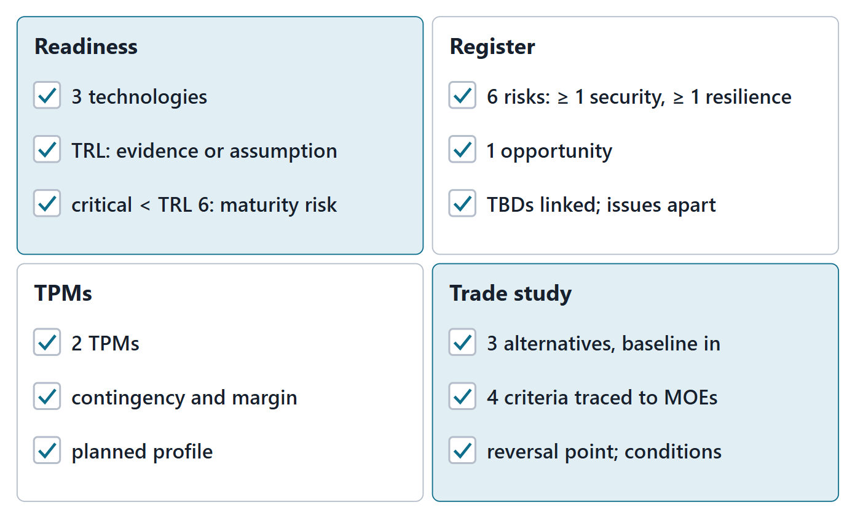
Lab L3 brief: readiness, risk, TPMs and a trade study
3 technologies; 6 risks (≥ 1 security, ≥ 1 resilience)
2 TPMs; 3 alternatives incl. baseline; 4 criteria
Team of three: 2, 4, 1, 3, 3
Your enterprise, never AeroLink; due before Week 4
Figure. Lab L3 at a glance: the four parts added to the Team Record and their minimums for a team of four.

Slide 18
Team work: choose the decision and the technologies
DECISION STATEMENT
How should [enterprise] [achieve objective X] given [constraint]?
Choose the technologies to assess
Choose one decision that matters to a stakeholder
Draft three genuinely different alternatives, including the baseline
Name the MOE behind your most important criterion
Sources: R18 p.465

Slide 19
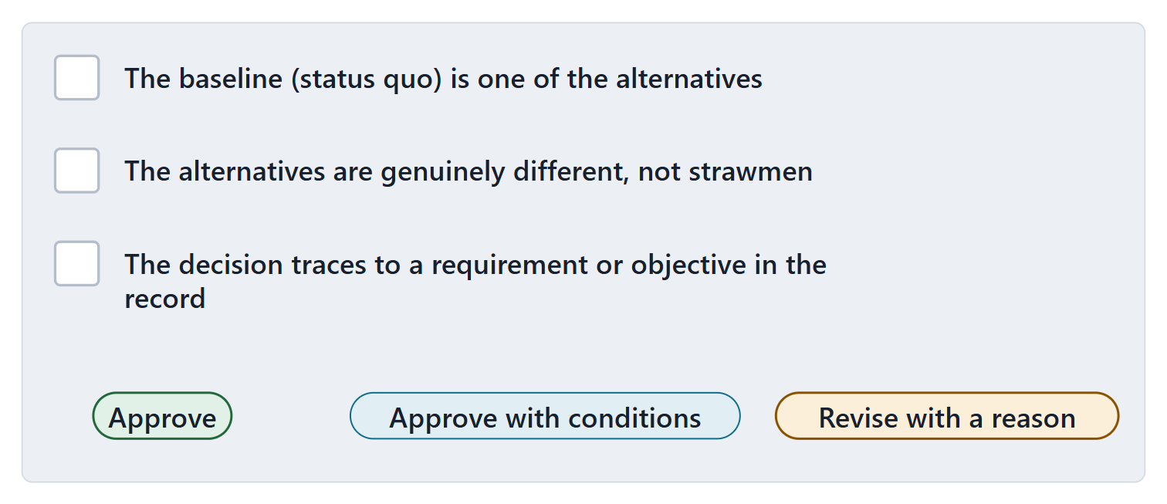
Instructor checkpoint: decision and alternatives
The baseline (status quo) is one of the alternatives
The alternatives are genuinely different, not strawmen
The decision traces to a requirement or objective in the record
NOTE
Approve, approve with conditions, or revise with a reason.
Figure. The checkpoint card: three checks and three possible decisions.

Slide 20
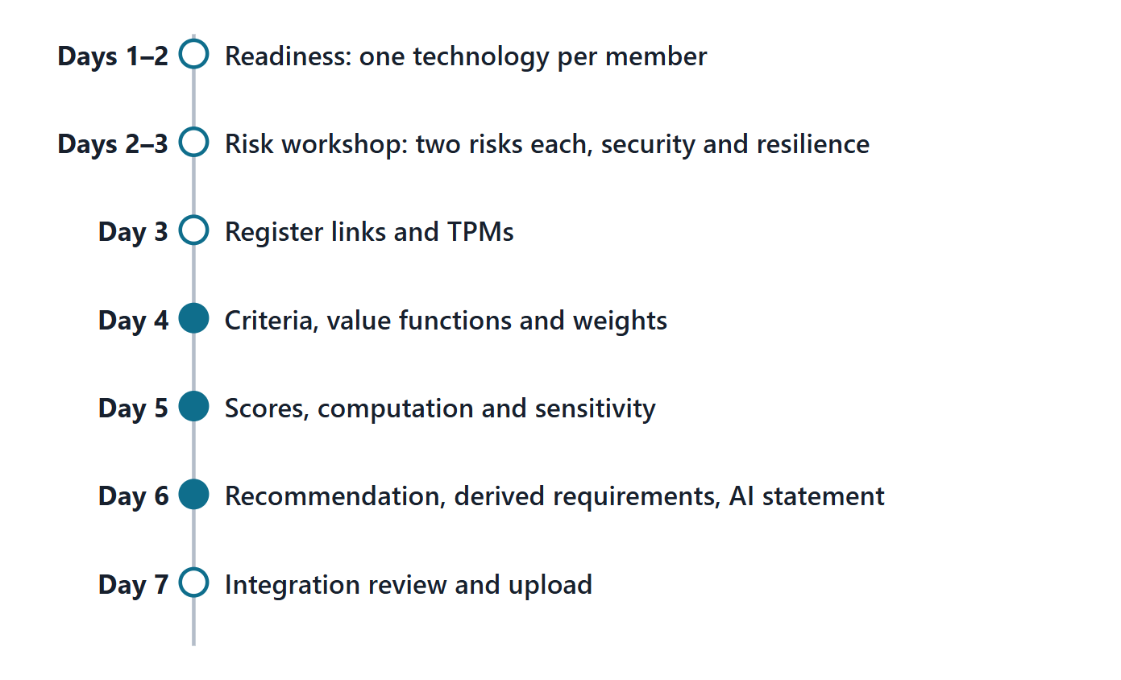
Close: the next seven days
Days 1–3: readiness, risk workshop, register, TPMs
Days 4–6: criteria, weights, scores, sensitivity, recommendation
Day 7: integration review and upload
Quiz Q3 and the applied exercise open now
Figure. A seven-day plan for Lab L3, with the lead role for each step.

Slide 21
References and credits
R16 · SEBoK v2.14 (2026), “Product Systems Engineering Special Activities”, p.766–768
R18 · SEBoK v2.14 (2026), “Decision Management”, p.463–474
R24 · SEBoK v2.14 (2026), “System Resilience”, p.1203–1204, 1206, 1208–1209
R25 · SEBoK v2.14 (2026), “System Security”, p.1229, 1231–1232
R43 · OUSD(R&E) Systems Engineering Guidebook (2021/2022), “Decision Analysis Process”, p.110
R44 · OUSD(R&E) Systems Engineering Guidebook (2021/2022), “Technical Assessment Process”, p.112–114, 116–117
R46 · OUSD(R&E) Systems Engineering Guidebook (2021/2022), “Risk Management Process”, p.124–127
R48 · OUSD(R&E) Systems Engineering Guidebook (2021/2022), “Stakeholder Requirements Definition Process”, p.146
R61a · The MITRE Systems Engineering Guide (2014), “Risk Identification”, p.630–631, 633
R61c · The MITRE Systems Engineering Guide (2014), “Risk Mitigation Planning, Implementation, and Progress Monitoring”, p.642, 644
R75 · Seidewitz, Intro to the SysML v2 Language: Textual Notation (Release 2026-08), “Analysis Case Definitions”, sl.95
R78 · Seidewitz, Intro to the SysML v2 Language: Textual Notation (Release 2026-08), “Standard View Definitions and Domain Libraries (metadata, analysis, cause and effect, requirements derivation)”, sl.147, 152
CREDITS AND LICENSES
Introduction to the SysML v2 Language, Textual Notation (Release 2026-08): Copyright © 2019–2026 Model Driven Solutions, Inc. Licensed under the Creative Commons Attribution 4.0 International License (CC BY 4.0).
SEBoK v2.14: “This material is used under a Creative Commons Attribution-NonCommercial ShareAlike 3.0 Unported License from The Trustees of the Stevens Institute of Technology.” (SEBoK, “Bkcase Wiki:Copyright”, PDF p.31). Quotations are short and cited; no SEBoK figure or table is reproduced.
OUSD(R&E) Systems Engineering Guidebook: Distribution Statement A. Approved for public release. Distribution is unlimited.
The MITRE Systems Engineering Guide: © 2014 by The MITRE Corporation. All rights reserved. Approved for public release; distribution unlimited (Case Numbers 10-4072 and 12-1089). Quoted briefly with attribution.
Figures are original drawings for this course; none redraws a figure from the sources.
AeroLink Urban Mobility is a fictional teaching case: every number, name and statement about it is a teaching value.

