Slide 1
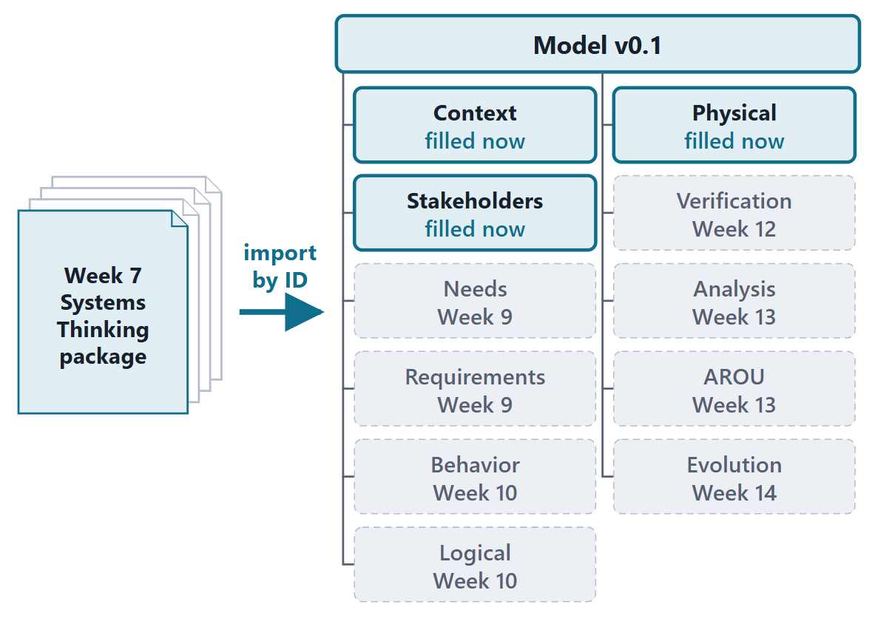
Import Systems Thinking Artifacts / Stakeholders
Session 1: From documents to a model: MBSE and the SysML v2 language
Today: what a model changes, and the core of SysML v2
Session 2: packages and names, the toolchain, the import, stakeholders and concerns
This week: Learn, Guided Practice, the Assessment, and model v0.1 of your own enterprise from the Phase I export tool
Figure. Week 8 turns the Systems Thinking package into model v0.1: Context, Stakeholders, Physical are filled now; the other packages wait, each labeled with the week that fills it.

Slide 2
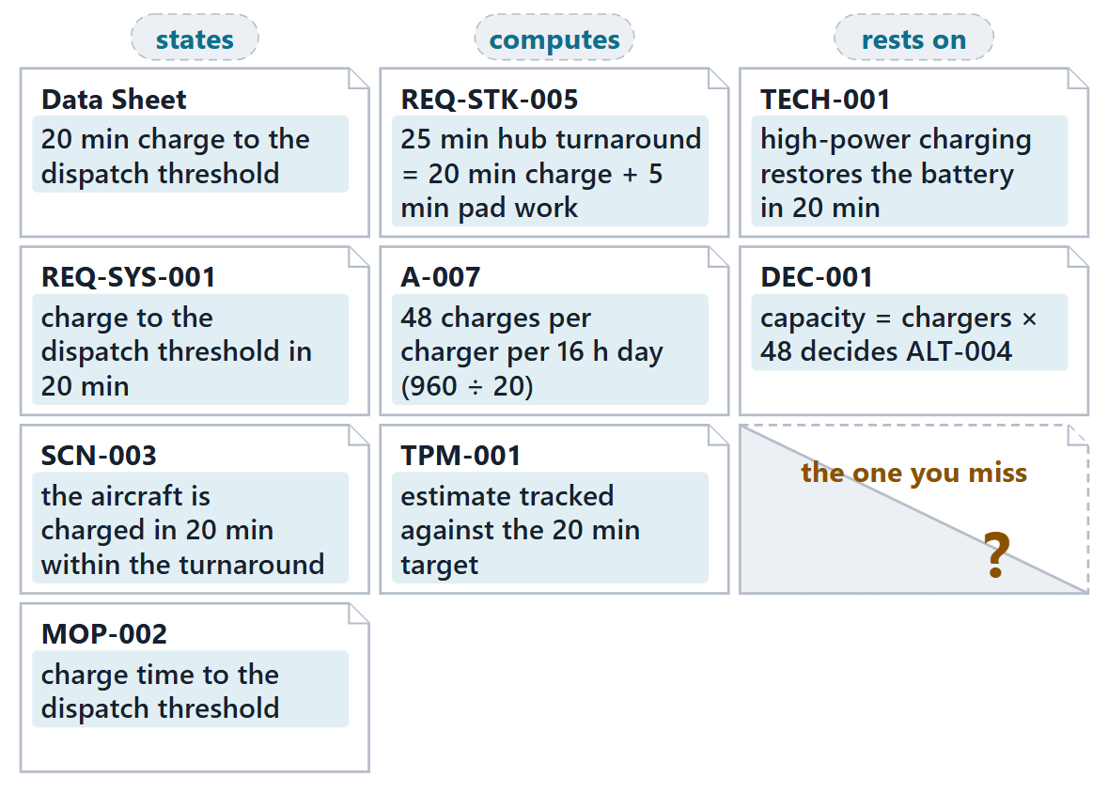
The driving question: one number, nine places
WHAT IF (FICTIONAL)
The charger supplier now says 24 minutes, not 20.
Which artifacts must change?
How would you be sure you found them all?
Figure. AeroLink’s 20-minute charge to the dispatch threshold appears in nine artifacts of its Phase I package: stated, computed from, or relied on. (FICTIONAL)

Slide 3
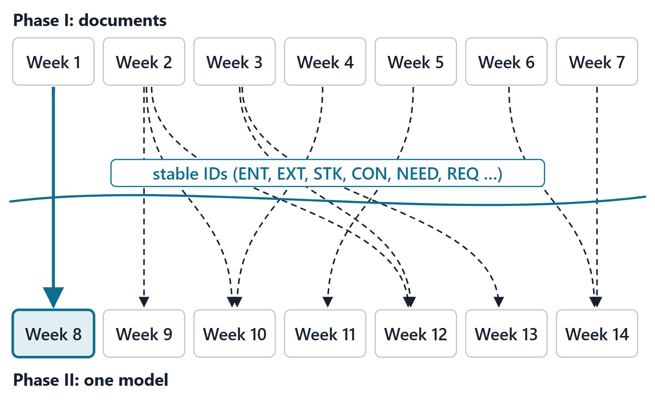
Phase II: your package becomes one model
Phase I: a document-based Systems Thinking package
Phase II: the same enterprise as one SysML v2 model
Each week models a named Phase I artifact
Stable IDs are the thread: the same ID in document and model
AeroLink first, then your own enterprise
Figure. Every Phase II week models a Phase I artifact by ID; Week 14 presents one coherent SysML v2 model of your enterprise.

Slide 4
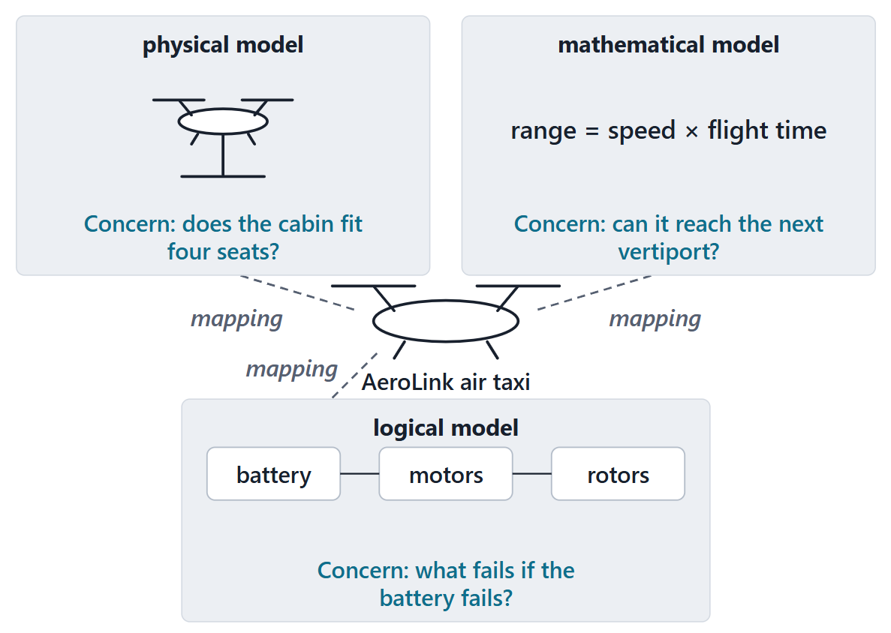
What a model is
MODEL (OMG, AS LISTED BY SEBOK)
“a selective representation of some system whose form and content are chosen based on a specific set of concerns”
R33a · SEBoK v2.14 (2026), "What is a Model?", p.290
Related to the system by a mapping
Physical, mathematical or logical
One system usually needs many models
Figure. Three models of one aircraft, each selective: a physical mockup, a mathematical model and a logical model, chosen for different concerns. (AeroLink, FICTIONAL)
Sources: R33a p.290

Slide 5
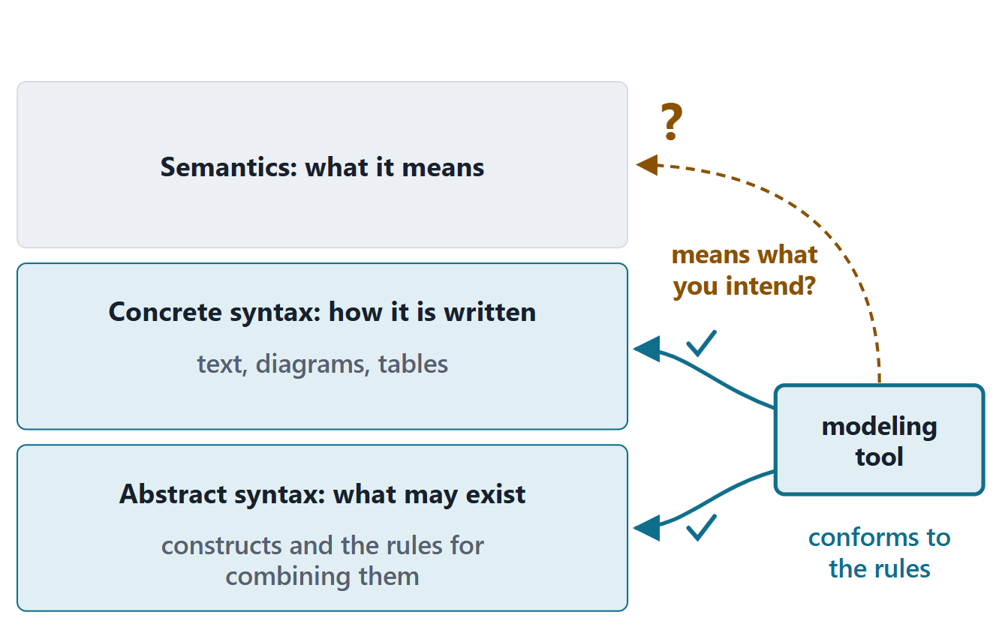
Modeling languages and tools
Abstract syntax: the constructs and the rules for building a model
Concrete syntax: the symbols or text that express them
Semantics: what the constructs mean
Tools check that a model conforms to the language’s rules
Figure. A modeling language has an abstract syntax, a concrete syntax and semantics. A tool checks conformance to the rules; whether the model means what you intend is a separate question.
Sources: R33a p.291–292

Slide 6
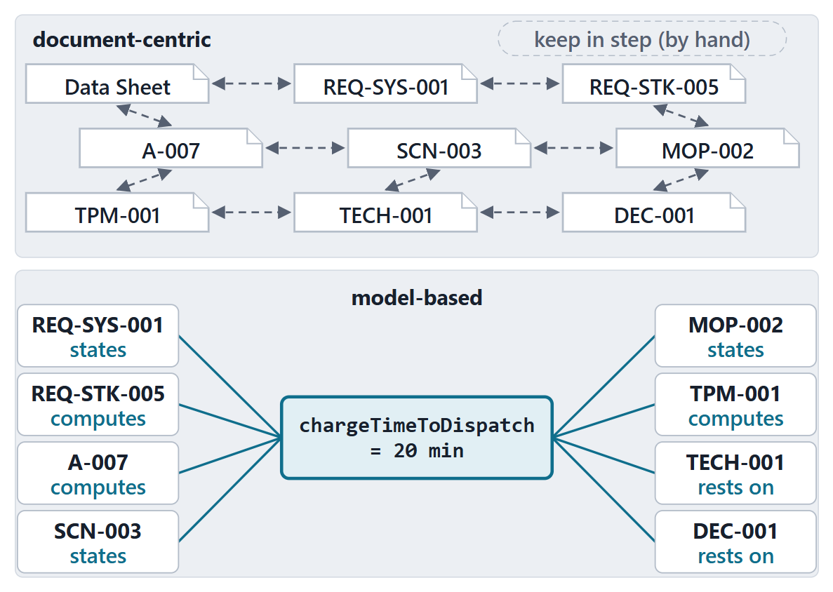
MBSE versus a document-centric package
MBSE (INCOSE, QUOTED BY SEBOK)
“the formalized application of modeling to support system requirements, design, analysis, verification, and validation activities”
R33a · SEBoK v2.14 (2026), "What is a Model?", p.292
Models are the primary, controlled artifacts
One repository as the single source of truth
Figure. Left: nine documents kept in step by hand. Right: one model element that the dependent elements are related to. (AeroLink, FICTIONAL)
Sources: R33a p.292; R28 p.370; R27 p.56

Slide 7
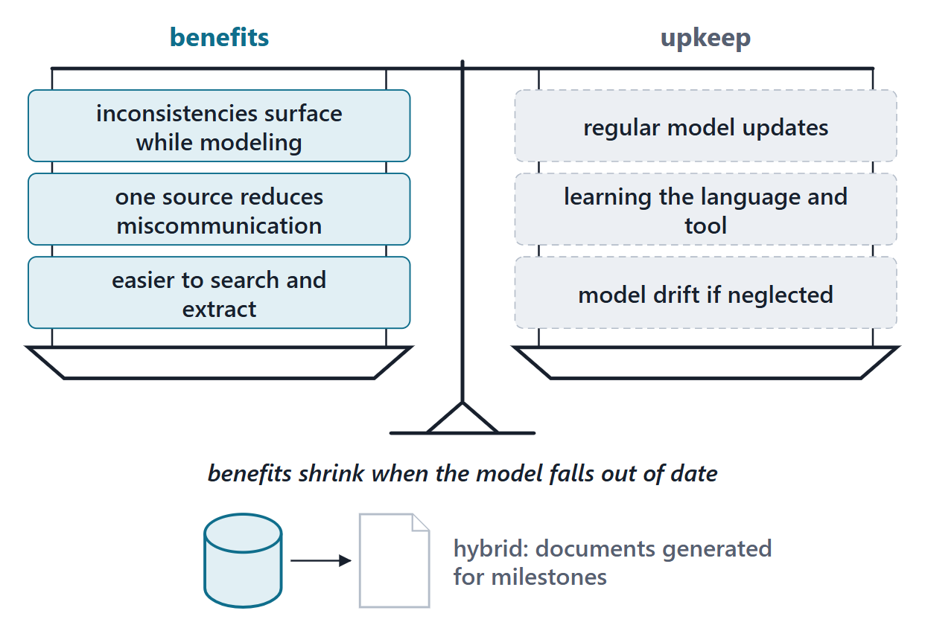
What MBSE buys, and what it costs
Inconsistencies surface while the model is built
One source: fewer miscommunications
Easier to search and extract
Cost: an out-of-date model loses its benefits
Hybrid: documents generated from the model
Figure. The benefits SEBoK names, weighed against the upkeep they depend on.
Sources: R28 p.373–374

Slide 8
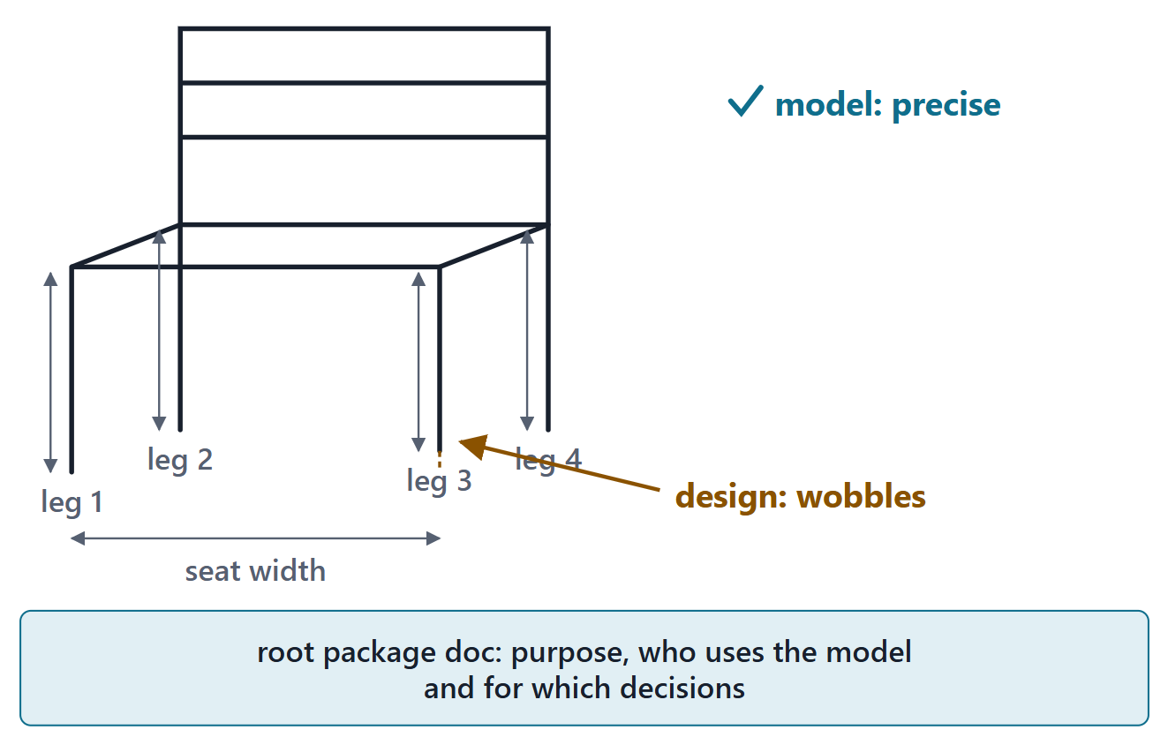
Model quality is not design quality
KEY POINT
“The quality of a model should not be confused with the quality of the design that the model represents.”
Define the model’s purpose first
Judge the model by how well it serves that purpose
Your root package states the purpose
Figure. A precise, well-made model of a poor design is still a poor design.
Sources: R33b p.295–296

Slide 9
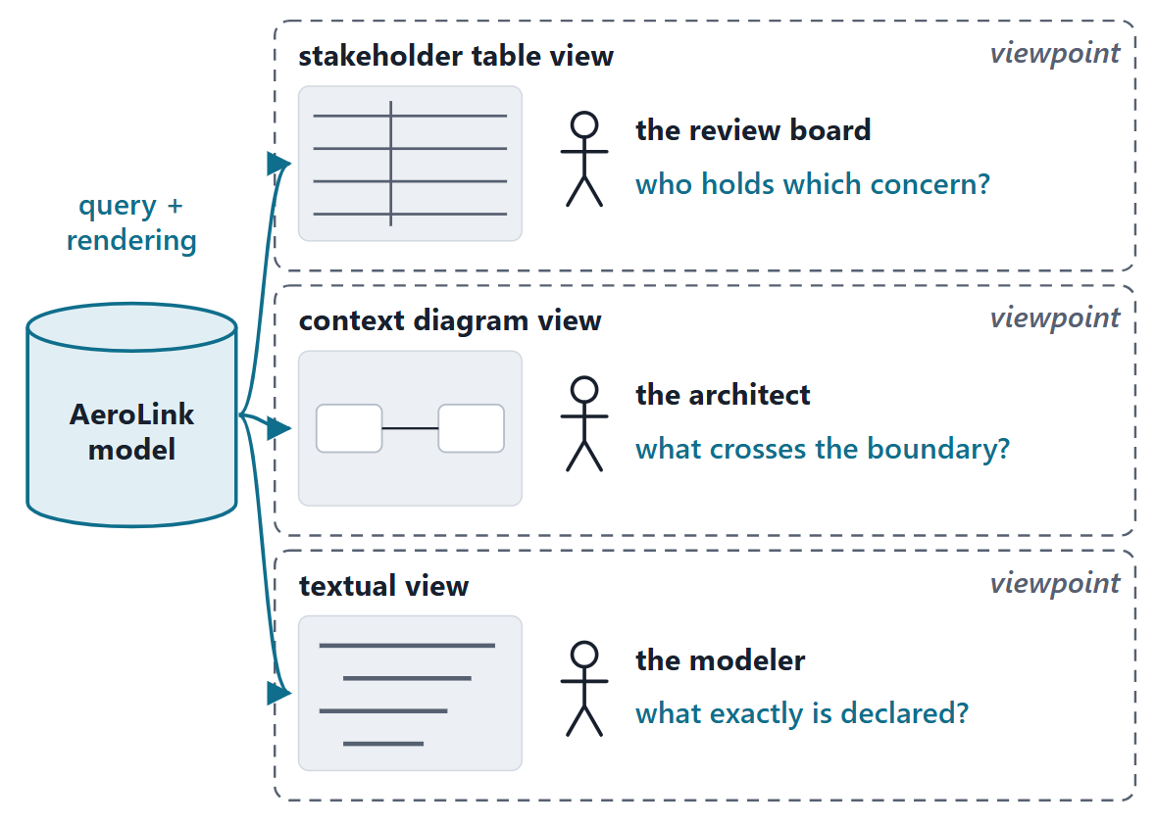
Model versus view
A system model can have many views
Viewpoint: the information a set of stakeholders needs
View: a query of the model and a rendering of its results
Your context diagram and register become views, not separate files
Figure. One model, several views: each view queries the model and renders the result for a stakeholder’s concern. (AeroLink, FICTIONAL)
Sources: R33c p.300; R80 p.48; R85 p.181

Slide 10
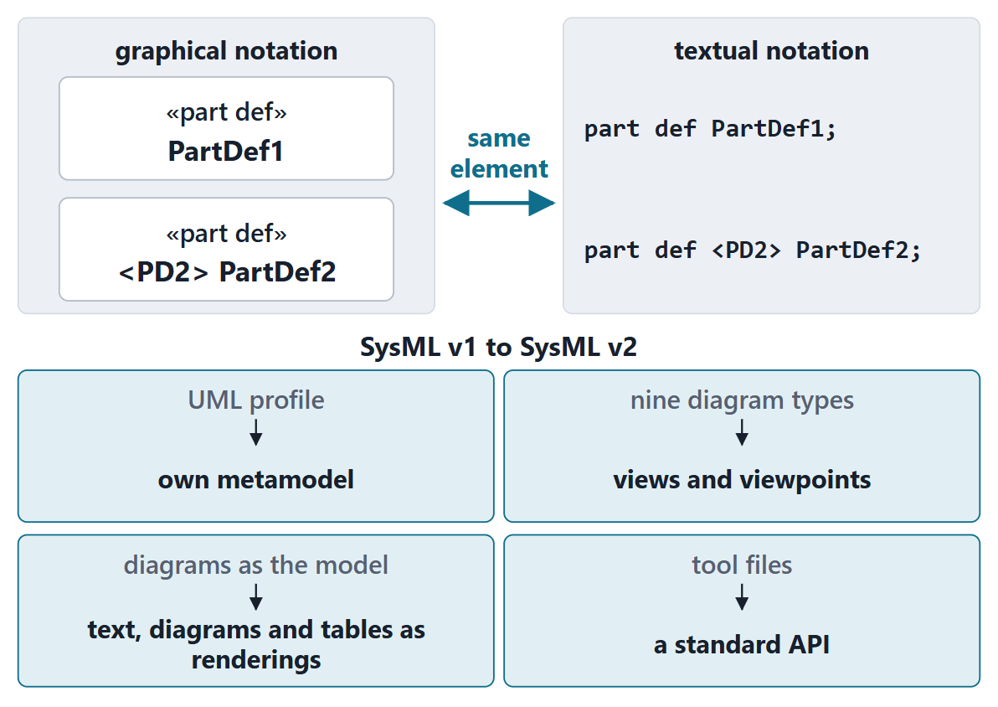
SysML v2: one model, textual and graphical notation
A new metamodel, not constrained by UML
Grounded in formal semantics
Views: graphical, tabular, textual
A standard API for other tools
Course convention: write text; diagrams are views
Figure. The same part definition in the graphical and the textual notation, as the specification’s representative-notation table shows it.
Sources: R90 sl.7, 9; R80 p.66; R28 p.372

Slide 11
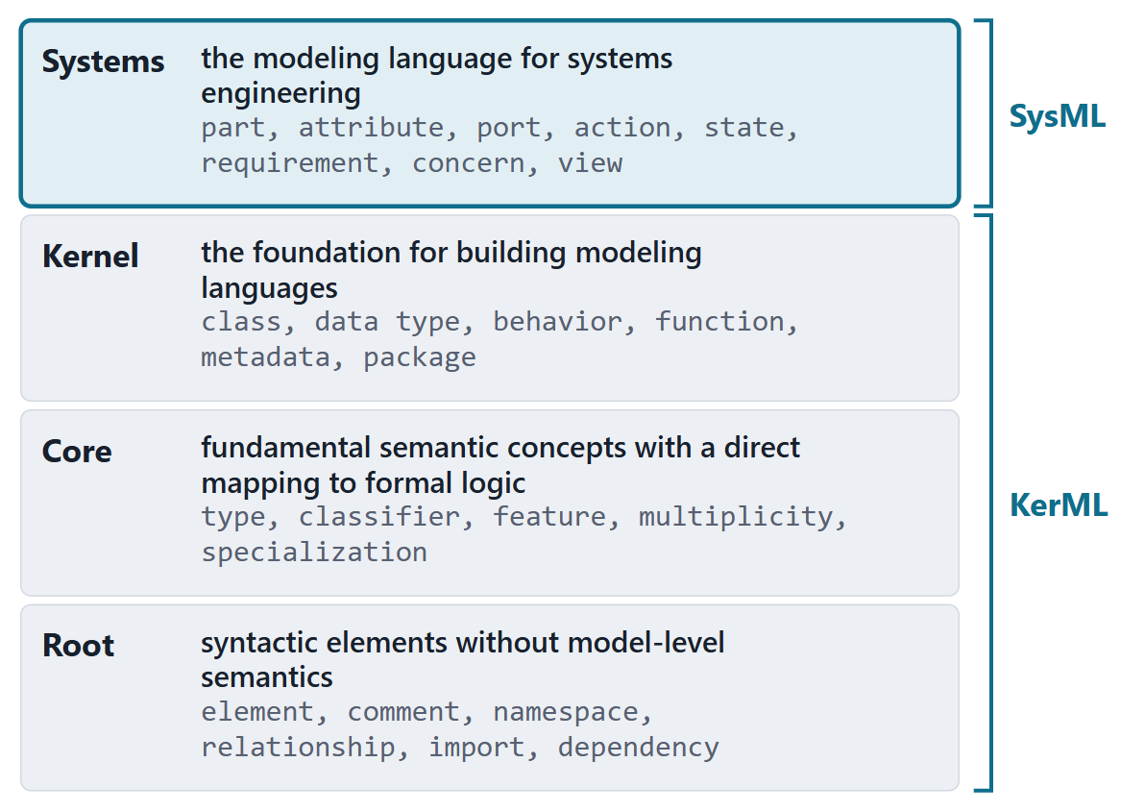
Four layers: KerML under SysML
Root: syntax without model-level semantics: elements, namespaces, imports
Core: type, feature, multiplicity; formal semantics
Kernel: foundation for modeling languages; the package lives here
Systems: SysML: parts, attributes, requirements, concerns …
Most SysML elements specialize KerML elements
Figure. The four-layer language architecture: KerML provides Root, Core and Kernel; SysML adds the Systems layer.
Sources: R70 sl.3–4; R90 sl.8; R80 p.47

Slide 12
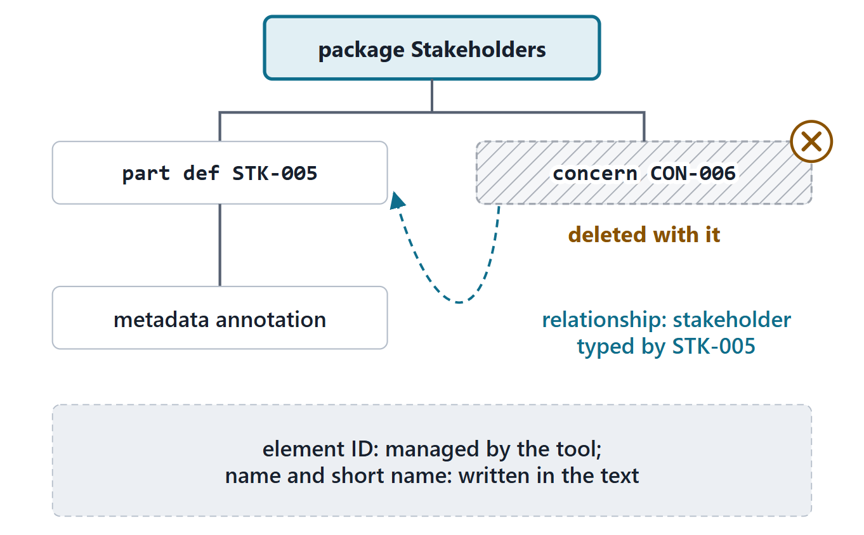
Elements, relationships, ownership
Elements; some elements are relationships
Ownership is a tree: delete an element, delete its subtree
The tool manages the element ID; you write a name and a short name
Figure. Ownership forms a tree: deleting an element deletes its whole subtree. A relationship can also link elements in different branches.
Sources: R80 p.48–49

Slide 13
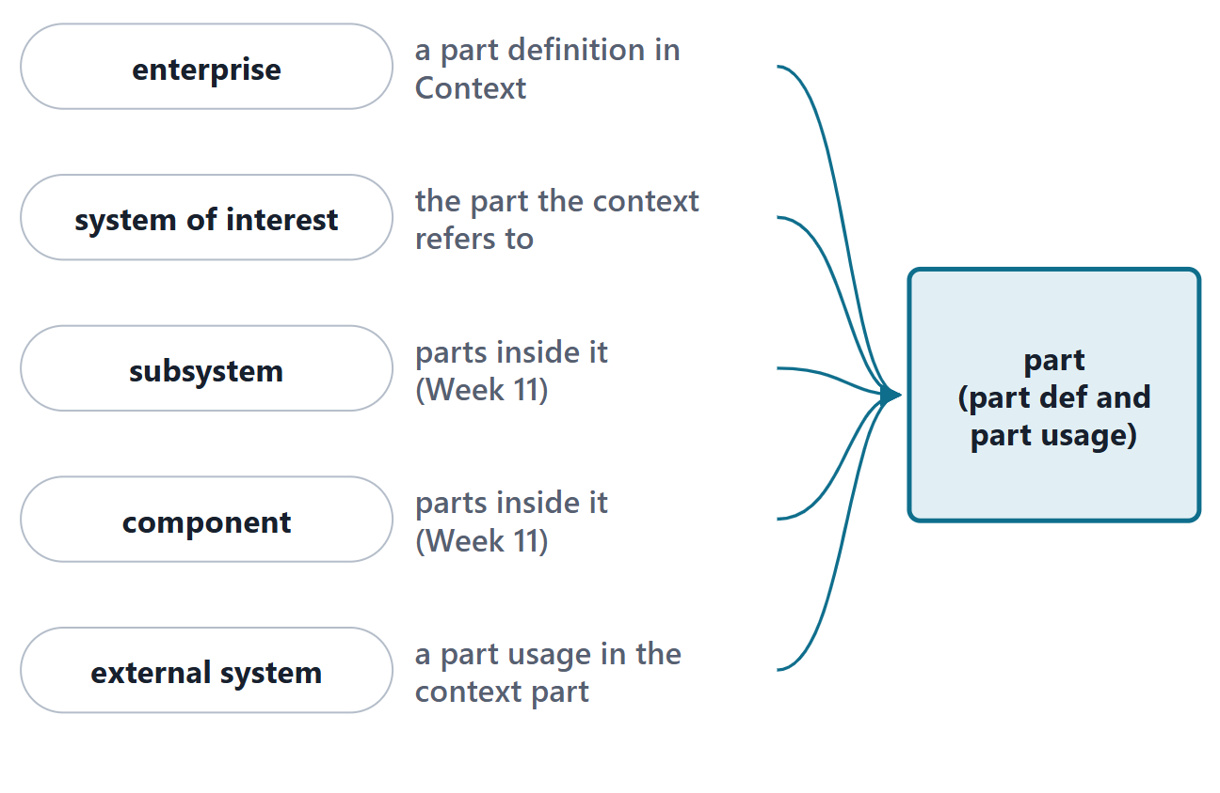
No “system” keyword: everything with structure and behavior is a part
No constructs called system, subsystem, assembly or component
An entity with structure and behavior is a part
Enterprise, service, vertiport, charger, external system: all parts
Figure. Phase I words for things with structure and behavior all become parts in SysML v2, at different places in a decomposition.
Sources: R80 p.48

Slide 14
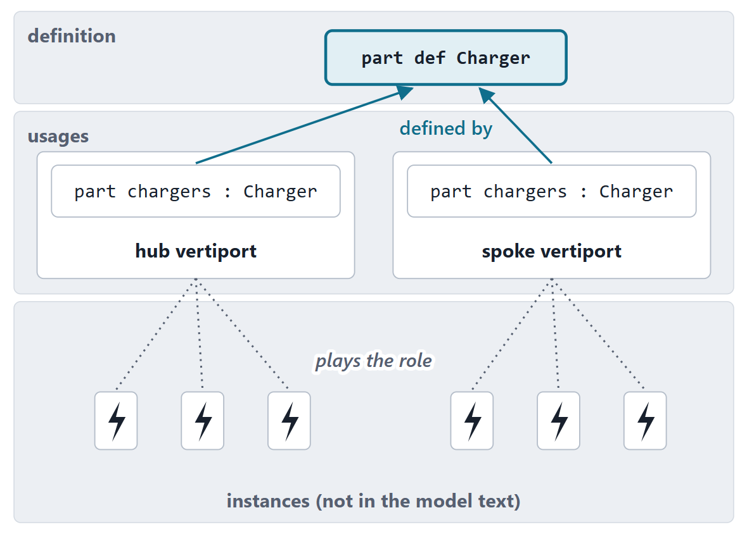
The definition–usage pattern
A definition classifies a kind of element
A usage is a usage of a definition in a context
Every usage is defined by at least one definition
Parts, attributes, ports, actions, requirements, concerns …
A usage is a role, not an instance
Figure. One definition, used in two contexts. The usages are roles in a context; the physical chargers are instances, which the model text does not list. (AeroLink, FICTIONAL)
Sources: R80 p.63; R90 sl.12

Slide 15
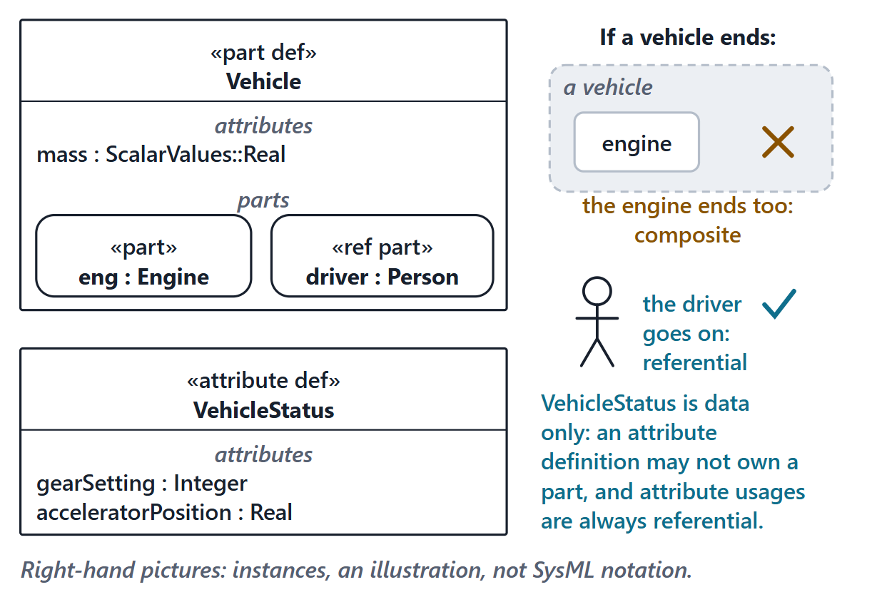
Part and attribute definitions; composite and referential
Part definition: systems or parts of systems, existing in space and time
Attribute definition: data that describes them
part: composite, ends with its owner; ref part: referential
Attributes are always referential
Figure. The training deck’s Vehicle (slide 9) in the graphical notation: an attribute, a composite part and a ref part; VehicleStatus holds only data. Right: what composite and referential mean for instances.
Sources: R70 sl.9; R80 p.64

Slide 16
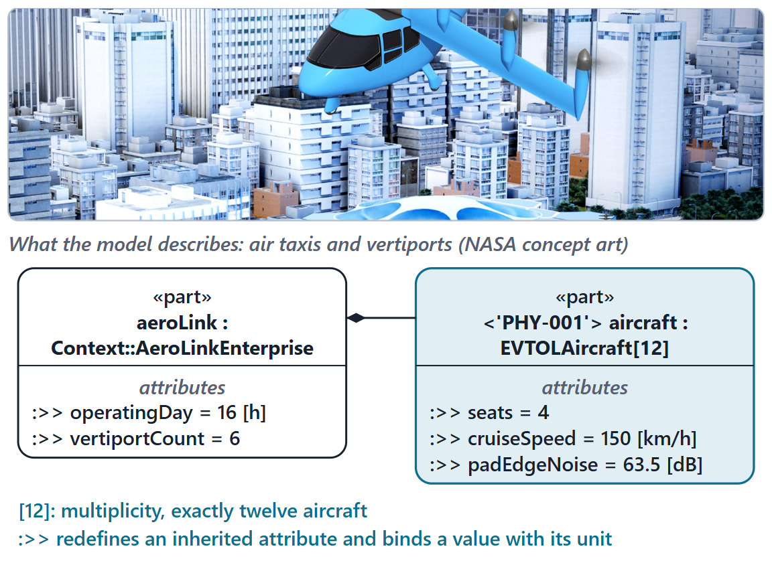
Features and multiplicity
Usages nested in a definition are its features
[12]: exactly twelve; [4..8]: four to eight; [1..*]: one or more
Owned part usage without subsetting or redefinition: 1..1 by default
A package-level usage can be specialized in context
Figure. The AeroLink configuration as usages: twelve aircraft, values bound with their units. Above: NASA concept art of an air taxi at a vertiport, the kind of system the model describes (public domain; credited in the references). (AeroLink, FICTIONAL; course SysML file)
Sources: R80 p.63–64, 73; R70 sl.12

Slide 17
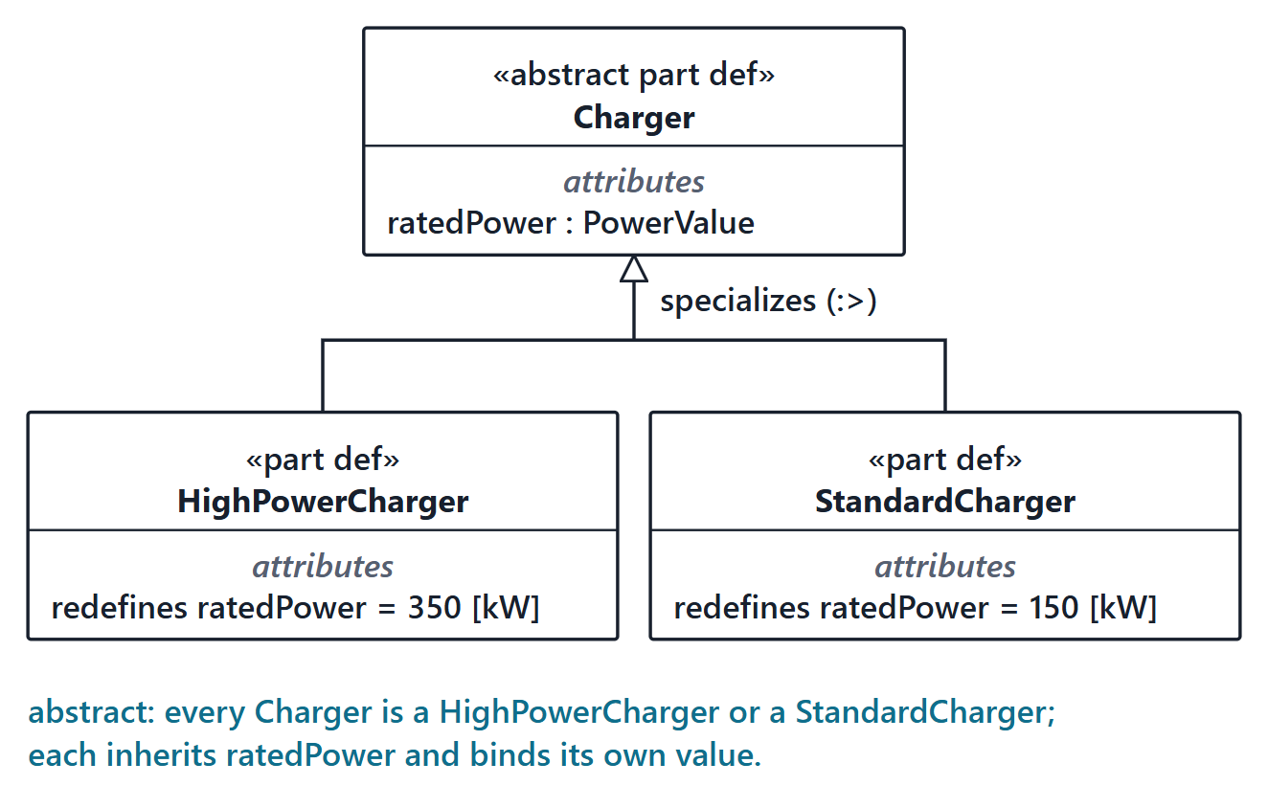
Specialization
A specialized definition classifies a subset of its general definition
It inherits the features and can add its own
:> is the same as specializes
abstract: every instance belongs to some specialization
Figure. An abstract charger and two specializations in the graphical notation: the hollow triangle points at the general definition. (AeroLink, FICTIONAL; ratings are instructor values)
Sources: R70 sl.10; R80 p.64, 72

Slide 18
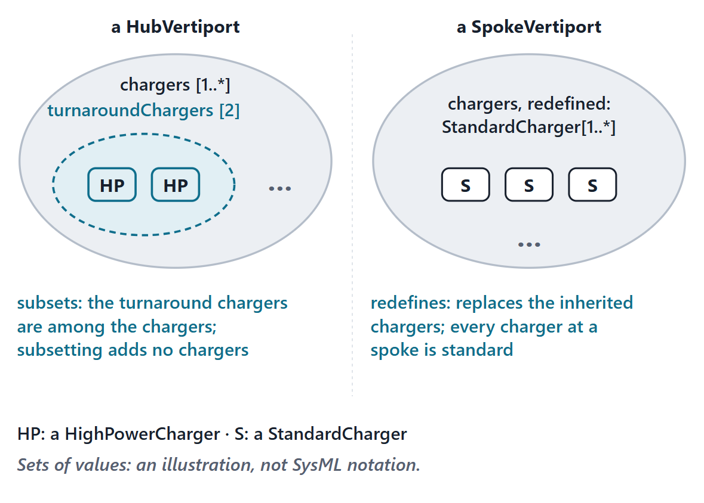
Subsetting
Subsetting: the values of one feature are a subset of another’s
The subsetting feature may narrow type and multiplicity
It is an additional feature; the subsetted one remains
THINK–PAIR (30 S)
A hub has chargers[4]; two of them are its turnaroundChargers. Four chargers in all, or six?
Figure. Subsetting and redefinition as sets of values: at a hub, the turnaround chargers are among the chargers; at a spoke, the chargers are replaced by standard ones. (AeroLink, FICTIONAL)
Sources: R70 sl.11; R80 p.64–65

Slide 19
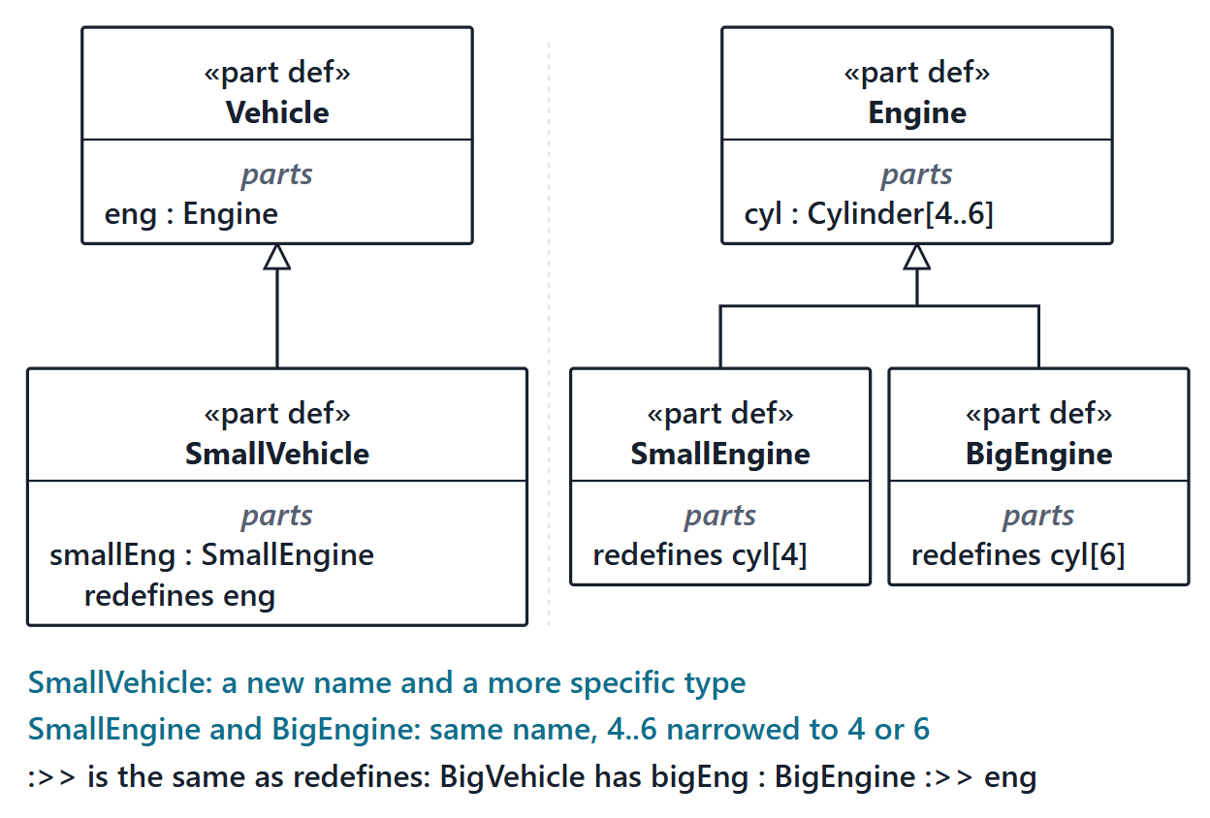
Redefinition
Redefinition is a kind of subsetting that replaces the redefined feature
Can change the name, specialize the type, constrain the multiplicity
:>> is the same as redefines
You use it this week: :>> padCount = 4 in Guided Practice
Figure. The training deck’s redefinition example (slide 12) in the graphical notation: a new name and type, and a narrower multiplicity under the same name.
Sources: R80 p.65; R70 sl.12, 15

Slide 20
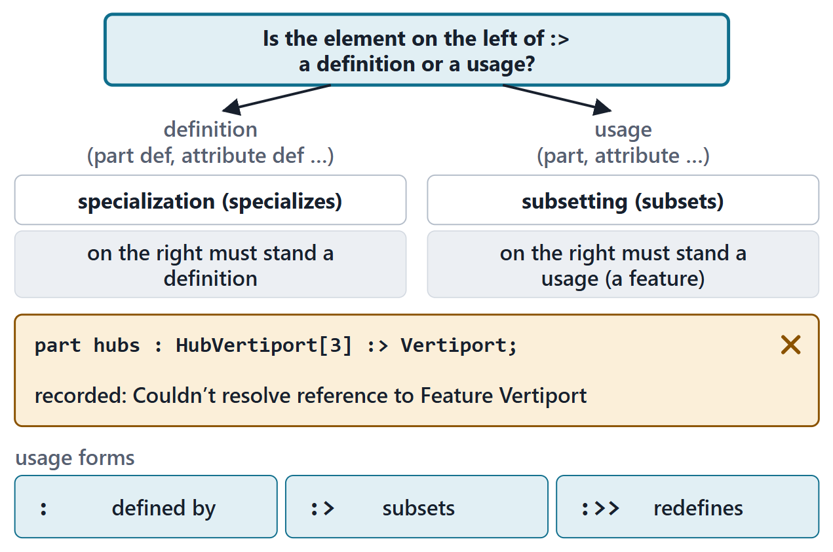
One symbol, two meanings
After a definition: :> means specializes
After a usage: :> means subsets: the right side must be a feature
A usage has three forms: : typing, :> subsetting, :>> redefinition
PREDICT (1 MIN)
part hubs : HubVertiport[3] :> Vertiport; — Vertiport is a part definition. Does the checker accept it?
Figure. Read :> by asking what stands on its left: a definition or a usage.
Sources: R80 p.72

Slide 21
Writing check: your first part definition
PAIRS, 2 MINUTES, ON PAPER
A bakery owns two to four ovens and works with one flour supplier that it does not own. Each oven has a capacity, a whole number. Write the part definitions.
Which keyword for the ovens, which for the supplier?
Where does the multiplicity go?
What type does the capacity have?
Sources: R70 sl.9; R80 p.64

Slide 22
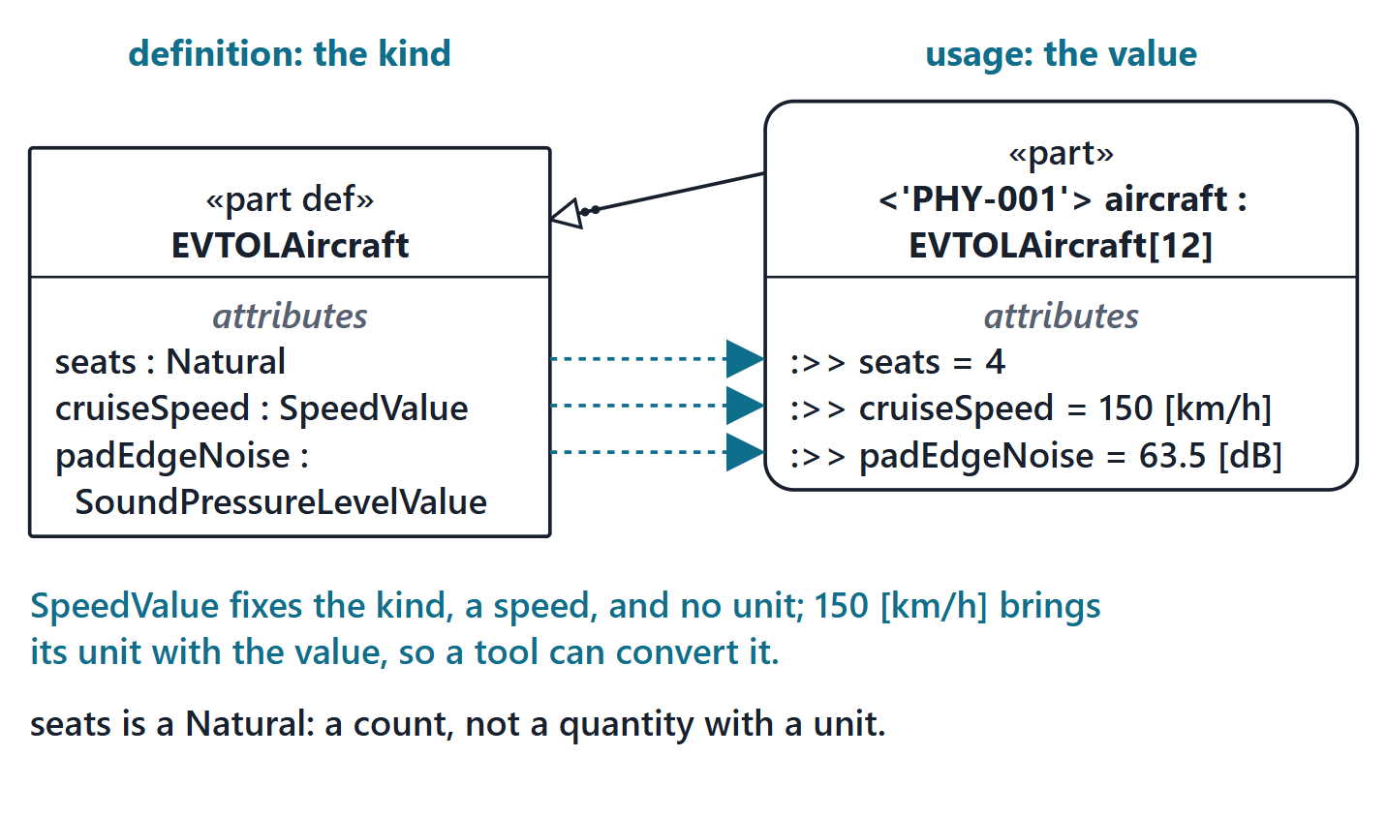
Attributes and quantities with units
An attribute definition defines a set of data values
Quantities use the Quantities and Units library
The definition fixes the kind: SpeedValue
The specific unit comes with the value: 150 [km/h]
Figure. The aircraft definition declares quantity kinds; the AeroLink usage binds each value with its unit. (AeroLink, FICTIONAL; course SysML files)
Sources: R80 p.77; R79 sl.164, 167

Slide 23
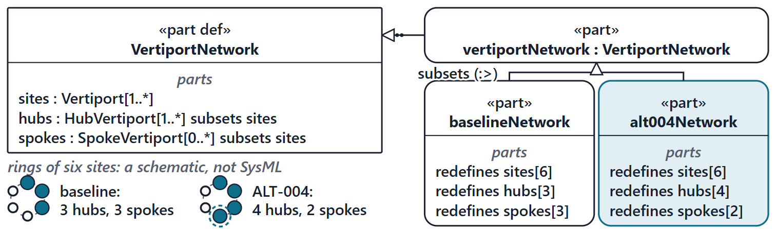
Worked example: kinds and configurations
Kinds: Which box defines a kind of thing?
Among: Which features are among other features?
Configurations: How do the baseline and the alternative differ, and what do they share?
Classify: Two tokens: is :> after baselineNetwork subsetting or specialization? What does part redefines sites[6] do?
Figure. The vertiport network as a definition, a package-level usage and two sibling configurations: the baseline and the recommended alternative. (AeroLink, FICTIONAL; course SysML file)
Sources: R80 p.65; R70 sl.15–16

Slide 24
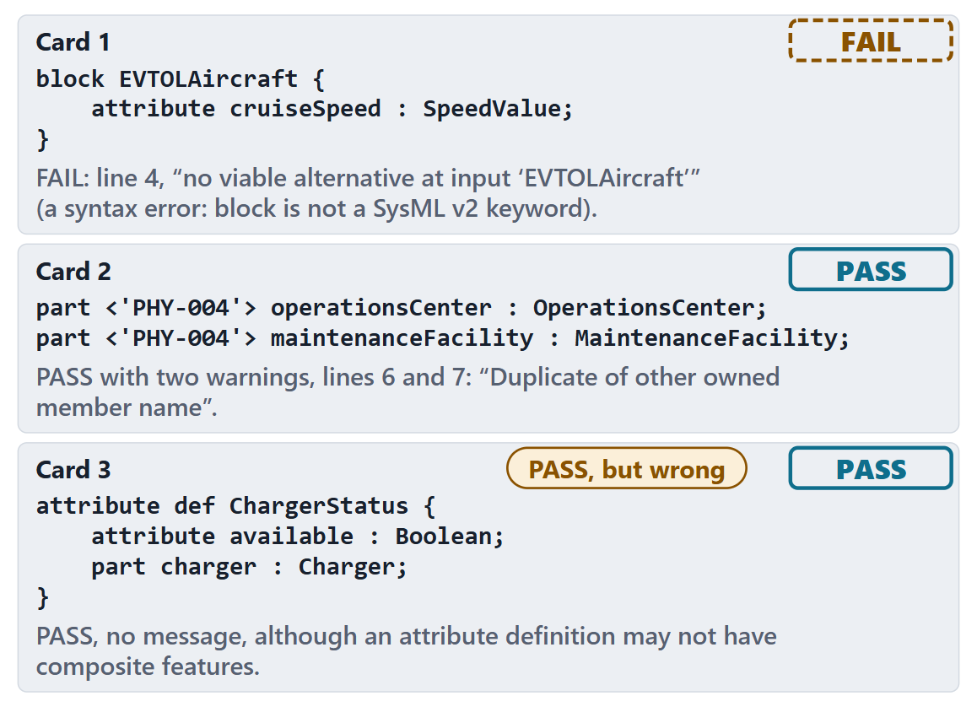
Predict the checker
1 · block EVTOLAircraft { … }
2 · two parts with the same short name
3 · an attribute definition that owns a part
KEY POINT
A PASS means the file parsed and no rule fired. Meaning is your responsibility.
Figure. Three listings and the results the course checker recorded for them. The third passed with a real modeling error.
Sources: R70 sl.9; R80 p.77

Slide 25
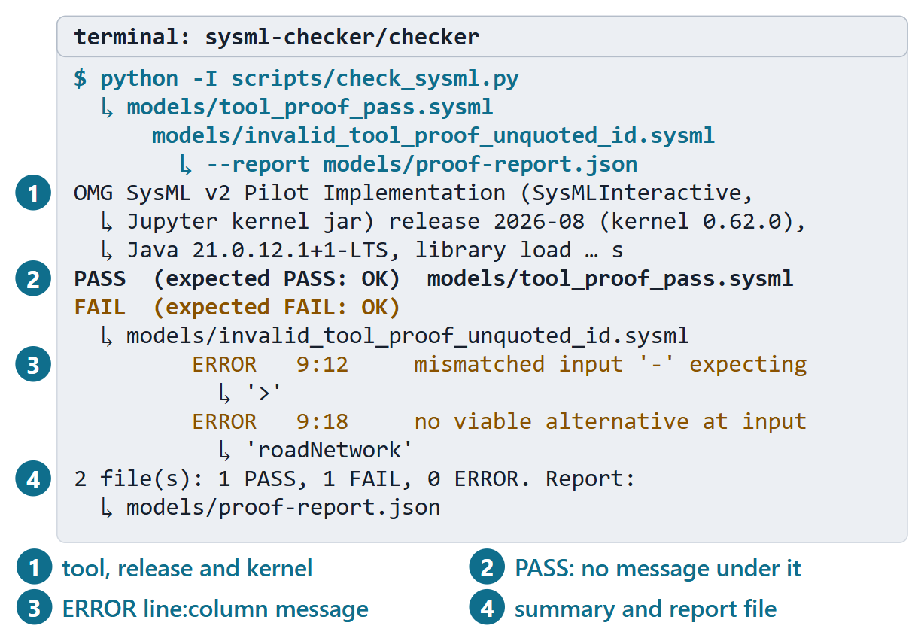
Live demonstration: running the course checker
Command: python -I scripts/check_sysml.py, then your files
PASS: parsed, every name resolved, no rule fired
ERROR line:column message: go to that place; fix the first error first
Guide: “Install and run the course checker”; one installation per team
Figure. The tool proof as the course checker prints it: the command, a PASS with no message, a FAIL with its diagnostics, and the summary (recorded course run).

Slide 26
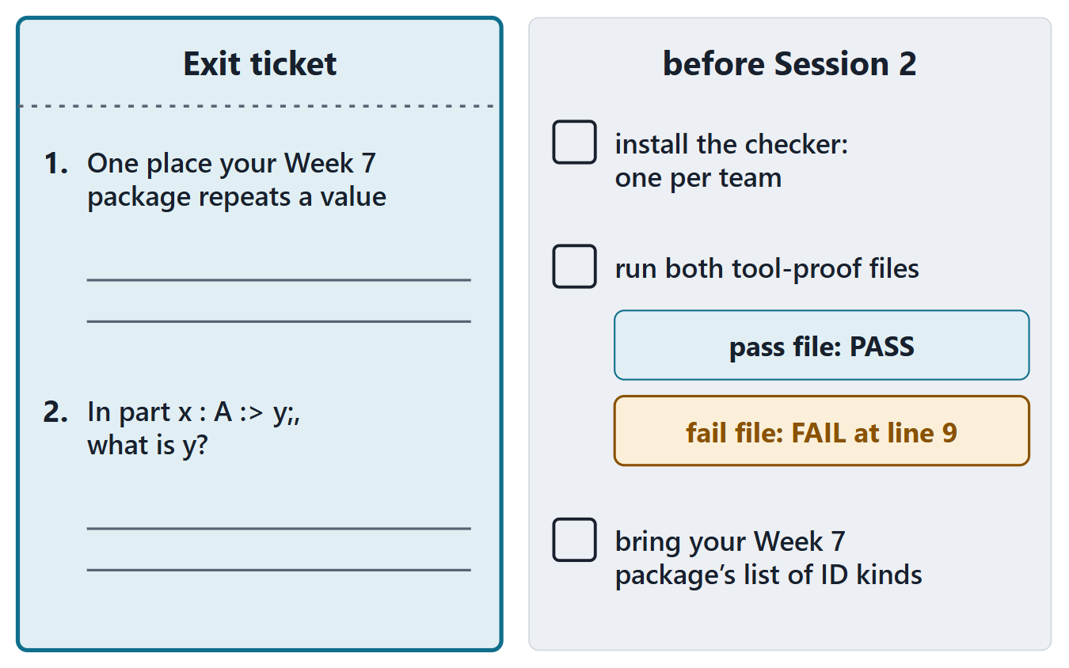
Exit and preparation for Session 2
Ticket 1: one place your Week 7 package repeats a value
Ticket 2: in part x : A :> y; what is y?
Before Session 2: one checker installation per team (guide: “Install and run the course checker”)
Each member: run the two tool-proof files
Bring the list of ID kinds in your package
Figure. The exit ticket, and what to do before Session 2: one checker installation per team, and the tool proof every member runs.

Slide 27
References and credits
R27 · SEBoK v2.14 (2026), “Fundamentals for Digital Engineering”, p.56
R28 · SEBoK v2.14 (2026), “Model-Based Systems Engineering (MBSE)”, p.370, 372–374
R33a · SEBoK v2.14 (2026), “What is a Model?”, p.290–292
R33b · SEBoK v2.14 (2026), “Why Model?”, p.295–296
R33c · SEBoK v2.14 (2026), “Types of Models”, p.300
R70 · Seidewitz, Intro to the SysML v2 Language: Textual Notation (Release 2026-08), “Introduction to the SysML v2 Language”, sl.3–12, 15–16
R79 · Seidewitz, Intro to the SysML v2 Language: Textual Notation (Release 2026-08), “Quantities and Units”, sl.164, 167
R80 · OMG SysML v2.1 Beta 2, Part 1 (Release 2026-07), “7.1 Language Overview”, p.47–51, 56, 60–61, 63–66, 72–73, 77
R85 · OMG SysML v2.1 Beta 2, Part 1 (Release 2026-07), “7.26 Views and Viewpoints”, p.181
R90 · Friedenthal, Intro to the SysML v2 Language: Graphical Notation (2023-03-07), “Systems Modeling Language”, sl.7–9, 12, 22
CREDITS AND LICENSES
Introduction to the SysML v2 Language, Textual Notation (Release 2026-08): Copyright © 2019–2026 Model Driven Solutions, Inc. Licensed under the Creative Commons Attribution 4.0 International License (CC BY 4.0).
SEBoK v2.14: “This material is used under a Creative Commons Attribution-NonCommercial ShareAlike 3.0 Unported License from The Trustees of the Stevens Institute of Technology.” (SEBoK, “Bkcase Wiki:Copyright”, PDF p.31). Quotations are short and cited; no SEBoK figure or table is reproduced.
Figures are original drawings for this course, except the photographs credited here; none redraws a figure from the sources.
AeroLink Urban Mobility is a fictional teaching case: every number, name and statement about it is a teaching value.
Photograph in the figure “The AeroLink usage and the thing it describes”: “Vertiport CU rev3”, artist concept by NASA Headquarters (Lillian Gipson and Kyle Jenkins), 2021, https://commons.wikimedia.org/wiki/File:Vertiport_CU_rev3.jpg (NASA photo ID vertiport_CU_rev3). Public domain in the United States (created solely by NASA); no endorsement by NASA is implied.

