Slide 1
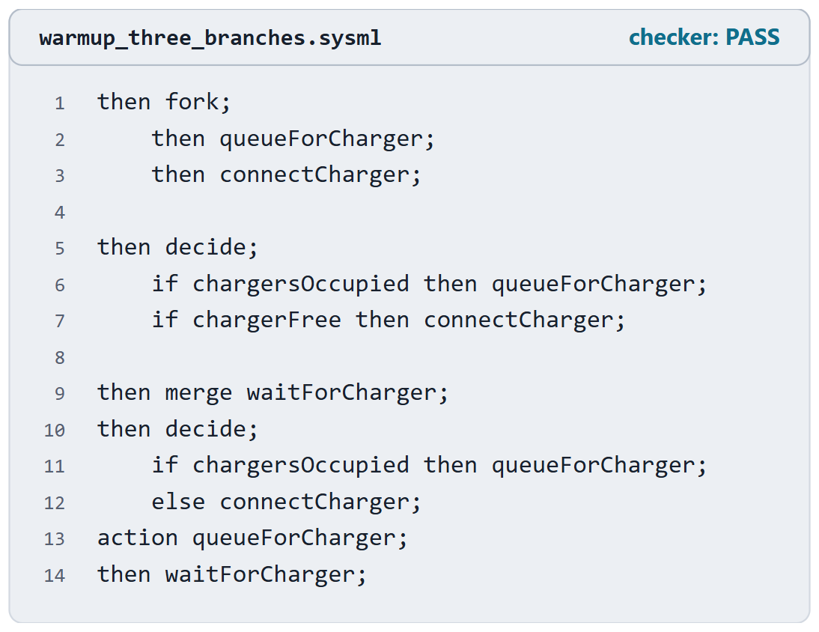
Warm-up: three drafts of one branch
ConOps: if both hub chargers are occupied, queue the aircraft; otherwise connect
Draft A, draft B, draft C (top to bottom)
Which one says what the ConOps says?
What is wrong with the other two?
Figure. Three drafts of one branch of the AeroLink charging scenario, shown as the lines that differ: draft A, draft B and draft C, top to bottom. Pairs: which one says what the ConOps says? Checked: PASS. (FICTIONAL)

Slide 2
Reveal: exactly one branch, and every case covered
Draft A: a fork starts both: the aircraft queues and is connected
Draft B: two guards that can both hold, or both fail; no else
Draft C: right. Queue, or connect; the queue loops back to the merge
KEY POINT
All three pass the checker.
Sources: R72 sl.38; R72 sl.40

Slide 3
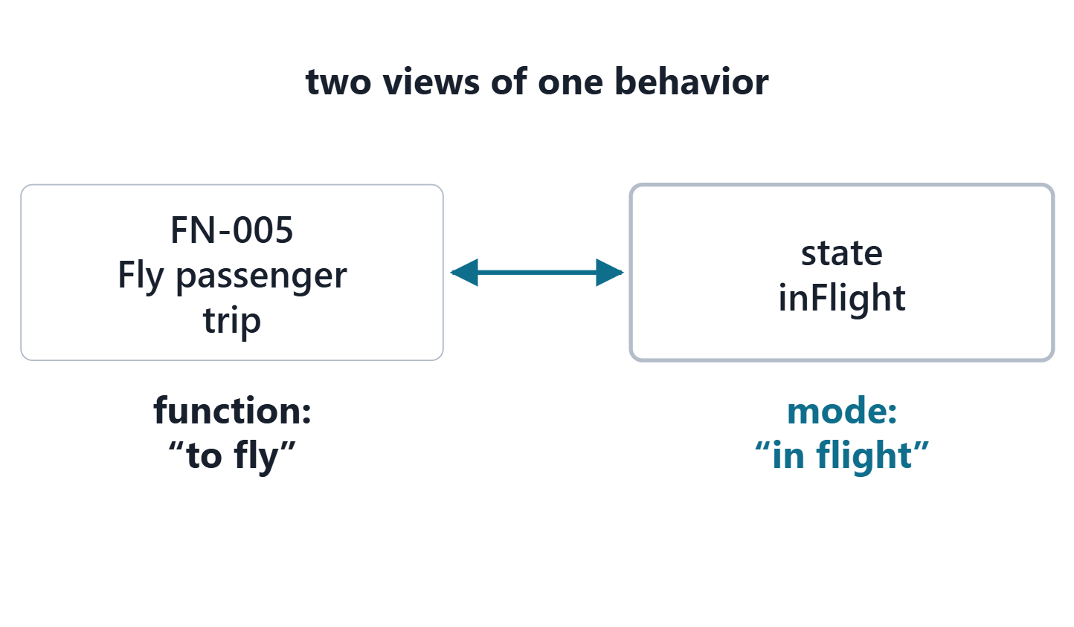
Function or operational mode?
A scenario of modes: a chain of modes, joined by transitions
A transition is triggered by an event; an action can run within it
A function (“to fly”) and its mode (“in flight”) are two views of one behavior
Figure. One AeroLink function and its operational mode: FN-005 Fly passenger trip, “to fly”, beside the state inFlight, “in flight”. Course illustration, not SysML v2 graphical notation. (FICTIONAL)
Sources: R20b p.589; R20b p.594

Slide 4
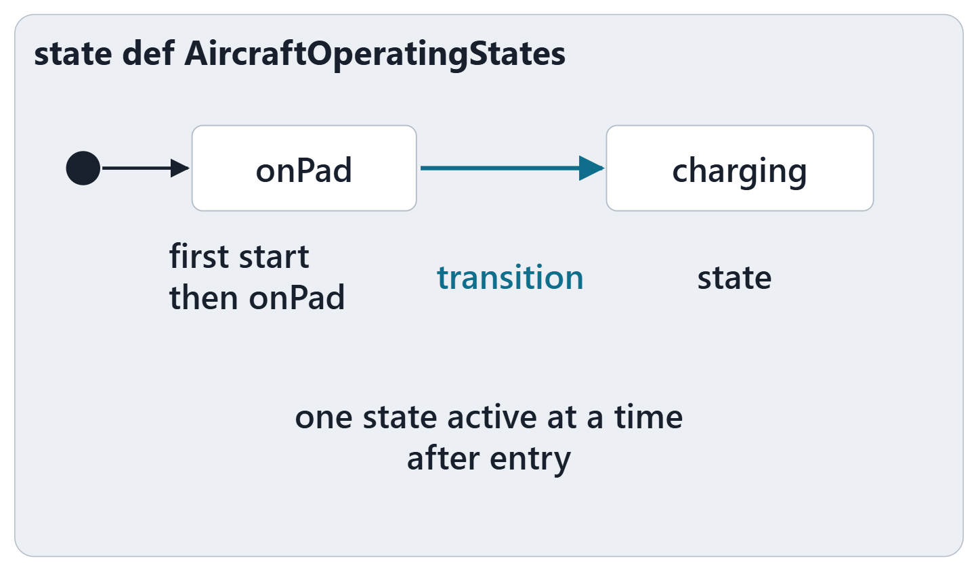
State definitions and the initial state
STATE DEFINITION (SYSML V2.1 BETA 2)
“a kind of action definition … that defines the conditions under which other actions can execute”
R82 · OMG SysML v2.1 Beta 2, Part 1 (Release 2026-07), "7.17 Actions", p.145
Like a state machine; exhibited by a system
Nested states, joined by transitions
Initial state: first start then the state
After entry, exactly one substate is active
Figure. The parts of a state definition on the AeroLink aircraft: the start and the initial state, two states and a transition between them. Course illustration, not SysML v2 graphical notation. (FICTIONAL)
Sources: R73 sl.48; R82 p.145; R82 p.146

Slide 5
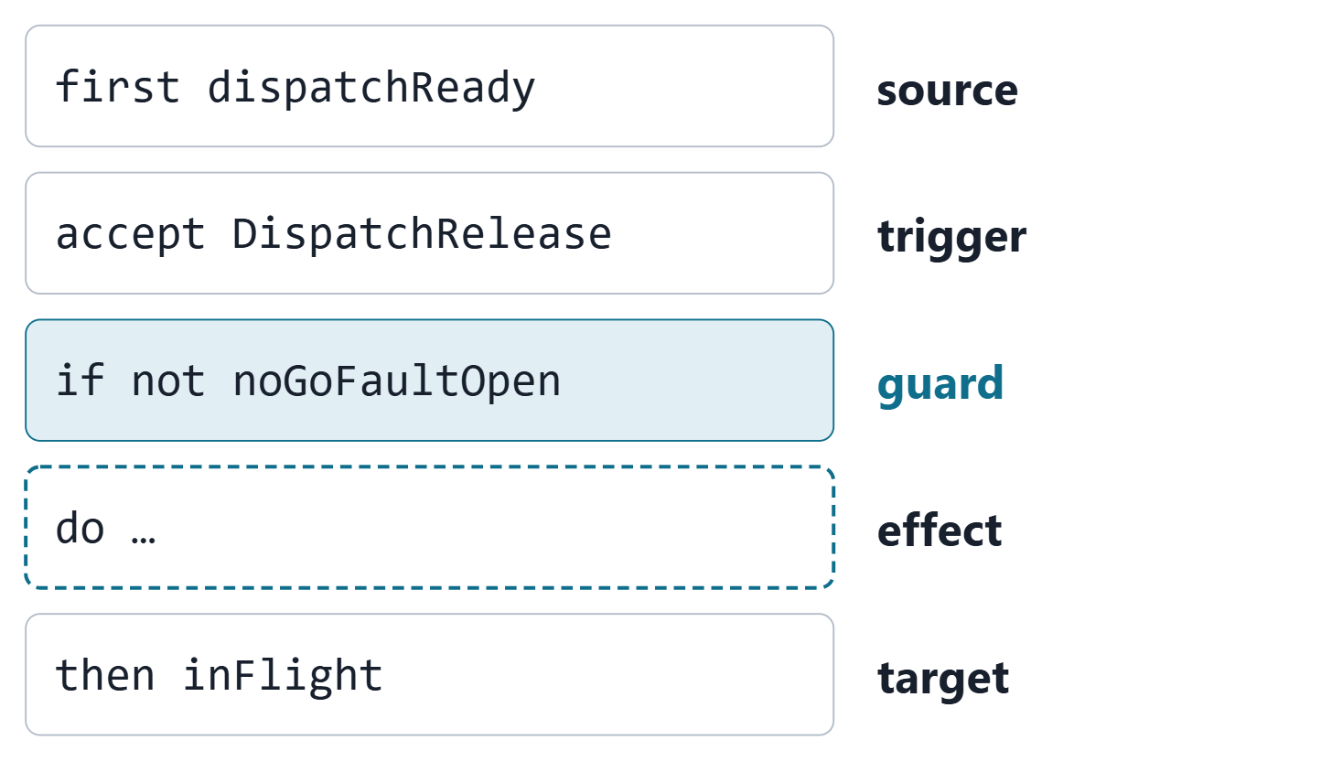
Transitions: trigger, guard, effect, target
first the source, accept the trigger, if the guard, do the effect, then the target
The guard must be true for the transition to fire
The effect runs when it fires, before the target is entered
Shorthand: accept … then … after a state takes that state as source
Figure. One AeroLink transition in its five parts, in the order the textual notation requires; the effect is optional and absent here. Course illustration, not SysML v2 graphical notation. (FICTIONAL)
Sources: R73 sl.48–49; R73 sl.53; R82 p.146

Slide 6
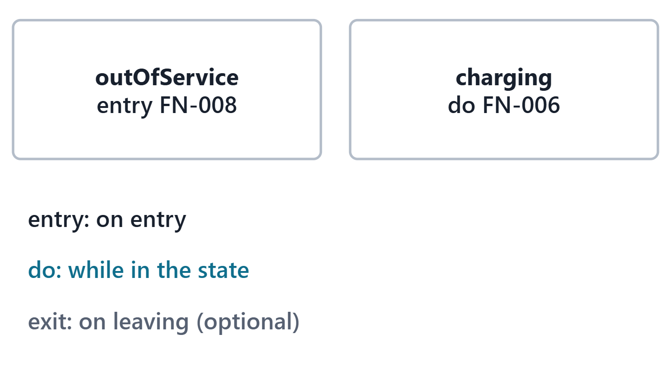
Entry, do and exit actions
entry: performed on entry to the state
do: performed while in the state
exit: performed on leaving it
Each references a function defined elsewhere, or defines an action in place
Figure. Two AeroLink states that run functions: one on entry, one while the aircraft is in the state. Course illustration, not SysML v2 graphical notation. (FICTIONAL)
Sources: R73 sl.52; R82 p.145

Slide 7
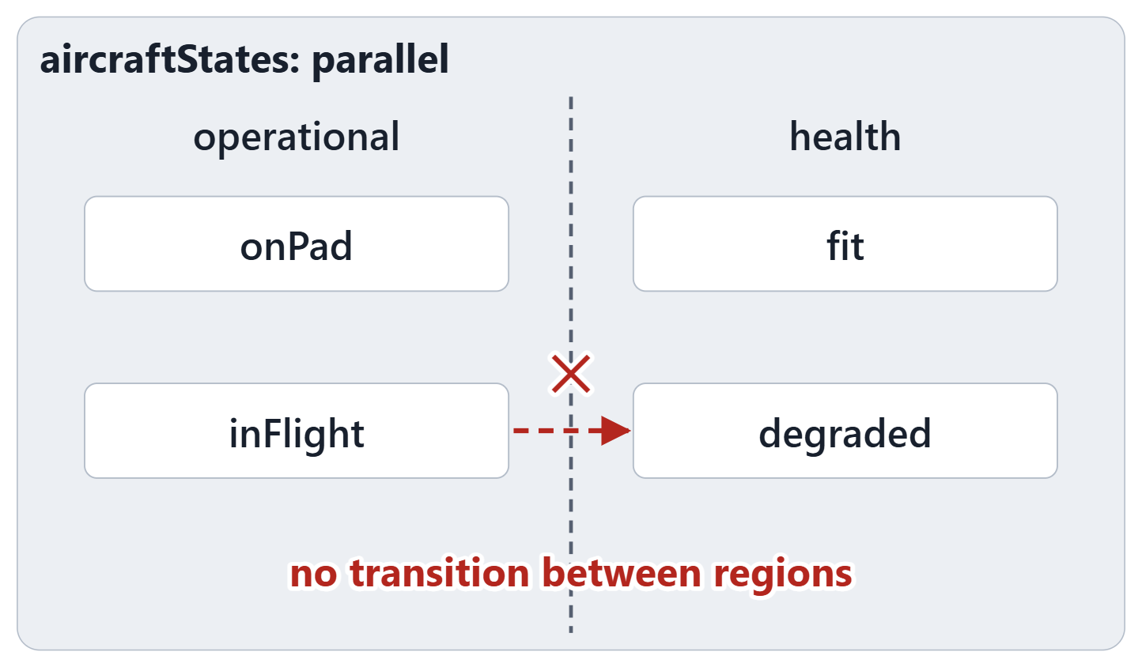
Parallel states and the one-active-substate rule
Parallel: the substates run concurrently
No transitions between concurrent substates
Not parallel: exactly one substate active after entry
Need two conditions at once? Two regions, not one tangled machine
Figure. An aircraft with two concurrent regions, operational and health, and a transition between them, struck through. Course illustration, not SysML v2 graphical notation. (FICTIONAL)
Sources: R73 sl.51; R82 p.146

Slide 8
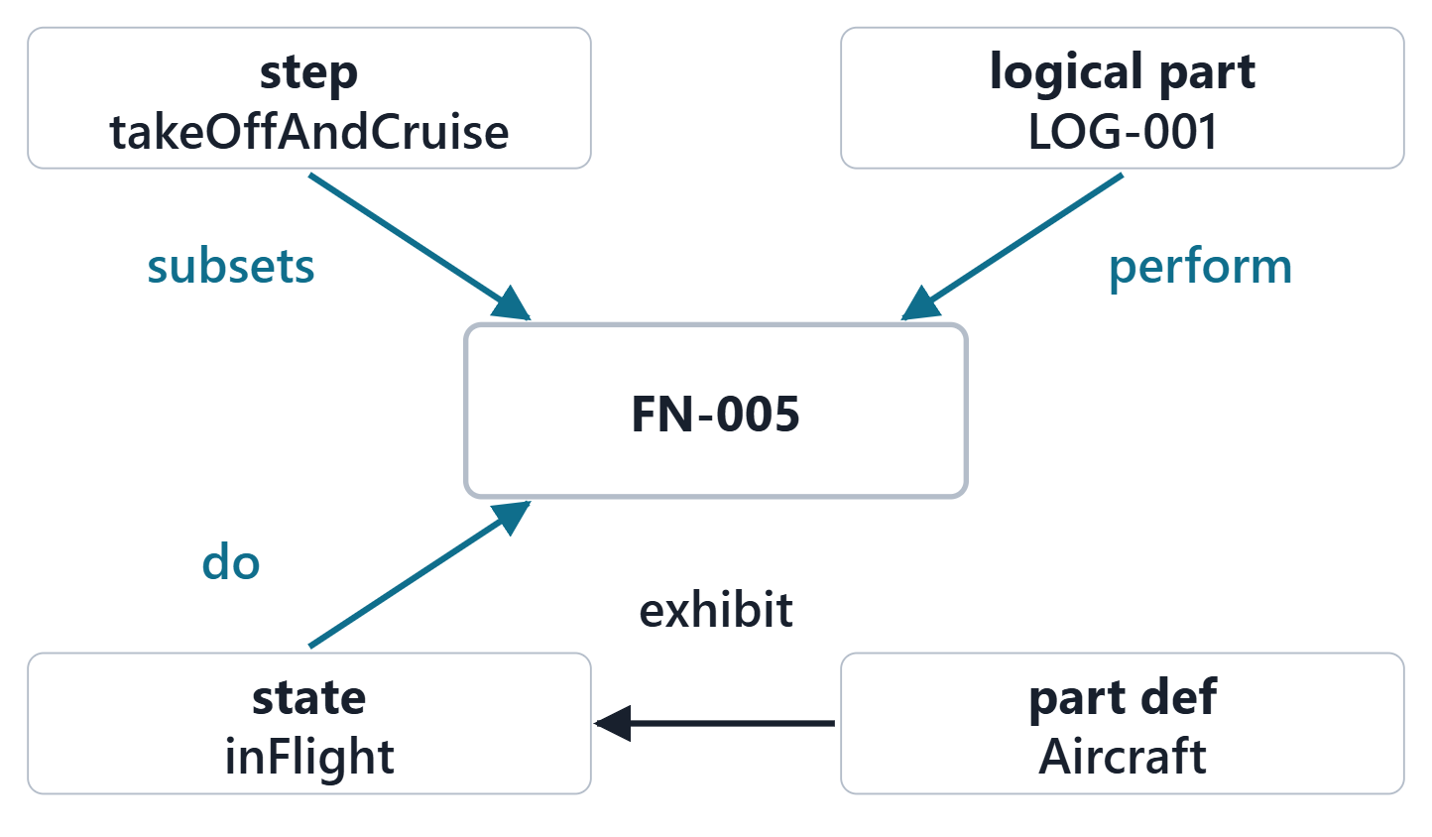
exhibit, and the four links from behavior to structure
Subsets (course convention): this step is an occurrence of the function
perform: this logical part is the performer
do: performed while in this state
exhibit: this part exhibits these states
Figure. FN-005 Fly passenger trip in AeroLink model v0.3, reached by four links: a scenario step subsets it, LOG-001 performs it, the state inFlight does it, and the part definition Aircraft exhibits the states. Course illustration, not SysML v2 graphical notation. (FICTIONAL)
Sources: R73 sl.56; R72 sl.41; R73 sl.52; R82 p.146

Slide 9
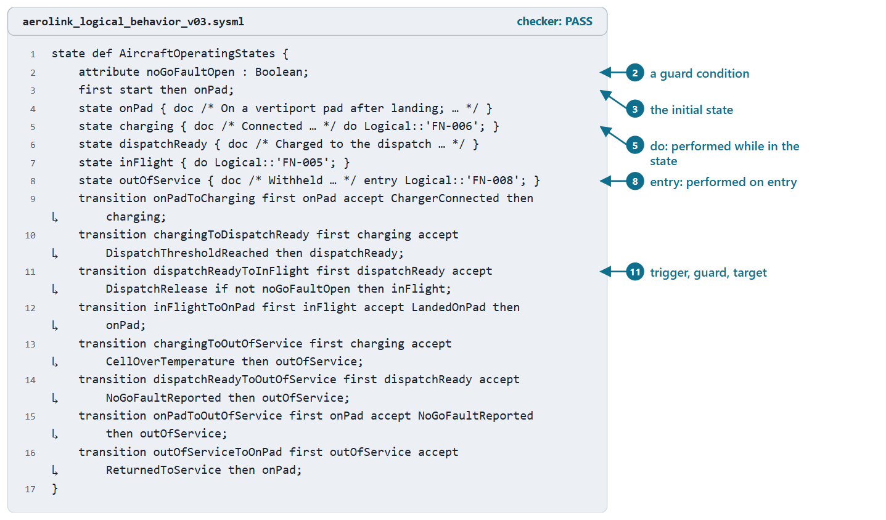
Worked example III: the aircraft’s operating states
5 states, 8 transitions, 1 guard
Each transition traced to a ConOps step
The guard writes “no dispatch with an open no-go fault”
Exhibited by the aircraft part definition
PAIRS, 1 MIN
An aircraft becomes fit to fly while it is out of service. Where does the model send it?
Figure. The aircraft’s operating states in AeroLink model v0.3: five states, eight transitions and one guard (doc lines omitted on the slide). Checked: PASS. (FICTIONAL)
Sources: R73 sl.48; R73 sl.52–53; R82 p.145–146

Slide 10
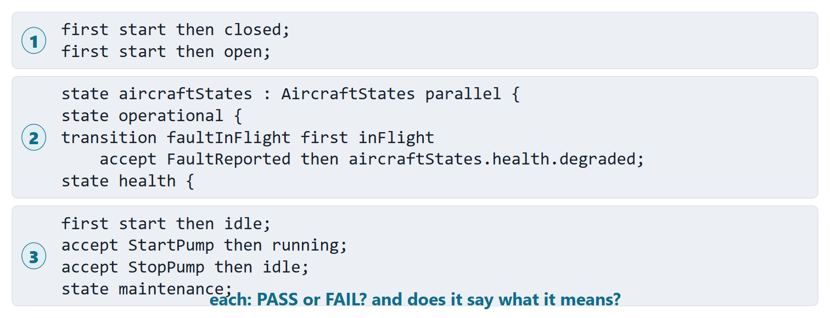
Predict the checker: three state definitions
Figure. Three state listings to judge before the reveal: predict PASS or FAIL, and say whether each says what it means. Course illustration, not SysML v2 graphical notation.

Slide 11
Reveal: all three pass; all three are yours to check
Listing | Recorded result | Says what it means?
1 · two initial states | PASS, no message | No, not caught
2 · transition across regions, inside a region | PASS, no message | No, not caught
3 · unreachable state | PASS, no message | No, not caught
Sources: R82 p.146; R82 p.150; R73 sl.51

Slide 12
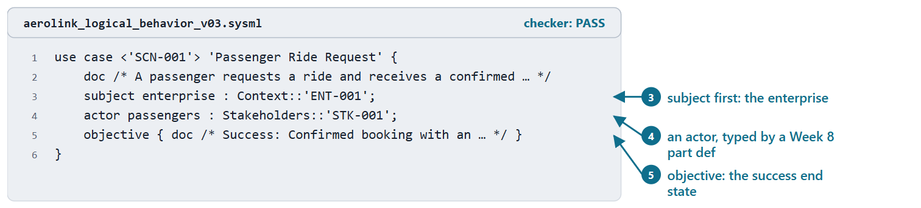
Use cases: subject, actors, objective
USE CASE DEFINITION (SYSML V2.1 BETA 2)
“specifies the required behavior of its subject relative to one or more external actors”
R116 · OMG SysML v2.1 Beta 2, Part 1 (Release 2026-07), "7.25 Use Cases", p.177
Objective: an observable result of value to the actors
Actors: roles of external entities, typed by part definitions
The subject is declared first, before any actor
Figure. SCN-001 Passenger Ride Request as a use case in AeroLink model v0.3: subject, actor and objective (the doc is shortened on the slide). Checked: PASS. (FICTIONAL)
Sources: R116 p.177; R76 sl.100–101

Slide 13
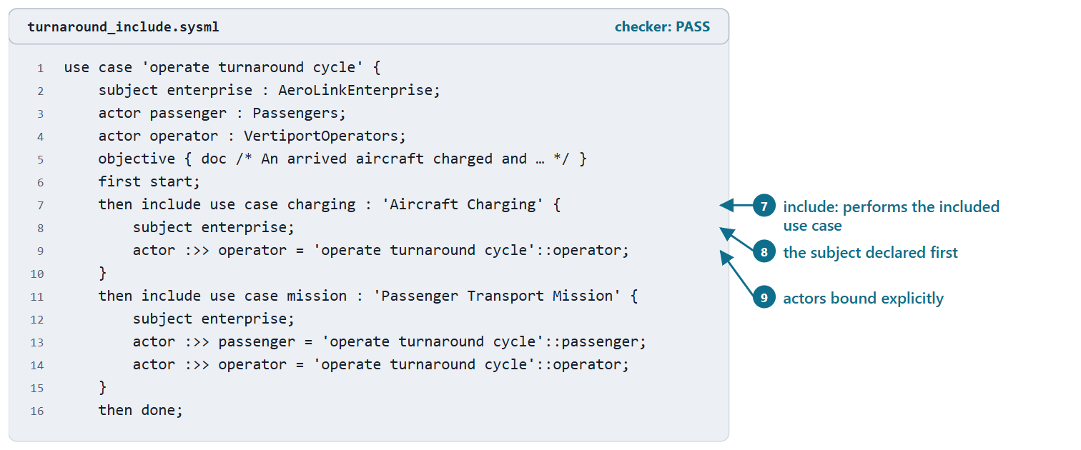
include, and what is not supported
include: performs a use case defined elsewhere
Same subject; actors bound explicitly
extend is not supported yet: use a guarded branch or a separate use case
Figure. A containing AeroLink use case that includes Aircraft Charging and then the Passenger Transport Mission, with the subject declared first and the actors bound. Checked: PASS. (FICTIONAL)
Sources: R116 p.177; R76 sl.101

Slide 14
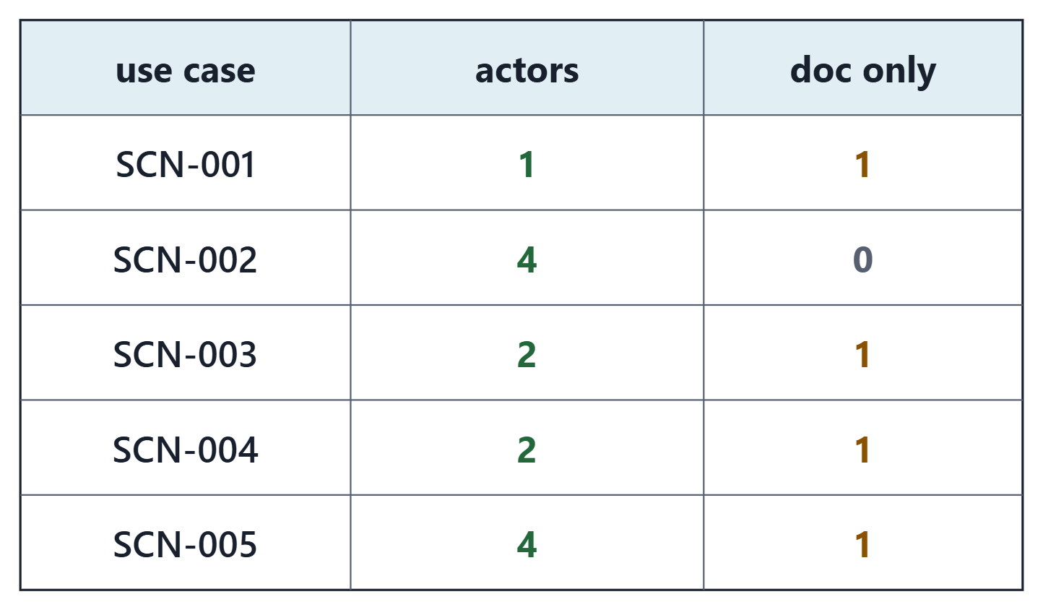
Worked example IV: five scenarios as use cases
Course convention: the enterprise is the subject
13 actors typed by Week 8 stakeholder or context definitions
four roles inside the enterprise stay in the doc
One scenario, SCN-002, carries its flow
Figure. The five AeroLink scenarios as use cases in model v0.3: the actors modeled as parts, and the roles named in the doc only. Course illustration, not SysML v2 graphical notation. (FICTIONAL)
Sources: R76 sl.100; R116 p.177

Slide 15
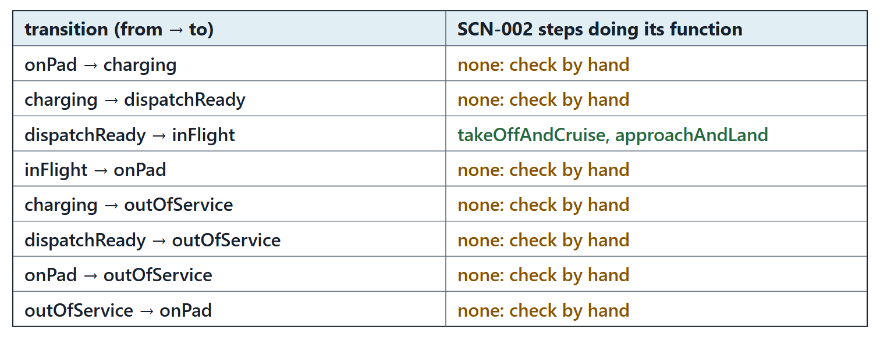
Cross-checking the flow and the states
Figure. The AeroLink cross-check: for each transition of the operating states, the SCN-002 steps whose function the target state performs. Course illustration, not SysML v2 graphical notation. (FICTIONAL)
Sources: R73 sl.48

Slide 16
Common errors in behavior models
Error | Instead
Fork for a choice | decide, guards, else
Guard gap, no else | Cover every case
Rejoins where it should end | then done
Transition across regions | Act within a region
Two initial states | One first start
Function, no performer | perform in a part
States nobody exhibits | exhibit in the part
Sources: R72 sl.38; R72 sl.40; R73 sl.51; R82 p.146; R72 sl.41; R73 sl.56

Slide 17
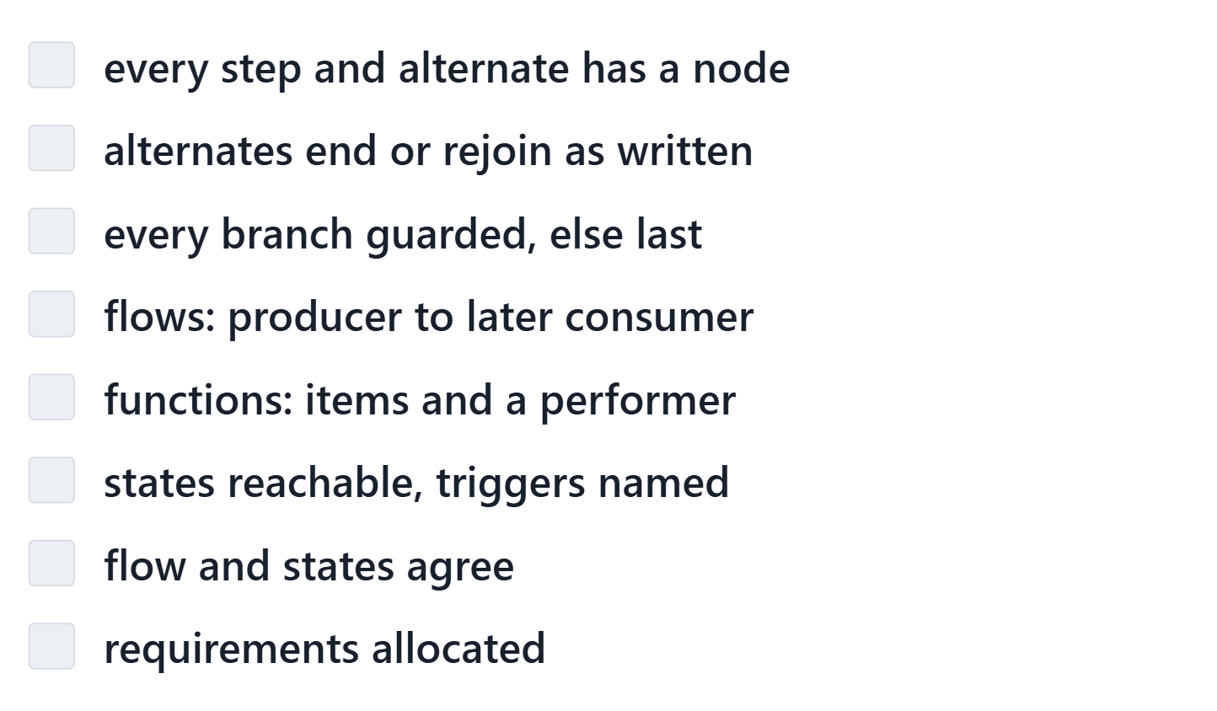
The behavior review checklist
Course convention: eight checks against the ConOps and the model
Each: met, or a finding with a note
The tool gives evidence; the judgment is yours
Every finding gets a disposition
Figure. The behavior review checklist (course convention): the eight checks your team records in the lab, each met or a finding. Course illustration, not SysML v2 graphical notation.
Sources: R72 sl.35–38; R82 p.146

Slide 18
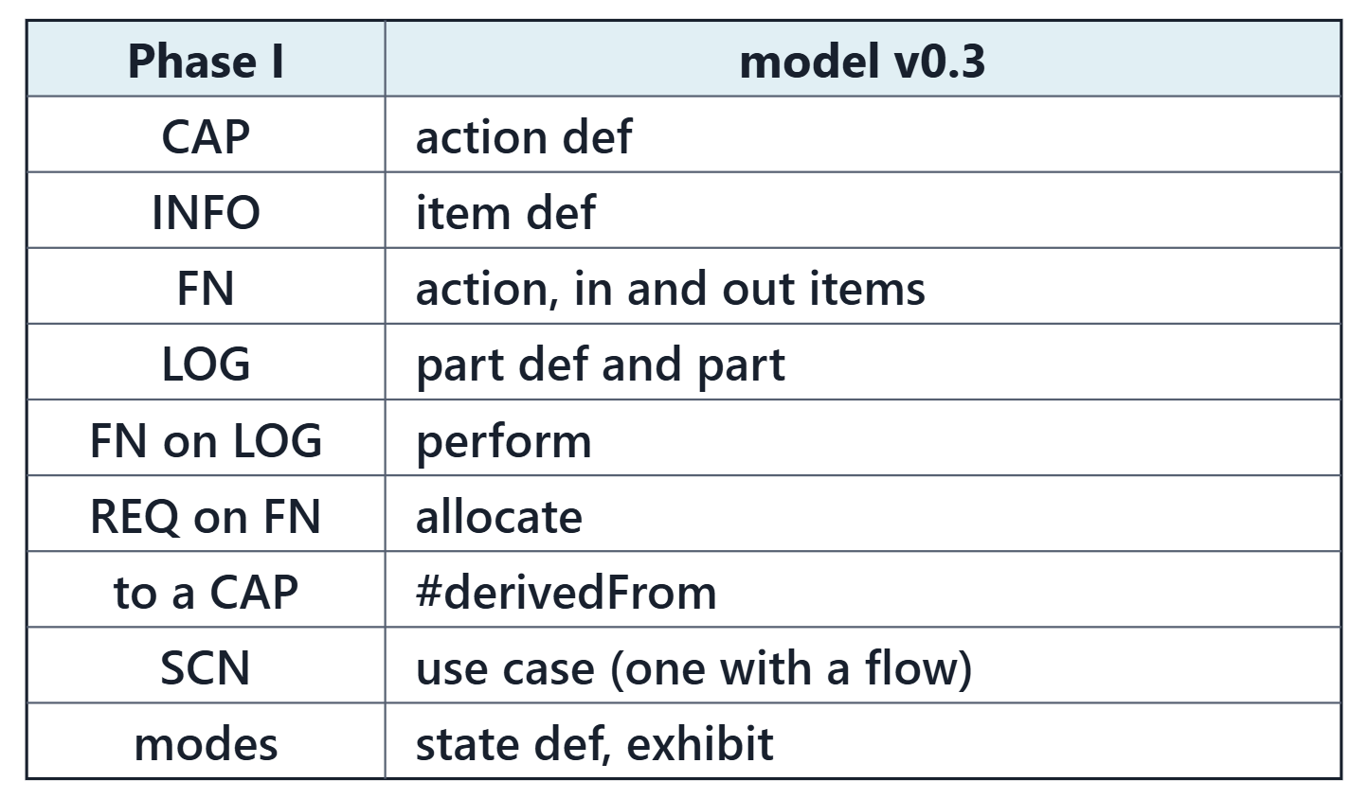
From your package to model v0.3
Course convention: the mapping is generated from your exports
You decide: each function’s items, one scenario’s steps and guards, the states
The tool keeps every ID; new ones continue after the highest
Nothing from Weeks 8 and 9 is changed
Figure. The course mapping for Week 10, short form: each Phase I element of the Week 2 and Week 4 package and the model element it becomes. Course illustration, not SysML v2 graphical notation.

Slide 19
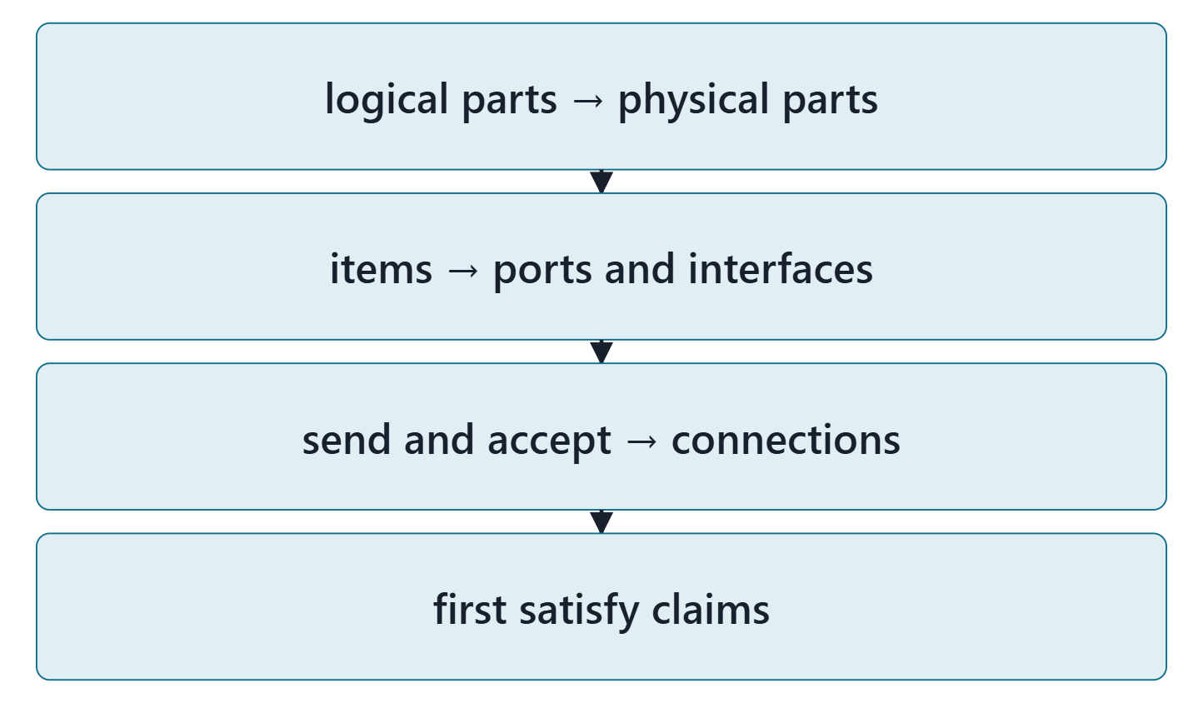
Bridge: Week 11, physical parts and interfaces
Logical parts allocated to physical parts
Items carried on ports and interfaces
Send and accept over real connections
Keep every function and item ID stable
Figure. What Week 11 does with the logical architecture and behavior modeled this week. Course illustration, not SysML v2 graphical notation.
Sources: R76 sl.106

Slide 20
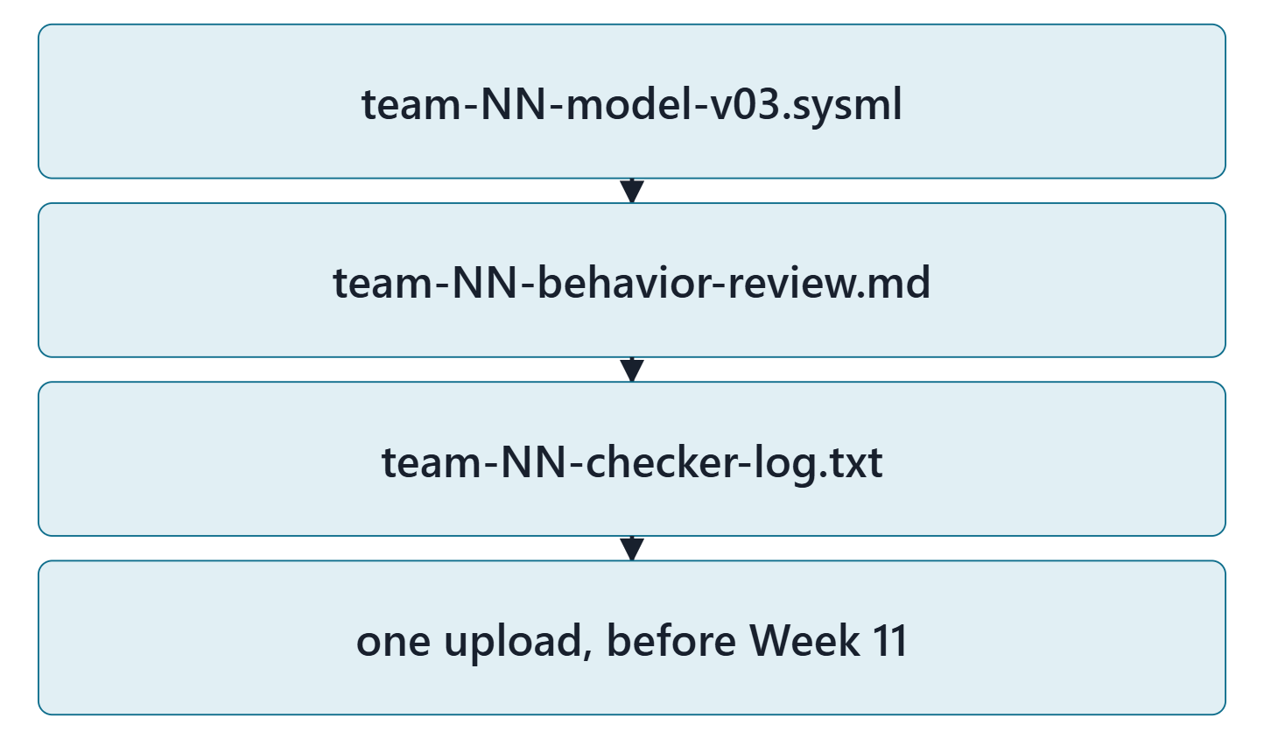
Lab L10: model v0.3 of your enterprise
Due before Week 11, Session 1, on the LMS; your own enterprise, never AeroLink
Your own enterprise, never AeroLink
Three files: team-NN-model-v03.sysml, team-NN-behavior-review.md, team-NN-checker-log.txt
Zero checker errors; every warning explained
Formative feedback before Week 11, Session 2
Figure. Lab L10 deliverables: three files, one upload (course convention). Course illustration, not SysML v2 graphical notation.

Slide 21
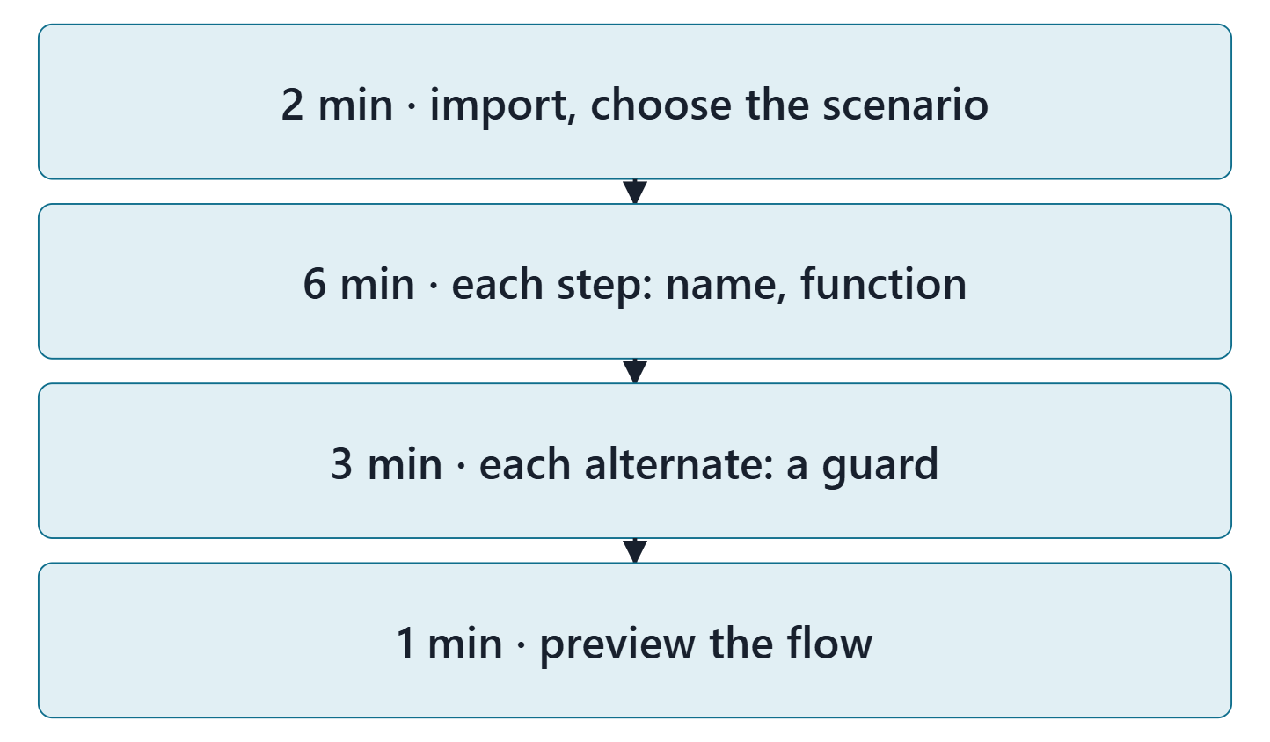
Team work: map one scenario in the lab tool
12 minutes, in teams, in the Week 10 lab tool
Import your Week 9 model and your Week 2 and Week 4 exports
Choose the scenario with the most alternates (team of three: any with one)
Each step: a short name and its function (or none)
Each alternate: a guard that says its condition; preview
Figure. In class: import, choose the scenario, map each step and alternate, preview the flow in the lab tool. Course illustration, not SysML v2 graphical notation.

Slide 22
Instructor checkpoint
Per team: the scenario, one decision, one item flow
Show: the scenario and why it was chosen
Show: one decision; read its guards and else aloud
Show: one item flow, from which step to which
Note one fix to make before day 2

Slide 23
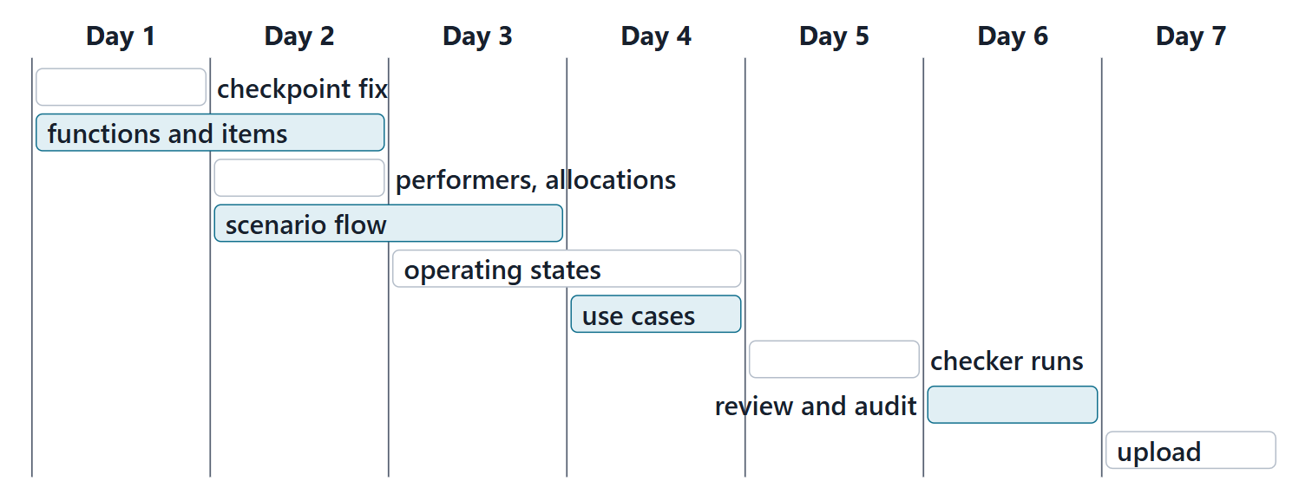
Close: the next seven days
Quiz Q10 and the applied exercise open today. Log your hours.
Figure. A suggested seven-day plan for Lab L10, with the lead role for each task (course convention). Course illustration, not SysML v2 graphical notation.

Slide 24
References and credits
R20b · SEBoK v2.14 (2026), “Logical Architecture”, p.587–592, 594
R72 · Seidewitz, Intro to the SysML v2 Language: Textual Notation (Release 2026-08), “Action Definition”, sl.30–38, 40–41, 45–46
R73 · Seidewitz, Intro to the SysML v2 Language: Textual Notation (Release 2026-08), “State Definitions”, sl.48–49, 51–53, 56
R76 · Seidewitz, Intro to the SysML v2 Language: Textual Notation (Release 2026-08), “Use Case Definition”, sl.100–101, 106–107
R82 · OMG SysML v2.1 Beta 2, Part 1 (Release 2026-07), “7.17 Actions”, p.117–118, 134–136, 145–146, 150
R116 · OMG SysML v2.1 Beta 2, Part 1 (Release 2026-07), “7.25 Use Cases”, p.177
CREDITS AND LICENSES
Introduction to the SysML v2 Language, Textual Notation (Release 2026-08): Copyright © 2019–2026 Model Driven Solutions, Inc. Licensed under the Creative Commons Attribution 4.0 International License (CC BY 4.0).
SEBoK v2.14: “This material is used under a Creative Commons Attribution-NonCommercial ShareAlike 3.0 Unported License from The Trustees of the Stevens Institute of Technology.” (SEBoK, “Bkcase Wiki:Copyright”, PDF p.31). Quotations are short and cited; no SEBoK figure or table is reproduced.
Figures are original drawings for this course; none redraws a figure from the sources.
AeroLink Urban Mobility is a fictional teaching case: every number, name and statement about it is a teaching value.

