Slide 1
Warm-up: three questions from Session 1
1. Is “Charger” a good function name? Why not?
2. Which allocation pitfall skips a plane?
3. What does a decision record hold besides the choice?
Sources: R20b p.587; R20c p.602

Slide 2
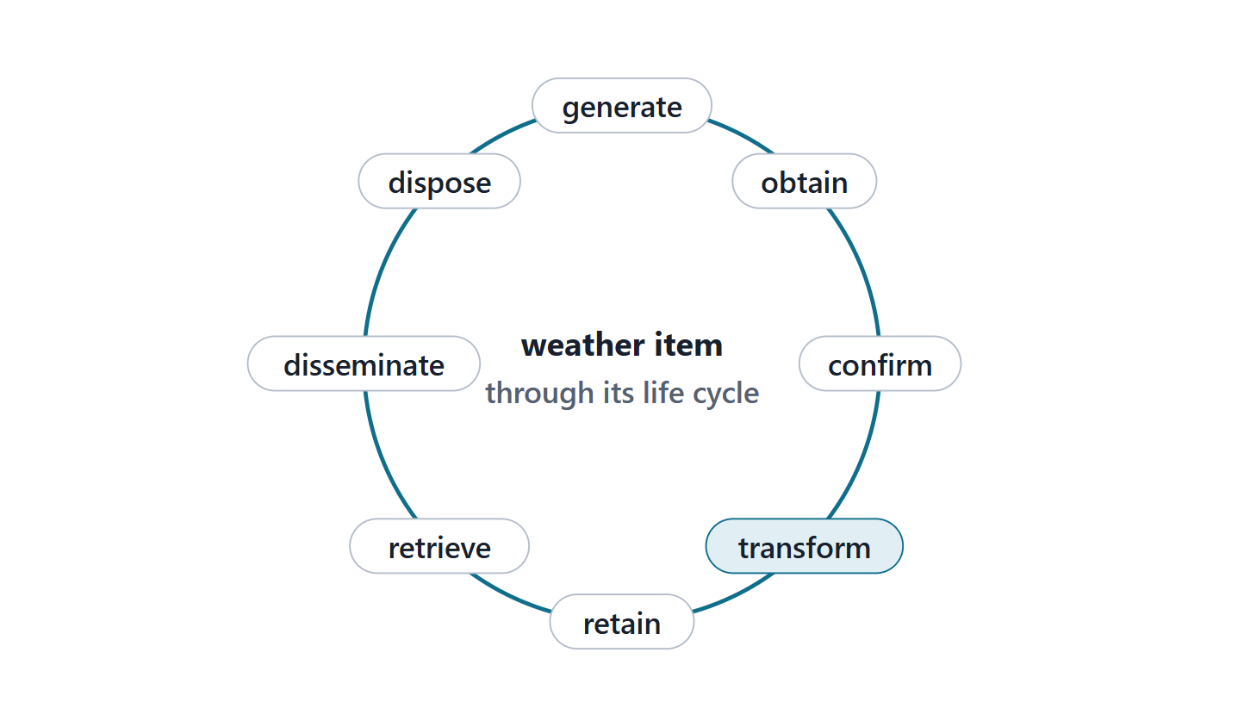
What information management is for
Relevant, complete, verified, protected, distributed
Generate, obtain, confirm, transform … dispose
Supports analytics and decision-making
Data becomes useful information for decisions
Figure. The eight verbs of the 15288 information management purpose, with the AeroLink weather item placed at each stage. (FICTIONAL)
Sources: R21 p.510; R21 p.511; R21 p.512; R66 p.112

Slide 3
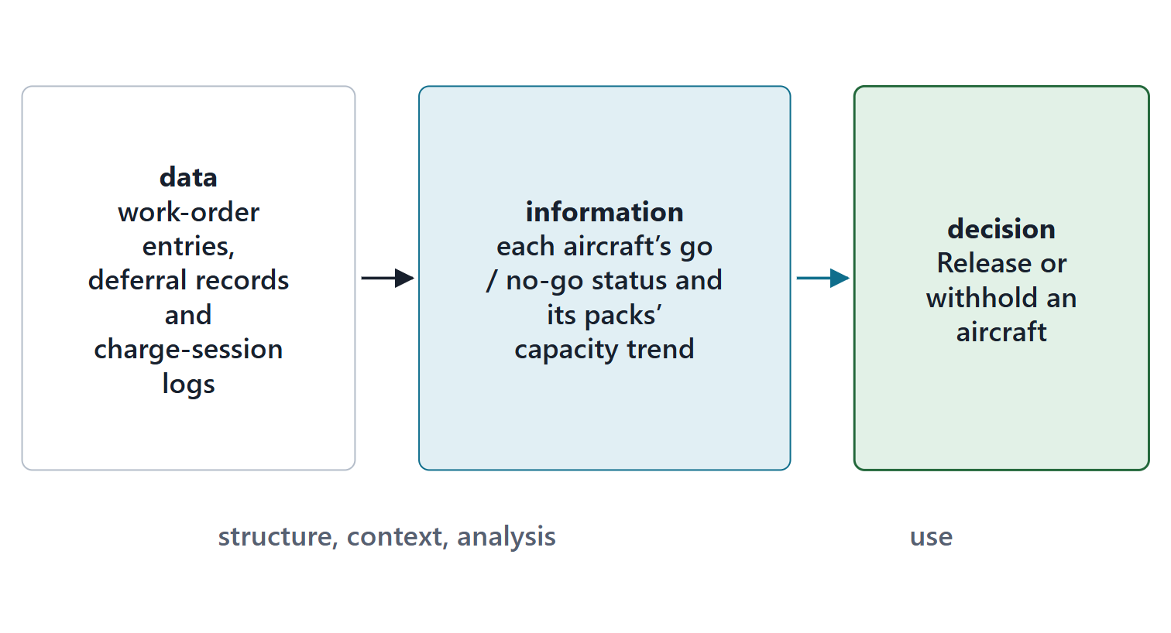
Data versus information
DATA AND INFORMATION
data are raw unstructured values, and information is structured data in context that has been analyzed and interpreted
R21 · SEBoK v2.14 (2026), "Information Management", p.512
Standards draw the line slightly differently
Data without context has no value
Figure. From raw readings, to information in context, to a decision. (FICTIONAL)
Sources: R21 p.511; R21 p.512; R66 p.113

Slide 4
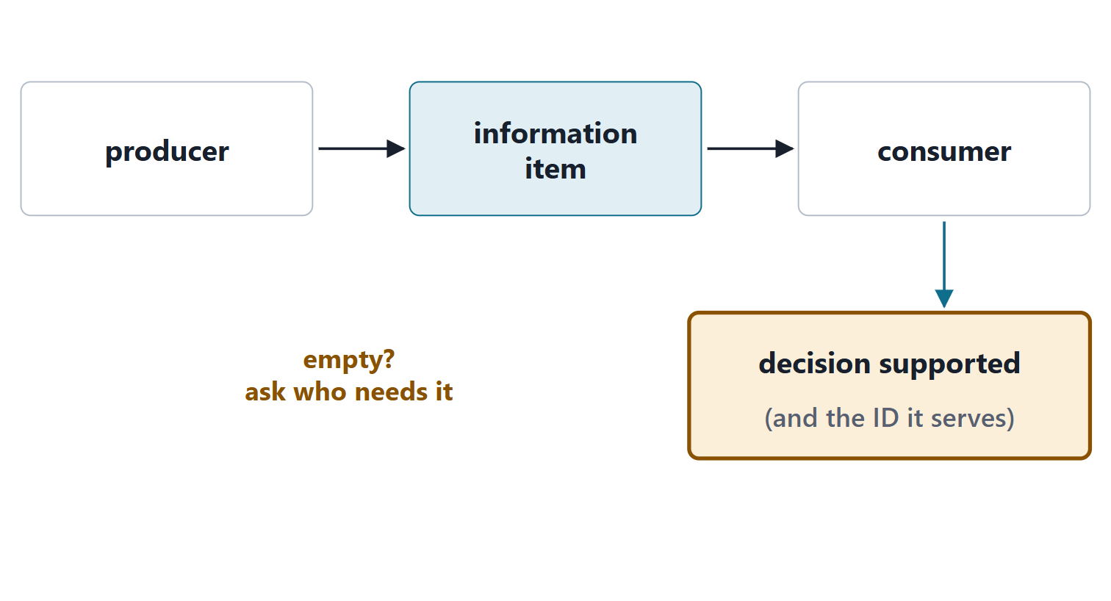
The course method: producer → consumer → decision
Producer: the element that creates it
Consumer: the element or AI capability that uses it
Decision: what it supports, with the ID it serves
No decision? Data not yet information, or not needed
Figure. The three-box template for every information item; an empty decision box means the item is not information yet.
Sources: R21 p.515; R62 p.345; R62 p.346

Slide 5
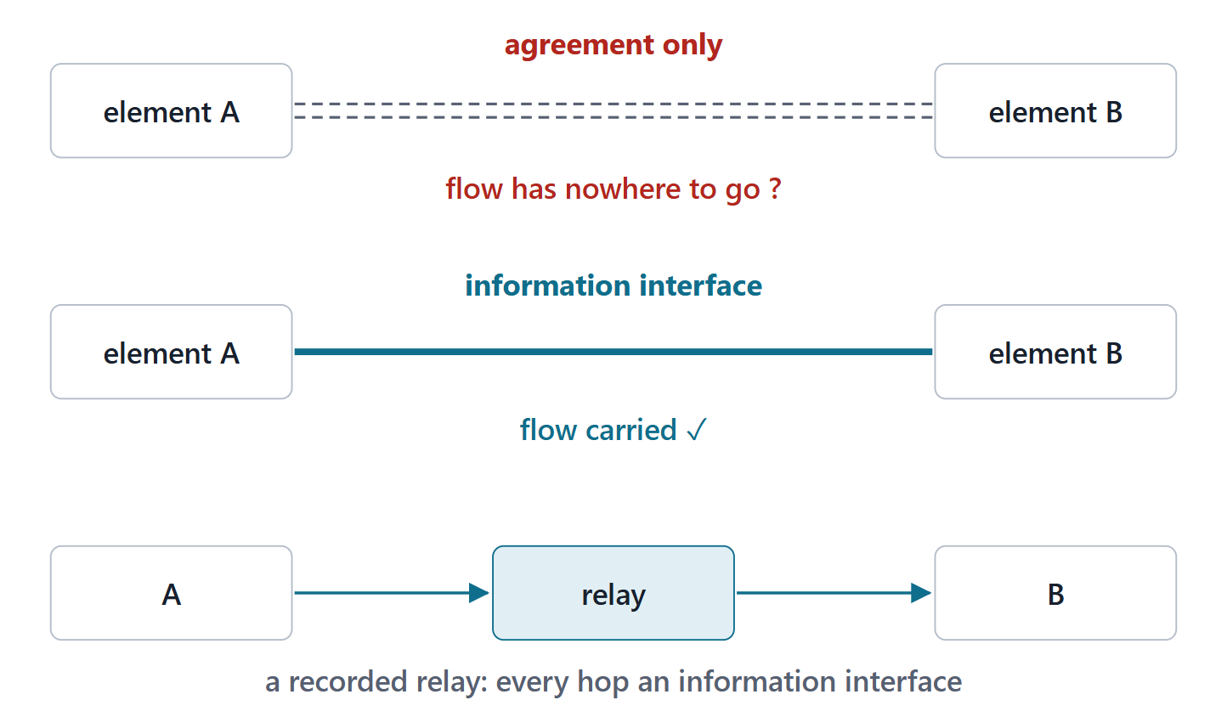
Information flows check the physical view
Related views must be consistent
A flow between elements crosses an information interface
Or a recorded relay of them
An organizational agreement carries no flow
Figure. An agreement line between two elements carries no data; a flow needs an information interface, or a recorded relay of them.
Sources: R62 p.345

Slide 6
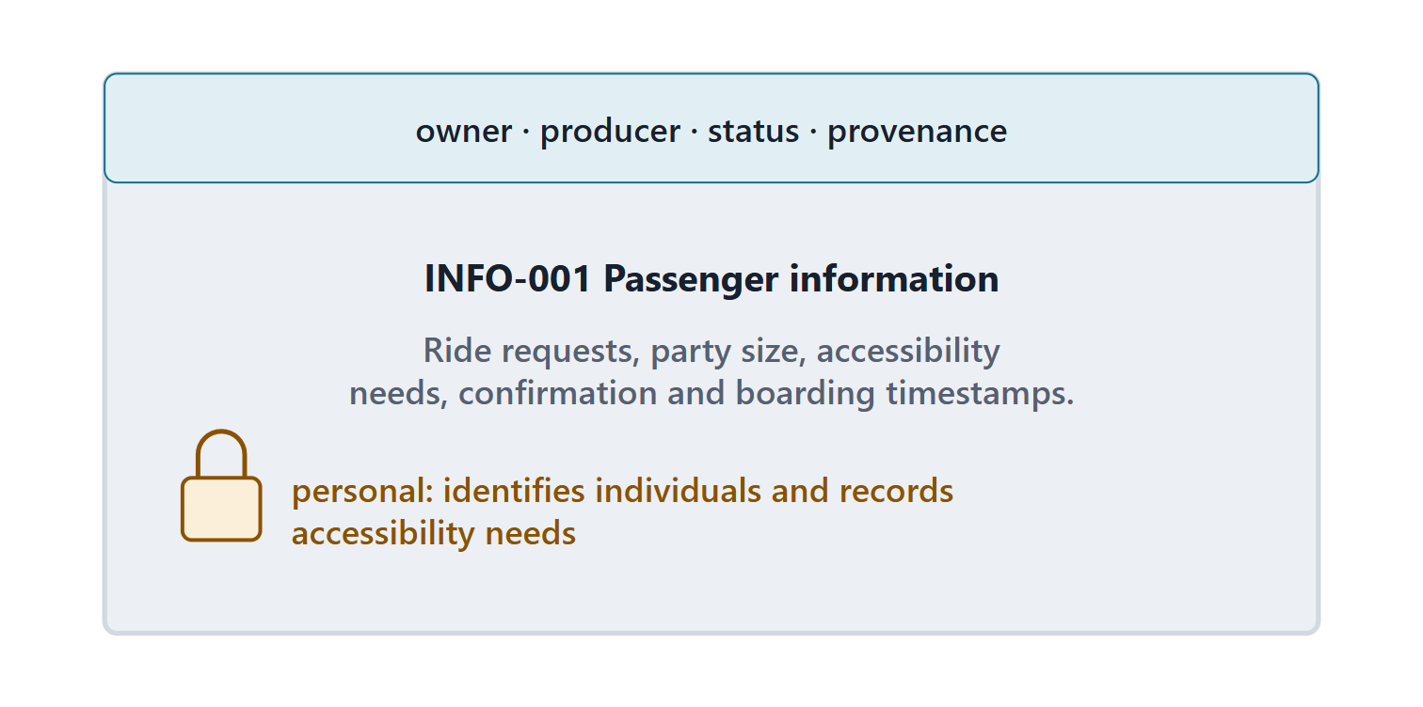
Metadata and sensitive information
Metadata: data about data (title, author, provenance, status)
Security starts by defining sensitive information
Passenger information: personal: identifies individuals and records accessibility needs
Figure. INFO-001 Passenger information with its metadata strip and a lock for its sensitivity. (FICTIONAL)
Sources: R21 p.513; R21 p.514

Slide 7
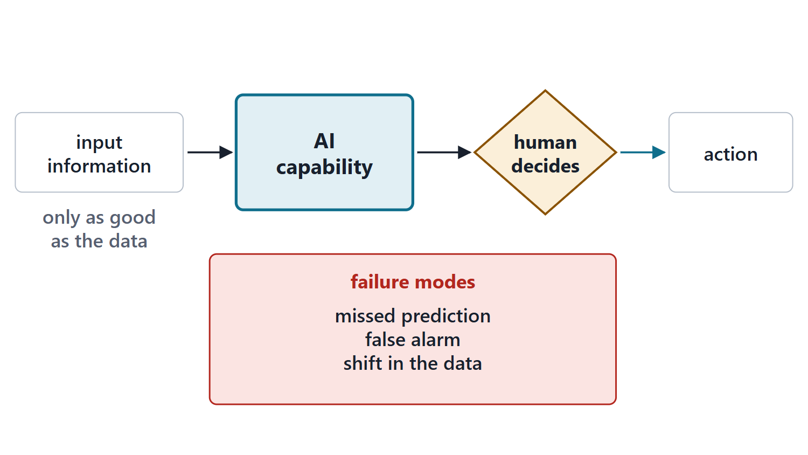
AI capabilities in the information view
A human validates what the system learned
Only as good as the data it was trained on
New failure modes, including distributional shift
Course card: inputs, outputs, oversight, failure
Figure. An AI capability between information items, with a human decision downstream and the failure modes beside it.
Sources: R31 p.1370; R31 p.1371

Slide 8
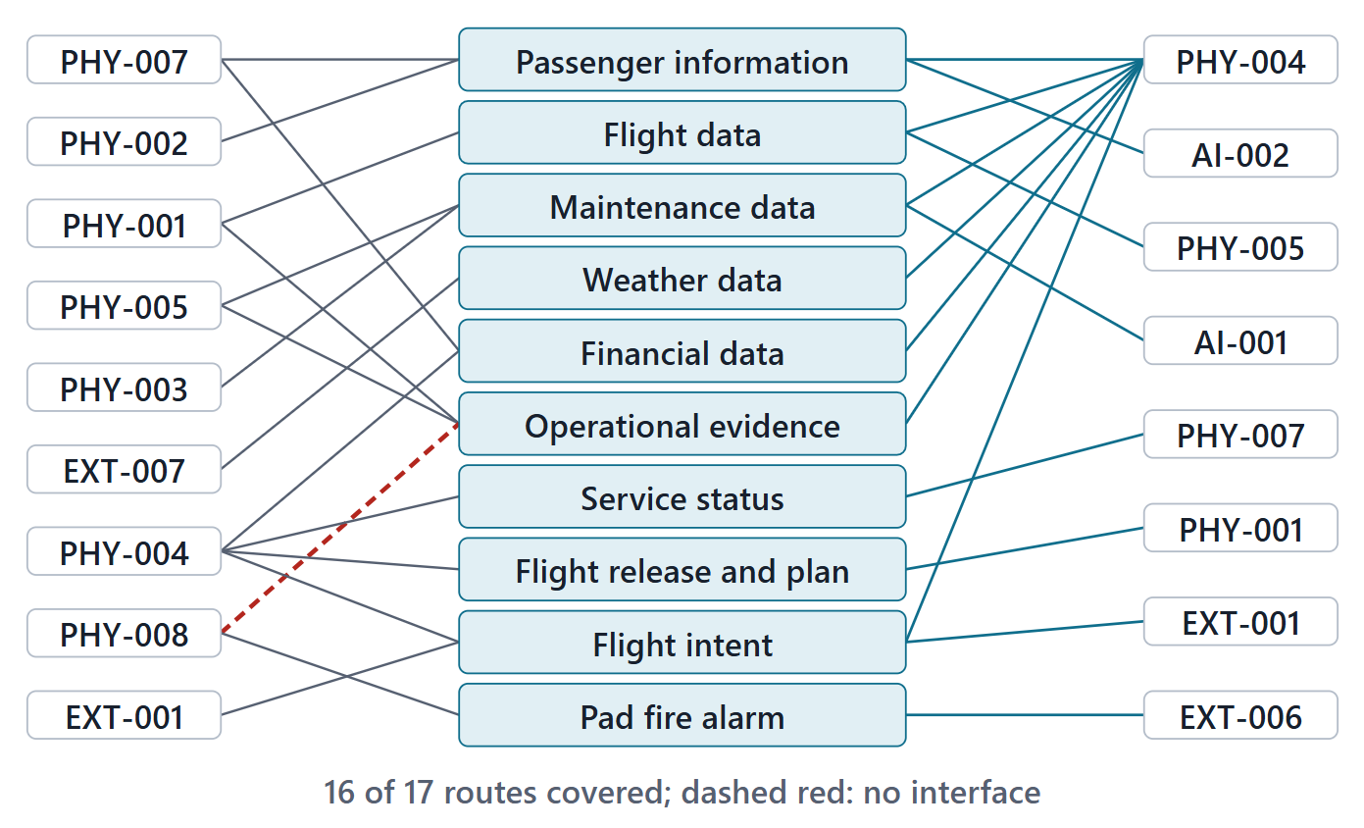
Worked example I: AeroLink’s information items
10 items, each with producer, consumer and decision
20 of 20 function flows between elements carried by an item
16 of 17 producer–consumer routes covered
Two items corrected; five new
Figure. 10 information items from their producers to their consumers; the class supplies each item’s decision before the instructor reveals it. (FICTIONAL)
Sources: R21 p.512

Slide 9
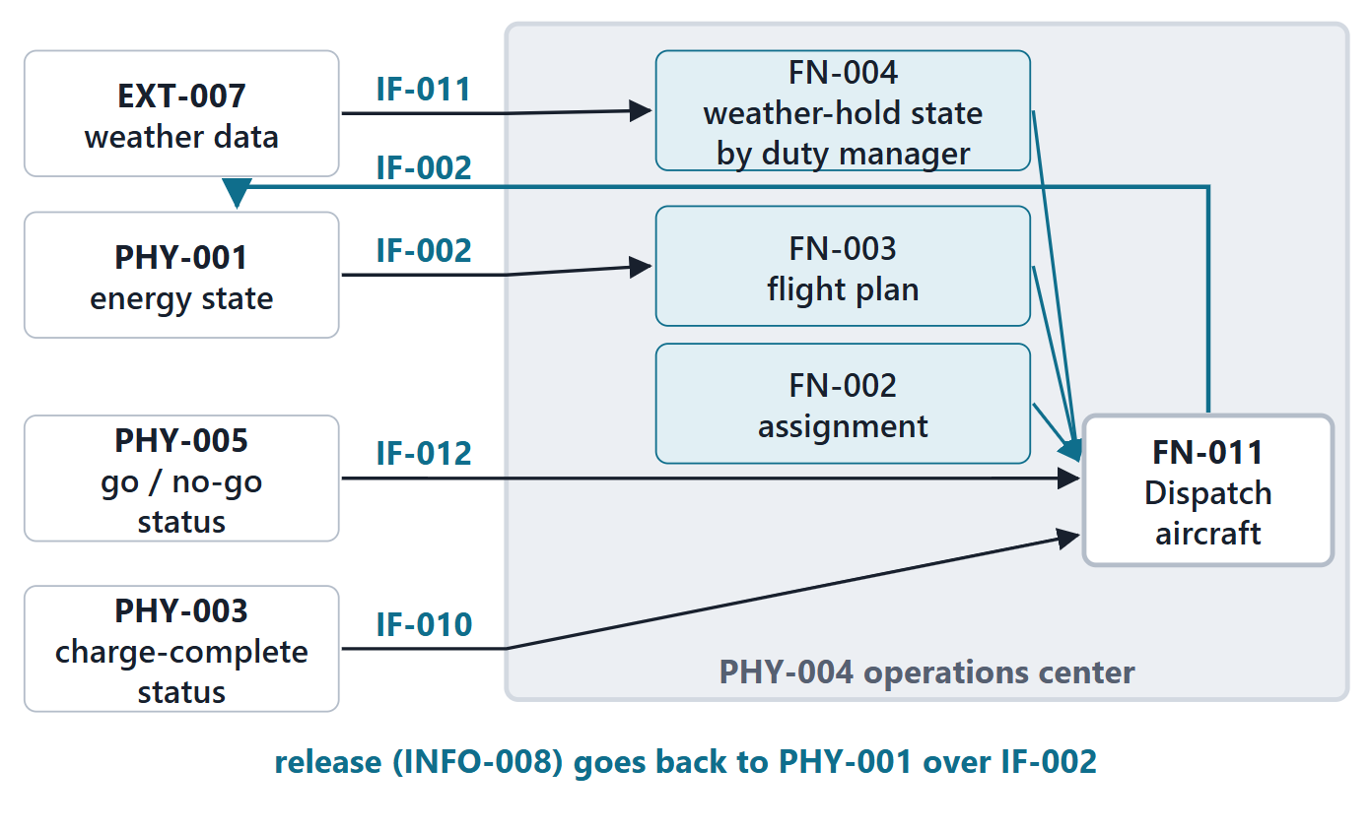
Answering the driving question
Decides: dispatch aircraft, at the operations center
Two inputs cross an interface; three are made inside
Weather data cross; the hold is a decision made inside
History: the trace once found a missing interface
Figure. The Session 1 scene redrawn: what crosses an information interface into the operations center, and what is decided inside it before the release. (FICTIONAL)
Sources: R62 p.345

Slide 10
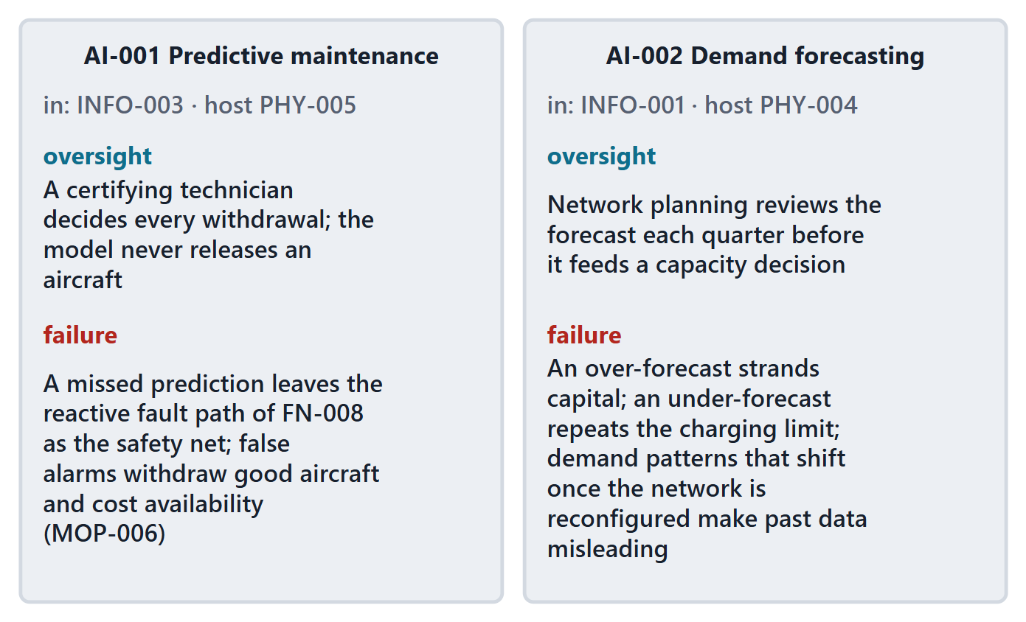
Worked example II: two AI capability cards
Predictive maintenance: technicians decide every withdrawal
Demand forecasting: planners review before any capacity decision
Each names what it may not do
Each names its data-quality weakness
Figure. AI-001 Predictive maintenance and AI-002 Demand forecasting, each with inputs, outputs, oversight and failure modes. (FICTIONAL)
Sources: R31 p.1370; R31 p.1371

Slide 11
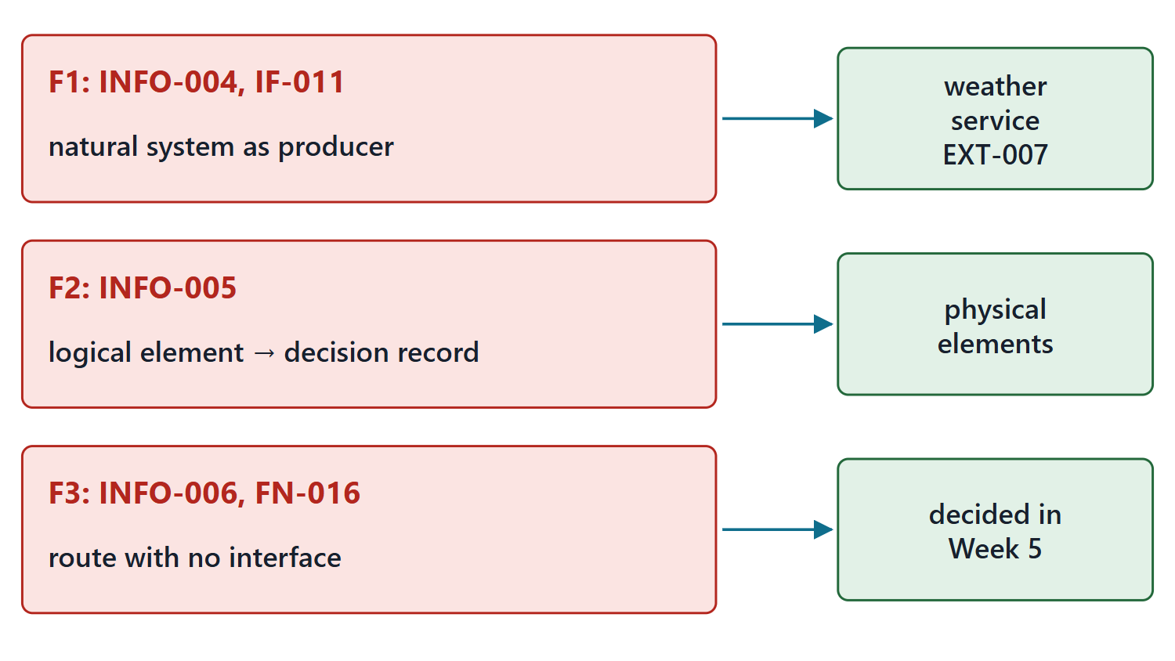
Auditing the view: two reference defects and one new gap
Reference: weather as a producer, with no owner
Reference: a logical element feeding a decision record
New item: incident records with no route
Each fix proposed; the instructor confirms
Figure. Three findings, each with its proposed fix: a natural system as producer and a flow from a logical element into a decision record, both in the reference, and a route with no interface in the new evidence item. (FICTIONAL)
Sources: R62 p.345; R21 p.514

Slide 12
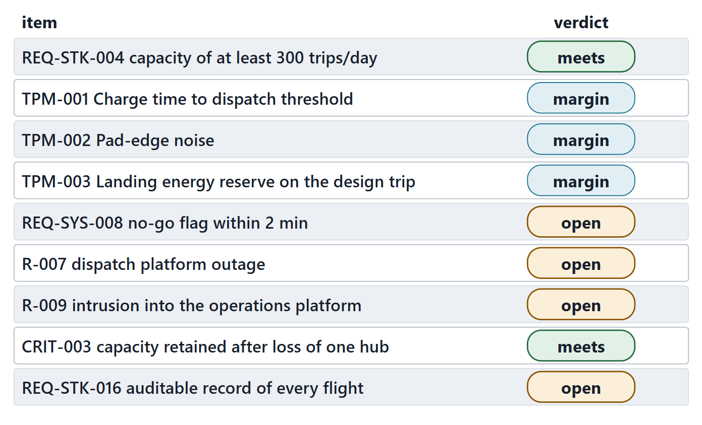
Evaluating the architecture against requirements and TPMs
Assess candidates against criteria from the requirements
Trace each requirement to the elements that meet it
TPMs are allocated down the hierarchy
Four rows open, each with an owner week
Figure. Each requirement, TPM or risk with its verdict; four rows are open. What each row is allocated to, and its evidence, are in the notes and the lesson table. (FICTIONAL)
Sources: R20b p.592; R20c p.599; R56 p.386; R56 p.387; R44 p.115

Slide 13
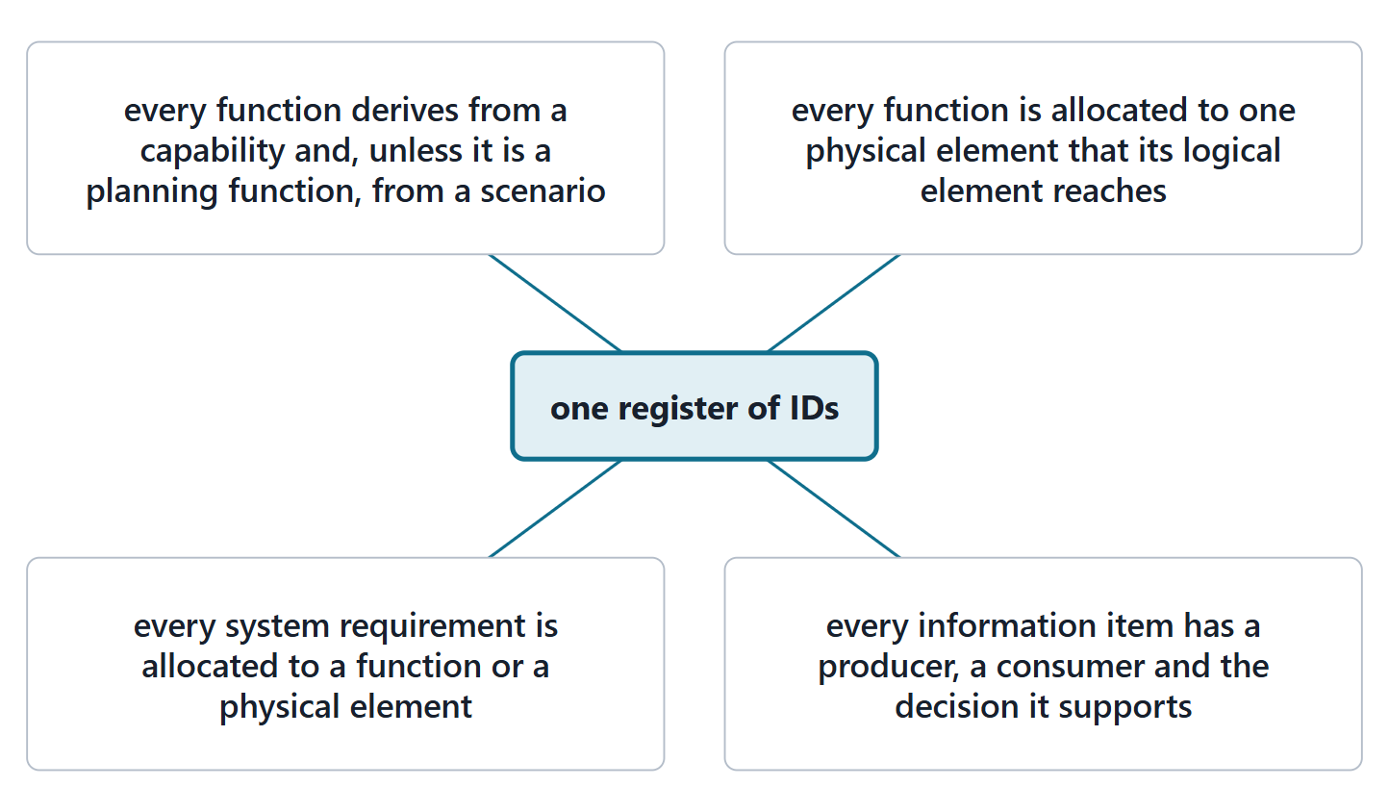
Keeping the views consistent, and common errors
Errors: physical names in the functional view
Functions without inputs and outputs; too deep
Allocation without a criterion; no logical plane
Items with no decision; AI with no oversight
Figure. Four views around one register of IDs; each spoke is one of the four consistency checks.
Sources: R62 p.344; R62 p.345; R20b p.594; R20c p.602; R31 p.1370

Slide 14
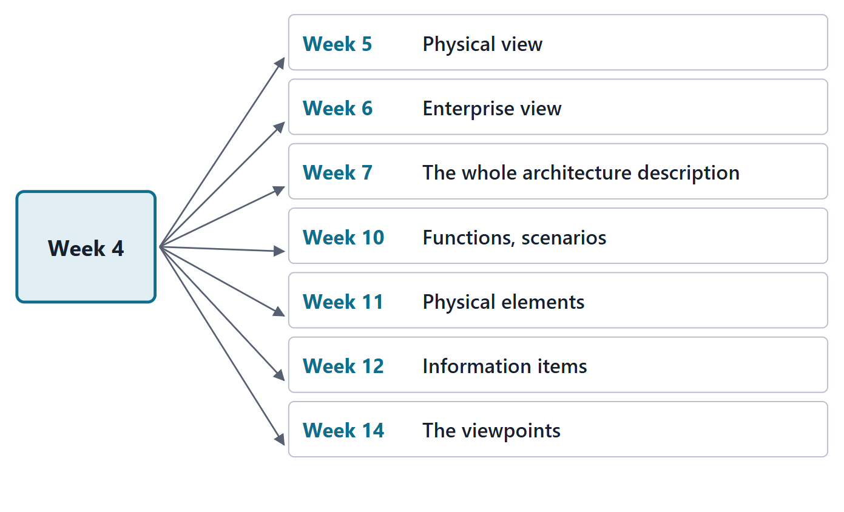
What this week feeds, and what it does not do
Week 5: components and every interface
Week 6: as-is and to-be views; Week 7: the package
Weeks 10–12: actions, parts, allocations, the thread
Not yet: interfaces, sequences, modes, timing
Figure. Week 4 artifacts and the weeks that consume them.
Sources: R72 sl.30; R85 p.181; R20a p.581

Slide 15
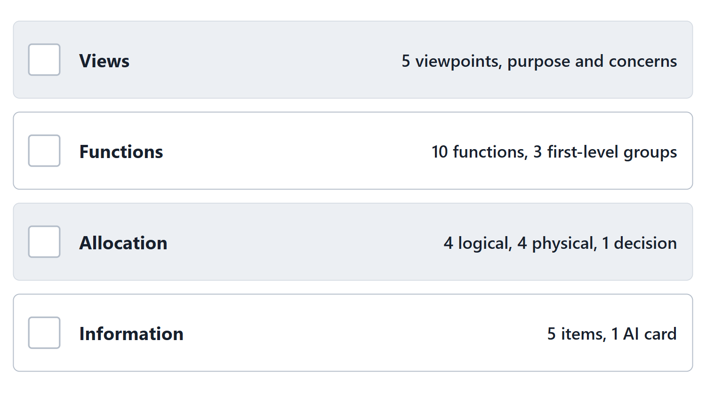
Lab L4 brief: your architecture description
5 viewpoints; 10 functions; 4 logical, 4 physical
1 decision; 5 information items; 1 AI card
Team of three: 7 functions, 3 items
Your enterprise, never AeroLink; due before Week 5
Figure. Lab L4 at a glance: the four parts added to the Team Record and their minimums for a team of four.

Slide 16
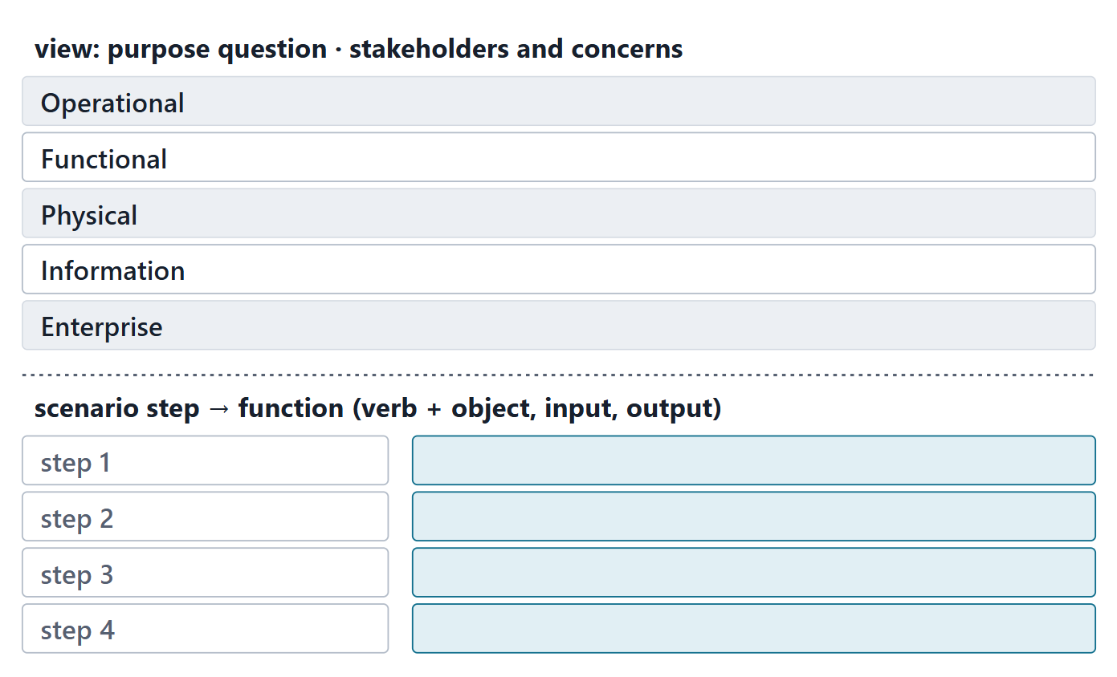
Team work: view purposes and the first scenario walk
Write one purpose question per required view
Name the stakeholders and concerns each serves
Walk one Week 2 scenario into functions
Verb + object, with an input and an output
Figure. The in-class template: one purpose question per view, then one scenario walked into functions.
Sources: R62 p.344; R20b p.594

Slide 17
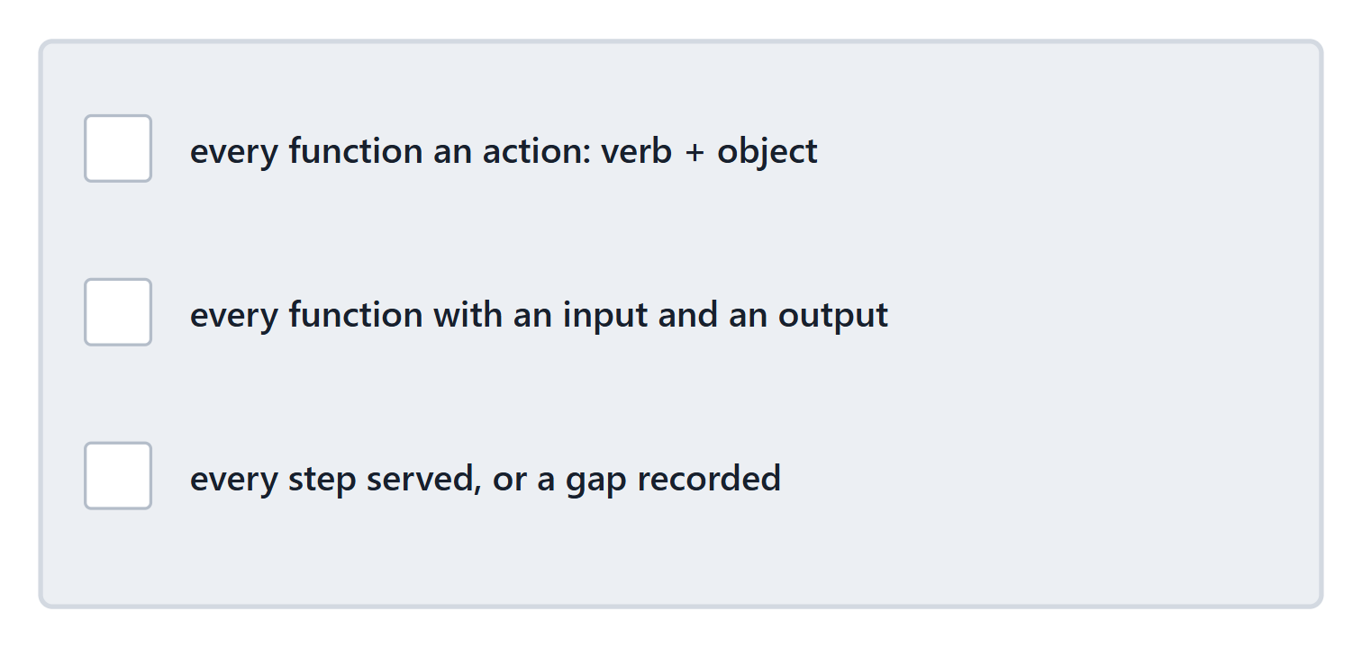
Instructor check: one scenario walk per team
Every function an action: verb + object
Every function with an input and an output
Every step served, or a gap recorded
Figure. The check card: three questions for every scenario walk.

Slide 18
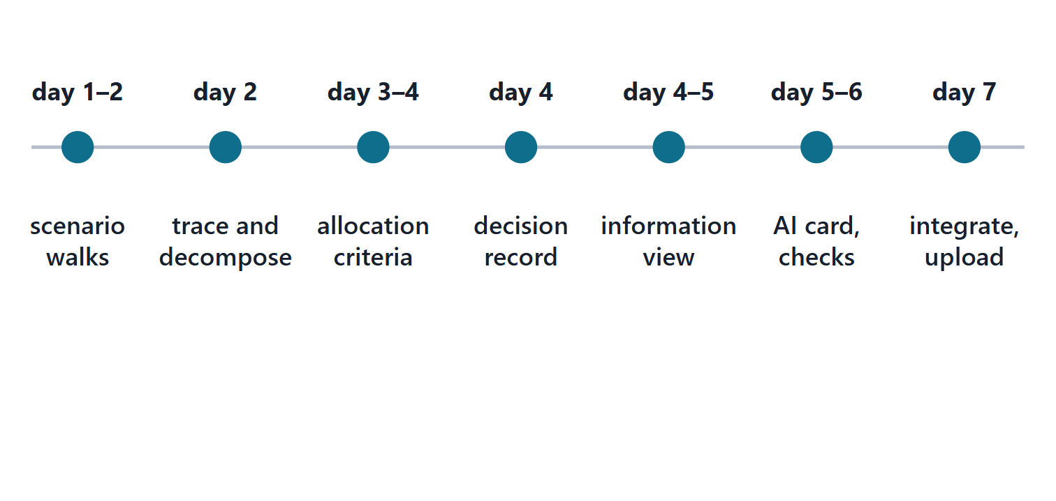
Close: the next seven days
Days 1–2: scenario walks; trace and decomposition
Days 3–4: allocation with criteria; the decision
Days 4–6: information view, AI card, checks
Day 7: integration and upload; quiz Q4 opens
Figure. A seven-day plan for Lab L4, with the lead role for each step.

Slide 19
References and credits
R20a · SEBoK v2.14 (2026), “Functional Architecture”, p.580–582
R20b · SEBoK v2.14 (2026), “Logical Architecture”, p.587, 591–594
R20c · SEBoK v2.14 (2026), “Physical Architecture”, p.596–600, 602
R21 · SEBoK v2.14 (2026), “Information Management”, p.510–515
R31 · SEBoK v2.14 (2026), “Artificial Intelligence”, p.1370–1371
R44 · OUSD(R&E) Systems Engineering Guidebook (2021/2022), “Technical Assessment Process”, p.115
R56 · The MITRE Systems Engineering Guide (2014), “Assess the Design”, p.386–387
R62 · The MITRE Systems Engineering Guide (2014), “Architectural Frameworks, Models, and Views”, p.341–342, 344–346
R66 · The MITRE Systems Engineering Guide (2014), “Information and Data Management”, p.112–113
R72 · Seidewitz, Intro to the SysML v2 Language: Textual Notation (Release 2026-08), “Action Definition”, sl.30
R85 · OMG SysML v2.1 Beta 2, Part 1 (Release 2026-07), “7.26 Views and Viewpoints”, p.181
CREDITS AND LICENSES
Introduction to the SysML v2 Language, Textual Notation (Release 2026-08): Copyright © 2019–2026 Model Driven Solutions, Inc. Licensed under the Creative Commons Attribution 4.0 International License (CC BY 4.0).
SEBoK v2.14: “This material is used under a Creative Commons Attribution-NonCommercial ShareAlike 3.0 Unported License from The Trustees of the Stevens Institute of Technology.” (SEBoK, “Bkcase Wiki:Copyright”, PDF p.31). Quotations are short and cited; no SEBoK figure or table is reproduced.
OUSD(R&E) Systems Engineering Guidebook: Distribution Statement A. Approved for public release. Distribution is unlimited.
The MITRE Systems Engineering Guide: © 2014 by The MITRE Corporation. All rights reserved. Approved for public release; distribution unlimited (Case Numbers 10-4072 and 12-1089). Quoted briefly with attribution.
Figures are original drawings for this course; none redraws a figure from the sources.
AeroLink Urban Mobility is a fictional teaching case: every number, name and statement about it is a teaching value.

