Slide 1
WEEK 7 · SESSION 1
Final Presentation
Session 1: The Phase I engineering package and its design review
Today: the package, its audit and the design review
Session 2: presenting and defending your decisions; the review itself
Your output: the Systems Thinking Engineering Package

Slide 2
The driving question: is the package ready to become a model?
SCENARIO (FICTIONAL)
AeroLink’s six weekly records are done. The package holds 265 IDs and some items are still open. The board asks: is it ready to become the baseline of a SysML v2 model?
A: Not ready: items are still open
B: Ready: every week was submitted
C: Ready with conditions, if every gap is dispositioned and owned

Slide 3
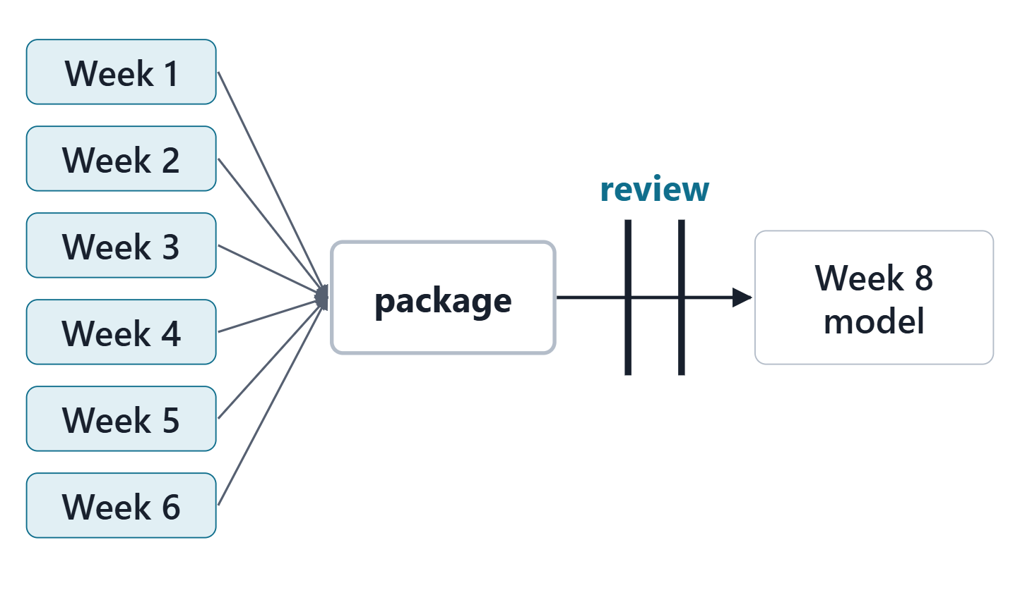
Where Week 7 sits: six weeks in, one model out
Weeks 1–6: six records, six exports
Week 7: one package, audited and reviewed
Week 8: the package becomes model v0.1
Every inconsistency left now becomes a modeling defect
Figure. Six weekly exports become one package; the review decides whether it is the baseline Week 8 starts from.

Slide 4
The package is a baseline: the reference point for every later change
CONFIGURATION BASELINE
A formally approved snapshot of a system’s attributes at a specific point in its development
R36 · SEBoK v2.14 (2026), "Configuration Baselines", p.498
A reference point that guides and controls later change
Its content can be digital: models, databases, files
Your package: the Phase I baseline Week 8 changes from
Sources: R36 p.498; R36 p.499

Slide 5
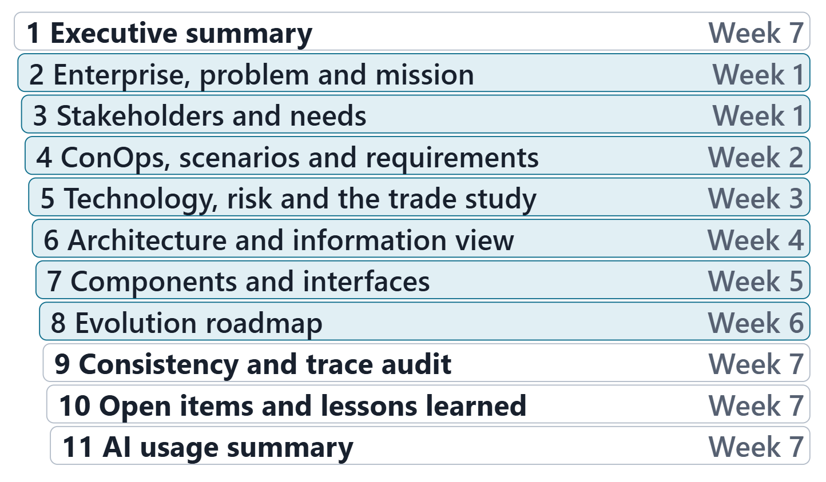
What the package contains
Built from all six weekly exports
Plus: executive summary, consistency and trace audit
Plus: open items, lessons learned and an AI usage summary
Course convention: no source defines this package
Figure. The eleven sections of the package, each marked with the week that supplies it.

Slide 6
A baseline records what is open, with its history
A requirements baseline includes what could not be met
Approved changes are incorporated, with rationale
The traceability matrix keeps allocation history
Open is acceptable; silent is not
KEY POINT
An owned open item is a decision. An unrecorded gap is a defect.
Sources: R56 p.389; R45 p.119

Slide 7
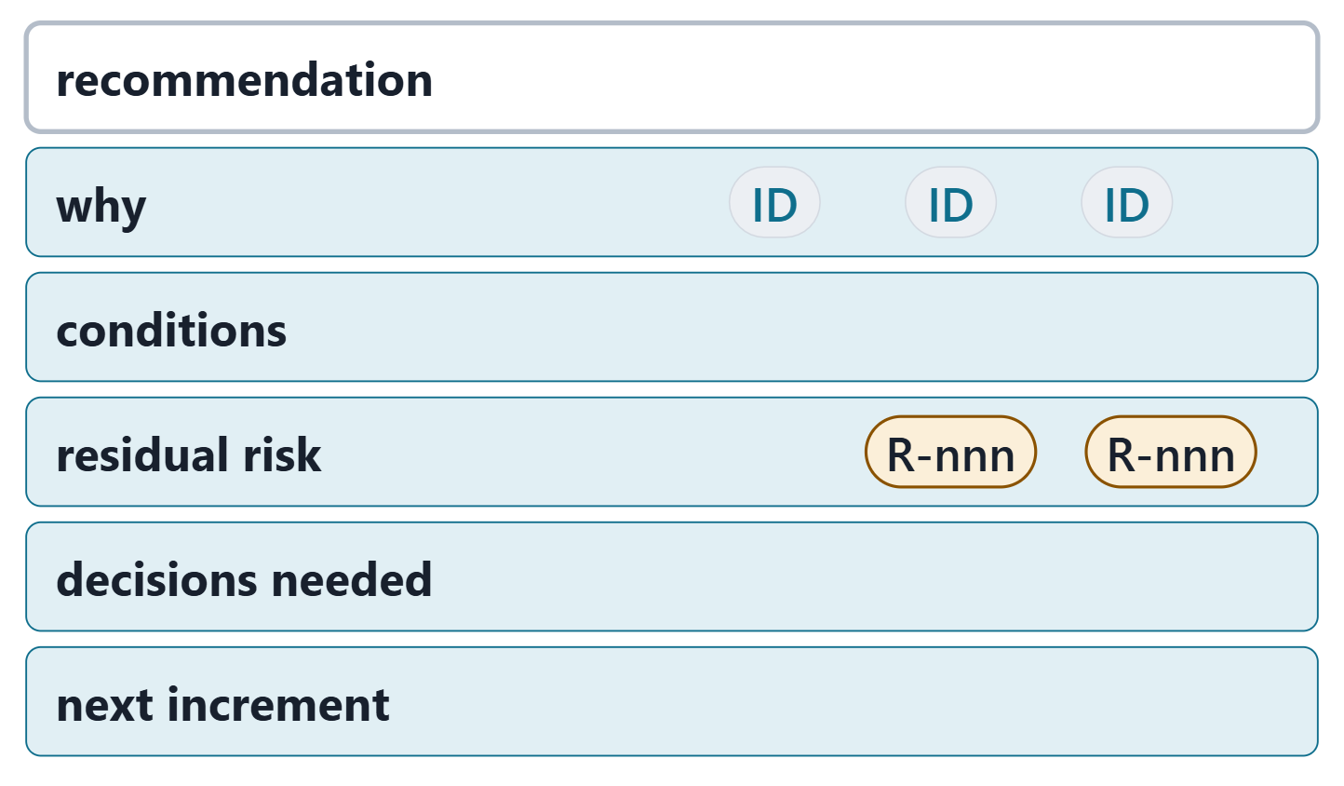
The executive summary: six fields a decision maker reads first
Recommendation: what you ask the decision maker to approve
Why: the evidence, cited by ID
Conditions: what must stay true
Residual risk: what remains, by R ID
Decisions needed from the reviewer
Next: the roadmap increment that comes next
Figure. The executive summary skeleton: six fields, each one a gate in the package tool.
Sources: R18 p.473; R43 p.110

Slide 8
One enterprise, one ID, one meaning
One enterprise, one ID, one meaning
Stale export: a later week built from an older file
ID no longer defined: deleted or renumbered upstream
Collision: two elements share one ID; never a rename
Disposition no longer true: a later week closed the gap
IDENTITY RULE
Same element only if the names match or one contains the other whole.
Sources: R13 p.565

Slide 9
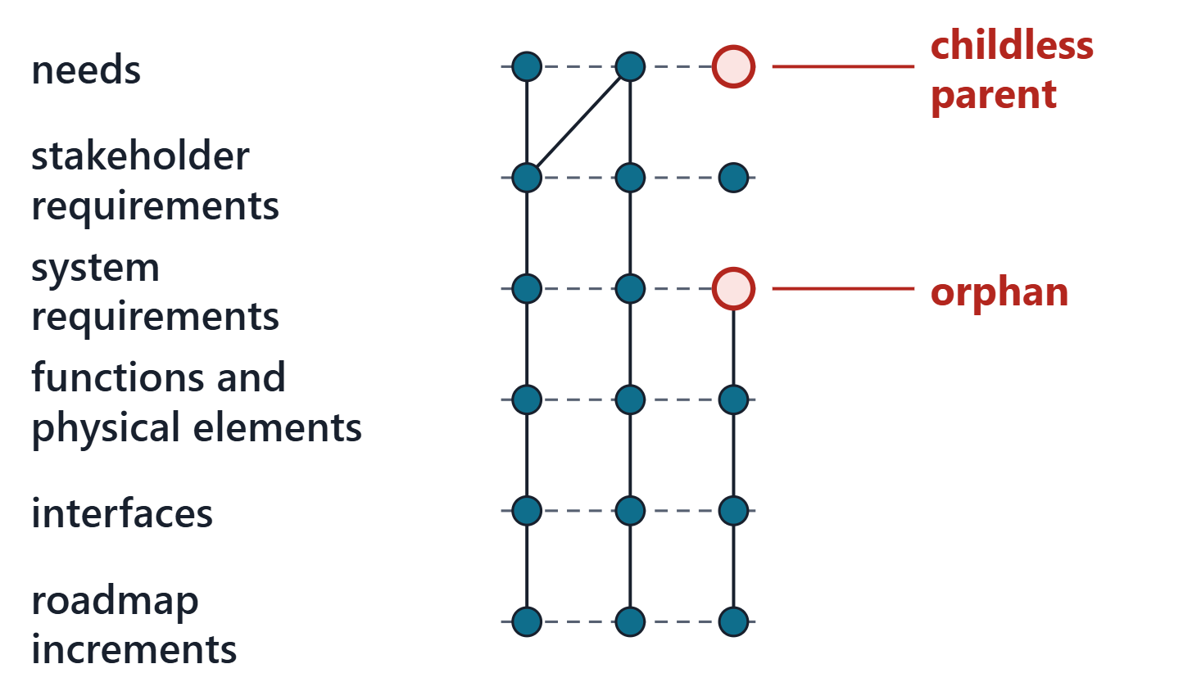
Bidirectional traceability: no orphans, no childless parents
Orphan: a lower item with no valid parent
Childless parent: a higher item nothing addresses
Layers: need, requirement, architecture, interface, increment
Count both directions at every layer
Figure. The audit’s trace ladder from needs to the roadmap, with an orphan and a childless parent marked.
Sources: R45 p.118

Slide 10
Well formed and right: requirement verification and validation
REQUIREMENT VERIFICATION
Are the requirements well formed: do they follow the rules for well-formed requirements?
R13 · SEBoK v2.14 (2026), "System Requirements Definition", p.566
REQUIREMENT VALIDATION
Do we have the right requirements: do they carry the intent of the needs and sources they came from?
R13 · SEBoK v2.14 (2026), "System Requirements Definition", p.566
NOTE
A trace link can exist and still carry only part of a need. The tool counts links; a reviewer reads them.
Sources: R13 p.566; R06c p.387

Slide 11
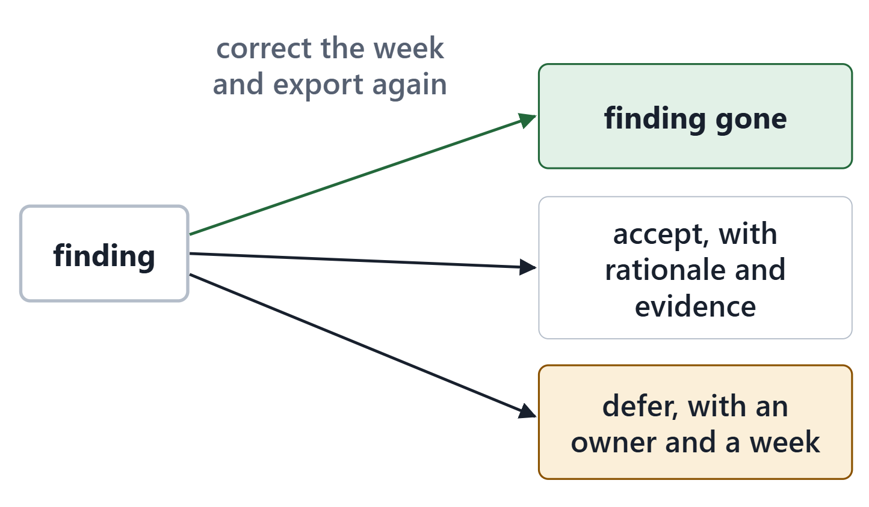
Coverage, findings and dispositions
Coverage per layer: covered of total, as a percentage
Every finding: accept with rationale, or defer
Accept: a rationale with its evidence
Defer: name who closes it, and the week
Correct: fix the week and import it again
A claim of “fixed” is not a rationale
Figure. Every finding leaves the audit one of three ways: corrected and re-imported, accepted with a rationale and its evidence, or deferred to a week with an owner.
Sources: R44 p.111; R13 p.565

Slide 12
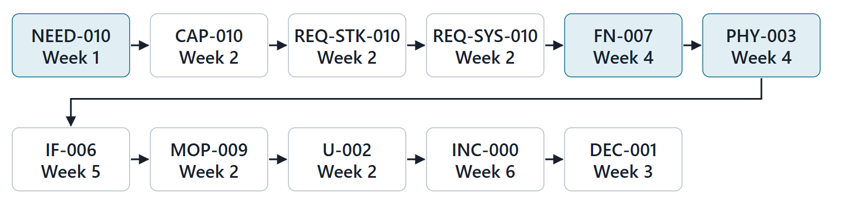
Worked example: one AeroLink thread, end to end
NOTE
Walk one thread from a need to the architecture, then on to the interface and the roadmap.
Down: NEED-010 → CAP-010 → REQ-STK-010 → REQ-SYS-010 → FN-007 → PHY-003
Out: IF-006 → MOP-009 → U-002 → INC-000 → DEC-001
Figure. One AeroLink thread followed through the package from NEED-010: 11 linked items across six weeks. (FICTIONAL)
Sources: R13 p.565

Slide 13
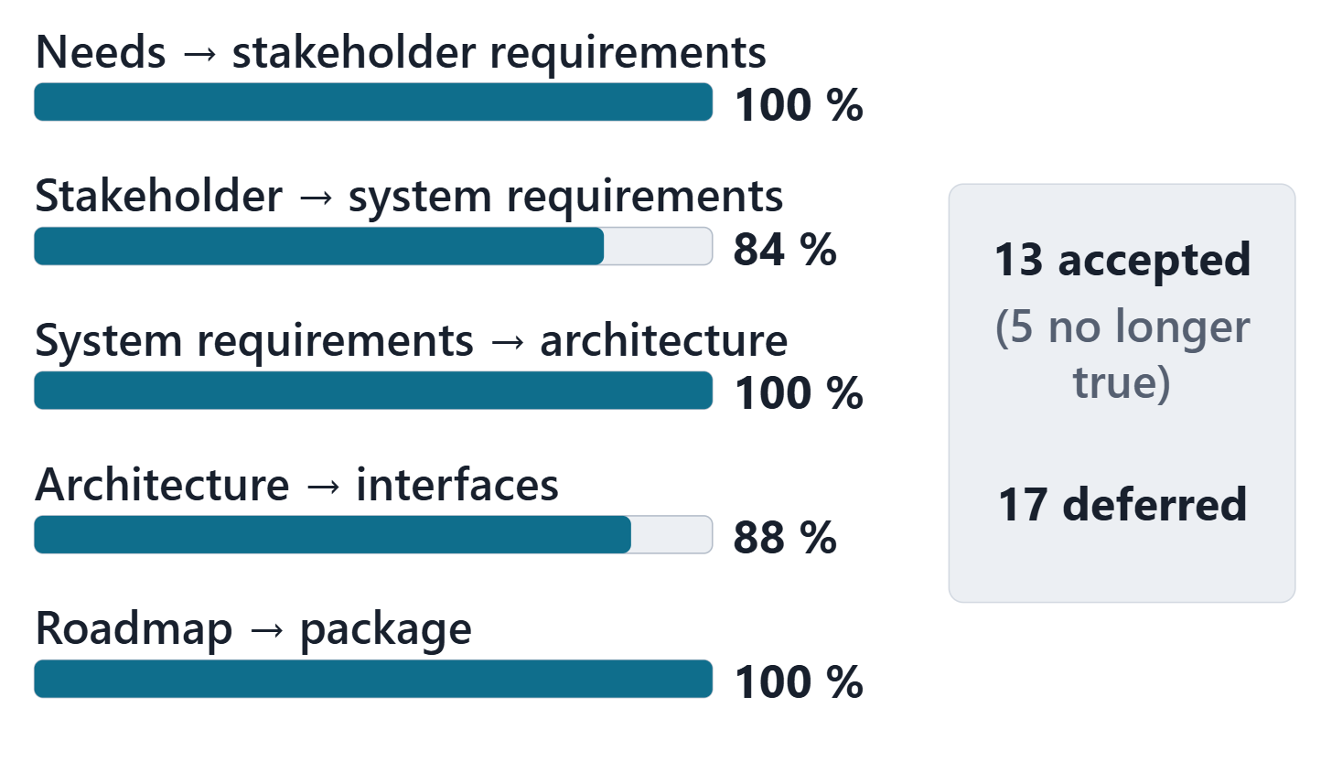
Worked example: AeroLink’s package audit
30 findings: 13 accepted, 17 deferred
5 Week 2 dispositions made false by later weeks
Week 2 open items dropped by Week 6: 2 deferred (NEED-008, NEED-006) and NEED-017 carried through U-006
3 stakeholder requirements with no child, by decision
PHY-006: an element no interface ends at
Figure. AeroLink’s coverage per layer, and how its 30 findings were dispositioned. (FICTIONAL)
Sources: R45 p.118; R56 p.389

Slide 14
What a technical review is for
TECHNICAL REVIEWS AND AUDITS
A mechanism by which sufficiently independent and knowledgeable stakeholders analyze the current state of a system or work products using pre-established criteria
R06c · SEBoK v2.14 (2026), "Technical Reviews and Audits", p.386
Results support programmatic and technical decisions
They help establish readiness for the next stage
They support baselines and early validation
Sources: R06c p.386

Slide 15
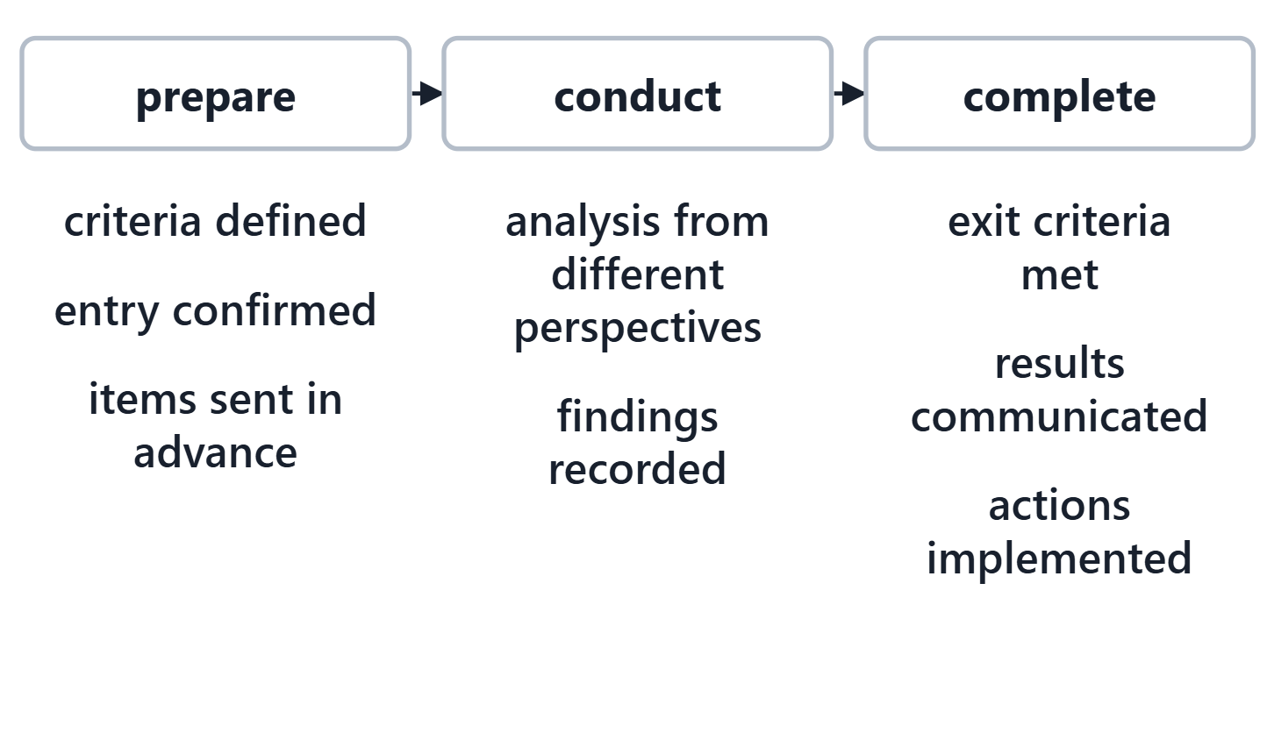
Prepare, conduct, complete
Prepare: entry and exit criteria defined; entry confirmed
Items to be assessed sent in advance
Conduct: analysis from different perspectives
Complete: exit met, results communicated, actions done
Figure. The three stages of a technical review, with the course’s criteria under each.
Sources: R06c p.387; R06c p.388

Slide 16
The Phase I review’s entry and exit criteria
Entry: package sent 24 h before Session 2
Entry: every finding dispositioned, none silent
Entry: summary, owners, thread prepared
One key decision, with its alternatives
Exit: every RID dispositioned, with a response
Exit: every accepted or deferred RID owned
Exit: the closed package exported again
Sources: R40 p.70; R44 p.111

Slide 17
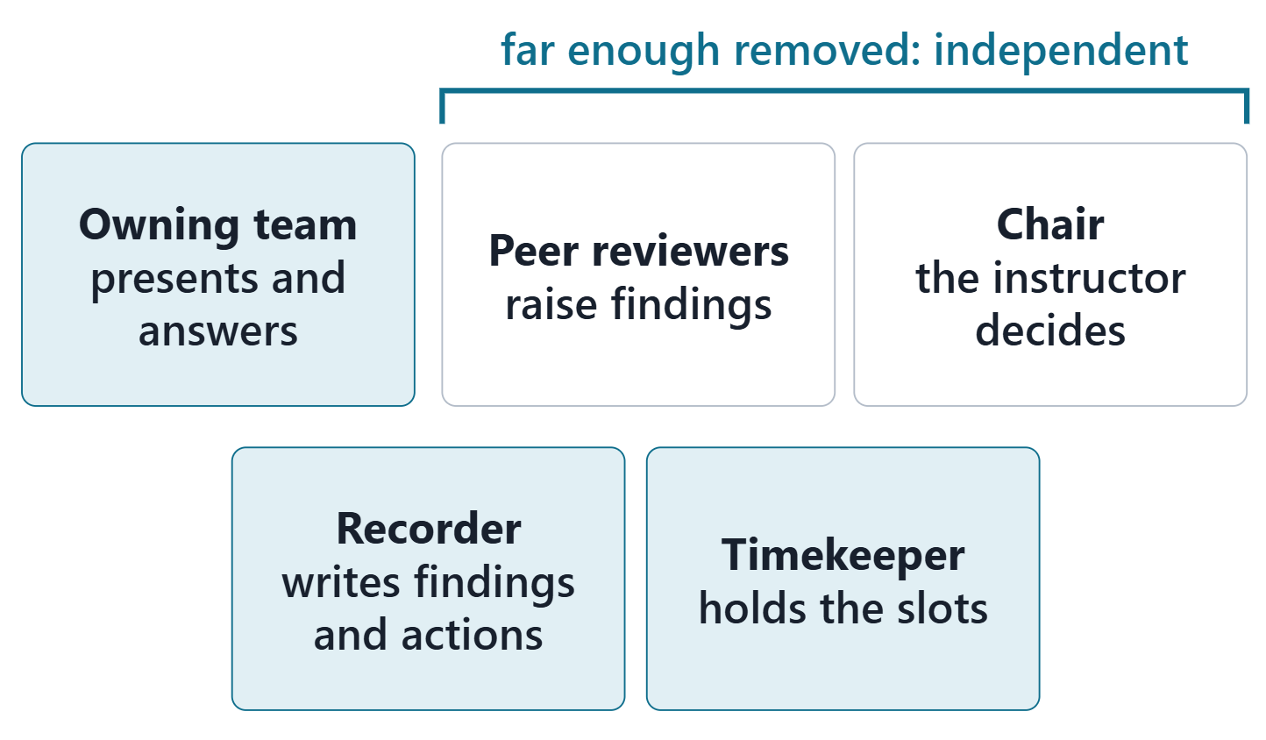
Review roles: owners, reviewers, chair, recorder
Every member presents and answers for the sections they own
Peer reviewers: far enough removed to see what you miss
Chair (instructor) decides; recorder writes actions
Independent review counters bias
Figure. The roles in the course design review, with what each brings to the room.
Sources: R06c p.388; R18 p.474

Slide 18
The closest professional analogy: the SRR
Requirements consistent with technology maturation plans
Clearly stated, measurable and testable
Traceable in both directions
Verification methods for all; risks with mitigation plans
All interfaces documented
COURSE ANALOGY
The Phase I review borrows these questions. It sets no contractual baseline.
Sources: R40 p.69; R40 p.70

Slide 19
Ready for Week 8? The answer for AeroLink
C: ready with conditions
Every finding dispositioned; every open item owned
Week 8 needs stable IDs, one name per ID, typed links
Deferred items become the first modeling tasks

Slide 20
Studio: load your six exports and read your audit
Load your six exports into the package tool
Read the coverage and every finding
Re-export any stale week now if you can
Disposition three findings: record or defer
Name the owner of each package section

Slide 21
Before Session 2
Package index and readiness report: 24 h before Session 2
Peer pairings and review order: posted today
Each reviewer: read your sections, write at least two RIDs
Session 2: how to defend, then the review

Slide 22
References and credits
R06c · SEBoK v2.14 (2026), “Technical Reviews and Audits”, p.386–388
R13 · SEBoK v2.14 (2026), “System Requirements Definition”, p.565–566
R18 · SEBoK v2.14 (2026), “Decision Management”, p.473–474
R36 · SEBoK v2.14 (2026), “Configuration Baselines”, p.498–499
R40 · OUSD(R&E) Systems Engineering Guidebook (2021/2022), “3.2 System Requirements Review”, p.69–70
R43 · OUSD(R&E) Systems Engineering Guidebook (2021/2022), “Decision Analysis Process”, p.109–110
R44 · OUSD(R&E) Systems Engineering Guidebook (2021/2022), “Technical Assessment Process”, p.111
R45 · OUSD(R&E) Systems Engineering Guidebook (2021/2022), “Requirements Management Process”, p.118–119
R56 · The MITRE Systems Engineering Guide (2014), “Assess the Design”, p.387, 389
CREDITS AND LICENSES
SEBoK v2.14: “This material is used under a Creative Commons Attribution-NonCommercial ShareAlike 3.0 Unported License from The Trustees of the Stevens Institute of Technology.” (SEBoK, “Bkcase Wiki:Copyright”, PDF p.31). Quotations are short and cited; no SEBoK figure or table is reproduced.
OUSD(R&E) Systems Engineering Guidebook: Distribution Statement A. Approved for public release. Distribution is unlimited.
The MITRE Systems Engineering Guide: © 2014 by The MITRE Corporation. All rights reserved. Approved for public release; distribution unlimited (Case Numbers 10-4072 and 12-1089). Quoted briefly with attribution.
Figures are original drawings for this course; none redraws a figure from the sources.
AeroLink Urban Mobility is a fictional teaching case: every number, name and statement about it is a teaching value.

