Slide 1
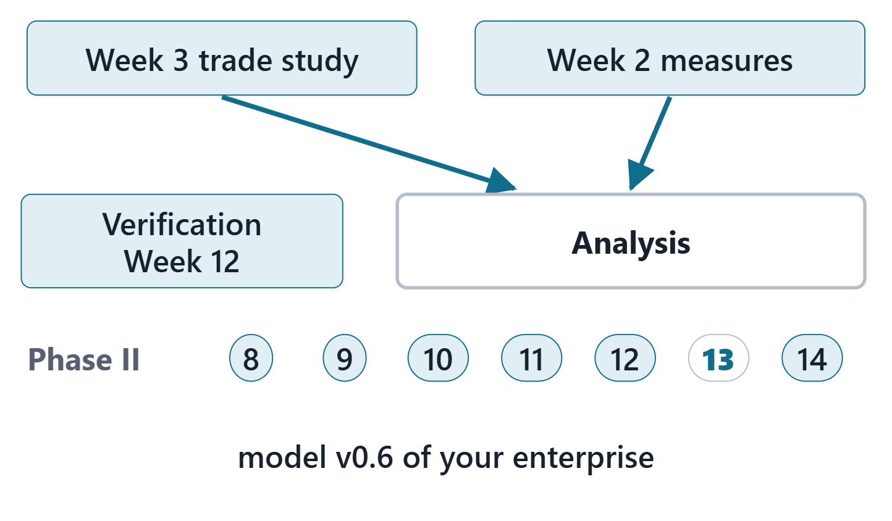
Trade Study / Analysis
Session 1: Measures, calculations, constraints and analysis cases
Today: measures, calculations, constraints, analysis cases
Session 2: the trade study in the model, sensitivity, the decision record, the Lab L13 launch
Your output: model v0.6 of your own enterprise
Figure. Week 13 fills the Analysis package: the Week 3 trade study and the Week 2 measures enter the model your team built since Week 8. Course illustration, not SysML v2 graphical notation.

Slide 2
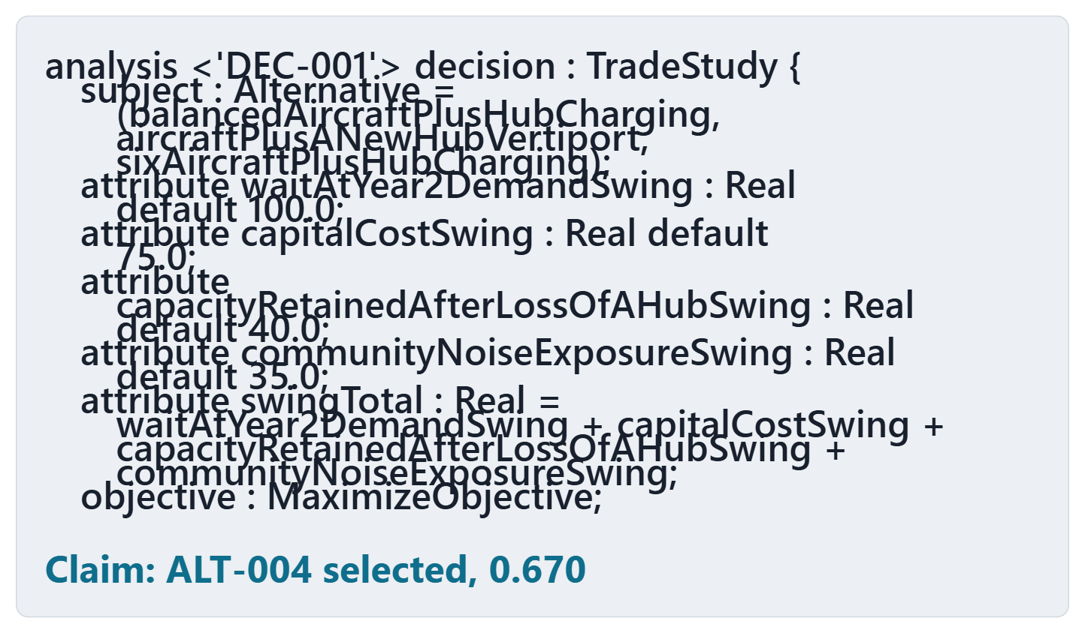
Driving question: who computed the 0.670?
VOTE
“The model selected ALT-004, value 0.670.” Who computed it?
A · The checker, when it accepted the file
B · The model says how; a tool outside the checker computed it
C · Someone typed the number in
D · It cannot be told from the model
Figure. The AeroLink trade study in model v0.6, and a claim about its result (lines shortened for display). Course illustration, not SysML v2 graphical notation. (FICTIONAL)

Slide 3
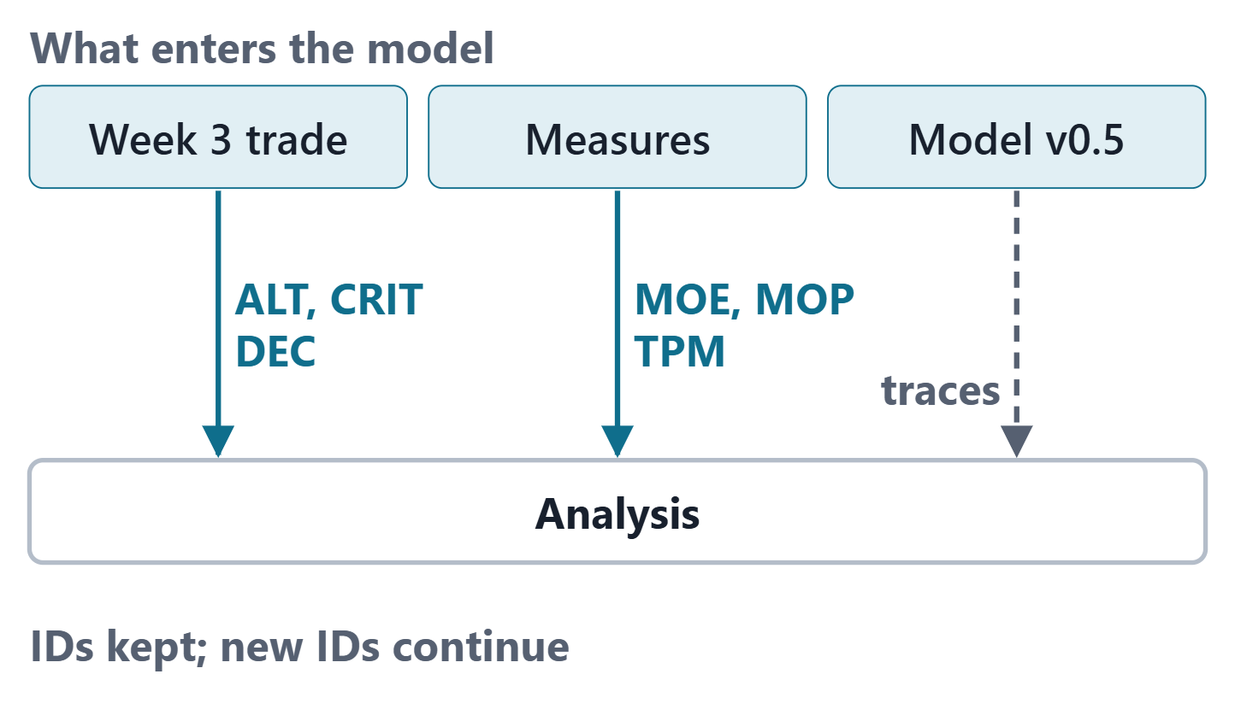
What Week 13 imports from Phase I
Week 3: alternatives, criteria, screens, weights, scores, the decision, TPMs
Week 2: measures of effectiveness and performance
Model v0.5: requirements, concerns, design elements to trace to
IDs kept; new IDs continue after the highest
Figure. What enters model v0.6: the Phase I trade study and measures, and what model v0.5 already holds for them to trace to. Course illustration, not SysML v2 graphical notation.

Slide 4
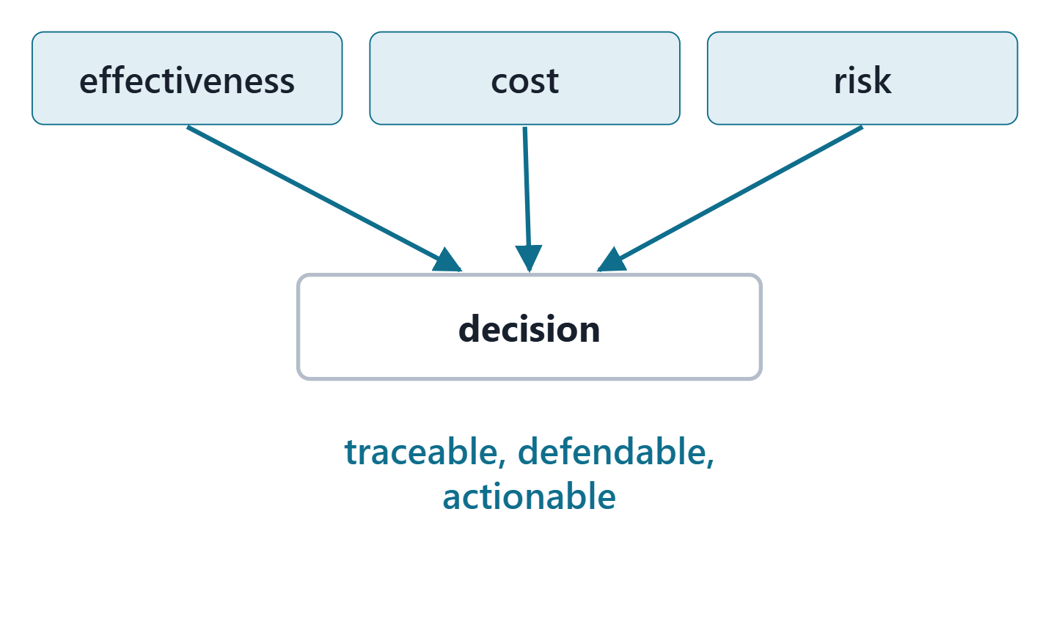
Analysis gives decisions a rigorous basis
System analysis: a rigorous approach to technical decisions
Trade studies compare alternative solutions against criteria
Objective and subjective criteria; check the sensitivity
Decision analysis: traceable, defendable, actionable
Figure. System analysis feeds a decision through effectiveness, cost and risk. Course illustration, not SysML v2 graphical notation.
Sources: R34 p.608–609; R43 p.109

Slide 5
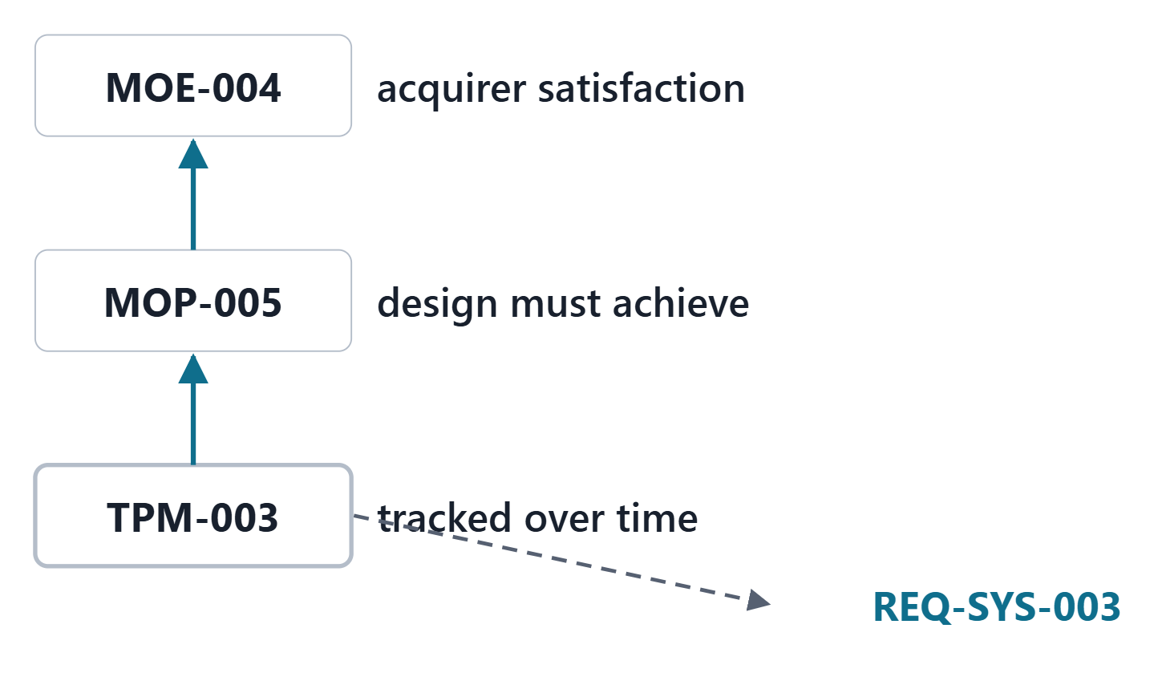
Measures of effectiveness, of performance, and TPMs
MEASURE OF EFFECTIVENESS (MOE)
The metrics by which an acquirer will measure satisfaction with products produced by the technical effort.
R122 · SEBoK v2.14 (2026), "Measure of Effectiveness (MoE) (glossary)", p.1562
MoP: an engineering measure needed to satisfy an MoE
TPM: how well a system element satisfies specified requirements
Figure. One AeroLink chain of measures: an MOE, the MOP that supports it, and the TPM that tracks a design attribute against a requirement. Course illustration, not SysML v2 graphical notation. (FICTIONAL)
Sources: R122 p.1562; R123 p.1663; R15 p.532

Slide 6
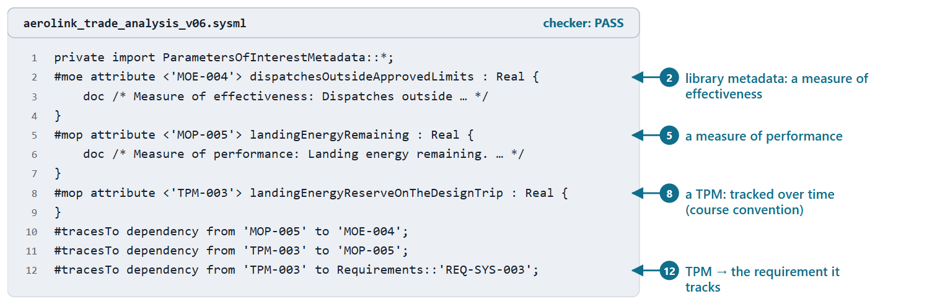
Measures in the model: #moe and #mop
#moe and #mop: library metadata on an attribute usage
A TPM: #mop plus its own documentation (course convention)
Links run from the measure to what it supports or tracks
Figure. AeroLink model v0.6: an MOE and an MOP marked with the library metadata, a TPM, and their trace links. Checked: PASS. (FICTIONAL)
Sources: R78 sl.149; R124 p.561–562; R69 p.193

Slide 7
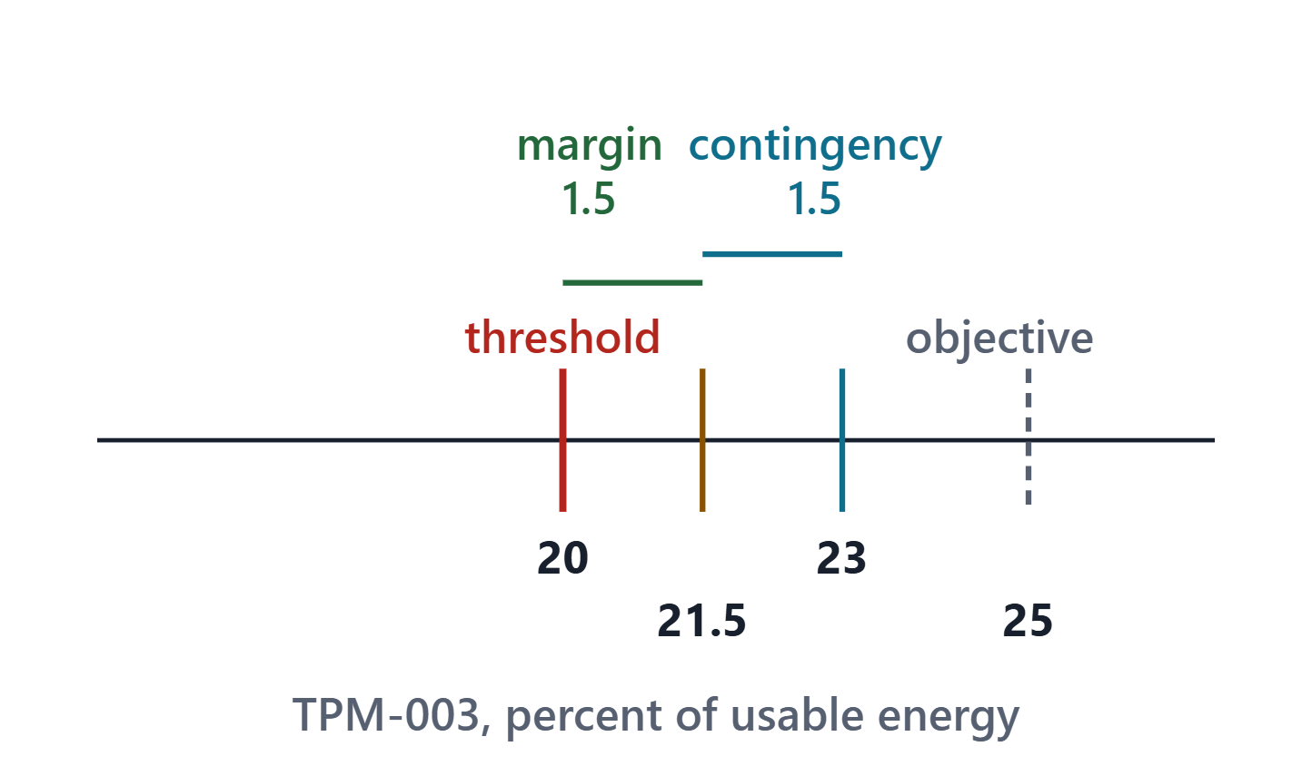
A TPM over time: estimate, contingency, margin
TPMs: measures collected over time, estimated early
Worst case = current estimate adjusted by the contingency
Margin = how far the worst case stays inside the threshold
Margin is trade space
Figure. TPM-003 now: the current estimate, the contingency that gives the worst case, and the margin to the threshold (computed from the Week 3 record). Course illustration, not SysML v2 graphical notation. (FICTIONAL)
Sources: R44 p.113; R44 p.117

Slide 8
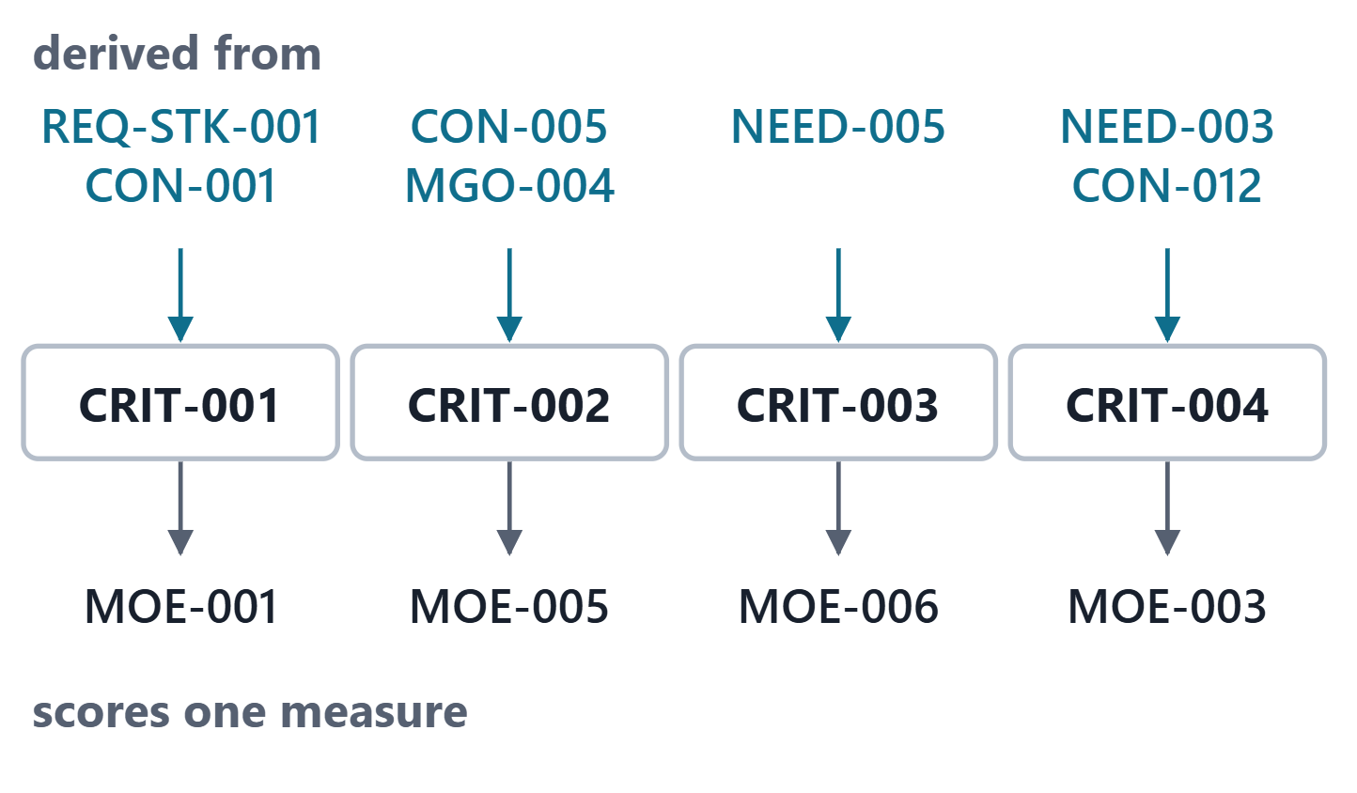
Criteria come from requirements and concerns
Objectives and measures come from stakeholders
Each objective essential; the set complete and non-redundant
One measure, one criterion: no double counting
Must-meet limits are screens, not weights
Figure. Each AeroLink criterion scores one measure and is derived from what the stakeholders asked for: a requirement, a concern, a need or an objective. Course illustration, not SysML v2 graphical notation. (FICTIONAL)
Sources: R18 p.465; R18 p.466

Slide 9
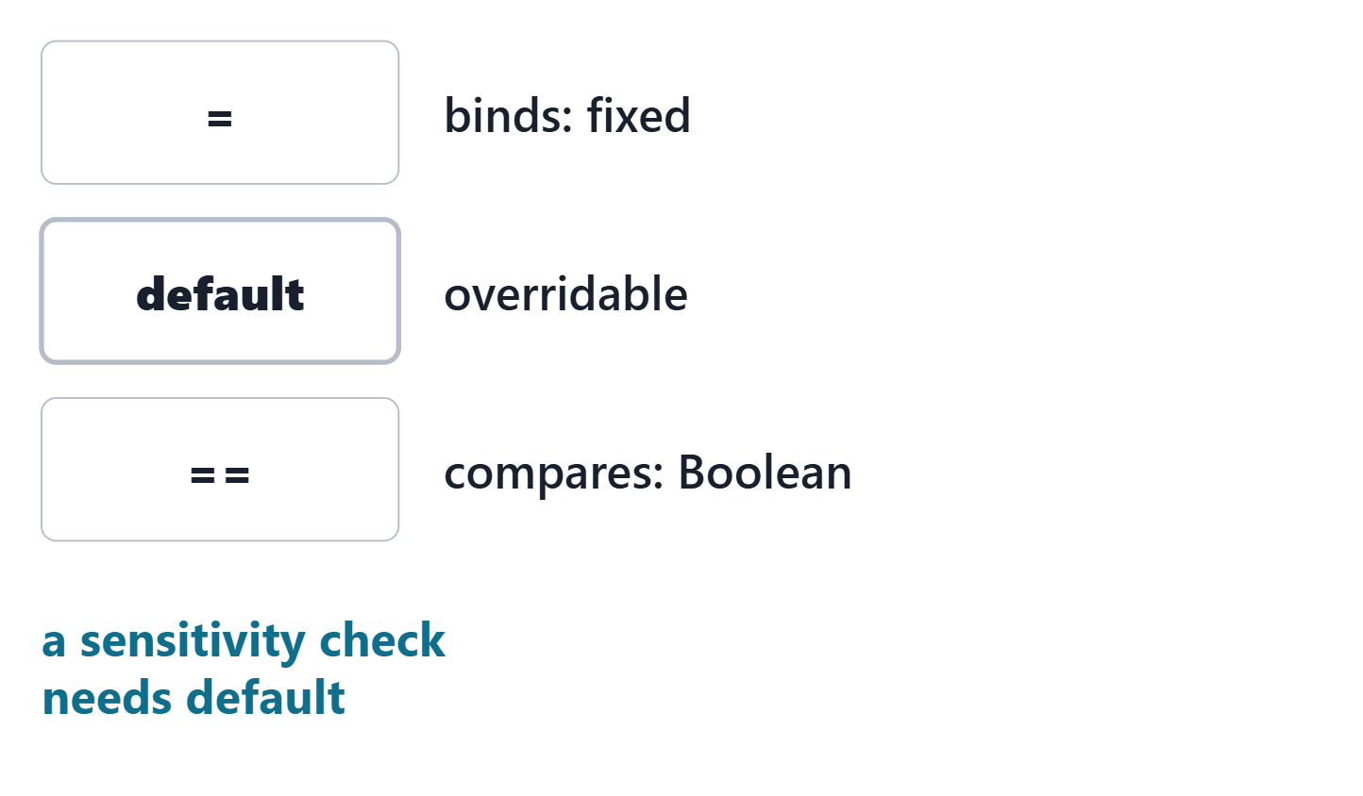
Feature values: binding, default, equality
A feature value binds the feature to an expression
A default applies unless a redefinition overrides it
== is Boolean equality; = denotes binding
Figure. Three symbols students confuse: = binds a value for good, default sets one that a redefinition may override, and == compares. Course illustration, not SysML v2 graphical notation.
Sources: R120 sl.72; R120 sl.74; R120 sl.83

Slide 10
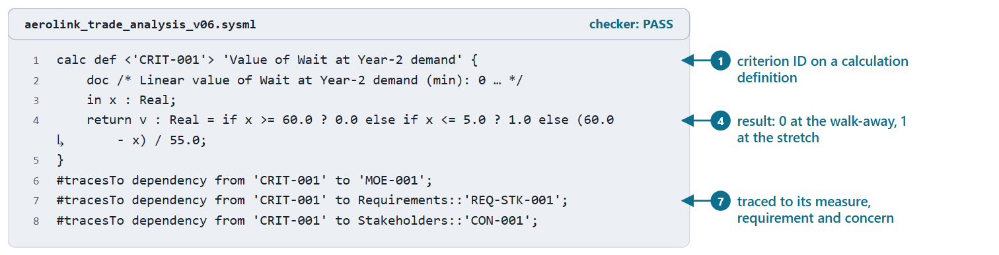
Calculation definitions: inputs and one result
A kind of action definition with a result parameter
return declares the result; bind it, or end with a result expression
No semicolon after a result expression
A value function should be pure
Figure. AeroLink model v0.6: the value function of the wait criterion as a calculation definition, traced to its measure, requirement and concern. Checked: PASS. (FICTIONAL)
Sources: R119 p.155–157; R120 sl.76

Slide 11
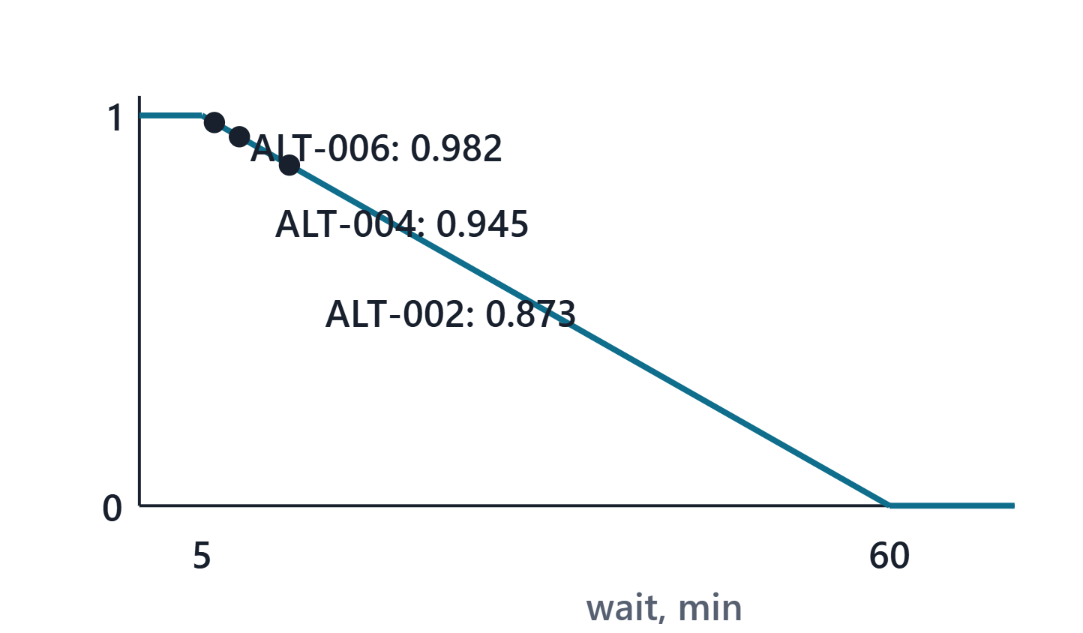
A value function maps a score to a value
Walk-away point: value 0, the decision maker walks away
Stretch goal: value 1, no more value beyond
Document the shape and its rationale
Clamped between the anchors
Figure. The wait criterion’s value function: value 0 at the 60-minute walk-away point, 1 at the 5-minute stretch goal, with three alternatives placed on it (values computed). Course illustration, not SysML v2 graphical notation. (FICTIONAL)
Sources: R18 p.465–466

Slide 12
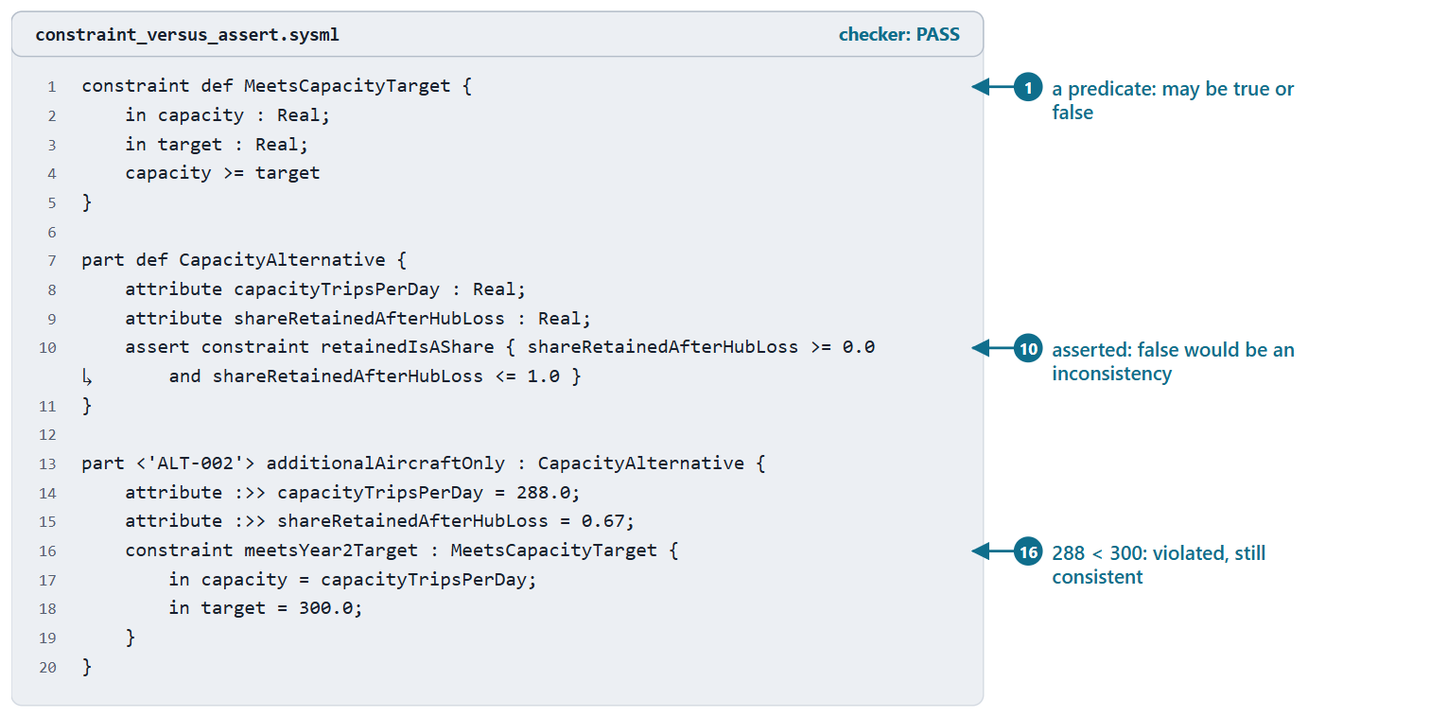
Constraint definitions: a predicate that may be false
A logical predicate: in parameters, a Boolean result
Satisfied if true, violated otherwise
A violated constraint leaves the model consistent
Figure. A constraint ALT-002 violates (288 against 300 trips per day) and an asserted constraint on every alternative. Checked: PASS. (FICTIONAL)
Sources: R119 p.157–158; R120 sl.79

Slide 13
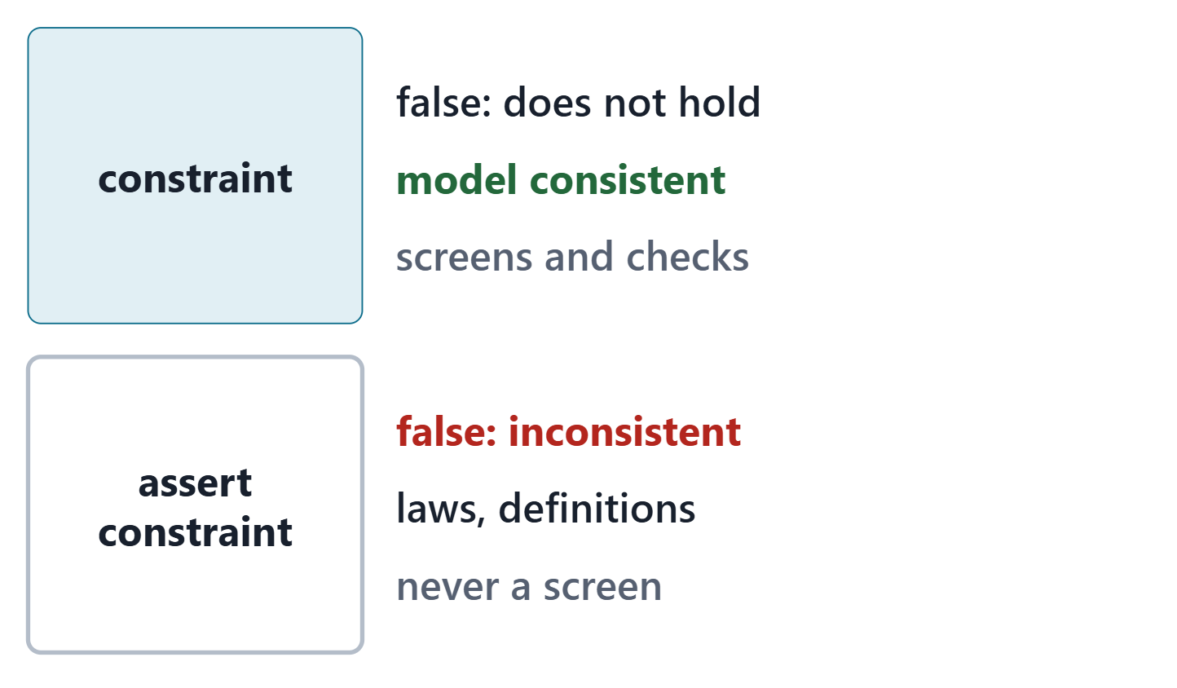
Asserted constraints: a violation is an inconsistency
assert: the constraint must be true at all times
If it can be found false, the model is inconsistent
Assert laws of physics and definitions
Never assert what an alternative is allowed to fail
Figure. The same condition as a constraint and as an assertion: what a false value means in each case. Course illustration, not SysML v2 graphical notation.
Sources: R119 p.158; R120 sl.81

Slide 14
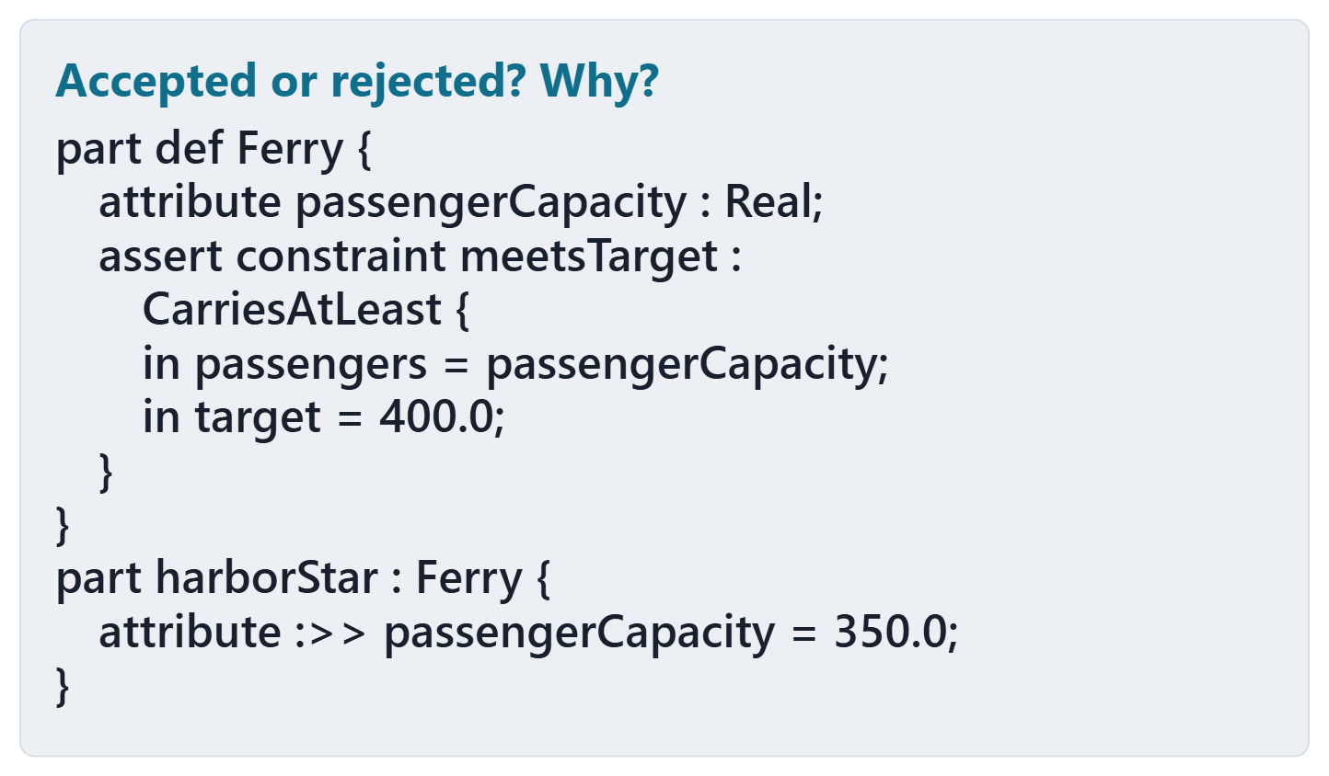
Predict: a false assertion
Is this model consistent?
Will the checker accept it?
Write one line for each answer
Figure. A ferry operator asserts that every ferry carries at least 400 passengers; one carries 350. Will the checker accept the file? Course illustration, not SysML v2 graphical notation. (FICTIONAL)

Slide 15
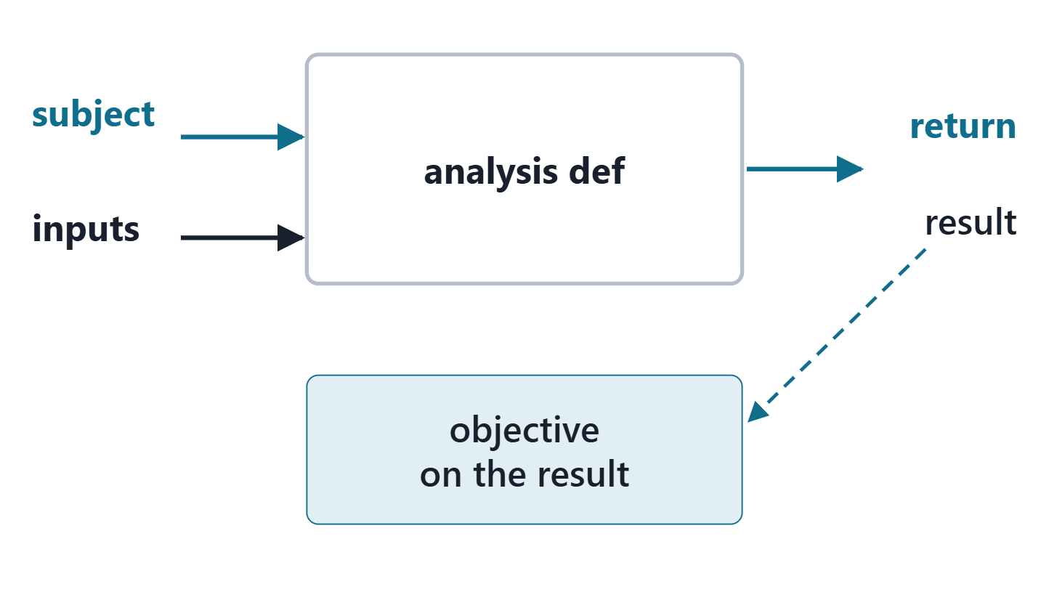
Analysis case definitions: subject, objective, result
Subject: what is analyzed, declared first
Return: the result about the subject
Objective: a requirement on the result
Usages make the subject and inputs specific
Figure. The anatomy of an analysis case: a subject goes in with the inputs, the result comes out, and the objective is a requirement on the result. Course illustration, not SysML v2 graphical notation.
Sources: R84 p.170; R84 p.172; R75 sl.92

Slide 16
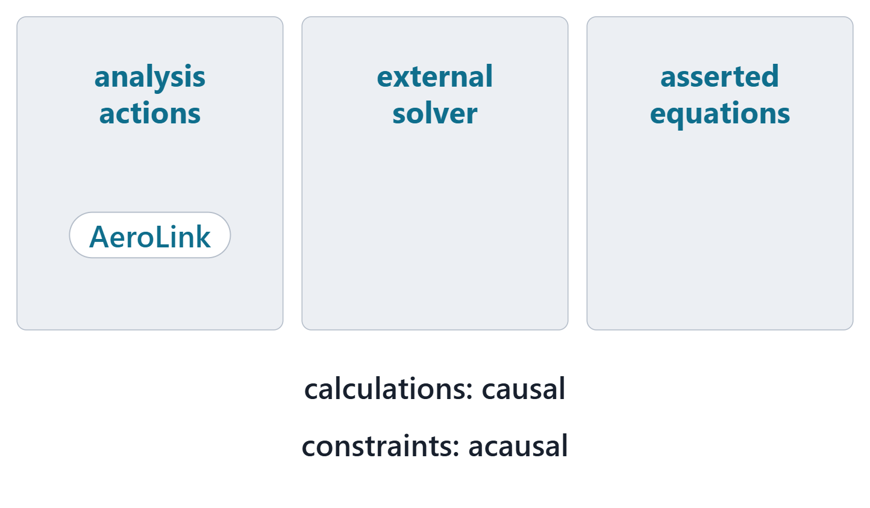
Three ways to perform an analysis case
Analysis actions whose calculations return results
Specified in SysML, solved by an external solver
Simultaneous equations asserted for a solver
Calculations are causal; constraints are acausal
Figure. Three ways an analysis case can be performed, and where the AeroLink examples sit. Course illustration, not SysML v2 graphical notation.
Sources: R84 p.170; R75 sl.93; R120 sl.84

Slide 17
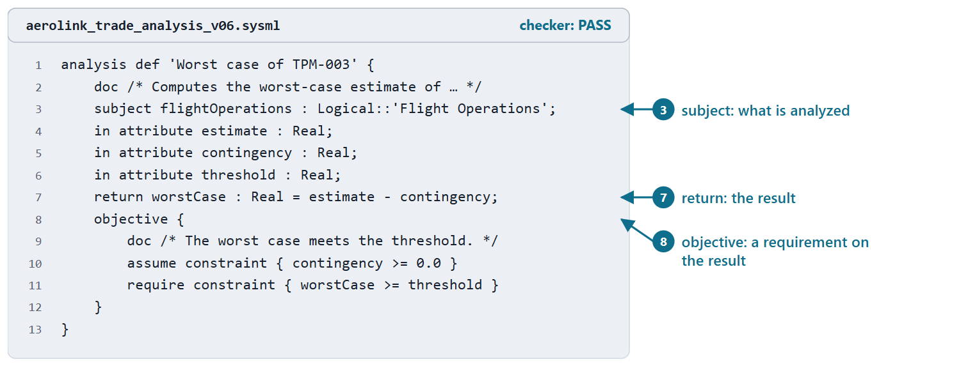
Worked example I: the TPM-003 analysis definition
Subject: the flight-operations logical part
Inputs: estimate, contingency, threshold
Result: the worst case, an expression
Objective: assume, then require on the result
Figure. AeroLink model v0.6: the analysis case definition that computes the worst case of TPM-003 and requires it to meet the threshold. Checked: PASS. (FICTIONAL)
Sources: R84 p.170; R84 p.172; R75 sl.92

Slide 18
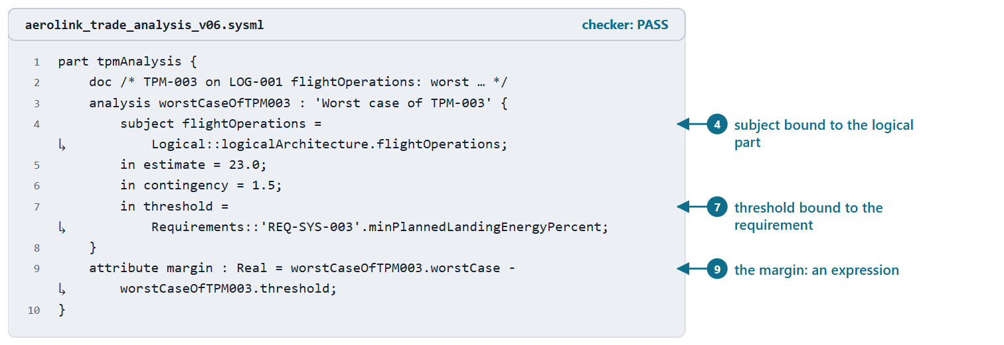
Worked example II: the analysis usage and the margin
The subject bound to the logical part
The threshold bound to the requirement’s attribute
Worst case 21.5; margin 1.5 (computed)
No satisfy: an estimate is not evidence
Figure. AeroLink model v0.6: the TPM-003 analysis usage, its threshold bound to the requirement’s attribute, and the margin as an expression. Checked: PASS. (FICTIONAL)
Sources: R75 sl.94; R84 p.170

Slide 19
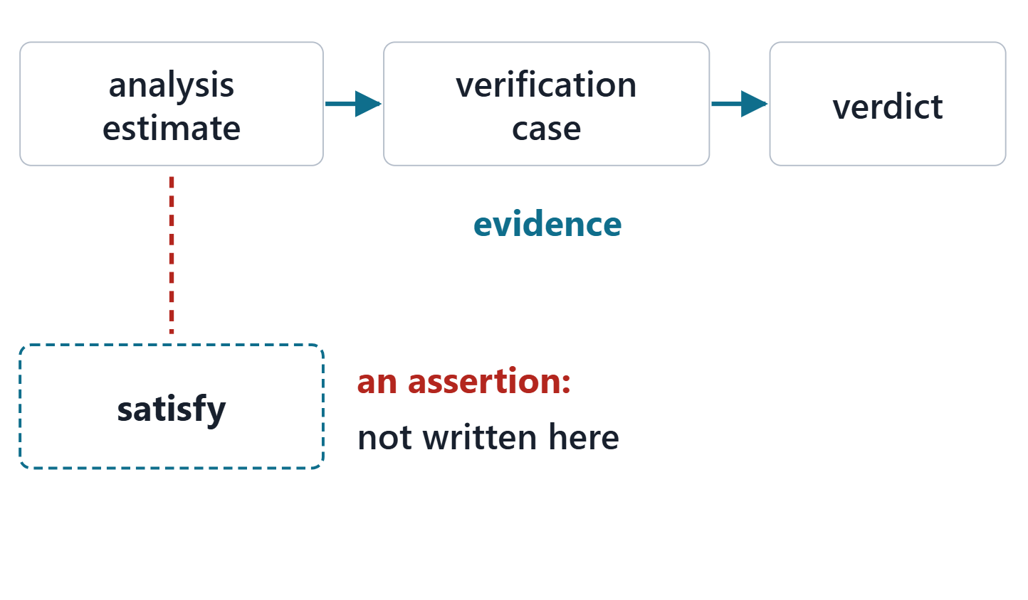
An estimate is not evidence
A satisfy asserts that a requirement is satisfied
A false assertion makes the model inconsistent
Evidence comes from a verification case
Analysis results feed TPMs and verification
Figure. An analysis estimate updates a TPM; it becomes verification evidence only when a verification case uses it, and a satisfy is an assertion, not a check. Course illustration, not SysML v2 graphical notation.
Sources: R83 p.162; R44 p.113

Slide 20
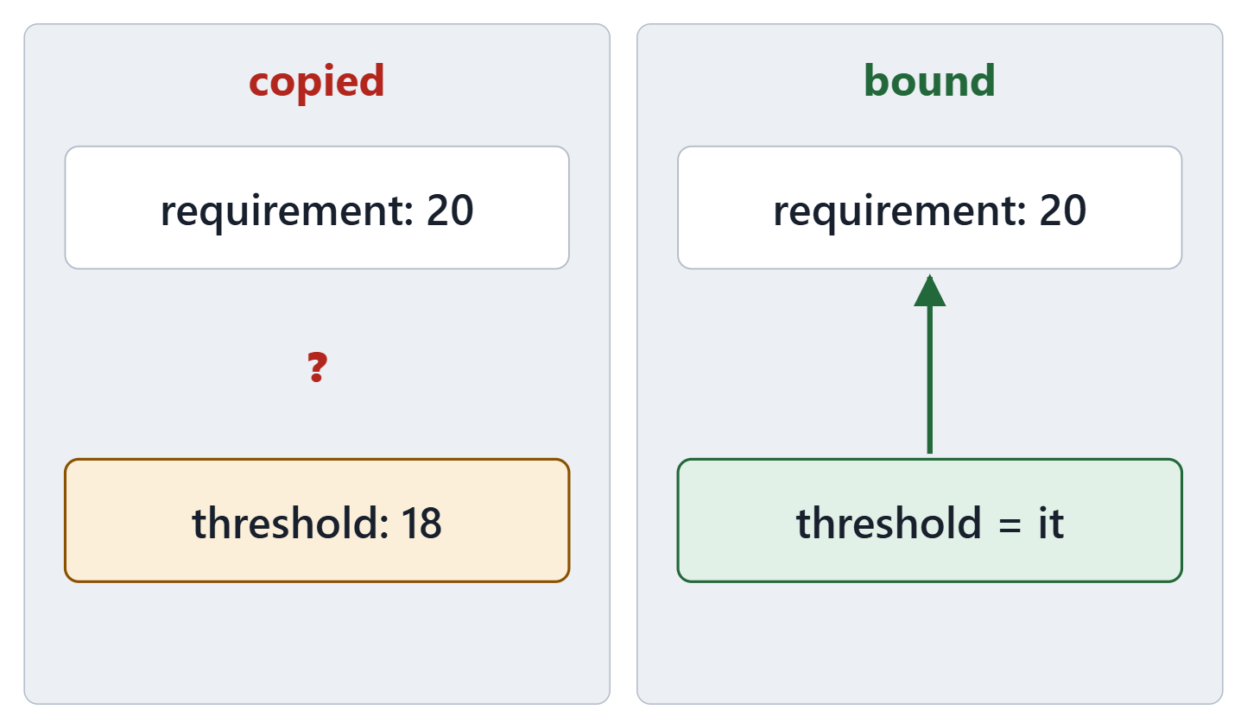
Write each limit once
Bind a threshold to the requirement’s attribute
A copied number can drift from its source
The checker accepts a copied, wrong limit
A limit with a unit: bind by hand, or record why not
Figure. A limit written twice can drift; a limit bound to the requirement’s attribute cannot. Course illustration, not SysML v2 graphical notation.
Sources: R120 sl.72

Slide 21
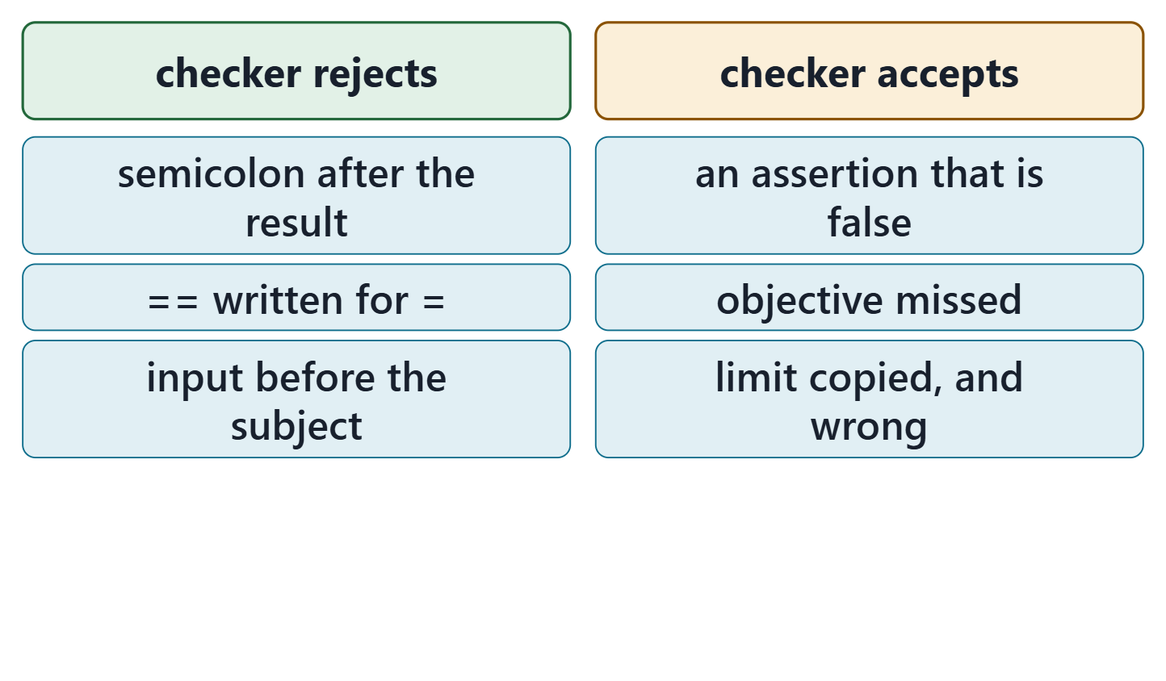
What the checker checks, and what it cannot
The ferry: accepted, no message; the model is inconsistent
Rejected: syntax and a few rules
Accepted silently: false assertions, missed objectives, copied limits
The checker evaluates no expression
Figure. Recorded results of the course checker (release 2026-08) on 6 course files: what it rejects, and what it accepts without complaint. Course illustration, not SysML v2 graphical notation.
Sources: R119 p.157–158; R120 sl.83

Slide 22
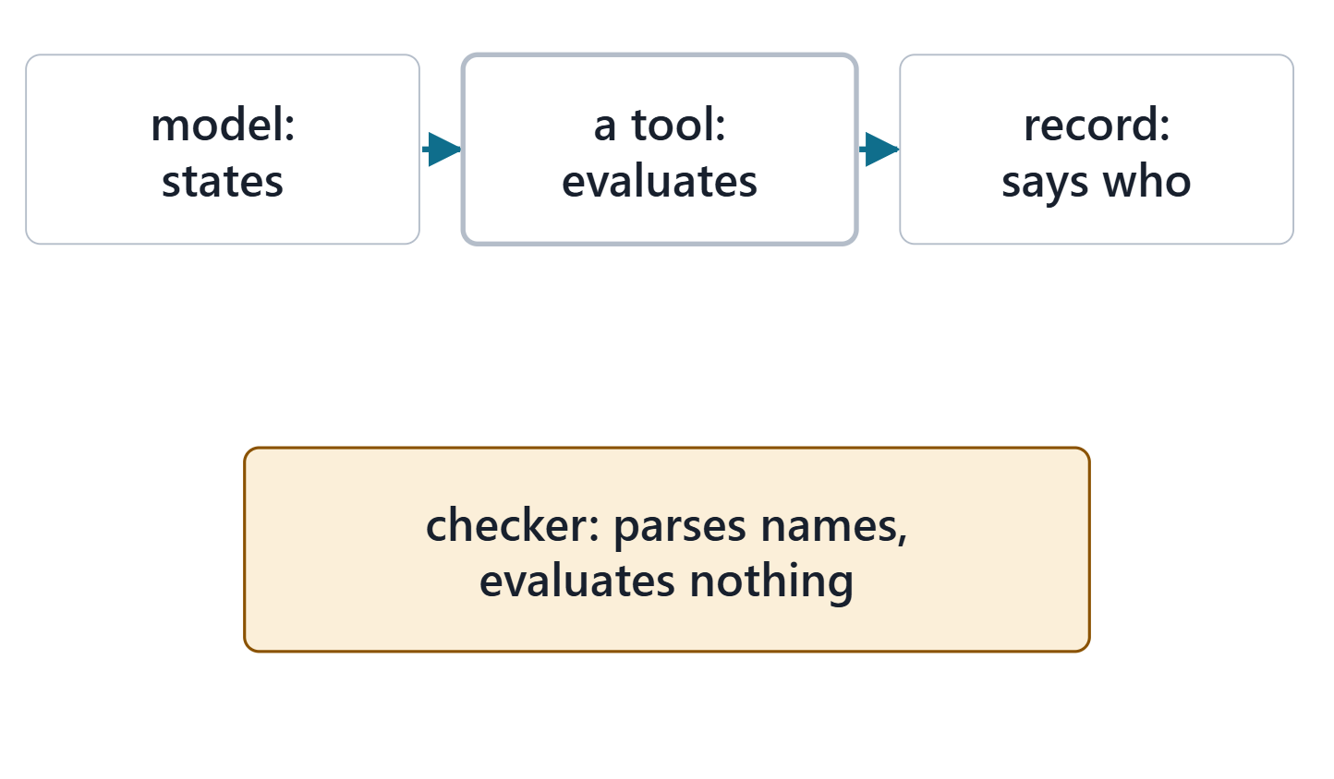
Answer: the model says how; a tool computes
Answer: B
The model states inputs and expressions
A tool that evaluates expressions computes
Every reported number names who computed it
Figure. Who does what with a number in an analysis model: the model states it, a tool evaluates it, the record says which tool. Course illustration, not SysML v2 graphical notation.
Sources: R84 p.170

Slide 23
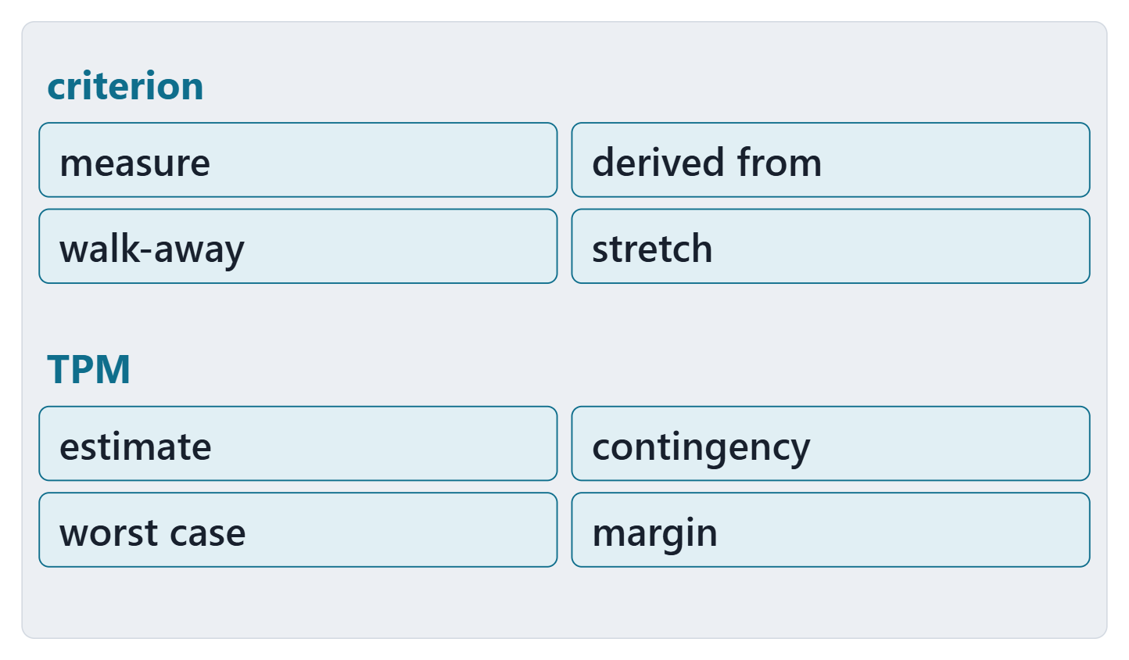
Exit: one criterion and one TPM of yours
One criterion: its measure, what it is derived from, its anchors
One TPM: estimate, contingency, worst case, margin
Which requirement holds the TPM’s threshold?
Figure. The exit card: four fields for one criterion of your Week 3 trade, and four for one TPM. Course illustration, not SysML v2 graphical notation.

Slide 24
References and credits
R15 · SEBoK v2.14 (2026), “Measurement”, p.532
R18 · SEBoK v2.14 (2026), “Decision Management”, p.465–466, 468–469, 472–473
R34 · SEBoK v2.14 (2026), “System Analysis”, p.608–609, 612
R43 · OUSD(R&E) Systems Engineering Guidebook (2021/2022), “Decision Analysis Process”, p.109
R44 · OUSD(R&E) Systems Engineering Guidebook (2021/2022), “Technical Assessment Process”, p.113, 117
R69 · OMG SysML v2.1 Beta 2, Part 1 (Release 2026-07), “7.27 Metadata”, p.193
R75 · Seidewitz, Intro to the SysML v2 Language: Textual Notation (Release 2026-08), “Analysis Case Definitions”, sl.92–95
R78 · Seidewitz, Intro to the SysML v2 Language: Textual Notation (Release 2026-08), “Standard View Definitions and Domain Libraries (metadata, analysis, cause and effect, requirements derivation)”, sl.148–149, 152
R83 · OMG SysML v2.1 Beta 2, Part 1 (Release 2026-07), “7.21 Requirements”, p.162
R84 · OMG SysML v2.1 Beta 2, Part 1 (Release 2026-07), “7.23 Analysis Cases”, p.170, 172–173
R119 · OMG SysML v2.1 Beta 2, Part 1 (Release 2026-07), “7.19 Calculations”, p.155–158
R120 · Seidewitz, Intro to the SysML v2 Language: Textual Notation (Release 2026-08), “Expressions and Feature Values”, sl.72, 74, 76, 79, 81, 83–84
R122 · SEBoK v2.14 (2026), “Measure of Effectiveness (MoE) (glossary)”, p.1562
R123 · SEBoK v2.14 (2026), “Technical Performance Measure (TPM) (glossary)”, p.1663
R124 · OMG SysML v2.1 Beta 2, Part 1 (Release 2026-07), “9.3.4 Parameters of Interest Metadata”, p.561–562
CREDITS AND LICENSES
Introduction to the SysML v2 Language, Textual Notation (Release 2026-08): Copyright © 2019–2026 Model Driven Solutions, Inc. Licensed under the Creative Commons Attribution 4.0 International License (CC BY 4.0).
SEBoK v2.14: “This material is used under a Creative Commons Attribution-NonCommercial ShareAlike 3.0 Unported License from The Trustees of the Stevens Institute of Technology.” (SEBoK, “Bkcase Wiki:Copyright”, PDF p.31). Quotations are short and cited; no SEBoK figure or table is reproduced.
OUSD(R&E) Systems Engineering Guidebook: Distribution Statement A. Approved for public release. Distribution is unlimited.
Figures are original drawings for this course; none redraws a figure from the sources.
AeroLink Urban Mobility is a fictional teaching case: every number, name and statement about it is a teaching value.

