Slide 1
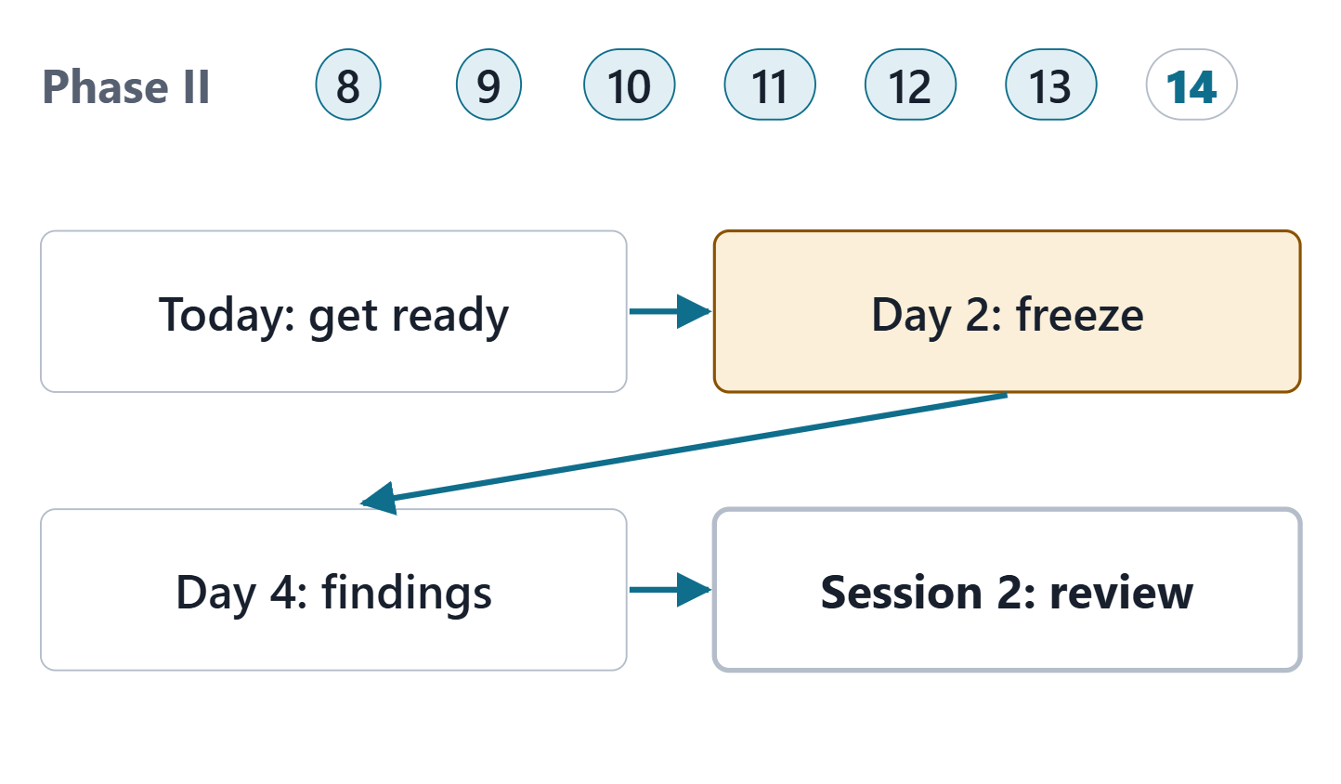
Final Presentation
Session 1: The coherent model, views for stakeholders, the evolution increment and the review
Today: the coherent model, stakeholder views, the evolution increment, the review
Then: a frozen review copy, findings from a paired team
Session 2: the final review of your own model
Figure. Week 14 closes Phase II: today you make the model ready, the paired team reviews a frozen copy, and Session 2 is the final review. Course illustration, not SysML v2 graphical notation.

Slide 2
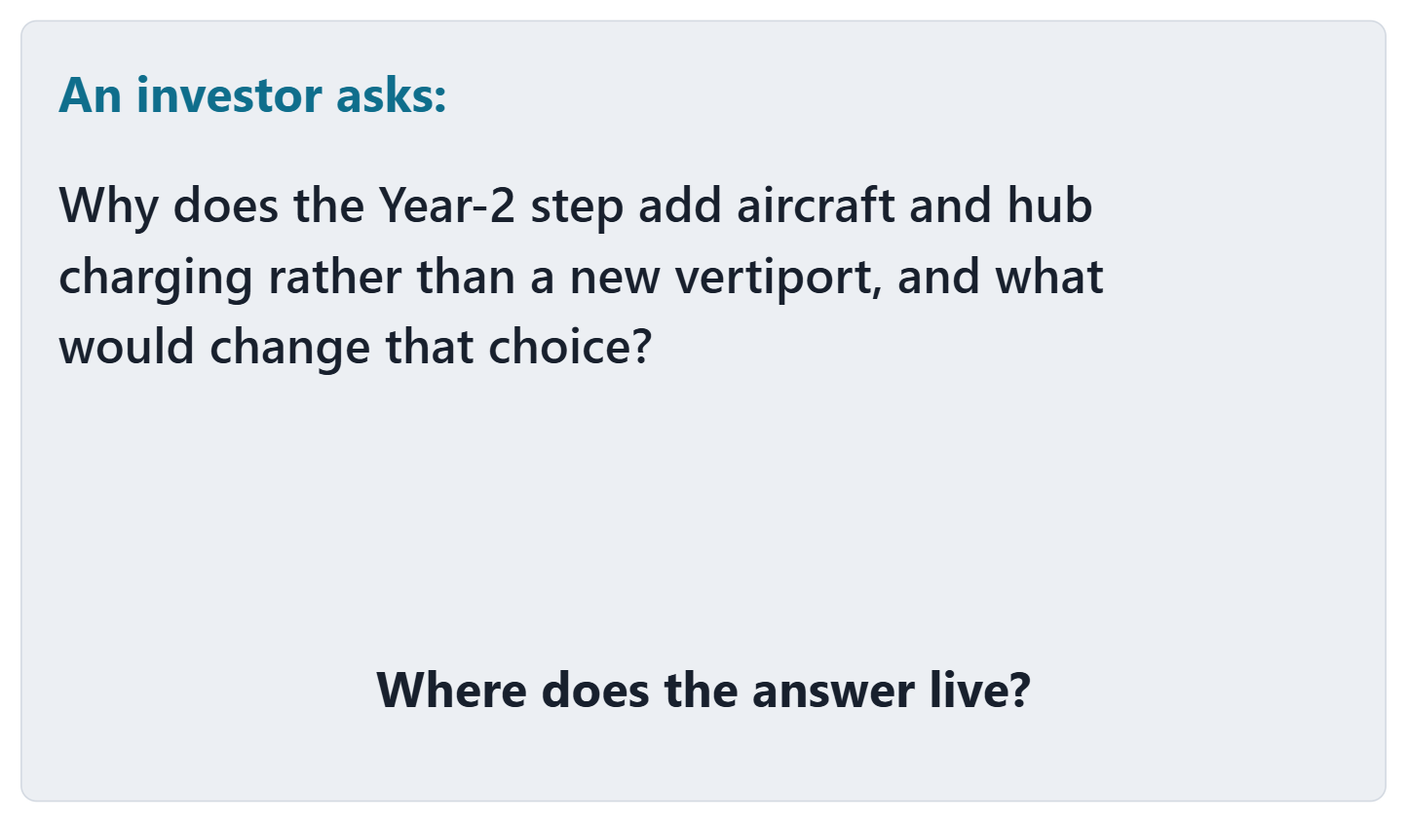
Driving question: where does the answer live?
VOTE
Where does the answer live in a Phase II team’s work?
A · The requirements package
B · The analysis package: the decision record and its traces
C · A slide in the review deck
D · Nowhere yet
Figure. A question an AeroLink investor asks in the review (FICTIONAL). Course illustration, not SysML v2 graphical notation.

Slide 3
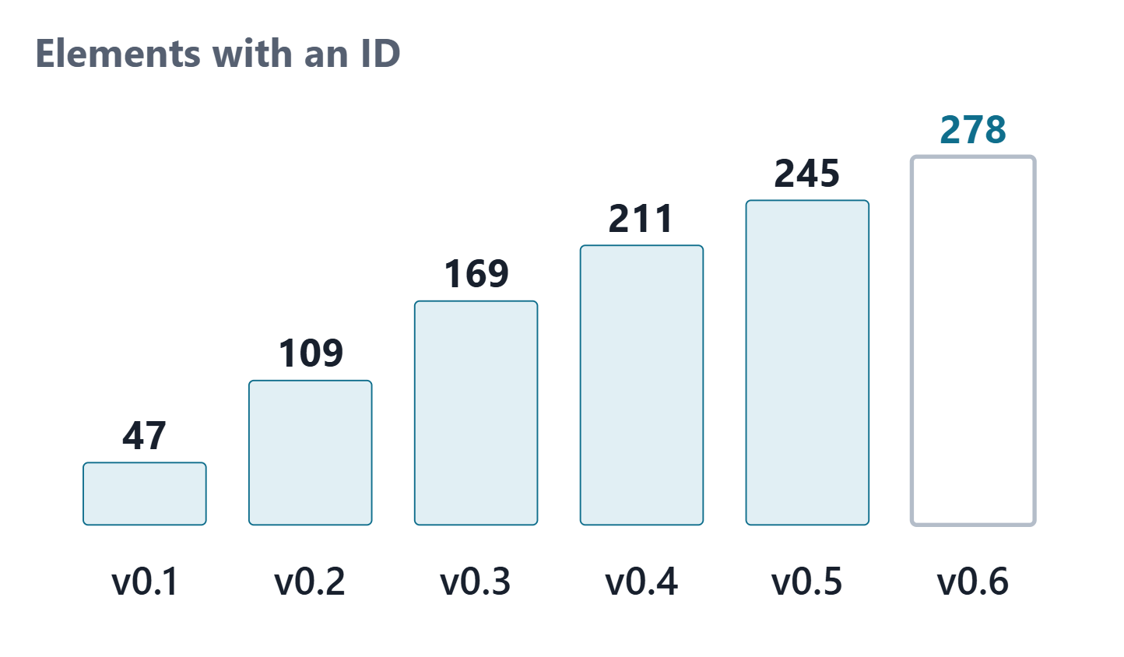
What Phase II built, week by week
Each week modeled one part of the Phase I package
Every ID kept the number it was given
Week 14: the roadmap increment and the stakeholder views
Figure. Elements with an ID declared in each AeroLink model version, v0.1 (Week 8) to v0.6 (Week 13), counted by the Week 14 audit. Course illustration, not SysML v2 graphical notation. (FICTIONAL)
Sources: R29 p.1383

Slide 4
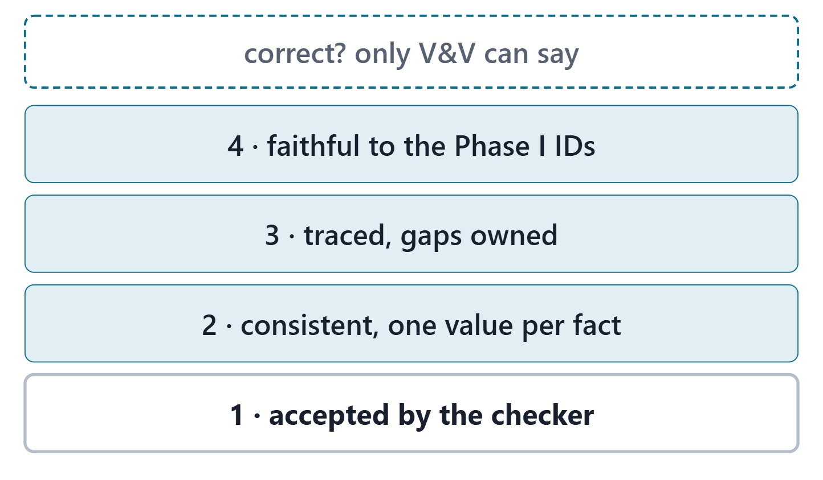
What “coherent” means for the final model
Accepted: zero errors, warnings explained
Consistent: one value per fact, no claim the model contradicts
Traced: the course links complete, each gap owned
Faithful: every element keeps its Phase I ID
KEY POINT
Course convention. A clean checker run is the first test, not the last.
Figure. Coherent, as the course uses the word: four tests stacked from the first to the last. Correct is above them: only verification and validation can support it. Course illustration, not SysML v2 graphical notation.
Sources: R29 p.1383–1384

Slide 5
The final model audit
Audit line (course convention) | AeroLink model v0.6
IDs kept since first issued | all; none removed or renamed
Defects | 0
Gaps to disposition | 3
Complete threads | 26 of 36 requirements
Cases with a pass (reported) | 0 of 34
Sources: R06c p.387

Slide 6
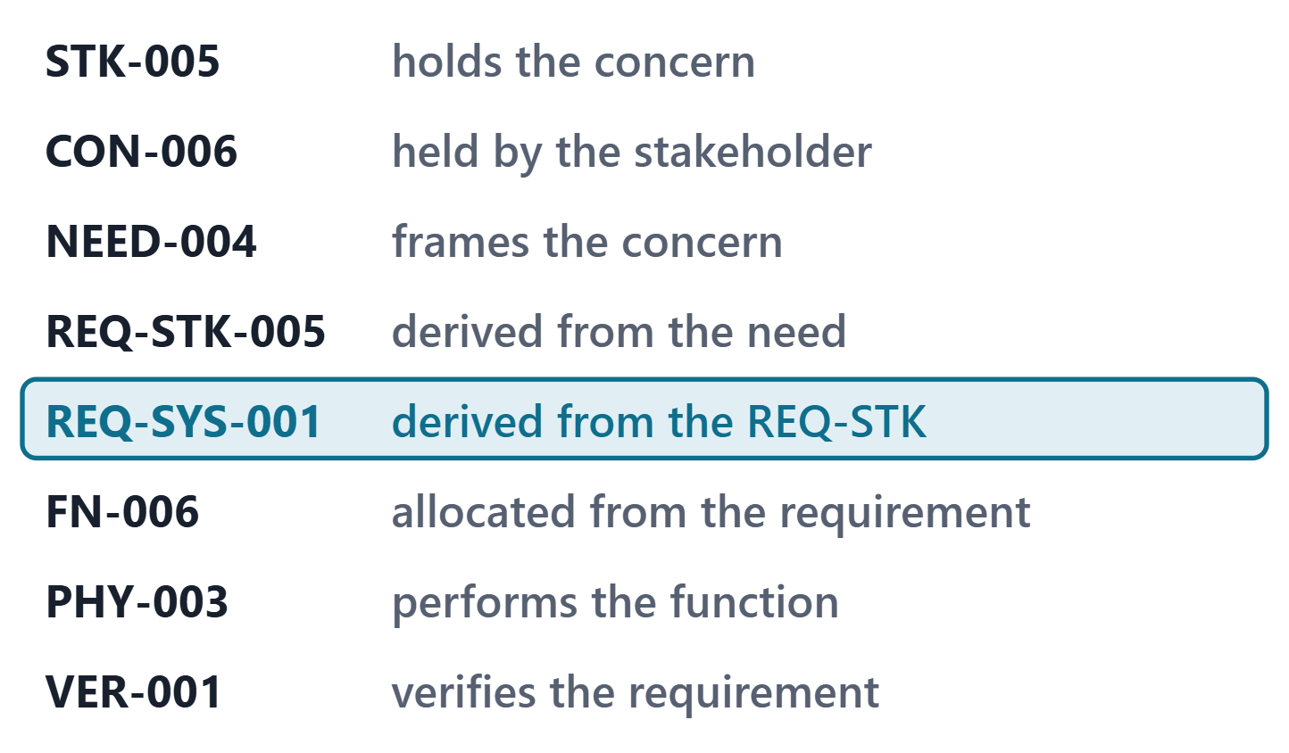
A complete thread, hop by hop
Up: stakeholder, concern, need, stakeholder requirement
Down: function, physical element, verification case
Say the relationship at every hop
Figure. The thread through REQ-SYS-001 in AeroLink model v0.6, as the Week 14 audit walks it; each hop names the relationship followed. Course illustration, not SysML v2 graphical notation. (FICTIONAL)

Slide 7
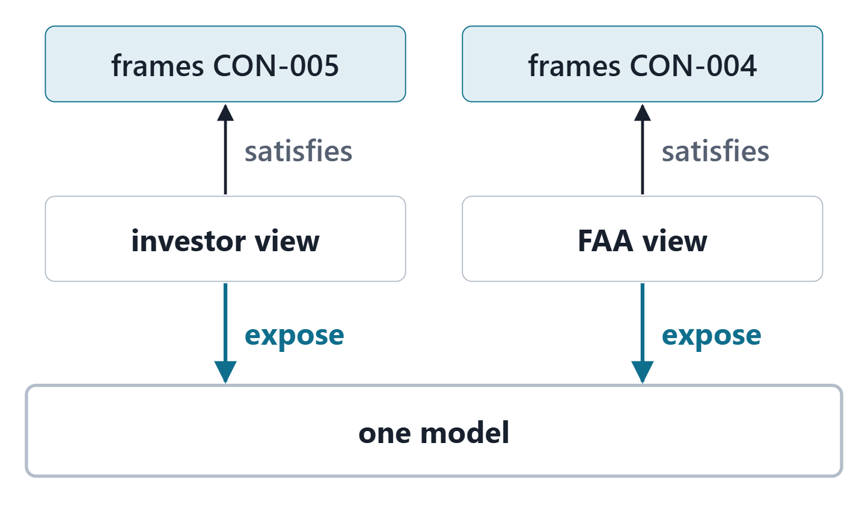
Model versus view, made precise
VIEWPOINT DEFINITION
A kind of requirement definition that frames the concerns of one or more stakeholders.
R85 · OMG SysML v2.1 Beta 2, Part 1 (Release 2026-07), "7.26 Views and Viewpoints", p.181
View definition: a kind of part definition; view conditions and a rendering
View usage: exposes a portion of the model
Figure. One model, several views: each view exposes part of the model and renders it for one stakeholder’s concern; the model underneath is unchanged. Course illustration, not SysML v2 graphical notation.
Sources: R85 p.181

Slide 8
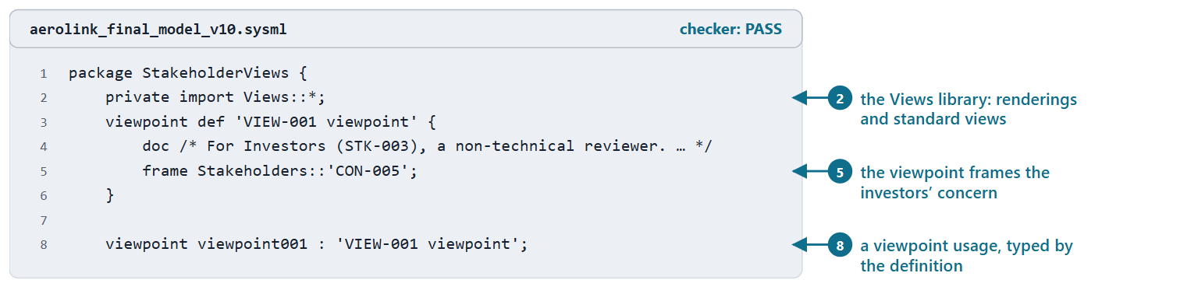
Stakeholders, concerns and viewpoints
A concern: a specific topic stakeholders want addressed
A viewpoint frames concerns you modeled in Week 8
Course pattern: a viewpoint definition, then a usage typed by it
Figure. AeroLink model v1.0: the stakeholder views package imports the Views library; the viewpoint definition frames the investors’ concern, and a viewpoint usage is typed by it. Checked: PASS. (FICTIONAL)
Sources: R77 sl.115–116; R85 p.181

Slide 9
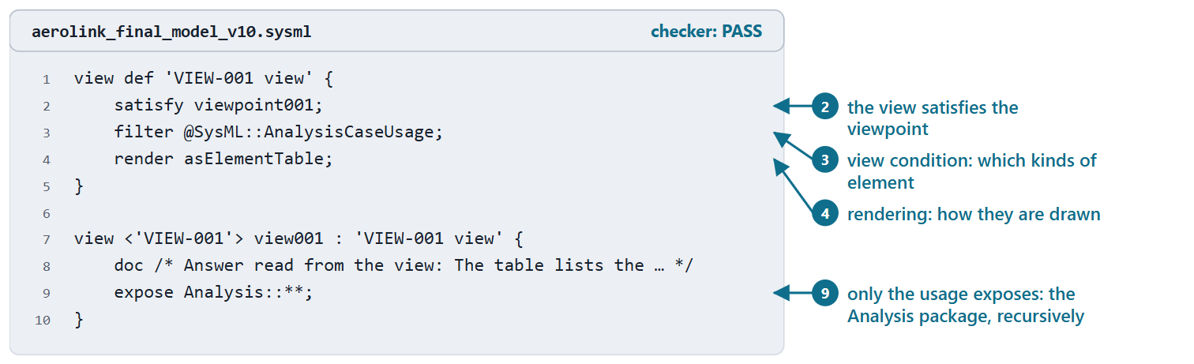
View definitions and view usages: filter, render, expose
Definition: satisfy a viewpoint, filter, render
Usage: inherits them, exposes what to include
An expose is written like an import, with no visibility keyword
Figure. AeroLink model v1.0: the investor view definition (satisfy, filter, render) and the view usage that exposes the Analysis package recursively. Checked: PASS. (FICTIONAL)
Sources: R85 p.184; R77 sl.117–118

Slide 10
Standard views and renderings
Standard view | Short name
General View | gv
Interconnection View | iv
Action Flow View | afv
State Transition View | stv
Sequence View | sv
Geometry View | gev
Grid View | grv
Browser View | bv
NOTE
Renderings: tree diagram, interconnection diagram, textual notation, element table.
Sources: R125 p.541–543; R125 p.548; R125 p.551; R85 p.186

Slide 11
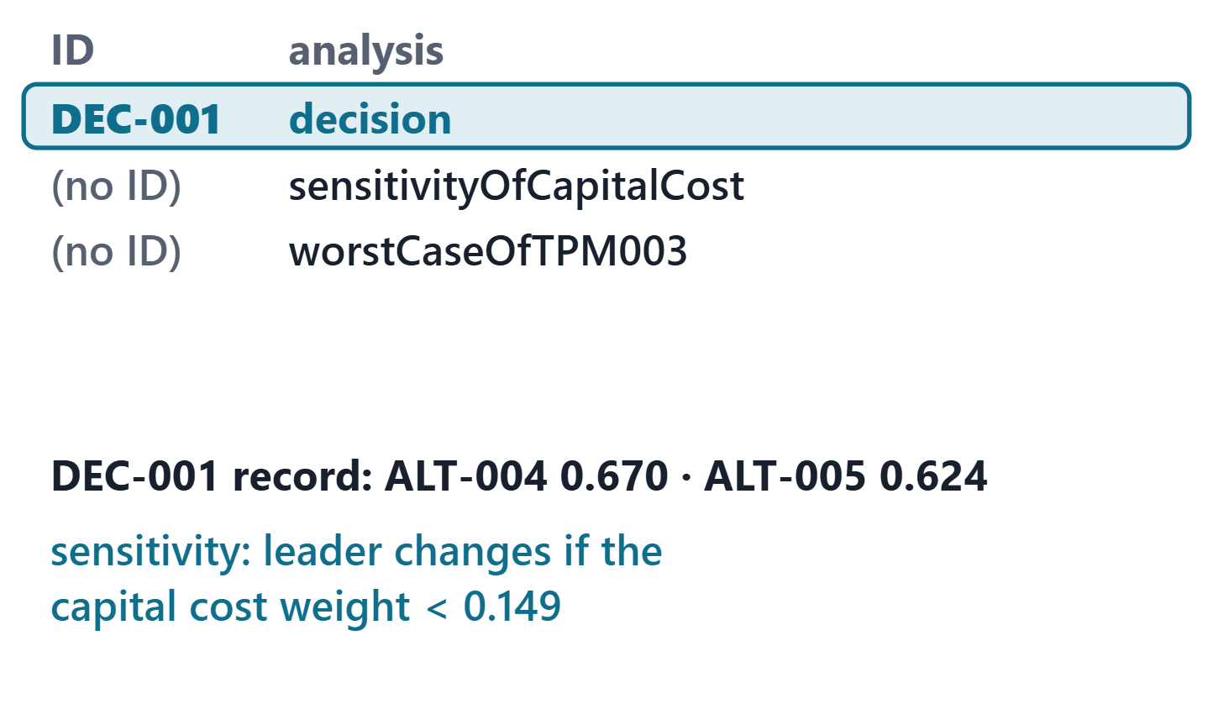
Worked example I: the investor view
ANSWER: B
The decision record and its traces, in the analysis package. The view selects it; it adds nothing.
ALT-004 0.670; ALT-005 0.624
Reverses if the capital cost weight falls below 0.149
If a view needs a fact the model lacks, fix the model
Figure. What the AeroLink investor view lists (the Analysis package, analysis usages, as an element table): the decision record, which states the ranking, and its sensitivity check, which states the condition that reverses it. Course illustration, not SysML v2 graphical notation. (FICTIONAL)
Sources: R85 p.181

Slide 12
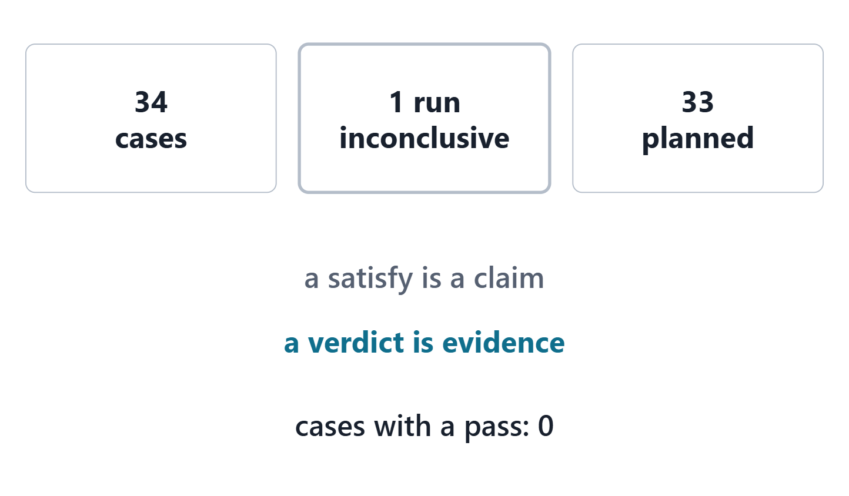
Worked example II: a regulator view
Frames airworthiness and operational safety
Keeps verification case definitions only
A satisfy is a claim; the verdict is the evidence
Figure. What the AeroLink regulator view lists today: the verification case definitions and their status, read from model v0.6. Course illustration, not SysML v2 graphical notation. (FICTIONAL)
Sources: R83 p.168

Slide 13
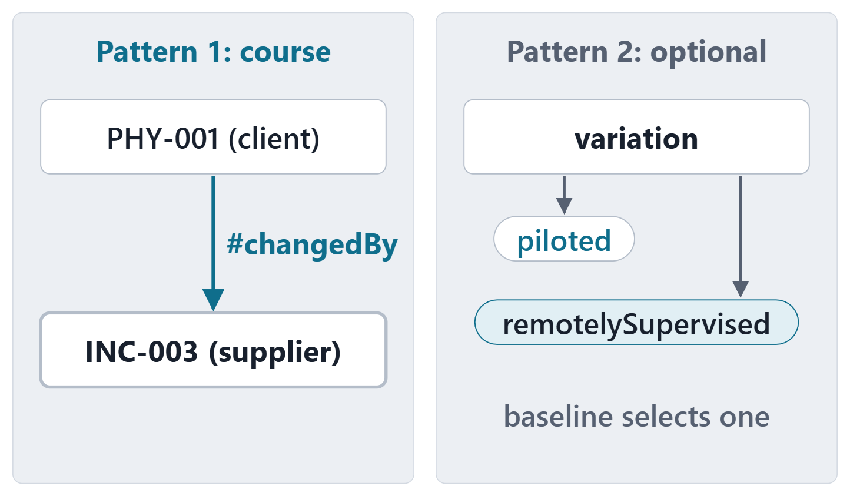
Two light ways to model an increment
Pattern 1 (course): the increment in the Evolution package, one #changedBy dependency per changed element
From the changed element (client) to the increment (supplier)
Pattern 2 (optional): a variation and its variants
Figure. Two ways to put a roadmap increment in the model: dependencies from each changed element to the increment (the course pattern), or a variation whose variants are the allowed choices (optional). Course illustration, not SysML v2 graphical notation.
Sources: R80 p.50–51; R80 p.75; R26 p.682

Slide 14
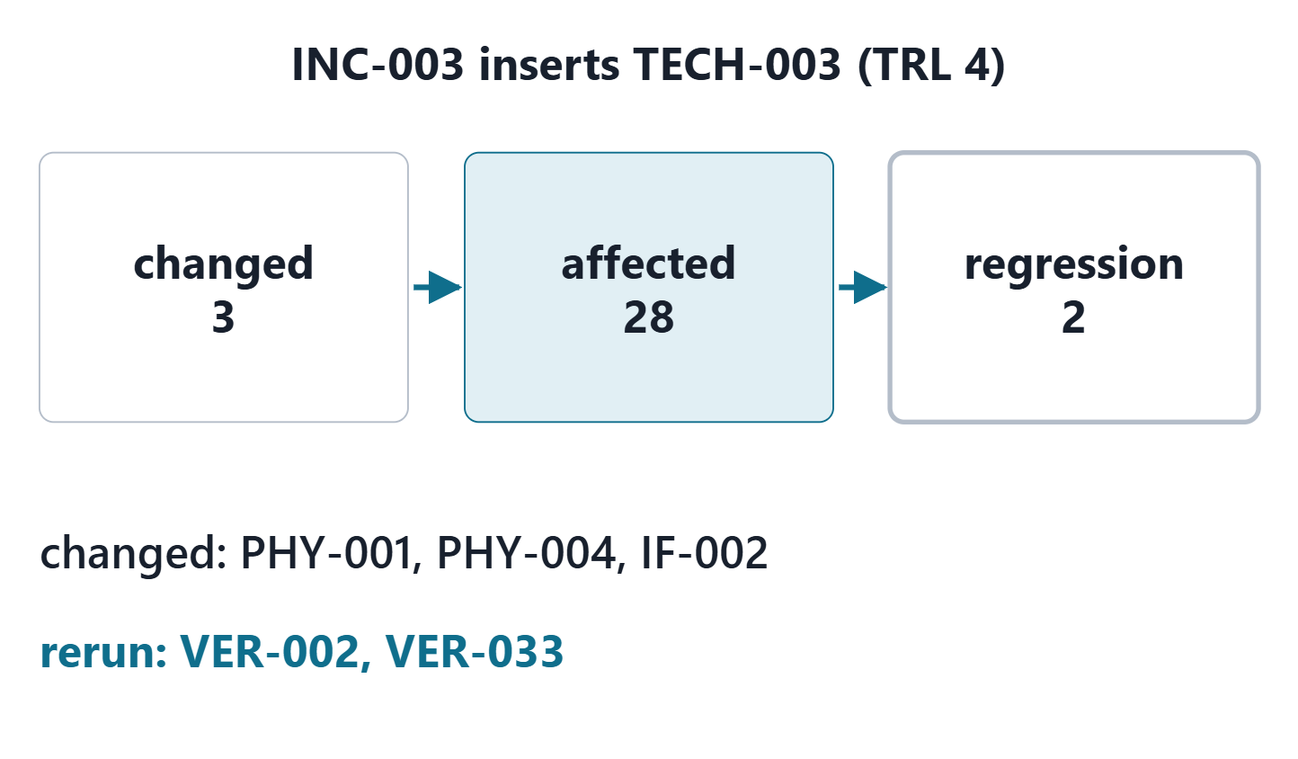
Worked example III: the AeroLink autonomy increment
Remote or autonomous flight operations: far horizon
Changes 3 elements; 28 affected one hop away
Regression set: 2 verification cases
Figure. The AeroLink increment INC-003 in model v1.0: the elements it changes, the affected set one trace hop away, and the verification cases to run again. Course illustration, not SysML v2 graphical notation. (FICTIONAL)
Sources: R26 p.682

Slide 15
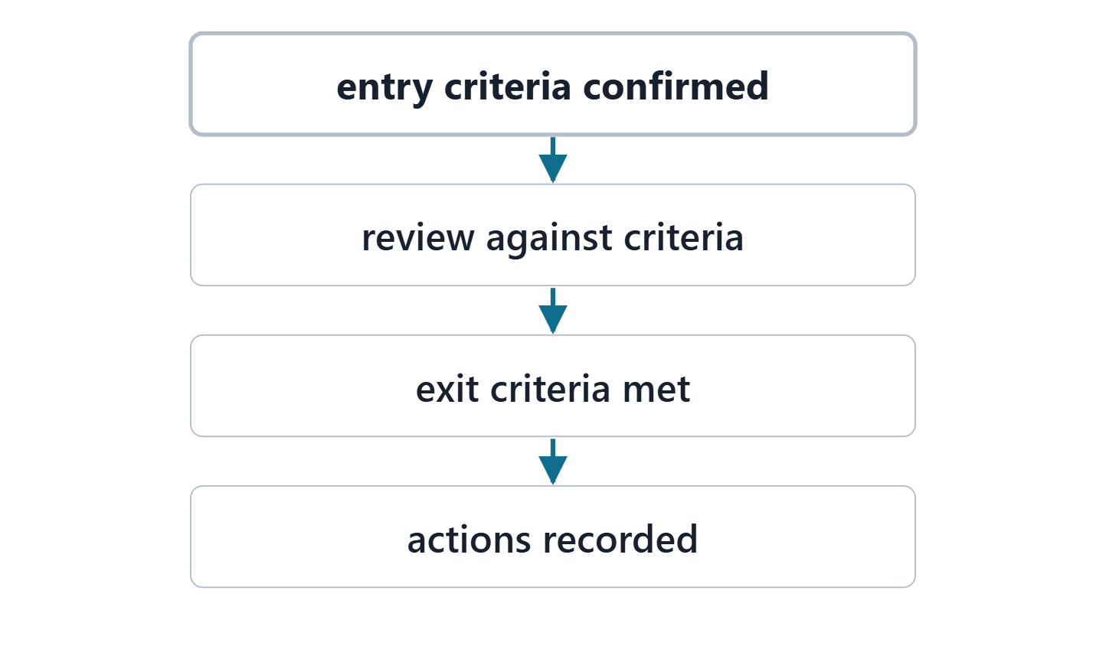
What a technical review is for
Knowledgeable reviewers judge work products against agreed criteria
Entry criteria are confirmed before the review starts
The review closes when its exit criteria are met
Figure. A technical review as SEBoK describes it: entry criteria confirmed first, the review against pre-established criteria, then exit criteria and actions. Course illustration, not SysML v2 graphical notation.
Sources: R06c p.386–388

Slide 16
The final review format
Segment | Min
The enterprise and the system of interest | 1
Complete threads, walked live in the model | 3
The key decision and its sensitivity | 2
One what-if question answered from the model | 1
The stakeholder views and the evolution increment | 1
Dispositions of the peer findings | 1
Individual questions | 3

Slide 17
Live demonstration: navigating a thread
Start from the reviewer’s concern, not the package tree
“Which case verifies this requirement, and what is its verdict?” Answer from the model
Rehearse the route; have the checker log and a static rendering ready

Slide 18
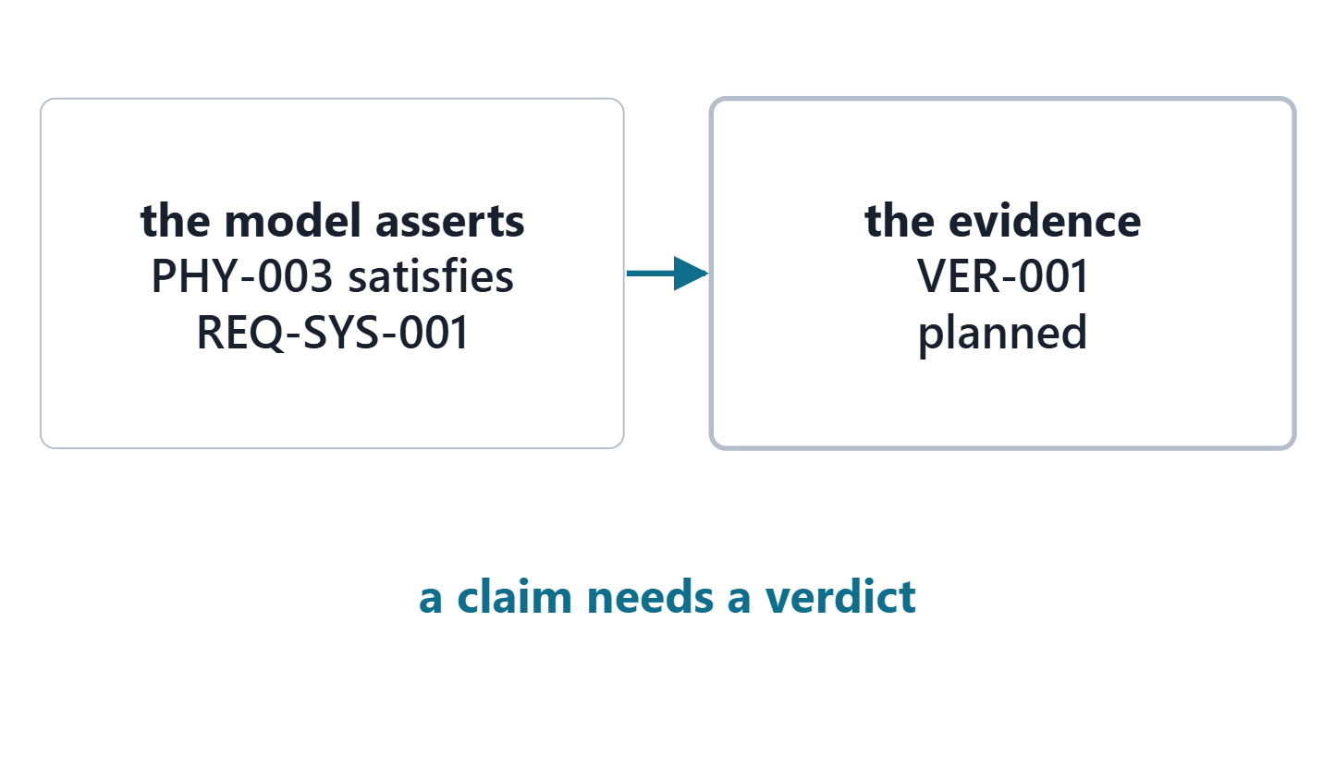
Individual questions: owning your elements
You answer on elements you own
What does this satisfy assert?
What evidence supports it, and what is its status?
What changes if this value changes?
Figure. What a satisfy asserts and what supports it: the AeroLink requirement REQ-SYS-001, its satisfy claim in the model, and the status of its verification case. Course illustration, not SysML v2 graphical notation. (FICTIONAL)
Sources: R83 p.168

Slide 19
The AI usage and validation statement
Tool, purpose, example prompts, what it produced
How you checked it, and what you contributed
Every accepted fragment passes the checker and has an owner who can explain it
AI output is never evidence of a trace, a margin or a verdict

Slide 20
Team readiness check
A team audit of your own model, not a quiz
Import model v0.6, your earlier versions and your Week 6 file; read the audit
Each defect: who corrects it. Each gap: fix or reason, and an owner
Choose your 3 threads; check each is complete
Name the stakeholders your views will serve

Slide 21
Peer review pairing and order
Freeze a review copy at the latest 4 days before Session 2; record its hash
Write at least 3 findings on your paired team’s copy
Each finding: where, which rule it breaks, a proposed fix
Disposition every finding you receive before Session 2
Sources: R06c p.388

Slide 22
Exit card
EXIT CARD
One question a reviewer could ask that your model cannot yet answer, and who on your team fixes it.
Review copy frozen: at the latest 4 days before Session 2
Findings to your paired team: within 48 hours of receiving the copy, at the latest 2 days before Session 2
Session 2: the final review

Slide 23
References and credits
R06c · SEBoK v2.14 (2026), “Technical Reviews and Audits”, p.386–388
R26 · SEBoK v2.14 (2026), “Capability Updates, Upgrades, and Modernization”, p.682
R29 · SEBoK v2.14 (2026), “Transitioning Systems Engineering to a Model-based Discipline”, p.1383–1384
R77 · Seidewitz, Intro to the SysML v2 Language: Textual Notation (Release 2026-08), “Metadata”, sl.115–118
R80 · OMG SysML v2.1 Beta 2, Part 1 (Release 2026-07), “7.1 Language Overview”, p.50–51, 75
R83 · OMG SysML v2.1 Beta 2, Part 1 (Release 2026-07), “7.21 Requirements”, p.168
R85 · OMG SysML v2.1 Beta 2, Part 1 (Release 2026-07), “7.26 Views and Viewpoints”, p.181, 184, 186
R125 · OMG SysML v2.1 Beta 2, Part 1 (Release 2026-07), “Views library and Standard View Definitions (9.2.19-9.2.20)”, p.541–543, 548, 551
CREDITS AND LICENSES
Introduction to the SysML v2 Language, Textual Notation (Release 2026-08): Copyright © 2019–2026 Model Driven Solutions, Inc. Licensed under the Creative Commons Attribution 4.0 International License (CC BY 4.0).
SEBoK v2.14: “This material is used under a Creative Commons Attribution-NonCommercial ShareAlike 3.0 Unported License from The Trustees of the Stevens Institute of Technology.” (SEBoK, “Bkcase Wiki:Copyright”, PDF p.31). Quotations are short and cited; no SEBoK figure or table is reproduced.
Figures are original drawings for this course; none redraws a figure from the sources.
AeroLink Urban Mobility is a fictional teaching case: every number, name and statement about it is a teaching value.

