Slide 1
WEEK 3 · SESSION 1
Technology Assessment / Risk Management / Trade Study
Session 1: Readiness, risk and the measures that track it
Today: technology readiness, the risk register, technical performance measures
Session 2: the trade study, worked in full, and the Lab L3 launch
Your Team Record grows: readiness assessment, risk register, TPMs, trade study

Slide 2
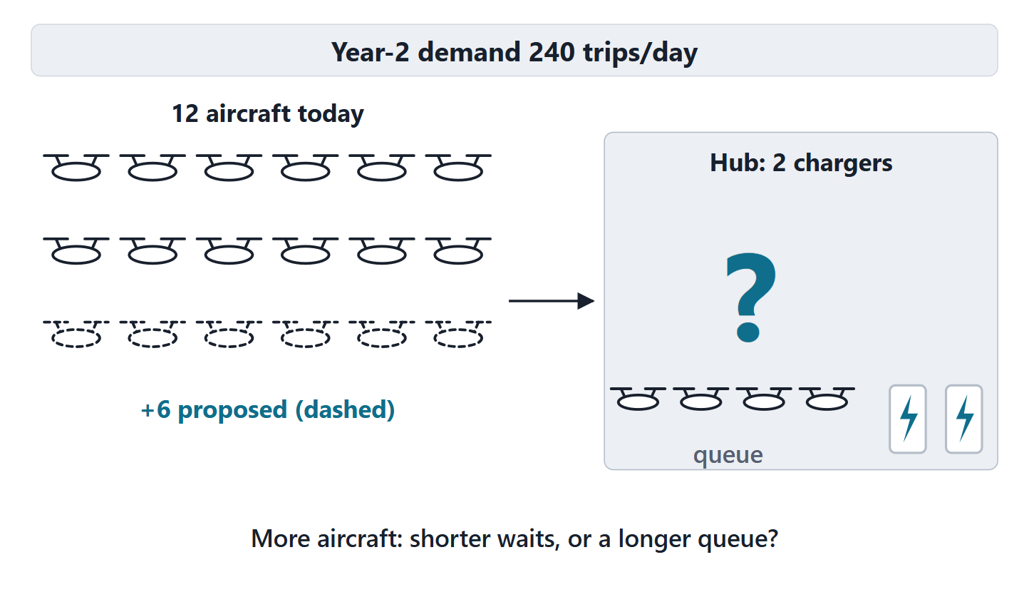
The driving question: should AeroLink buy six more aircraft?
SCENARIO (FICTIONAL)
Demand will reach 240 trips/day. The board proposes 6 more aircraft: 18 in all.
A · Yes: more aircraft, shorter waits
B · Only with more charging
C · Build a seventh vertiport instead
D · Cannot tell yet
Figure. Waits are forecast to grow as Year-2 demand reaches 240 trips/day. The board proposes six more aircraft. (FICTIONAL)

Slide 3
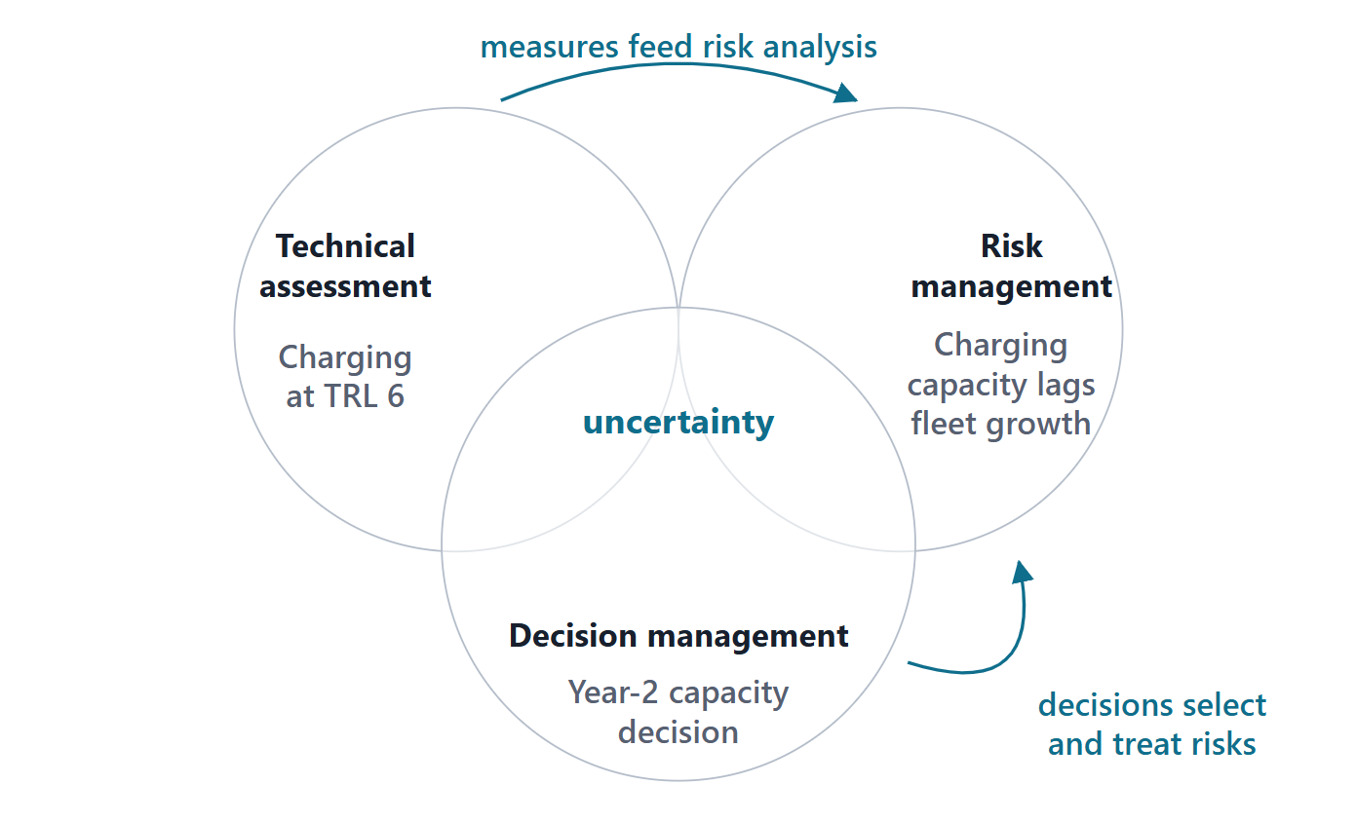
Three processes, one subject: uncertainty
Risk: the effect of uncertainty on objectives, or probability and severity of harm
Uncertainty: not having accurate or sufficient knowledge
Measurement gives indicators for risk analysis
Decision management evaluates alternatives that treat risks
Figure. Technical assessment, risk management and decision management overlap; what they share is uncertainty. One AeroLink artifact in each.
Sources: R17 p.481; R17 p.485; R39s p.1668

Slide 4
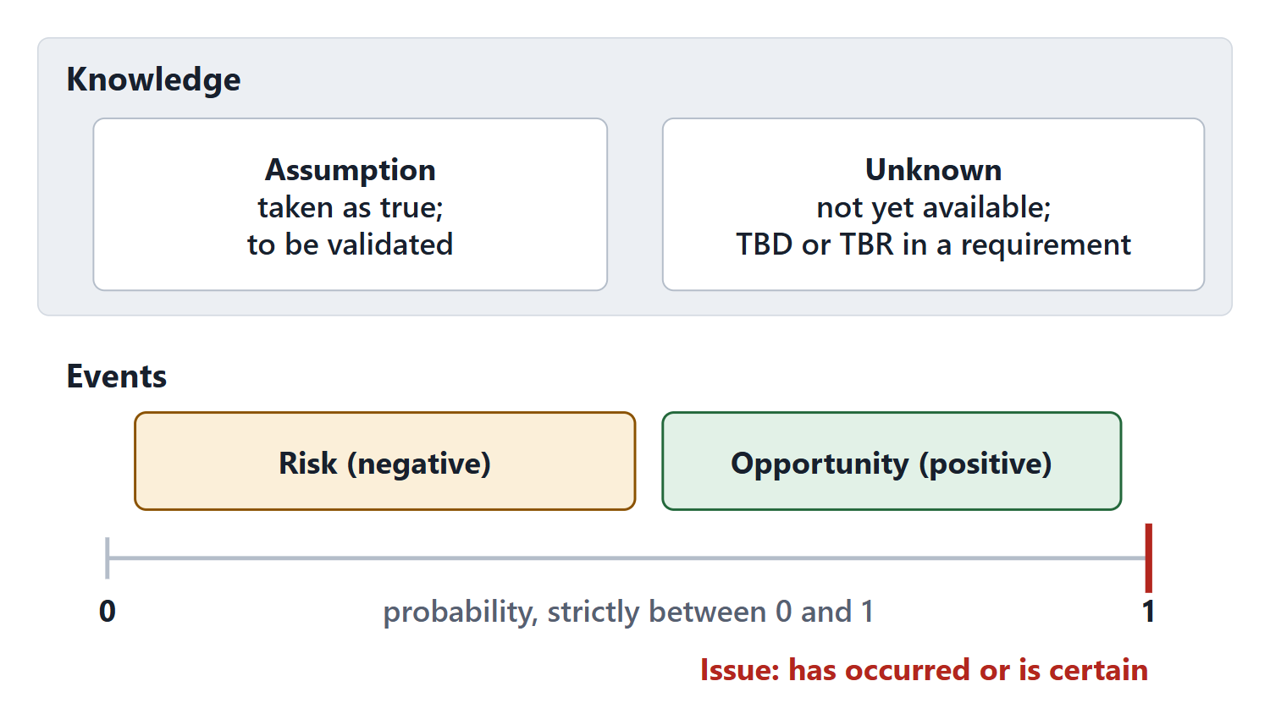
Five kinds of entry: assumption, risk, opportunity, unknown, issue
Risk: 0 < probability < 1, consequence > 0, in the future
Issue: has occurred or is certain (probability 1)
Opportunity: an outcome better than expected
Assumption: taken as true; must be validated
Unknown: information not yet available (TBD/TBR)
Figure. Risks and opportunities sit strictly between probability 0 and 1; an issue sits at exactly 1. Assumptions and unknowns are about knowledge.
Sources: R39q p.1610; R39r p.1582; R46 p.127; R13 p.565

Slide 5
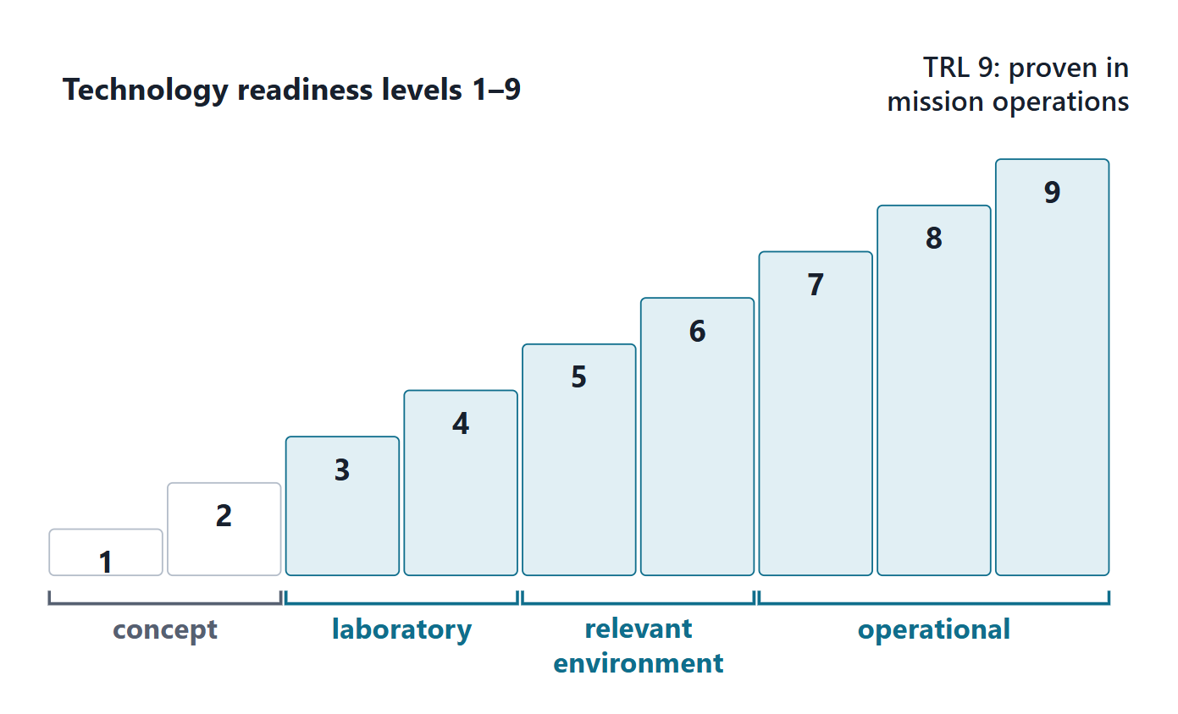
What a readiness assessment is for
Qualifies technology development and supports investment decisions
A TRL summarizes a technology’s degree of maturity
Nine levels: basic principles (1) to proven in mission operations (9)
Assess maturity and risk of the critical technologies
Figure. The nine technology readiness levels as a staircase, grouped by the environment in which the technology has been shown to work.
Sources: R16 p.766; R44 p.112

Slide 6
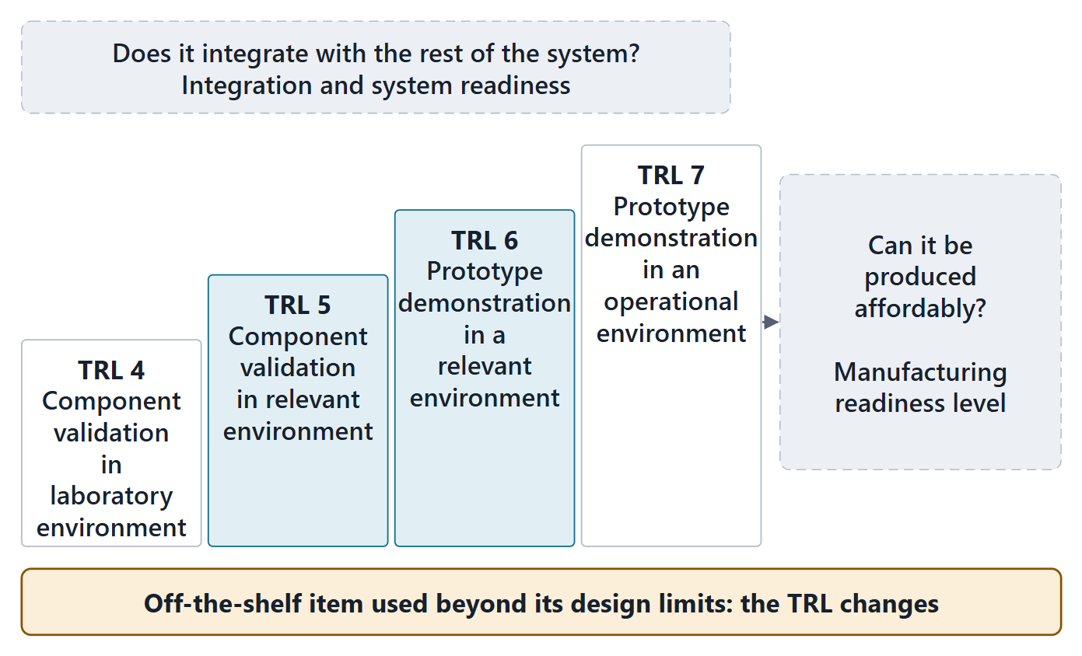
The scale, read exactly, and what it does not tell you
TRL | SEBoK wording
4 | Component validation in laboratory environment
5 | Component validation in relevant environment
6 | Prototype demonstration in a relevant environment
7 | Prototype demonstration in an operational environment
Not measured: producibility, integration, criticality, changed environments
Figure. TRL measures demonstrated maturity in an environment. Producibility, integration and changed environments need other questions.
Sources: R16 p.767; R16 p.768

Slide 7
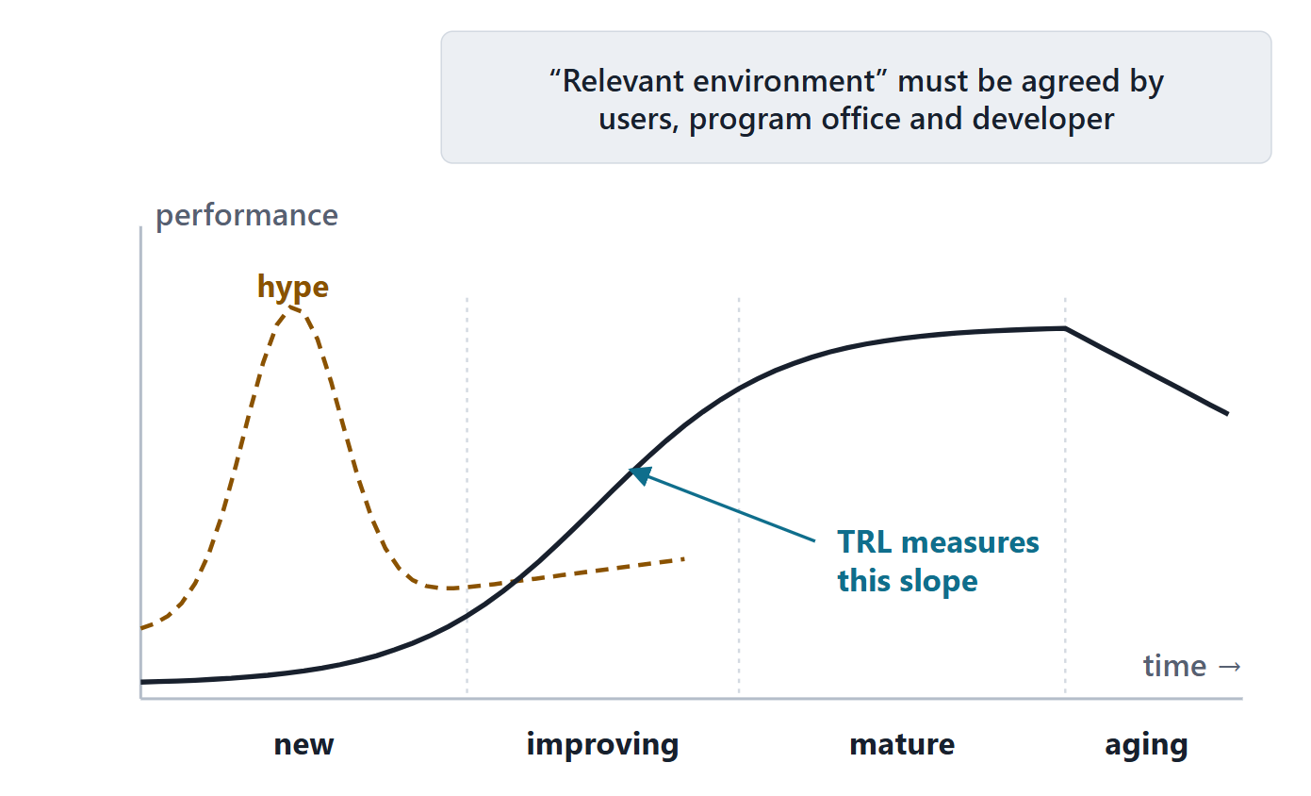
Maturity in practice: hype, the s-curve and shared meanings
Hype can draw funding to unsuitable technology: assess before committing
TRL measures the rising slope of the s-curve
Agree what “relevant environment” means for your system
TRL does not say how well a technology fits your architecture
Figure. Technology matures along an s-curve; TRL is the accepted way to measure its rising slope. Hype often runs ahead of maturity.
Sources: R60 p.524; R60 p.525

Slide 8
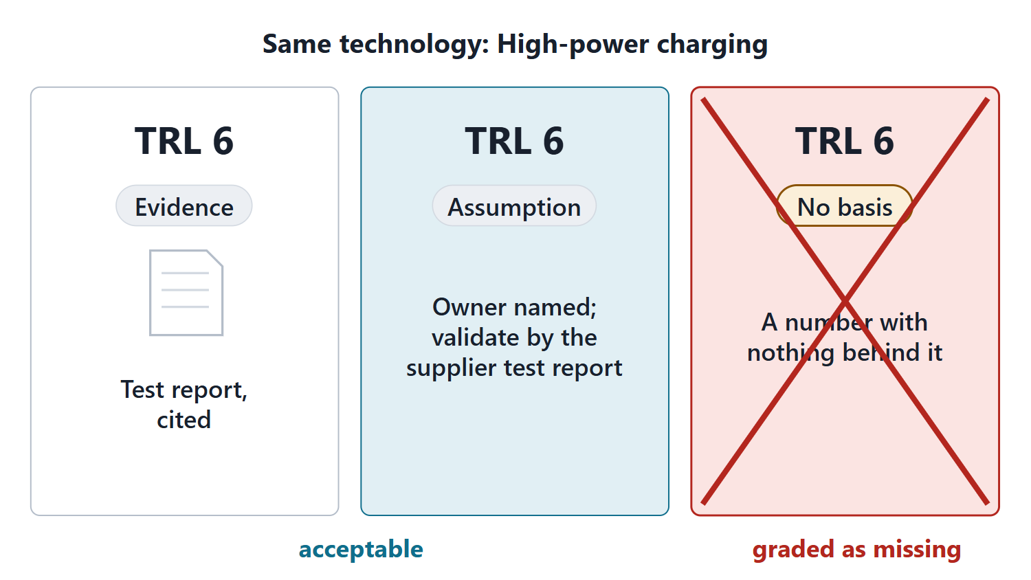
Evidence, or a labeled assumption
COURSE RULE
Every TRL cites evidence, or is recorded as an assumption with an owner and a validation action.
Most student TRLs will be assumptions: acceptable when labeled
Interpret the environment words for your system
Figure. Two acceptable TRL claims and one that is not: cite the evidence, or record the claim as an assumption with an owner and a validation action.
Sources: R60 p.525

Slide 9
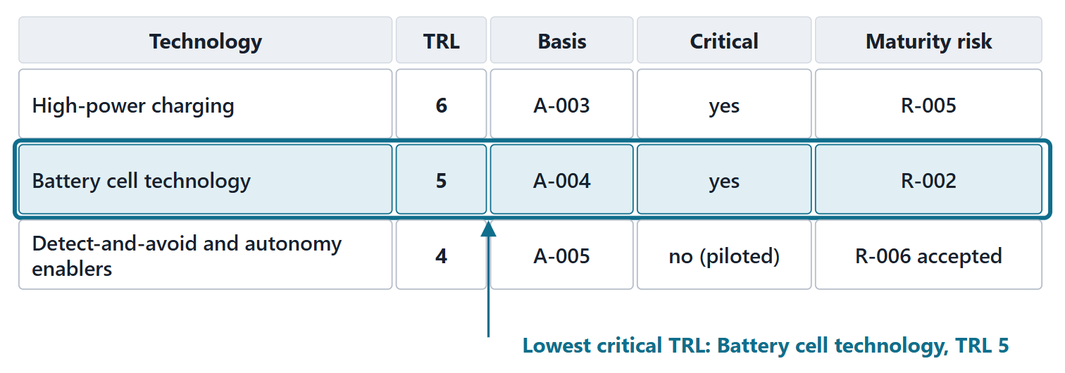
Worked example I: AeroLink’s three enabling technologies
Select: the critical technologies the requirements depend on
Rate: each on the scale, with evidence or a labeled assumption
Judge: criticality and what the TRL does not tell
Summarize: the lowest critical TRL and its maturity risk
Figure. AeroLink’s readiness assessment. The lowest TRL among the critical technologies leads the summary. Every TRL rests on an assumption. (FICTIONAL)
Sources: R16 p.767; R60 p.525; R60 p.526

Slide 10
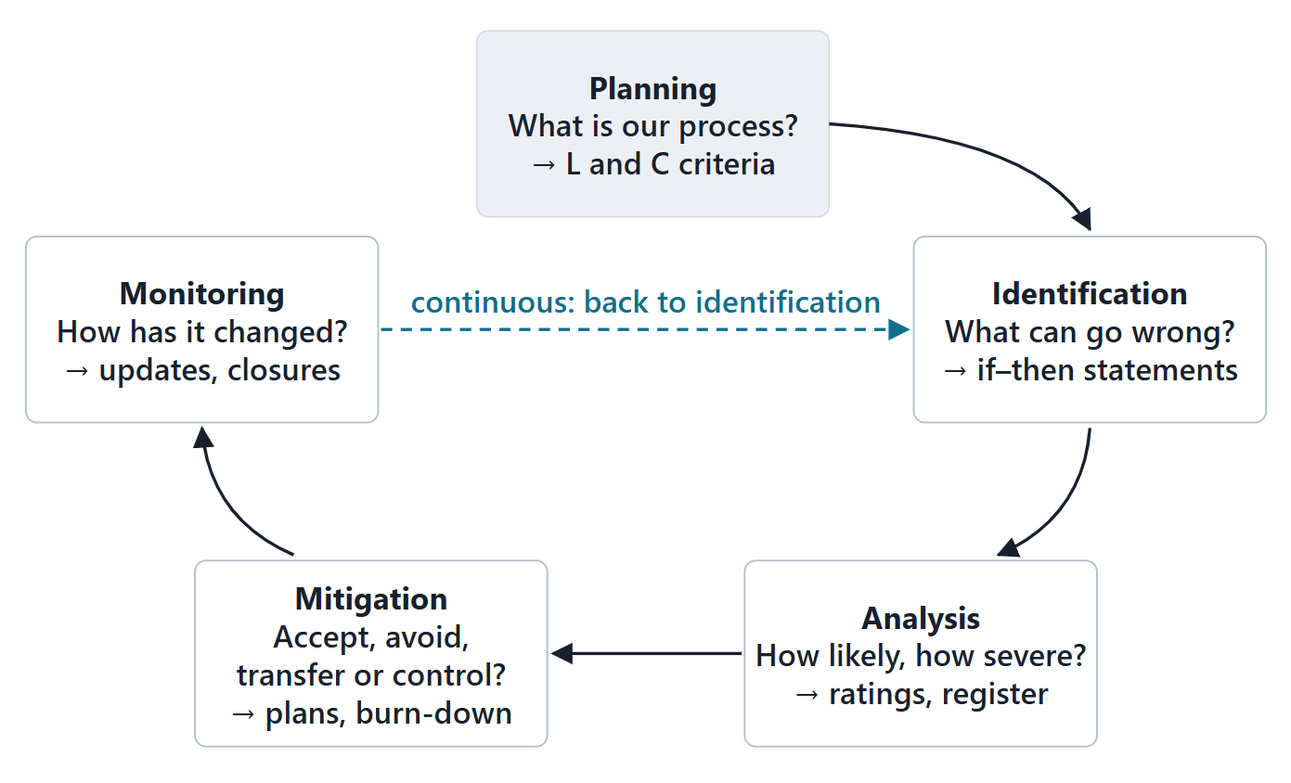
The risk process: five activities and what each produces
Planning: what is our process, and our scales?
Identification: what can go wrong?
Analysis: how likely, how severe?
Mitigation: accept, avoid, transfer or control?
Monitoring: how has the risk changed?
Figure. The risk process as a loop: each activity answers one question and produces something the next one uses.
Sources: R17 p.482; R46 p.124; R46 p.125

Slide 11
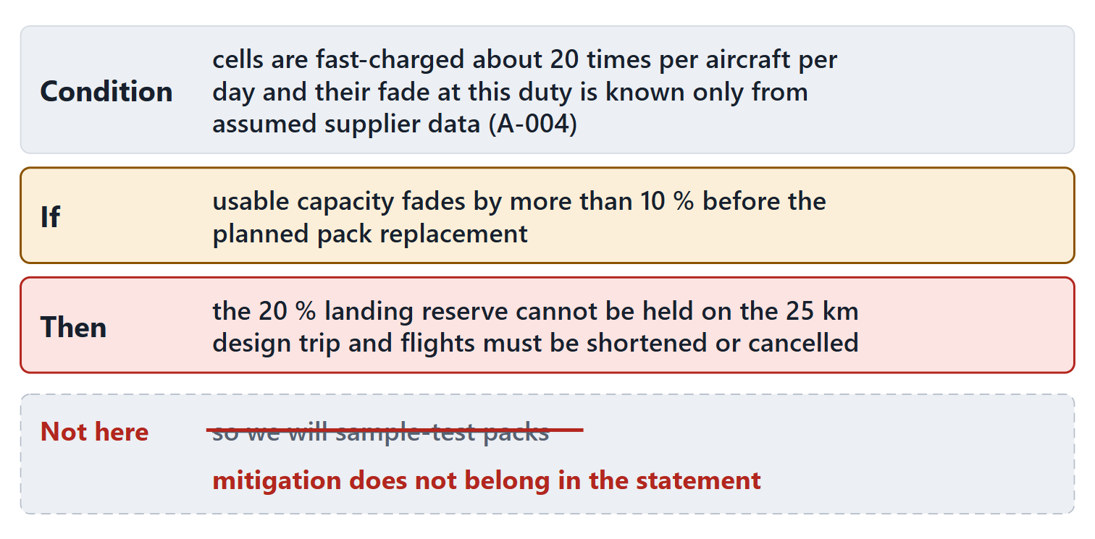
Writing a risk: condition, if, then
Condition: what is known today, the root cause
If: the uncertain risk event
Then: the consequences if it occurs
Never write the mitigation into the statement
Figure. A risk in the condition–if–then form, with the most common defect struck out: a mitigation written into the statement.
Sources: R17 p.483; R46 p.125; R61a p.630; R61a p.631; R61a p.633

Slide 12
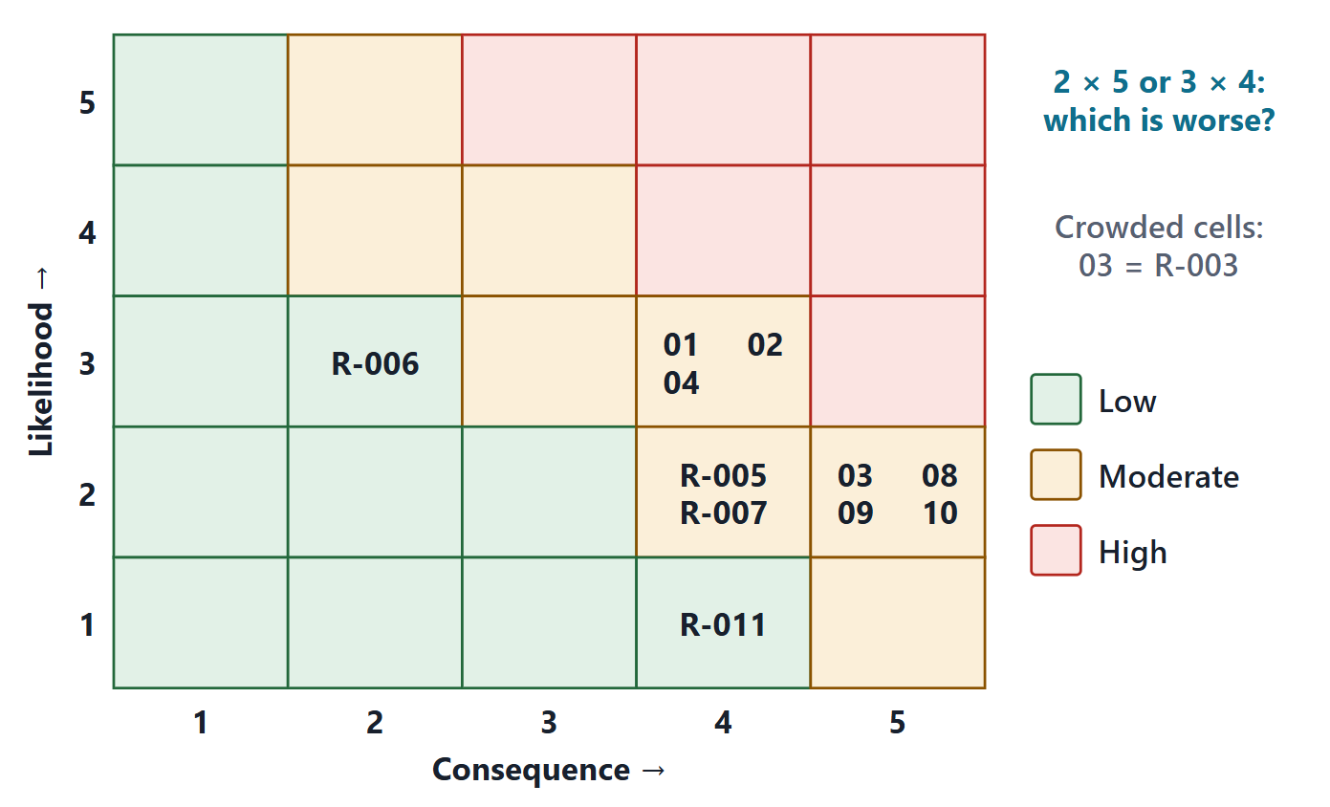
Rating risks: defined scales and the reporting matrix
Likelihood | Probability band
1 Not likely | > 1 % to ≤ 20 %
2 Low likelihood | > 20 % to ≤ 40 %
3 Likely | > 40 % to ≤ 60 %
4 Highly likely | > 60 % to ≤ 80 %
5 Near certainty | > 80 % to ≤ 99 %
Consequence: deviation from the performance, schedule or cost baseline, tailored to the program
Figure. The 5 × 5 reporting matrix with AeroLink’s 11 risks plotted by likelihood and consequence. Cell levels as in DoD Figure 4-9. (FICTIONAL ratings)
Sources: R17 p.483; R46 p.125; R46 p.126; R61b p.635; R61b p.637

Slide 13
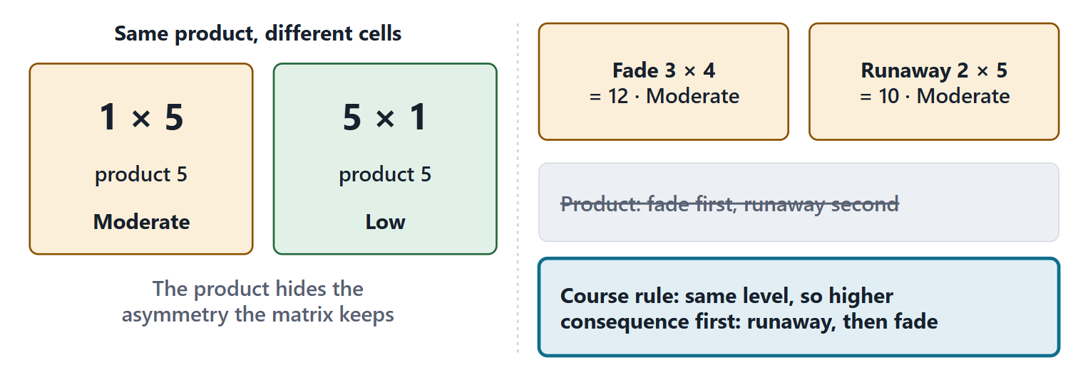
What the matrix cannot say: ordinal scales are not numbers
Same product: 1 × 5 = 5 × 1 = 5, but the cells differ
Wrong order: fade 3 × 4 = 12 outranks runaway 2 × 5 = 10
Course rule: rank by cell level, then consequence
Cardinal: multiply only measured quantities
Figure. The product of two ordinal ratings ranks a safety risk below a performance risk, and gives the same number to cells the matrix treats differently.
Sources: R17 p.483; R17 p.486; R61b p.636; R61b p.637

Slide 14
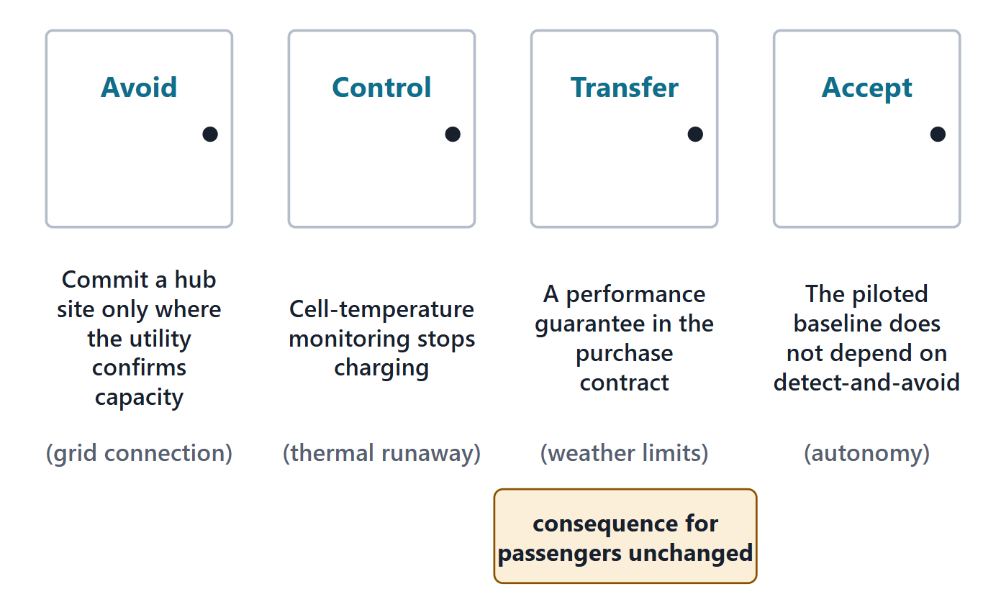
Handling options: evaluate all four before choosing
Avoid: change requirements or plans so the risk goes away
Control: reduce likelihood, consequence or both
Transfer: move accountability to a willing party
Accept: a deliberate, approved decision; then monitor
Evaluate all four; do not default to mitigation
Figure. Four handling options, each shown with one AeroLink risk. Transfer changes who pays, not what passengers experience.
Sources: R17 p.484; R17 p.485; R46 p.126; R61c p.642; R61c p.644

Slide 15
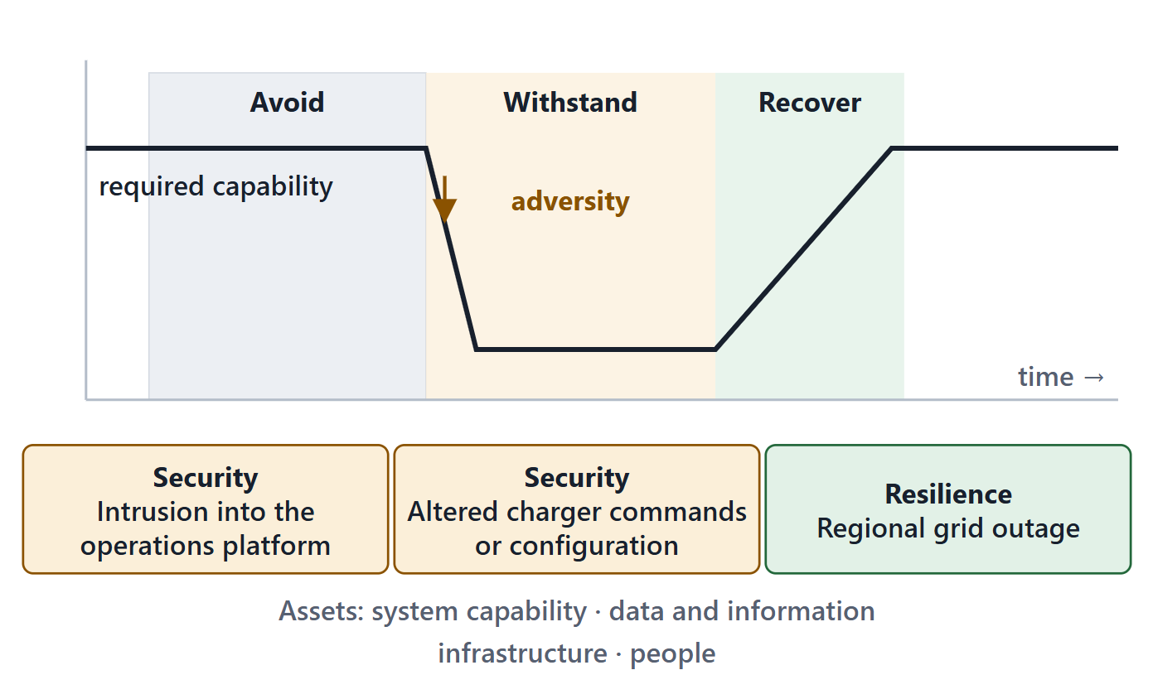
Security and resilience risks belong in the same register
Resilience: provide required capability when facing adversity
Objectives: avoid, withstand, recover
Security: freedom from conditions that lead to loss of assets
Adversity includes attacks, faults and outages
Plan risk management to take these risks
Figure. Adversity, whether attack, fault or outage, degrades capability. Resilience aims to avoid, withstand and recover; security limits loss of assets.
Sources: R24 p.1203; R24 p.1204; R24 p.1208; R25 p.1229; R25 p.1231; R39q p.1610

Slide 16
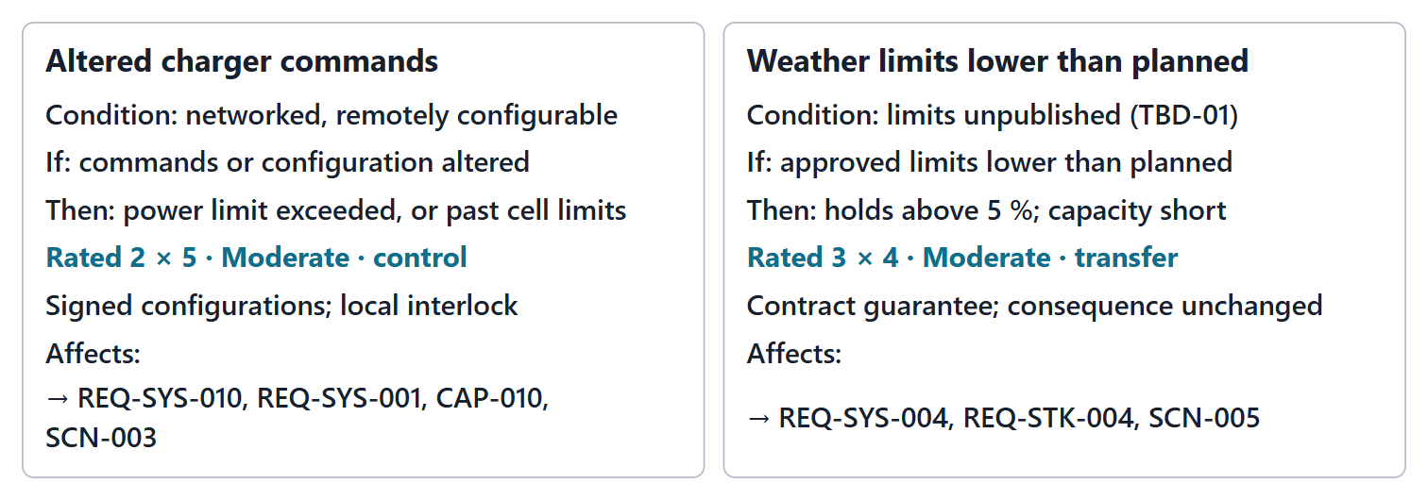
Worked example II: writing, rating and handling two risks
Write: condition, if, then; no treatment inside
Rate: likelihood and consequence, each with a reason
Handle: compare all four options; owner, treatment, trigger
Link: to the requirements and scenarios it threatens
Figure. Two register entries expanded: the condition–if–then parts, the ratings with reasons, the handling, and the requirements each threatens. (FICTIONAL)
Sources: R61a p.630; R17 p.484; R46 p.126; R24 p.1206; R25 p.1231

Slide 17
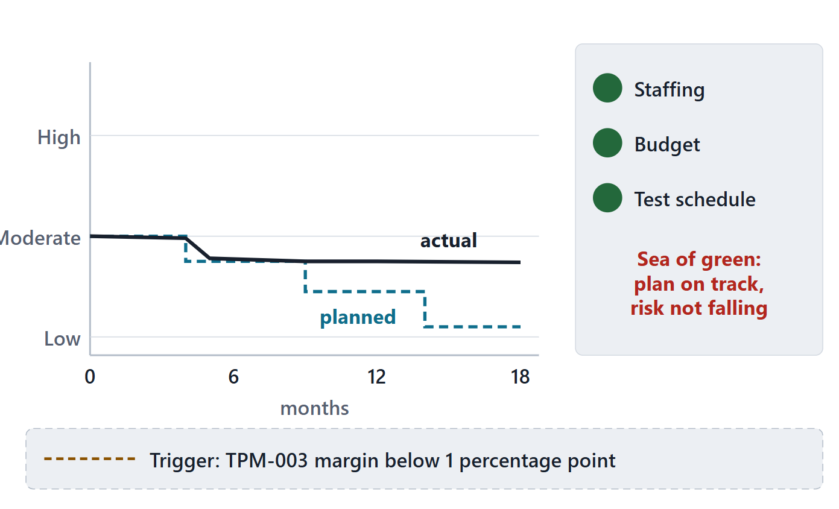
Monitoring, triggers and the pitfalls to avoid
Monitor with metrics, including TPMs, against a burn-down
Sea of green: track the risk, not the plan
Done only for reviews → keep the register continuous
Automatic mitigation → evaluate all four options
Band-aid treatment → address the root cause
Figure. A burn-down for battery fade: planned and actual risk level over time, the trigger on its TPM, and the “sea of green” trap.
Sources: R17 p.484; R17 p.485; R17 p.486; R46 p.127

Slide 18
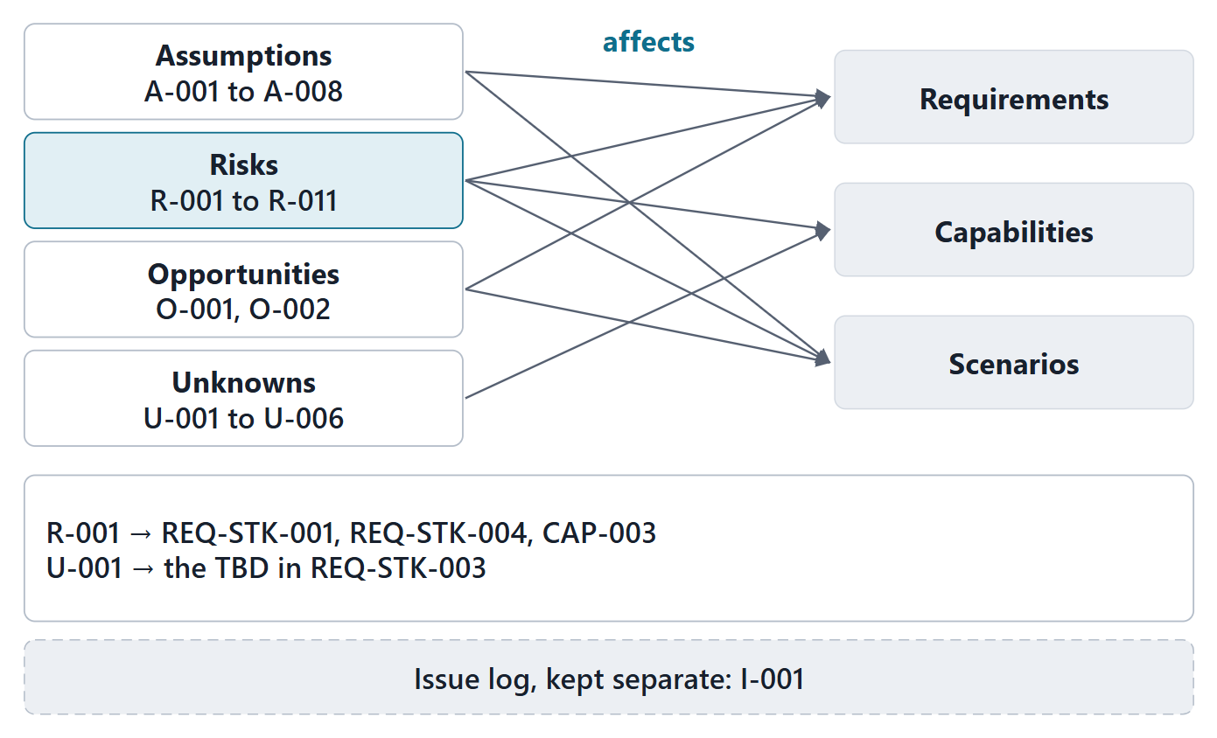
Worked example III: the register, linked to the package
Every entry affects named requirements, capabilities or scenarios
Each Week 2 TBD or TBR links to an unknown
Issues kept in a separate log
Owners and triggers make the register actionable
Figure. AeroLink’s register entries on the left, the Week 2 artifacts they affect on the right. Unknowns link to the TBDs of the requirements. (FICTIONAL)
Sources: R13 p.565; R17 p.483

Slide 19
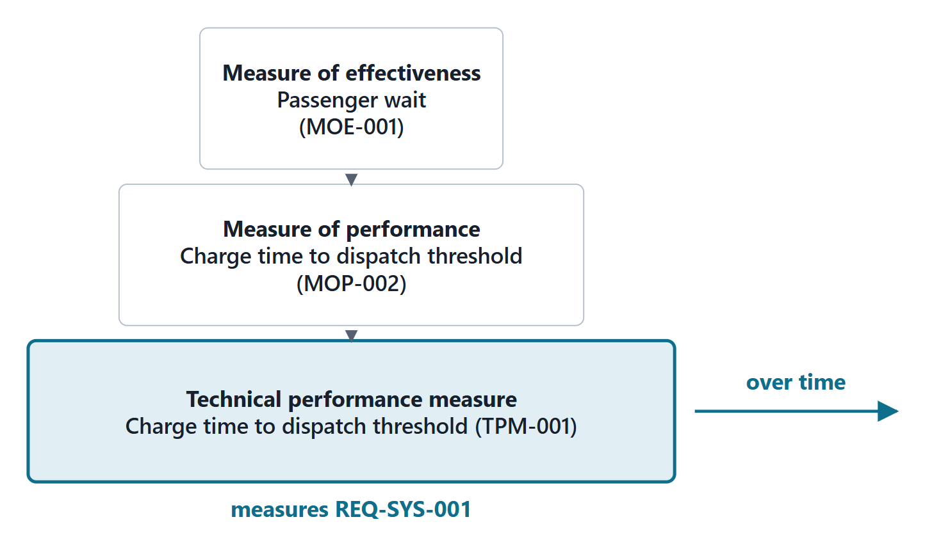
From MOE and MOP to TPM
TPMs: measures collected over time to see trends and forecast progress to plan
Estimated early from models; replaced by demonstrated data
Leading indicators of deficiencies and risk
Good TPM: quantifiable, routine, planned profile, tied to a risk
Figure. The measures hierarchy with the TPM level added: a TPM tracks, over development, a design parameter behind an MOP.
Sources: R15 p.532; R44 p.113; R44 p.116

Slide 20
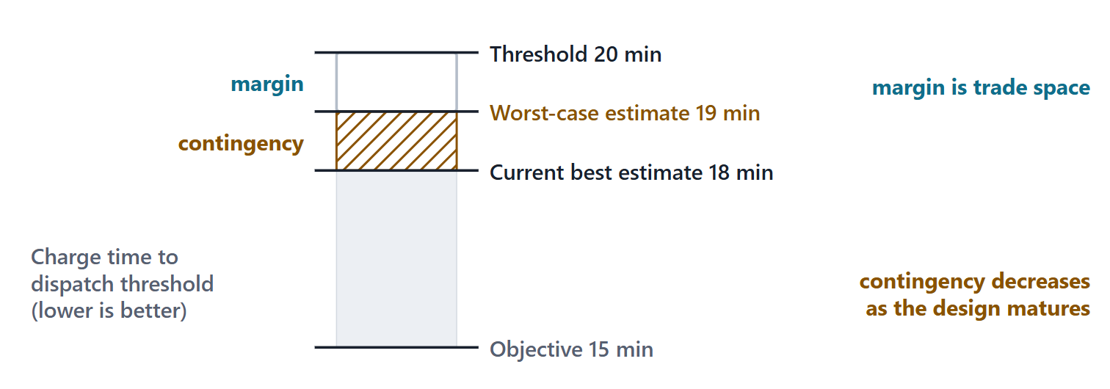
Current estimate, contingency, worst case and margin
WCE = CBE + contingency margin = threshold − WCE
CBE = current best estimate contingency = allowance for uncertainty; shrinks as the design matures margin = growth still possible within the threshold
NOTE
Higher-is-better: subtract contingency, and margin = WCE − threshold.
Figure. For a lower-is-better TPM: the current best estimate, plus contingency to the worst case, then margin up to the threshold. The objective lies below.
Sources: R44 p.117

Slide 21
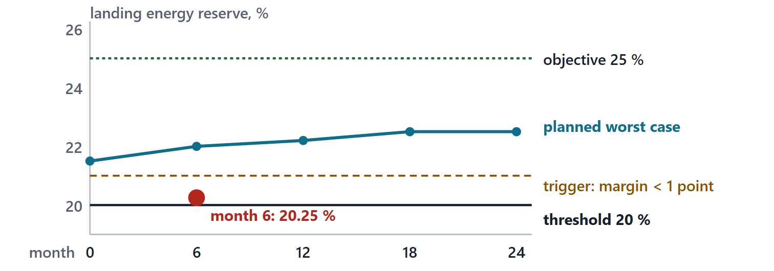
Worked example IV: AeroLink’s TPMs, margins and planned profile
TPM | CBE | Cont. | WCE | Margin
Charge time to dispatch threshold (min) | 18 | 1.0 | 19 | 1.0
Pad-edge noise (dBA) | 63.5 | 1.0 | 64.5 | 0.5
Landing energy reserve on the design trip (%) | 23 | 1.5 | 21.5 | 1.5
Figure. Landing energy reserve: planned worst case at five reviews against the 20 % threshold, and a hypothetical month-6 reading that crosses the trigger. (FICTIONAL)
Sources: R44 p.116; R44 p.117
Compute: worst case and margin
Read: the planned profile

Slide 22
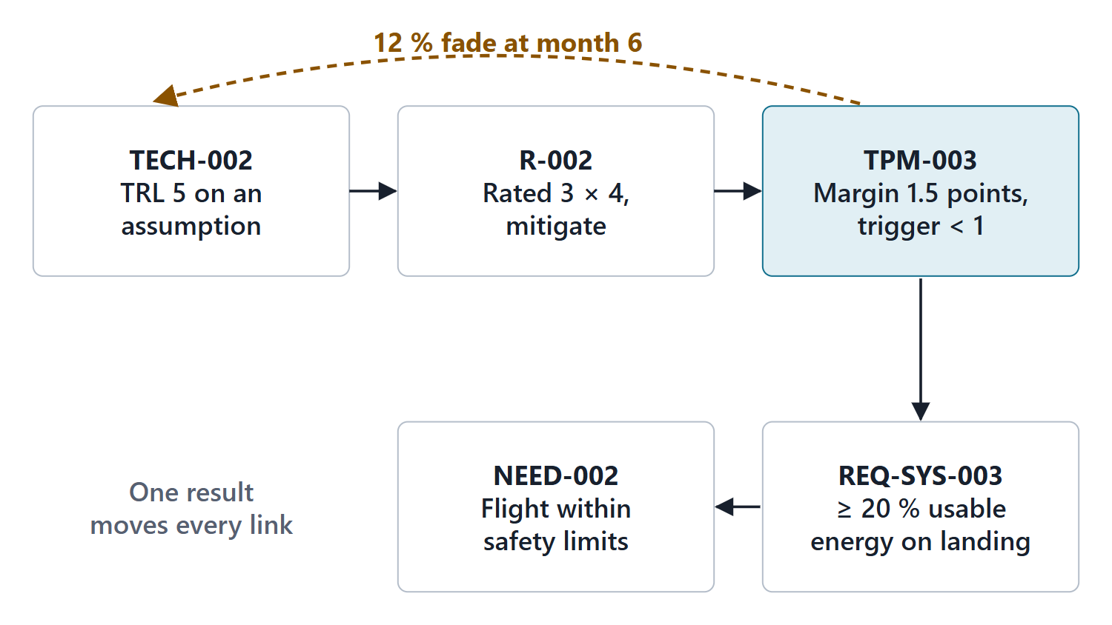
One chain through all three instruments
Technology → risk → TPM → requirement → need
12 % fade: reserve 21.25 %, margin 0.25: trigger fires
15 % fade: reserve 18.5 %, below the threshold
One result changes the whole chain
Figure. Battery cells (TRL 5) → capacity fade risk → landing-energy TPM → planned landing reserve → assurance of flight within safety limits. A test result propagates along the chain. (FICTIONAL)
Sources: R44 p.113; R17 p.484

Slide 23
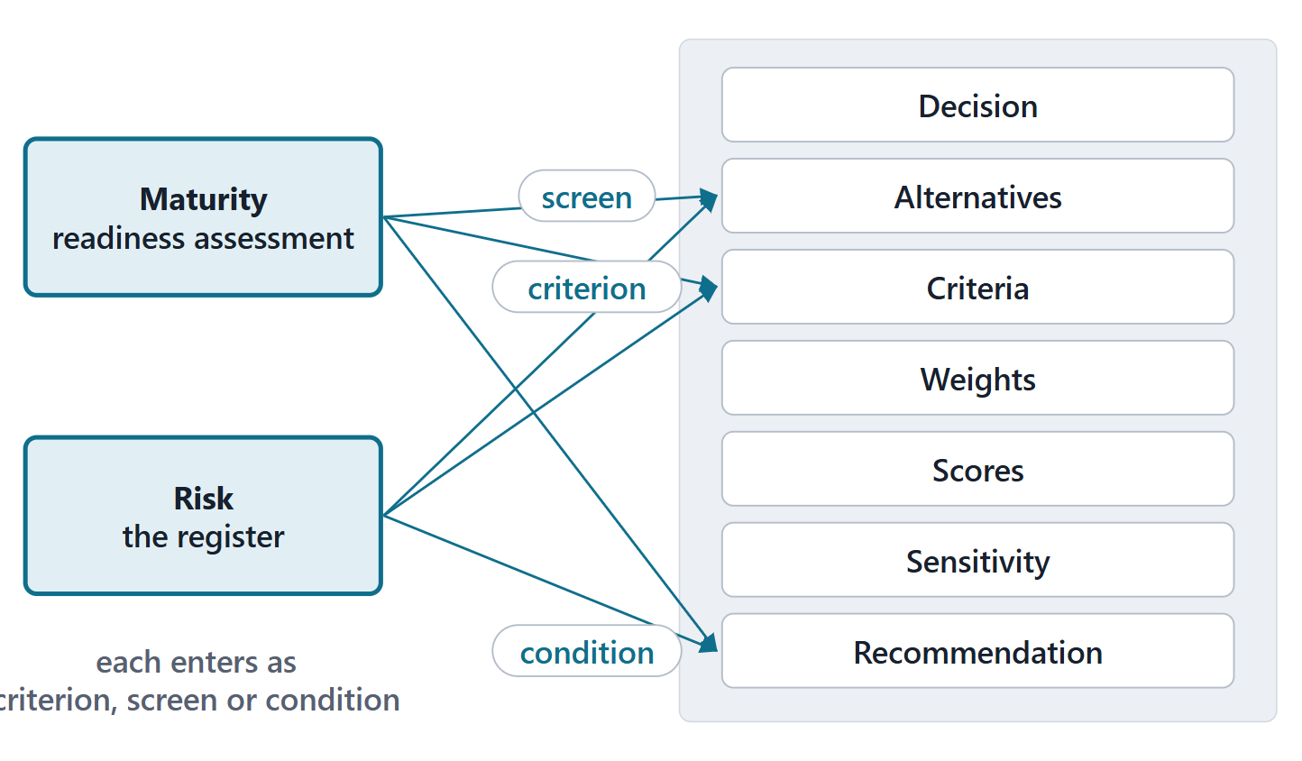
What Session 2 needs from today
Identify uncertainty and assess risk for each decision
Maturity and risk enter as criteria, screens or conditions
Resilience can be a criterion; security a must-meet screen
Bring your enterprise’s technologies and one decision
Figure. A trade study frame with two sockets highlighted: maturity and risk enter as criteria, as must-meet screens, or as conditions on the decision.
Sources: R18 p.464; R24 p.1208

Slide 24
Exit: retrieval and preparation
ONE-MINUTE PAPER
Rewrite as condition–if–then: “The new app might be late.”
Each member: two technologies your enterprise depends on, a first TRL and its basis
One decision your team will soon face
Read the trade-study pages listed on the week page

Slide 25
References and credits
R13 · SEBoK v2.14 (2026), “System Requirements Definition”, p.565
R15 · SEBoK v2.14 (2026), “Measurement”, p.532
R16 · SEBoK v2.14 (2026), “Product Systems Engineering Special Activities”, p.766–768
R17 · SEBoK v2.14 (2026), “Risk Management”, p.481–486
R18 · SEBoK v2.14 (2026), “Decision Management”, p.463–474
R24 · SEBoK v2.14 (2026), “System Resilience”, p.1203–1204, 1206, 1208–1209
R25 · SEBoK v2.14 (2026), “System Security”, p.1229, 1231–1232
R39q · SEBoK v2.14 (2026), “Risk (glossary)”, p.1610
R39r · SEBoK v2.14 (2026), “Opportunity (glossary)”, p.1582
R39s · SEBoK v2.14 (2026), “Uncertainty (glossary)”, p.1668
R44 · OUSD(R&E) Systems Engineering Guidebook (2021/2022), “Technical Assessment Process”, p.112–114, 116–117
R46 · OUSD(R&E) Systems Engineering Guidebook (2021/2022), “Risk Management Process”, p.124–127
R60 · The MITRE Systems Engineering Guide (2014), “Assessing Technical Maturity”, p.524–526
R61a · The MITRE Systems Engineering Guide (2014), “Risk Identification”, p.630–631, 633
R61b · The MITRE Systems Engineering Guide (2014), “Risk Impact Assessment and Prioritization”, p.635–637
R61c · The MITRE Systems Engineering Guide (2014), “Risk Mitigation Planning, Implementation, and Progress Monitoring”, p.642, 644
CREDITS AND LICENSES
SEBoK v2.14: “This material is used under a Creative Commons Attribution-NonCommercial ShareAlike 3.0 Unported License from The Trustees of the Stevens Institute of Technology.” (SEBoK, “Bkcase Wiki:Copyright”, PDF p.31). Quotations are short and cited; no SEBoK figure or table is reproduced.
OUSD(R&E) Systems Engineering Guidebook: Distribution Statement A. Approved for public release. Distribution is unlimited.
The MITRE Systems Engineering Guide: © 2014 by The MITRE Corporation. All rights reserved. Approved for public release; distribution unlimited (Case Numbers 10-4072 and 12-1089). Quoted briefly with attribution.
Figures are original drawings for this course; none redraws a figure from the sources.
AeroLink Urban Mobility is a fictional teaching case: every number, name and statement about it is a teaching value.

