Slide 1
WEEK 4 · SESSION 1
Architecture / Information View
Session 1: Views, functions and allocation
Today: architecture and its description, functions, allocation
Session 2: the information view, evaluation and the Lab L4 launch
Your Team Record grows: views, functions, allocation, information view

Slide 2
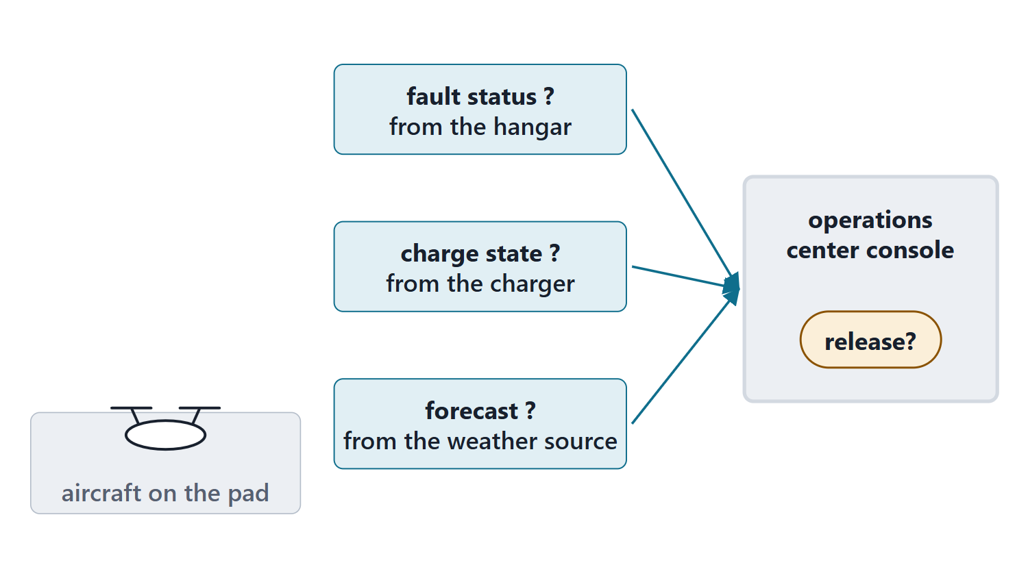
The driving question: who decides that an aircraft may fly?
SCENARIO (FICTIONAL)
An AeroLink aircraft is ready on a hub pad. A passenger party is boarding.
Who makes the release decision?
Where is the fault status, the charge state and the forecast produced?
What carries each one to the decision?
Figure. Three pieces of information an AeroLink dispatch decision needs, each produced somewhere else. (FICTIONAL)

Slide 3
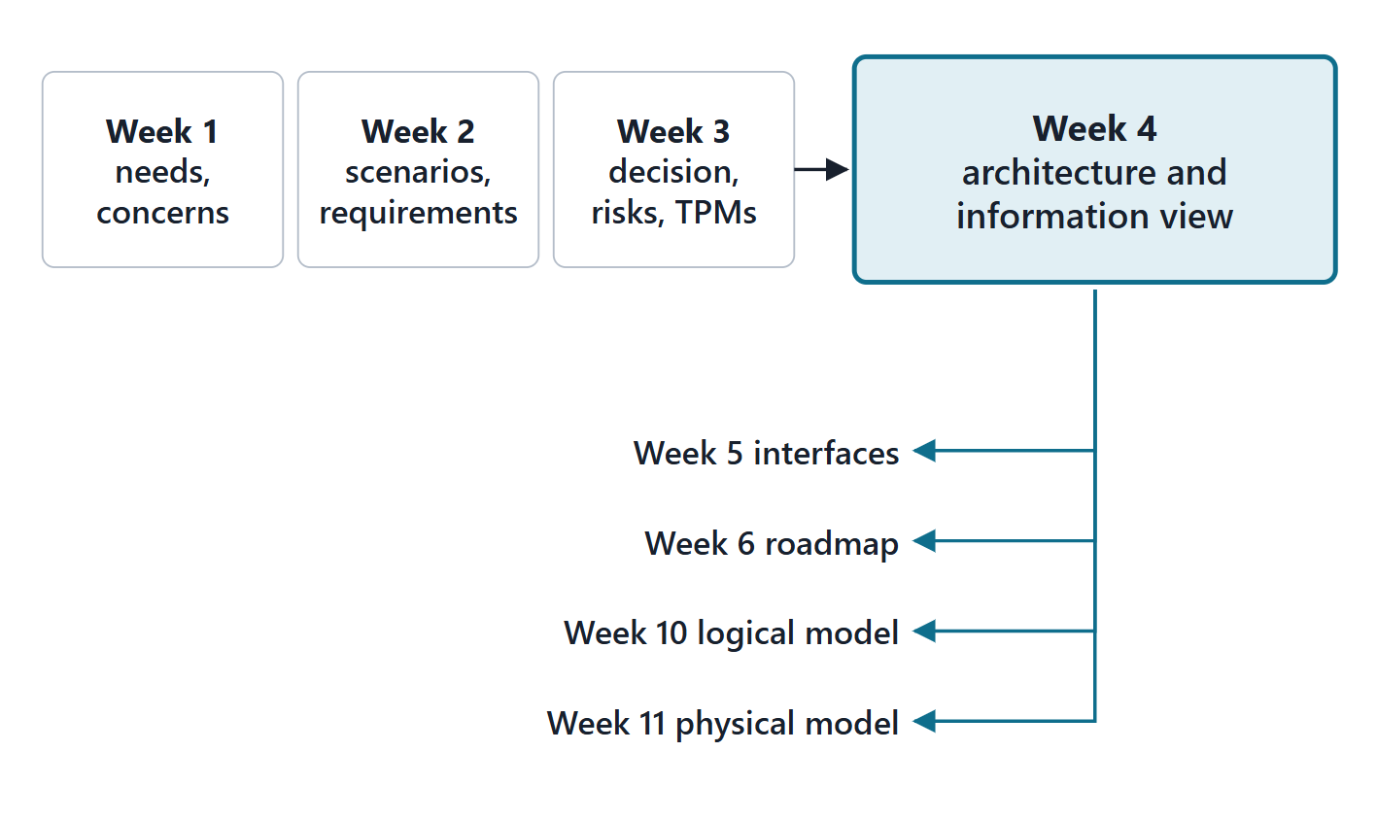
Where Week 4 sits: from requirements to the first how
In: concerns, needs, scenarios, capabilities, requirements
In: the Week 3 decision, risks and TPMs
Requirements form the basis of architecture
Out: Week 5 interfaces, Week 6 roadmap, Weeks 10–11 models
Figure. Week 4 takes the needs, requirements, scenarios and the trade decision, and feeds the interfaces, the roadmap and the Phase II models.
Sources: R13 p.557; R13 p.561

Slide 4
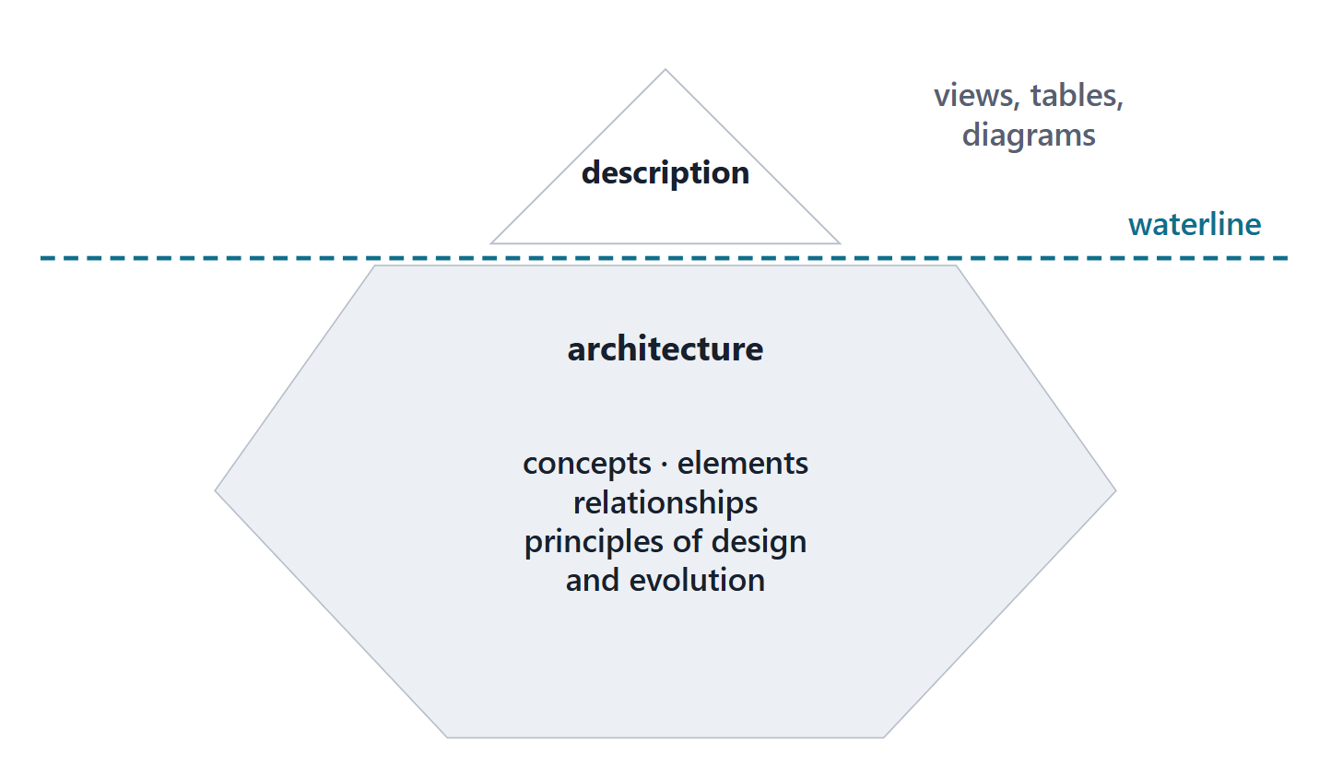
What an architecture is
ARCHITECTURE
Fundamental concepts or properties of a system in its environment embodied in its elements, relationships, and in the principles of its design and evolution
R39t · SEBoK v2.14 (2026), "Architecture (glossary)", p.1445
Conceptual; realized through a description
A description justifies what it includes and excludes
Figure. The description is what can be seen and reviewed; the architecture is the conception it describes.
Sources: R39t p.1445; R19 p.569

Slide 5
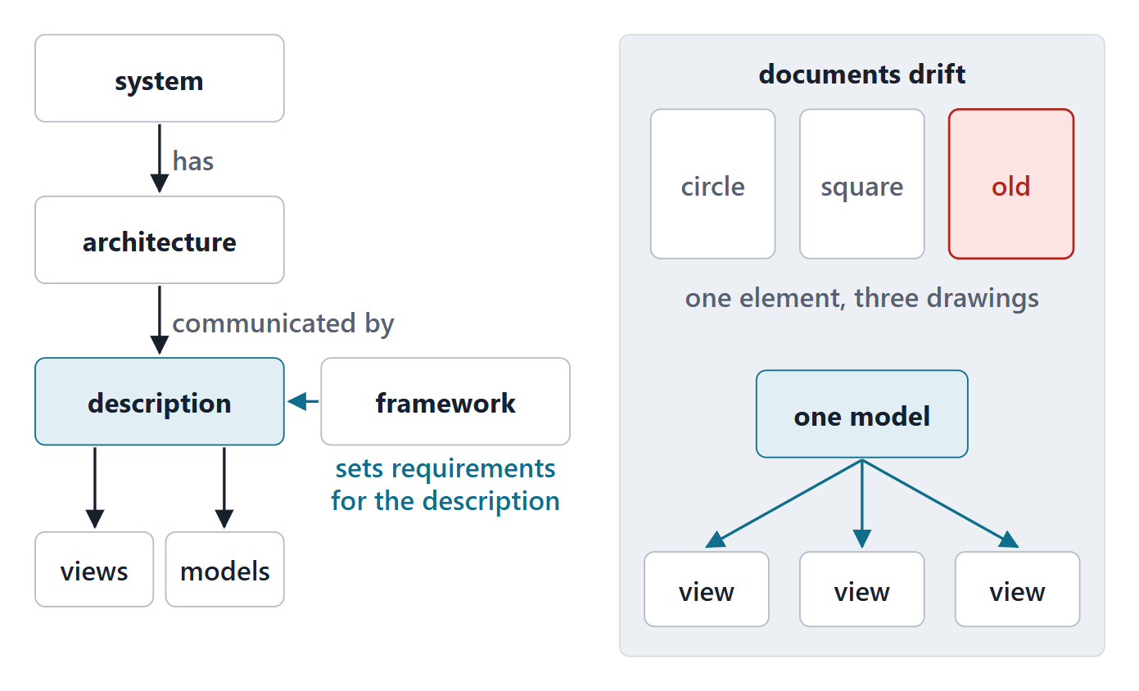
How a description is organized, and why documents drift
A description consists of views and models
A framework sets requirements for the description
Separate documents need manual synchronization
A model can be one authoritative source of truth
Figure. A system has an architecture; a description communicates it through views and models; a framework sets requirements for the description.
Sources: R62 p.342; R19 p.569; R19 p.570; R20a p.582

Slide 6
Framework, model, view, viewpoint: the words, and a gap
Term | MITRE | SEBoK glossary
Framework | Minimum practices and requirements for artifacts | Conventions and practices for describing architectures
View | Partial expression from a perspective | Representation from a viewpoint’s perspective
Viewpoint | Representations covering a stakeholder’s issues | Rules for constructing a view for stakeholder concerns
Paraphrased; the source wording is in the notes and the lesson.
Sources: R62 p.341; R39u p.1446; R39v p.1677; R39w p.1678; R20b p.593

Slide 7
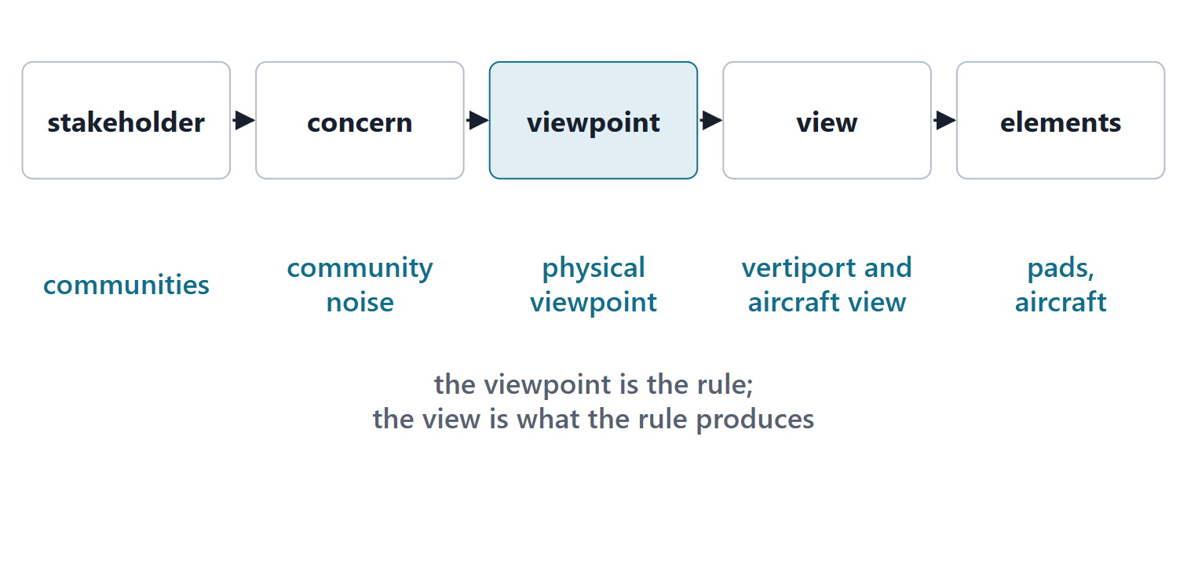
Choosing views: purpose is paramount
Views directly relevant to stakeholders’ concerns
Generate only the views the purpose needs
Each view helps a stakeholder conclude objectives will be met
Course minimum: operational, functional, physical, information, enterprise
Figure. From a stakeholder to the model elements a view shows, with one AeroLink example at every link. (FICTIONAL)
Sources: R62 p.342; R62 p.344; R04 p.275; R19 p.573

Slide 8
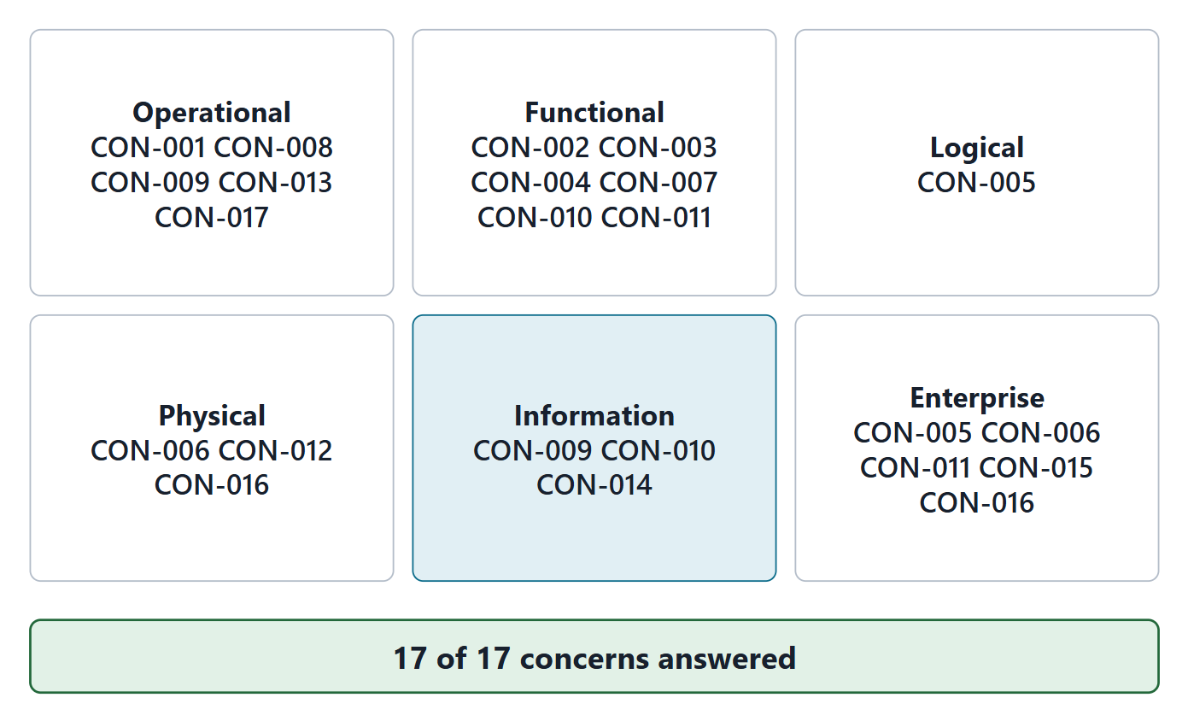
AeroLink’s view set, chosen from concerns
6 viewpoints, each with a question
17 of 17 Week 1 concerns answered
Logical view added: supplier choice stays open
Drop the information view: one concern left without one
Figure. Six viewpoints answer all 17 Week 1 concerns; each states its purpose as a question. (FICTIONAL)
Sources: R62 p.344

Slide 9
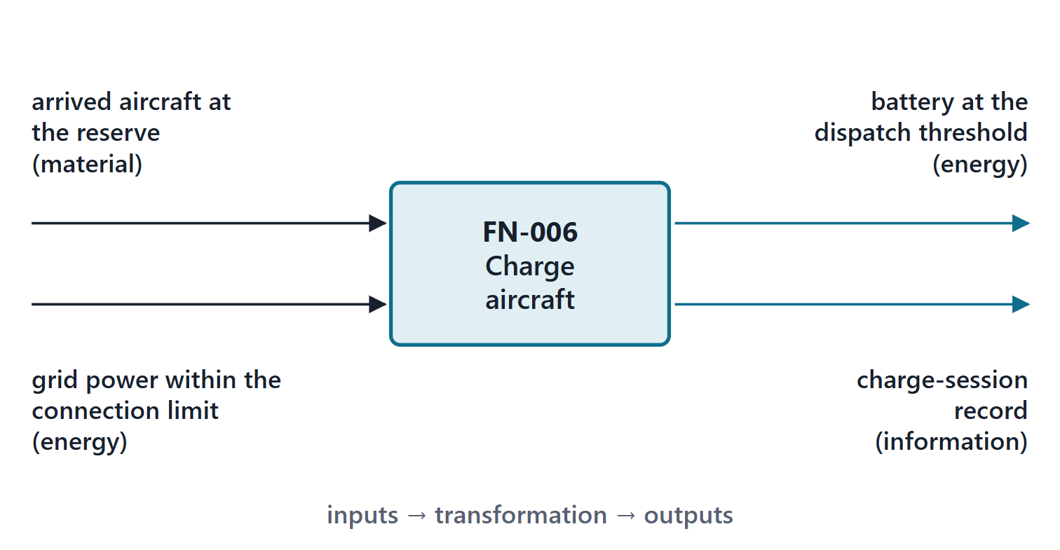
What a function is
FUNCTION
A function is defined by the transformation of input flows to output flows, with defined performance
R39x · SEBoK v2.14 (2026), "Function (glossary)", p.1510
Flows: data, materials or energy
Name: verb + object, never an element
Figure. FN-006 Charge aircraft: inputs on the left, outputs on the right, each tagged information, energy or material. (FICTIONAL)
Sources: R39x p.1510; R20b p.587; R20a p.580

Slide 10
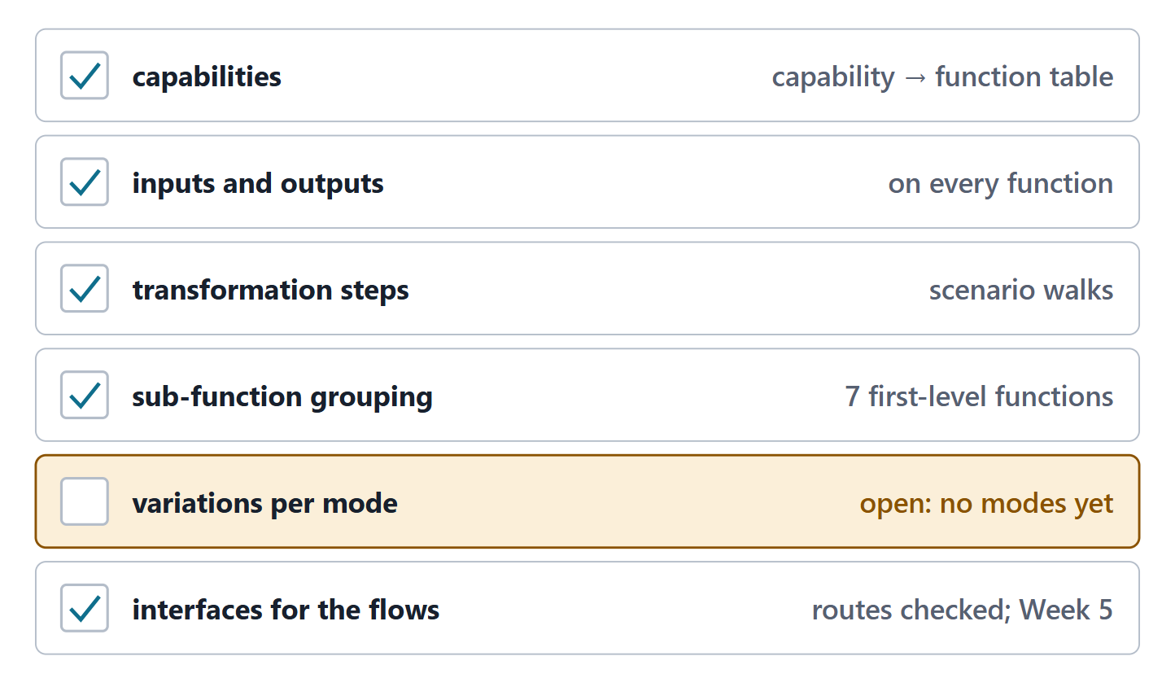
What a functional view must contain
Capabilities; inputs and outputs; transformation steps
Grouping into sub-functions
Variations per mode; interfaces carrying the flows
Functional: input–output; behavioral: sequence and control
Figure. SEBoK’s six minimum contents of a functional view, with the AeroLink item that meets each; modes are an open row. (FICTIONAL)
Sources: R20a p.581; R20b p.587

Slide 11
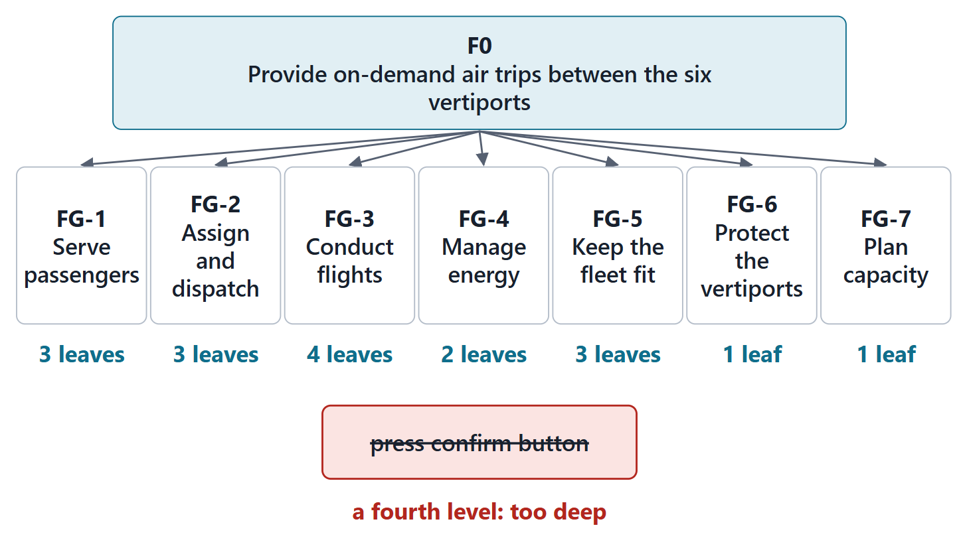
Decomposition: how deep, and in which order
From the mission (one black box) down to leaves
Stop where a physical solution is known or imaginable
Built over iterations, not one top-down pass
Pitfalls: too deep; no scenarios; no inputs and outputs
Figure. AeroLink’s three-level decomposition: the mission function, 7 first-level functions, 17 leaves; a fourth level is marked too deep. (FICTIONAL)
Sources: R20b p.587; R20b p.594; R20c p.597

Slide 12
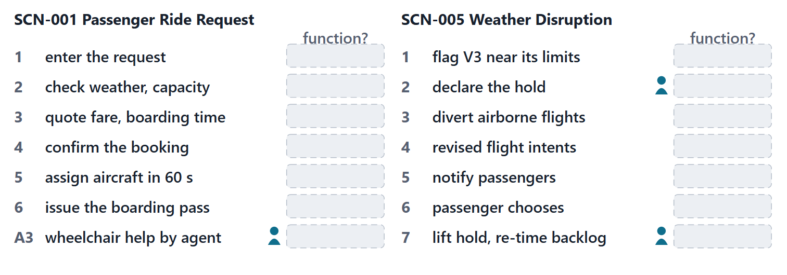
Worked example I: walking two scenarios to find functions
Walk: Read each step; ask which transformation it needs
Name: Verb + object, with inputs and outputs
Reuse: A step served by an existing function adds no function
Expose: A step no function serves is a new function or a gap
Figure. The two scenarios as a worksheet: each step with an empty box for the function the class names; a person marks a step where a human decides. The answers are in the notes and the lesson. (FICTIONAL)
Sources: R20b p.594; R48c p.145

Slide 13
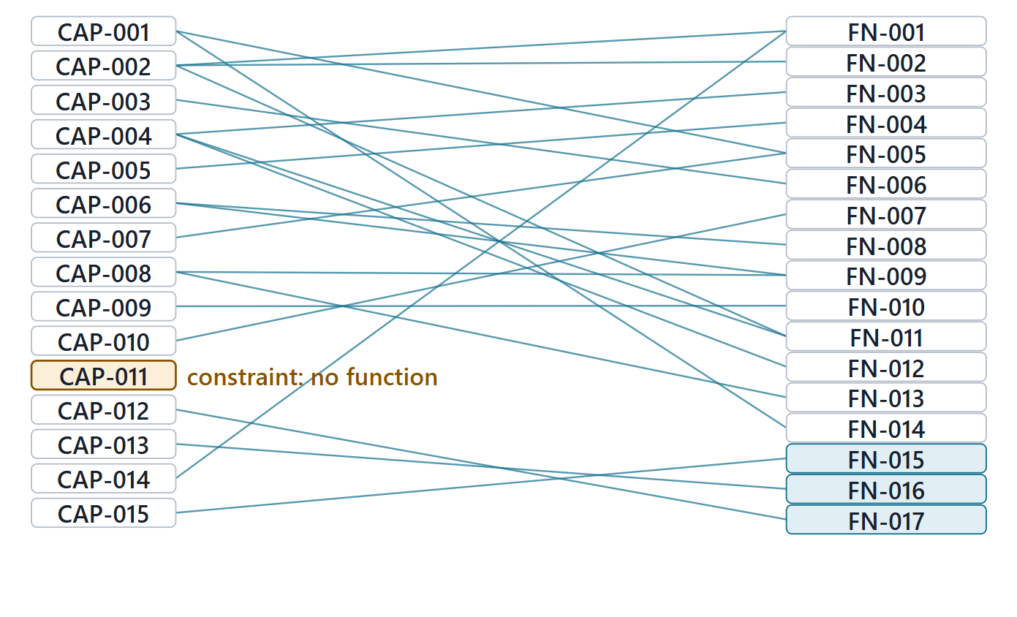
Functions from capabilities: the coverage check
14 of 15 capabilities served by a function
CAP-011 is a constraint: a disposition, not a function
12 of 12 system requirements allocated
FN-013 serves planning: no requirement, by reason
Figure. 15 capabilities on the left, 17 functions on the right; one capability has a disposition instead of a function. (FICTIONAL)
Sources: R20b p.592; R20c p.598; R48c p.146

Slide 14
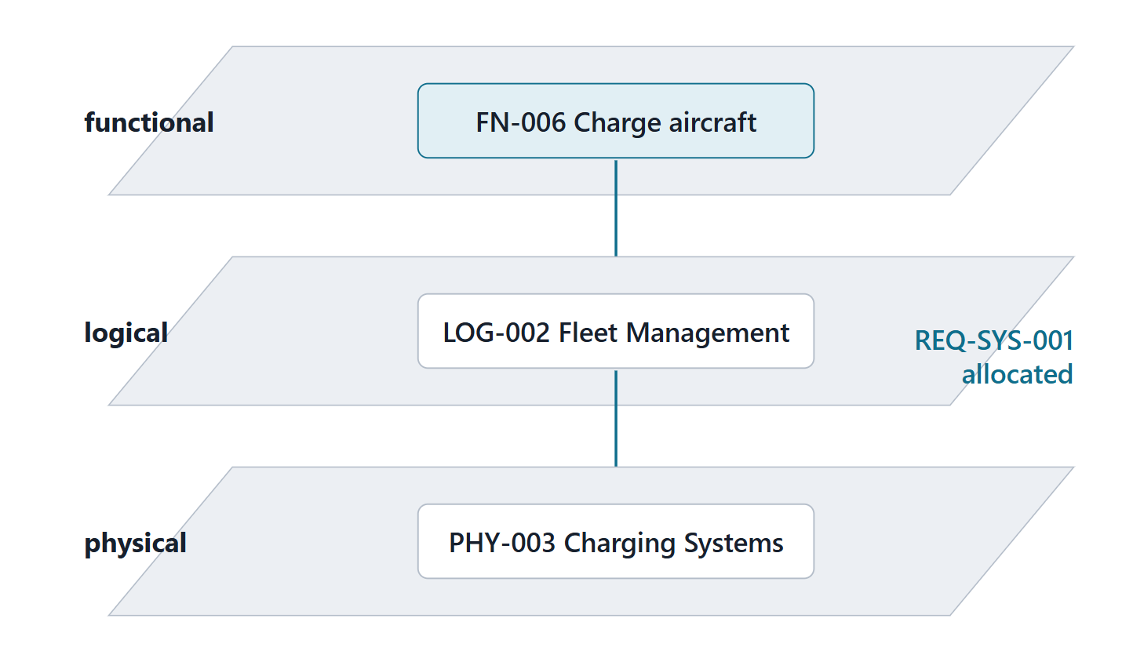
Logical and physical: two structural views
Logical: allocated functions, no specific implementation
Physical: the specific implementation of each logical element
Requirements are allocated to both
Elements include people, procedures and facilities
Figure. Three planes: FN-006 is performed by LOG-002 and allocated to PHY-003; requirements are allocated to both structural planes. (FICTIONAL)
Sources: R19 p.571; R20b p.587; R20c p.596; R20c p.597

Slide 15
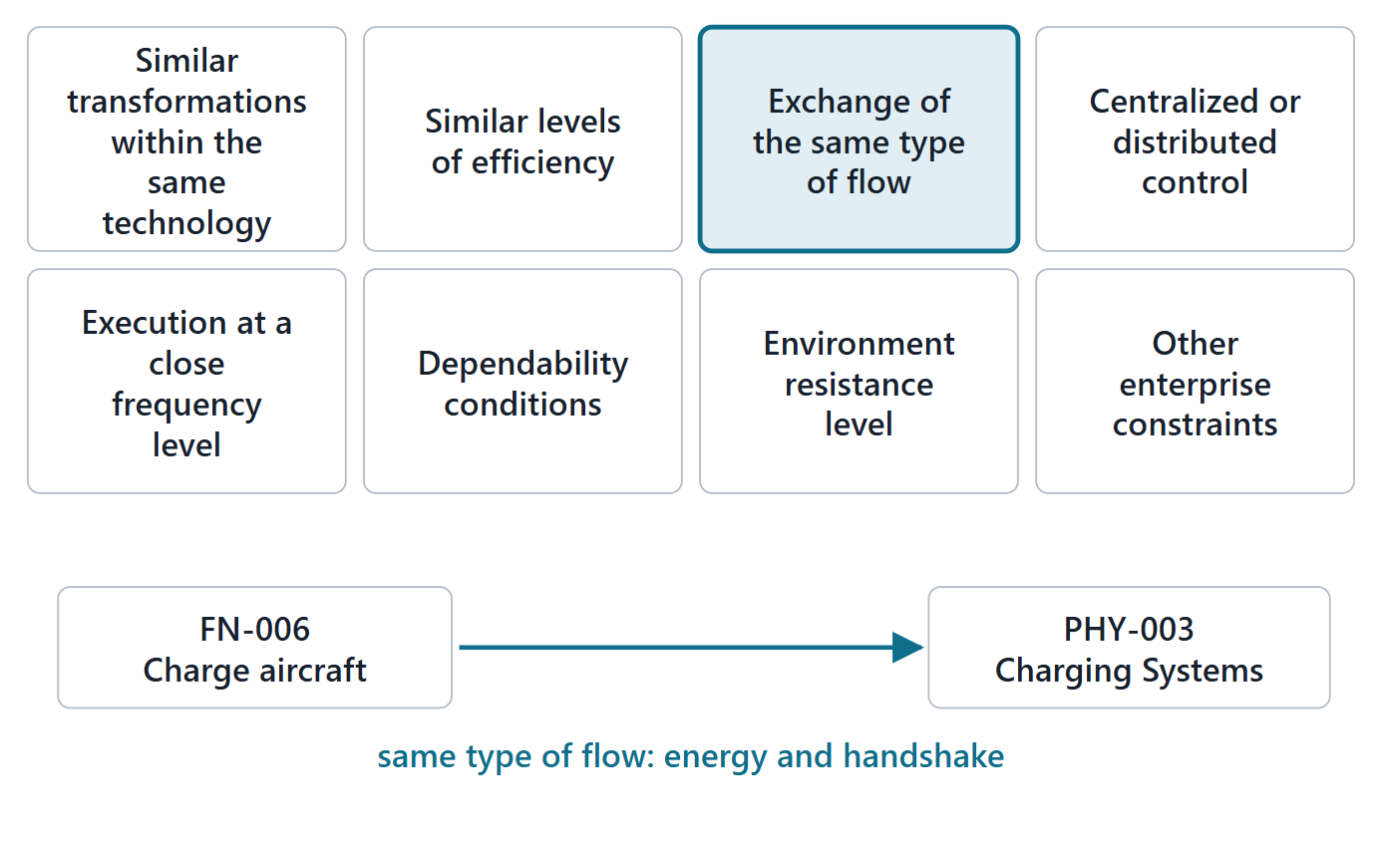
Allocation needs a reason: SEBoK’s criteria
Same transformation, efficiency, flow type
Central or distributed control; frequency
Dependability, environment, enterprise constraints
Course rule: one sentence per allocation, resting on an ID
Figure. Eight affinity criteria for grouping and allocating functions; one card is laid on an AeroLink allocation. (FICTIONAL)
Sources: R20c p.598; R20c p.599; R20c p.600

Slide 16
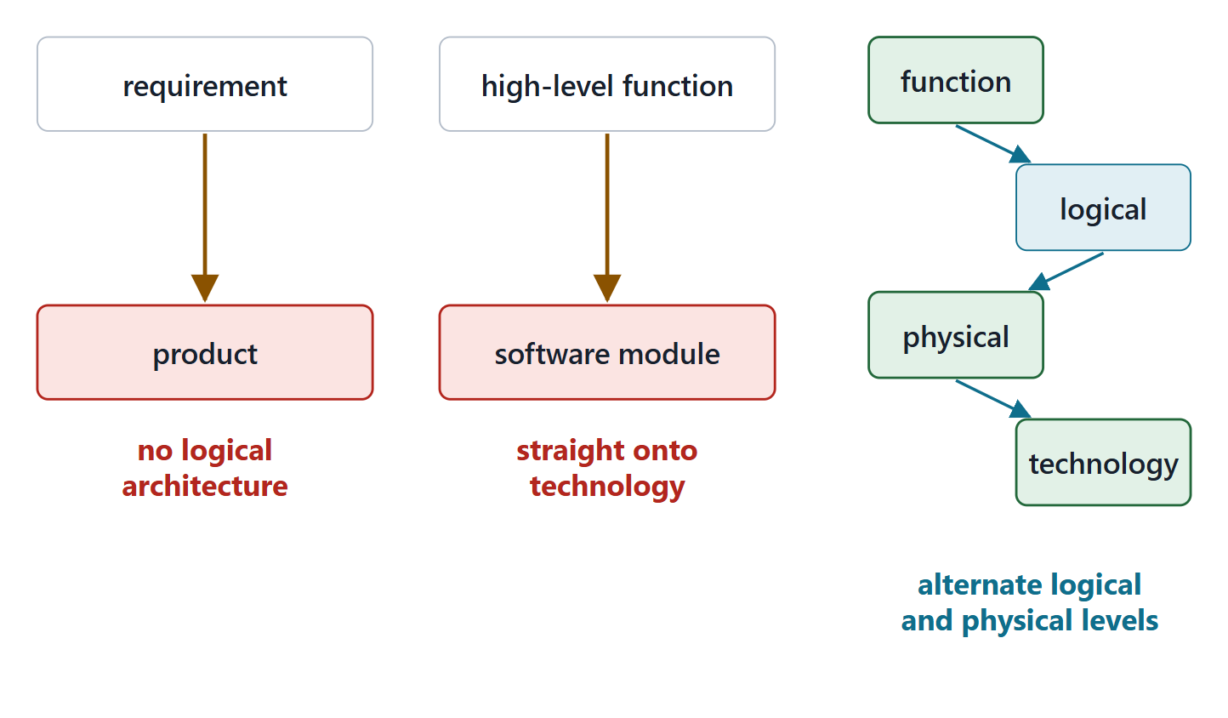
Two allocation pitfalls
Requirements straight to a product: no logical architecture
High-level functions straight onto technologies
Right: alternate logical and physical levels
Figure. Two wrong paths, requirement straight to a product and function straight to a technology, against the right path through a logical plane.
Sources: R20c p.602

Slide 17
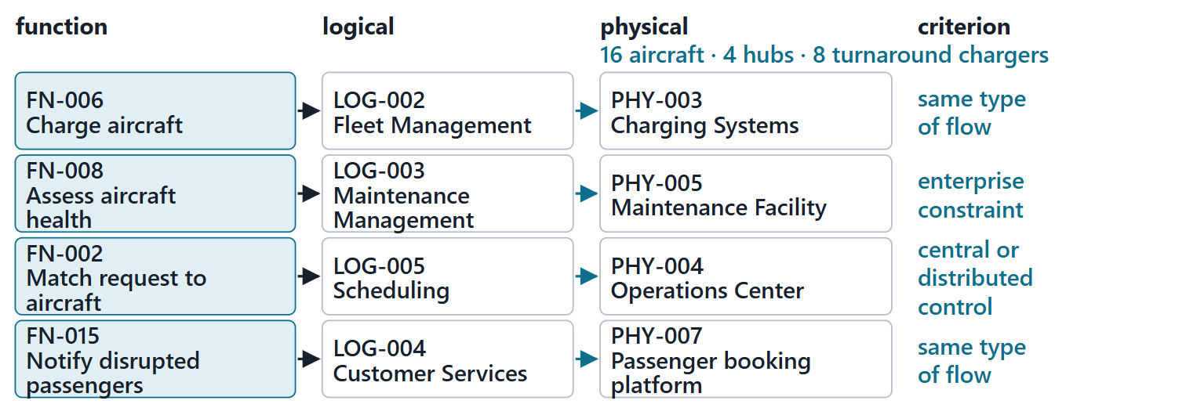
Worked example II: function → logical → physical, with the reason
Logical: Which technology-independent element performs it?
Physical: Which element implements that, in the Week 3 configuration?
Criterion: Name the affinity and the ID it rests on
Check: The physical element is one the logical element reaches
Figure. Four AeroLink allocations in three lanes, each arrow labeled with its criterion; the physical lane carries the Week 3 configuration. (FICTIONAL)
Sources: R20c p.598; R20c p.599; R48c p.145

Slide 18
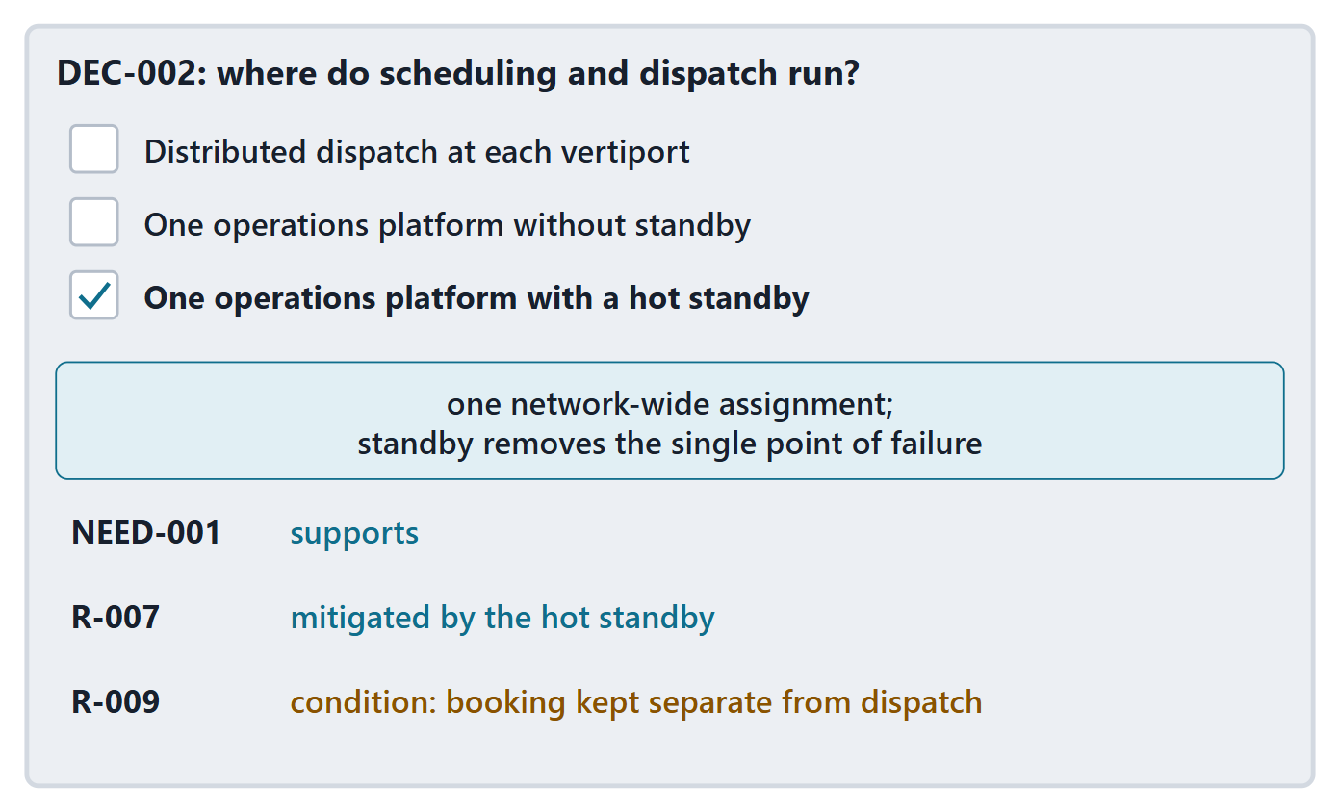
Recording an architecture decision
Question, alternatives, choice, rationale
Tested against the needs and risks it touches
Conditions and what would reverse it
Decisions create derived requirements
Figure. DEC-002: the question, three alternatives with the chosen one ticked, the rationale and the three tests. (FICTIONAL)
Sources: R48c p.146; R20b p.591

Slide 19
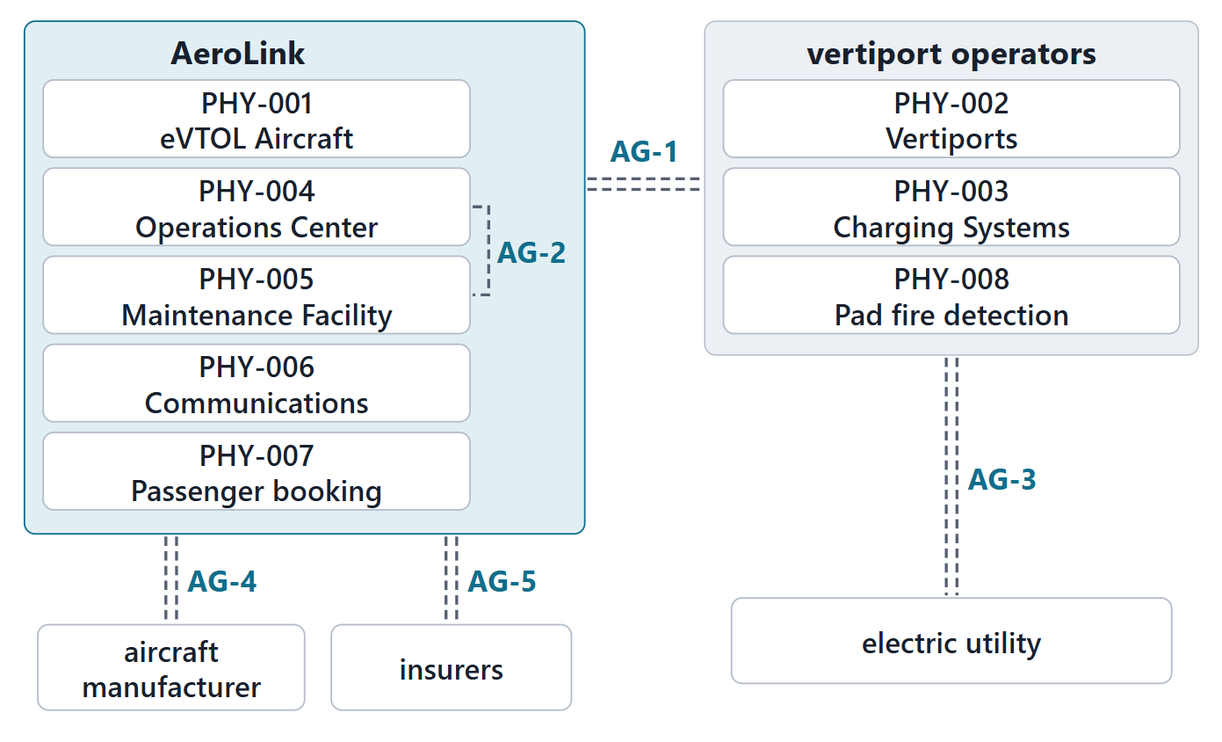
The enterprise view: owners and agreements
AeroLink owns 5; vertiport operators own 3
Agreements record duties; they carry no data
As-is and to-be views show migration paths
Enterprise elements: organizations, departments, teams
Figure. The physical elements tinted by owner, with the organizational agreements between owners. (FICTIONAL)
Sources: R62 p.345; R20c p.597

Slide 20
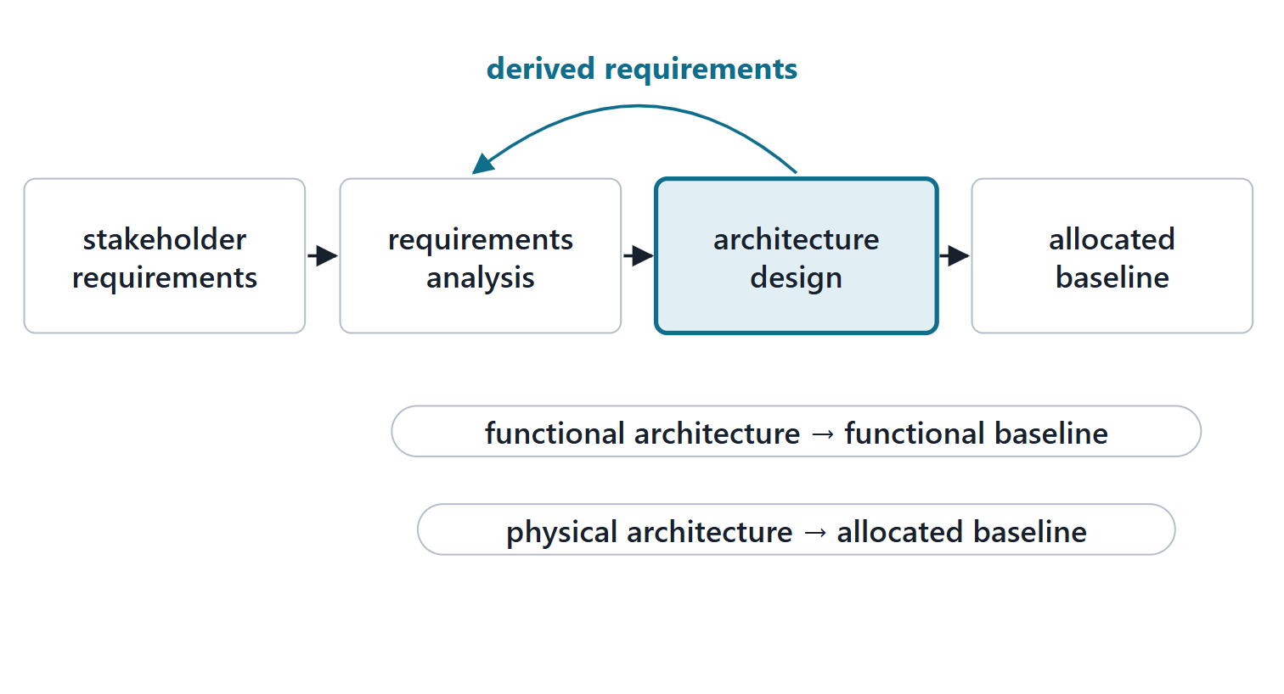
The process frame: the DoD Architecture Design process
Translates requirements into alternative design solutions
Functions allocated to hardware, software, facilities and people
Derived requirements come from solution decisions
Output: the allocated baseline
Figure. Stakeholder requirements and requirements analysis feed architecture design; its output is the allocated baseline, with derived requirements fed back.
Sources: R48c p.144; R48c p.145; R48c p.146

Slide 21
Exit: one function, one reason; preparation for Session 2
ONE-MINUTE PAPER
Name one function of your enterprise, verb and object, and the criterion you would use to allocate it.
Before Session 2 (about 15 min):
List three decisions your enterprise makes every day
For each: the information it needs, and where it comes from

Slide 22
References and credits
R04 · SEBoK v2.14 (2026), “Principles of Systems Thinking”, p.275
R13 · SEBoK v2.14 (2026), “System Requirements Definition”, p.557, 561
R19 · SEBoK v2.14 (2026), “System Architecture Design Definition”, p.569–571, 573
R20a · SEBoK v2.14 (2026), “Functional Architecture”, p.580–582
R20b · SEBoK v2.14 (2026), “Logical Architecture”, p.587, 591–594
R20c · SEBoK v2.14 (2026), “Physical Architecture”, p.596–600, 602
R39t · SEBoK v2.14 (2026), “Architecture (glossary)”, p.1445
R39u · SEBoK v2.14 (2026), “Architecture Framework (glossary)”, p.1446
R39v · SEBoK v2.14 (2026), “View (glossary)”, p.1677
R39w · SEBoK v2.14 (2026), “Viewpoint (glossary)”, p.1678
R39x · SEBoK v2.14 (2026), “Function (glossary)”, p.1510
R48c · OUSD(R&E) Systems Engineering Guidebook (2021/2022), “Architecture Design Process”, p.144–146
R62 · The MITRE Systems Engineering Guide (2014), “Architectural Frameworks, Models, and Views”, p.341–342, 344–346
CREDITS AND LICENSES
SEBoK v2.14: “This material is used under a Creative Commons Attribution-NonCommercial ShareAlike 3.0 Unported License from The Trustees of the Stevens Institute of Technology.” (SEBoK, “Bkcase Wiki:Copyright”, PDF p.31). Quotations are short and cited; no SEBoK figure or table is reproduced.
OUSD(R&E) Systems Engineering Guidebook: Distribution Statement A. Approved for public release. Distribution is unlimited.
The MITRE Systems Engineering Guide: © 2014 by The MITRE Corporation. All rights reserved. Approved for public release; distribution unlimited (Case Numbers 10-4072 and 12-1089). Quoted briefly with attribution.
Figures are original drawings for this course; none redraws a figure from the sources.
AeroLink Urban Mobility is a fictional teaching case: every number, name and statement about it is a teaching value.

