Slide 1
WEEK 5 · SESSION 1
Components / Interfaces
Session 1: Breaking the system down, and the N² chart
Today: components, interfaces, the N² chart, interface definitions
Session 2: managing interfaces, their security and resilience, and the Lab L5 launch
Your Team Record grows: breakdown, N² and interface table, interface requirements, management notes

Slide 2
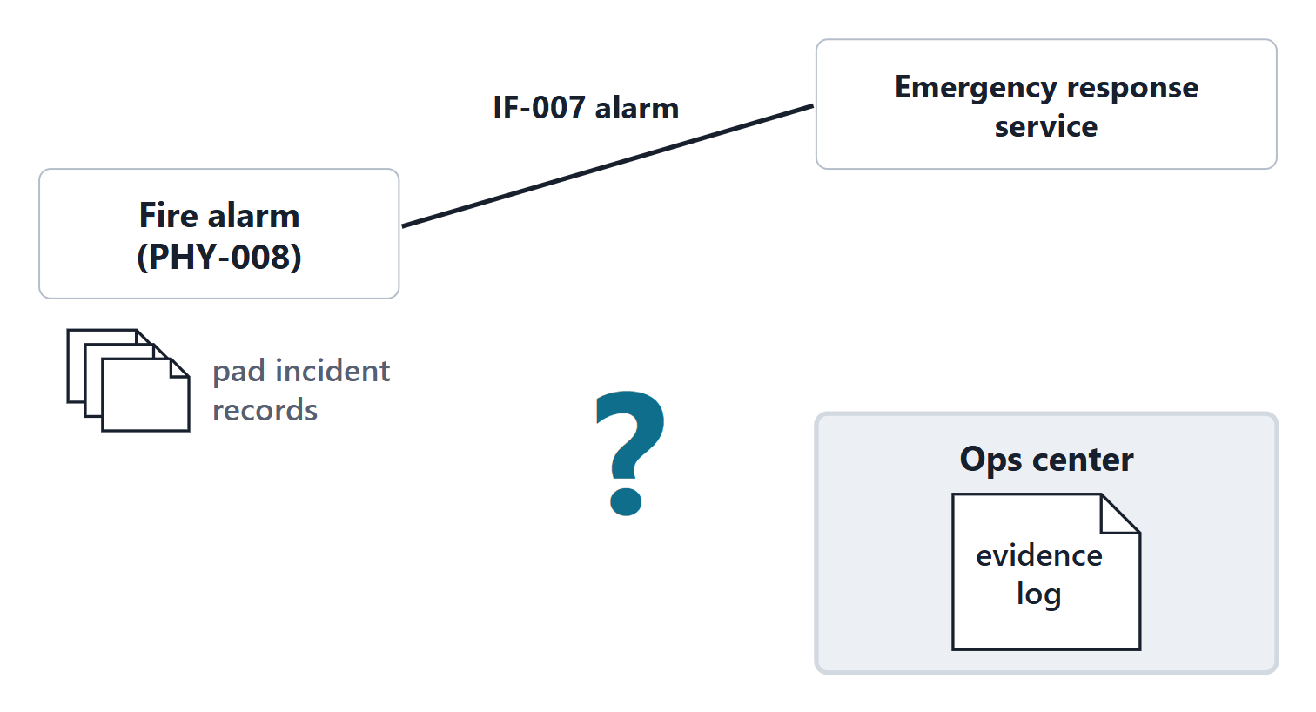
The driving question: how do the pad incident records reach the evidence log?
WEEK 4 FINDING (FICTIONAL)
The evidence log must hold every pad incident. The incident records have no route from the fire alarm system.
A · A new interface, fire alarm to operations center
B · Relay them through the vertiport systems
C · Staff re-enter each incident
D · Nothing new: the alarm interface already carries them
Figure. The fire detection system already sends its alarm to the emergency services. The evidence log at the operations center also needs its incident records, and no interface joins the two. (FICTIONAL)

Slide 3
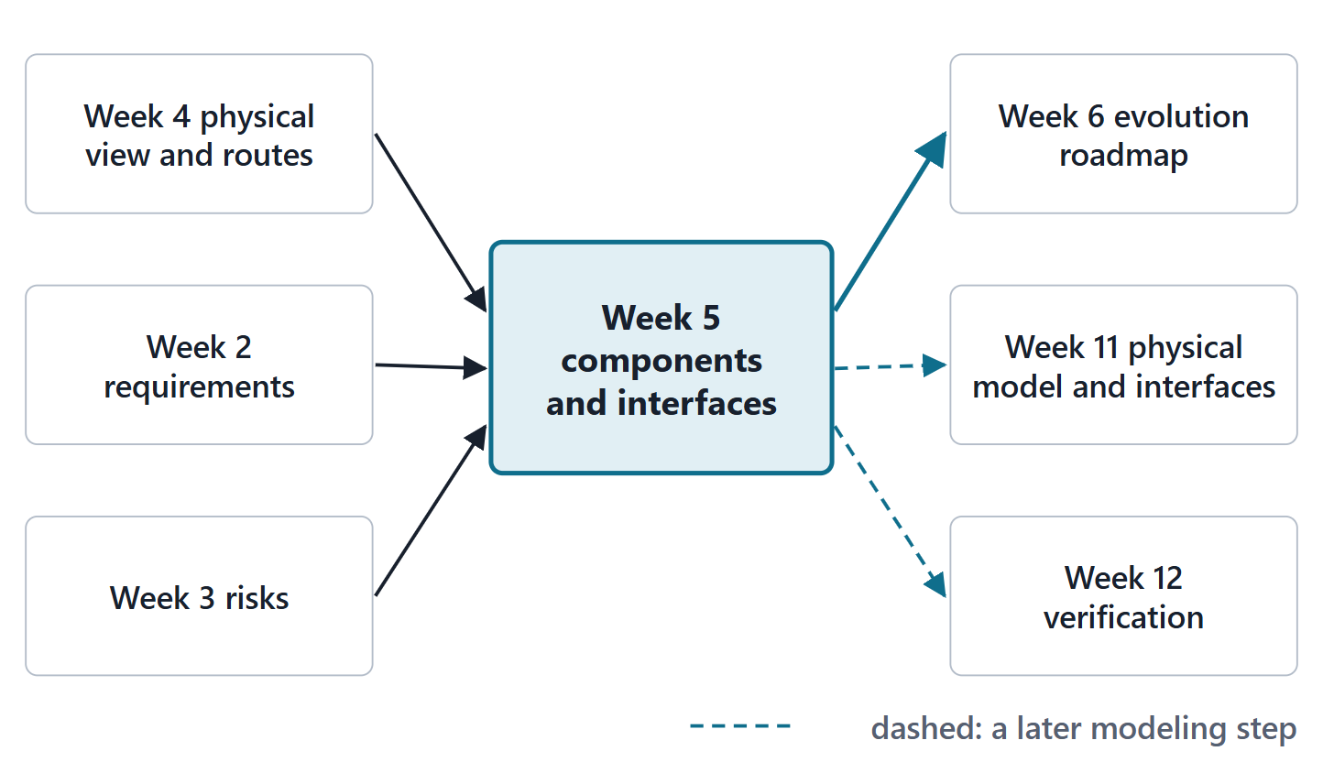
Where Week 5 sits: from the physical view to parts and connections
In: Week 4 physical view, allocation and information routes
In: Week 2 requirements; Week 3 risks
Out: Week 6 roadmap (what new technology must plug into)
Out: Week 11 parts, ports and connections; Week 12 verification
Figure. Week 5 takes the Week 4 physical view and information routes, and the Week 2 and Week 3 requirements and risks. Its components and interfaces feed the Week 6 roadmap, the Week 11 physical model and the Week 12 verification.
Sources: R47 p.140

Slide 4
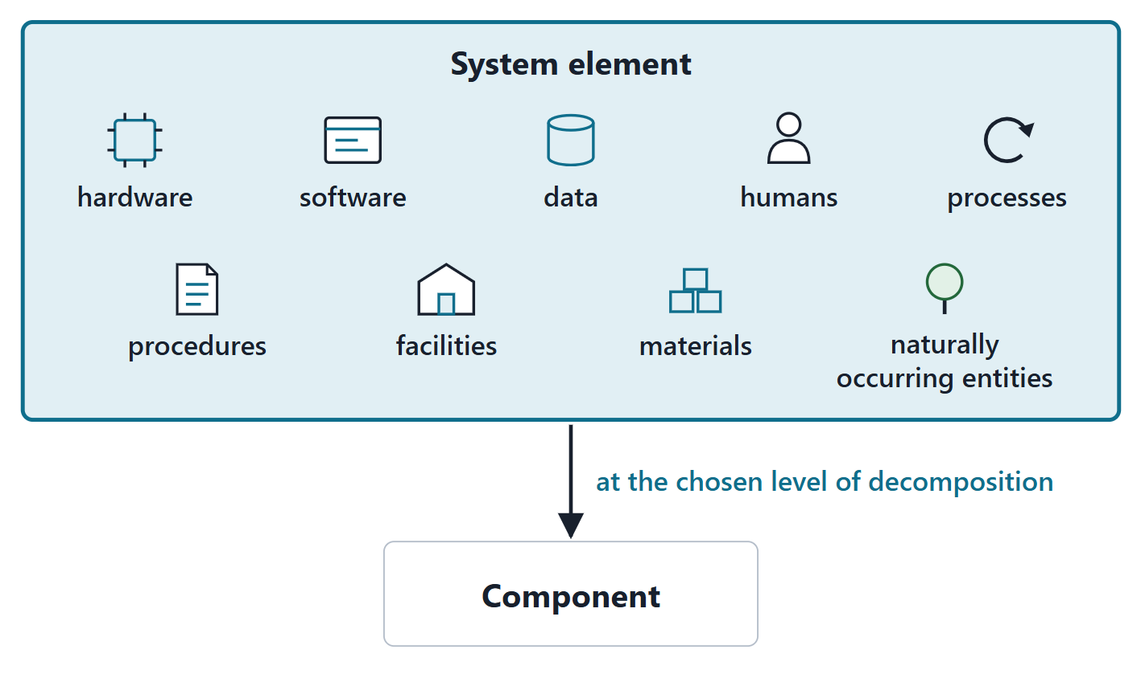
System element and component
SYSTEM ELEMENT
A discrete part of a system that can be implemented to fulfill specified requirements
R102 · SEBoK v2.14 (2026), "System Element (glossary)", p.1643
Hardware, software, data, humans, processes, procedures, facilities, materials
Component: “one of the parts that make up a system”
Figure. A system element is any discrete part that can be implemented to meet requirements, and it need not be hardware. A component is a system element at the level where it is no longer treated as complex.
Sources: R102 p.1643; R101 p.1467; R20c p.597

Slide 5
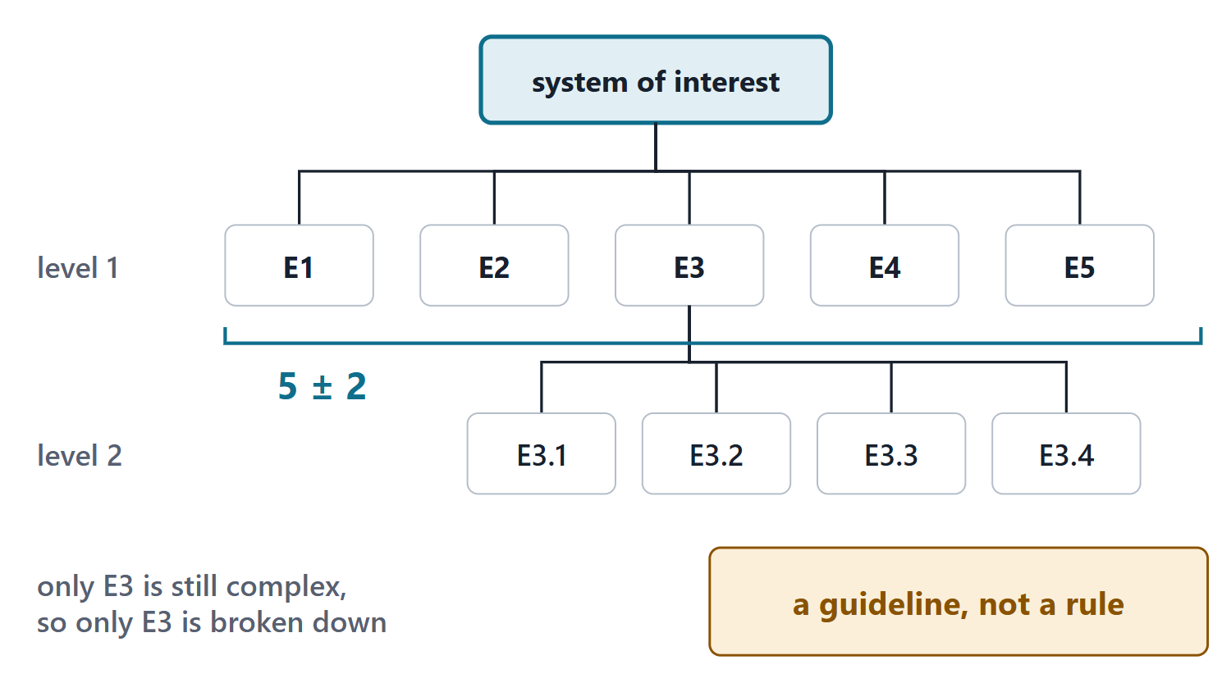
Layers, and five plus or minus two per level
A complex system is structured in layers of systems and system elements
Keep each level to a few elements: about five plus or minus two
Stop where an element is no longer complex
A guideline: justify a level that breaks it
Figure. A system structured in layers of systems and system elements, a few elements per level. Five plus or minus two is a common guideline, not a rule.
Sources: R20c p.597; R101 p.1467

Slide 6
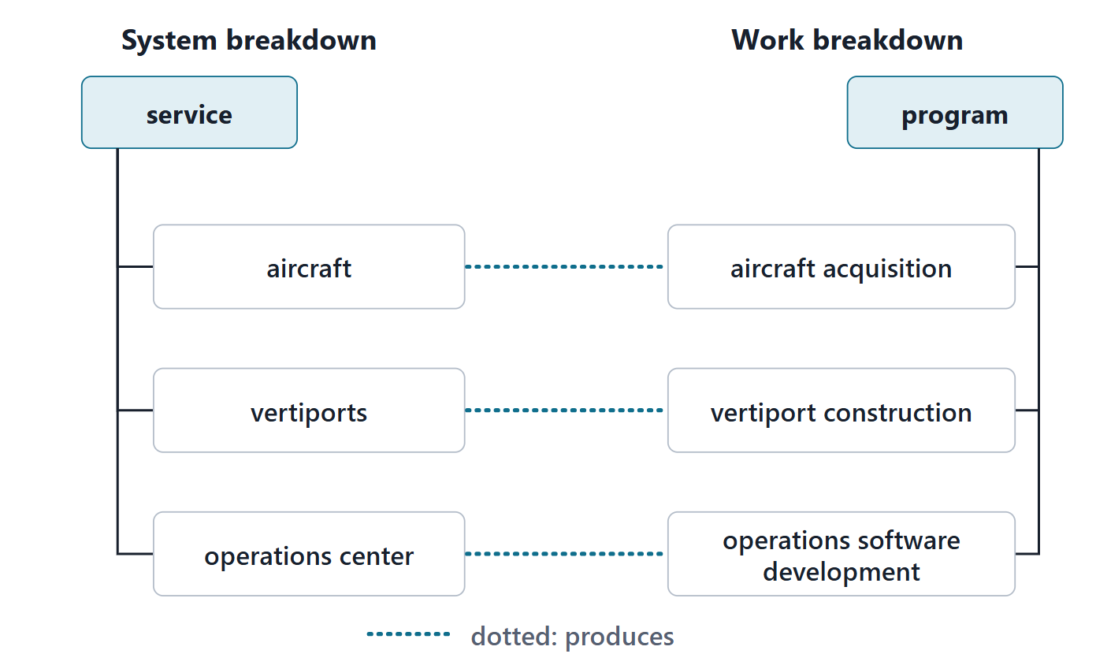
System breakdown structure and work breakdown structure
System breakdown: a hierarchy of elements used to assign teams, conduct reviews and partition work
Work breakdown: a product-oriented decomposition of the work and deliverables
Work elements are outcomes, not actions; they do not overlap
Figure. The system breakdown says what the system is made of; the work breakdown says what work delivers it. Each work element produces one or more system elements.
Sources: R103 p.1640; R104 p.104

Slide 7
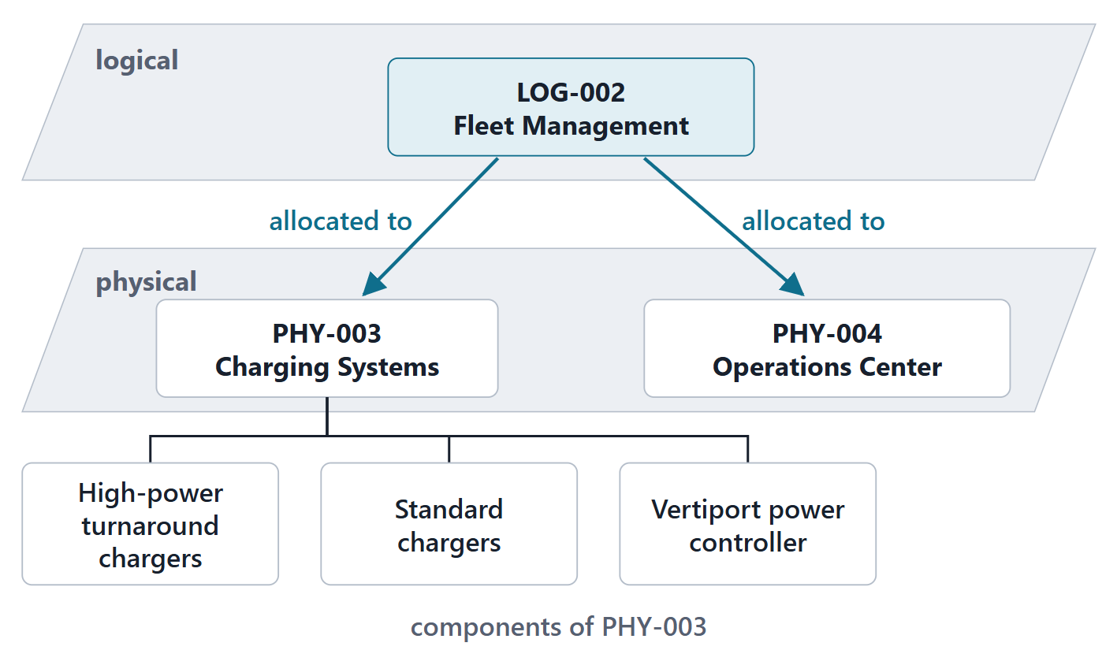
Logical and physical: which elements we break down
Logical items: allocated functions and interfaces, no specific implementation
Physical items: a specific implementation of each logical element
Components refine the physical elements
Interfaces join physical elements, components and external elements
Figure. One logical element, Fleet Management, is implemented by two physical elements, the chargers and the operations center. Components refine the physical elements. (FICTIONAL)
Sources: R19 p.571; R20c p.597

Slide 8
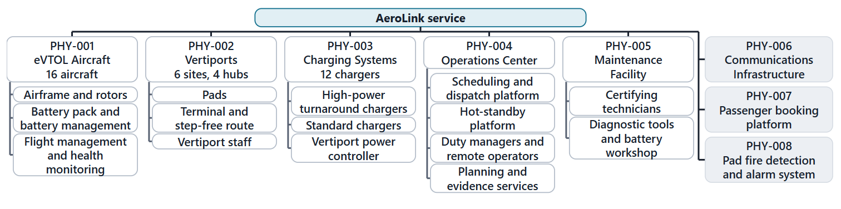
Worked example I: AeroLink’s component breakdown
Start: from the Week 4 physical elements: level 1
Ask: is this element still complex? If not, stop
Split: into a few components of any kind
Check: each component carries some of its parent’s functions
Figure. AeroLink’s breakdown: 8 physical elements at level 1; 15 level-2 components under the 5 elements that are still complex. Counts from the Week 3 decision. (FICTIONAL; level 2 proposed)
Sources: R20c p.597; R101 p.1467

Slide 9
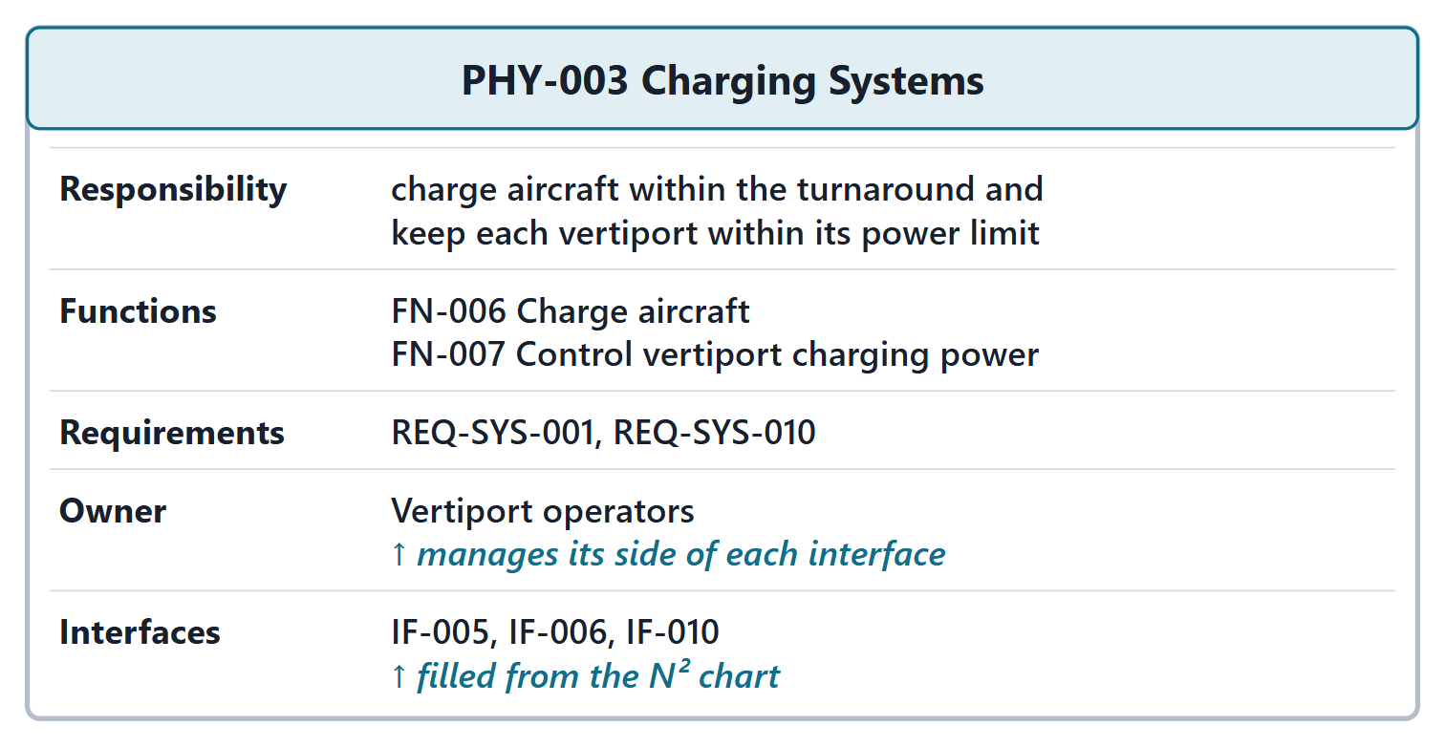
Responsibility cards: one per element
COURSE CARD
Responsibility · functions · requirements · owner · interfaces
The owner manages the element’s side of every interface
An element with no responsibility is a candidate for deletion
Figure. The responsibility card for the charging systems: what it is responsible for, the functions and requirements it carries, who owns it and which interfaces it has. (FICTIONAL)
Sources: R47 p.139

Slide 10
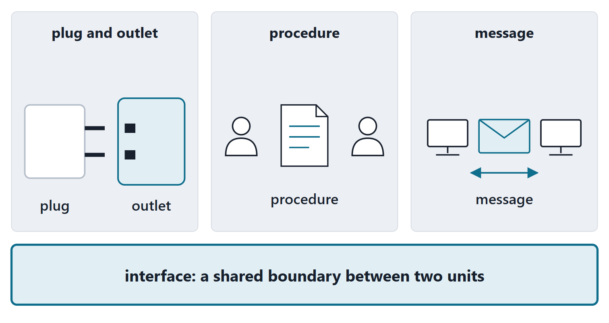
What an interface is
INTERFACE
A shared boundary between two functional units, defined by various characteristics pertaining to the functions, physical signal exchanges, and other characteristics
R100 · SEBoK v2.14 (2026), "Interface (glossary)", p.1541
Binds two system elements, like a link or a connector
In services and enterprises: protocols, procedures, documents
Figure. Three interfaces: a plug and an outlet, a procedure document, a data message. Each is a shared boundary between two units.
Sources: R100 p.1541; R20c p.597; R57 p.410; R57 p.411

Slide 11
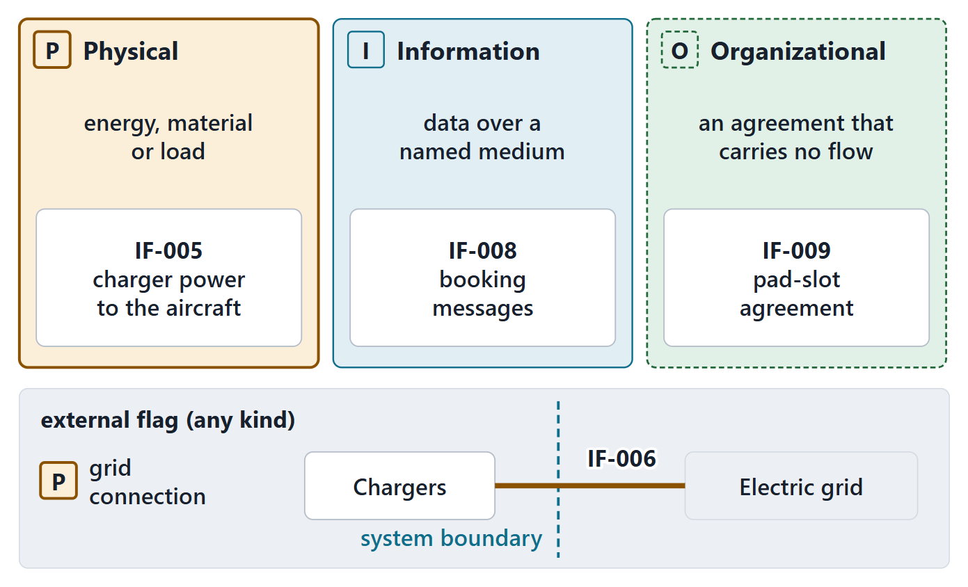
Typing interfaces: physical, information, organizational; external flagged
Kind | What crosses
Physical | energy, material, mechanical load (things that move or bind)
Information | data, over a named medium
Organizational | nothing: it records an agreement, a procedure or a responsibility between owners
External: one end outside the system of interest (a flag, any kind)
Figure. The course’s three kinds, each with one AeroLink interface. External is a flag on any kind: the grid connection is physical and external. (FICTIONAL)
Sources: R20c p.597

Slide 12
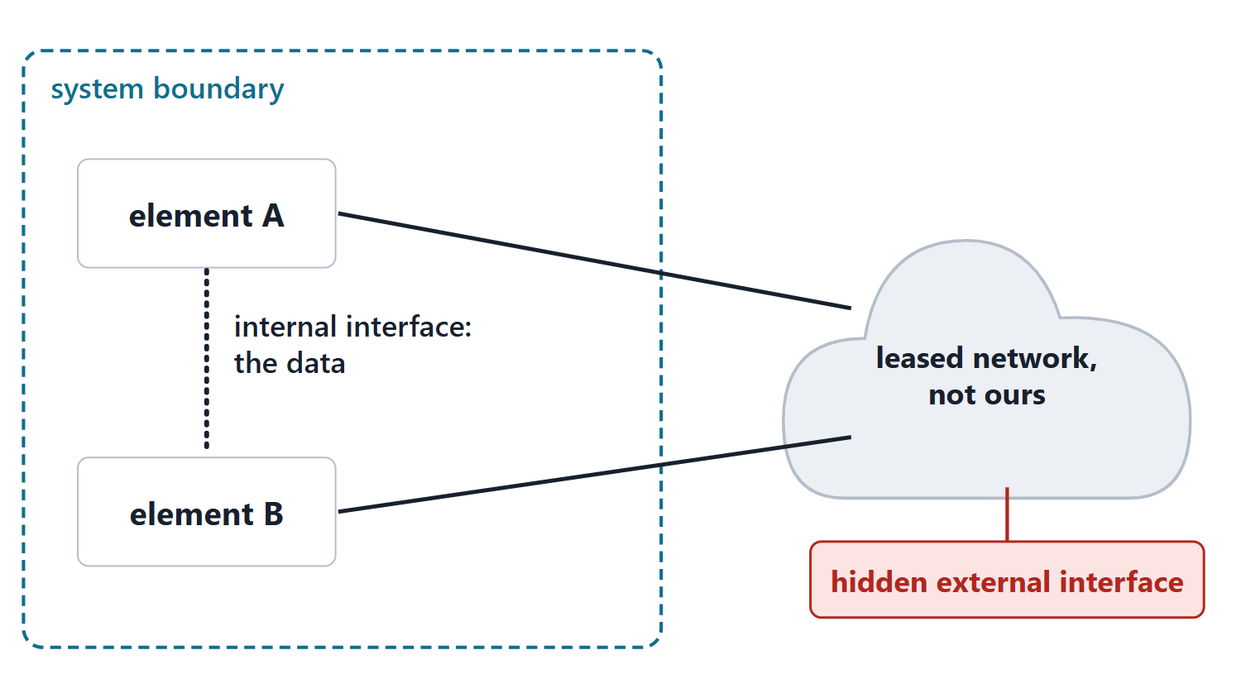
External and hidden external interfaces
Include every external interface; major internal ones too
Internal elements talking over a medium you do not own, or over radio: a hidden external interface
The medium column is how you find them
Figure. Two internal elements that talk over a network the system does not own have an internal interface (the data) and a hidden external one (the network).
Sources: R54 p.331; R55 p.369

Slide 13
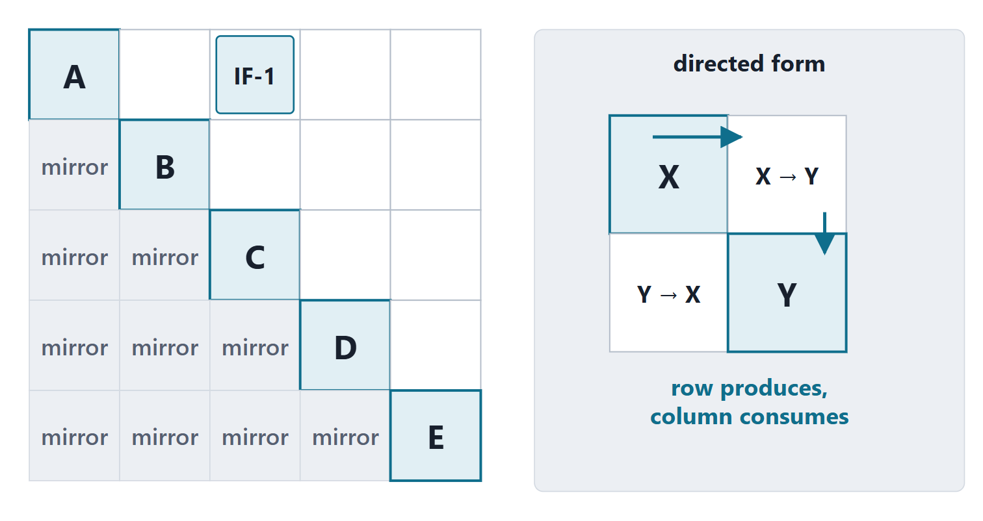
The N² chart: how it is built
Elements on the diagonal: yours and the external ones
Each cell: the interfaces joining that pair, written once above the diagonal (course convention)
Directed form: the row produces, the column consumes (course convention)
Check: the degrees sum to twice the number of interfaces
Figure. A five-element teaching N²: elements on the diagonal, each interface written once above it. An inset shows the directed form, where the row produces and the column consumes.
Sources: R22 p.630; R22 p.631

Slide 14
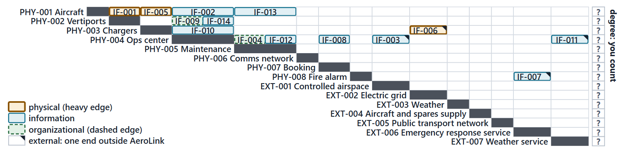
Worked example II: AeroLink’s N² from the fourteen interfaces
Diagonal: the 8 physical and 7 external elements
Place: each interface in the cell of its two ends
Type: color each cell by kind; mark external
Count: each element’s degree; check the sum
Figure. The N² of the 14 interfaces received from Week 4 over 15 elements, each cell colored by kind. The degree column is left for you to fill. (FICTIONAL)
Sources: R22 p.630; R22 p.631

Slide 15
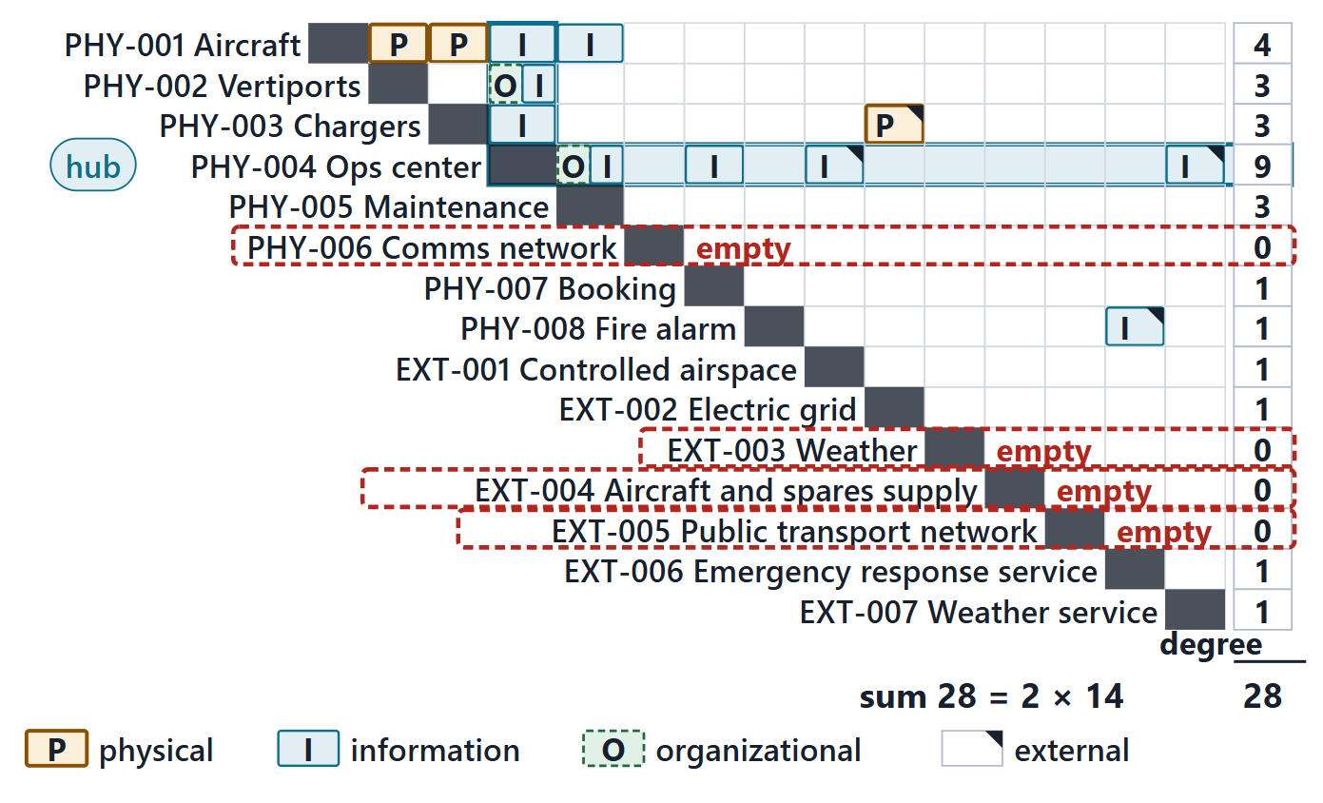
Reading the N²: the hub, the empty rows, the sum
Hub: the operations center, degree 9
Empty rows: each needs an interface or a recorded reason
Sum: 28 = 2 × 14
Figure. Degrees revealed: the operations center touches 9 of the 14 interfaces. 4 rows are empty: the network (it is the medium), weather, the spares supply and public transport. Sum 28 = 2 × 14. (FICTIONAL)
Sources: R55 p.369; R20c p.603

Slide 16
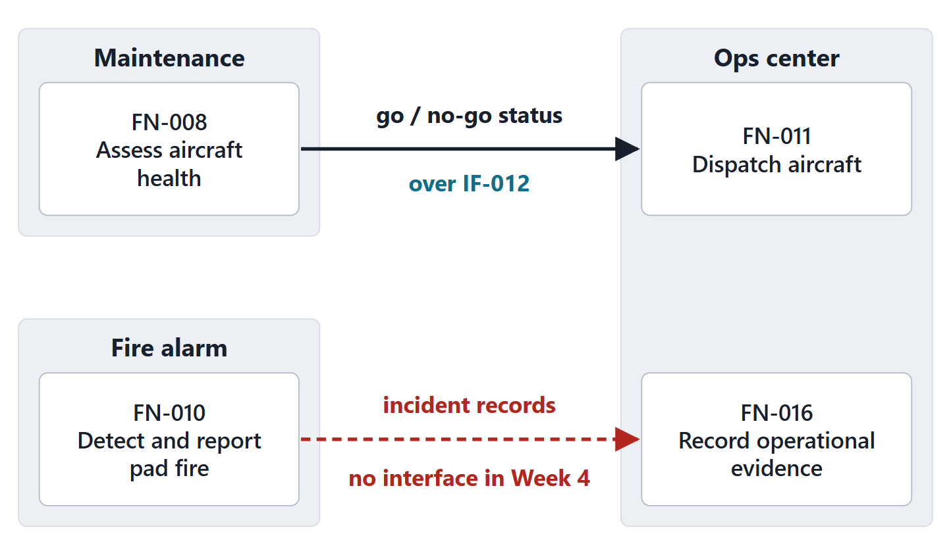
Functional flows across the physical boundary
A flow whose two functions sit on different elements is a crossing flow
Each crossing flow rides an information interface, or a recorded relay
AeroLink: 20 crossing flows, computed from the Week 4 functions
Figure. Overlay the allocation on the N²: a flow between functions on two different elements needs an interface of the matching kind. The go / no-go status rides IF-012; the incident records had nothing to ride. (FICTIONAL)
Sources: R22 p.630

Slide 17
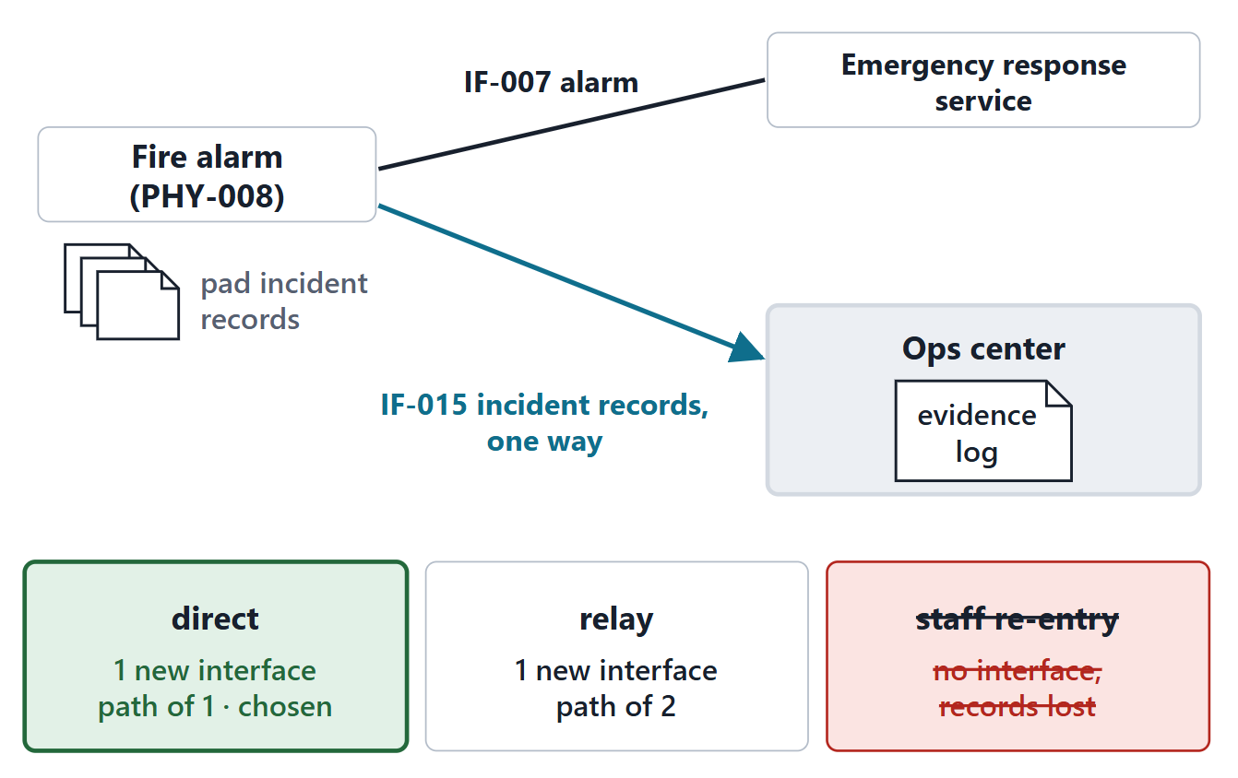
Answering the driving question: a new interface, chosen with reasons
A chosen: one new interface, one way, over the ground network
B relay: one new interface too, but a path of two and a second system
C re-entry: a manual procedure that loses records
D wrong: the alarm goes outside AeroLink
Figure. The decision: a one-way information interface from the fire detection system to the operations center (IF-015). A relay also adds one new interface, but its path has two hops and depends on another system; re-entry loses records. (FICTIONAL; proposed)
Sources: R20c p.599

Slide 18
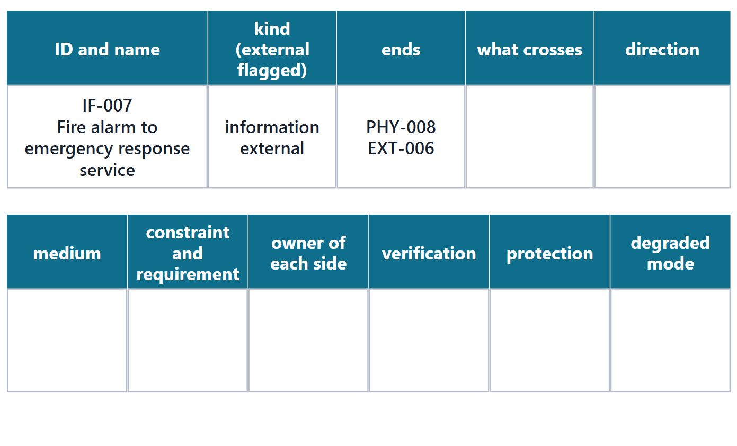
The interface definition table
Describe every interface with the same attributes
Include how it is used, not only its technical form
Course columns: what crosses, direction, medium, constraint, owners, verification
Pairs: complete the fire alarm row
Figure. The course interface table, one row per interface. For the exercise, only the identity and ends of the fire alarm interface are filled in.
Sources: R57 p.413; R57 p.411

Slide 19
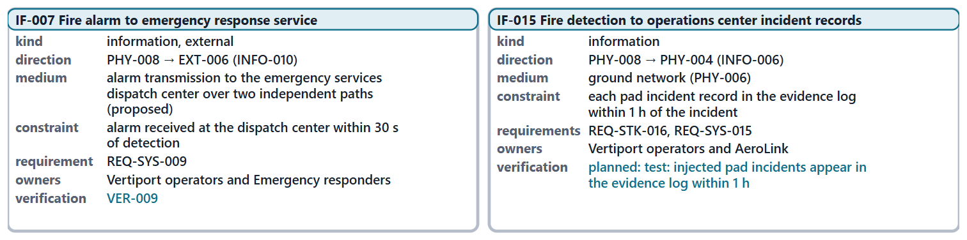
Worked example III: defining the fire alarm and incident-record interfaces
Crosses: the item, from the Week 4 information view
Direction: from producer to consumer, per item
Constraint: the requirement that bounds it
Owners: one per side; then verification
Figure. Two completed rows: the external fire alarm interface and the new incident-record interface. Direction is computed from the Week 4 routes. (FICTIONAL; attribute values proposed)
Sources: R57 p.413; R22 p.630

Slide 20
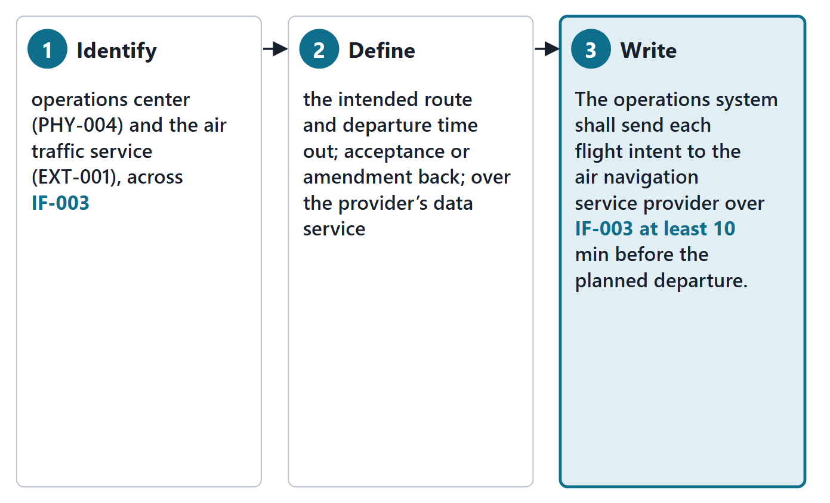
Interface requirements in three steps
1 Identify the boundaries and the interactions across them
2 Define each interaction: what crosses, and the media
3 Write the interface requirement
Name the definition it points to
Figure. The three steps worked on the flight-intent interface to the air traffic service. The requirement names the interface it governs. (FICTIONAL; value proposed)
Sources: R13 p.563

Slide 21
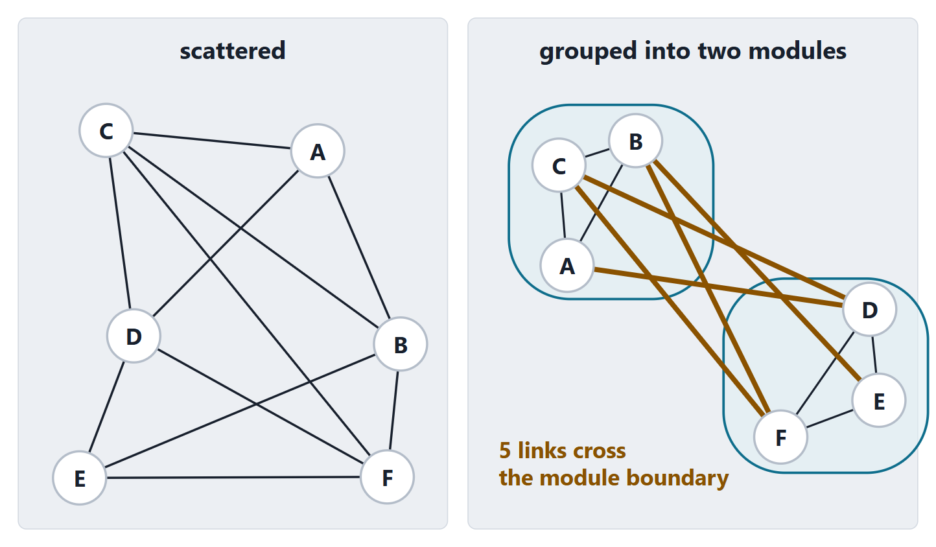
Modularity: maximum consistency inside, minimum interfaces outside
Aim: fewer physical interfaces; modularity (low interdependence)
Maximum consistency inside an element, minimum interfaces outside
Focus on interfaces at abstract levels
But concentration can cost resilience: Session 2
Figure. Six elements joined by eleven links, drawn two ways: scattered, with no grouping; grouped into two modules, five links cross the module boundary.
Sources: R20c p.599; R20c p.603

Slide 22
Exit: one interface of your enterprise
ONE-MINUTE PAPER
Name one organizational interface of your enterprise, the agreement it records, and who owns each side.
Before Session 2 (about 15 min): list your Week 4 physical elements and externals
Mark every pair that exchanges something, and what
Bring it: you draft your N² in class

Slide 23
References and credits
R13 · SEBoK v2.14 (2026), “System Requirements Definition”, p.563
R19 · SEBoK v2.14 (2026), “System Architecture Design Definition”, p.571
R20c · SEBoK v2.14 (2026), “Physical Architecture”, p.596–597, 599, 603
R22 · SEBoK v2.14 (2026), “System Integration”, p.630–631
R47 · OUSD(R&E) Systems Engineering Guidebook (2021/2022), “Interface Management Process”, p.138–140
R54 · The MITRE Systems Engineering Guide (2014), “Analyzing and Defining Requirements”, p.331
R55 · The MITRE Systems Engineering Guide (2014), “Develop System-Level Technical Requirements”, p.369
R57 · The MITRE Systems Engineering Guide (2014), “Interface Management”, p.410–414
R100 · SEBoK v2.14 (2026), “Interface (glossary)”, p.1541
R101 · SEBoK v2.14 (2026), “Component (glossary)”, p.1467
R102 · SEBoK v2.14 (2026), “System Element (glossary)”, p.1643
R103 · SEBoK v2.14 (2026), “System Breakdown Structure (glossary)”, p.1640
R104 · OUSD(R&E) Systems Engineering Guidebook (2021/2022), “Work Breakdown Structure”, p.104
CREDITS AND LICENSES
SEBoK v2.14: “This material is used under a Creative Commons Attribution-NonCommercial ShareAlike 3.0 Unported License from The Trustees of the Stevens Institute of Technology.” (SEBoK, “Bkcase Wiki:Copyright”, PDF p.31). Quotations are short and cited; no SEBoK figure or table is reproduced.
OUSD(R&E) Systems Engineering Guidebook: Distribution Statement A. Approved for public release. Distribution is unlimited.
The MITRE Systems Engineering Guide: © 2014 by The MITRE Corporation. All rights reserved. Approved for public release; distribution unlimited (Case Numbers 10-4072 and 12-1089). Quoted briefly with attribution.
Figures are original drawings for this course; none redraws a figure from the sources.
AeroLink Urban Mobility is a fictional teaching case: every number, name and statement about it is a teaching value.

