Slide 1
Warm-up: three questions from Session 1
1 · The pad-slot agreement between the vertiport operators and AeroLink: which kind, and what crosses it?
2 · Why does the communications network have no interface of its own on the N²?
3 · What turns an internal interface into a hidden external one?
Sources: R55 p.369

Slide 2
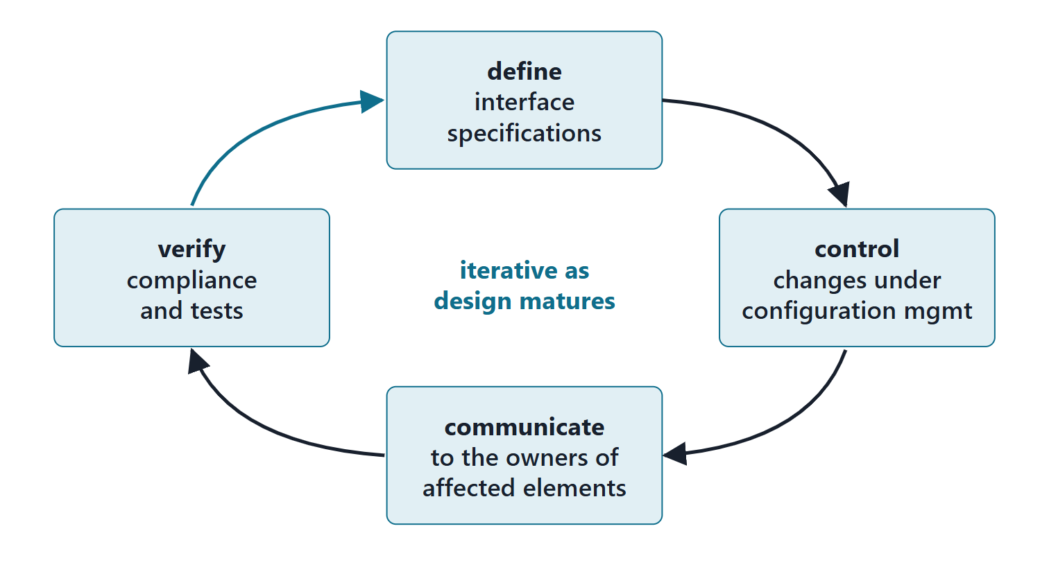
Why interfaces are managed, not just defined
Identify, define, manage and ensure compliance of internal and external interfaces
Poor interface control degrades performance, affordability, sustainability, maintainability
Interface attributes act as constraints on design change
Iterative: refined as the design matures
Figure. Interface management as a loop: define, control, communicate, verify, and back to define as knowledge grows.
Sources: R47 p.138; R47 p.139; R57 p.411

Slide 3
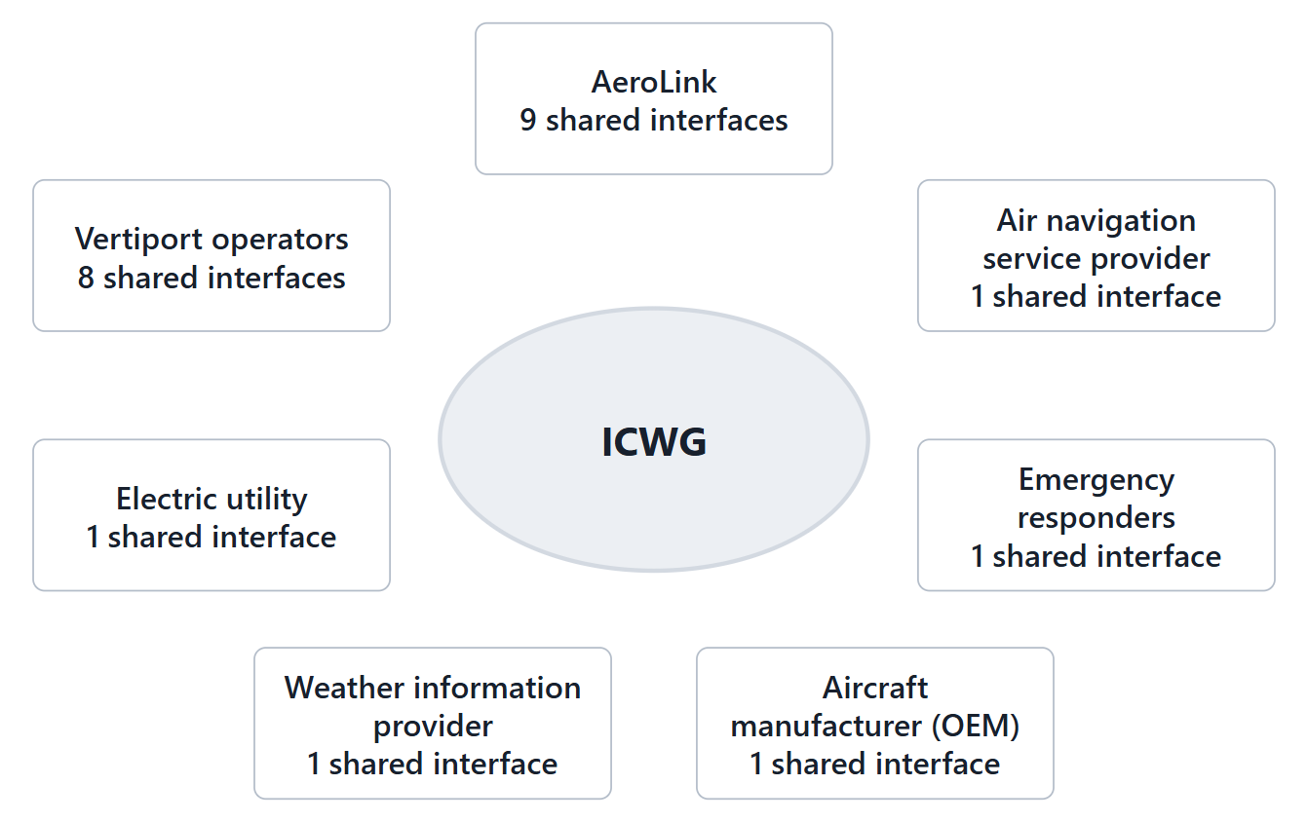
Governance and the interface control working group
Loosely coupled architectures need more governance, not less
ICWG: technical representatives of the interfacing activities
Its purpose: interface issues engineer-to-engineer contact cannot resolve
The interface management plan lists interfaces, standards and tests
Figure. AeroLink’s proposed interface control working group: one seat for each owner of an interface that joins two organizations, 7 in all, with the number of cross-owner interfaces each seat shares. (FICTIONAL; proposed)
Sources: R57 p.412; R57 p.414; R47 p.140

Slide 4
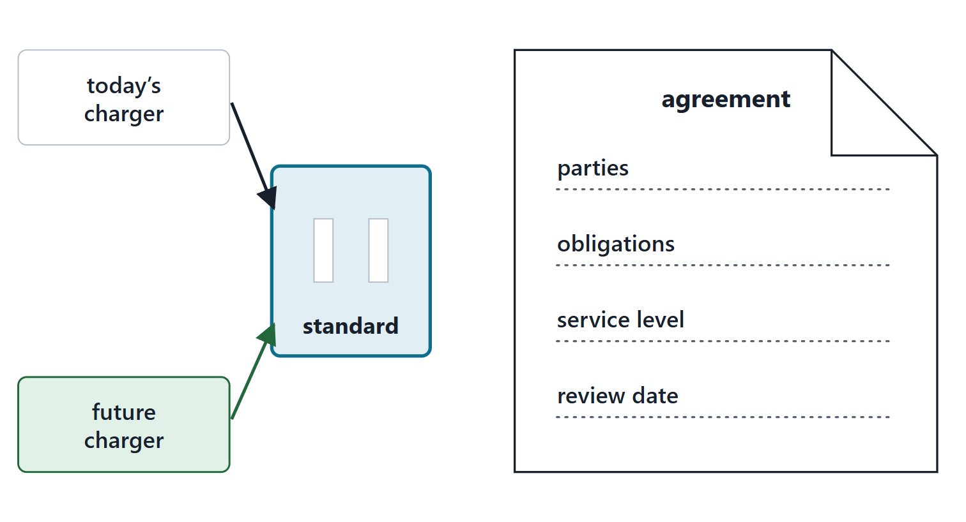
Standards and service-level agreements
Standards-based interfaces support interoperability and reuse
Standard interfaces enable modular open systems and future technology insertion
Service-level agreements state the performance each side may expect
An organizational interface is managed by its agreement
Figure. A standard interface lets today’s charger and a future one plug into the same socket; a service-level agreement says what each side may expect.
Sources: R57 p.413; R47 p.139; R20c p.596

Slide 5
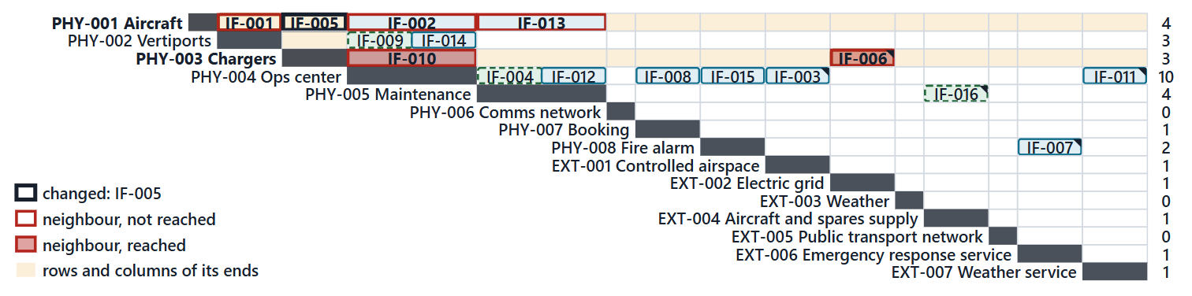
Worked example I: one interface change, traced through the N²
Request: state the change to one interface
Neighbours: read the rows and columns of its two ends
Reach: judge which neighbours and requirements it affects
Decide: the owners decide; baseline the new version
Figure. Change ICR-001 to IF-005: the rows and columns of its two ends show 5 neighbouring interfaces; two of them and one requirement are actually reached. (FICTIONAL; proposed)
Sources: R47 p.138; R47 p.139; R36 p.498; R36 p.499; R57 p.414

Slide 6
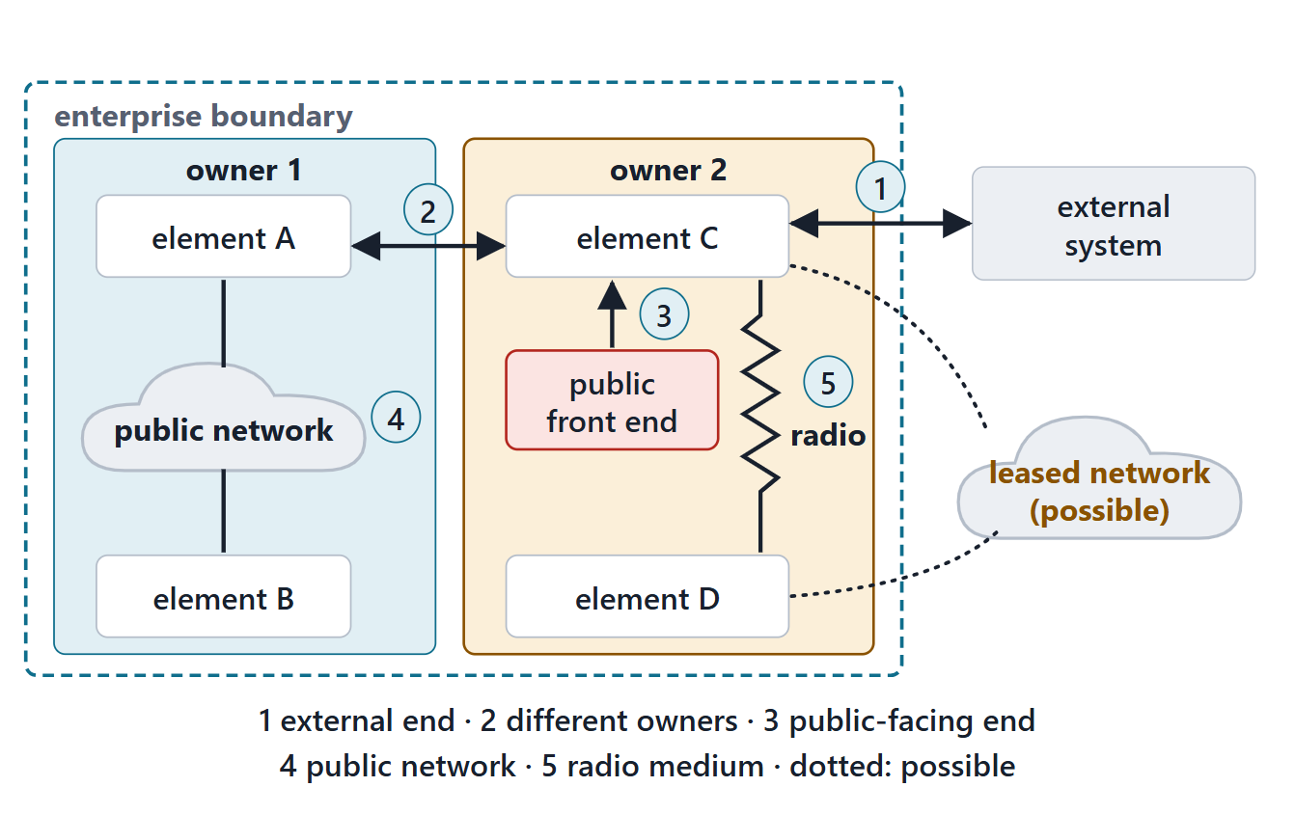
Interface security: trust boundaries
Adversity often comes through or from connected systems
Data are protected from unauthorized alteration, exfiltration, infiltration, destruction
Course rule: a crossing needs protection, or a reason it needs none
Which of the grid connection, the booking link and the charger data link cross?
Figure. Five ways an interface crosses a trust boundary: an external end, ends with different owners, a public-facing end, a public network between the ends, or a radio medium anyone with a transmitter can reach. A leased wired network makes a possible crossing.
Sources: R25 p.1234; R25 p.1231; R25 p.1229; R54 p.331

Slide 7
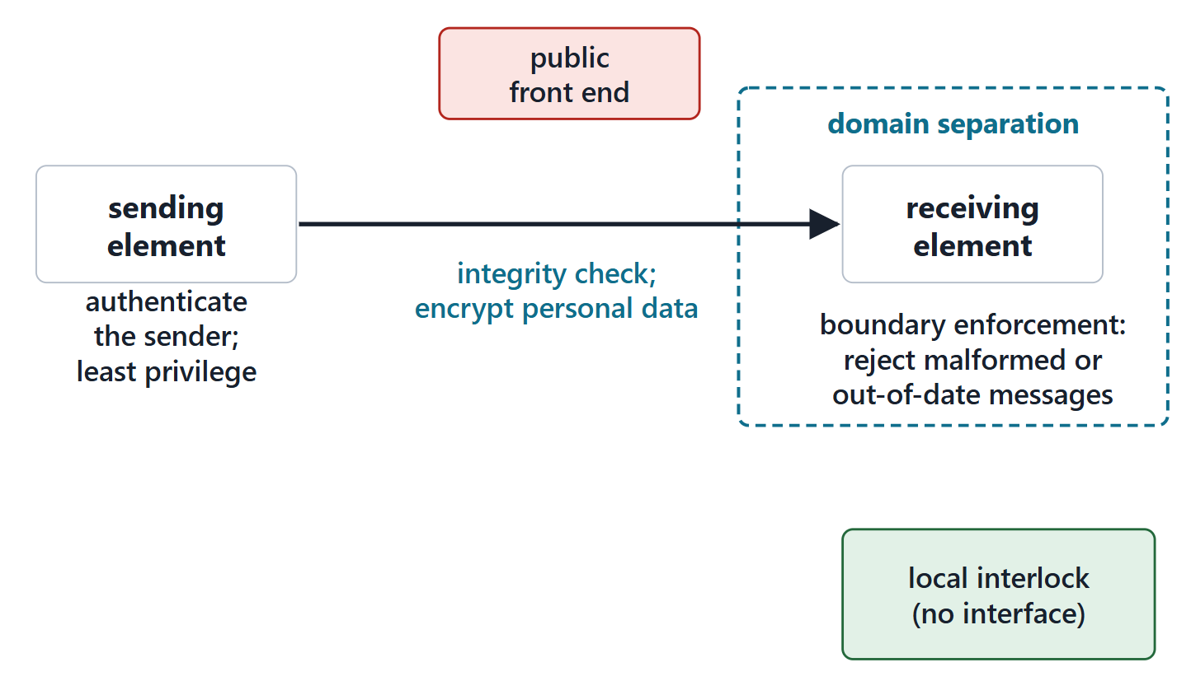
Protection at the interface: integrity, authentication, separation
Authenticate the sender; integrity-check every message
Domain separation: isolate items with different protection needs
Least privilege; boundary enforcement on format and rate
Defense in depth: a local interlock that acts without the interface
Figure. Protection measures placed on one information interface: checks at the sending end, along the path and at the receiving end, and a local interlock that does not depend on the interface at all.
Sources: R24 p.1205; R24 p.1206; R24 p.1207

Slide 8
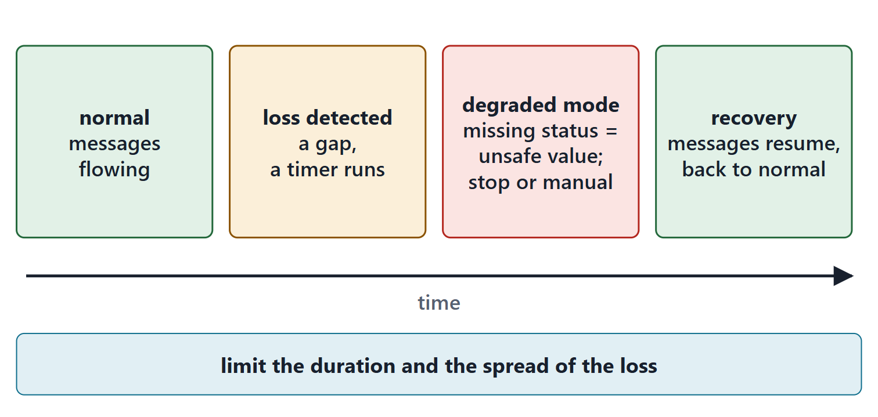
Degraded modes at interfaces: what each side does when it fails
Degrade gracefully: partial function instead of total failure
Fail safe (course default): treat a missing status as the unsafe value
Continue on the last valid value for a stated time, then stop
Limit the duration and the spread of the loss
Figure. An interface failure over time: normal exchange, loss detected, the degraded mode each side enters, recovery. The degraded mode is decided at design time, not at the moment of failure.
Sources: R24 p.1205; R24 p.1207; R25 p.1233

Slide 9
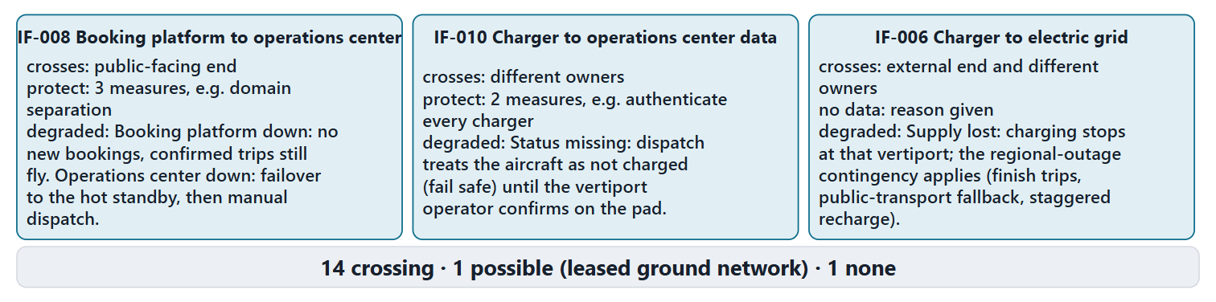
Worked example II: trust boundaries, protection and degraded modes on AeroLink
Cross?: apply the five reasons to each interface
Protect: measures matched to what crosses
Degrade: what each side does on failure
Link: the risk each treatment answers
Figure. Three AeroLink interfaces read for security and resilience. Across all 16, 14 cross a trust boundary, 1 crosses only if the ground network is leased, and 1 crosses none. (FICTIONAL; proposed)
Sources: R25 p.1234; R24 p.1206; R24 p.1205

Slide 10
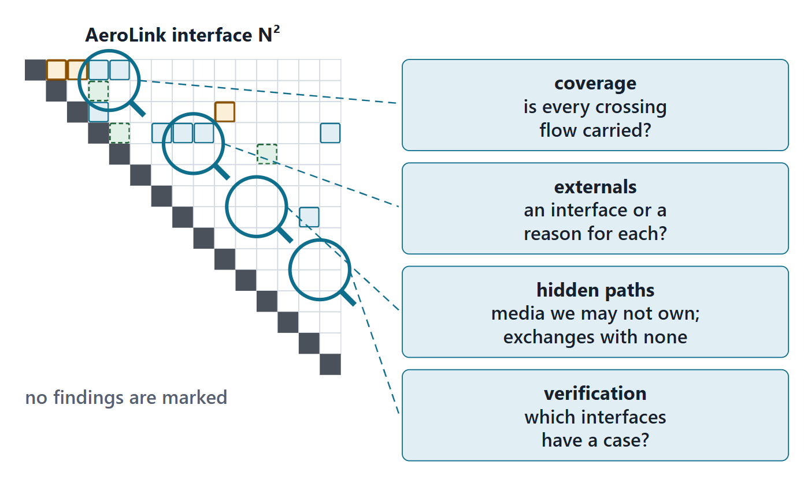
Auditing the interface set: four lenses
Coverage: is every crossing flow carried?
Externals: an interface or a reason for each?
Hidden paths: media we may not own; exchanges with no interface
Verification: which interfaces have a case?
Figure. The four audit lenses applied to the interface set: coverage, externals, hidden paths, verification. Find the gaps before the findings are read out.
Sources: R22 p.630; R55 p.369

Slide 11
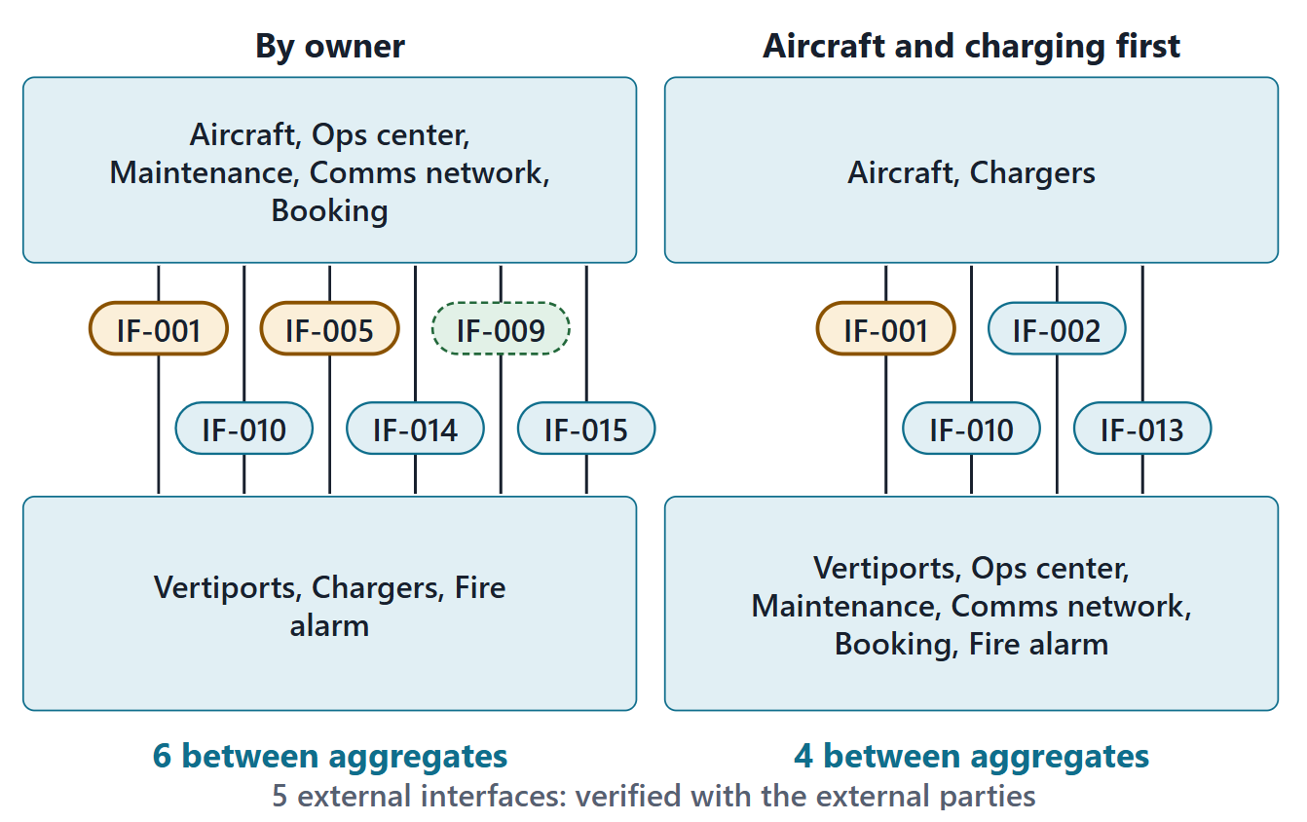
Integration: aggregates from the N²
Group elements so that fewer interfaces lie between aggregates
Verify inside each aggregate, then the interfaces between them; compare groupings of similar size
No element or interface forgotten; every one verified
External interfaces: with the external party
Figure. Two groupings of AeroLink’s eight physical elements into integration aggregates. By owner, 6 internal interfaces lie between aggregates; aircraft and charging first, 4. The 5 external interfaces are verified with their external parties. (FICTIONAL)
Sources: R22 p.630; R22 p.631

Slide 12
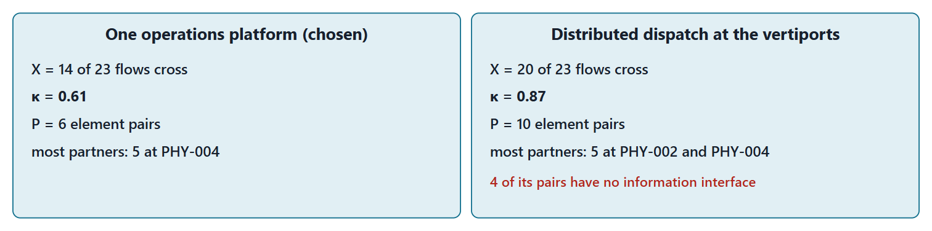
Worked example III: the coupling count Week 4 deferred
Define: E flows; X crossing; κ = X ÷ E; P pairs
Compute: each alternative on the same flows
Compare: and check crossings against interfaces
Limit: say what the count cannot see
Figure. Two allocations of the same 23 function flows. One platform (chosen): 14 cross, κ = 0.61, 6 element pairs. Distributed dispatch: 20 cross, κ = 0.87, 10 pairs. Course metric. (FICTIONAL)
Sources: R20c p.599; R22 p.631

Slide 13
What the method cannot tell you
The N² shows that an interface exists, not that it performs
Latency budget: 120 s = 30 + 30 + 30 s + 30 s margin; a hold precedes classification
The typing, the columns and the trust-boundary rule are course conventions
No interface control document template is held: the table is a teaching form
People: passengers and staff need human–system interfaces, modeled later
Sources: R20c p.597; R57 p.413

Slide 14
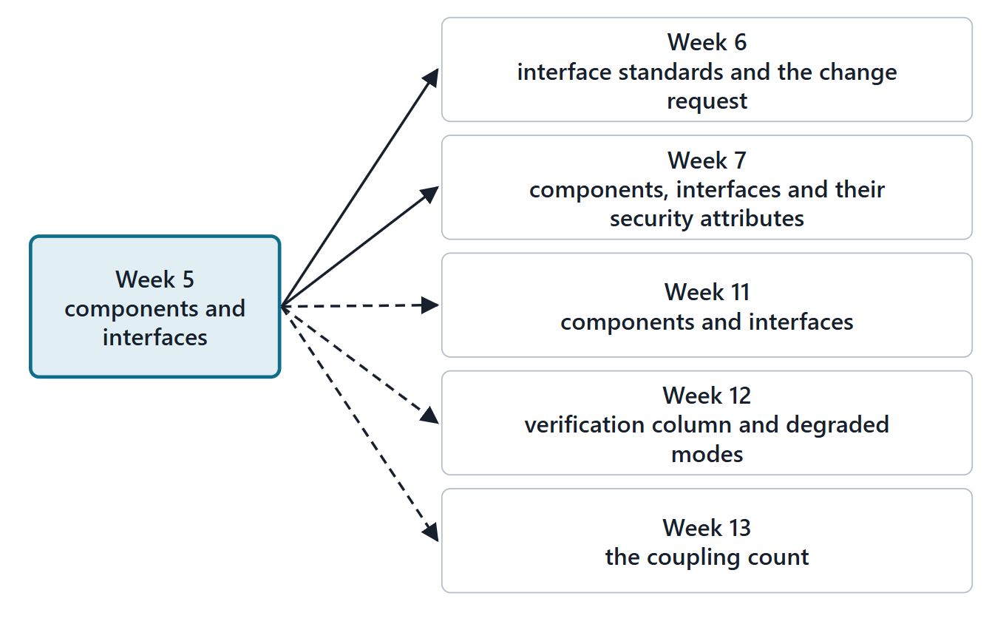
Where this goes: Weeks 6, 7, 11 and 12
Week 6: insertion points are interfaces; standards make them cheap
Week 7: components and interfaces join the engineering package
Week 11: components become parts, ends become ports, interfaces become connections
Week 12: verification cases for every interface
Figure. Week 5’s artifacts and the weeks that use them: insertion points for the roadmap, a package section, the physical model in SysML v2, verification, and an optional analysis in Week 13.
Sources: R71 sl.18; R47 p.140

Slide 15
Lab L5: components, the N² and interface definitions for your enterprise
At least 5 components with responsibility cards
An N² and at least 8 interface definitions, every column
At least 3 interface requirements; one change request
Protection and degraded mode for every interface
Team of three: 4 components, 6 interfaces, 2 requirements
Due before Week 6, Session 1
Your own enterprise
The tool imports your Week 4 record

Slide 16
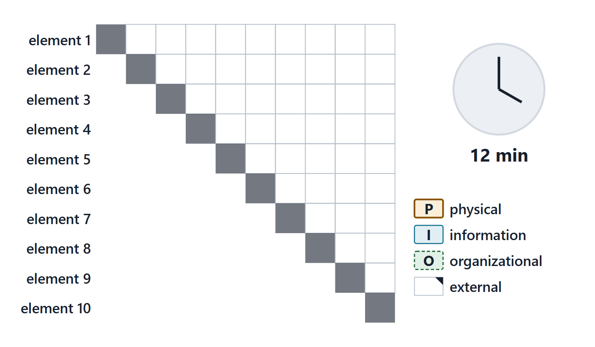
Team work: your first N²
Diagonal: your Week 4 physical elements, then your externals
Fill each cell from the pre-work; type it P, I or O
Check the crossing flows from your Week 4 information view
Count the degrees; check the sum
Figure. A blank N² template with a 12-minute timer: physical elements, then externals, on the diagonal; one interface ID per cell with its kind.
Sources: R22 p.630

Slide 17
Instructor check: degrees and one external
Two teams: read the degree of each element and the sum
The room checks: is the sum twice the number of interfaces?
Each team names one external interface and its owner

Slide 18
Close: the seven days ahead
Days 1–2: breakdown and cards; days 2–4: N², table, security columns
Days 4–5: interface requirements; day 5: management notes and the change request
Day 6: audit and AI usage statement; day 7: export and upload
Quiz Q5 opens today; log your hours

Slide 19
References and credits
R20c · SEBoK v2.14 (2026), “Physical Architecture”, p.596–597, 599, 603
R22 · SEBoK v2.14 (2026), “System Integration”, p.630–631
R24 · SEBoK v2.14 (2026), “System Resilience”, p.1205–1207
R25 · SEBoK v2.14 (2026), “System Security”, p.1229, 1231, 1233–1234
R36 · SEBoK v2.14 (2026), “Configuration Baselines”, p.498–499
R47 · OUSD(R&E) Systems Engineering Guidebook (2021/2022), “Interface Management Process”, p.138–140
R54 · The MITRE Systems Engineering Guide (2014), “Analyzing and Defining Requirements”, p.331
R55 · The MITRE Systems Engineering Guide (2014), “Develop System-Level Technical Requirements”, p.369
R57 · The MITRE Systems Engineering Guide (2014), “Interface Management”, p.410–414
R71 · Seidewitz, Intro to the SysML v2 Language: Textual Notation (Release 2026-08), “Connections”, sl.18
CREDITS AND LICENSES
Introduction to the SysML v2 Language, Textual Notation (Release 2026-08): Copyright © 2019–2026 Model Driven Solutions, Inc. Licensed under the Creative Commons Attribution 4.0 International License (CC BY 4.0).
SEBoK v2.14: “This material is used under a Creative Commons Attribution-NonCommercial ShareAlike 3.0 Unported License from The Trustees of the Stevens Institute of Technology.” (SEBoK, “Bkcase Wiki:Copyright”, PDF p.31). Quotations are short and cited; no SEBoK figure or table is reproduced.
OUSD(R&E) Systems Engineering Guidebook: Distribution Statement A. Approved for public release. Distribution is unlimited.
The MITRE Systems Engineering Guide: © 2014 by The MITRE Corporation. All rights reserved. Approved for public release; distribution unlimited (Case Numbers 10-4072 and 12-1089). Quoted briefly with attribution.
Figures are original drawings for this course; none redraws a figure from the sources.
AeroLink Urban Mobility is a fictional teaching case: every number, name and statement about it is a teaching value.

