Slide 1
Warm-up: three questions from Session 1
1. What does a TRL not tell you?
2. Name the two ways to define increments
3. What is an off-ramp, and when does an increment need one?
Sources: R60 p.525; R106 p.583; R46 p.126

Slide 2
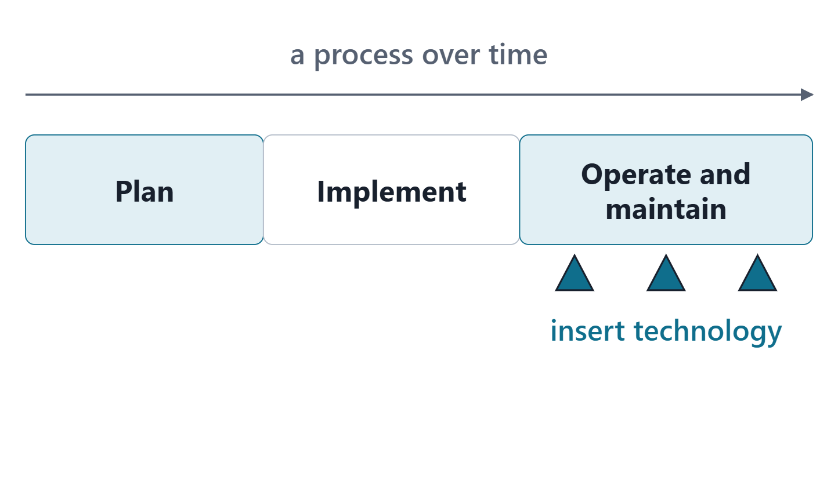
Transition is a process, not a date
Transition: from development to fielding and sustainment
A process over time: plan, implement, operate and maintain
Plan it early; design for insertion during operation
Strategies: simultaneous operation, cutover, retirement
Figure. Transition is planned, implemented and lived with; technology insertion recurs during operation.
Sources: R107 p.447; R107 p.448

Slide 3
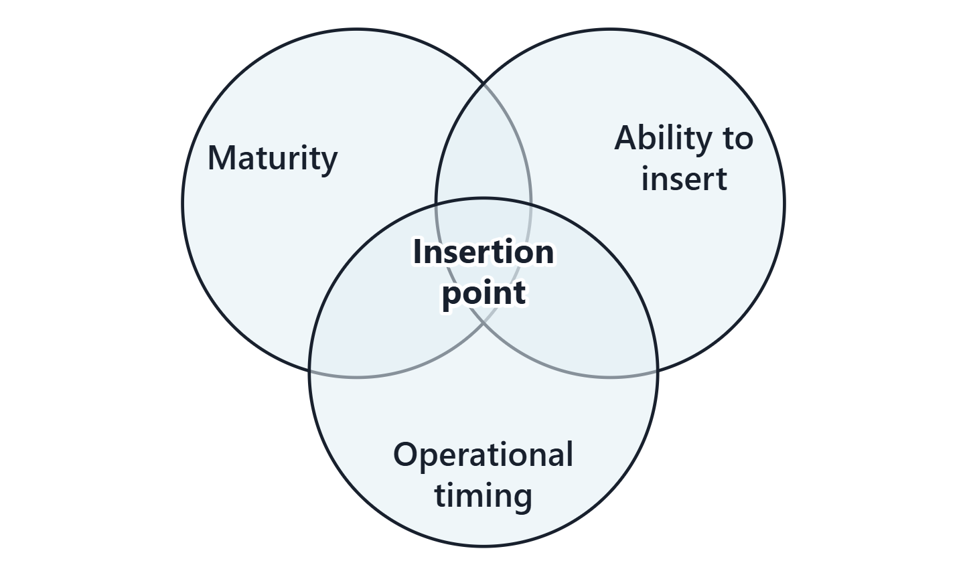
A flexible technology roadmap: when to insert
Plan when, how and why to insert improvements after deployment
Balance maturity, the ability to insert, and operational timing
Open, standard interfaces make later insertion easier
Figure. An insertion point is where maturity, the ability to insert and operational timing all hold.
Sources: R107 p.449; R47 p.139

Slide 4
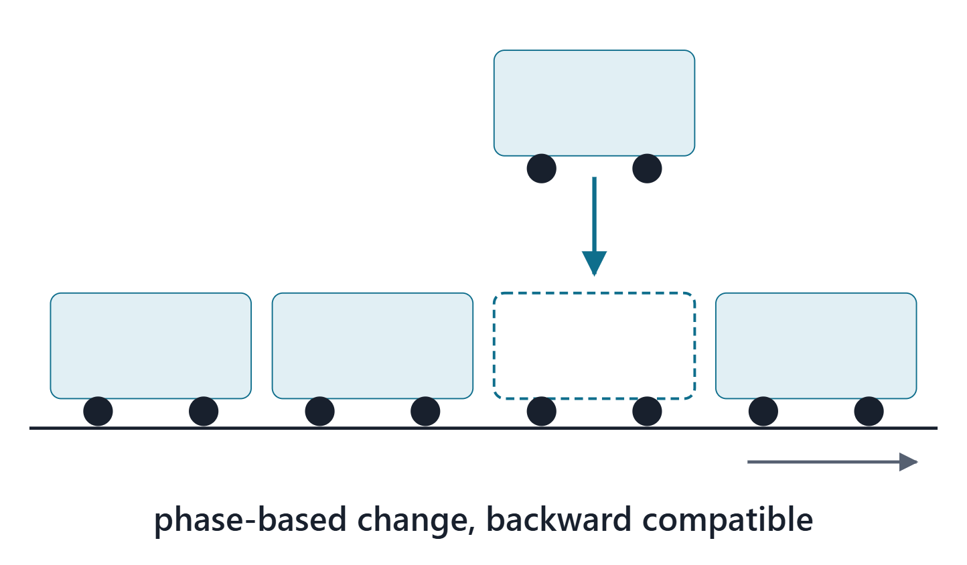
Modernizing a service or an enterprise while it operates
Reasons include obsolescence and new uses
A service must stay backward compatible during the change
Large services change in phases, area by area
The largest challenge: changing while the system operates
Figure. A service changed while it runs: one part is replaced at a time, and the old and the new must work together.
Sources: R26 p.681; R26 p.682; R26 p.683

Slide 5
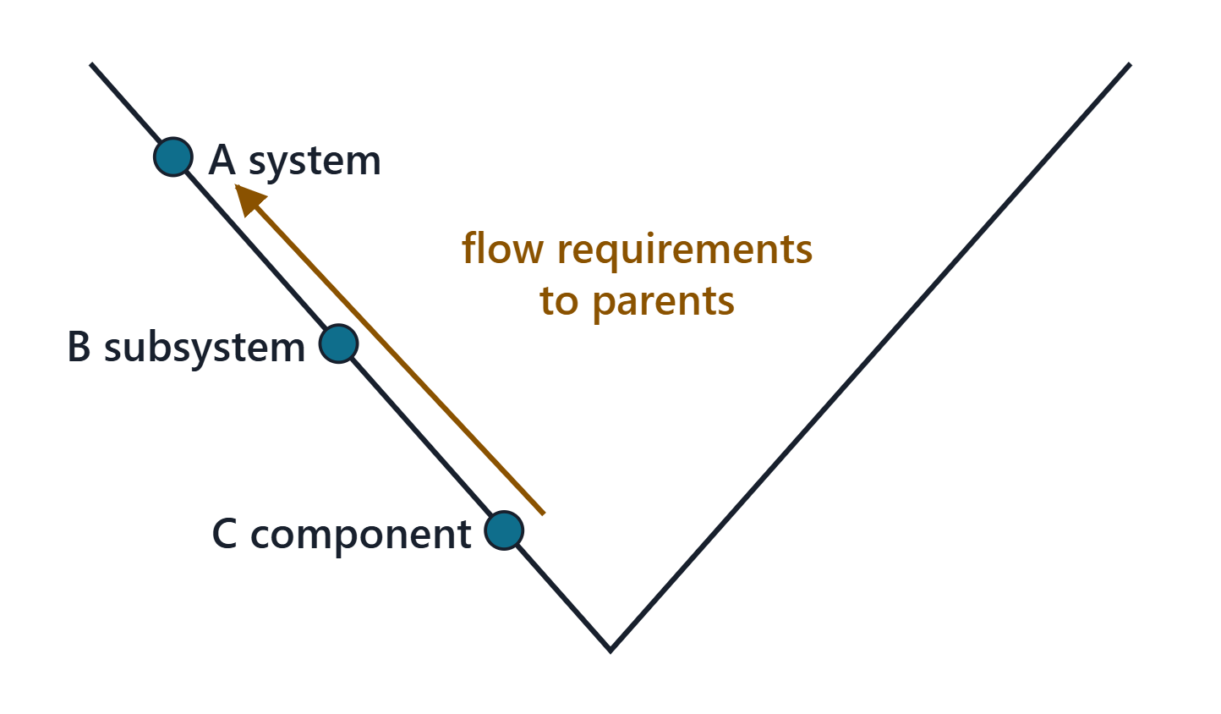
Changing without breaking: the Vee entry point, compatibility, regression
A change enters the Vee at its own level
Lower-level changes flow up through parent requirements
A component change should keep form, fit, function and interface
Regression test what was not changed
Concurrent changes: a block, or continuous integration
Figure. A modification enters the Vee at its own level; a lower-level change flows upward through its parent requirements.
Sources: R26 p.682; R26 p.683; R26 p.684

Slide 6
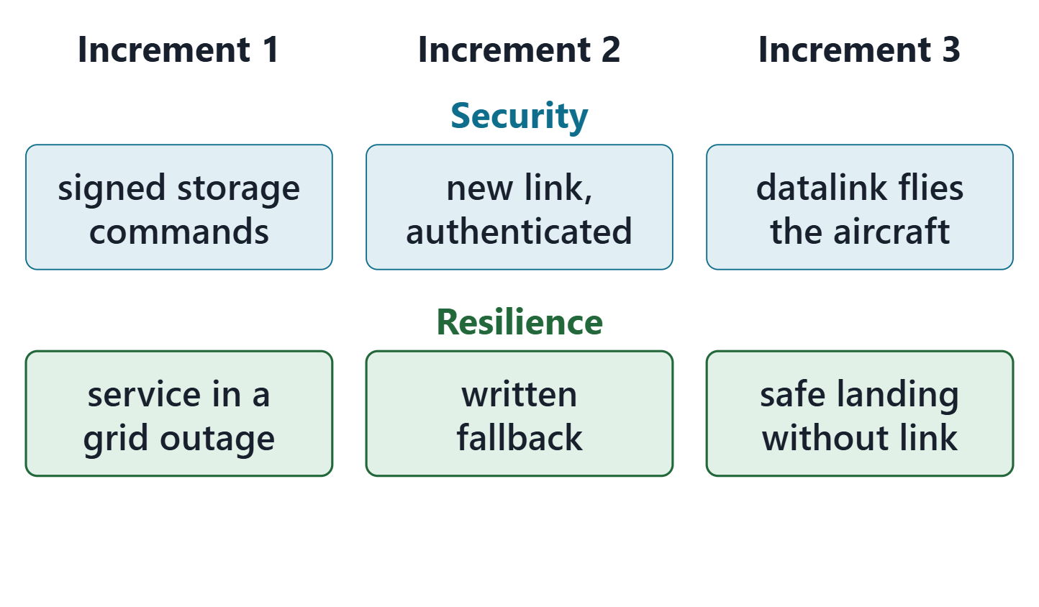
Security and resilience as the enterprise evolves
For each increment, state its security and resilience change
Security cannot be added by retrofit
Link each new risk to the increment that creates it
Your roadmap links at least one security or resilience risk
A transition risk exists only while the change is being made
Figure. Each AeroLink increment changes security and resilience; the change is planned with the increment, not after it. (FICTIONAL)
Sources: R25 p.1231; R25 p.1234; R24 p.1203; R24 p.1205; R24 p.1208

Slide 7
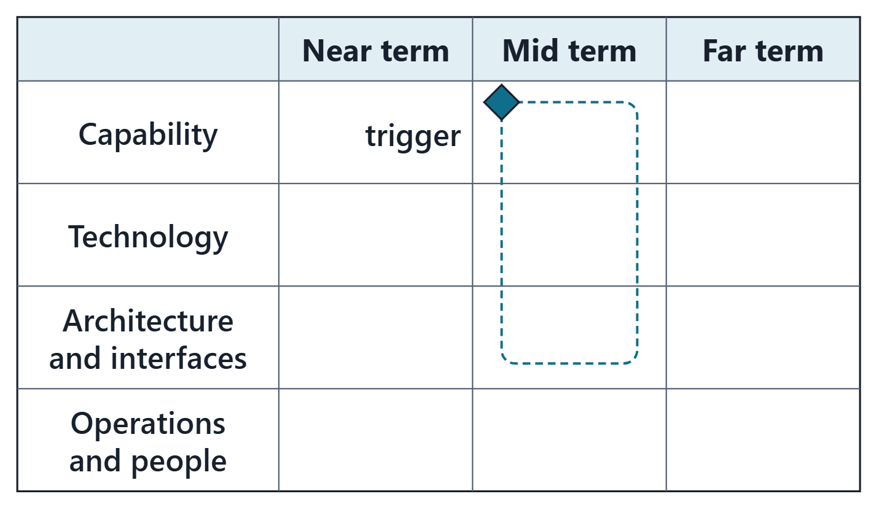
Anatomy of a roadmap
Horizons: near, mid and far, each with an end state
Lanes: capability, technology, architecture and interfaces, operations and people
Each increment: content, entry trigger, dependencies, off-ramp, transition
Each increment linked to the gap, need or objective it serves
Dependencies point back in time: a cycle has no first step
Figure. The course roadmap: three horizon columns, four lanes, and increment bars that start at a trigger.
Sources: R12 p.862; R12 p.863; R105 p.530

Slide 8
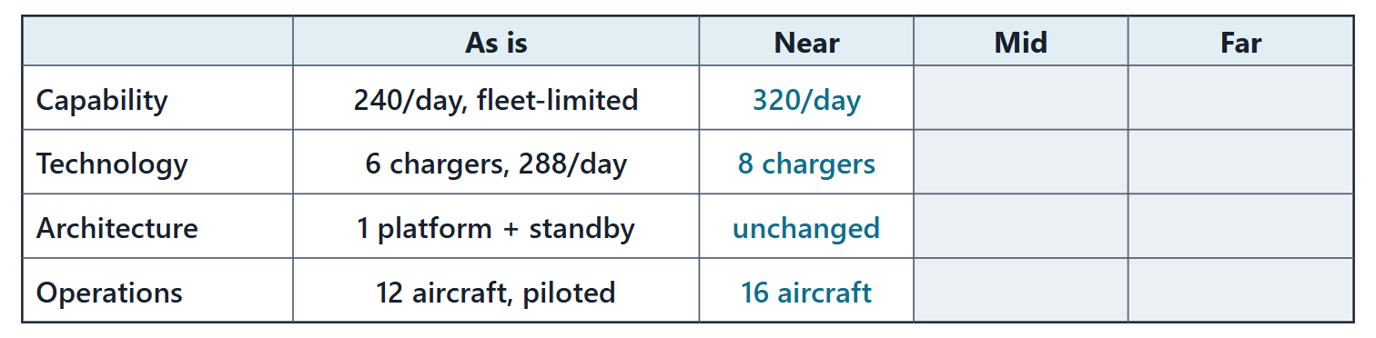
Worked example I: Increment 0, the baseline trajectory
As is: Every roadmap starts from an honest “as is”
Fleet: 12 × 20 = 240 trips/day
Chargers: 6 × 48 = 288 charges/day
Trajectory: 240 at entry; 320 by month 24, committed
Figure. AeroLink’s as-is at entry into service and, in the near column, the committed Year-2 step: together, the baseline trajectory. (FICTIONAL)
Sources: R109 p.131; R109 p.132; R12 p.860

Slide 9
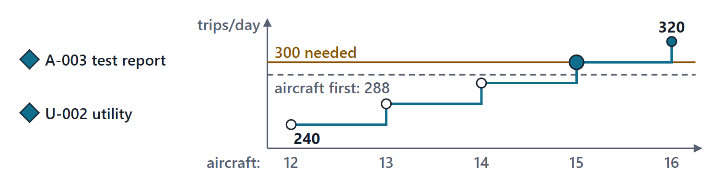
Worked example II: the committed Year-2 step and its transition order
Content: +4 aircraft; a fourth hub (committed)
Conditions: charger test report (A-003); utility agreement (U-002)
Off-ramp: refused spoke: a new hub vertiport
Transition: hub first; 300 with aircraft 15
Figure. The committed step, hub first, then aircraft: capacity climbs 20 trips per aircraft and reaches 300 with aircraft 15; aircraft first would stall at 288. (FICTIONAL)
Sources: R26 p.682; R46 p.126; R108 p.392

Slide 10
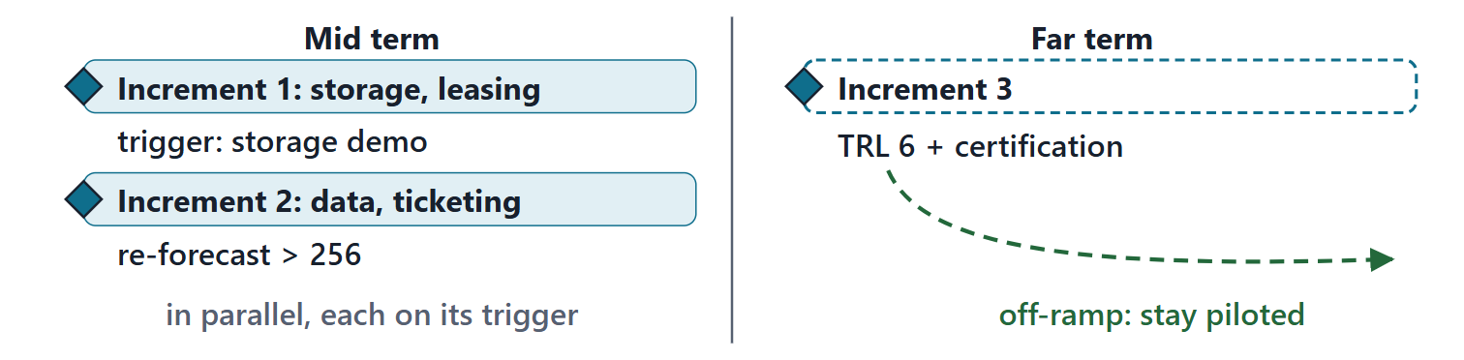
Worked example III: Increments 1 to 3, toward resilience and autonomy
Increment 1: storage at the hubs, one first; overnight leasing
Increment 2: data, workload evidence, ticketing; capacity above 256/day
Increment 3: remote operation at TRL 6+, with certification
Approaches: incremental, incremental, evolutionary
Figure. Increments 1 and 2 start on their triggers in the mid term; Increment 3 stays dashed until detect-and-avoid reaches TRL 6, with an off-ramp to stay piloted. (FICTIONAL; proposed)
Sources: R106 p.583; R106 p.584; R108 p.393; R46 p.126

Slide 11
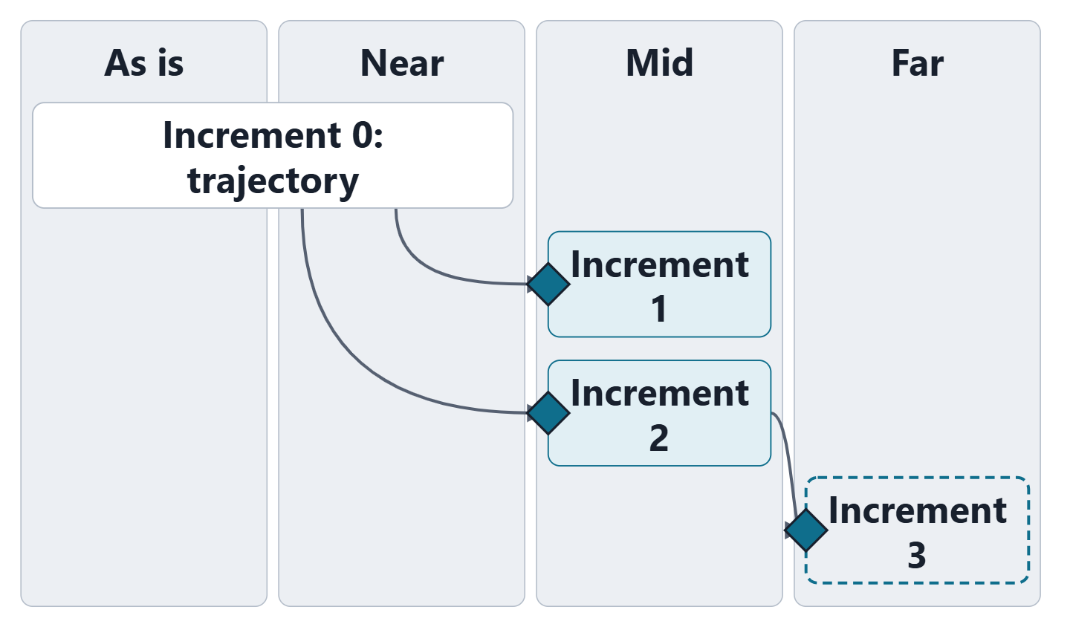
Worked example IV: triggers, dependencies, and the answer to the board
Triggers: a demonstration, demand above a computed line, TRL evidence
Dependencies point back in time; autonomy needs Increment 2’s evidence
The board’s answer: none of the three first; resilience first
Autonomy is prepared for, not scheduled
Figure. AeroLink’s roadmap: the baseline trajectory and three increments, each starting at its trigger, with the dependencies drawn. (FICTIONAL; Increments 1 to 3 proposed)
Sources: R106 p.584; R105 p.530

Slide 12
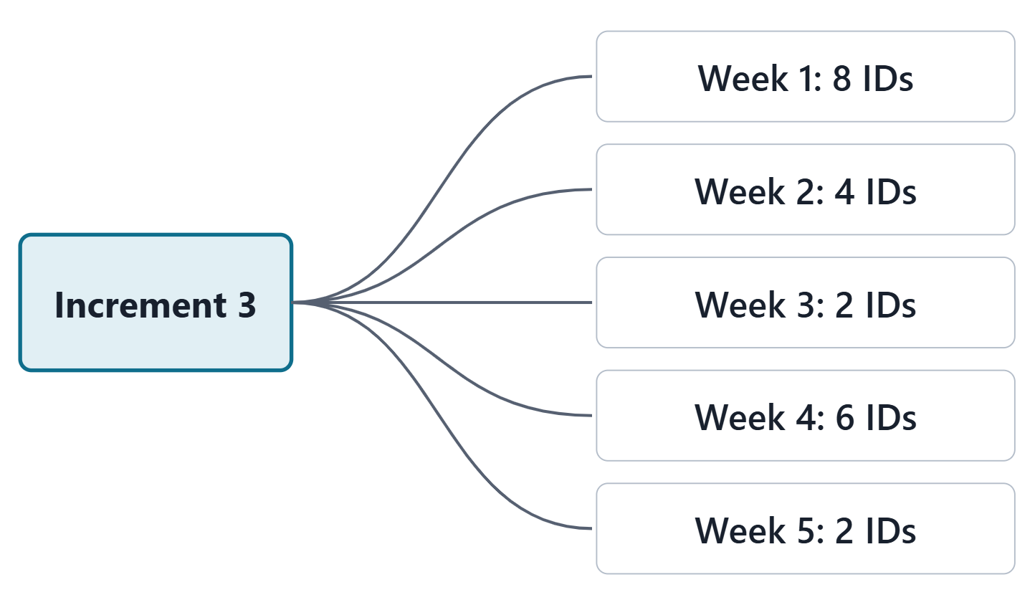
Worked example V: an increment’s impact across the package
List the IDs an increment changes, from every earlier week
Links propose candidates; you judge which are reached
AeroLink: 22 of 34 candidates reached
The list is the checklist for the Week 14 model change
Figure. Increment 3 fans out to the earlier IDs it changes, grouped by week: 22 of the 34 candidates the links found. (FICTIONAL)
Sources: R13 p.565; R106 p.583

Slide 13
The roadmap as a decision instrument, and its limits
Use it to decide:
what to start, and on what evidence
what waits, and for which unknown
what would change the plan
It cannot:
predict demand or technology progress
prove maturity or architecture fit
stay right without review
Sources: R105 p.529; R105 p.531; R106 p.584; R12 p.863

Slide 14
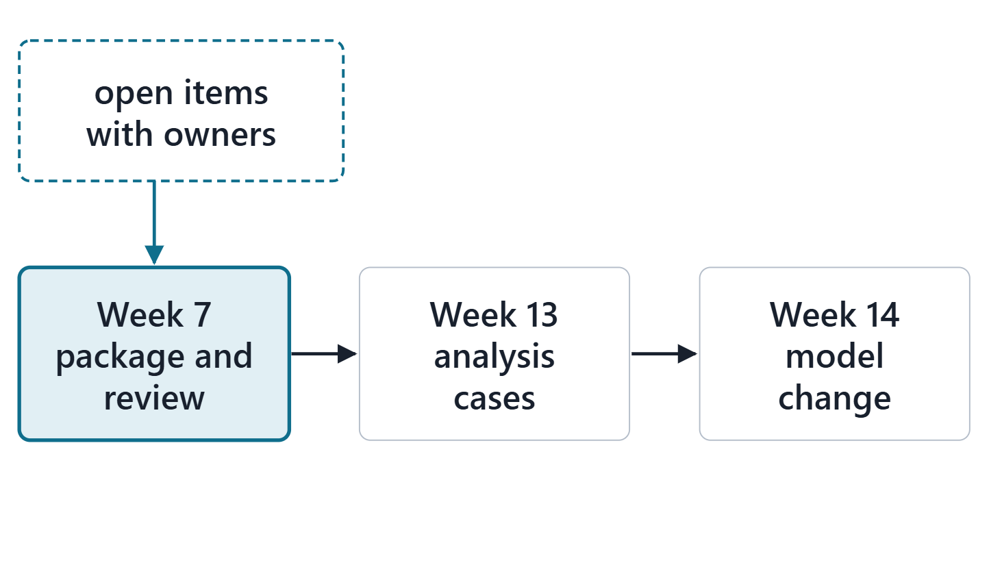
Preparing the Phase I baseline for Week 7, and what comes after
For each week, state ready or name each open item and its owner
IDs are the keys Week 7 imports
Week 13 may reuse your triggers as analysis cases
Week 14 models one increment as a change
Figure. The roadmap and the baseline review enter the Week 7 package; triggers feed Week 13 and one increment becomes the Week 14 model change.
Sources: R105 p.531; R13 p.565

Slide 15
Lab L6 brief: your enterprise evolution roadmap
4 gaps over three horizons; 3 technologies with insertion points
4 increments counting the baseline; 4 known unknowns
An impact list for one increment; a baseline review for Week 7
Team of three: 3 gaps, 2 technologies, 3 increments, 3 unknowns
Your enterprise, never AeroLink; due before Week 7

Slide 16
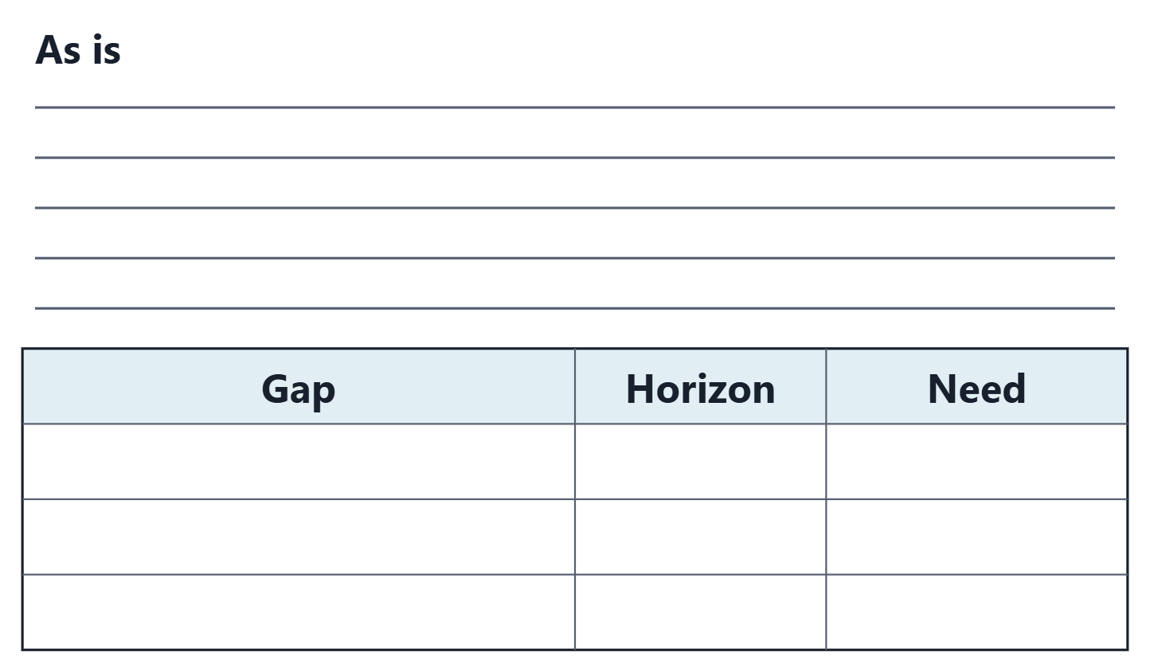
Team work: baseline and gaps
Write your as-is in five lines
List your top three gaps, each with a horizon
Name the need, objective or requirement behind each
Choose your bucket lengths, and say why
Figure. The in-class worksheet: the as-is in five lines, then three gaps with a horizon and the need behind each.
Sources: R12 p.862

Slide 17
Instructor check: the first increment and its trigger
State your first increment after the baseline
Its entry trigger: what evidence starts it?
The unknown that gates it, and who closes it

Slide 18
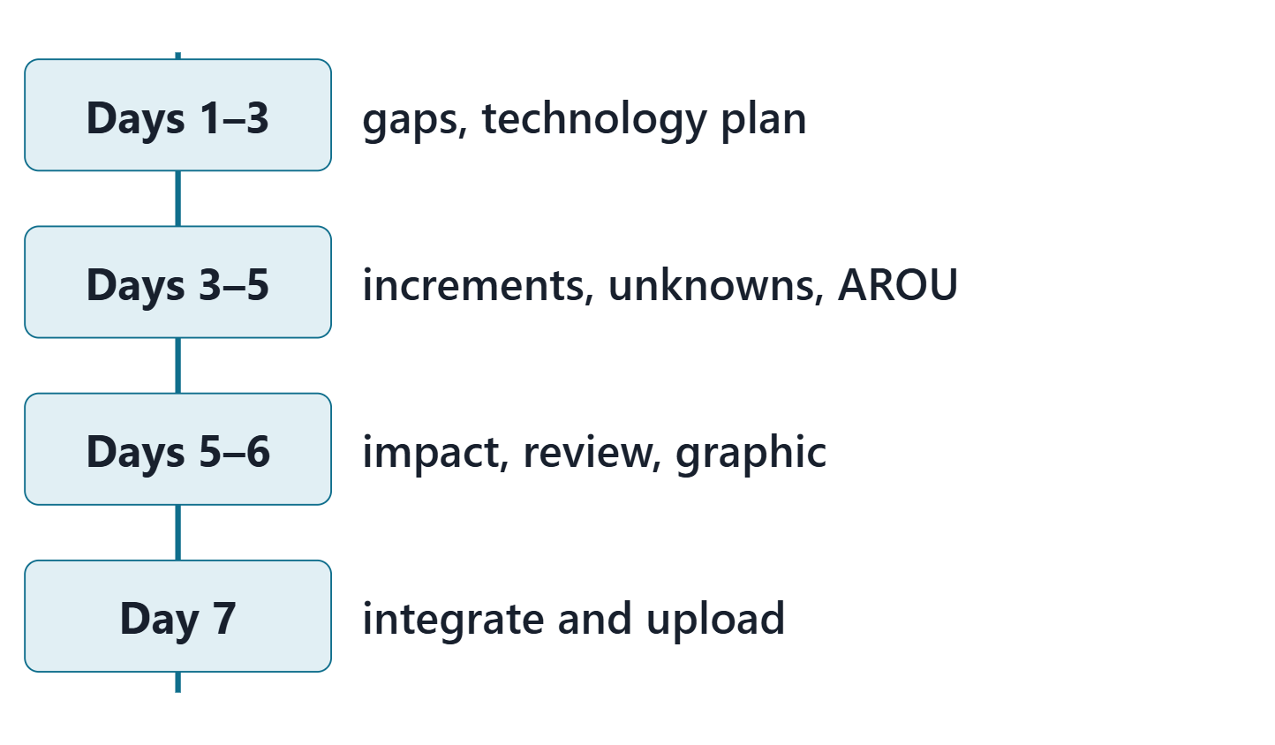
Close: the next seven days
Days 1–3: gaps and the technology plan
Days 3–5: increments, unknowns, AROU update
Days 5–6: impact list, baseline review, graphic
Day 7: integration and upload; quiz Q6 opens
Figure. A seven-day plan for Lab L6; the notes name the lead role for each step.

Slide 19
References and credits
R12 · SEBoK v2.14 (2026), “Enterprise Capability Management”, p.860–863
R13 · SEBoK v2.14 (2026), “System Requirements Definition”, p.565
R24 · SEBoK v2.14 (2026), “System Resilience”, p.1203, 1205, 1208–1210
R25 · SEBoK v2.14 (2026), “System Security”, p.1231, 1234
R26 · SEBoK v2.14 (2026), “Capability Updates, Upgrades, and Modernization”, p.681–684
R46 · OUSD(R&E) Systems Engineering Guidebook (2021/2022), “Risk Management Process”, p.126
R47 · OUSD(R&E) Systems Engineering Guidebook (2021/2022), “Interface Management Process”, p.139
R60 · The MITRE Systems Engineering Guide (2014), “Assessing Technical Maturity”, p.525–526
R105 · The MITRE Systems Engineering Guide (2014), “Technology Planning”, p.528–531
R106 · The MITRE Systems Engineering Guide (2014), “Evolutionary Acquisition”, p.582–585
R107 · The MITRE Systems Engineering Guide (2014), “Implementation, O&M, and Transition”, p.447–449
R108 · SEBoK v2.14 (2026), “Development Approach Concepts”, p.391–393
R109 · The MITRE Systems Engineering Guide (2014), “Architectures Federation”, p.131–132
CREDITS AND LICENSES
SEBoK v2.14: “This material is used under a Creative Commons Attribution-NonCommercial ShareAlike 3.0 Unported License from The Trustees of the Stevens Institute of Technology.” (SEBoK, “Bkcase Wiki:Copyright”, PDF p.31). Quotations are short and cited; no SEBoK figure or table is reproduced.
OUSD(R&E) Systems Engineering Guidebook: Distribution Statement A. Approved for public release. Distribution is unlimited.
The MITRE Systems Engineering Guide: © 2014 by The MITRE Corporation. All rights reserved. Approved for public release; distribution unlimited (Case Numbers 10-4072 and 12-1089). Quoted briefly with attribution.
Figures are original drawings for this course; none redraws a figure from the sources.
AeroLink Urban Mobility is a fictional teaching case: every number, name and statement about it is a teaching value.

