Slide 1
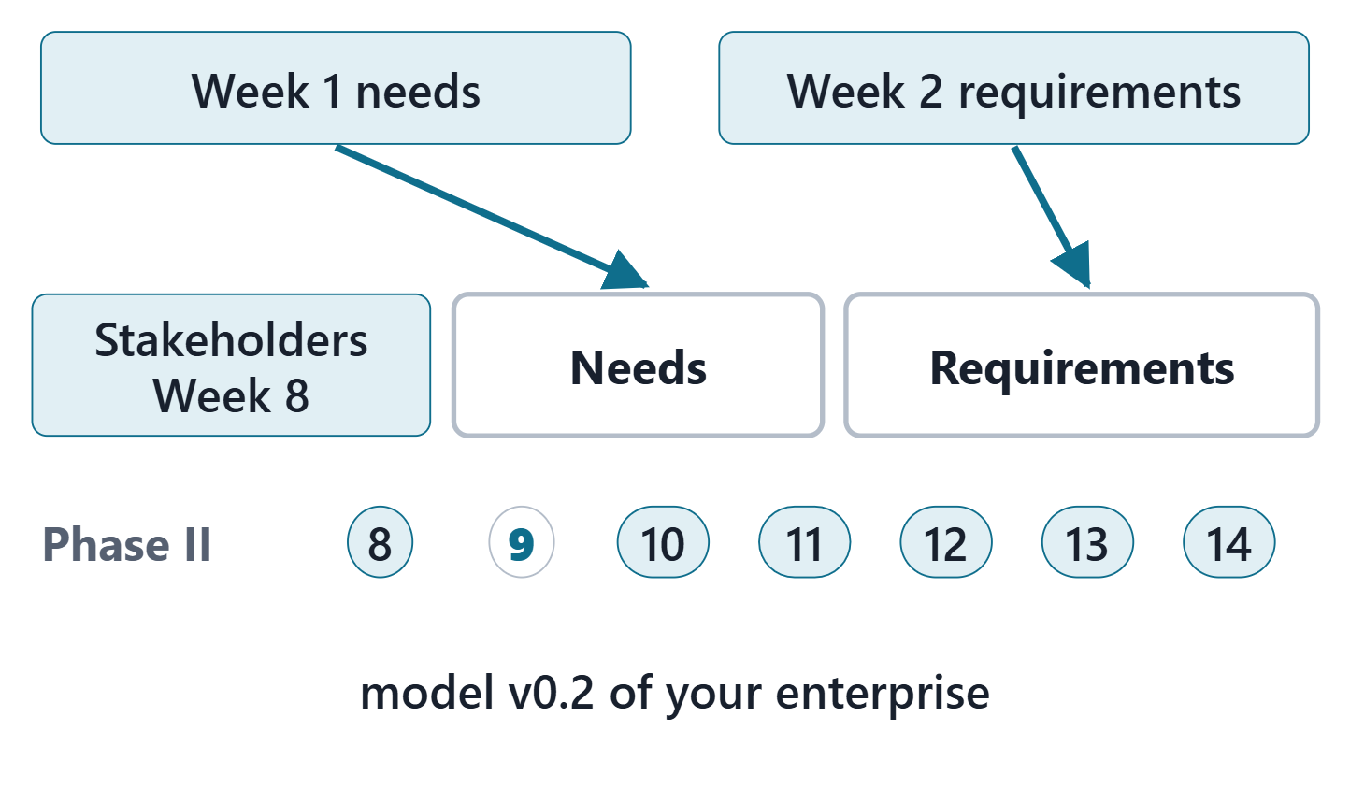
Needs / Requirements
Session 1: Requirements as model elements
Today: the requirement construct of SysML v2 and the relationships around it
Session 2: requirement quality, AeroLink worked examples, AI-assisted review, the Lab L9 launch
Your output: model v0.2 of your own enterprise
Figure. Week 9 fills two packages of the model your team built in Week 8: the Week 1 needs go into Needs, the Week 2 requirements into Requirements. Course illustration, not SysML v2 graphical notation.

Slide 2
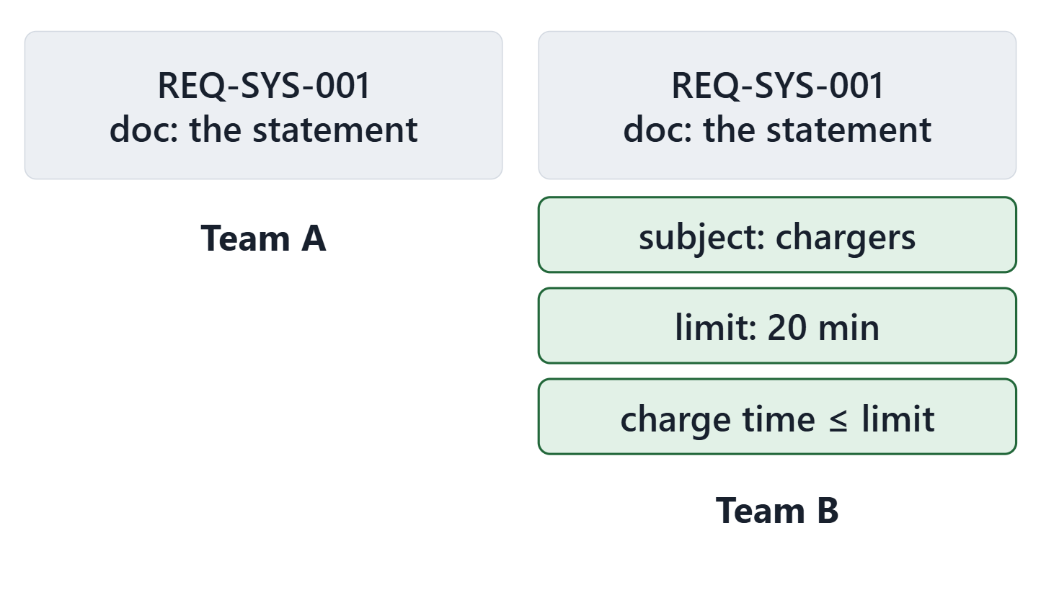
Driving question: what can the model know about a requirement?
VOTE
Which is true?
A · The two models say the same thing
B · Team B’s model says more
C · Team B’s model proves the design meets it
D · Only Team A’s model is a requirement
Figure. One AeroLink system requirement modeled by two teams: Team A writes the statement only; Team B adds three lines. Course illustration, not SysML v2 graphical notation. (FICTIONAL)

Slide 3
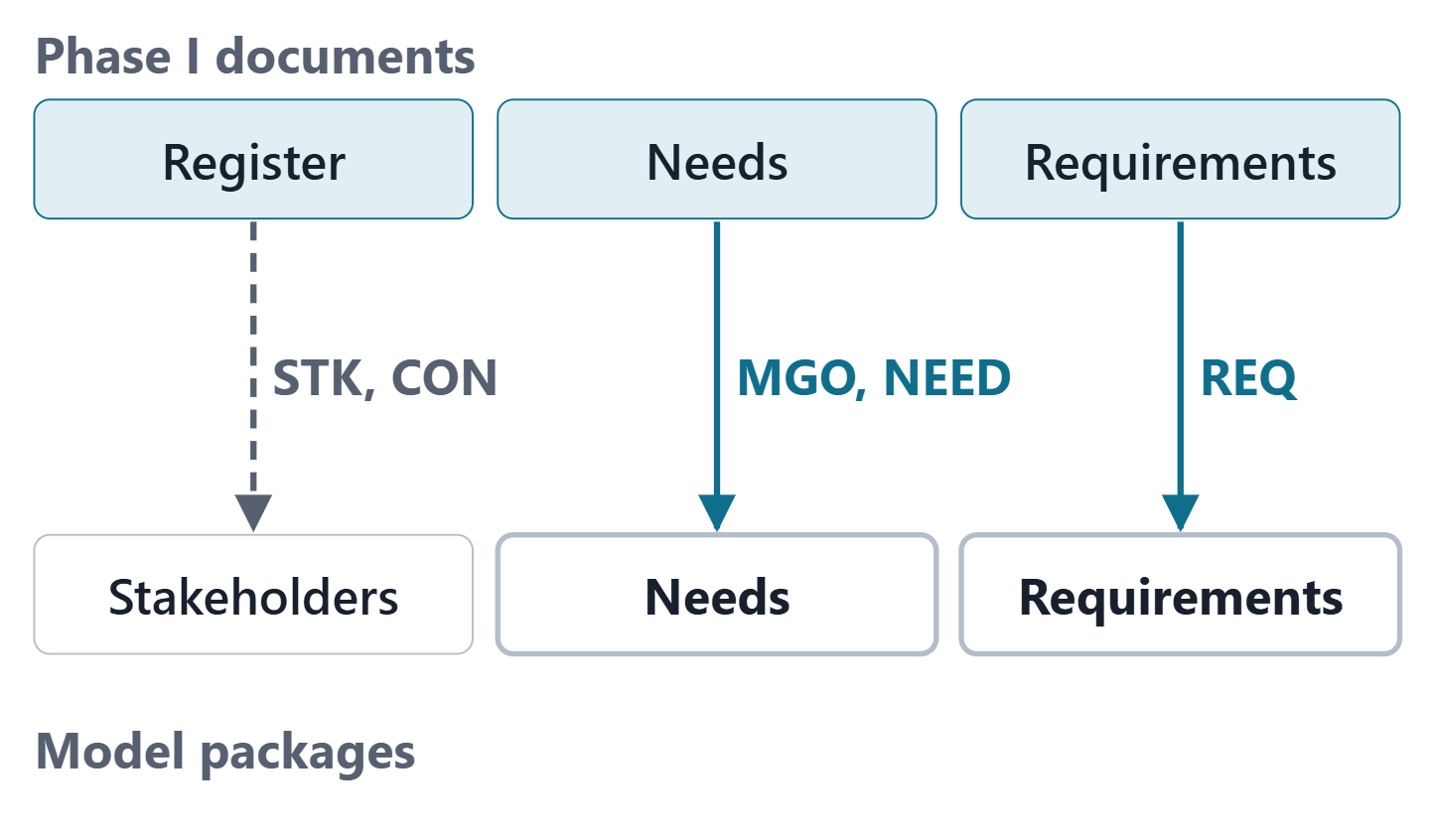
What Week 9 imports from Phase I
Week 1: register, concerns, mission and objectives, needs
Week 2: stakeholder and system requirements, traced to needs
Week 8: stakeholders and concerns already in the model
Week 9: needs and requirements join them, with the same IDs
Figure. The Phase I documents and the model packages they enter, with the ID prefixes that cross: STK and CON in Week 8, MGO, NEED, REQ-STK and REQ-SYS this week. Course illustration, not SysML v2 graphical notation.
Sources: R83 p.165

Slide 4
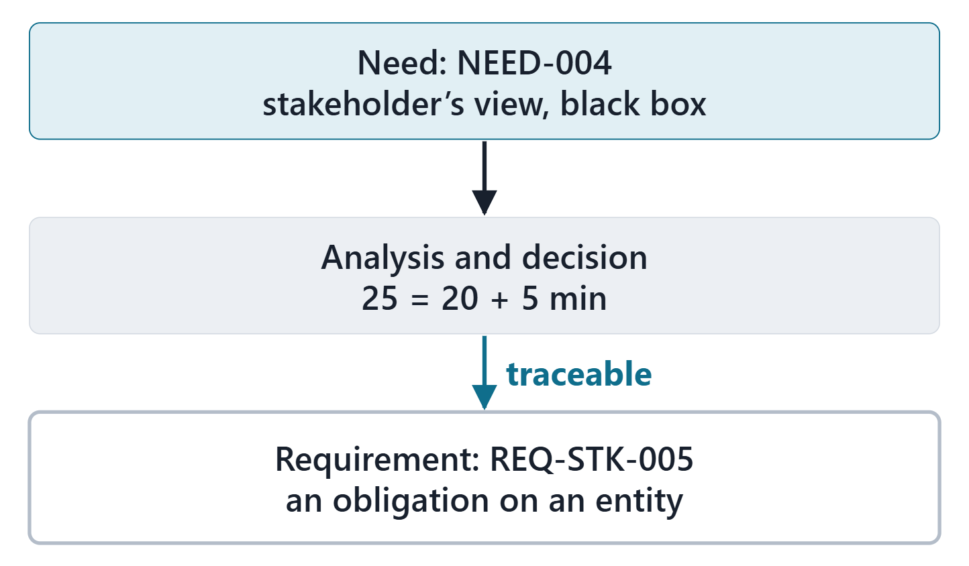
Needs are not requirements
REQUIREMENT STATEMENT (SEBOK, QUOTING THE INCOSE NEEDS AND REQUIREMENTS MANUAL)
“formal transformation of one or more needs or parent requirements into an agreed-to obligation for an entity”
R13 · SEBoK v2.14 (2026), "System Requirements Definition", p.558
Needs: the stakeholder’s view, a black box
Requirements: the developer’s view, an obligation on an entity
Figure. From need to requirement on AeroLink: the stakeholder’s view, the transformation, and the obligation on an entity. Course illustration, not SysML v2 graphical notation. (FICTIONAL)
Sources: R13 p.557–558

Slide 5
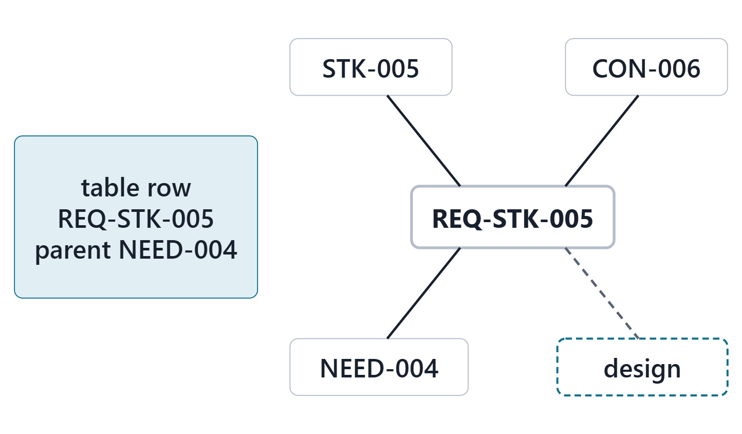
What a model adds to a requirements table
Completeness: functions, inputs, sources, outputs, destinations
Communication
Interdependencies with the rest of the system data
Quantitative analysis and simulation
The text stays: part of a requirement model element
Figure. A requirements table row and the same requirement as a model element, related to a stakeholder, a concern, a parent and a design element. Course illustration, not SysML v2 graphical notation.
Sources: R13 p.564

Slide 6
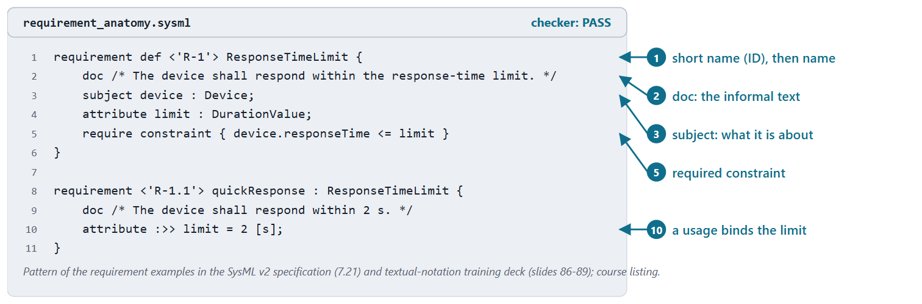
A requirement is a constraint
REQUIREMENT DEFINITION (SYSML V2.1 BETA 2)
“a kind of constraint definition … that specifies stakeholder-imposed constraints that a design solution must satisfy to be a valid solution”
R83 · OMG SysML v2.1 Beta 2, Part 1 (Release 2026-07), "7.21 Requirements", p.161
Informal “shall” text, or formal constraint expressions
True or false: satisfied when it evaluates to true
Figure. The anatomy of a requirement, on a neutral example: an ID and a name, the informal text, the subject, a parameter and a required constraint; then a usage that binds the limit. Checked: PASS.
Sources: R83 p.161–162; R74 sl.86

Slide 7
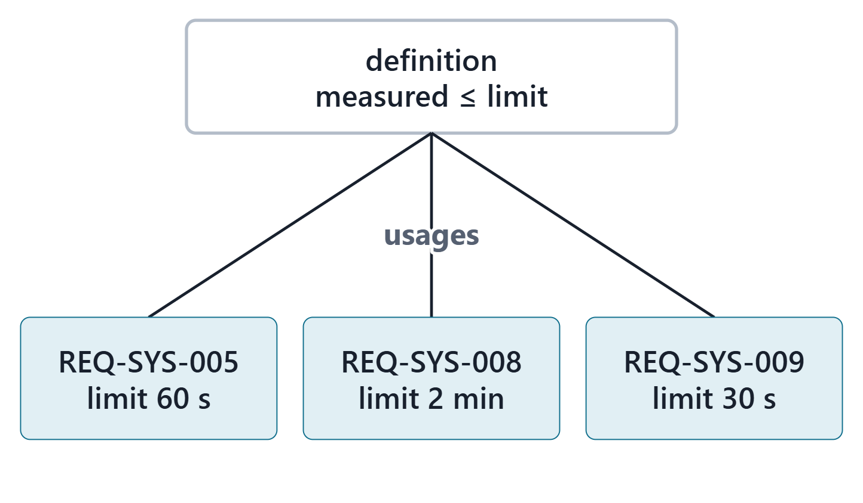
Requirement definitions and requirement usages
A usage: a definition used in a context (a package, a part, another requirement)
A usage may redefine and bind the definition’s features
One requirement definition per usage
Course convention: write a definition only when several requirements share a form
Figure. One requirement definition used three times: each AeroLink usage binds its own measured feature and limit. Course illustration, not SysML v2 graphical notation. (FICTIONAL)
Sources: R83 p.161; R83 p.165; R74 sl.89

Slide 8
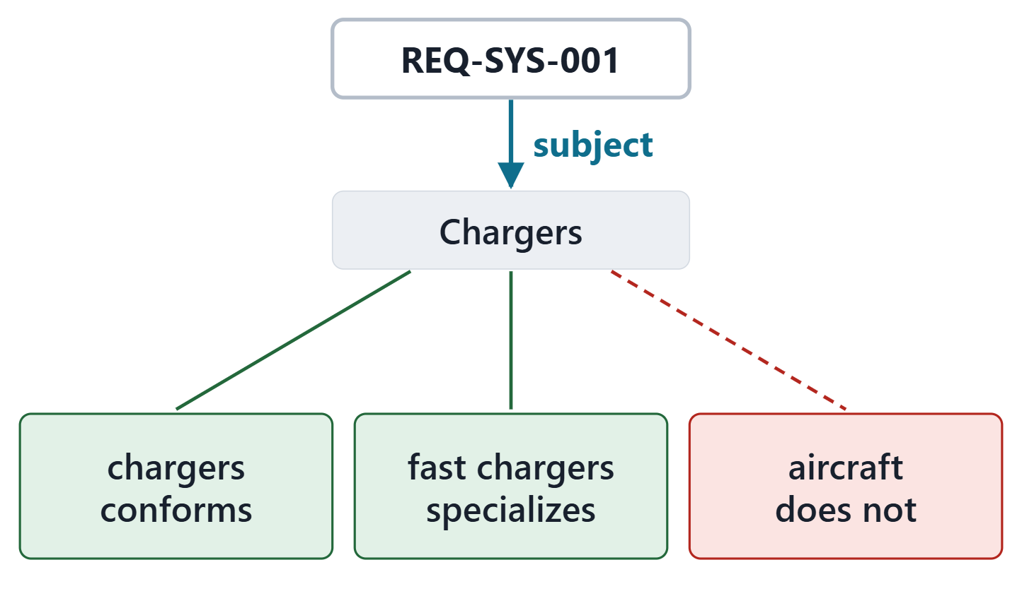
The subject: what the requirement is about
SUBJECT (SYSML V2.1 BETA 2)
“a distinguished parameter that identifies the entity on which the requirement is being specified”
R83 · OMG SysML v2.1 Beta 2, Part 1 (Release 2026-07), "7.21 Requirements", p.161
Only an entity conforming to the subject’s definition can satisfy it
Not declared: Anything. Declared: first, before any other parameter
Course convention: the enterprise for stakeholder requirements; for system requirements, the element the “shall” is about
Figure. REQ-SYS-001 has the chargers as its subject: only an entity that conforms to that definition can satisfy it. Course illustration, not SysML v2 graphical notation. (FICTIONAL)
Sources: R83 p.161–162; R83 p.166; R74 sl.88

Slide 9
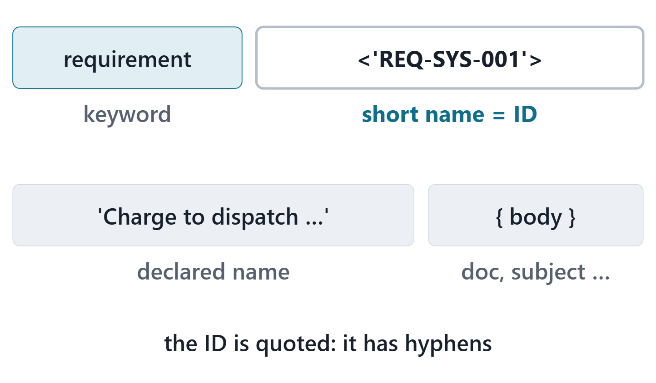
The requirement ID and the informal text
The doc comments are the informal text
A short name is also the requirement ID
Course convention: the Phase I ID as a quoted short name; the doc is the Phase I statement, word for word
Figure. One declaration line in four parts: the keyword, the short name that is the requirement ID, the declared name, and the body. Course illustration, not SysML v2 graphical notation.
Sources: R83 p.165; R80 p.49

Slide 10
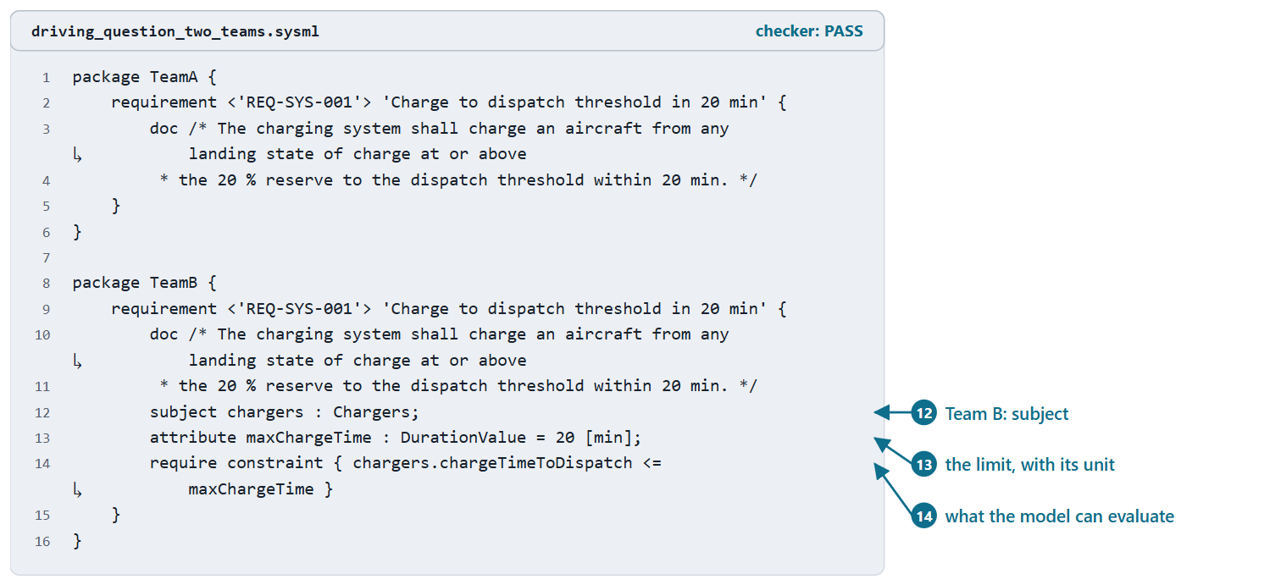
Doc alone is not enough: the required constraint
Team A: a requirement with nothing the model can evaluate
Team B: names the subject, the quantity and the limit
Answer B. Not C: meeting it needs a satisfy claim, consistent values and, later, evidence
KEY POINT
Both files pass the checker. Validity is not meaning.
Figure. The two teams’ requirements as checked listings: Team A’s statement only, Team B’s subject, limit and required constraint. Both PASS the checker. (FICTIONAL)
Sources: R83 p.161; R83 p.165

Slide 11
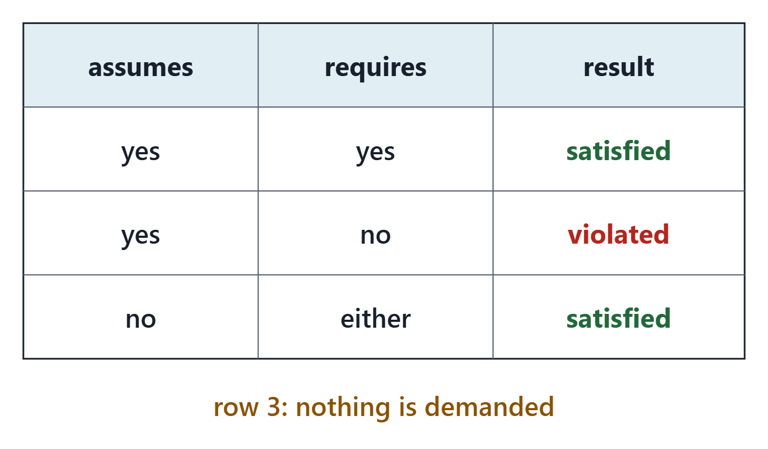
Assumptions: when a requirement applies
Effective constraint: if all assumptions are true, all required constraints must be true
Declared with the keywords assume and require
Where an assumption is false, the requirement demands nothing
COURSE REASONING
Every assumption marks a region the requirement leaves uncovered. Someone must decide whether another requirement covers it.
Figure. The effective constraint of a requirement is an implication: if every assumption holds, every required constraint must hold. Course illustration, not SysML v2 graphical notation.
Sources: R83 p.165; R74 sl.87; R74 sl.91

Slide 12
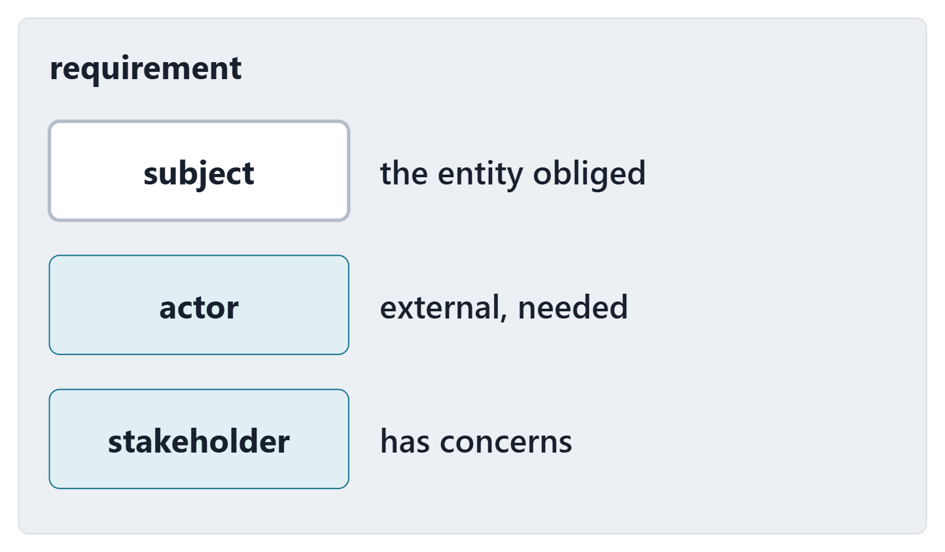
Actors and stakeholders as requirement parameters
Actors and stakeholders: further distinguished parameters, written as part usages
Actor: external to the subject, necessary for satisfaction
Stakeholder: has concerns related to the requirement
Week 8 made every stakeholder a part definition: now it types these parameters
Figure. A requirement has three kinds of distinguished parameter: the subject, actors and stakeholders. Course illustration, not SysML v2 graphical notation.
Sources: R83 p.162; R83 p.166

Slide 13
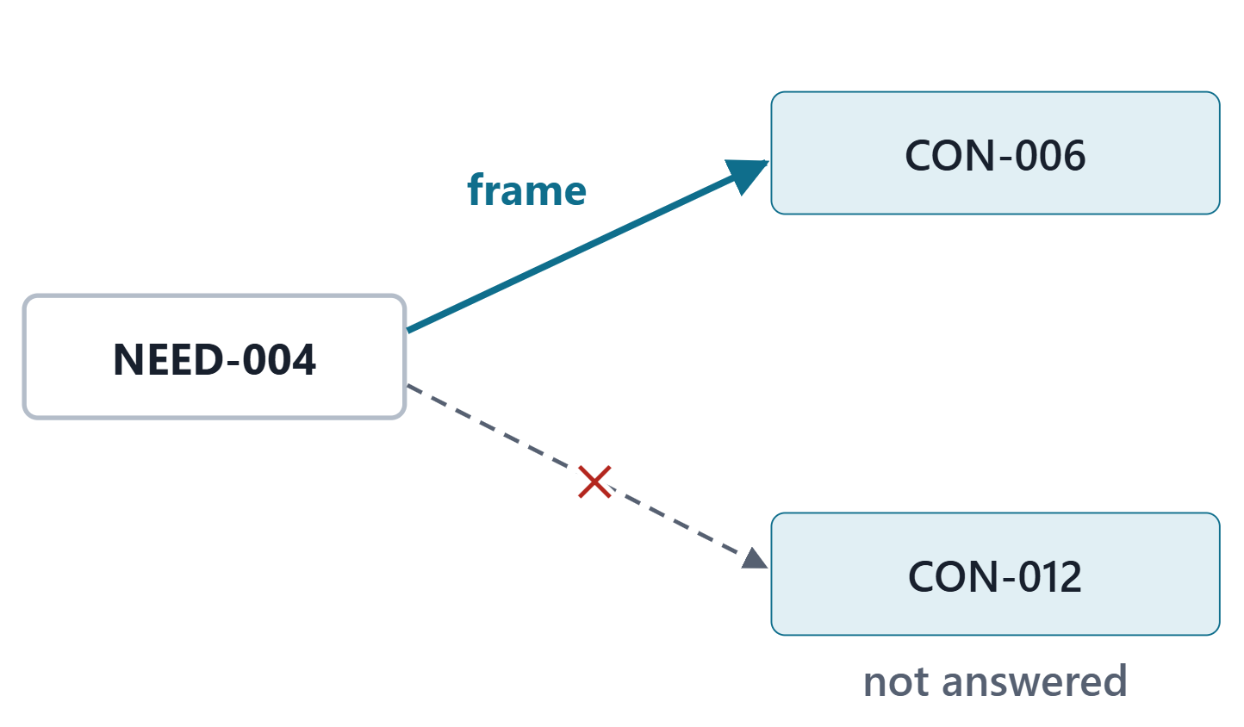
Concerns and framing
A concern is a kind of requirement; its stakeholders are parameters
A requirement can frame concerns: each must then be addressed for it to be satisfied
A framed concern is a subrequirement, so a required constraint
Frame only the concerns the need answers
Figure. NEED-004 frames the concern it answers, CON-006, from the Week 8 model; a frame to a concern it does not answer is crossed out. Course illustration, not SysML v2 graphical notation. (FICTIONAL)
Sources: R83 p.162; R83 p.167

Slide 14
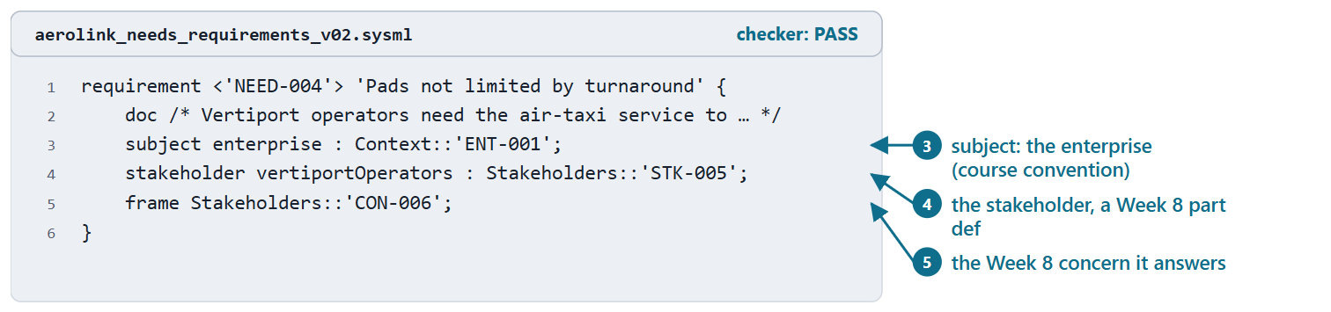
AeroLink worked example I: the Needs package
Course convention: a need is a requirement usage whose subject is the enterprise
stakeholder: typed by the Week 8 part definition
frame: each concern the need answers
The doc keeps the stakeholder’s words, condition and rationale
PAIR, 1 MIN
NEED-010: who is its stakeholder, and which concern should it frame?
Figure. NEED-004 in AeroLink model v0.2, generated from the Week 1 case: subject, stakeholder and frame (the doc is shortened on the slide). Checked: PASS. (FICTIONAL)
Sources: R83 p.162; R83 p.167

Slide 15
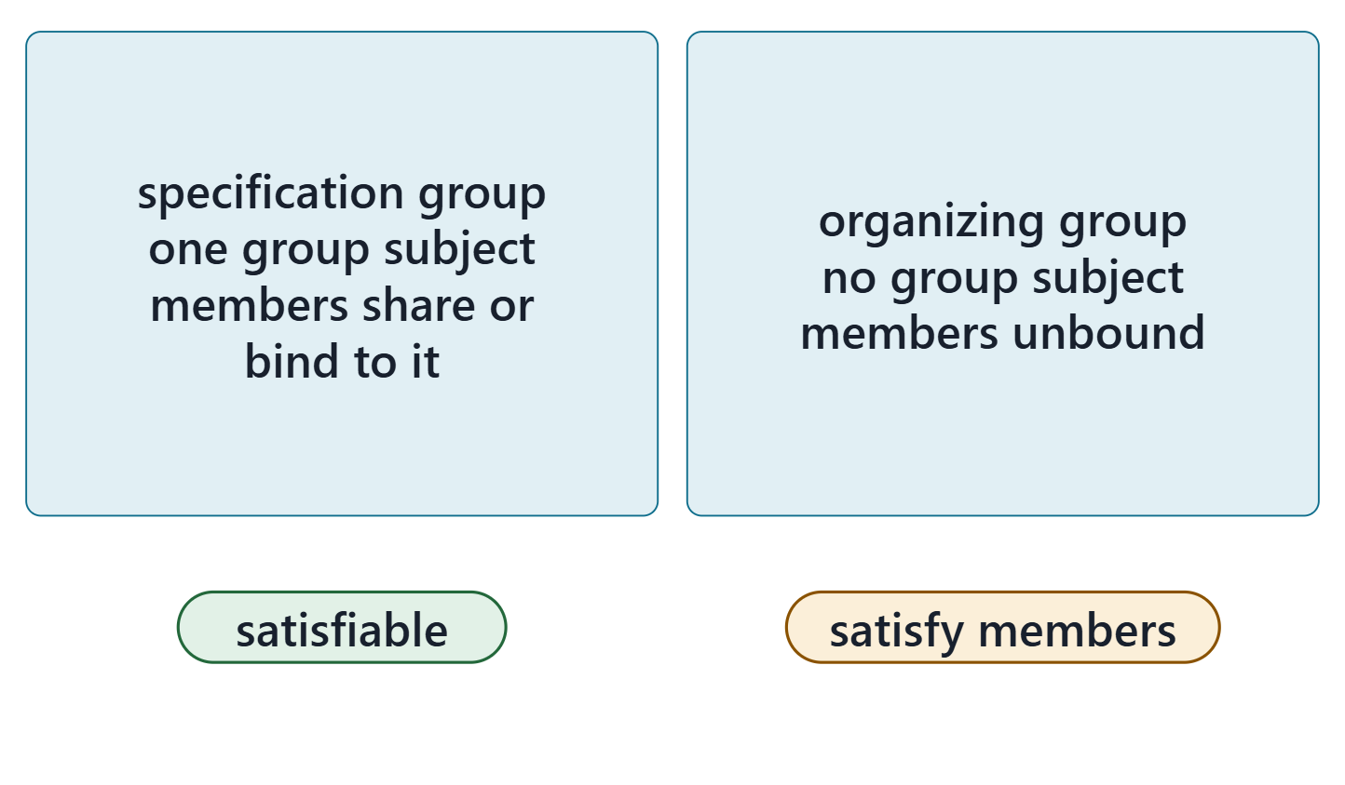
Requirement groups
A requirement can group others: by reference (require) or by composition
Members take the group’s subject or bind theirs to a feature of it: subject engine = vehicle.engine;
Members with independent, unbound subjects: an organizing group, not satisfiable as a whole; satisfy its members
Figure. Two kinds of group: a specification group whose members share its subject or bind theirs to a feature of it, and an organizing group whose members keep independent, unbound subjects. Course illustration, not SysML v2 graphical notation.
Sources: R74 sl.90; R83 p.161; R83 p.167

Slide 16
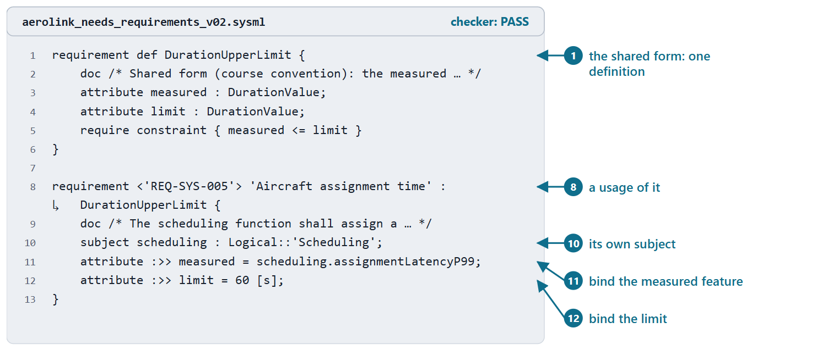
Worked example II: three latency requirements, one definition
Three system requirements, one form: a measured latency at most a limit
One definition; each usage has its own ID, doc, subject and two bindings
Unbound measured feature: the constraint reads nothing the design has
Figure. The shared duration form and REQ-SYS-005, one of its three usages in AeroLink model v0.2 (metadata lines omitted on the slide). Checked: PASS. (FICTIONAL)
Sources: R74 sl.86–89; R83 p.161; R83 p.166

Slide 17
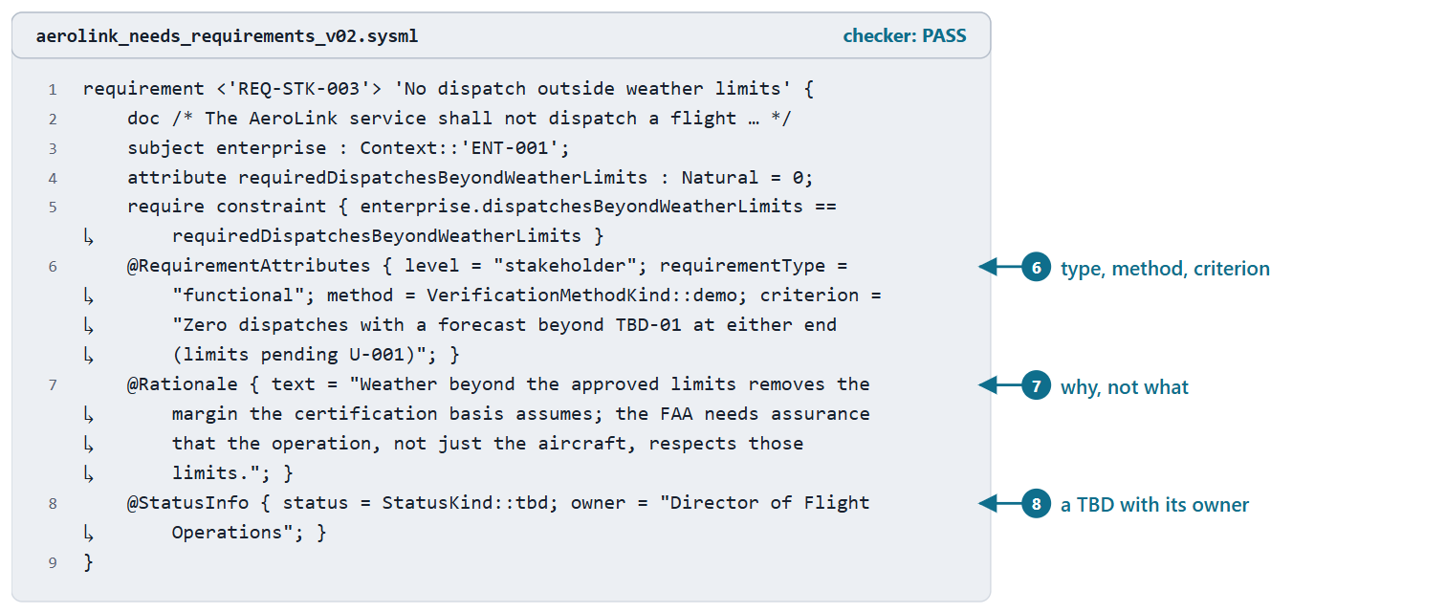
Requirement attributes as metadata: rationale, method, status
Metadata: defined by a metadata definition, applied as an annotation
Library: Rationale (text), StatusInfo (status, owner), StatusKind (tbd, tbc, open, done …)
Verification methods: inspect, analyze, demo, test
Course convention: RequirementAttributes for type, method and criterion
Figure. REQ-STK-003 in AeroLink model v0.2: its attributes, rationale and TBD status as three annotations. Checked: PASS. (FICTIONAL)
Sources: R77 sl.108; R114 p.555–557; R84 p.175

Slide 18
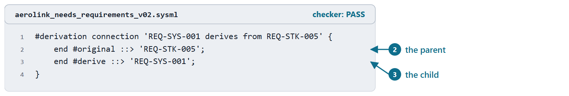
Derivation: the library connection
DERIVATION (SYSML V2.1 BETA 2 DOMAIN LIBRARY)
“asserts that one or more derivedRequirements are derived from a single originalRequirement”
R115 · OMG SysML v2.1 Beta 2, Part 1 (Release 2026-07), "9.6 Requirement Derivation Domain Library", p.580
Any subject satisfying the original should satisfy each derived one
Ends: #original (the parent), #derive (the child)
Reads: parent satisfied implies child satisfied
Figure. The derivation of REQ-SYS-001 from REQ-STK-005 in AeroLink model v0.2: the parent is the #original end, the child the #derive end. Checked: PASS. (FICTIONAL)
Sources: R115 p.580–583

Slide 19
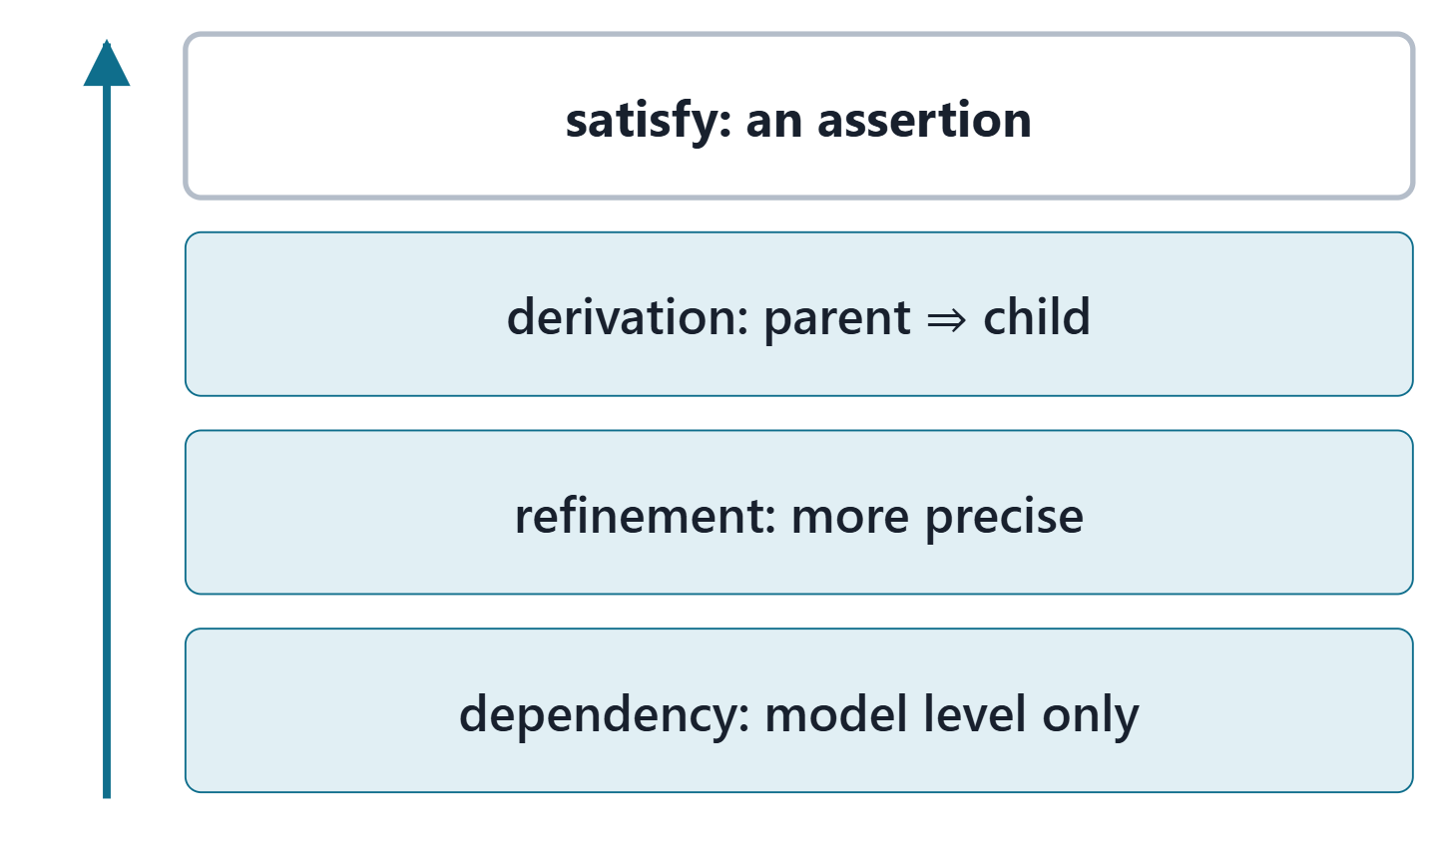
Dependencies, refinement and the direction rule
Dependency: clients need suppliers for their complete specification; model level only
Direction: from = the dependent element (client), to = what it depends on (supplier)
Refinement metadata tags a dependency as a refinement
Use the strongest relationship you can defend
Figure. Relationships ordered by how much they claim: a dependency, a refinement-tagged dependency, a derivation, a satisfy assertion. Course illustration, not SysML v2 graphical notation.
Sources: R76 sl.105; R80 p.50–51; R114 p.556

Slide 20
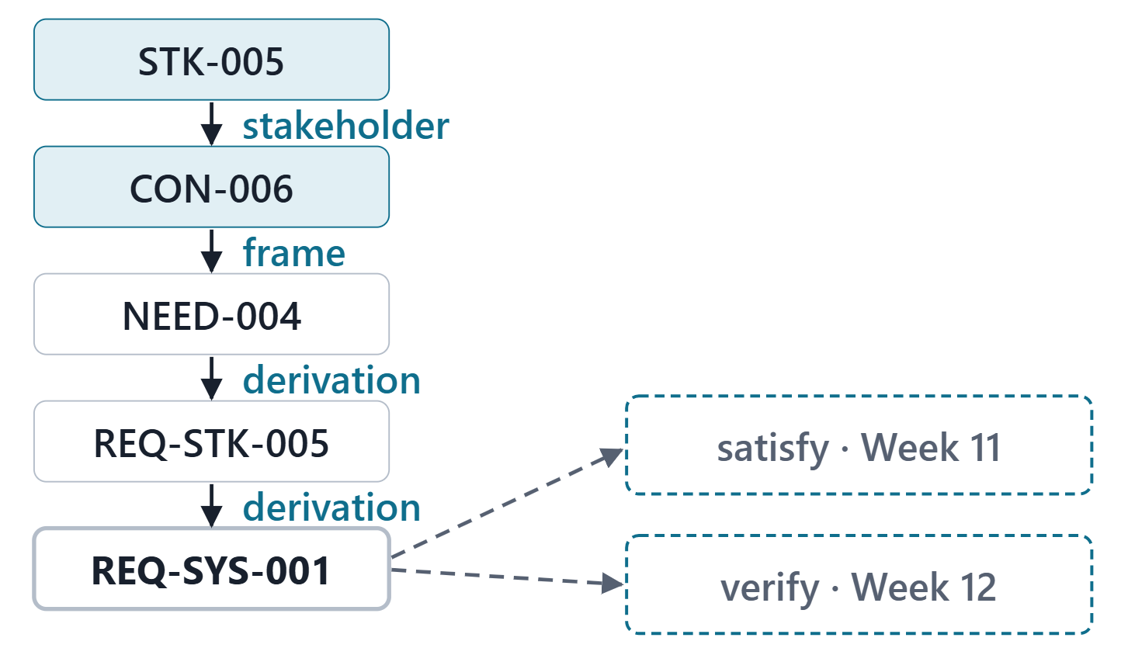
The course trace pattern: stakeholder to system requirement
Stakeholder → concern → need → stakeholder requirement → system requirement
Every arrow is an element you write in the model
Later: satisfied by a design element (Week 11), verified by a verification case (Week 12)
CAUTION
The drawing is a course illustration. The model is the text the checker reads.
Figure. The AeroLink thread from STK-005 to REQ-SYS-001, with the model element behind each arrow; satisfy and verify follow in Weeks 11 and 12. Course illustration, not SysML v2 graphical notation. (FICTIONAL)
Sources: R83 p.162; R115 p.580

Slide 21
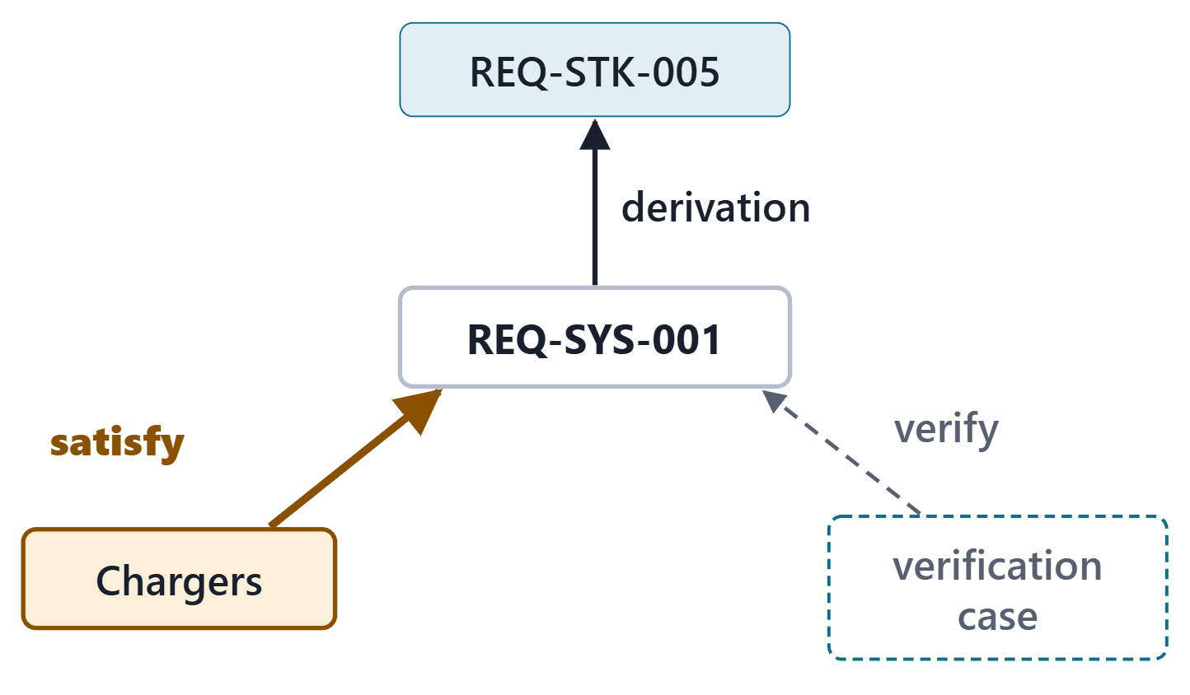
A first look at satisfy: an assertion, not a trace link
SATISFY REQUIREMENT USAGE (SYSML V2.1 BETA 2)
“asserts that a requirement is satisfied when a given feature is bound to the subject parameter of the requirement”
R83 · OMG SysML v2.1 Beta 2, Part 1 (Release 2026-07), "7.21 Requirements", p.162
An assertion about a design, not a trace link
Course rule: not between two requirements; use a derivation
Preview: verify, in a verification case’s objective (Week 12)
Figure. Three relationships of REQ-SYS-001: derived from its parent, claimed satisfied by a design element (an assertion), and checked by a verification case (Week 12). Course illustration, not SysML v2 graphical notation. (FICTIONAL)
Sources: R83 p.162; R83 p.168; R84 p.176

Slide 22
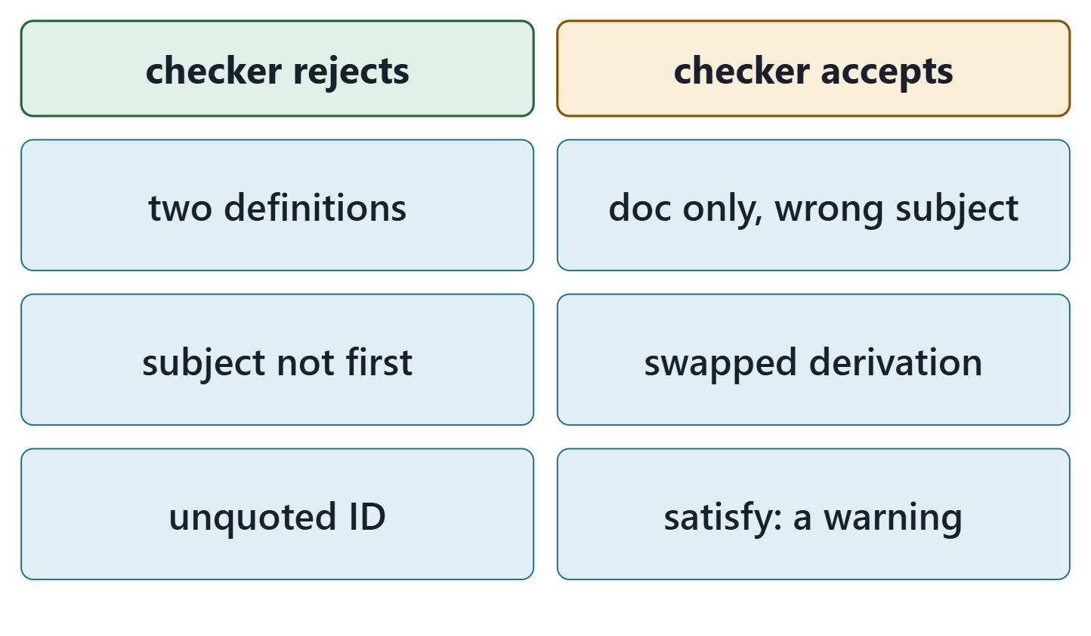
What the checker checks, and what it cannot
Zero errors is necessary, never sufficient
Read every requirement for subject, constraint and intent
Recorded for one release; a new release may differ
Figure. Recorded results of the course checker (release 2026-08) on six course files: what it rejects, and what it accepts without complaint. Course illustration, not SysML v2 graphical notation.
Sources: R83 p.165–166

Slide 23
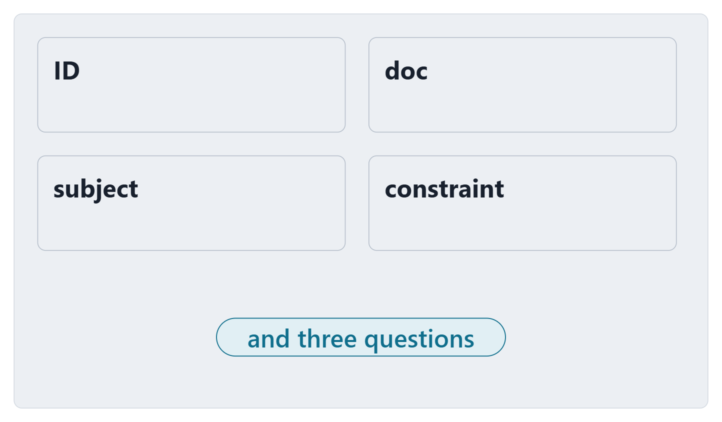
Exit: one requirement, three questions
Write one team system requirement as a usage: ID, doc, subject, required constraint
What is its subject, and why that element?
Is any condition in its text an assumption, or part of the quantity?
Which need or parent does it derive from?
Figure. The exit card: four fields to write and three questions to answer, for one of your team’s Week 2 system requirements. Course illustration, not SysML v2 graphical notation.

Slide 24
References and credits
R13 · SEBoK v2.14 (2026), “System Requirements Definition”, p.557–558, 564, 566
R74 · Seidewitz, Intro to the SysML v2 Language: Textual Notation (Release 2026-08), “Requirement Definitions”, sl.86–91
R76 · Seidewitz, Intro to the SysML v2 Language: Textual Notation (Release 2026-08), “Use Case Definition”, sl.105
R77 · Seidewitz, Intro to the SysML v2 Language: Textual Notation (Release 2026-08), “Metadata”, sl.108
R80 · OMG SysML v2.1 Beta 2, Part 1 (Release 2026-07), “7.1 Language Overview”, p.49–51
R83 · OMG SysML v2.1 Beta 2, Part 1 (Release 2026-07), “7.21 Requirements”, p.161–162, 165–168
R84 · OMG SysML v2.1 Beta 2, Part 1 (Release 2026-07), “7.23 Analysis Cases”, p.175–176
R114 · OMG SysML v2.1 Beta 2, Part 1 (Release 2026-07), “9.3.2 Modeling Metadata”, p.555–557
R115 · OMG SysML v2.1 Beta 2, Part 1 (Release 2026-07), “9.6 Requirement Derivation Domain Library”, p.580–583
CREDITS AND LICENSES
Introduction to the SysML v2 Language, Textual Notation (Release 2026-08): Copyright © 2019–2026 Model Driven Solutions, Inc. Licensed under the Creative Commons Attribution 4.0 International License (CC BY 4.0).
SEBoK v2.14: “This material is used under a Creative Commons Attribution-NonCommercial ShareAlike 3.0 Unported License from The Trustees of the Stevens Institute of Technology.” (SEBoK, “Bkcase Wiki:Copyright”, PDF p.31). Quotations are short and cited; no SEBoK figure or table is reproduced.
Figures are original drawings for this course; none redraws a figure from the sources.
AeroLink Urban Mobility is a fictional teaching case: every number, name and statement about it is a teaching value.

