Slide 1
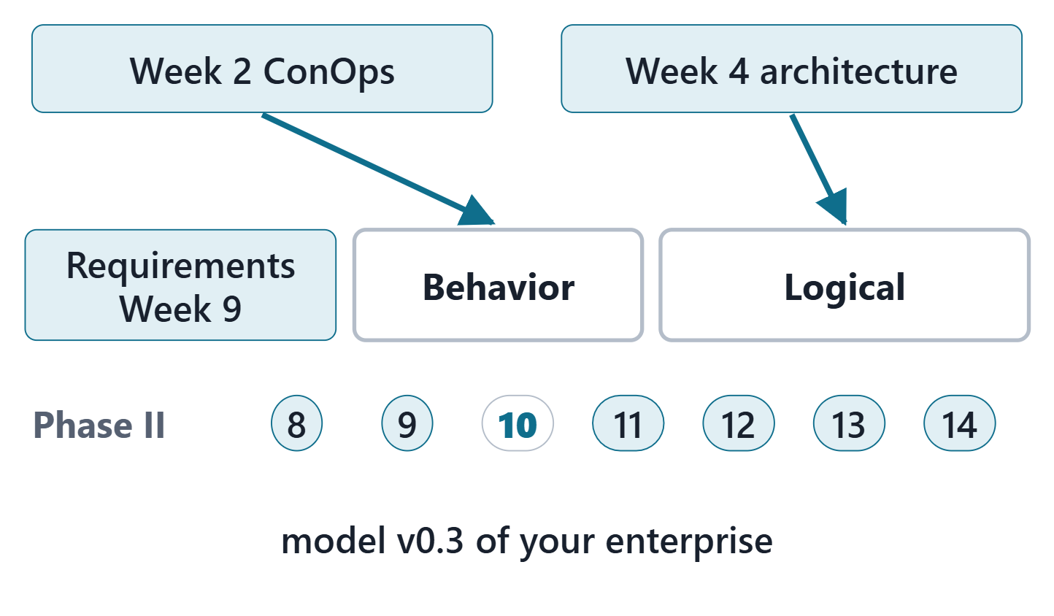
Logical / Behavioral Modeling
Session 1: Logical architecture and action flows
Today: the logical architecture and action flows
Session 2: operating states, use cases, consistency checks, the Lab L10 launch
Your output: model v0.3 of your own enterprise
Figure. Week 10 fills two packages of your model: the Week 2 ConOps goes into Behavior, the Week 4 architecture into Logical; Requirements was filled in Week 9. Course illustration, not SysML v2 graphical notation.

Slide 2
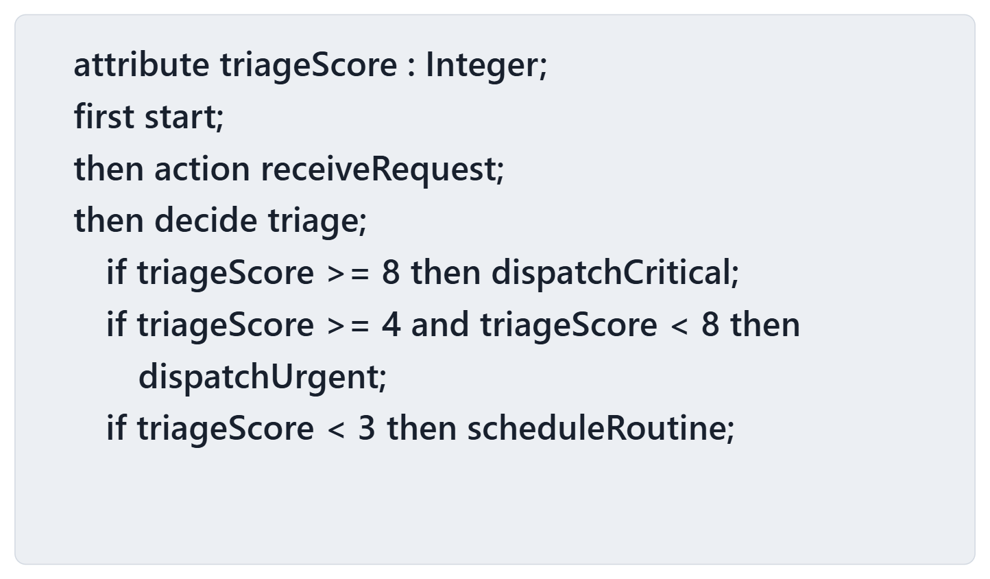
Driving question: the flow is well formed. Does it always continue?
VOTE
A whole-number triage score arrives. Which is true?
A · The flow always continues to one of the three actions
B · For some scores no successor is possible
C · The checker rejects this file
D · It cannot be told from the text
Figure. A dispatch decision for a hospital patient-transfer service: three guarded branches on a triage score (lines wrapped for display). Course illustration, not SysML v2 graphical notation. (FICTIONAL)

Slide 3
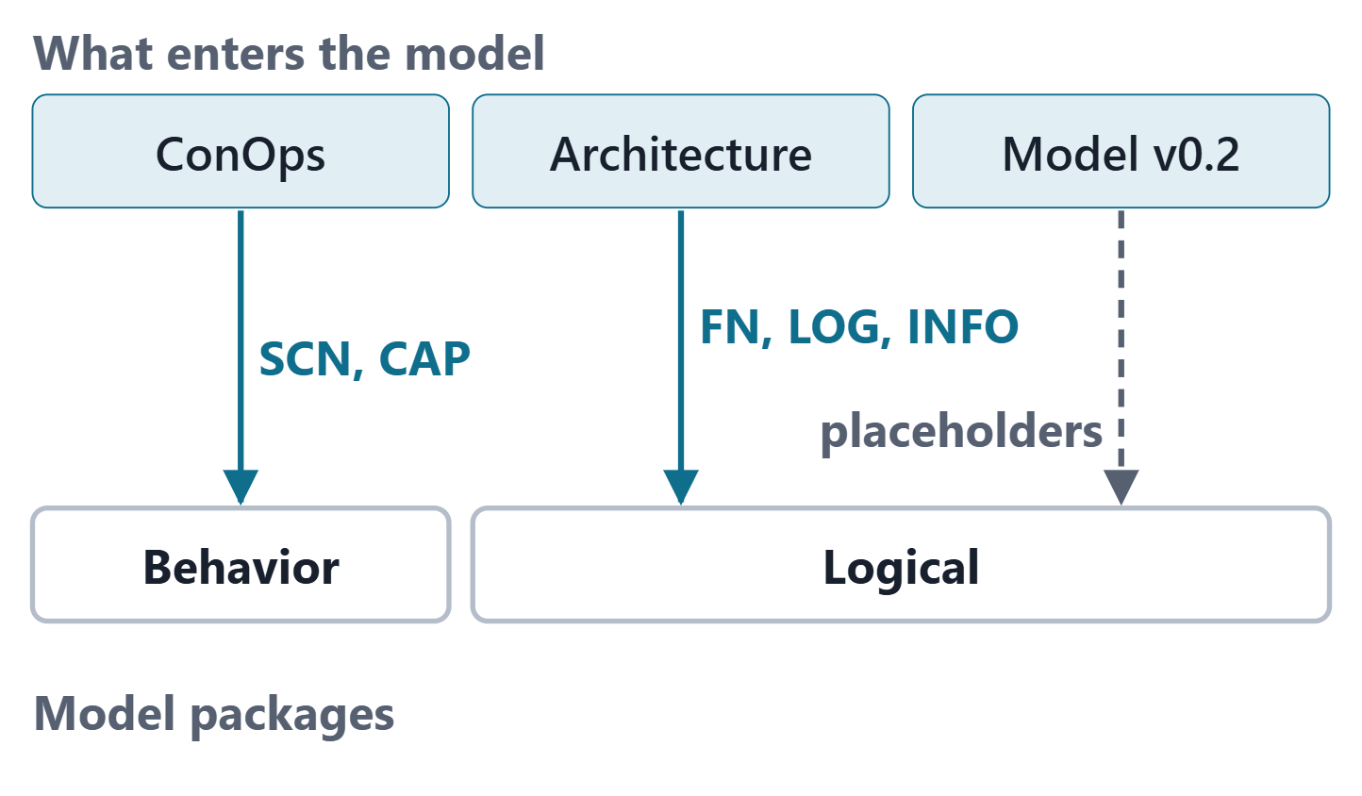
What Week 10 imports from Phase I
Week 2: scenarios with steps and alternates; capabilities
Week 4: functions with their items, logical elements, information items, allocations
Week 9: placeholder subjects in Logical; capability links still waiting
Same IDs throughout
Figure. The sources of this week and the model packages they enter, with the ID prefixes that cross: SCN and CAP from the ConOps, FN, LOG and INFO from the architecture, and the placeholders of model v0.2. Course illustration, not SysML v2 graphical notation.

Slide 4
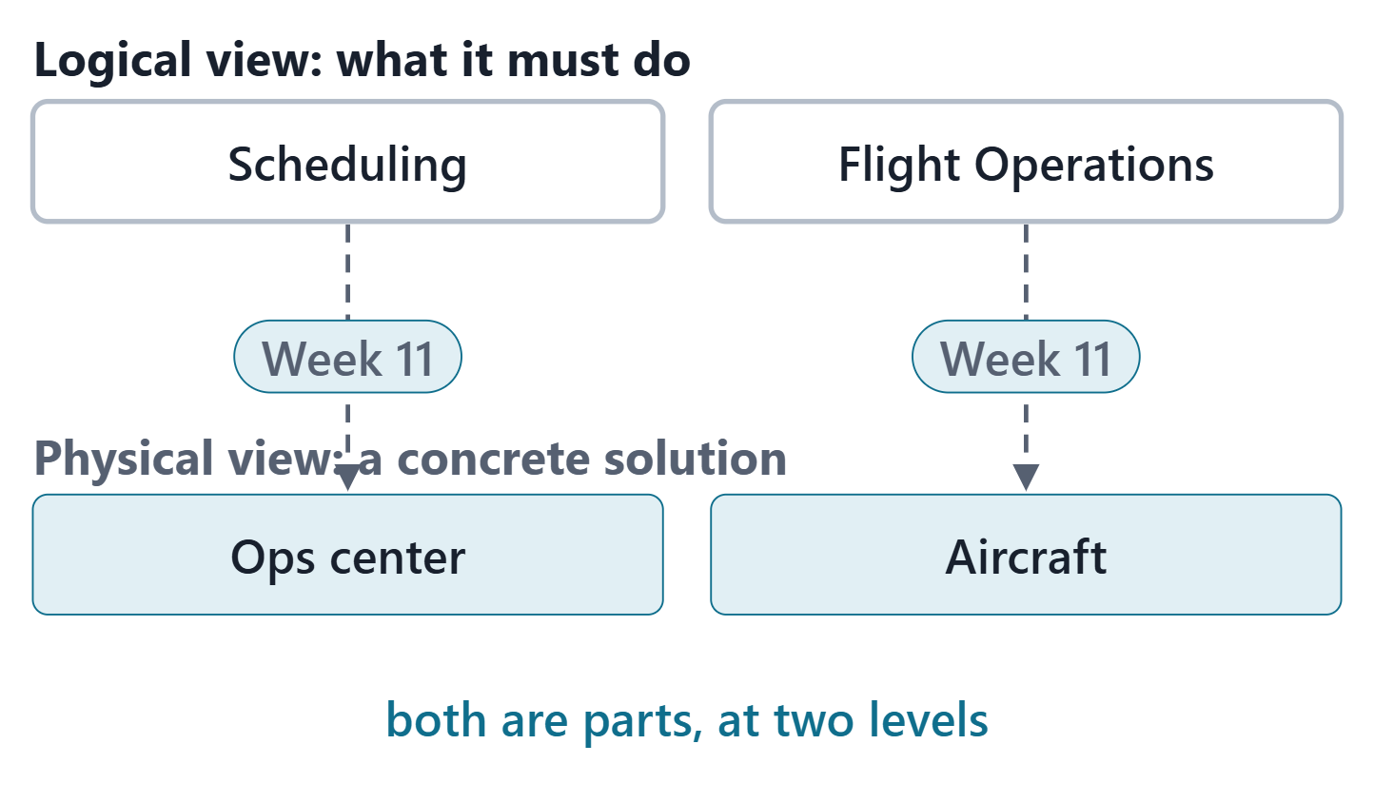
Logical versus physical architecture
PURPOSE OF LOGICAL ARCHITECTURE (SEBOK)
“models and views of the functionality and behavior of the future engineered system as it should operate while in service”
R20b · SEBoK v2.14 (2026), "Logical Architecture", p.587
Physical architecture: a concrete solution that accommodates the logical one
In SysML v2 both are parts: purely logical, or physical
Week 10 models the logical view; Week 11 the physical
Figure. Two AeroLink logical elements, each with the principal physical element that will realize it (Flight Operations is also realized at the ops center): the logical view says what must be done, the physical view gives a concrete solution, allocated in Week 11. Course illustration, not SysML v2 graphical notation. (FICTIONAL)
Sources: R20b p.587; R20c p.596; R81 p.90

Slide 5
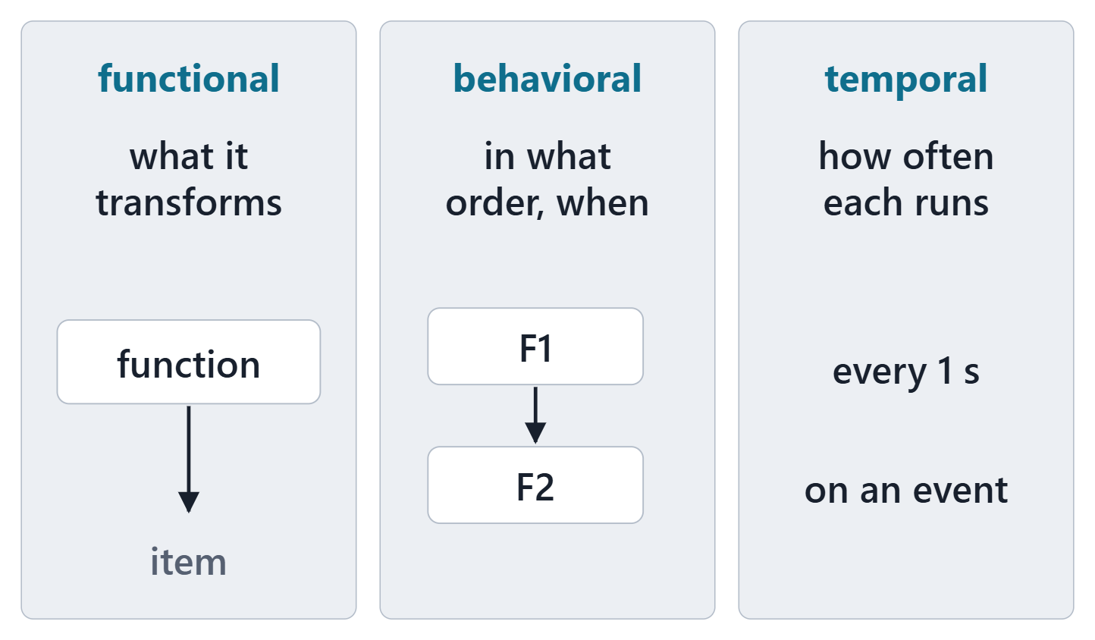
Three views of a logical architecture
Functional: functions and sub-functions, with their inputs and outputs
Behavioral: scenarios of functions and operational modes
Temporal: functions classed by how often they run
An output: a trace between logical elements and system requirements
Figure. The three views SEBoK names for a logical architecture: what is transformed, in what order and on what condition, and how often each function runs. Course illustration, not SysML v2 graphical notation.
Sources: R20b p.587–588; R20b p.590–591

Slide 6
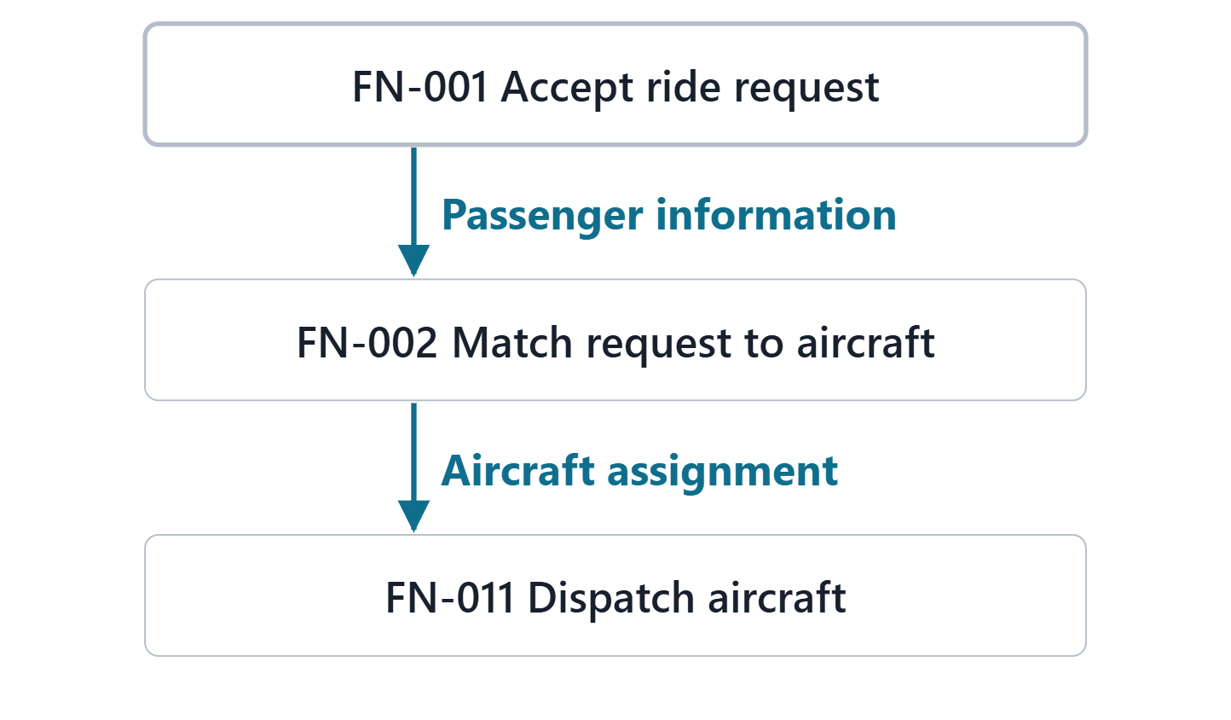
Functions and the items they exchange
FUNCTION (SEBOK)
“an action that transforms inputs and generates outputs, involving data, materials, and/or energies”
R20b · SEBoK v2.14 (2026), "Logical Architecture", p.587
Inputs and outputs: the items functions exchange
Deduced from requirements, or derived from a design choice
A static tree alone does not show the flows
Figure. Three AeroLink functions in the order a booking is served, with the item each passes to the next where one is modeled. Course illustration, not SysML v2 graphical notation. (FICTIONAL)
Sources: R20b p.587

Slide 7
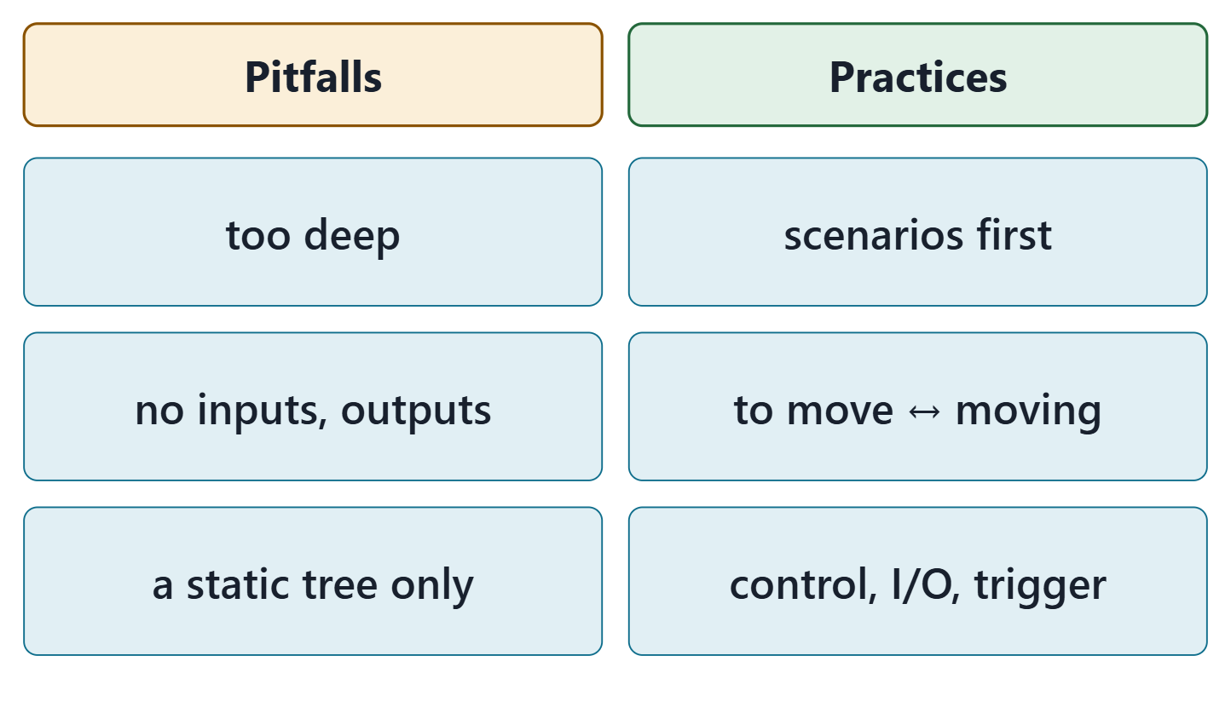
Pitfalls and proven practices
Pitfalls: decomposing too deep; functions without inputs and outputs; a static tree only
Practices: scenarios of functions before the tree; a function “to move” and its mode “moving”
Build a scenario: control flow, then items, then triggers
Figure. Three pitfalls and three proven practices from SEBoK’s tables for logical architecture, in short form. Course illustration, not SysML v2 graphical notation.
Sources: R20b p.594

Slide 8
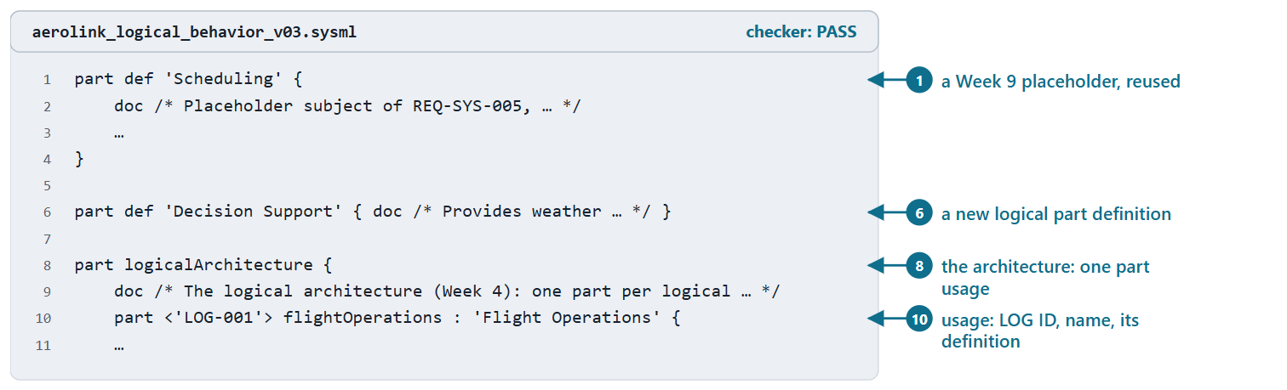
Logical decomposition: part definitions and part usages
Part definition: the kind of element; part usage: the element in this architecture
Course convention: the LOG ID on the usage, inside one part logicalArchitecture
A Week 9 placeholder with the same name becomes the definition; another name is specialized
Figure. Logical parts in AeroLink model v0.3: a Week 9 placeholder reused as a part definition, a new part definition, and the logical architecture as part usages (excerpt). Checked: PASS. (FICTIONAL)
Sources: R70 sl.15–16; R81 p.90

Slide 9
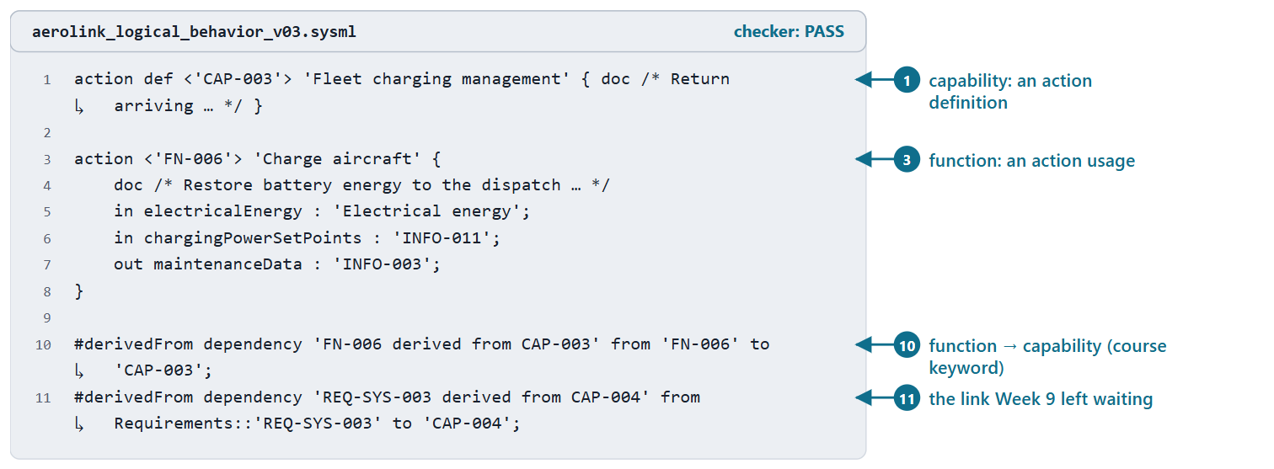
Capabilities, functions and the links Week 9 left waiting
Course convention: a capability is an action definition, a function an action usage
A function depends on its capability: a #derivedFrom dependency
A requirement traced to a capability links the same way: a derivation must end on requirements
Figure. A capability, a function derived from it and two #derivedFrom dependencies in AeroLink model v0.3: one from a function, one from a requirement. Checked: PASS. (FICTIONAL)
Sources: R72 sl.30; R115 p.580; R80 p.50–51

Slide 10
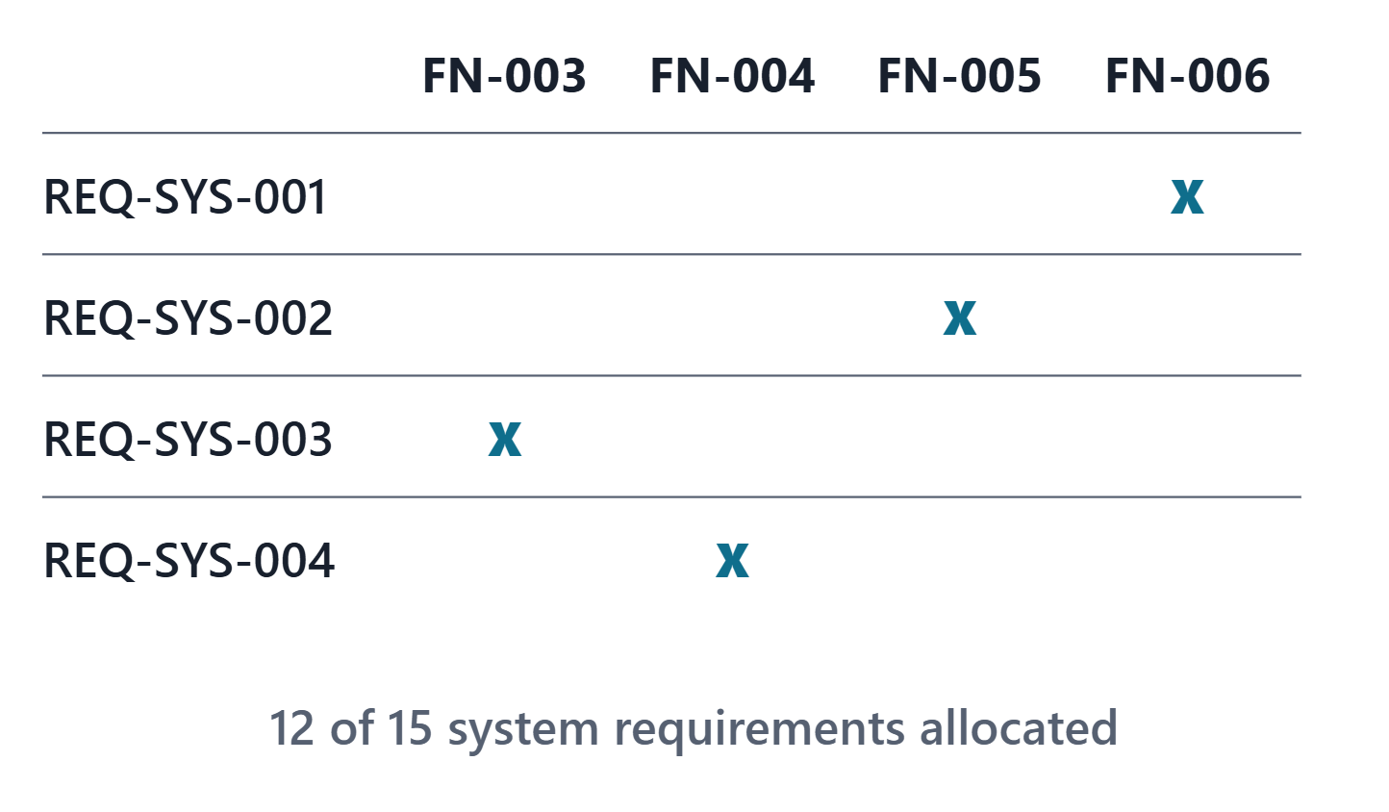
Requirements allocated to functions
SEBoK: assign system requirements to functional elements, and trace them
Each Week 4 allocation: allocate from the requirement to the function
AeroLink: 20 allocations; three system requirements not yet allocated
Figure. Four AeroLink system requirements and the functions they are allocated to in model v0.3, a fragment of the matrix read from the model. Course illustration, not SysML v2 graphical notation. (FICTIONAL)
Sources: R20b p.591–592; R81 p.110

Slide 11
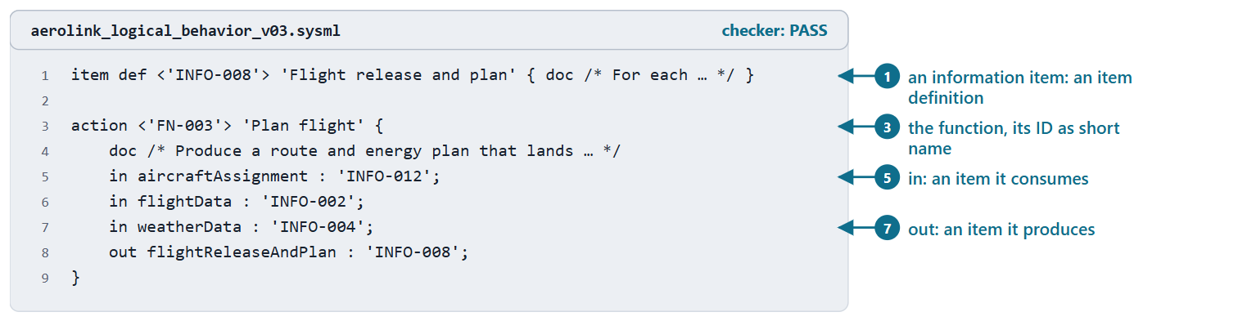
Functions as actions: parameters and items
ACTION DEFINITION (SYSML V2.1 BETA 2)
“a kind of occurrence definition … that classifies action performances”
R82 · OMG SysML v2.1 Beta 2, Part 1 (Release 2026-07), "7.17 Actions", p.117
Its in and out features are its parameters
Item definition: things that exist in time and space and may flow
Course convention: a function’s in and out items come from your information view
Figure. An information item as an item definition and FN-003 as an action usage with its in and out items, in AeroLink model v0.3. Checked: PASS. (FICTIONAL)
Sources: R82 p.117; R72 sl.30; R70 sl.17

Slide 12
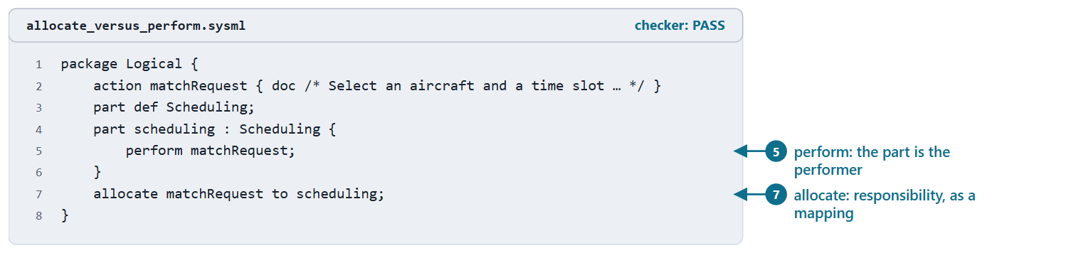
Allocating functions to logical elements: perform and allocate
ALLOCATION (SYSML V2.1 BETA 2)
“a target element is responsible for realizing some or all of the intent of the source element”
R81 · OMG SysML v2.1 Beta 2, Part 1 (Release 2026-07), "7.11 Parts", p.110
perform in a part: that part is the performer
allocate: a mapping across structures, often made early
Course convention: perform for functions; allocate for requirements now, logical to physical in Week 11
Figure. A neutral example: a logical part performs a function, and an allocation states the same responsibility as a mapping. Checked: PASS.
Sources: R72 sl.41; R82 p.136; R81 p.110–111; R76 sl.106–107

Slide 13
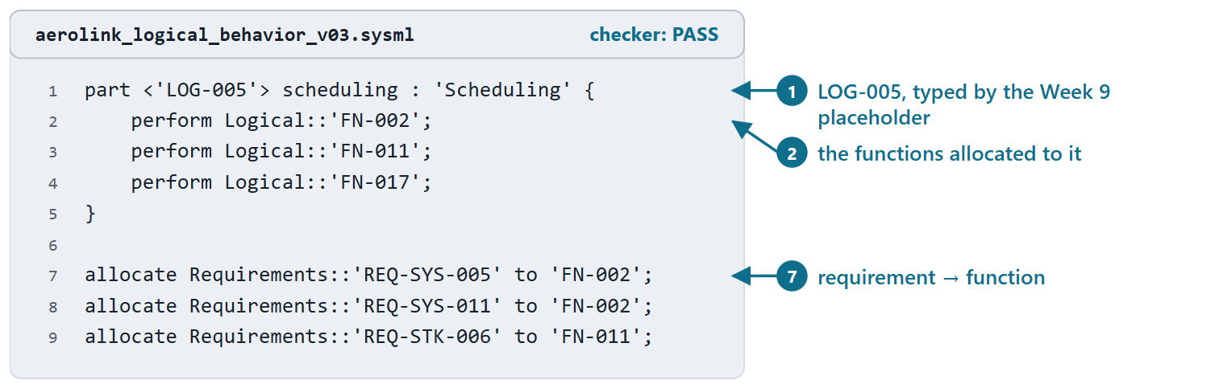
AeroLink worked example I: the logical architecture
7 logical parts perform 17 functions
20 requirement allocations, all from Week 4
Generated from the Week 4 case; nothing retyped
PAIR, 1 MIN
Who performs dispatch, and which requirement makes that a safety question?
Figure. LOG-005 in AeroLink model v0.3, typed by the Week 9 placeholder, performing the functions allocated to it, and three requirement allocations. Checked: PASS. (FICTIONAL)
Sources: R72 sl.41; R81 p.110

Slide 14
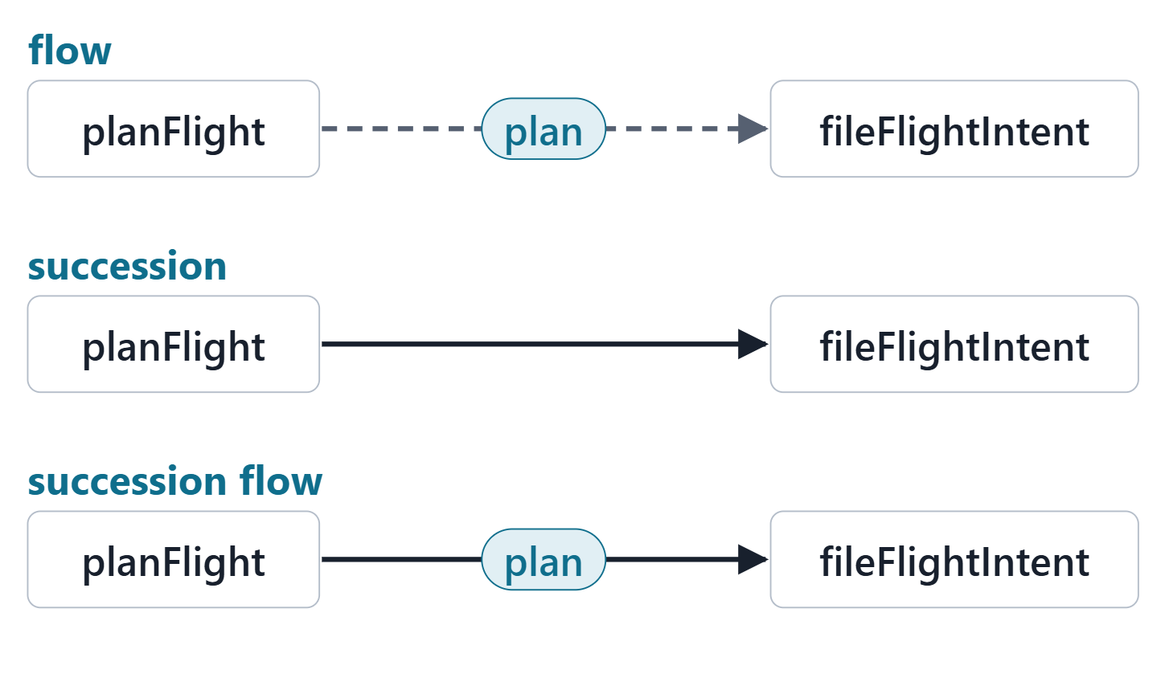
Ordering and transfer: successions and flows
Succession: the first completes before the second begins
Flow: transfers an item from an output to an input
Succession flow: the output is produced before the next begins consuming it
Figure. Three links between the same two AeroLink steps: a flow transfers the plan, a succession orders the steps, a succession flow does both. Course illustration, not SysML v2 graphical notation. (FICTIONAL)
Sources: R72 sl.30–32; R82 p.118

Slide 15
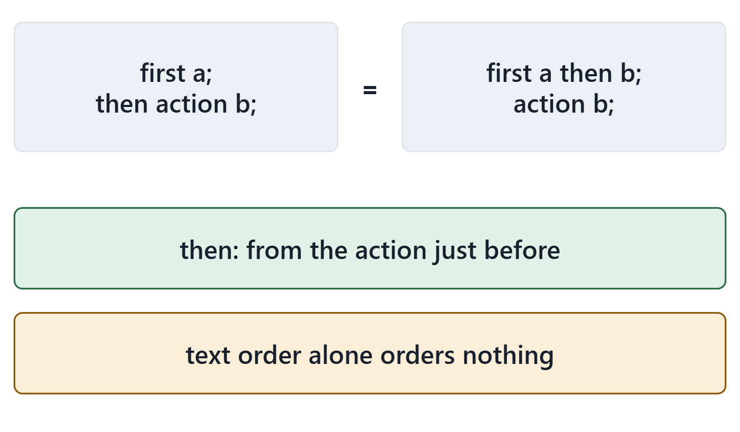
Shorthands: then, and decomposition
then: a succession from the lexically previous action
An action can be decomposed directly into actions
Course reading: text order alone orders nothing; successions do
Figure. Two equivalent ways to write that a precedes b, and two reading rules. Course illustration, not SysML v2 graphical notation.
Sources: R72 sl.33–34; R82 p.134–135

Slide 16
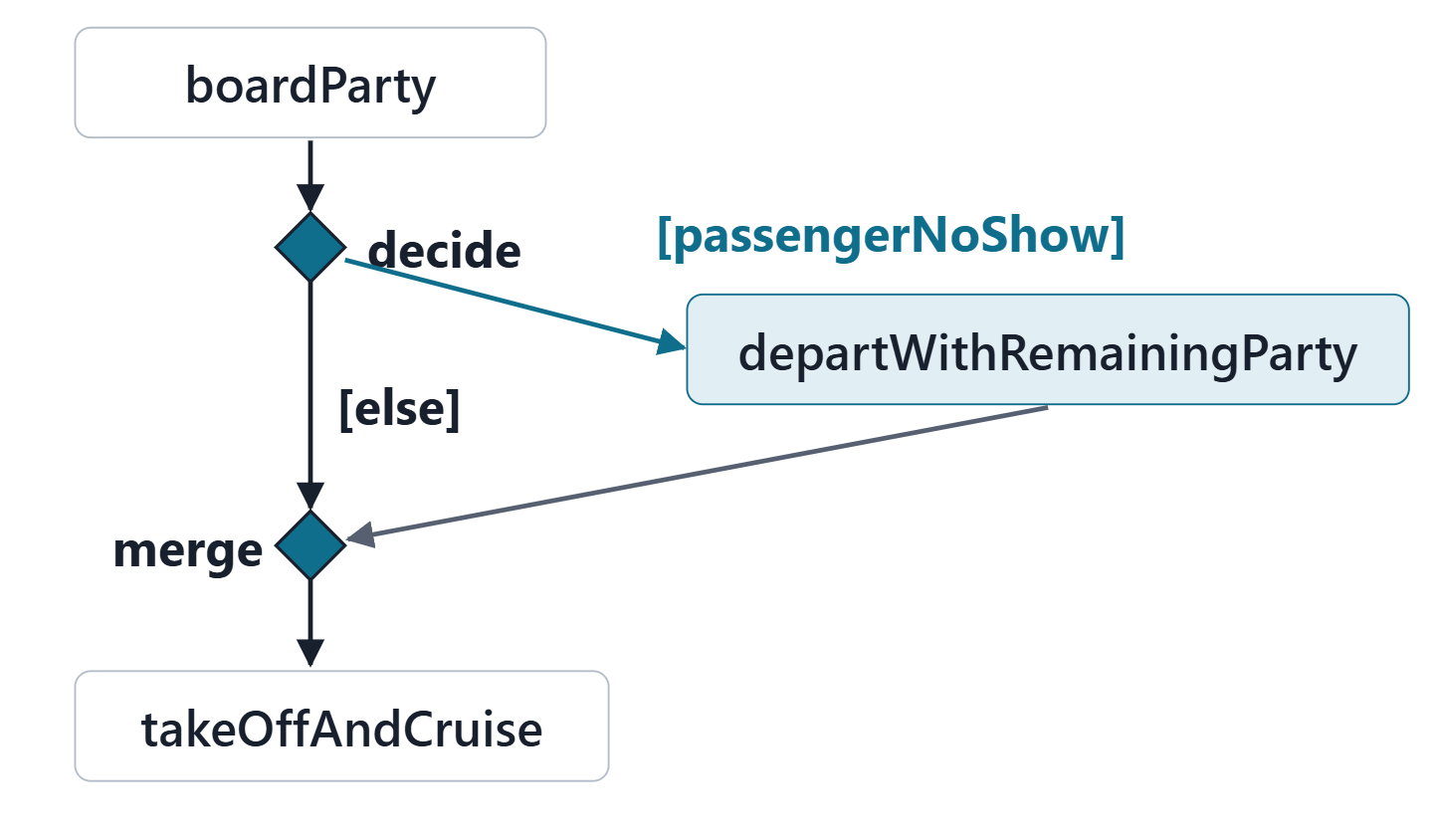
Choices: conditional successions, decide and merge
Conditional succession: taken only if its guard is true
decide: exactly one successor; else when every guard is false
merge: waits for any one predecessor
A branch target is named, never declared in place
Figure. SCN-002 step 4 in AeroLink model v0.3: a decision with one guarded branch and else, and a merge where the alternate rejoins. Course illustration, not SysML v2 graphical notation. (FICTIONAL)
Sources: R72 sl.35–38; R82 p.118; R82 p.135–136

Slide 17
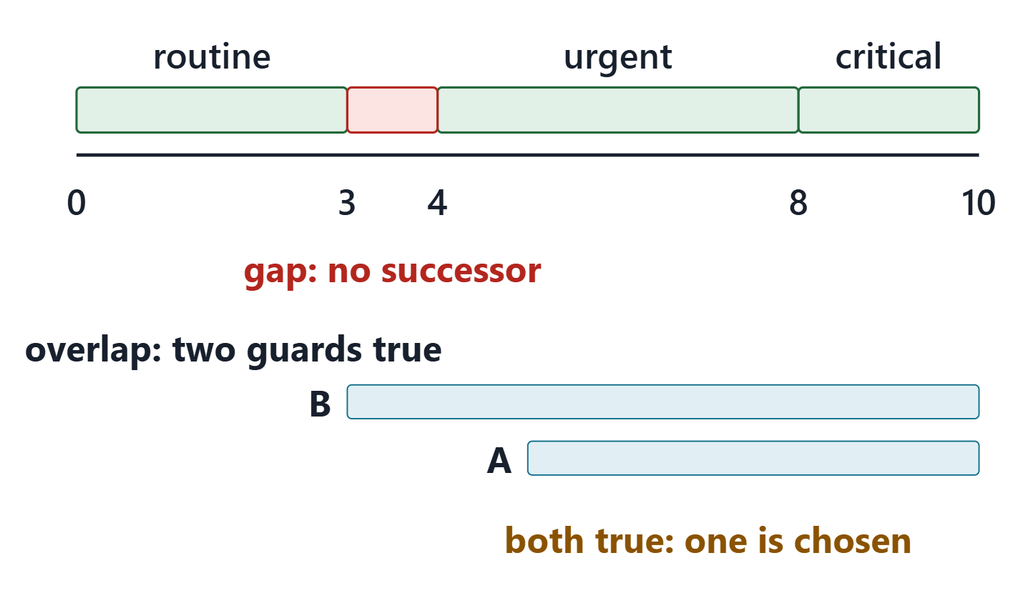
The semantics of choice: gaps and overlaps
Answer B: a score of 3 has no possible successor
Overlapping guards: only one successor is chosen; the model does not say which
The checker evaluates no guard: both files pass
KEY POINT
Cover every case: write else, and check each guard against its ConOps condition.
Figure. The driving question’s guards on a number line, with the uncovered score marked, and a second pair of guards that can both be true. Course illustration, not SysML v2 graphical notation.
Sources: R72 sl.35; R72 sl.38; R82 p.118; R82 p.134

Slide 18
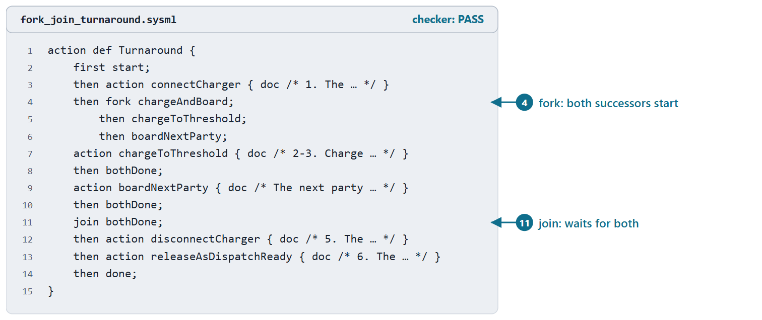
Concurrency: fork and join
fork: all its successors may start
join: waits for all its predecessors
Use a fork only where the ConOps says “at the same time”
Figure. The AeroLink turnaround: after the charger is connected, charging and boarding run concurrently, and the aircraft is released when both are done (course example). Checked: PASS. (FICTIONAL)
Sources: R72 sl.40; R82 p.118

Slide 19
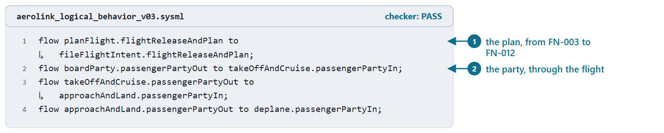
Item flows between steps, and messages at the boundary
Item flow: from an out parameter of one step to an in parameter of a later step
AeroLink SCN-002: 7 item flows, computed from the functions’ items
Across an organizational boundary: send and accept; ports follow in Week 11
Figure. Four of the item flows of SCN-002 in AeroLink model v0.3: the plan, and the passenger party through the flight. Checked: PASS. (FICTIONAL)
Sources: R72 sl.30; R72 sl.45–46; R82 p.118

Slide 20
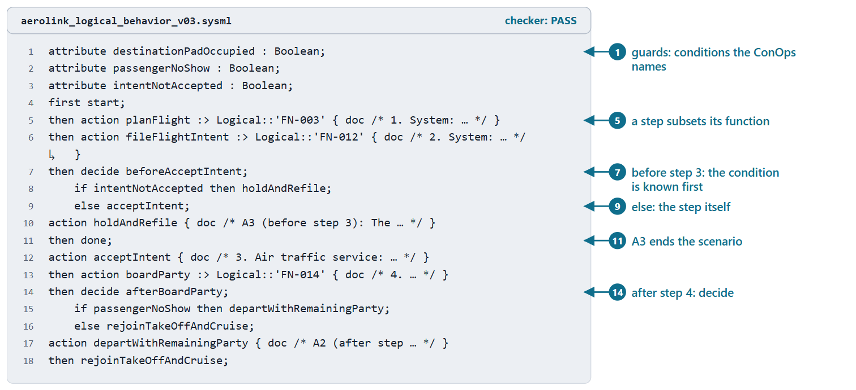
Worked example II: SCN-002 from ConOps table to action flow
Course convention: each step an action subsetting its function
Each alternate: a guarded branch where its condition becomes known, before or after its step
A rejoin: a merge before the step; an ending: done
SCN-002: 7 steps, 3 decisions, 2 merges
Figure. The first part of the SCN-002 flow inside its use case in AeroLink model v0.3: guards, steps subsetting their functions, two decisions and an ending alternate. Checked: PASS. (FICTIONAL)
Sources: R72 sl.30–38; R76 sl.101

Slide 21
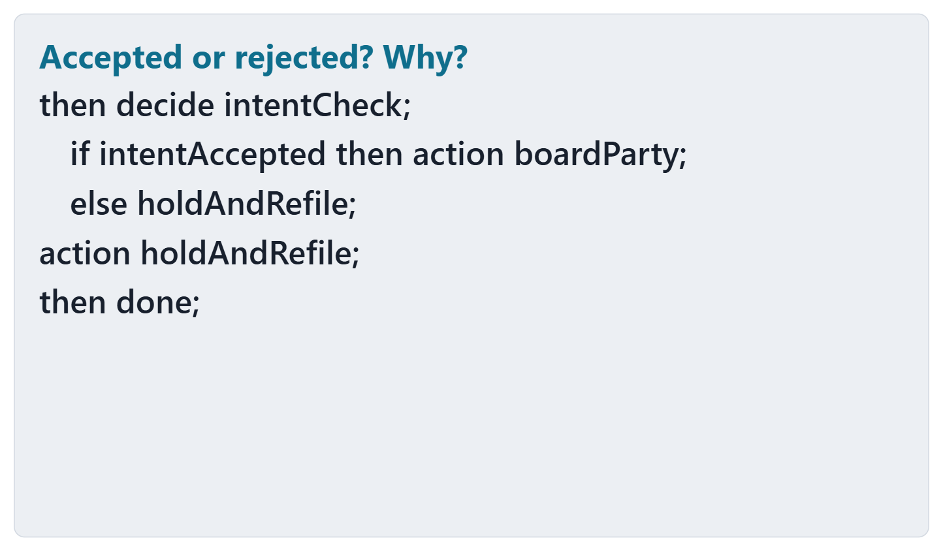
Predict: accepted or rejected?
PREDICT, 1 MIN
Will the checker accept this file?
Write: accepted or rejected
If rejected: the line, and the reason
Figure. A decision adapted from SCN-002 step 3, shown without its checker result. Course illustration, not SysML v2 graphical notation. (FICTIONAL)

Slide 22
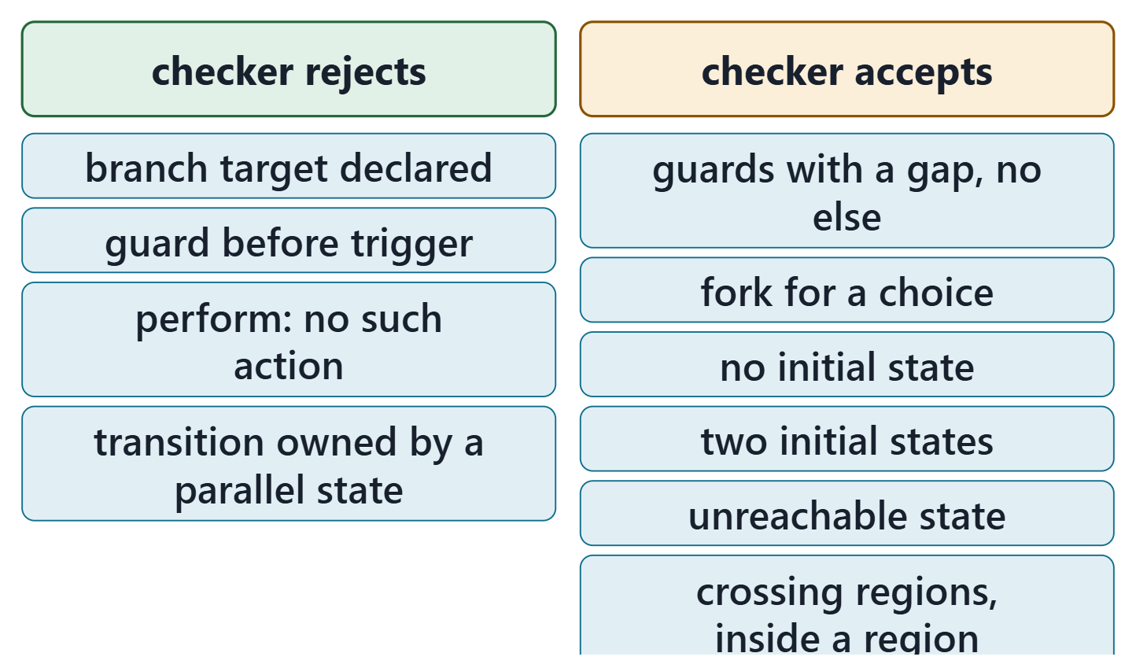
What the checker checks, and what it cannot
The predict card: rejected at the branch; a target is named, not declared
Rejected: syntax, unresolved names, a few rules
Accepted silently: gaps, forks for choices, missing or extra initial states, unreachable states, crossings written inside a region
Zero errors is necessary, never sufficient
Figure. Recorded results of the course checker (release 2026-08) on 10 course files: what it rejects, and what it accepts without complaint. Course illustration, not SysML v2 graphical notation.
Sources: R72 sl.35; R82 p.136; R82 p.146

Slide 23
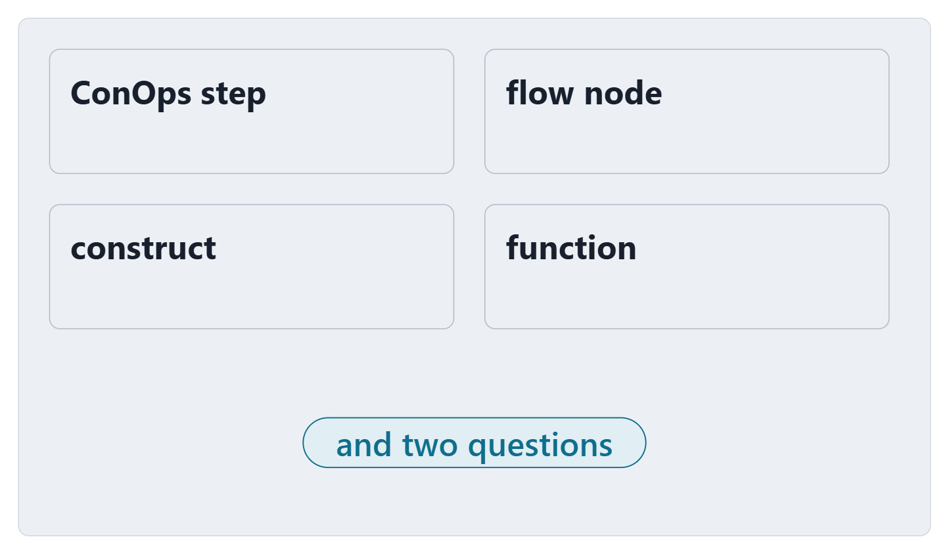
Exit: map one step and one alternate
Pick the scenario with the most alternates from your Week 2 ConOps
For one step and one alternate: node, construct, function
Is the alternate a choice or something happening at the same time?
Does it end the scenario, or rejoin, and where?
Figure. The exit card: four fields to fill for one step and one alternate of your team’s scenario, and two questions. Course illustration, not SysML v2 graphical notation.

Slide 24
References and credits
R20b · SEBoK v2.14 (2026), “Logical Architecture”, p.587–592, 594
R20c · SEBoK v2.14 (2026), “Physical Architecture”, p.596
R70 · Seidewitz, Intro to the SysML v2 Language: Textual Notation (Release 2026-08), “Introduction to the SysML v2 Language”, sl.15–17
R72 · Seidewitz, Intro to the SysML v2 Language: Textual Notation (Release 2026-08), “Action Definition”, sl.30–38, 40–41, 45–46
R76 · Seidewitz, Intro to the SysML v2 Language: Textual Notation (Release 2026-08), “Use Case Definition”, sl.100–101, 106–107
R80 · OMG SysML v2.1 Beta 2, Part 1 (Release 2026-07), “7.1 Language Overview”, p.50–51
R81 · OMG SysML v2.1 Beta 2, Part 1 (Release 2026-07), “7.11 Parts”, p.90, 110–111
R82 · OMG SysML v2.1 Beta 2, Part 1 (Release 2026-07), “7.17 Actions”, p.117–118, 134–136, 145–146, 150
R115 · OMG SysML v2.1 Beta 2, Part 1 (Release 2026-07), “9.6 Requirement Derivation Domain Library”, p.580
CREDITS AND LICENSES
Introduction to the SysML v2 Language, Textual Notation (Release 2026-08): Copyright © 2019–2026 Model Driven Solutions, Inc. Licensed under the Creative Commons Attribution 4.0 International License (CC BY 4.0).
SEBoK v2.14: “This material is used under a Creative Commons Attribution-NonCommercial ShareAlike 3.0 Unported License from The Trustees of the Stevens Institute of Technology.” (SEBoK, “Bkcase Wiki:Copyright”, PDF p.31). Quotations are short and cited; no SEBoK figure or table is reproduced.
Figures are original drawings for this course; none redraws a figure from the sources.
AeroLink Urban Mobility is a fictional teaching case: every number, name and statement about it is a teaching value.

