Slide 1
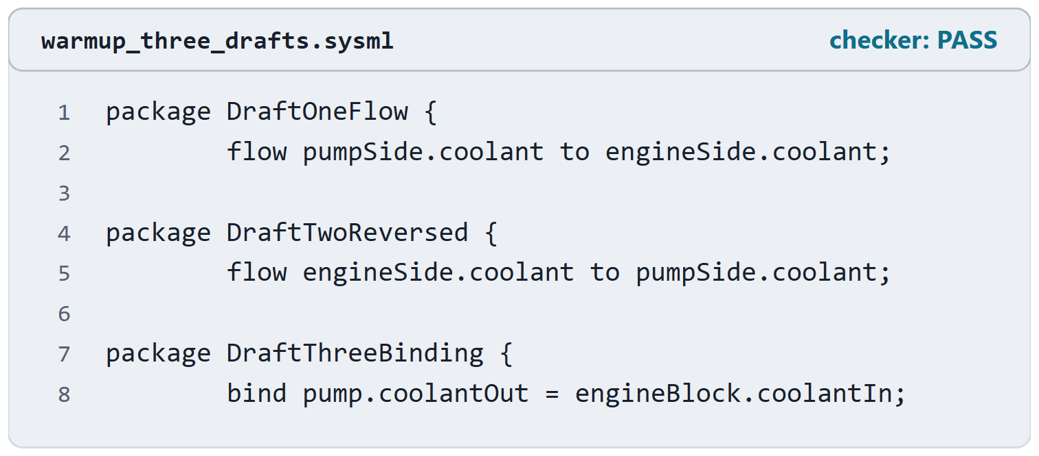
Warm-up: which draft moves the coolant?
VOTE
Which drafts say that coolant moves from the pump to the engine?
A · Draft one only
B · Drafts one and two
C · Drafts one and three
D · All three: the checker accepts them
Figure. Three drafts of the coolant connection between a pump and an engine block, from one checked file. Checked: PASS. (FICTIONAL)

Slide 2
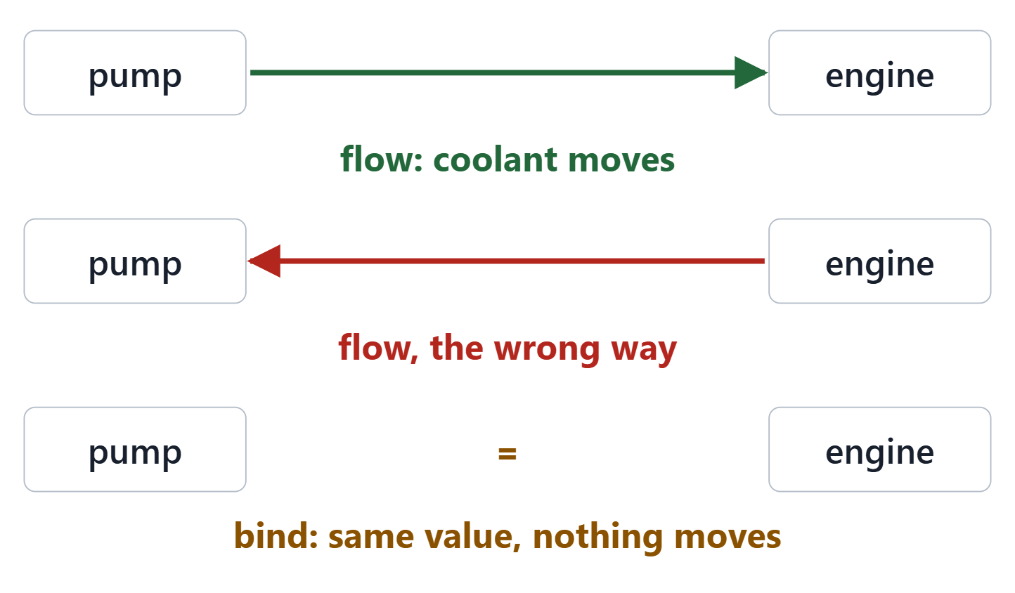
Reveal: one moves it, one reverses it, one moves nothing
Answer A: only draft one moves coolant from pump to engine
Draft two: a flow from the in item to the out item
Draft three: a binding asserts equal values; it is not a transfer
All three pass the checker
Figure. What each draft says: a flow from the pump to the engine, a flow the other way, and a binding that makes two features equal. Course illustration, not SysML v2 graphical notation.
Sources: R71 sl.24; R71 sl.26; R81 p.96

Slide 3
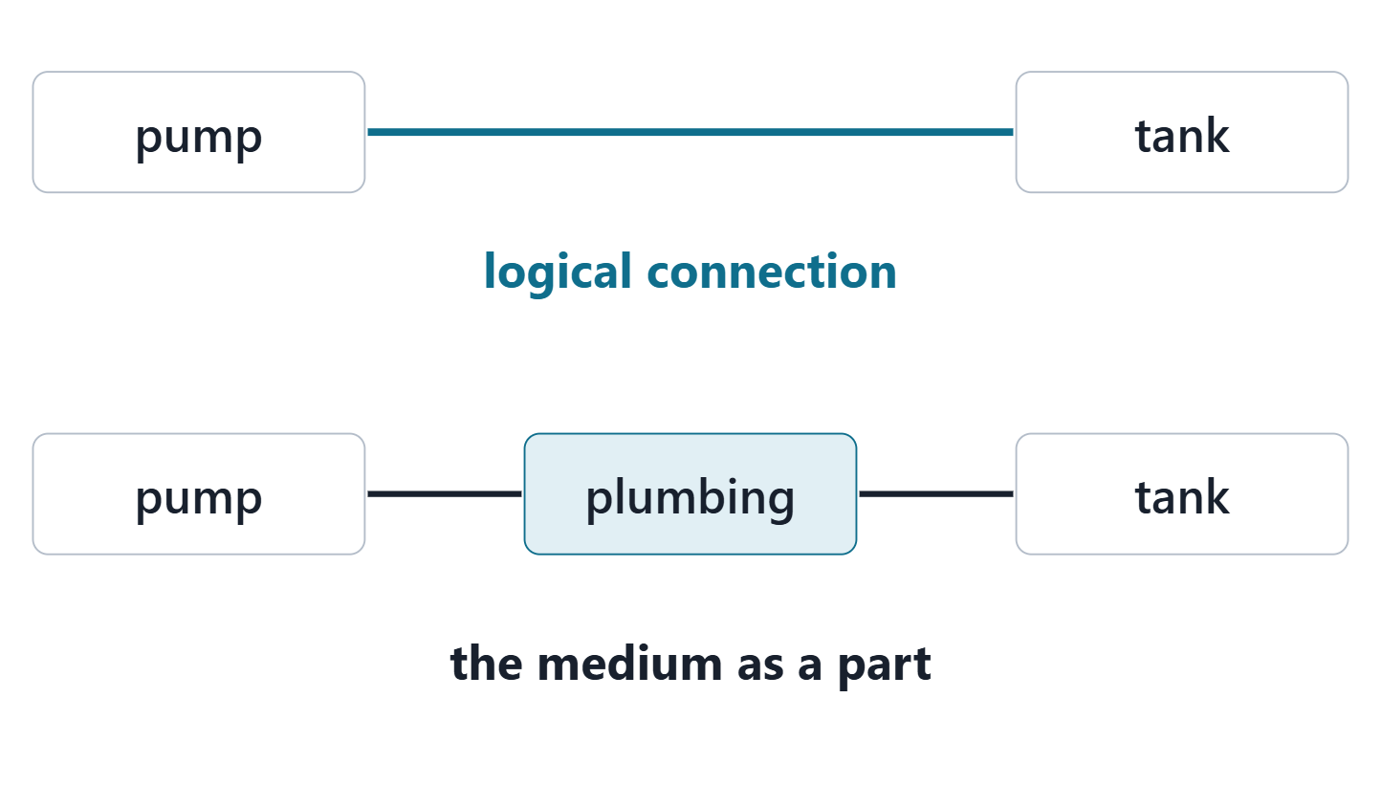
Connections, and the interface medium
CONNECTION DEFINITION (TRAINING DECK)
“a part definition whose usages are connections between its ends”
R71 · Seidewitz, Intro to the SysML v2 Language: Textual Notation (Release 2026-08), "Connections", sl.18
A connection usage connects two features in context
A logical connection abstracts the medium away
Or the medium is a part in between
Figure. Two ways to model a pump connected to a tank: a logical connection, and a connection through a medium modeled as a part. Course illustration, not SysML v2 graphical notation.
Sources: R71 sl.18; R71 sl.19; R81 p.96

Slide 4
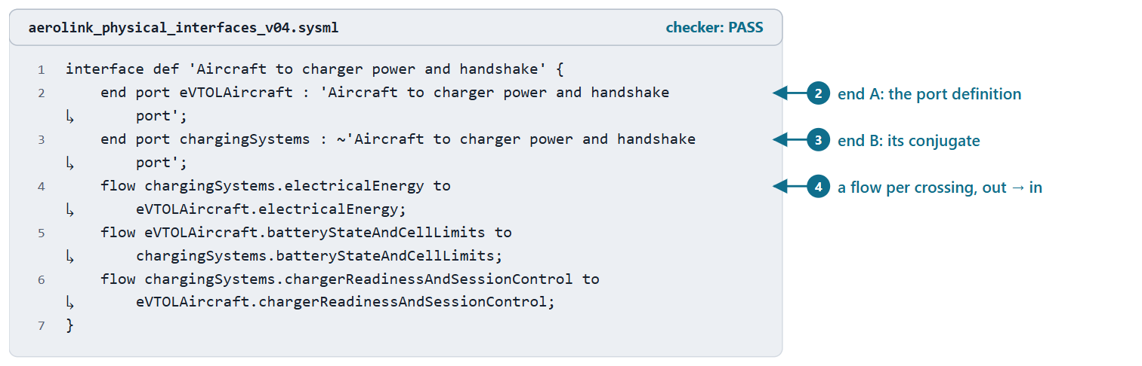
Interface definitions and interface usages
INTERFACE DEFINITION (SYSML V2.1 BETA 2)
“a kind of connection definition … whose ends are restricted to be port definitions”
R81 · OMG SysML v2.1 Beta 2, Part 1 (Release 2026-07), "7.11 Parts", p.106
An interface usage connects two compatible ports
connect a.p to b.q: dot notation to each port
Figure. The interface definition of IF-005 in AeroLink model v0.4: two port ends, one typed by the port definition and one by its conjugate, and a flow per crossing. Checked: PASS. (FICTIONAL)
Sources: R81 p.106; R81 p.109; R71 sl.22

Slide 5
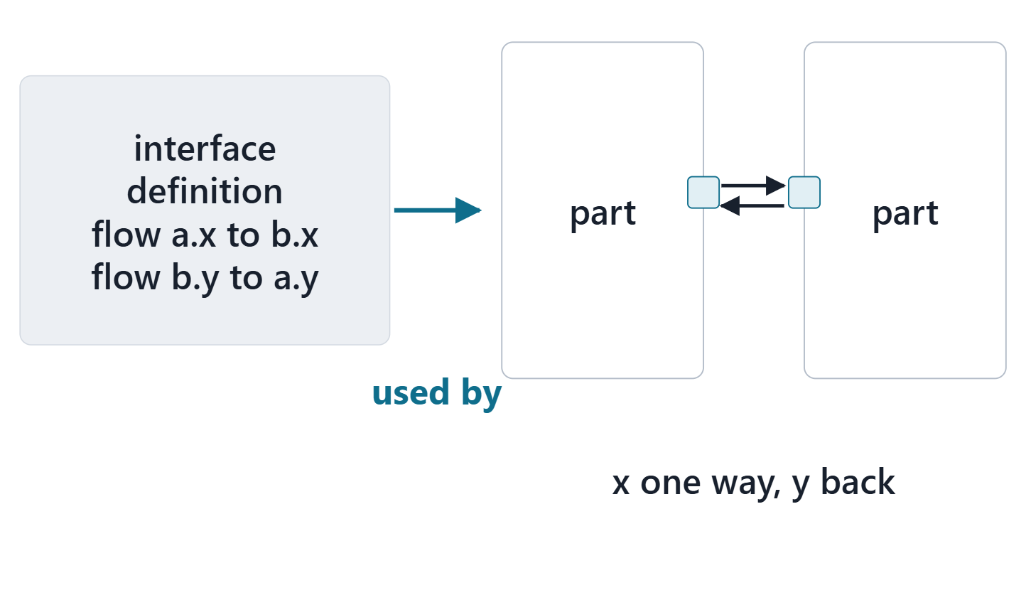
Flows across an interface
A flow: from an output of the source to an input of the target
Streaming: the transfer is ongoing while both act
Flows in an interface definition: established when the interface is used
Course convention: one flow per Week 5 crossing
Figure. Flows written once in the interface definition are established wherever the interface is used: two ports, connected, with the items moving out to in. Course illustration, not SysML v2 graphical notation.
Sources: R71 sl.26; R71 sl.27; R71 sl.28; R81 p.112; R81 p.116

Slide 6
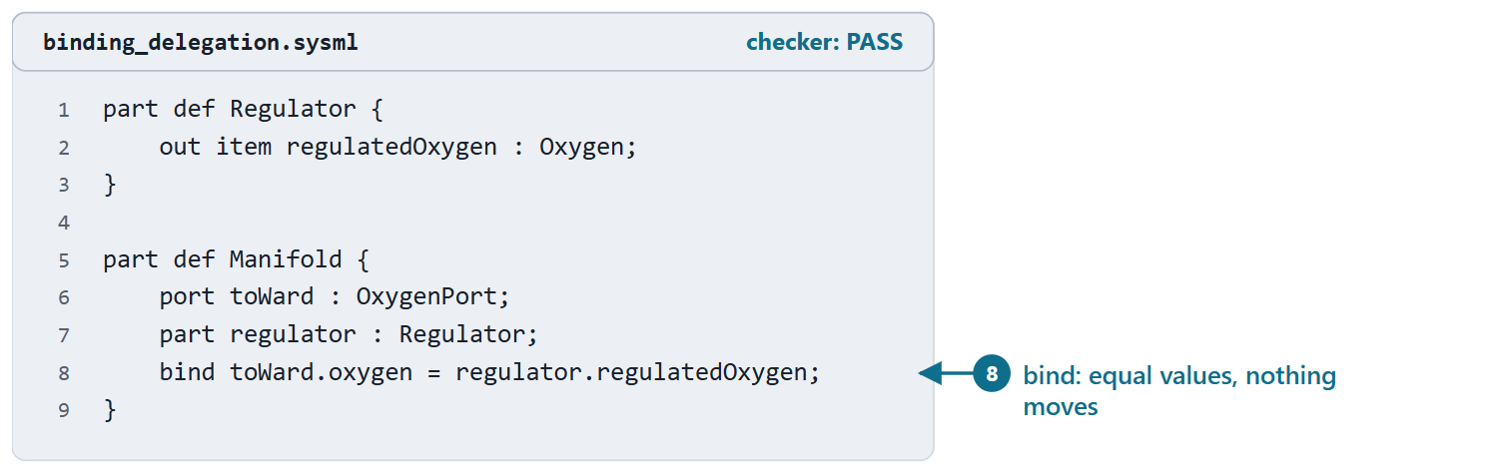
Binding connectors: delegation, not transfer
bind a = b: the two features have equal values in the same context
Typical use: delegate an outer port’s feature to the inner part
A feature value (= expression) is also a binding, not a default
Figure. A manifold’s outer port delegates its oxygen to the regulator inside it with a binding (course example). Checked: PASS. (FICTIONAL)
Sources: R71 sl.24; R71 sl.25; R81 p.96

Slide 7
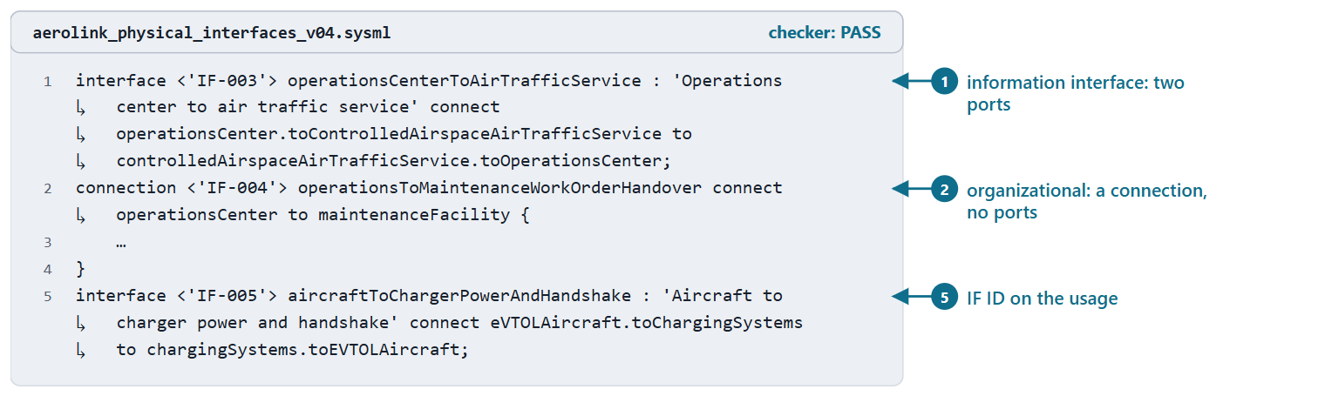
Information, physical and organizational interfaces in the model
Physical and information: an interface between two ports, with flows
Organizational: a connection between the two parts; the agreement in its doc
Course convention: nothing flows across an agreement, so no ports
Figure. Three interface usages in AeroLink model v0.4: an information interface, an organizational one and the charging interface. Checked: PASS. (FICTIONAL)
Sources: R20c p.597; R71 sl.18

Slide 8
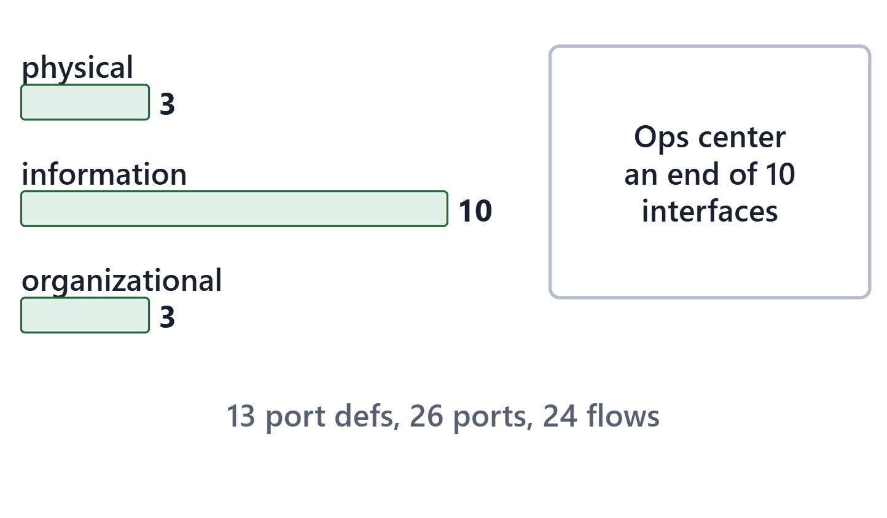
AeroLink worked example III: the interface set in the model
16 interfaces: 3 physical, 10 information, 3 organizational
26 ports, 24 flows
Generated from the Week 5 case; nothing retyped
PAIR, 1 MIN
Operations Center is an end of 10 interfaces. What does SEBoK’s modularity practice ask about that?
Figure. The AeroLink interfaces in model v0.4 by kind, and the element most of them meet at. Course illustration, not SysML v2 graphical notation. (FICTIONAL)
Sources: R20c p.603

Slide 9
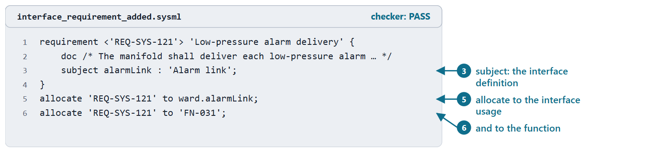
Interface requirements in the model
INTERFACE REQUIREMENT (SEBOK)
“a functional requirement that deals with an interaction of a system across an interface boundary with another system”
R13 · SEBoK v2.14 (2026), "System Requirements Definition", p.563
Interface management takes them as inputs, gives specifications as outputs
Course convention: one Week 9 did not model gets the interface definition as subject
Figure. An interface requirement with the interface definition as subject, allocated to the interface usage and to the function that realizes it (course example). Checked: PASS. (FICTIONAL)
Sources: R13 p.563; R57 p.411

Slide 10
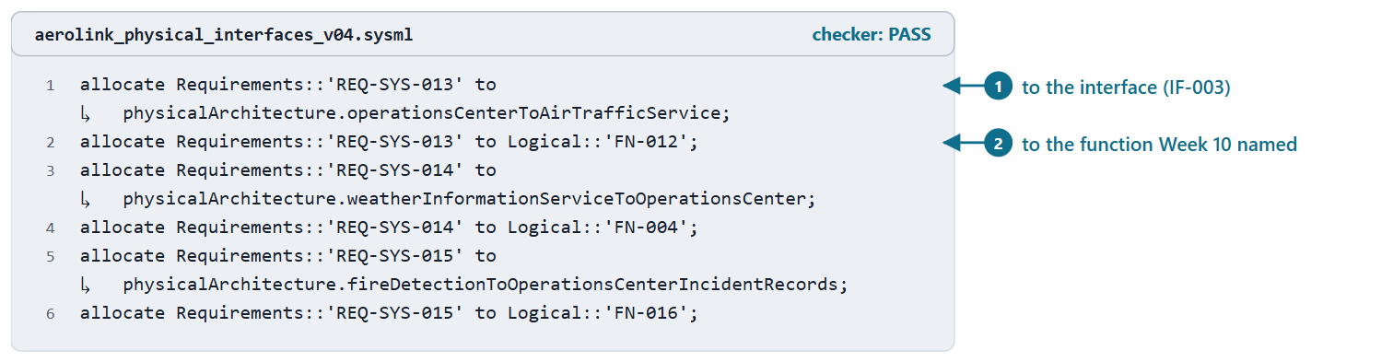
Allocating interface requirements: the open items close
Each interface requirement: allocate to its interface, and to its function
AeroLink: REQ-SYS-013, REQ-SYS-014, REQ-SYS-015 now allocated
Still open: REQ-STK-021, with its reason and owner
A gap with a disposition is honest
Figure. The three interface requirements Week 10 deferred, allocated in AeroLink model v0.4 to their interfaces and to the functions Week 10 named. Checked: PASS. (FICTIONAL)
Sources: R81 p.110; R20c p.601

Slide 11
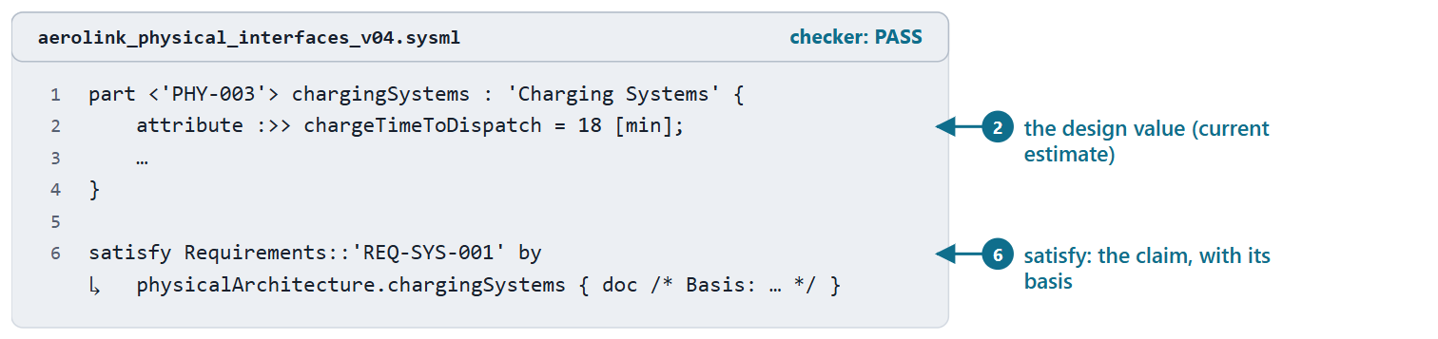
Satisfy claims: the design asserts it meets a requirement
satisfy R by e: R holds with e bound to its subject
e must be of the subject’s type
The design value is an attribute of e; the basis says where it comes from
A claim, verified in Week 12
Figure. The charging systems’ design value and the satisfy claim for the charge-time requirement in AeroLink model v0.4, with its basis. Checked: PASS. (FICTIONAL)
Sources: R83 p.162; R83 p.168

Slide 12
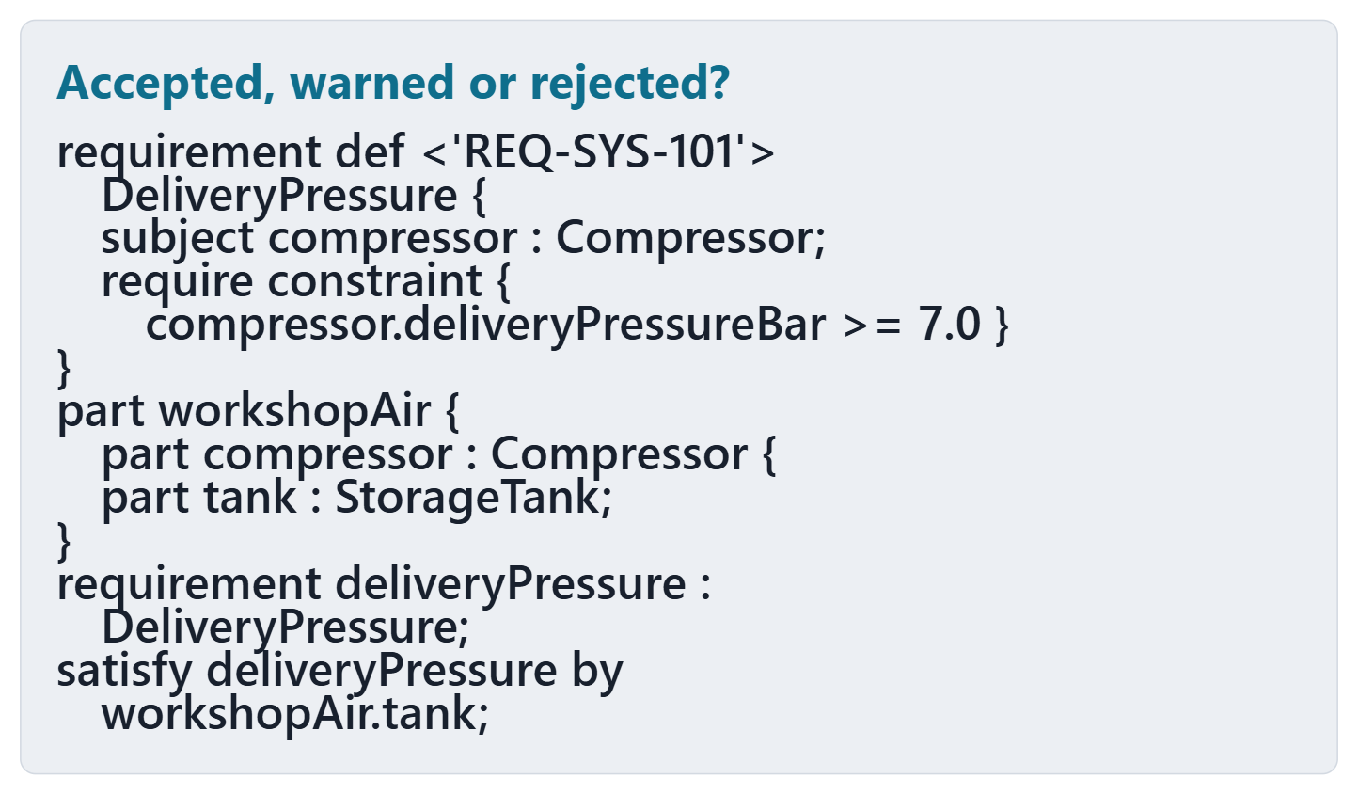
Predict: what does the checker say?
PREDICT, 1 MIN
Accepted silently, accepted with a warning, or rejected?
Write your choice
And: is the claim about the right element?
Figure. A requirement on a compressor and a satisfy claim in a workshop, shown without its checker result. Course illustration, not SysML v2 graphical notation. (FICTIONAL)

Slide 13
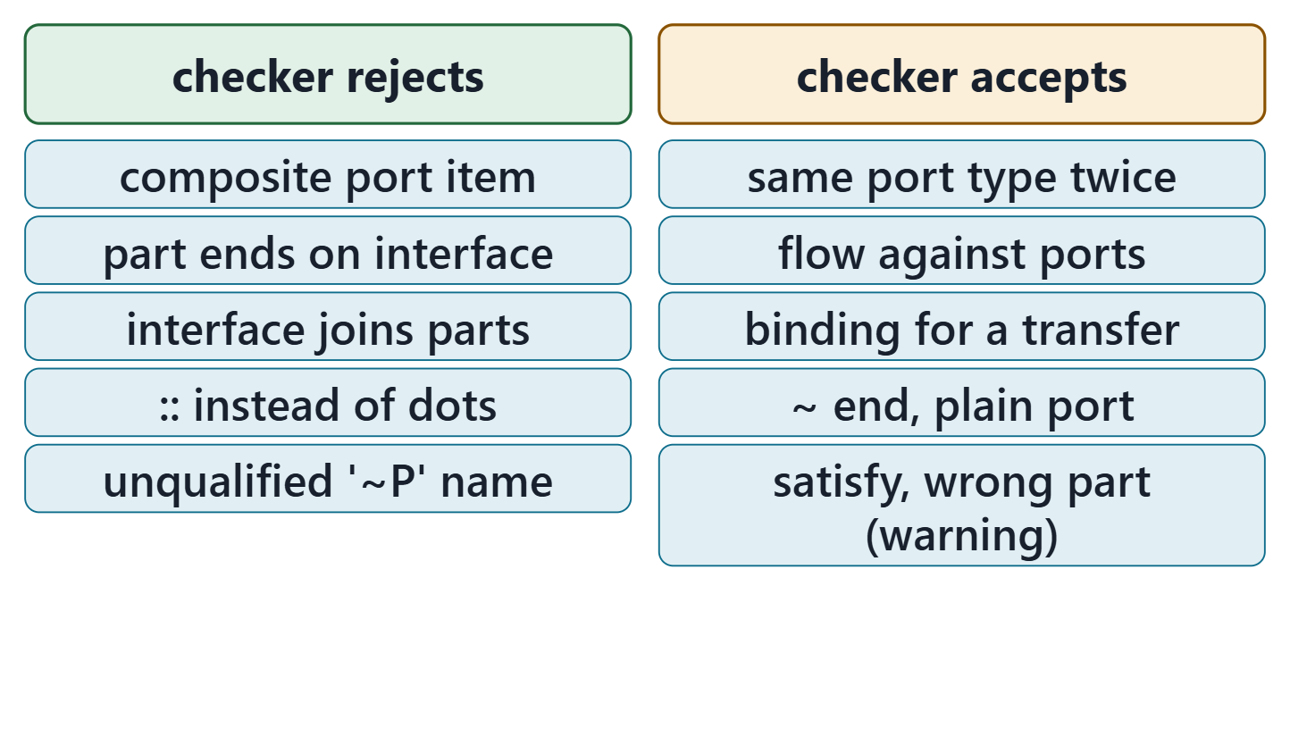
What the checker checks this week, and what it cannot
The predict card: accepted, with a warning only
Rejected: ends that are not ports, names that do not resolve
Accepted: mismatched ports, reversed flows, bindings for transfers
A warning is a finding until explained
Figure. Recorded results of the course checker (release 2026-08) on the week’s 10 calibration files: rejected, and accepted silently or with only a warning. Course illustration, not SysML v2 graphical notation.
Sources: R83 p.162; R81 p.106

Slide 14
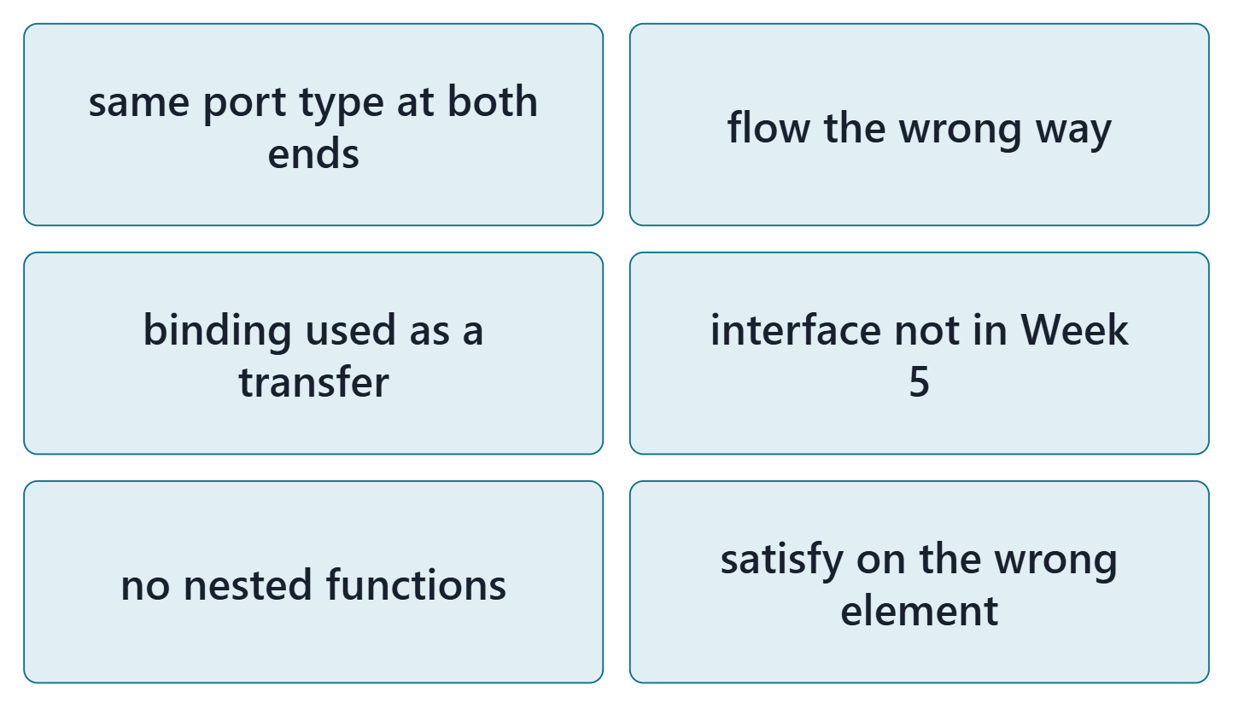
Common errors in physical and interface models
Both ends the same port type; a flow the wrong way
A binding where a transfer is meant
An interface the Week 5 table does not have
An allocation with no nested functions; satisfy on the wrong element
Figure. Six common errors in first physical and interface models, each with the check that catches it. Course illustration, not SysML v2 graphical notation.
Sources: R81 p.93; R71 sl.24

Slide 15
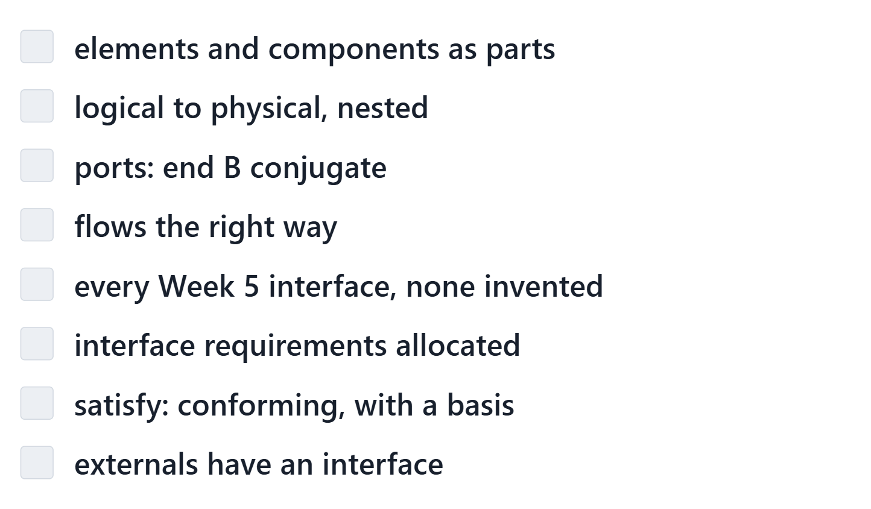
The interface review checklist
Course convention: eight checks against Week 5 and the model
Each: met, or a finding with a note
The tool gives evidence; the judgment is yours
Figure. The interface review checklist (course convention): the eight checks your team records in the lab, each met or a finding. Course illustration, not SysML v2 graphical notation.
Sources: R20c p.601; R81 p.93

Slide 16
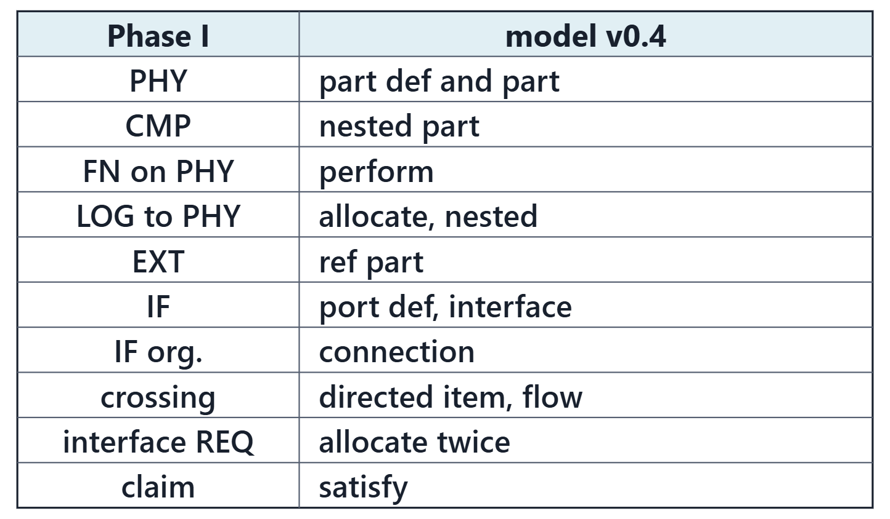
From your package to model v0.4
Course convention: generated from your Week 10 model and Week 5 export
You decide: placeholder links, placements of new functions, what crosses and which way, the functions of each interface requirement, the satisfy claims
Every ID kept; new ones continue after the highest
Figure. The course mapping for Week 11, short form: each Phase I element of the Week 4 and Week 5 package and the model element it becomes. Course illustration, not SysML v2 graphical notation.

Slide 17
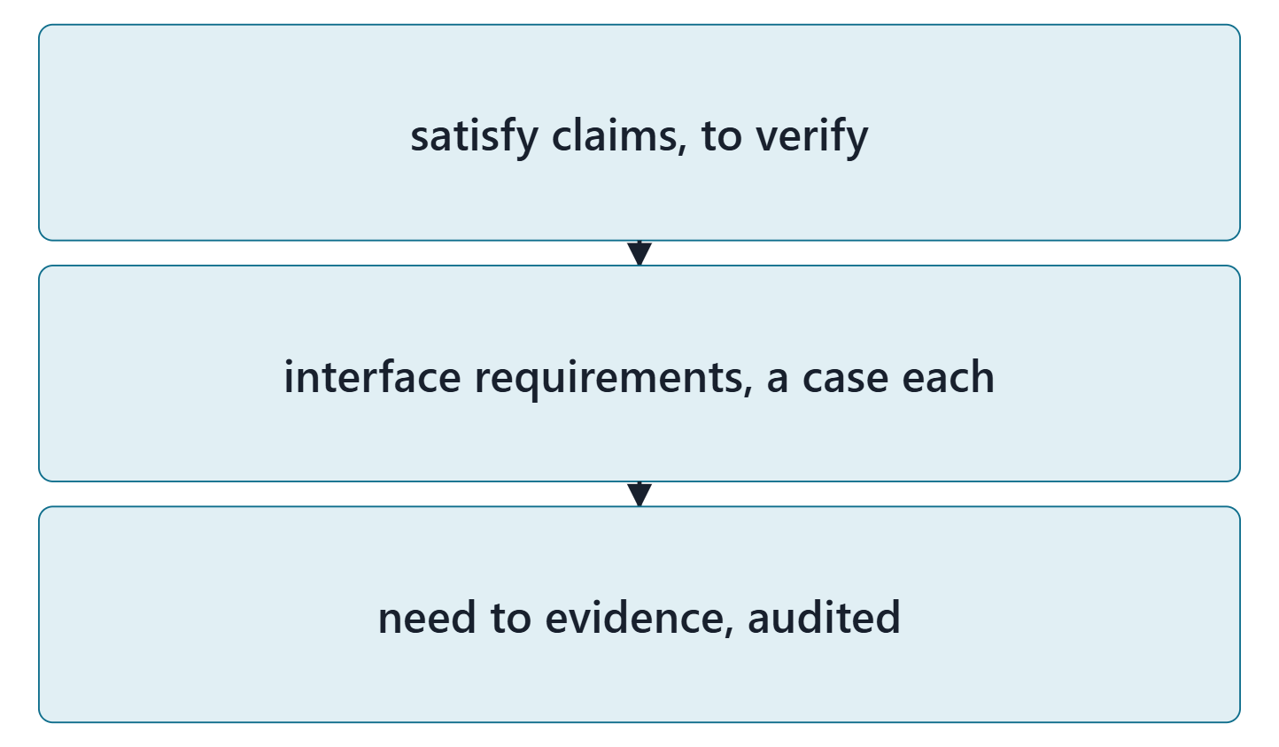
Bridge: Week 12, digital thread and verification
Each satisfy claim: a verification case plans its evidence
Each interface requirement: a method and a case
The digital thread: need to requirement to design to verification
Figure. What Week 12 does with the physical architecture and interfaces modeled this week. Course illustration, not SysML v2 graphical notation.

Slide 18
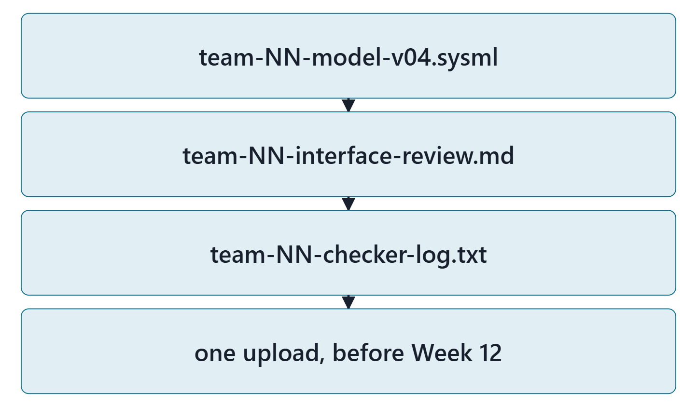
Lab L11: model v0.4 of your enterprise
Due before Week 12, Session 1, on the LMS; your own enterprise, never AeroLink
Your own enterprise, never AeroLink
Three files: team-NN-model-v04.sysml, team-NN-interface-review.md, team-NN-checker-log.txt
Zero checker errors; every warning explained
Formative feedback before Week 12, Session 2
Figure. Lab L11 deliverables: three files, one upload (course convention). Course illustration, not SysML v2 graphical notation.

Slide 19
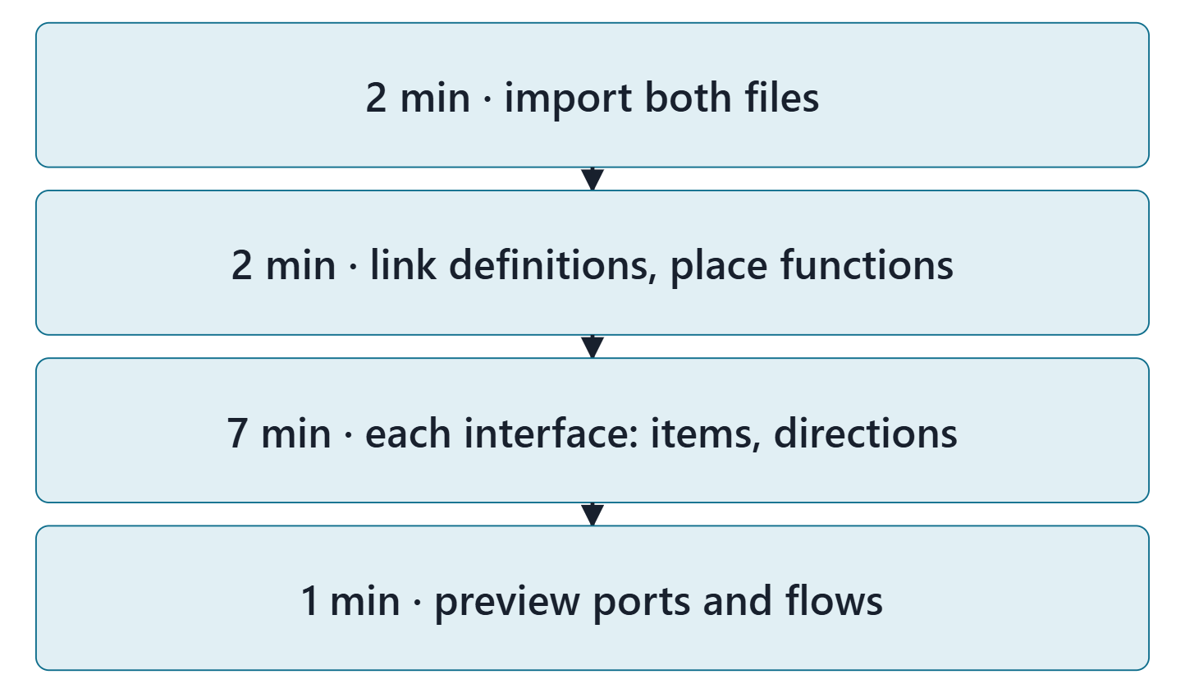
Team work: what crosses your interfaces
12 minutes, in teams, in the Week 11 lab tool
Import your Week 10 model and your Week 5 export
Link each Week 8 or 9 part definition; place Week 10’s new functions
Each interface: every crossing as an item, with its direction
Preview the ports and flows
Figure. In class: import, link and place, set the crossings, preview the ports in the lab tool. Course illustration, not SysML v2 graphical notation.

Slide 20
Instructor checkpoint
Per team: one interface, its port definition, one direction
Show: one interface and its crossings
Show: the port definition and which end is conjugate
Justify one direction from Week 4
Note one fix to make before day 2

Slide 21
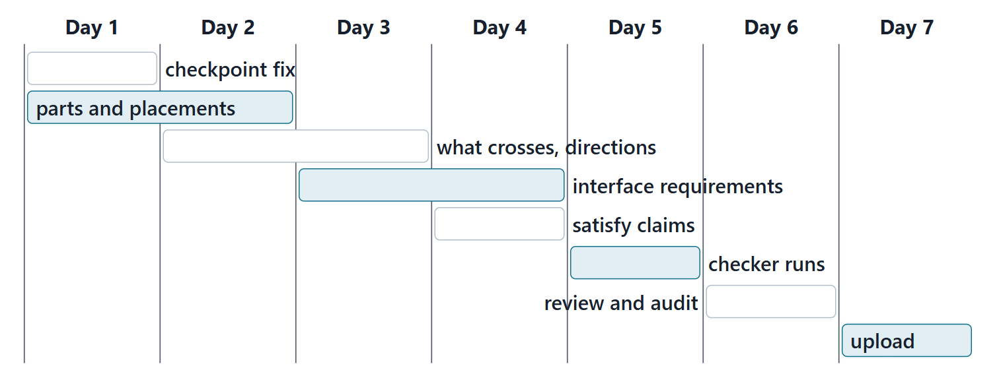
Close: the next seven days
Quiz Q11 and the applied exercise open today. Log your hours.
Figure. A suggested seven-day plan for Lab L11, with the lead role for each task (course convention). Course illustration, not SysML v2 graphical notation.

Slide 22
References and credits
R13 · SEBoK v2.14 (2026), “System Requirements Definition”, p.563
R20c · SEBoK v2.14 (2026), “Physical Architecture”, p.596–603
R57 · The MITRE Systems Engineering Guide (2014), “Interface Management”, p.411
R71 · Seidewitz, Intro to the SysML v2 Language: Textual Notation (Release 2026-08), “Connections”, sl.18–22, 24–28
R81 · OMG SysML v2.1 Beta 2, Part 1 (Release 2026-07), “7.11 Parts”, p.90, 93, 95–96, 106, 109–112, 116
R83 · OMG SysML v2.1 Beta 2, Part 1 (Release 2026-07), “7.21 Requirements”, p.162, 168
CREDITS AND LICENSES
Introduction to the SysML v2 Language, Textual Notation (Release 2026-08): Copyright © 2019–2026 Model Driven Solutions, Inc. Licensed under the Creative Commons Attribution 4.0 International License (CC BY 4.0).
SEBoK v2.14: “This material is used under a Creative Commons Attribution-NonCommercial ShareAlike 3.0 Unported License from The Trustees of the Stevens Institute of Technology.” (SEBoK, “Bkcase Wiki:Copyright”, PDF p.31). Quotations are short and cited; no SEBoK figure or table is reproduced.
The MITRE Systems Engineering Guide: © 2014 by The MITRE Corporation. All rights reserved. Approved for public release; distribution unlimited (Case Numbers 10-4072 and 12-1089). Quoted briefly with attribution.
Figures are original drawings for this course; none redraws a figure from the sources.
AeroLink Urban Mobility is a fictional teaching case: every number, name and statement about it is a teaching value.

