Slide 1
WEEK 6 · SESSION 1
Evolution Roadmap
Session 1: From capability gaps to a technology plan
Today: capability gaps over three horizons, increments, the technology plan
Session 2: transition, the AeroLink roadmap and the Lab L6 launch
Your Team Record grows: roadmap, technology plan, known unknowns, baseline review

Slide 2
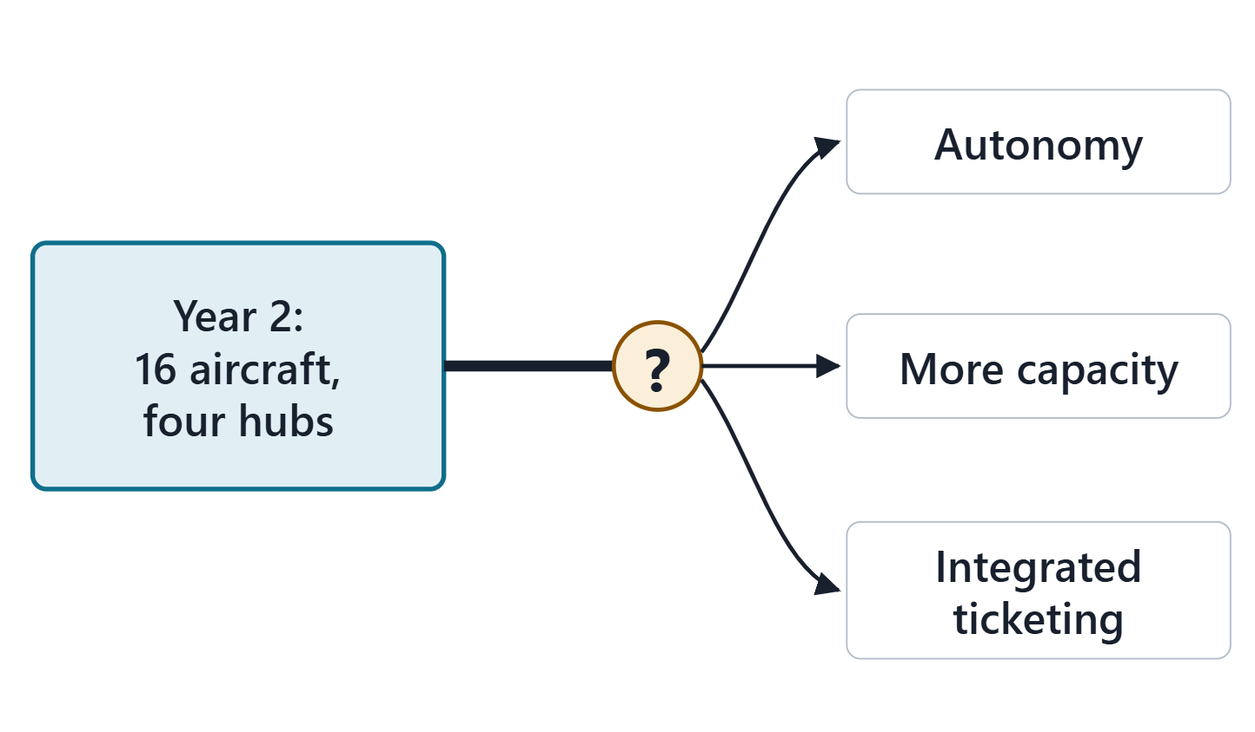
The driving question: after the Year-2 decision, what comes next?
SCENARIO (FICTIONAL)
Week 3 decided AeroLink’s Year-2 plan: four more aircraft and a fourth hub. The board asks what comes next.
A: autonomous operations first
B: more capacity first
C: integrated ticketing first
D: none of the three first
Figure. After the Year-2 decision the board sees three branches and asks which comes first. (FICTIONAL)

Slide 3
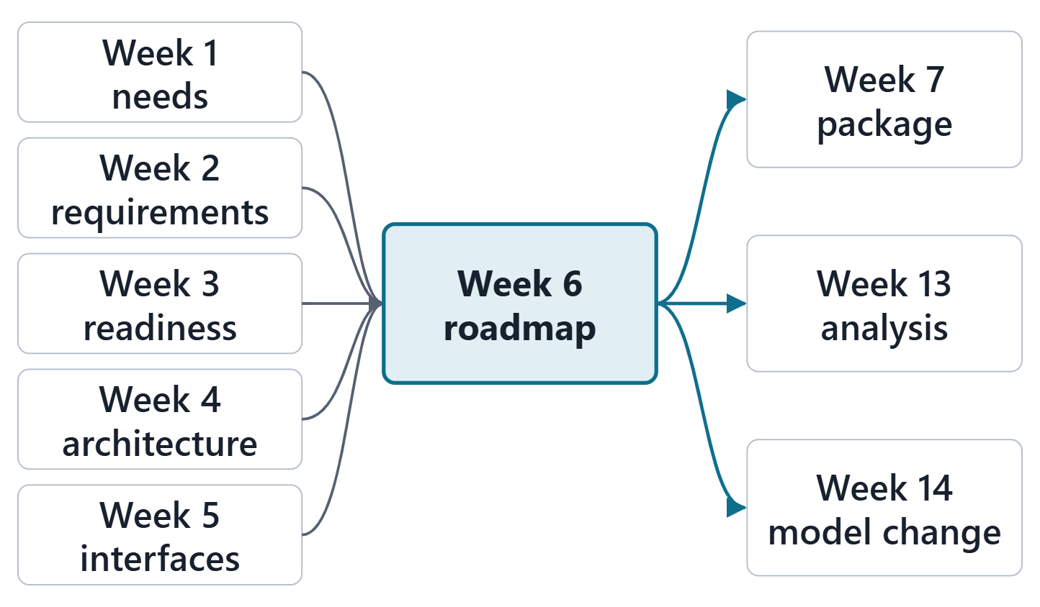
Where Week 6 sits: the roadmap reads every earlier artifact
Weeks 1–2: why change, for whom
Week 3: what is ready, what was decided
Weeks 4–5: where change lands
Week 6 adds when, and in what order
Out: Week 7 package, Week 13 analysis, Week 14 model change
Figure. Weeks 1 to 5 say why, what and where; the roadmap adds when and in what order, and feeds Weeks 7, 13 and 14.

Slide 4
Architecture includes the principles of its evolution
ARCHITECTURE
Fundamental concepts or properties of a system in its environment embodied in its elements, relationships, and in the principles of its design and evolution
R39t · SEBoK v2.14 (2026), "Architecture (glossary)", p.1445
Evolution is part of the architecture, not an appendix
Week 4 described the architecture; Week 6 plans its evolution
Sources: R39t p.1445; R109 p.131

Slide 5
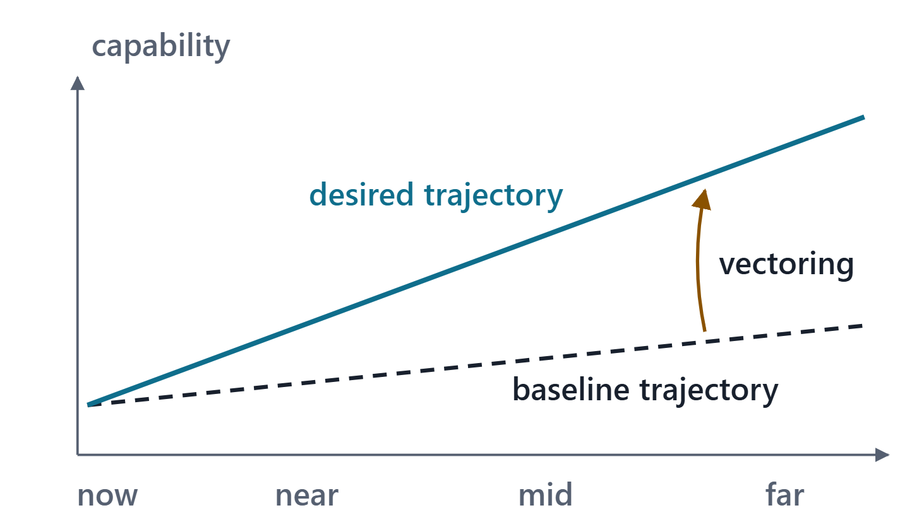
Three kinds of capability, and the baseline trajectory
Three kinds: organizational, system and operational capability
The baseline: current capability plus what is already planned
Capability management vectors the enterprise toward its goals
within its resources and other limits
Figure. The baseline trajectory is where current plans lead; capability management vectors the enterprise toward a better one.
Sources: R12 p.860

Slide 6
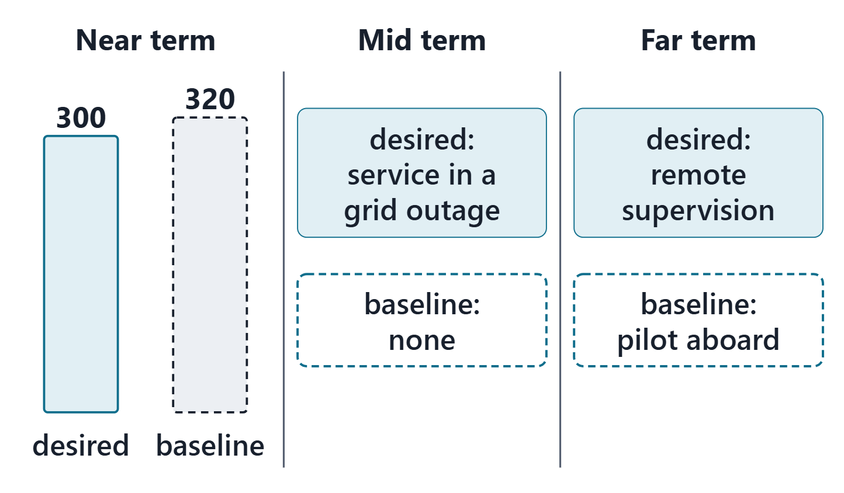
Operational needs, capability gaps and excesses over horizons
Desired levels come from the needs
Compare the desired capability with the baseline
The comparison finds gaps and excesses
Gap: baseline below desired; excess: baseline above it
Map them to near-, mid- and far-term buckets
Choose bucket lengths that fit how fast your enterprise changes
Figure. AeroLink’s desired levels and baseline trajectory in three horizons; compare the near-term levels before reading on. (FICTIONAL)
Sources: R12 p.861; R12 p.862

Slide 7
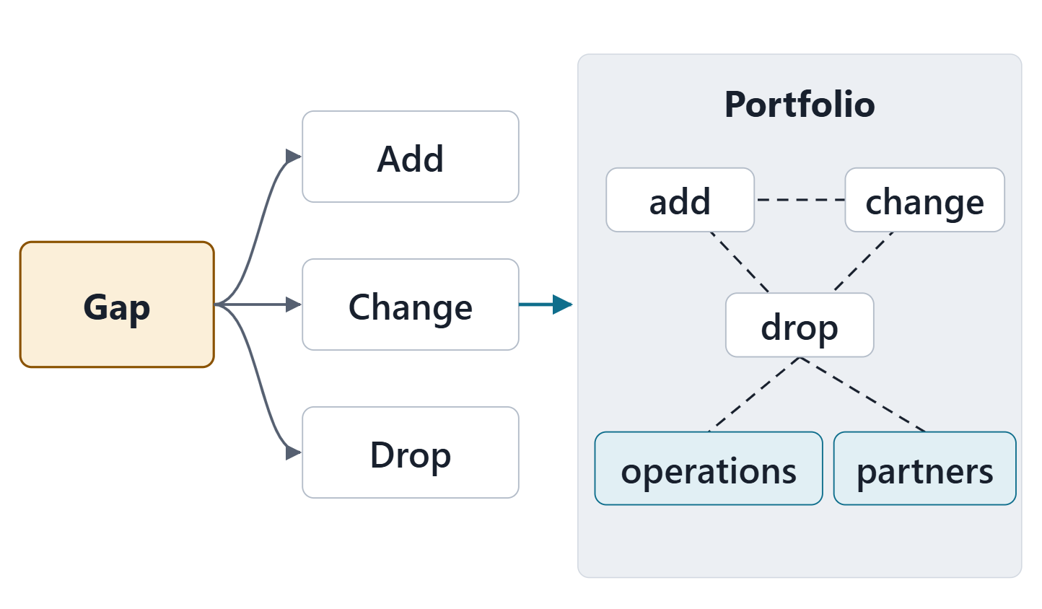
From gaps to changes: architecture, opportunities, portfolio
Architecture shows where elements are added, dropped or changed
Each change has benefits, costs and risks
Opportunities depend on each other, on operations and on partners
So assess them as a portfolio, each with a business case
Figure. A gap becomes candidate changes to the architecture; the candidates depend on each other, so they are judged as a portfolio.
Sources: R12 p.862

Slide 8
The enterprise plan and managing change
THE ENTERPRISE PLAN
Opportunities laid out over a long horizon, aligned with strategic goals; each planned change has a performance target that is monitored, and the plan is adjusted as needed.
Seven lenses for change:
strategic objectives, stakeholders
processes, performance metrics
current state alignment
resources, maturity assessment
Sources: R12 p.863

Slide 9
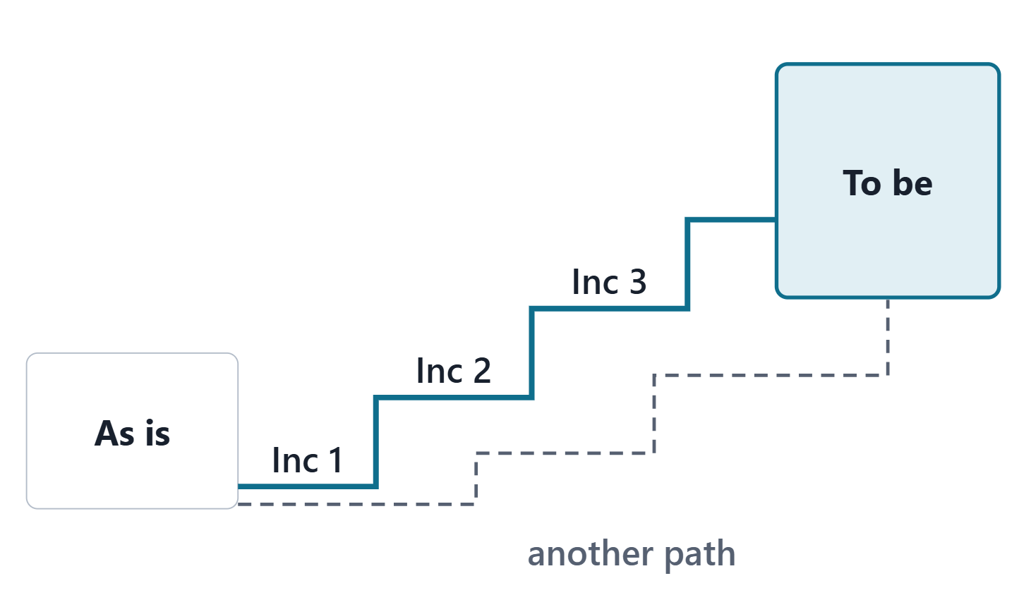
As is, to be, and the roadmap between them
Enterprise architecture: a snapshot of the current environment and of the target
plus an investment roadmap from “as is” to “to be”
As-is and to-be views show migration paths
Architectures help assess different evolutionary paths
Figure. Two snapshots and a path of increments between them; other paths are possible, and views help compare them.
Sources: R109 p.131; R109 p.132; R62 p.345

Slide 10
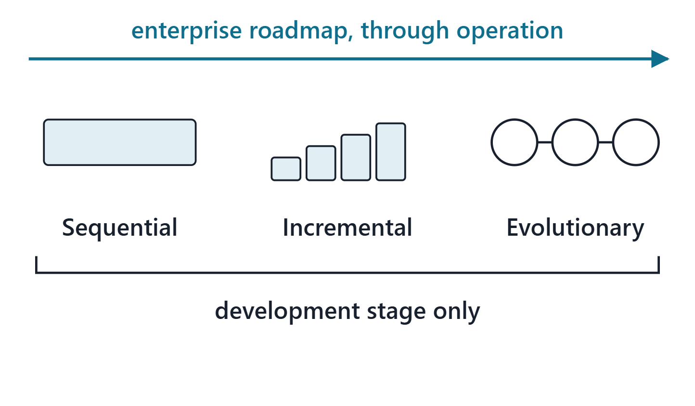
Development approaches: sequential, incremental, evolutionary
Sequential, incremental and evolutionary; the groups overlap
Grouped by how well requirements are known and what increments are for
The adjectives apply to the development stage only
For each increment, say which development approach fits
Figure. Three development approaches under a bracket “development stage only”; the enterprise roadmap runs above them, through operation.
Sources: R108 p.391; R108 p.392; R108 p.393

Slide 11
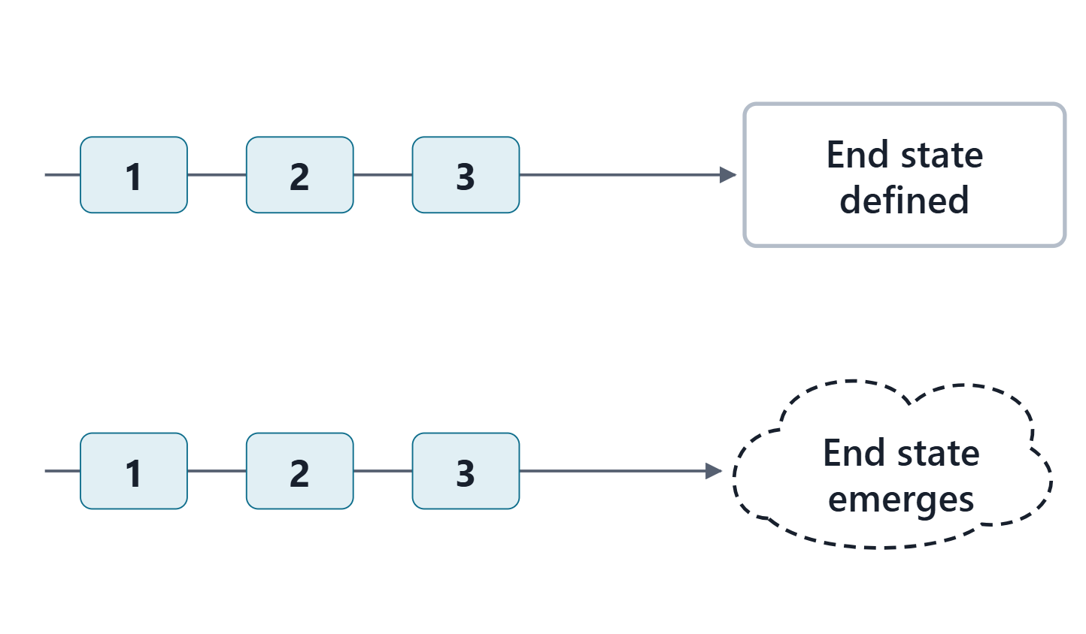
Evolutionary acquisition: two ways to define increments
Deliver capability in increments, planning for future improvement
Insert new technology when it is sufficiently mature
Approach 1: end state known; maturing technology sets each increment
Approach 2: end state unknown; technology matched with evolving needs
Figure. Above, the end state is known and maturing technology fills it; below, the end state emerges with each increment.
Sources: R106 p.582; R106 p.583

Slide 12
Five lessons for planning increments
Lesson | On AeroLink
Architecture first | Every increment builds on the platform (DEC-002)
Expect change | Increments 1 to 3 are revised each review
Users drive content | Operator workload sets the autonomy limit
No technology before its time | Autonomy waits for TRL 6 evidence
Parallel developments | Increments 1 and 2 run in parallel under configuration management
Lessons from MITRE’s evolutionary acquisition article.
Sources: R106 p.583; R106 p.584; R106 p.585

Slide 13
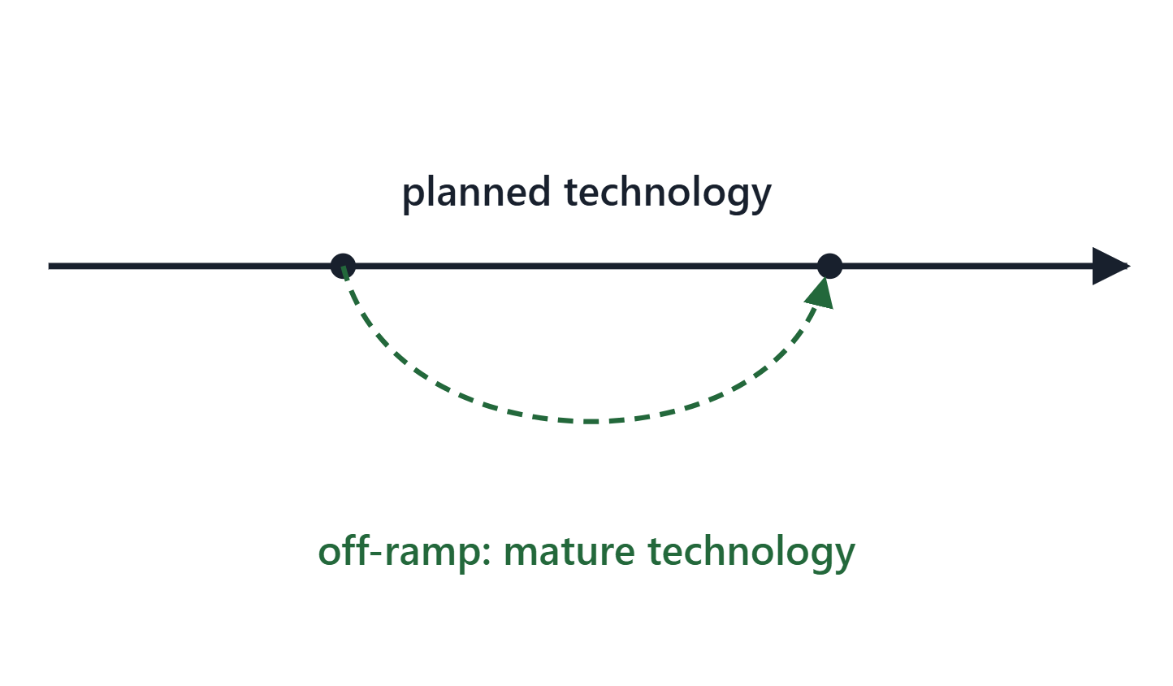
Deferral and off-ramps as risk control
Defer capability to a follow-on increment
Limit the number of critical technologies
Off-ramp: a contingency to use mature technology
Course rule: an increment that inserts an immature technology needs an off-ramp
Figure. The planned path relies on a maturing technology; the off-ramp uses mature technology and rejoins the roadmap.
Sources: R46 p.126

Slide 14
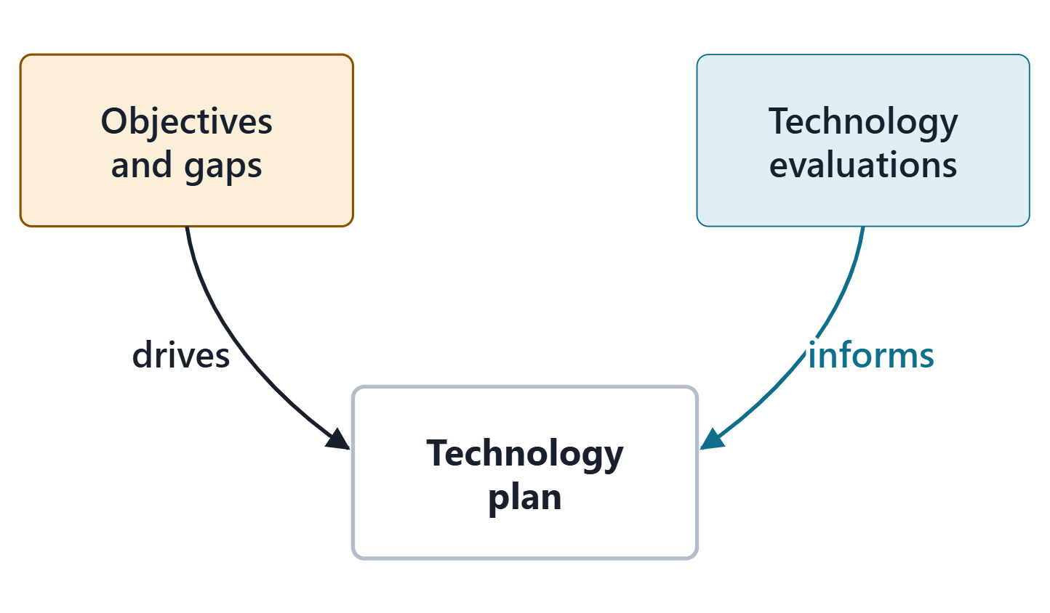
What technology planning is
TECHNOLOGY PLANNING
The process of planning the technical evolution of a program or system to achieve its future vision or end-state
R105 · The MITRE Systems Engineering Guide (2014), "Technology Planning", p.528
Needs and gaps drive the technology needs
Technology evaluations inform the plan
The plan is the roadmap for closing the gaps
Figure. Mission objectives and gaps drive the technology plan; technology evaluations inform it.
Sources: R105 p.528; R105 p.529

Slide 15
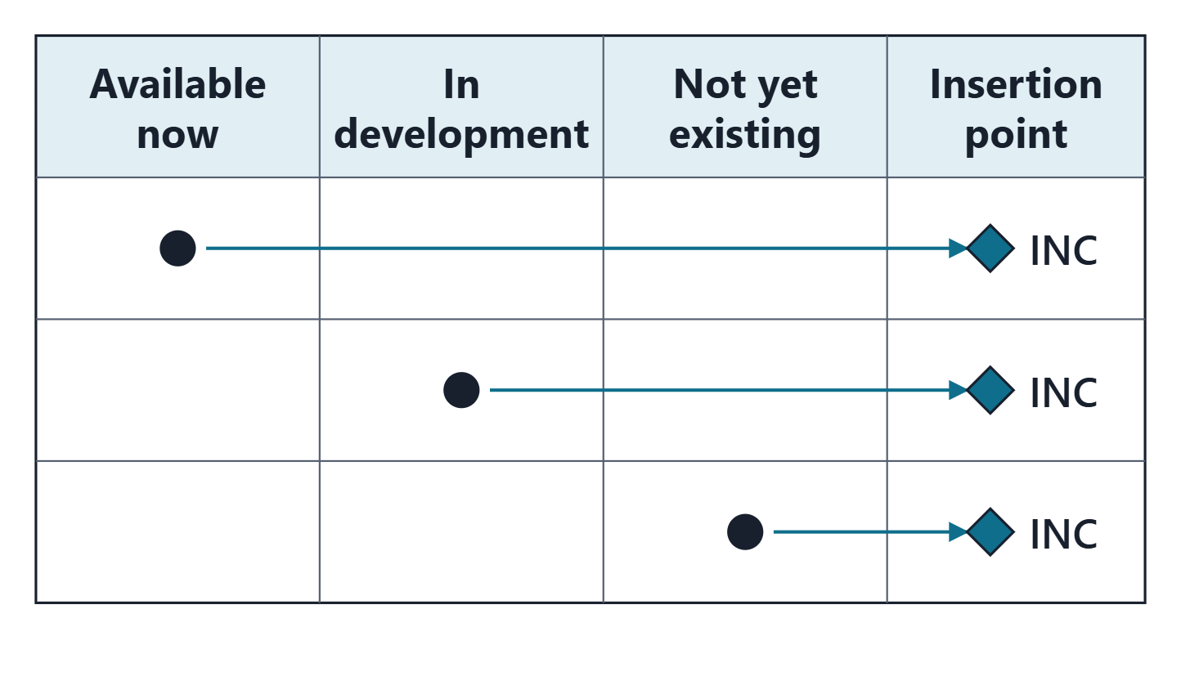
The contents of a technology plan
A plan lists every technology brought to bear
Is each available now, in development, or not yet existing?
Those in development are listed with their maturity levels
Insertion point: the increment that brings it in
Immature technologies carry a risk and a mitigation
Figure. Three columns for every technology brought to bear, and a fourth for its insertion point.
Sources: R105 p.529; R105 p.530

Slide 16
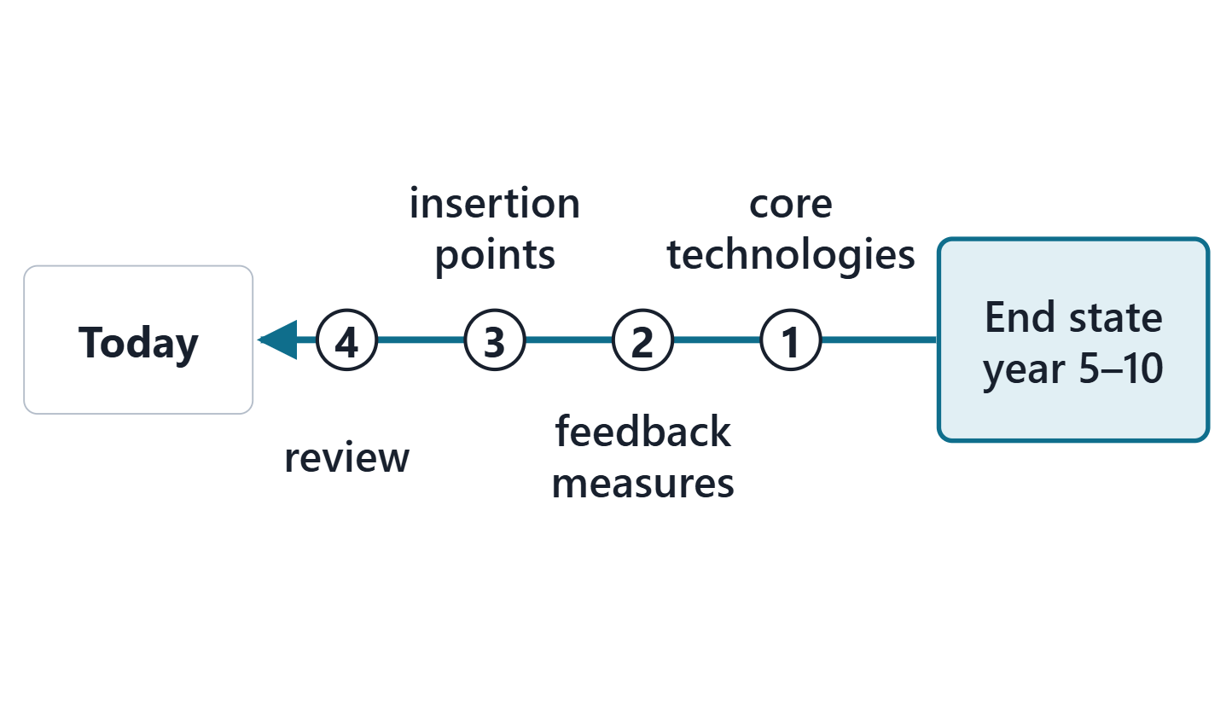
Forming the roadmap: the practice steps
Define results within a horizon, usually 5–10 years, then work back
Core technologies first; assess their maturation risk
Set a quantifiable feedback system
Form the roadmap: phasing, insertion points, investments
Review it annually or at an agreed period
Figure. Define the end state within the horizon, then plan backward to today, with feedback points to measure progress.
Sources: R105 p.530; R105 p.531

Slide 17
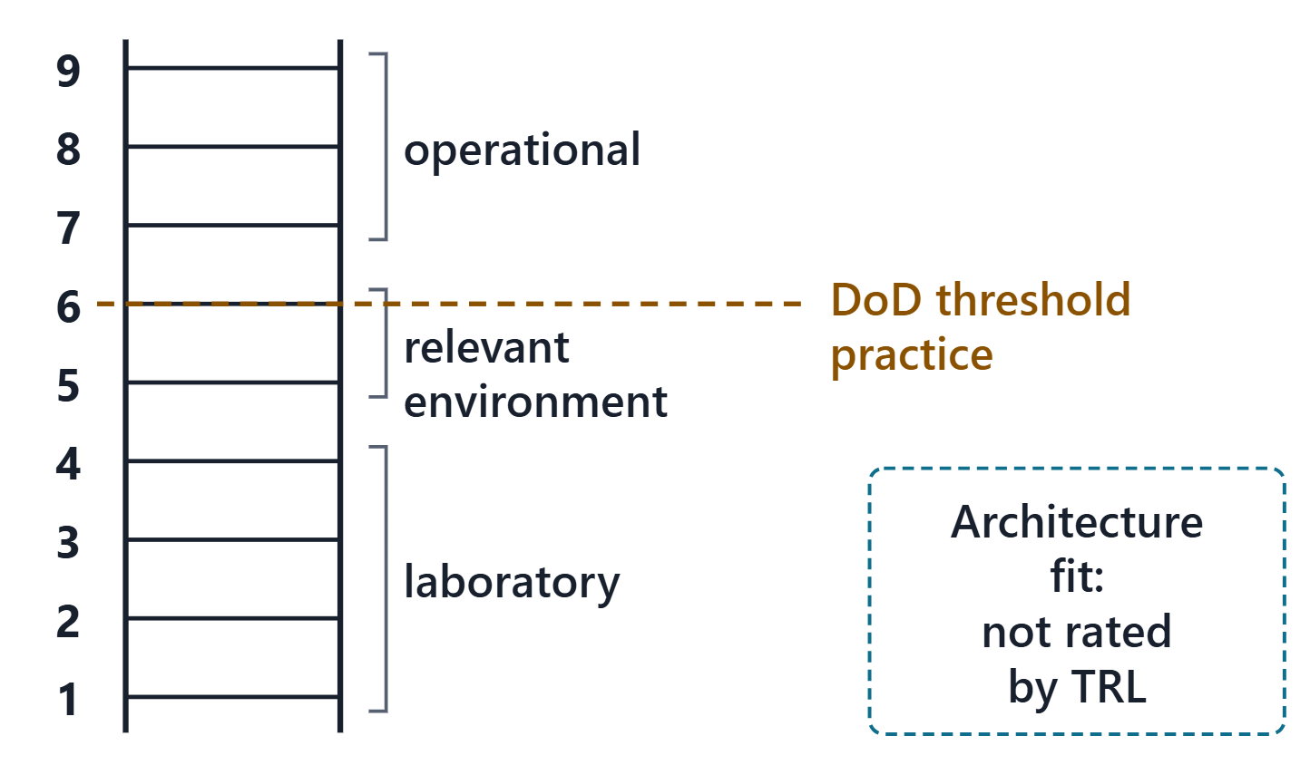
What maturity evidence can and cannot tell you
TRL rates development and testing, from lab to operation
Agree what “relevant environment” means
TRL does not rate fit with the architecture
Integration and system readiness are separate measures
Every TRL rests on evidence or a labeled assumption
Figure. TRL climbs from laboratory to operation; it does not rate how well a technology fits the architecture absorbing it.
Sources: R60 p.525; R60 p.526; R16 p.767; R16 p.768

Slide 18
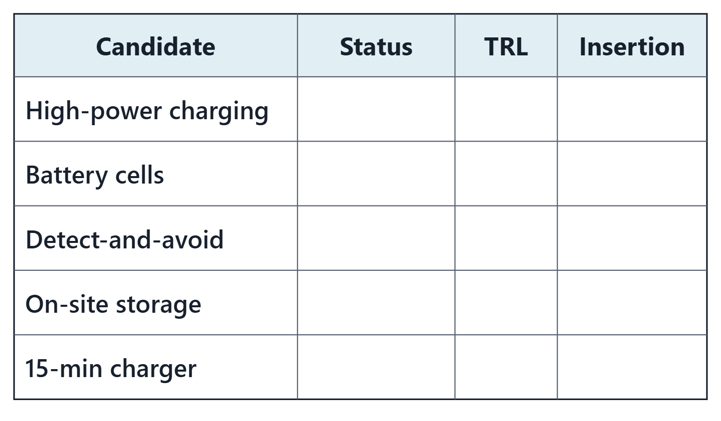
Your turn: classify AeroLink’s technology candidates
PAIRS, 90 SECONDS
Use the Week 3 TRLs from your handout.
For each: available now, in development, or not yet existing?
Which increment, if any, inserts it?
Figure. Five candidates with their status, TRL and insertion point left blank for you to fill. (FICTIONAL)

Slide 19
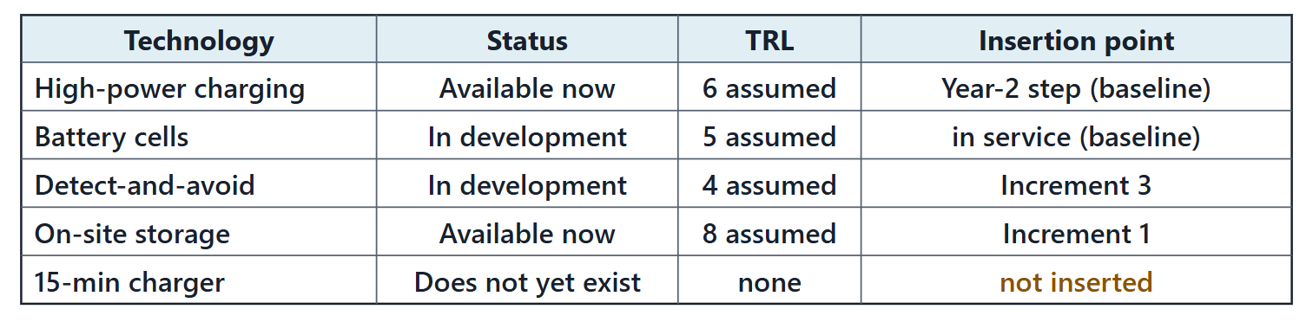
Worked example: AeroLink’s technology plan
Charging: Available, TRL 6 assumed: the committed Year-2 step
Cells: TRL 5, already in service: risk tracked
Autonomy: TRL 4: Increment 3, with an off-ramp
Storage: Product mature, integration unproven: Increment 1
15-min charger: No evidence; adds no trips now: not inserted
Figure. AeroLink’s technology plan: status, assumed TRL and insertion point for each candidate. (FICTIONAL; TRLs are assumptions)
Sources: R105 p.529; R105 p.530; R60 p.525

Slide 20
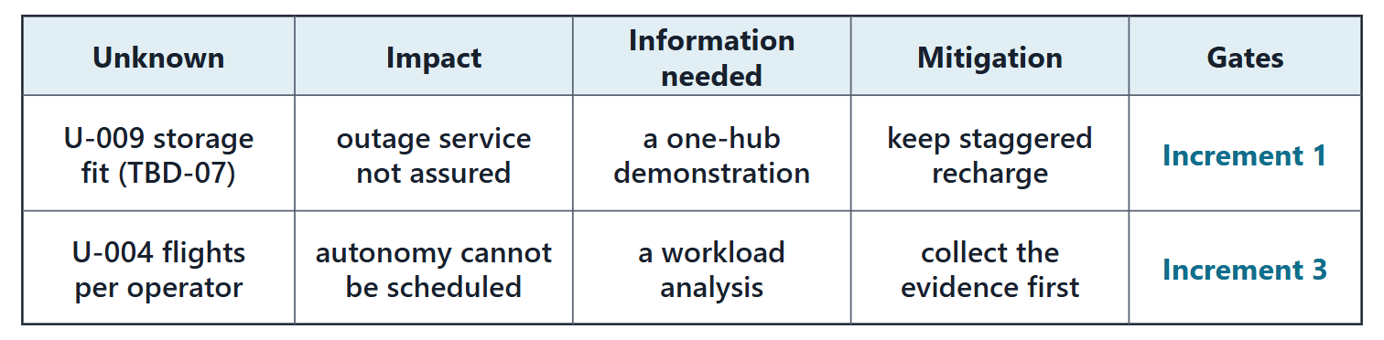
Known unknowns: a managed input to the roadmap
A TBD has no value yet; a TBR has a value held with low confidence
TBX management names the work, the owner and the closure
Each known unknown: impact, information needed and mitigation
Each record names the increment it gates
Figure. Two AeroLink known unknowns in the course record, each gating an increment. (FICTIONAL)
Sources: R13 p.565

Slide 21
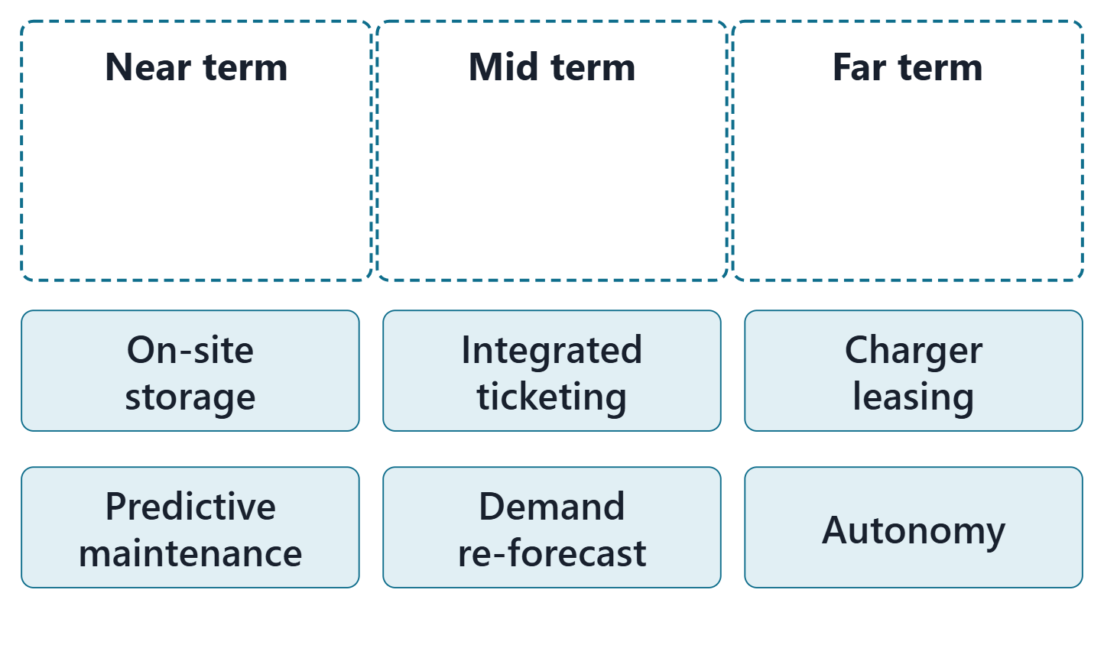
Think, pair, share: place six AeroLink changes on the horizons
PAIRS, TWO MINUTES
Place each card, then name what sets it.
Place six AeroLink changes on near, mid or far
For each, name the evidence or the unknown that sets it
Figure. Three horizon lanes and six change cards, not yet placed: Session 2 places them with reasons. (FICTIONAL)

Slide 22
Exit: one change you would not make yet; preparation for Session 2
ONE-MINUTE PAPER
Name one change to your enterprise you would not make in the near term, and the evidence that would change your mind.
Before Session 2 (about 20 min):
Each member brings one candidate change
with its gap, and the maturity or unknown that sets its timing

Slide 23
References and credits
R12 · SEBoK v2.14 (2026), “Enterprise Capability Management”, p.860–863
R13 · SEBoK v2.14 (2026), “System Requirements Definition”, p.565
R16 · SEBoK v2.14 (2026), “Product Systems Engineering Special Activities”, p.767–768
R39t · SEBoK v2.14 (2026), “Architecture (glossary)”, p.1445
R46 · OUSD(R&E) Systems Engineering Guidebook (2021/2022), “Risk Management Process”, p.126
R60 · The MITRE Systems Engineering Guide (2014), “Assessing Technical Maturity”, p.525–526
R62 · The MITRE Systems Engineering Guide (2014), “Architectural Frameworks, Models, and Views”, p.345
R105 · The MITRE Systems Engineering Guide (2014), “Technology Planning”, p.528–531
R106 · The MITRE Systems Engineering Guide (2014), “Evolutionary Acquisition”, p.582–585
R108 · SEBoK v2.14 (2026), “Development Approach Concepts”, p.391–393
R109 · The MITRE Systems Engineering Guide (2014), “Architectures Federation”, p.131–132
CREDITS AND LICENSES
SEBoK v2.14: “This material is used under a Creative Commons Attribution-NonCommercial ShareAlike 3.0 Unported License from The Trustees of the Stevens Institute of Technology.” (SEBoK, “Bkcase Wiki:Copyright”, PDF p.31). Quotations are short and cited; no SEBoK figure or table is reproduced.
OUSD(R&E) Systems Engineering Guidebook: Distribution Statement A. Approved for public release. Distribution is unlimited.
The MITRE Systems Engineering Guide: © 2014 by The MITRE Corporation. All rights reserved. Approved for public release; distribution unlimited (Case Numbers 10-4072 and 12-1089). Quoted briefly with attribution.
Figures are original drawings for this course; none redraws a figure from the sources.
AeroLink Urban Mobility is a fictional teaching case: every number, name and statement about it is a teaching value.

