Slide 1
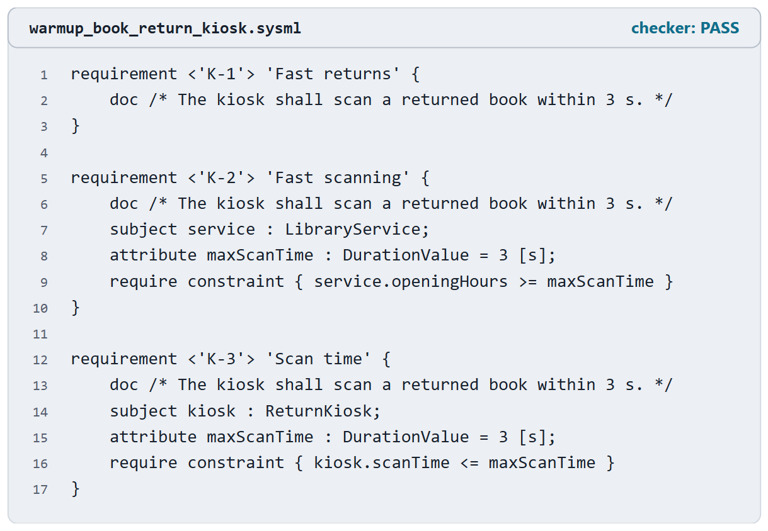
Warm-up: three declarations
Same statement, three models
Which one is right?
What is wrong with the other two?
Figure. Three requirements about a library’s book-return kiosk, with the same statement. Pairs: which one is right, and what is wrong with the other two? (FICTIONAL)

Slide 2
Reveal: subject and constraint decide
K-1: doc only. Nothing to evaluate
K-2: subject is the whole library service; the constraint reads its opening hours, not the kiosk’s scan time
K-3: right. The kiosk’s scan time at most 3 s
KEY POINT
All three pass the checker.
Sources: R83 p.161–162

Slide 3
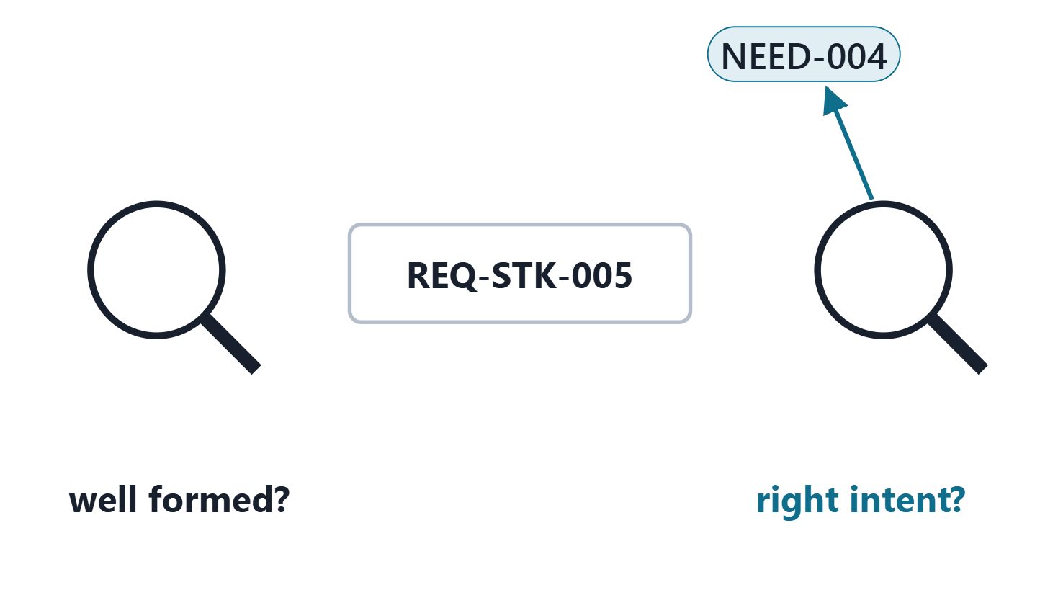
Requirement verification and requirement validation
Requirement verification: well formed? (the organization’s characteristics and rules)
Requirement validation: the right requirements? (the intent of the needs and parents)
Not system verification and validation (Week 12)
Methods: peer review; comparison with characteristics and with the needs
Figure. Two questions about one requirement: is it well formed, and is it the right requirement, true to the need it came from? Course illustration, not SysML v2 graphical notation.
Sources: R13 p.566

Slide 4
What the model makes visible, and what a reviewer must decide
Characteristic | The model makes visible | A reviewer decides
Traceable | a derivation to a parent | is it the right parent?
Verifiable | a constraint, a method | can the criterion be tested?
Unambiguous | nothing | does every reader read it alike?
Right limit, right subject | nothing | always
From the DoD list of attributes of good requirements
Sources: R48b p.144; R13 p.566

Slide 5
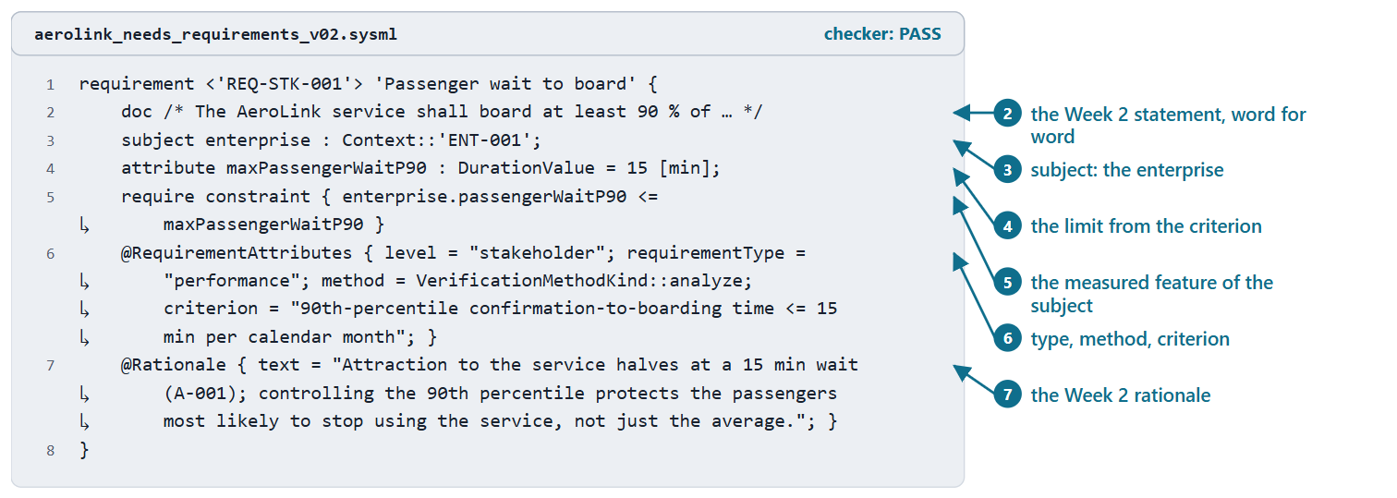
Worked example III: anatomy of a stakeholder requirement
ID and statement: the Week 2 row, word for word
Subject: the enterprise (course convention)
Limit and required constraint: the Week 2 criterion
Attributes and rationale: the Week 2 columns
Parent: a derivation from the Week 1 need
Figure. REQ-STK-001 in AeroLink model v0.2, generated from its Week 2 row: statement, subject, limit, required constraint, attributes and rationale (the doc is shortened on the slide). Checked: PASS. (FICTIONAL)
Sources: R83 p.161; R83 p.165; R114 p.555; R84 p.175

Slide 6
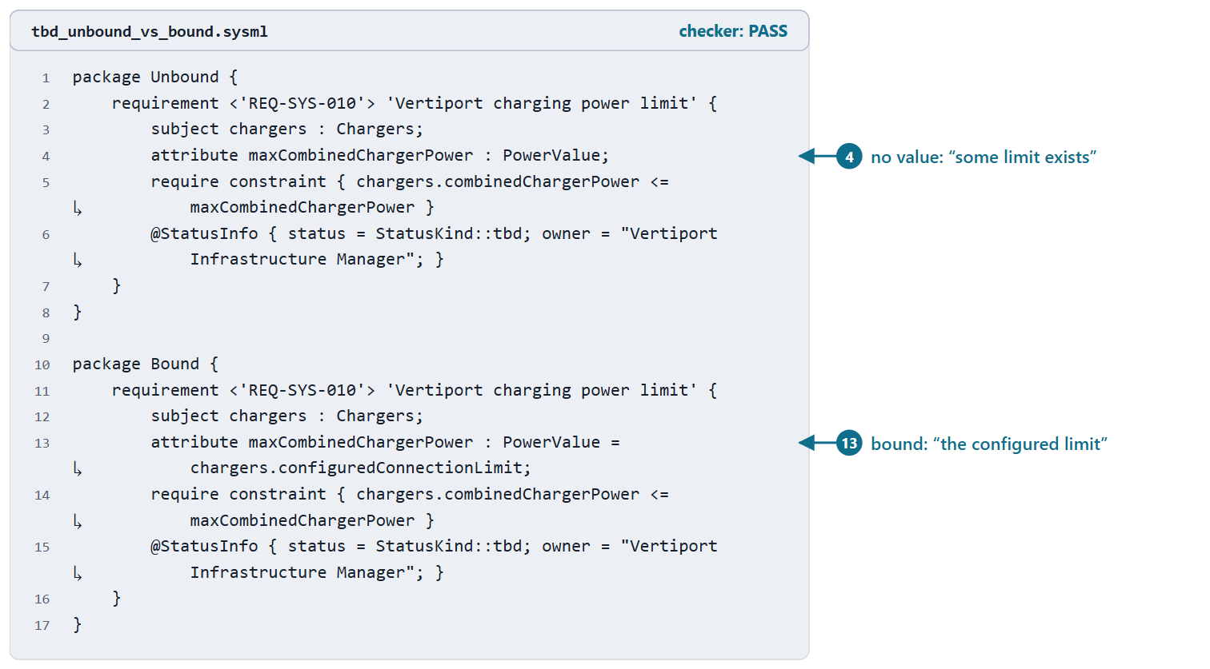
Worked example IV: a limit that is still to be decided
The constraint stays; StatusInfo records tbd and the owner
Unbound limit: reads as “some limit exists”
Bound to the configured value: reads as intended
A TBD is a recorded status with an owner, never a missing constraint
Figure. REQ-SYS-010 written two ways: the limit left unbound, as in model v0.2, and the limit bound to the value configured in the chargers. Both PASS the checker; only the second says what is meant. (FICTIONAL)
Sources: R114 p.556–557; R83 p.168

Slide 7
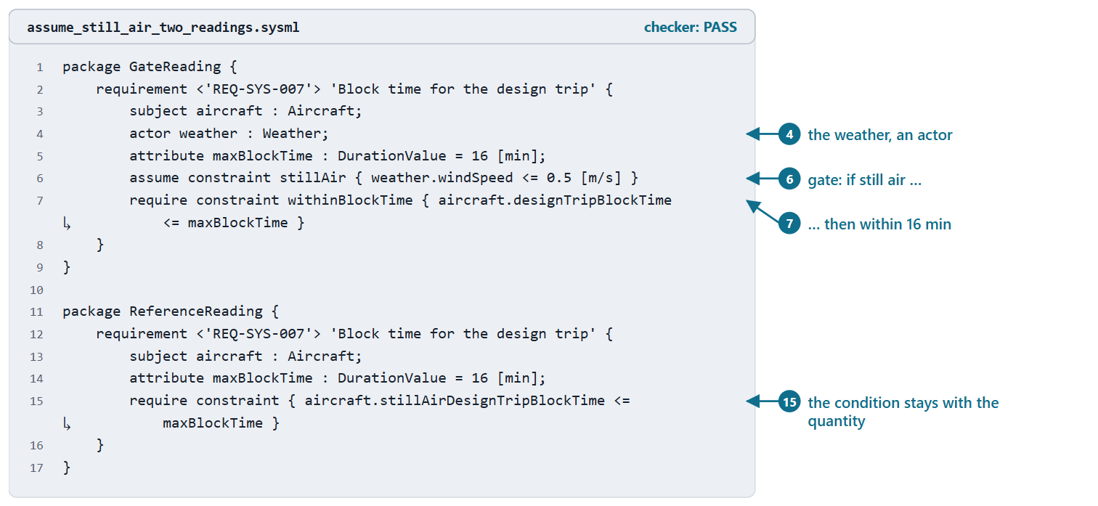
Worked example V: “in still air”: gate or reference condition?
Gate: weather as an actor; assume still air; require the block time
The block time is one still-air design value: in wind, the gate only switches the requirement off
Reference reading: the condition names the quantity; verification corrects to still air
Use an assumption when the condition bounds applicability
Figure. REQ-SYS-007 read two ways: “in still air” as an assumption about the weather (a gate), and as part of the quantity measured (a reference condition). Both PASS the checker. The 0.5 m/s still-air tolerance is a teaching value. (FICTIONAL)
Sources: R83 p.162; R83 p.165

Slide 8
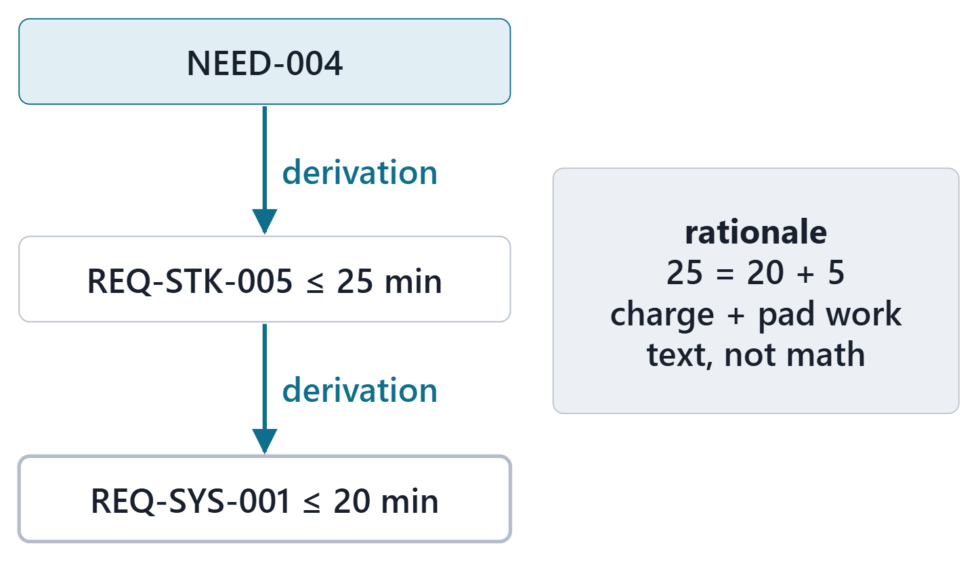
Worked example VI: a full derivation chain
NEED-004 → REQ-STK-005 → REQ-SYS-001
Each: any subject satisfying the parent should satisfy the child
The arithmetic, 25 = 20 + 5 min, is in the rationale
The derivation asserts the relation; it computes nothing
Figure. NEED-004 → REQ-STK-005 → REQ-SYS-001 in AeroLink model v0.2: two derivation connections, and the arithmetic that justifies them in the rationale. Course illustration, not SysML v2 graphical notation. (FICTIONAL)
Sources: R115 p.580–581

Slide 9
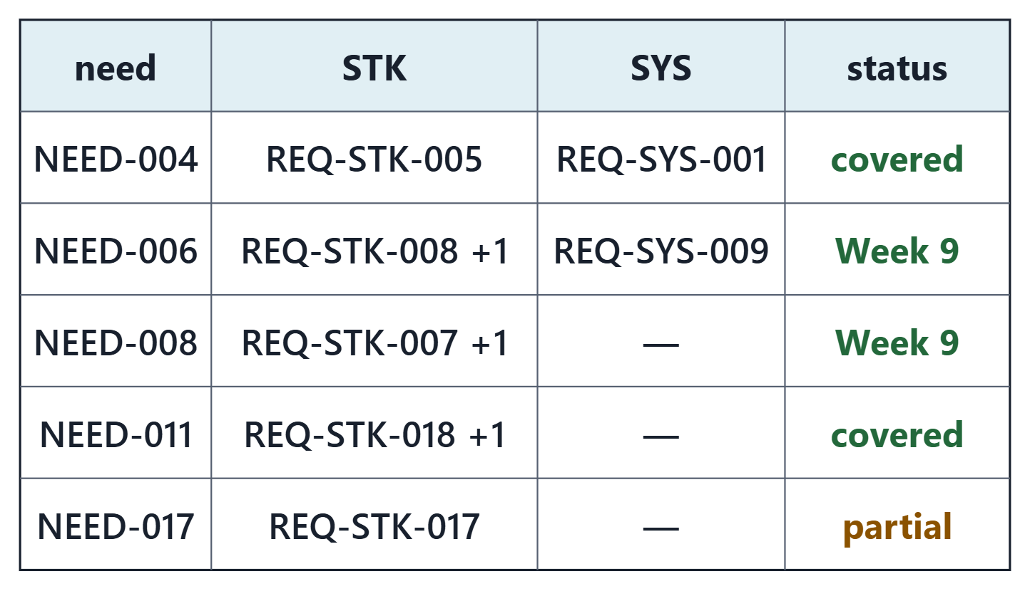
The trace matrix, read from the model
Every one of the 17 needs has a stakeholder requirement
Week 2 left three partly covered; Week 9 writes REQ-STK-020 and REQ-STK-021
one still open: NEED-017
nine stakeholder requirements have no system requirement yet
Each gap gets a disposition, never a borrowed link
Figure. A fragment of the AeroLink trace matrix, computed from the derivations in model v0.2, with the Week 2 open items the derivations cannot show. Course illustration, not SysML v2 graphical notation. (FICTIONAL)

Slide 10
Common errors in modeled requirements
Error | Instead
Enterprise subject on a system requirement | Element the shall is about
Doc only | Constraint, or recorded TBD
Definition where a usage was meant | Usage carries the ID
satisfy between requirements | Derivation
Unquoted hyphenated ID | Quoted short name
Mixed-subject group satisfied | Satisfy its members
Every concern framed | Only answered concerns
Sources: R83 p.161–162; R83 p.165; R83 p.168; R74 sl.90

Slide 11
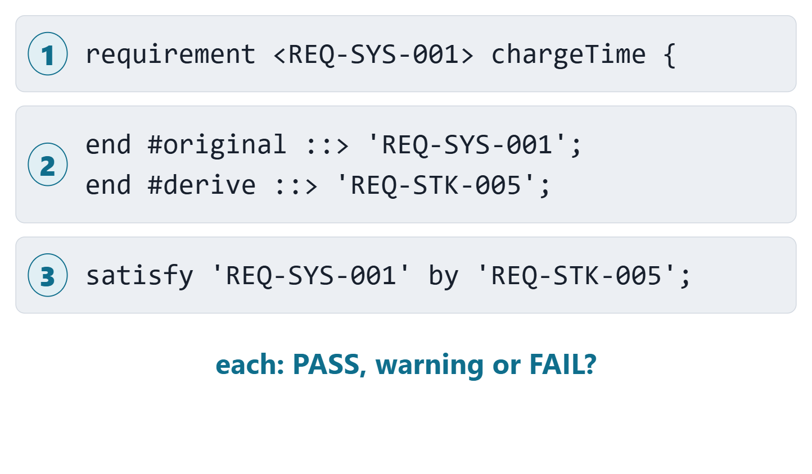
Predict the checker
1 · an ID without quotes
2 · a derivation with its ends swapped
3 · satisfy written between two requirements
For each: PASS, PASS with a warning, or FAIL?
Figure. Three listings to judge before the reveal: predict PASS, PASS with a warning, or FAIL, and say whether each says what it means. Course illustration, not SysML v2 graphical notation.

Slide 12
Reveal: all three are wrong; only the syntax error is rejected
Listing | Recorded result | Says what it means?
1 · unquoted ID | FAIL | No, and caught
2 · swapped derivation | PASS, no message | No, not caught
3 · satisfy between requirements | PASS, one warning | No, only a type warning
Sources: R115 p.580; R83 p.168

Slide 13
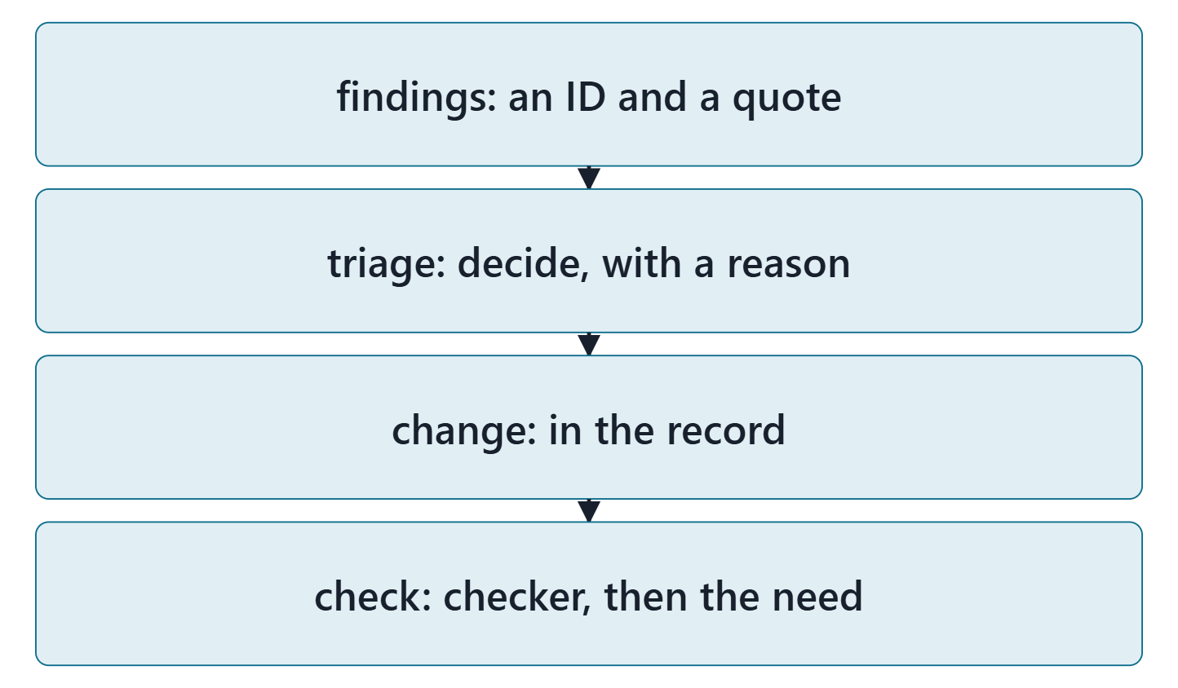
The method: AI findings are candidates to disposition
Export the requirements and their needs
Ask for findings in four categories, each with an ID and a quote
Decide each: accept or reject, with a reason
Change, re-run the checker, re-read against the need
COURSE METHOD
The AI sees only the text: “missing information” is a prompt, not a fact.
Figure. The course method for AI-assisted review: findings in, a decision and a reason for each, a change with an ID, then the checker and an intent re-read. Course illustration, not SysML v2 graphical notation.
Sources: R13 p.566

Slide 14
Demonstrated on AeroLink: a seeded review set
# | Draft | Category | Quoted phrase
1 | DRAFT-01 | ambiguity | “promptly”
2 | DRAFT-02 | duplication | “within 90 s”
3 | DRAFT-03 | conflict | “70 dBA LAmax”
4 | DRAFT-04 | missing information | “charge an aircraft”
5 | DRAFT-05 | duplication | “The booking function”
6 | DRAFT-06 | missing information | “before it asks”
7 | DRAFT-04 | conflict | “within 20 min”
8 | DRAFT-02 | ambiguity | “at least 99 %”

Slide 15
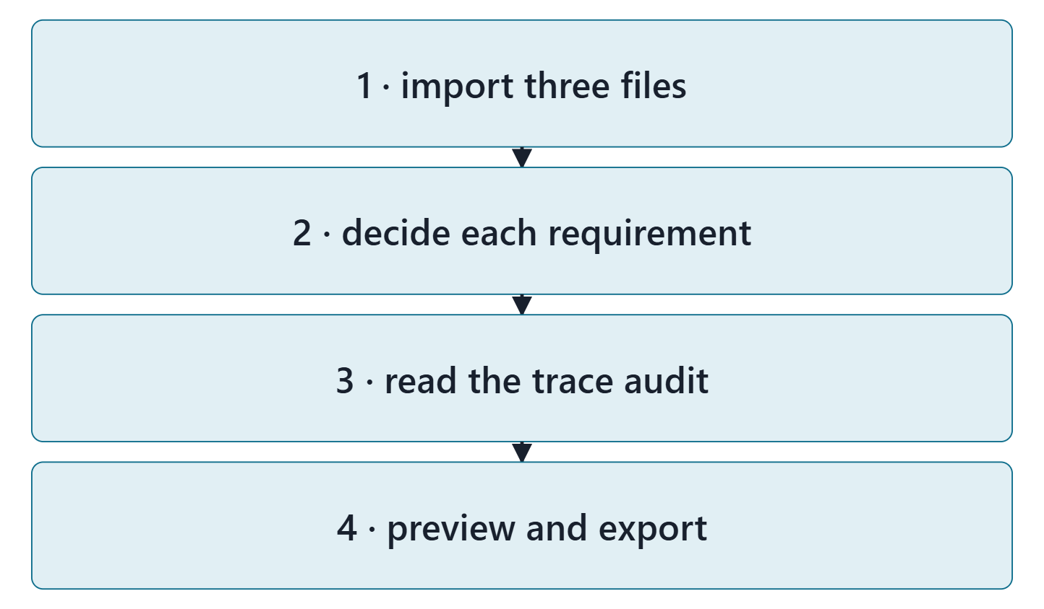
Mapping your package into the model: the lab tool
Needs → Needs: subject the enterprise, stakeholder, frame
Requirements → Requirements: subject, constraint, metadata
Parents → derivations; capabilities wait for Week 10
Per system requirement: decide the subject now (a placeholder if needed)
Figure. The Week 9 lab tool in four steps: import three files, decide each requirement, read the trace audit, preview and export. Course illustration, not SysML v2 graphical notation.

Slide 16
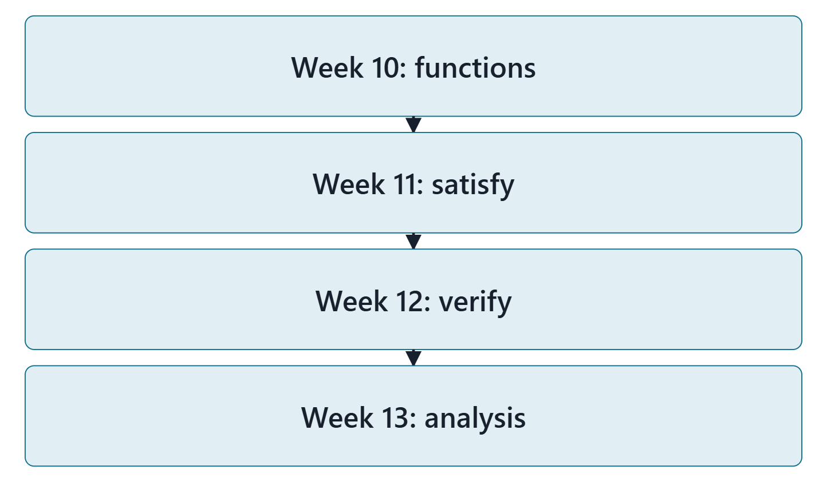
Bridge: where requirements go next
Week 10: functions and capabilities; the capability parents linked
Week 11: physical elements; the first defensible satisfy claims
Week 12: verification cases that verify requirements
Week 13: analysis cases that evaluate constraints
Figure. The requirements modeled this week are what Weeks 10 to 13 connect to: functions, design elements, verification cases and analyses. Course illustration, not SysML v2 graphical notation.

Slide 17
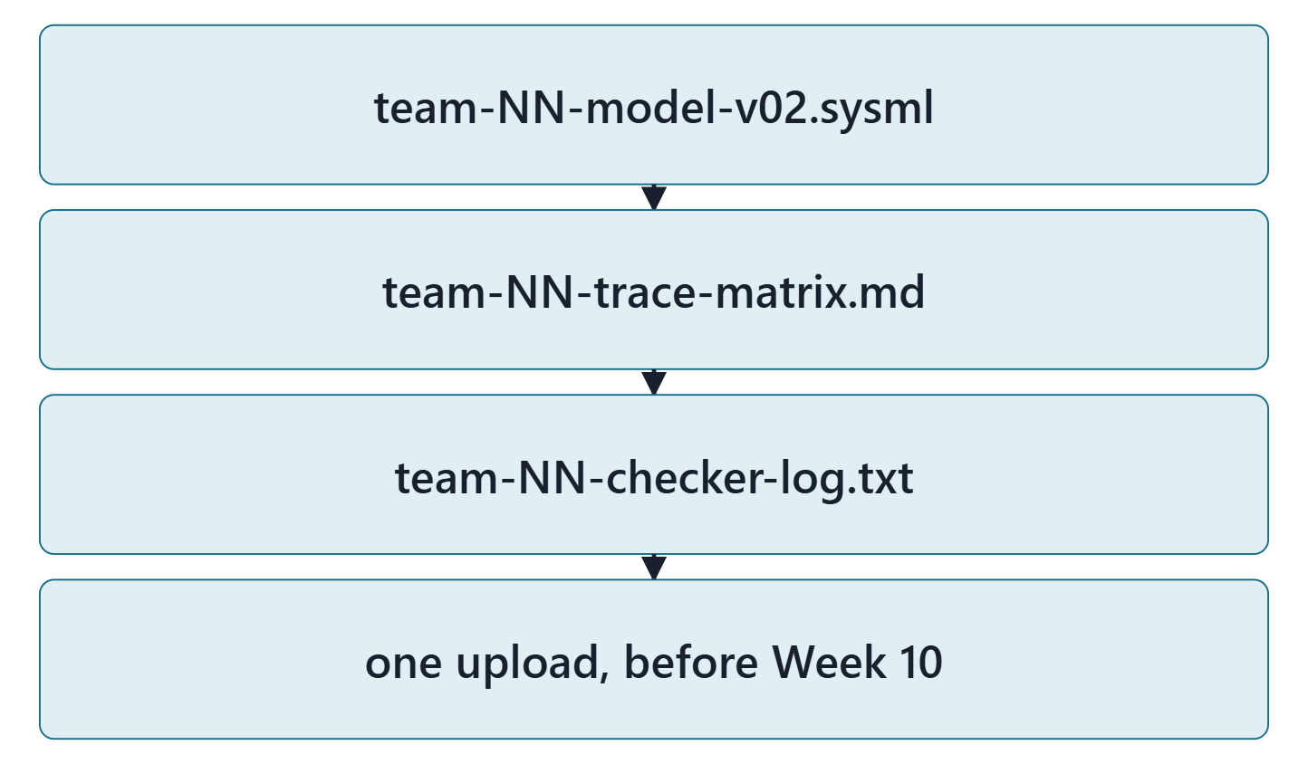
Lab L9: model v0.2 of your enterprise
Due before Week 10, Session 1, on the LMS; your own enterprise, never AeroLink
Your own enterprise, never AeroLink
Three files: team-NN-model-v02.sysml, team-NN-trace-matrix.md, team-NN-checker-log.txt
Zero checker errors; every warning explained
Formative feedback before Week 10, Session 2
Figure. Lab L9 deliverables: three files, one upload (course convention). Course illustration, not SysML v2 graphical notation.

Slide 18
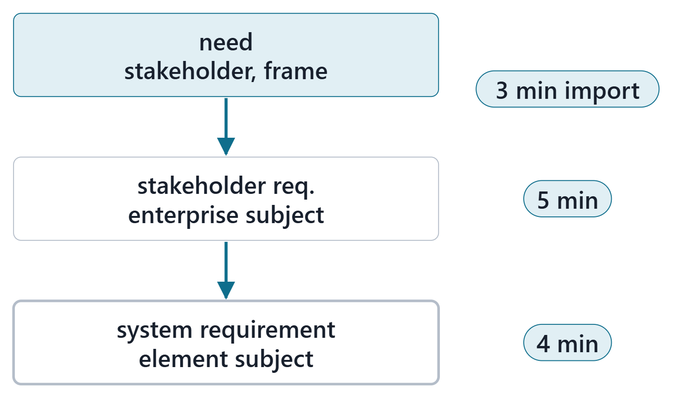
Team work: model one chain end to end
12 minutes, in teams, in the Week 9 lab tool
Import your Week 8 model and your Week 1 and Week 2 exports
Pick one need with a stakeholder requirement and a system requirement under it
Formalize both requirements: subject, feature, comparison, limit
Preview: find your two derivations in the text
Figure. In class: one need, its stakeholder requirement and one system requirement, with subject, constraint and both derivations, previewed in the lab tool. Course illustration, not SysML v2 graphical notation.

Slide 19
Instructor checkpoint
Per team: the system requirement’s subject, its constraint, one derivation
Show: the system requirement’s subject
Show: its required constraint, read aloud
Show: one derivation: which end is the parent?
Note one fix to make before day 2

Slide 20
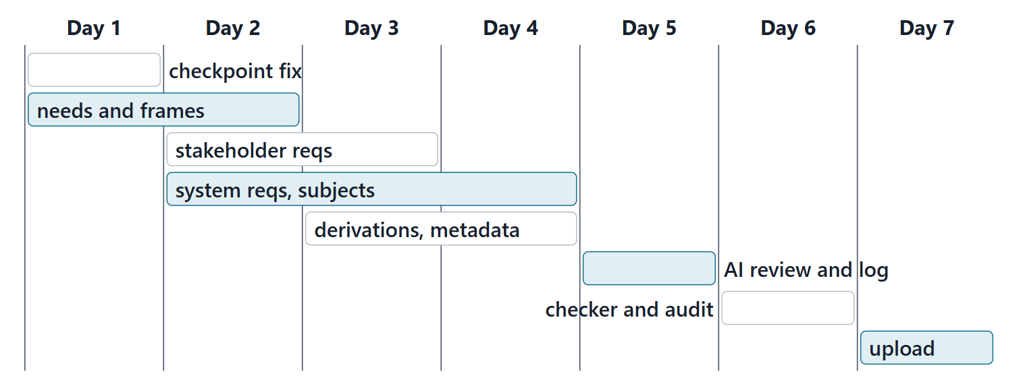
Close: the next seven days
Quiz Q9 and the applied exercise open today. Log your hours.
Figure. A suggested seven-day plan for Lab L9, with the lead role for each task (course convention). Course illustration, not SysML v2 graphical notation.

Slide 21
References and credits
R13 · SEBoK v2.14 (2026), “System Requirements Definition”, p.557–558, 564, 566
R48b · OUSD(R&E) Systems Engineering Guidebook (2021/2022), “Requirements Analysis Process”, p.144
R74 · Seidewitz, Intro to the SysML v2 Language: Textual Notation (Release 2026-08), “Requirement Definitions”, sl.86–91
R83 · OMG SysML v2.1 Beta 2, Part 1 (Release 2026-07), “7.21 Requirements”, p.161–162, 165–168
R84 · OMG SysML v2.1 Beta 2, Part 1 (Release 2026-07), “7.23 Analysis Cases”, p.175–176
R114 · OMG SysML v2.1 Beta 2, Part 1 (Release 2026-07), “9.3.2 Modeling Metadata”, p.555–557
R115 · OMG SysML v2.1 Beta 2, Part 1 (Release 2026-07), “9.6 Requirement Derivation Domain Library”, p.580–583
CREDITS AND LICENSES
Introduction to the SysML v2 Language, Textual Notation (Release 2026-08): Copyright © 2019–2026 Model Driven Solutions, Inc. Licensed under the Creative Commons Attribution 4.0 International License (CC BY 4.0).
SEBoK v2.14: “This material is used under a Creative Commons Attribution-NonCommercial ShareAlike 3.0 Unported License from The Trustees of the Stevens Institute of Technology.” (SEBoK, “Bkcase Wiki:Copyright”, PDF p.31). Quotations are short and cited; no SEBoK figure or table is reproduced.
OUSD(R&E) Systems Engineering Guidebook: Distribution Statement A. Approved for public release. Distribution is unlimited.
Figures are original drawings for this course; none redraws a figure from the sources.
AeroLink Urban Mobility is a fictional teaching case: every number, name and statement about it is a teaching value.

