Slide 1
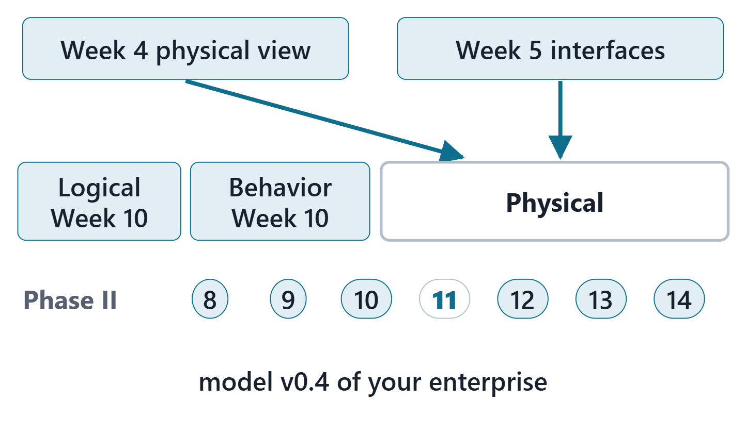
Physical / Interfaces
Session 1: Physical architecture, allocation and ports
Today: the physical architecture, its allocation and ports
Session 2: interfaces, connections, flows, interface requirements, satisfy claims, the Lab L11 launch
Your output: model v0.4 of your own enterprise
Figure. Week 11 fills the Physical package of your model from the Week 4 physical view and the Week 5 components and interfaces; Logical and Behavior were filled in Week 10. Course illustration, not SysML v2 graphical notation.

Slide 2
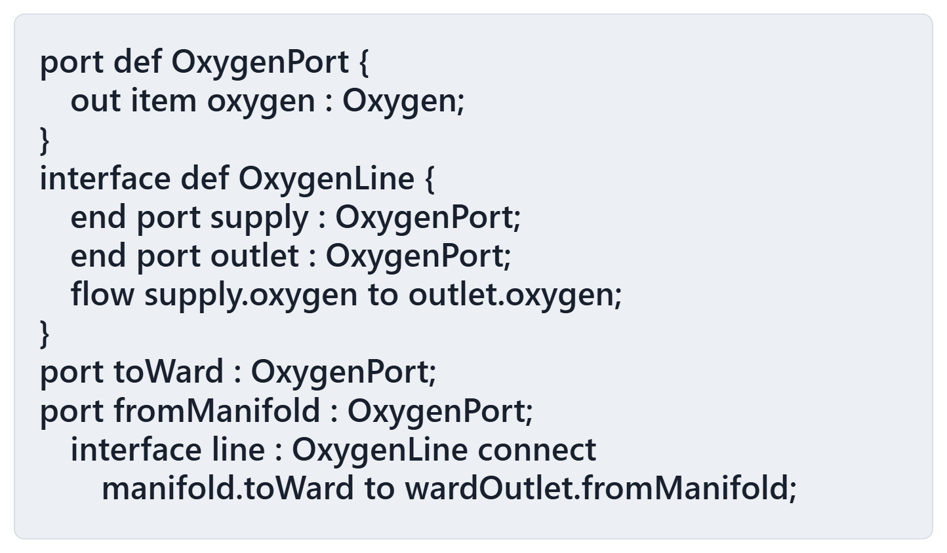
Driving question: the interface connects two typed ports. Does the oxygen arrive?
VOTE
The manifold sends oxygen. Which is true?
A · The oxygen reaches the ward outlet
B · No port here can receive the oxygen
C · The checker rejects this file
D · It cannot be told from the text
Figure. A hospital oxygen supply: a port definition, an interface definition and the interface that connects a manifold to a ward outlet. Course illustration, not SysML v2 graphical notation. (FICTIONAL)

Slide 3
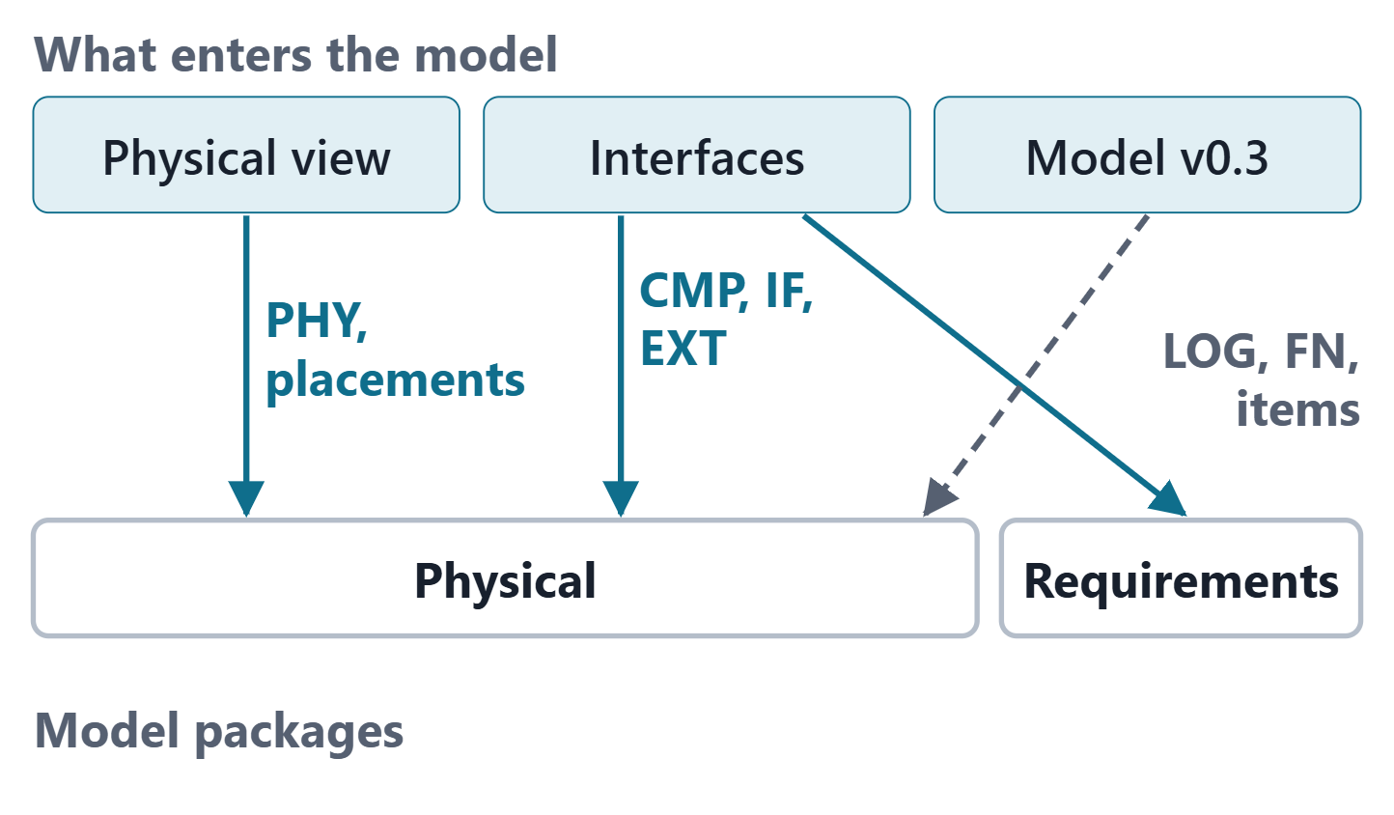
What Week 11 imports from Phase I
Week 4: physical elements; each function placed on one; information items with producers and consumers
Week 5: components, interfaces with their ends and crossings, interface requirements, externals
Week 10: logical parts, functions, items; Week 9 placeholders in Physical
Same IDs throughout
Figure. The sources of this week and the model packages they enter, with the ID prefixes that cross: PHY from the physical view, CMP, IF and EXT from the components and interfaces, and the logical parts and placeholders of model v0.3. Course illustration, not SysML v2 graphical notation.

Slide 4
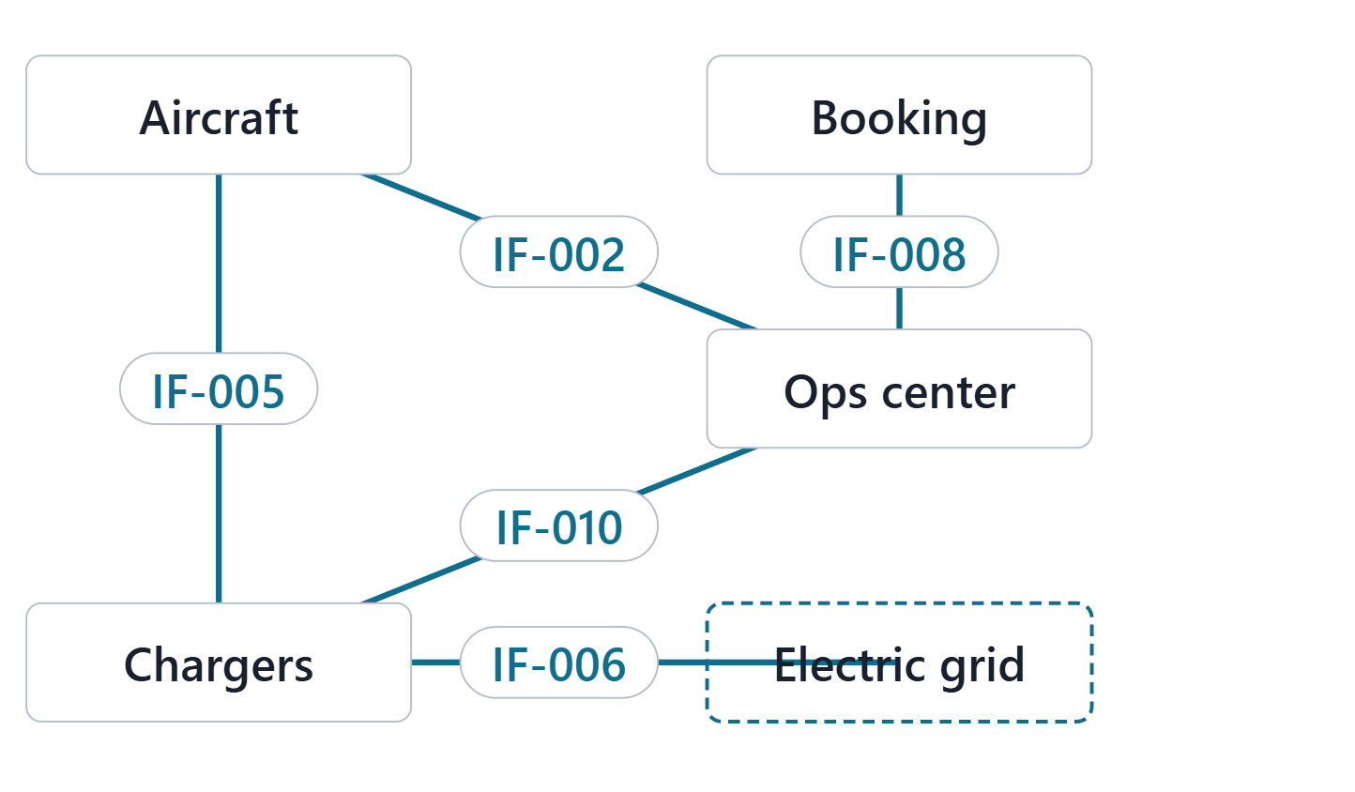
Physical architecture: elements and physical interfaces
PHYSICAL ARCHITECTURE MODEL (SEBOK)
“an arrangement of physical elements, (system elements and physical interfaces) that provides the solution for a product, service, or enterprise”
R20c · SEBoK v2.14 (2026), "Physical Architecture", p.596
A physical interface binds two system elements together
It accommodates the logical architecture and trades off the system requirements
System requirements are allocated to both architectures
Figure. Four AeroLink physical elements, one external, and the interfaces that bind them, read from the Week 5 interfaces of model v0.4. Course illustration, not SysML v2 graphical notation. (FICTIONAL)
Sources: R20c p.596; R20c p.597

Slide 5
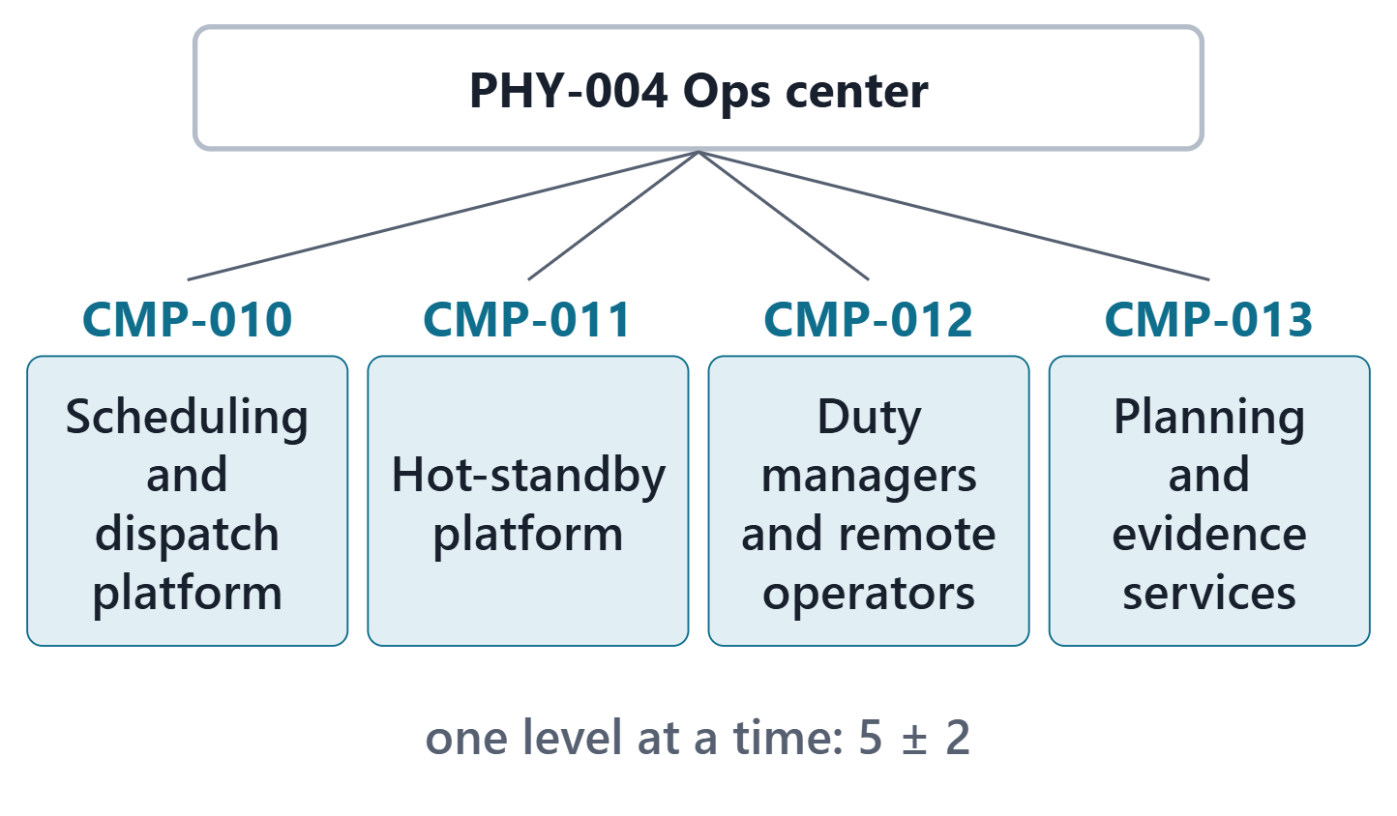
Layers: elements and their components
A system element may itself be a system: layers
Guideline: five plus or minus two elements in one level
Week 5 components sit one level below their element
AeroLink: 8 physical elements, 15 components
Figure. The AeroLink operations center and its four Week 5 components, one level down. Course illustration, not SysML v2 graphical notation. (FICTIONAL)
Sources: R20c p.597; R81 p.90

Slide 6
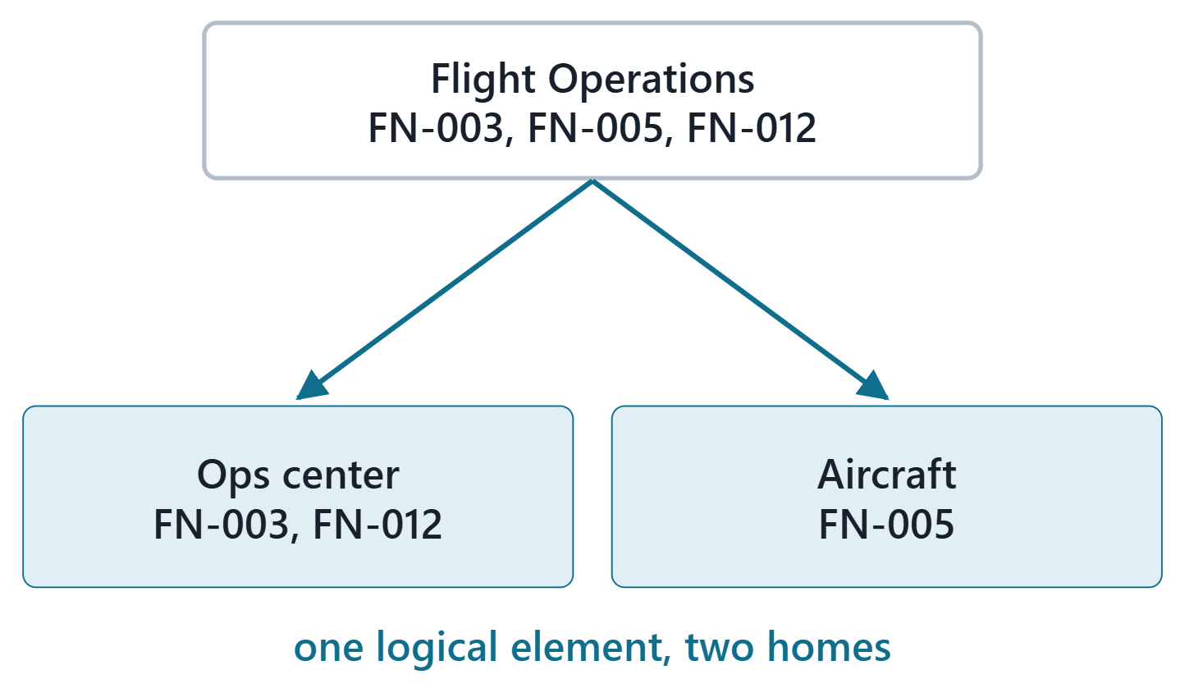
Allocating logical elements to physical elements
Find elements that can perform the functions, and interfaces that can carry the flows
Criteria: same kind of flow (information, energy, material), central or distributed control, environment, dependability
A logical element may land on several physical ones
Figure. LOG-001 Flight Operations in AeroLink: the functions it performs land on two physical elements, so the logical element has two physical homes. Course illustration, not SysML v2 graphical notation. (FICTIONAL)
Sources: R20c p.598; R20c p.599

Slide 7
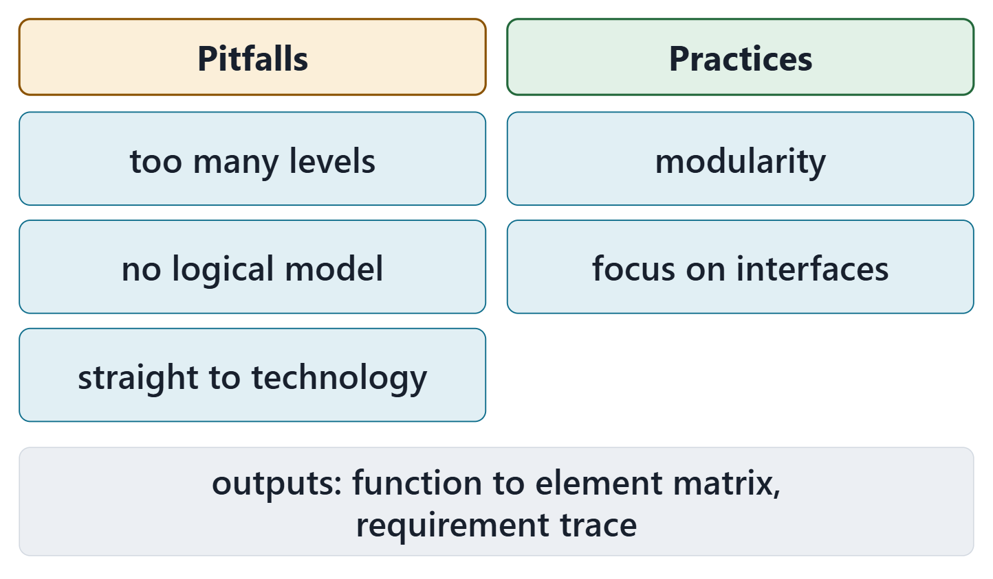
Pitfalls, proven practices and the outputs
Pitfalls: too many levels in one block; no logical architecture; allocating straight onto technologies
Practices: modularity; focus on interfaces
Outputs: an allocation matrix of functions to elements; a trace to the system requirements
Figure. SEBoK’s three pitfalls and two proven practices for physical architecture, in short form, and the two matrices the process outputs. Course illustration, not SysML v2 graphical notation.
Sources: R20c p.600; R20c p.602; R20c p.603

Slide 8
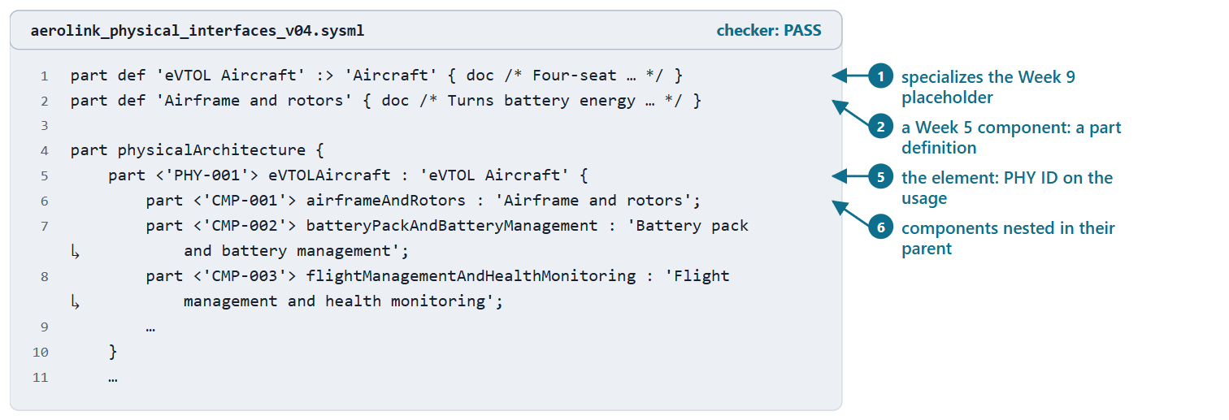
Physical elements and components as parts
Part definition: the kind of element; part usage: the element in this architecture
Course convention: PHY and CMP IDs on usages, inside one part physicalArchitecture
A Week 9 placeholder linked to an element is specialized: its requirements still conform
Figure. The aircraft in AeroLink model v0.4: a part definition that specializes the Week 9 placeholder, a component definition, and the element’s usage with its components nested (excerpt). Checked: PASS. (FICTIONAL)
Sources: R70 sl.15–16; R81 p.90

Slide 9
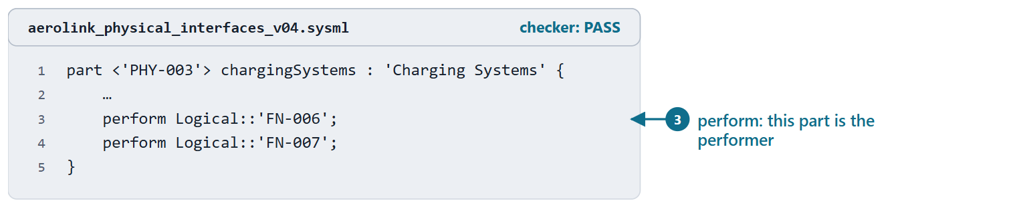
Functions performed by physical parts
perform in a part: that part is the performer
The Week 4 placement says which element performs each function
Course convention: performed at level 1; a component’s Week 5 functions are noted in its doc
Figure. The charging systems in AeroLink model v0.4 perform the two functions Week 4 placed on them (excerpt). Checked: PASS. (FICTIONAL)
Sources: R72 sl.41; R82 p.136

Slide 10
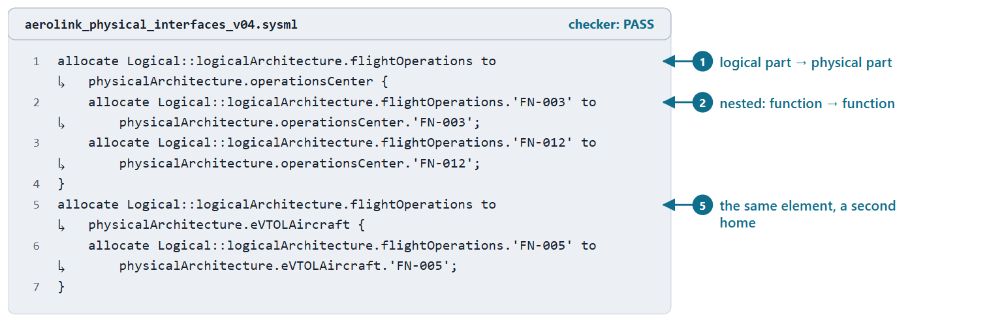
The logical-to-physical allocation, with nested allocations
ALLOCATION (SYSML V2.1 BETA 2)
“a target element is responsible for realizing some or all of the intent of the source element”
R81 · OMG SysML v2.1 Beta 2, Part 1 (Release 2026-07), "7.11 Parts", p.110
allocate the logical part to the physical part
Nested allocations: function to function
Course convention: read from the functions each element performs
Figure. Flight Operations allocated to both its physical homes in AeroLink model v0.4, each allocation refined by the functions performed there. Checked: PASS. (FICTIONAL)
Sources: R76 sl.106; R81 p.110; R81 p.111; R81 p.112

Slide 11
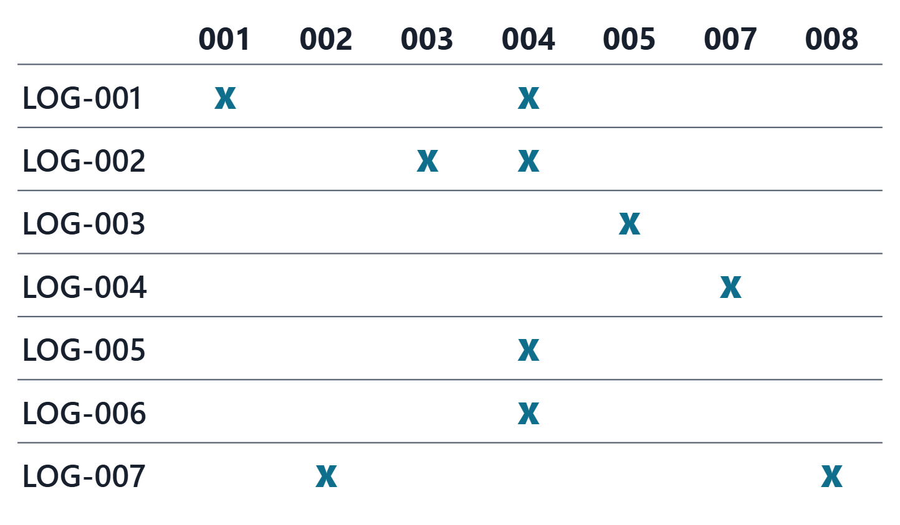
AeroLink worked example I: the allocation matrix
7 logical elements, 7 physical homes, 10 allocations
Every function performed by one physical element
Generated from the Week 4 placements; nothing retyped
PAIR, 1 MIN
Which column has the most X, and what does that tell an interface designer?
Figure. AeroLink logical elements by physical elements: an X where model v0.4 allocates one to the other. Course illustration, not SysML v2 graphical notation. (FICTIONAL)
Sources: R20c p.600; R76 sl.106

Slide 12
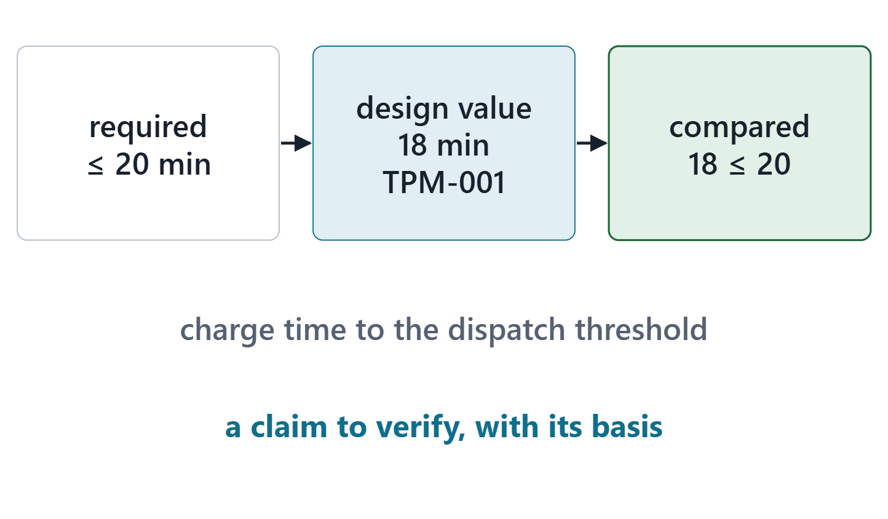
Design properties: what the physical element will be
A design property: assigned from requirements, estimates, analyses
In the model: an attribute value on the physical part
Compared with the requirement: a claim to verify later
Figure. A requirement constrains an attribute; the physical element gives it a design value; the two are compared. AeroLink charging, from the Week 3 performance measure. Course illustration, not SysML v2 graphical notation. (FICTIONAL)
Sources: R20c p.598

Slide 13
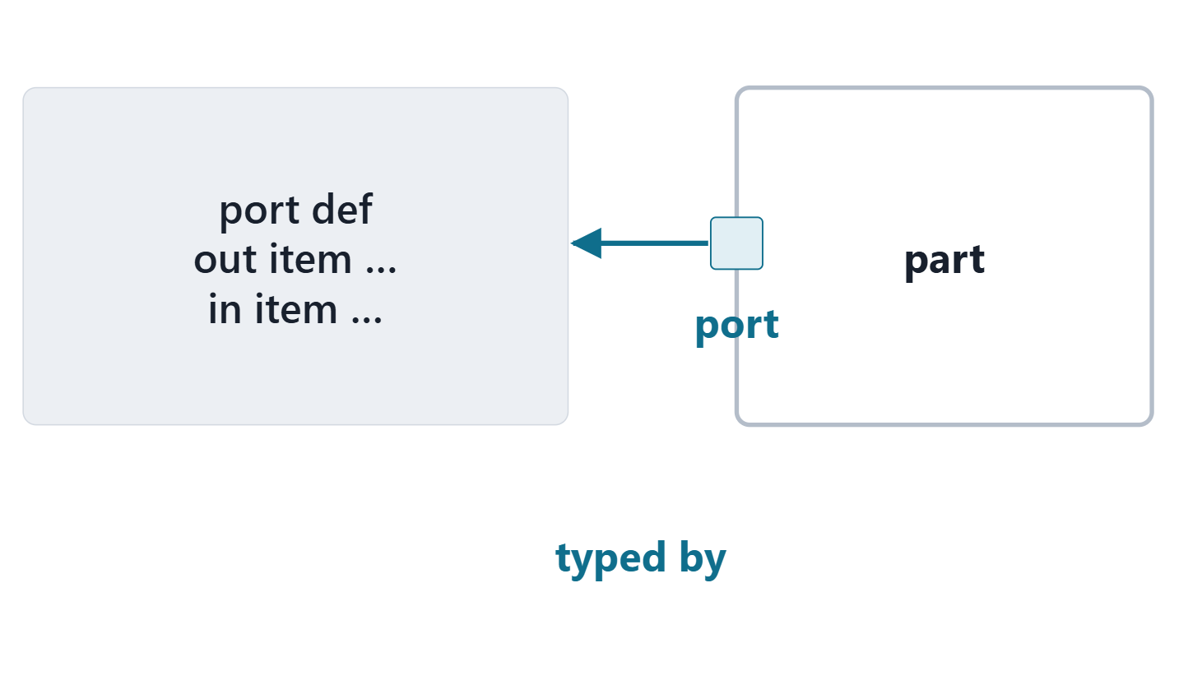
Port definitions and port usages
PORT DEFINITION (SYSML V2.1 BETA 2)
“a kind of occurrence definition … that defines a connection point to enable interactions between occurrences (most commonly parts)”
R81 · OMG SysML v2.1 Beta 2, Part 1 (Release 2026-07), "7.11 Parts", p.93
A port usage puts the connection point on a part
Its features say what can be exchanged
Figure. A port definition with its directed items, and a part that carries a port of it. Course illustration, not SysML v2 graphical notation.
Sources: R81 p.93; R71 sl.20

Slide 14
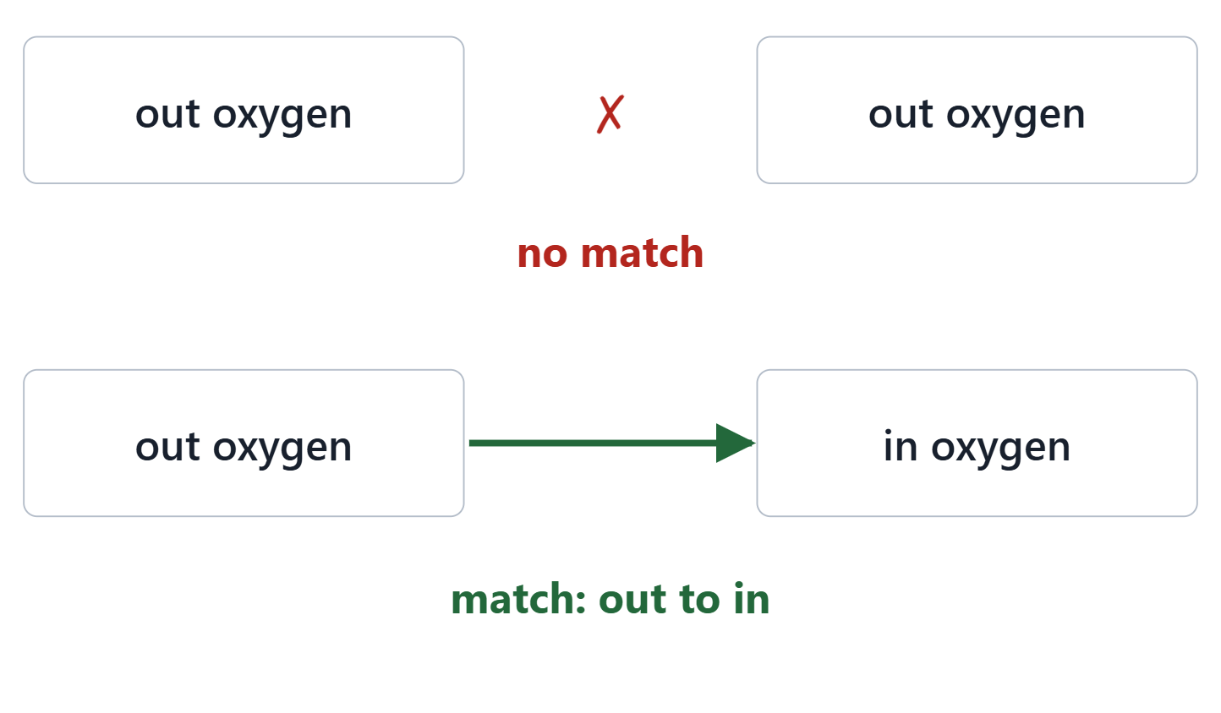
Directed features, and when two ports match
Directions: in, out, inout; directed features are referential
Two features match: conforming types and conjugate directions
A transfer: from an out feature to the matching in feature
Figure. Two ports face each other: the top pair both offer oxygen out and nothing matches; the bottom pair offer out and in, and they match. Course illustration, not SysML v2 graphical notation.
Sources: R81 p.93; R81 p.95; R71 sl.20

Slide 15
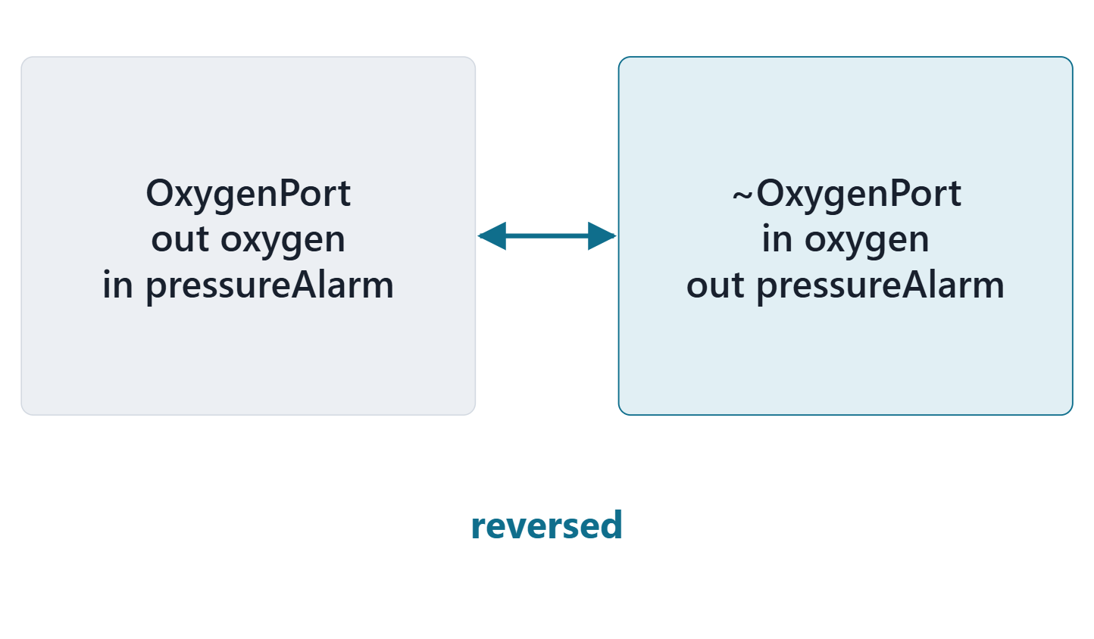
Conjugation: one port definition, both ends
Every port definition has a conjugate: directions reversed
port p : ~P; uses it without writing it
A conjugated port conforms to the original
Course convention: one port definition per interface; end B uses ~
Figure. A port definition and its conjugate: the same features, every in and out reversed. Course illustration, not SysML v2 graphical notation.
Sources: R81 p.93; R81 p.95; R71 sl.21

Slide 16
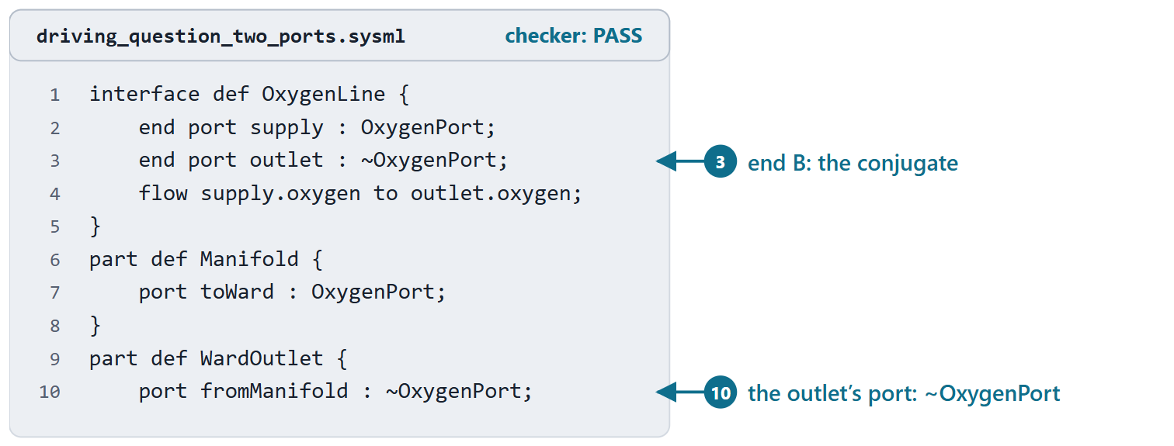
Reveal: both ports offer the oxygen, neither takes it
Answer B: both ends offer oxygen out; nothing can receive it
The fix: end B and the outlet’s port typed by ~OxygenPort
The checker accepts both versions: matching is yours to check
KEY POINT
For every interface: one end typed by the port definition, the other by its conjugate.
Figure. The corrected oxygen supply: the outlet end of the interface and the outlet’s port use the conjugate. Checked: PASS. (FICTIONAL)
Sources: R81 p.93; R71 sl.20; R71 sl.21

Slide 17
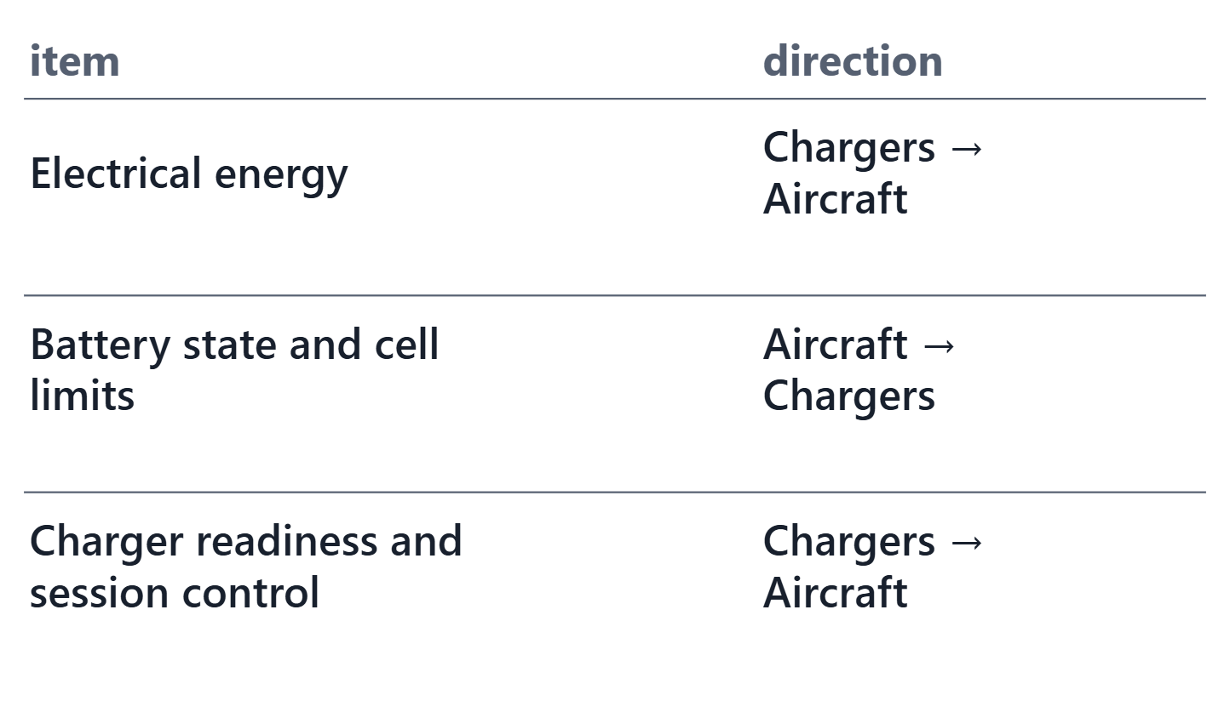
What crosses an interface: information, energy, material
Items: anything that exists in space and time and may flow
Reuse the Week 4 information items and the Week 10 items
A crossing with no item: add one; an information item takes the next ID (INFO-017 here)
Each crossing gets a direction from end A or to end A
Figure. What crosses the AeroLink charging interface (IF-005): each Week 5 crossing, the item it becomes in model v0.4 and its direction. Course illustration, not SysML v2 graphical notation. (FICTIONAL)
Sources: R70 sl.17; R20c p.598

Slide 18
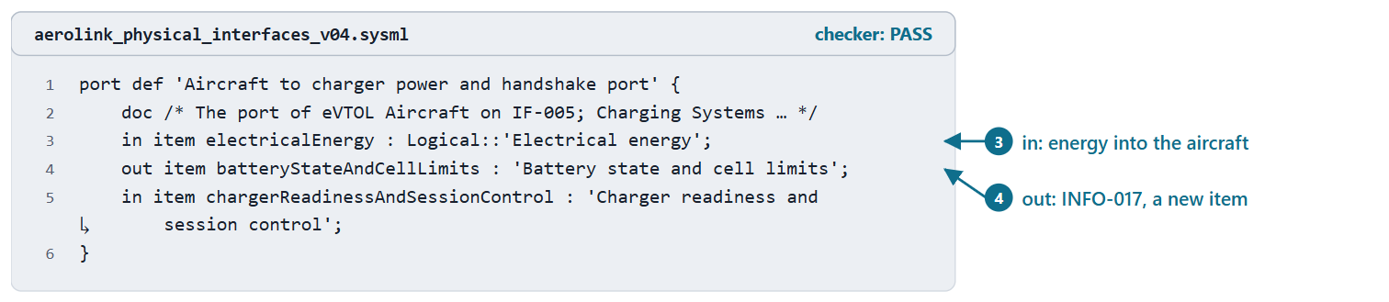
AeroLink worked example II: the charging interface’s ports
Course convention: written from end A (the aircraft)
Aircraft port: the definition; charger port: its conjugate
AeroLink: 13 port definitions, 26 ports
PAIR, 1 MIN
At the charger’s port, which of the three items are out?
Figure. The port definition of IF-005 in AeroLink model v0.4, written from the aircraft’s side: energy in, the battery state out, the charger’s readiness in. Checked: PASS. (FICTIONAL)
Sources: R71 sl.20; R71 sl.21; R81 p.95

Slide 19
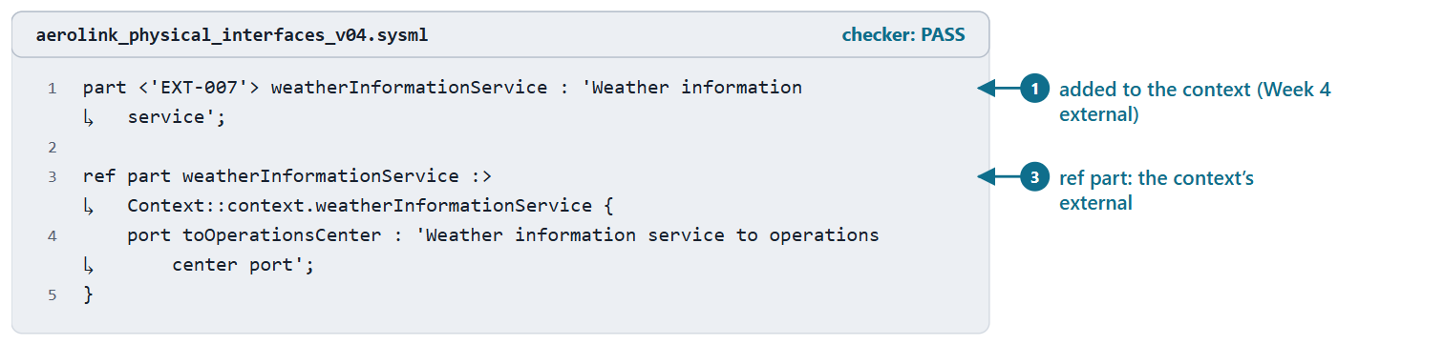
Externals: ports on the systems outside
An external is in the Week 8 context; it is not part of your system
In physicalArchitecture: a ref part that subsets it, carrying the port
An external added in Weeks 4 or 5 joins the context first (AeroLink: one)
Figure. The weather information service in AeroLink model v0.4: added to the context from the Week 4 record, and referenced in physicalArchitecture with the port of its interface. Checked: PASS. (FICTIONAL)
Sources: R81 p.90; R70 sl.15–16

Slide 20
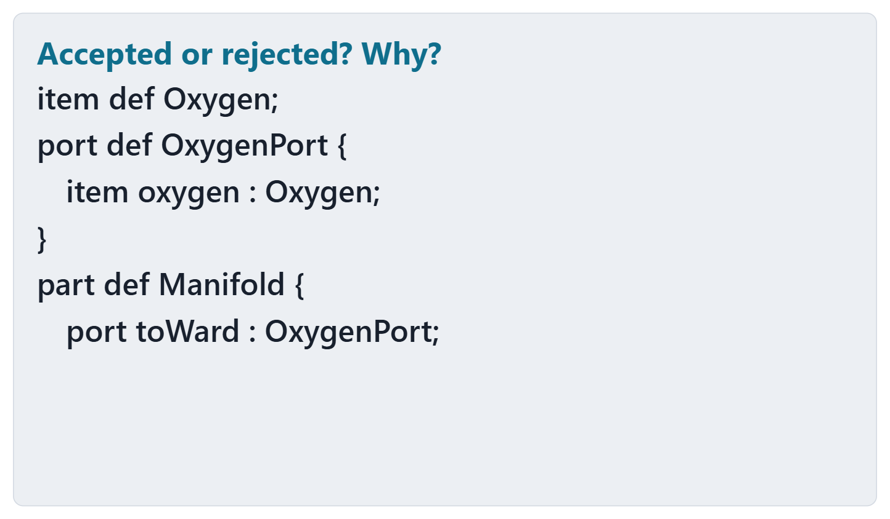
Predict: accepted or rejected?
PREDICT, 1 MIN
Will the checker accept this file?
Write: accepted or rejected
If rejected: the line, and the reason
Figure. A port definition from the oxygen supply, shown without its checker result. Course illustration, not SysML v2 graphical notation. (FICTIONAL)

Slide 21
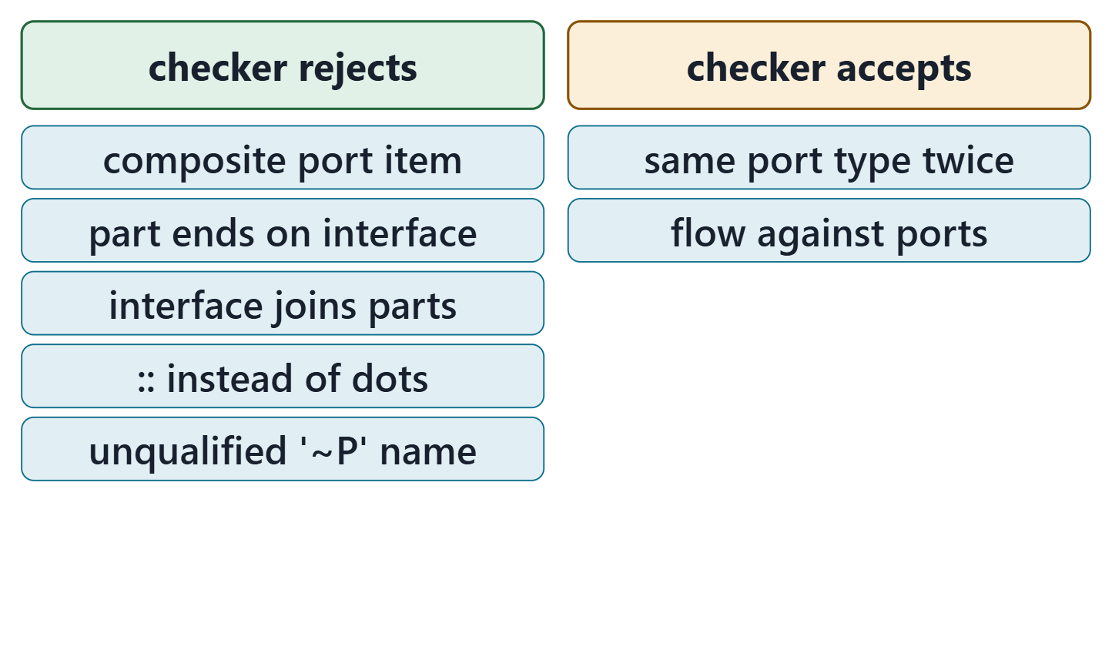
What the checker checks about ports, and what it cannot
The predict card: rejected; a port’s features must be referential, and an undirected item is not
Rejected: names that do not resolve, ends that are not ports
Accepted silently: ports that cannot match, flows the wrong way
Zero errors is necessary, never sufficient
Figure. Recorded results of the course checker (release 2026-08) on 7 course files about ports and interfaces: what it rejects, and what it accepts without complaint. Course illustration, not SysML v2 graphical notation.
Sources: R81 p.95; R71 sl.20; R81 p.106

Slide 22
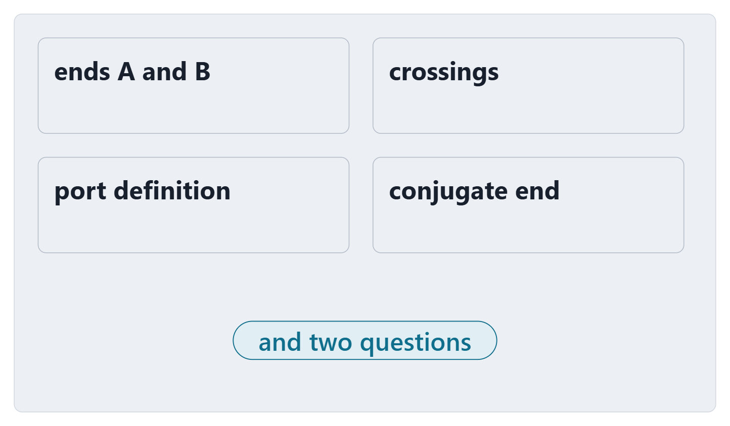
Exit: one interface from your Week 5 table
Pick a physical or information interface from your Week 5 table
Write: its two ends, each crossing as an item and a direction, the port definition from end A
Which crossing has no item in your model yet?
Which end takes the conjugate?
Figure. The exit card: four fields to fill for one interface of your team’s Week 5 table, and two questions. Course illustration, not SysML v2 graphical notation.

Slide 23
References and credits
R20c · SEBoK v2.14 (2026), “Physical Architecture”, p.596–603
R70 · Seidewitz, Intro to the SysML v2 Language: Textual Notation (Release 2026-08), “Introduction to the SysML v2 Language”, sl.15–17
R71 · Seidewitz, Intro to the SysML v2 Language: Textual Notation (Release 2026-08), “Connections”, sl.18–22, 24–28
R72 · Seidewitz, Intro to the SysML v2 Language: Textual Notation (Release 2026-08), “Action Definition”, sl.41
R76 · Seidewitz, Intro to the SysML v2 Language: Textual Notation (Release 2026-08), “Use Case Definition”, sl.106
R81 · OMG SysML v2.1 Beta 2, Part 1 (Release 2026-07), “7.11 Parts”, p.90, 93, 95–96, 106, 109–112, 116
R82 · OMG SysML v2.1 Beta 2, Part 1 (Release 2026-07), “7.17 Actions”, p.136
CREDITS AND LICENSES
Introduction to the SysML v2 Language, Textual Notation (Release 2026-08): Copyright © 2019–2026 Model Driven Solutions, Inc. Licensed under the Creative Commons Attribution 4.0 International License (CC BY 4.0).
SEBoK v2.14: “This material is used under a Creative Commons Attribution-NonCommercial ShareAlike 3.0 Unported License from The Trustees of the Stevens Institute of Technology.” (SEBoK, “Bkcase Wiki:Copyright”, PDF p.31). Quotations are short and cited; no SEBoK figure or table is reproduced.
Figures are original drawings for this course; none redraws a figure from the sources.
AeroLink Urban Mobility is a fictional teaching case: every number, name and statement about it is a teaching value.

