Slide 1
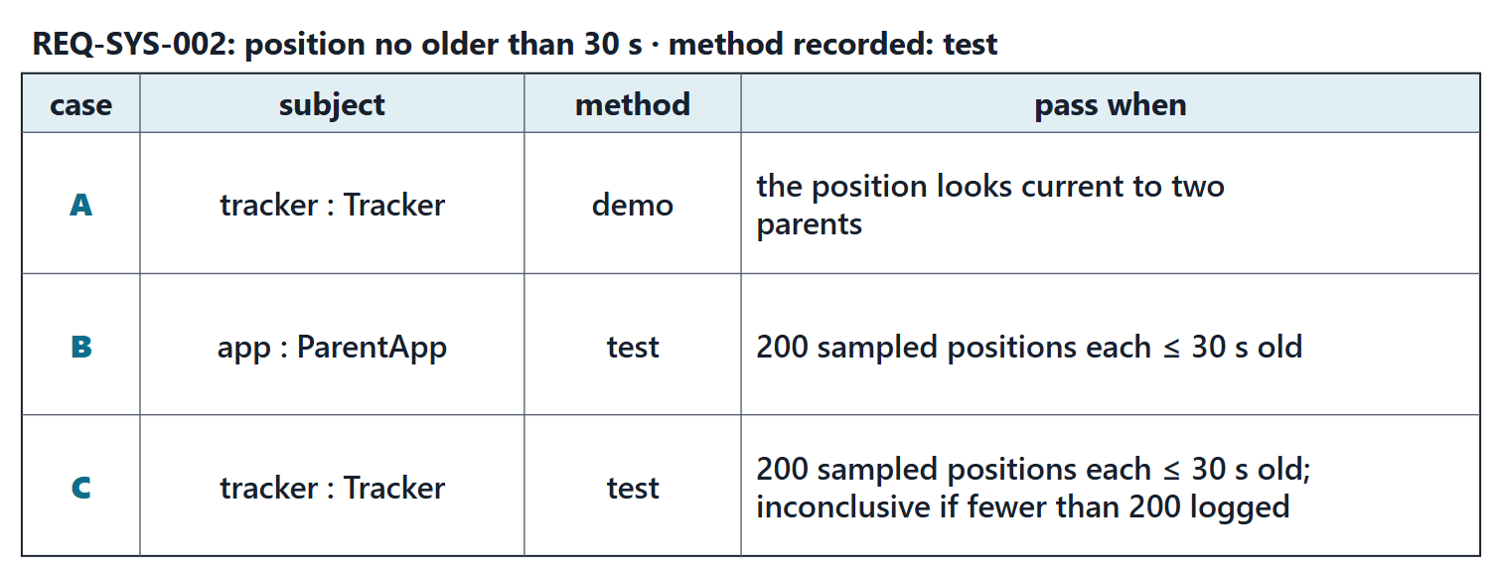
Warm-up: which case verifies the requirement?
Figure. Three verification cases written for one requirement of a school-bus tracker: the subject and the method of each, read from the checked file, and its pass condition in short. Course illustration, not SysML v2 graphical notation. (FICTIONAL)

Slide 2
Reveal: right subject, recorded method, measurable pass
Case A: demo instead of the recorded test; “looks current” cannot be measured
Case B: the subject is ParentApp, not the tracker
Case C: right subject, recorded method, a pass and an inconclusive condition
KEY POINT
All three pass the checker.
Sources: R84 p.173; R84 p.176

Slide 3
The digital thread
DIGITAL THREAD (SEBOK)
The digital thread would be the authoritative source of truth concerning the system data.
R30 · SEBoK v2.14 (2026), "Digital Engineering", p.1394
A second sense: end-to-end simulation linking tools
Course convention: authoritative, traceable links from need to evidence
need → requirement → function → element → case → verdict
Sources: R30 p.1394; R19 p.570; R19 p.576; R112 p.1666

Slide 4
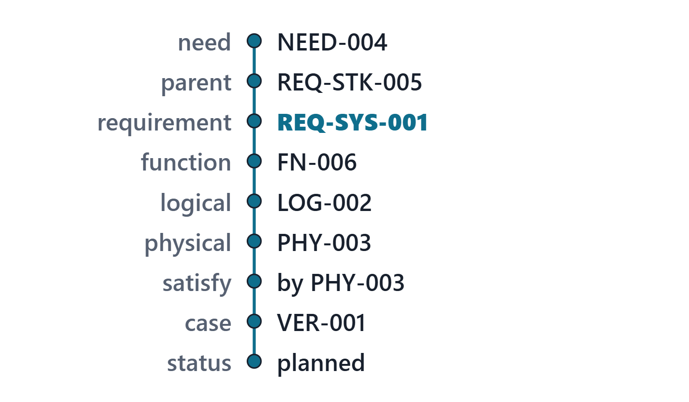
Worked example: the thread of one requirement
Up: need and parent (Week 9)
Down: function, logical, physical (Weeks 10 and 11)
Claim: satisfy (Week 11); check: the case (Week 12)
Every link written once, read by every week
Figure. The AeroLink thread of REQ-SYS-001, top to bottom, read from the generated thread table: each stop and the model element at it. Course illustration, not SysML v2 graphical notation. (FICTIONAL)
Sources: R30 p.1394; R84 p.176

Slide 5
Breaks in the thread: defect or right?
Requirement | Break | Reading
REQ-STK-013 | no function | right: site selection
REQ-STK-014 | no function | right: site selection
REQ-STK-015 | no case | deferred, owner named
REQ-STK-017 | no function; no case | deferred, owner named
REQ-STK-021 | no function | reviewer’s question
The breaks in the AeroLink thread table (FICTIONAL)
Sources: R23a p.640; R23b p.654

Slide 6
What makes the thread authoritative
One source: each link written once, read by every view
Stable IDs: never reused, never renumbered
Controlled change: through a baseline and an approval
Consistency, integrity and traceability over time
COURSE CONVENTION
The lab tool writes from your model and refuses another team’s file.
Sources: R118 p.491; R30 p.1394

Slide 7
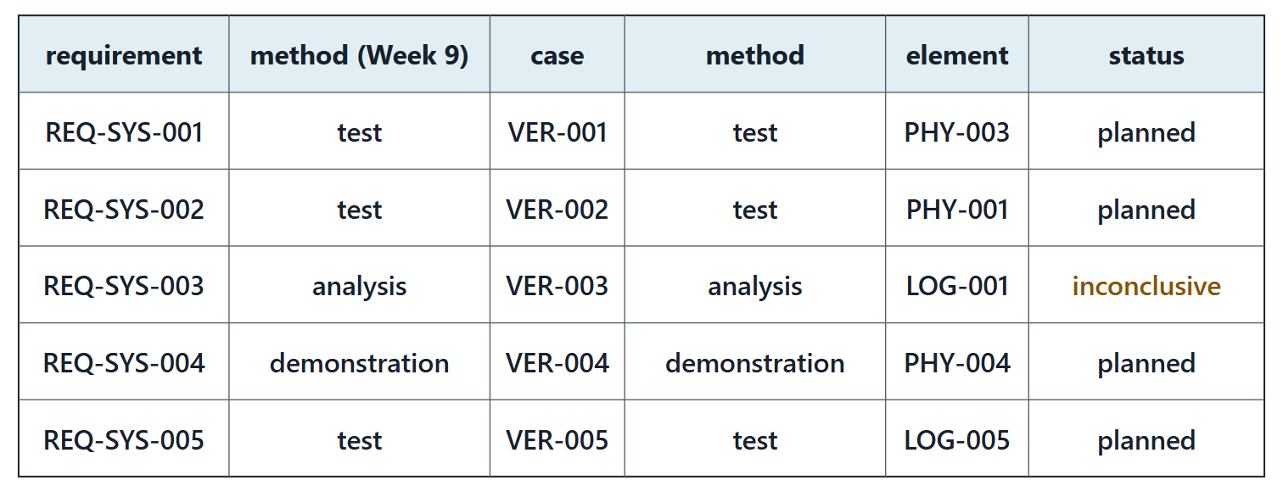
Worked example: the verification matrix
Figure. A fragment of the AeroLink verification matrix: the first system requirements with their case, method, element and status, read from model v0.5. Course illustration, not SysML v2 graphical notation. (FICTIONAL)
Sources: R23a p.638; R49 p.149

Slide 8
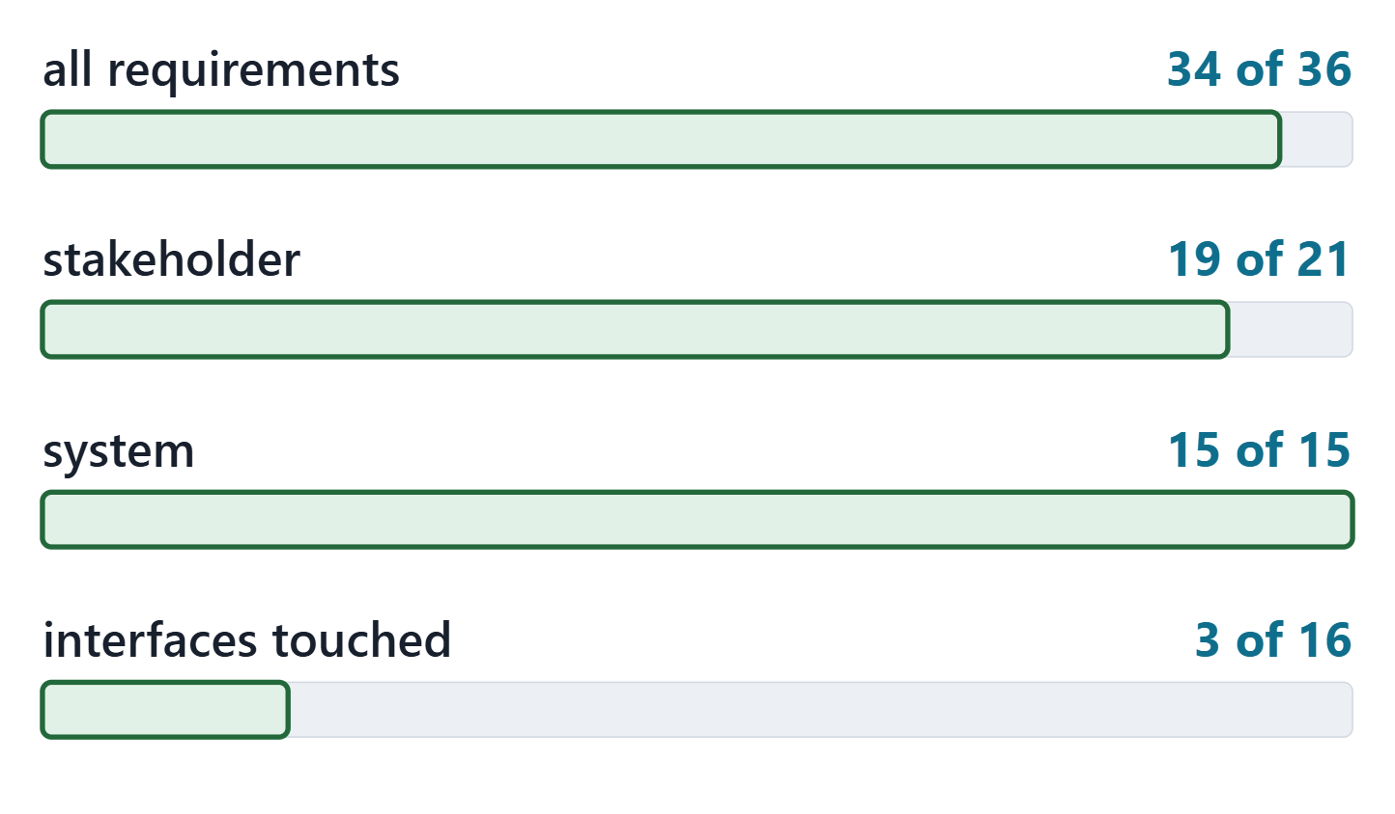
Coverage: what the numbers say, and what they do not
34 of 36 requirements have a case
11 still name an open value: a pass must wait
Coverage counts cases, not evidence
Children verified do not verify the parent
Figure. AeroLink verification coverage in model v0.5, computed: requirements with a case, by kind, and interfaces a case touches. Course illustration, not SysML v2 graphical notation. (FICTIONAL)
Sources: R115 p.581; R23a p.640

Slide 9
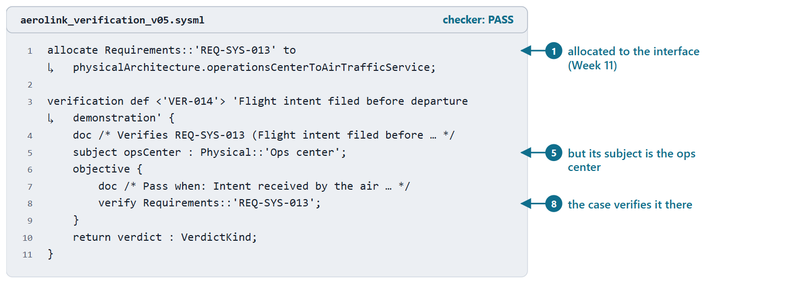
Allocated to an interface, verified on its subject
Allocation: the interface carries the requirement
Subject: what the requirement is about
The case binds the subject, not the allocation target
Figure. The AeroLink allocation of REQ-SYS-013 to an interface (Week 11) and VER-014, the case that verifies it on its subject, excerpted from model v0.5. Checked: PASS. (FICTIONAL)
Sources: R84 p.176

Slide 10
Validation activities: the stakeholders judge
Need | Judged by
NEED-001 Short, predictable wait to board | Passengers, with the Head of Customer Experience
NEED-003 Noise exposure within the local agreement | City noise officer and the residents’ association
NEED-008 Unassisted step-free travel | Passengers with reduced mobility and the accessibility advocate
The AeroLink validation activities written in model v0.5 (course convention; FICTIONAL)
Sources: R23b p.651; R23b p.652

Slide 11
A change travels along the thread
Assess every change for its impact on the baseline
Repeat the verification it invalidates
A board decides before the change is made
Course method: follow the model’s links, not memory
Sources: R49 p.150; R118 p.493; R118 p.494

Slide 12
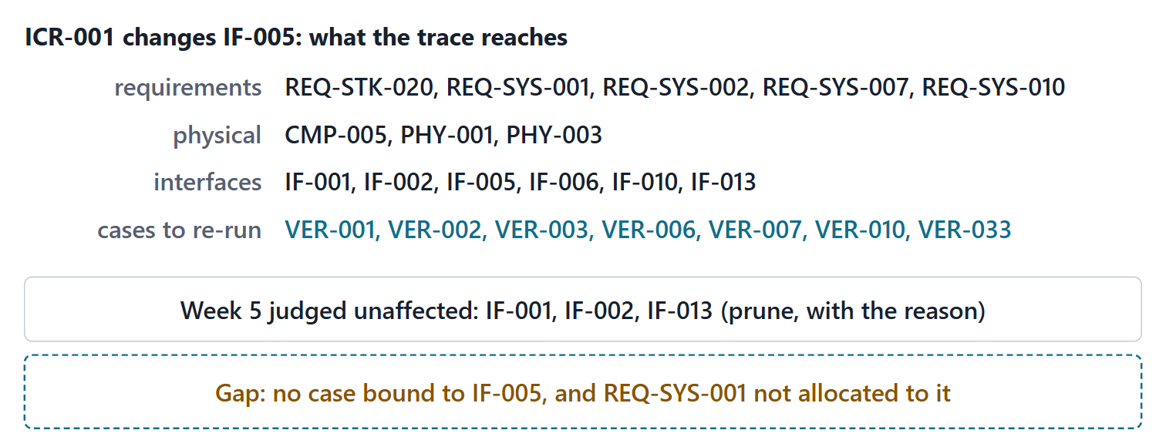
Worked example: tracing a change request
Figure. The impact of ICR-001, traced from IF-005 along AeroLink model v0.5: the requirements, physical elements, interfaces and cases it reaches, the neighbours Week 5 judged unaffected, and the gap the trace exposes. Course illustration, not SysML v2 graphical notation. (FICTIONAL)
Sources: R49 p.150

Slide 13
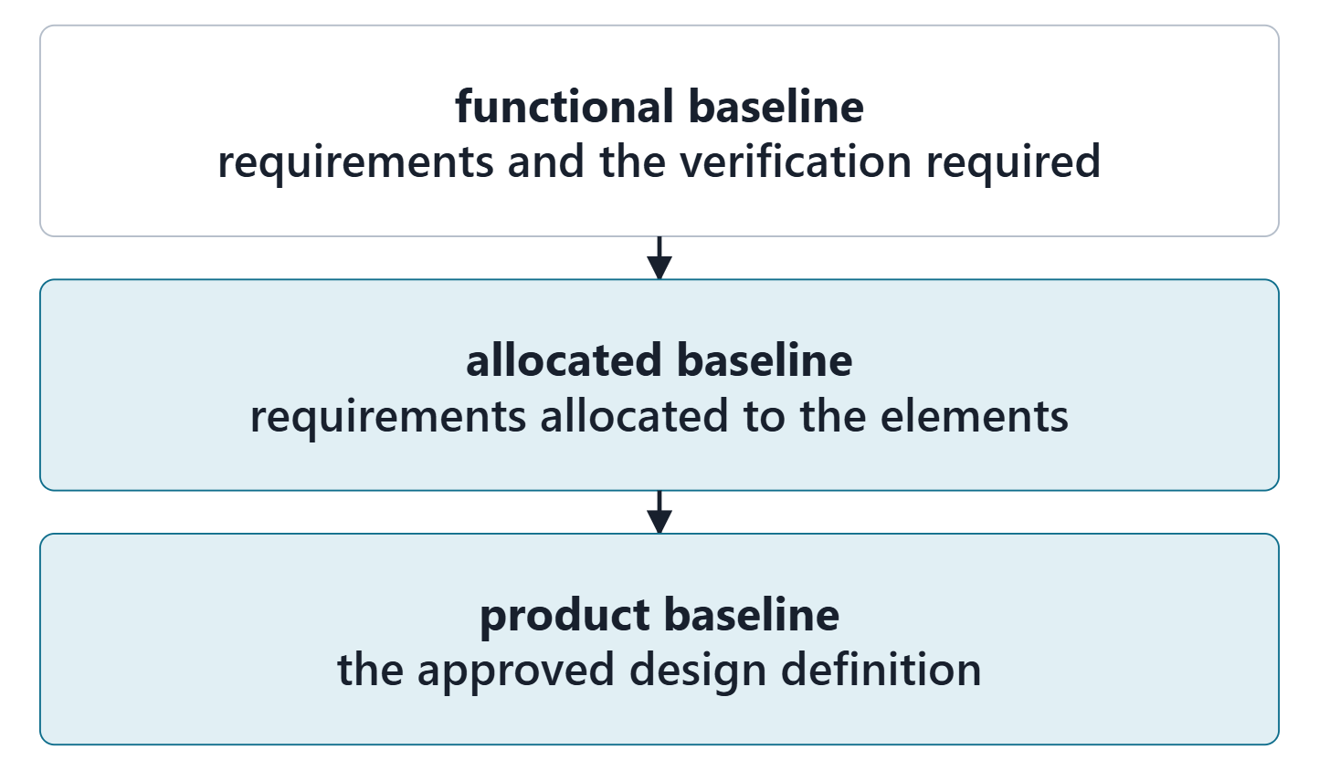
Configuration baselines
A formally approved snapshot at a point in development
Functional, allocated, product
Immutable: the starting point for further change
Not the Week 6 “baseline” increment
Figure. The three formal configuration baselines SEBoK names, in the order they are usually generated, with what each fixes. Course illustration, not SysML v2 graphical notation.
Sources: R36 p.498; R36 p.499; R36 p.502

Slide 14
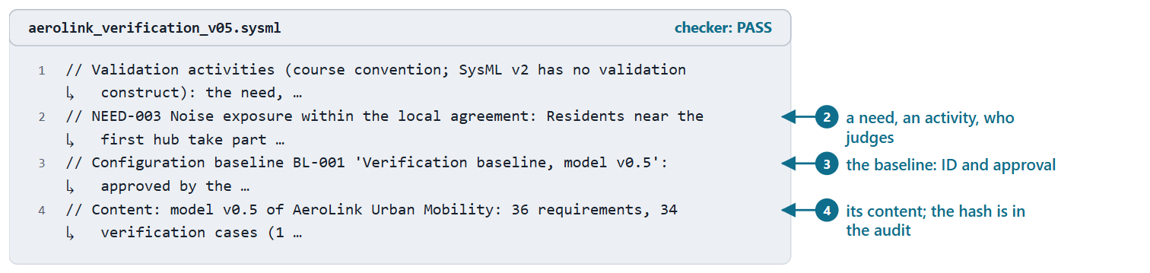
Baselines in SysML v2: outside the language
SysML v2 API: commits, and tags for baselines
Tags are immutable
Course convention: BL-001, its approval, and the file’s SHA-256
Figure. The validation and baseline comments of AeroLink model v0.5 (course convention), excerpted. Checked: PASS. (FICTIONAL)
Sources: R88 p.35

Slide 15
Common errors in verification models
Error | Instead
Case on the wrong element | Its subject
Method changed silently | Recorded method, or a reason
“Works” as pass | Value, limit, samples
Verdict without evidence | Name the report
Pass while a value is open | Inconclusive until set
Children verify parent | Its own case
Allocation as subject | Bind the subject
Impact from memory | Follow the links
Sources: R84 p.176; R115 p.581; R23a p.640; R49 p.150

Slide 16
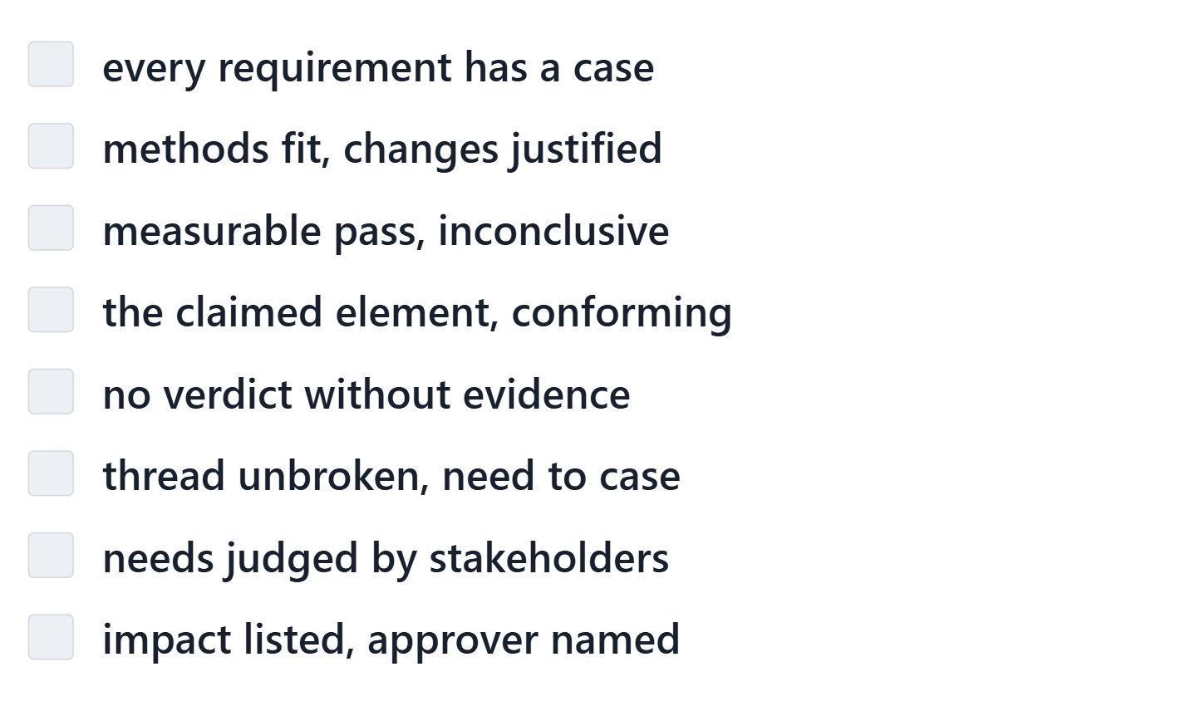
The V&V review checklist
Course convention: eight checks
Each: met, or a finding with a note
The tool gives evidence; the judgment is yours
Figure. The V&V review checklist (course convention): the eight checks your team records in the lab, each met or a finding. Course illustration, not SysML v2 graphical notation.
Sources: R23a p.640; R23b p.652

Slide 17
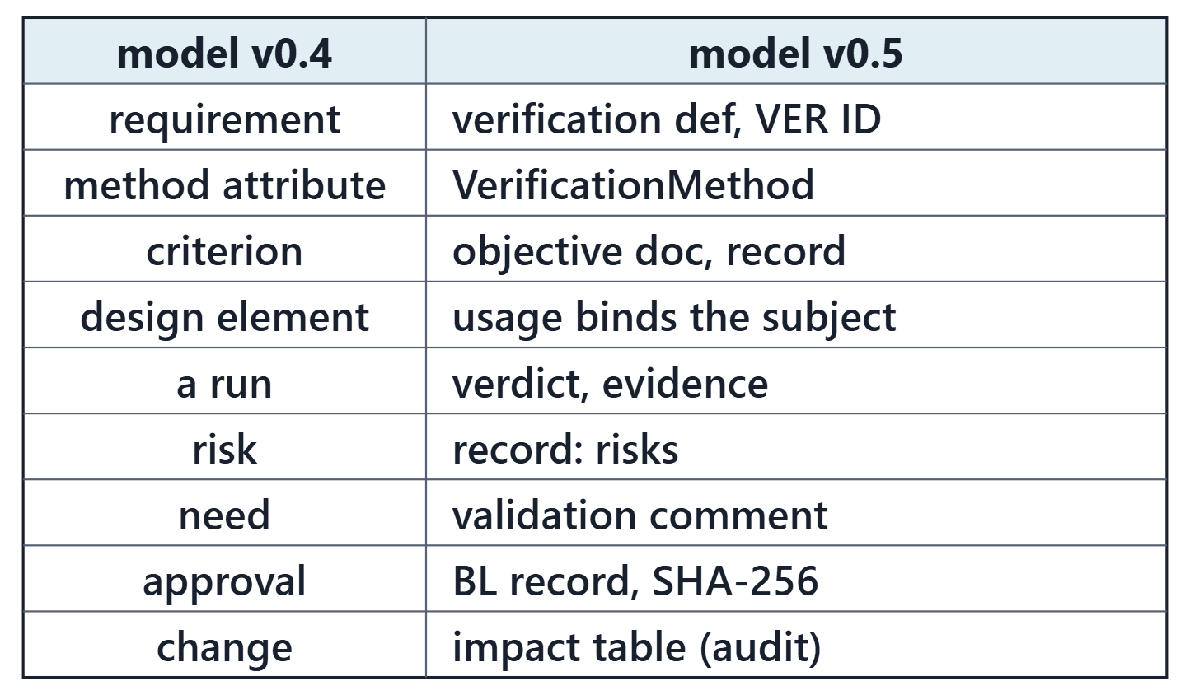
From model v0.4 to model v0.5
Course convention: drafted from your model
You decide: element, conditions, verdicts
IDs continue after the highest; none reused
Weeks 8 to 11 kept exactly
Figure. The course mapping for Week 12, short form: each element of model v0.4 and what it becomes in model v0.5. Course illustration, not SysML v2 graphical notation.

Slide 18
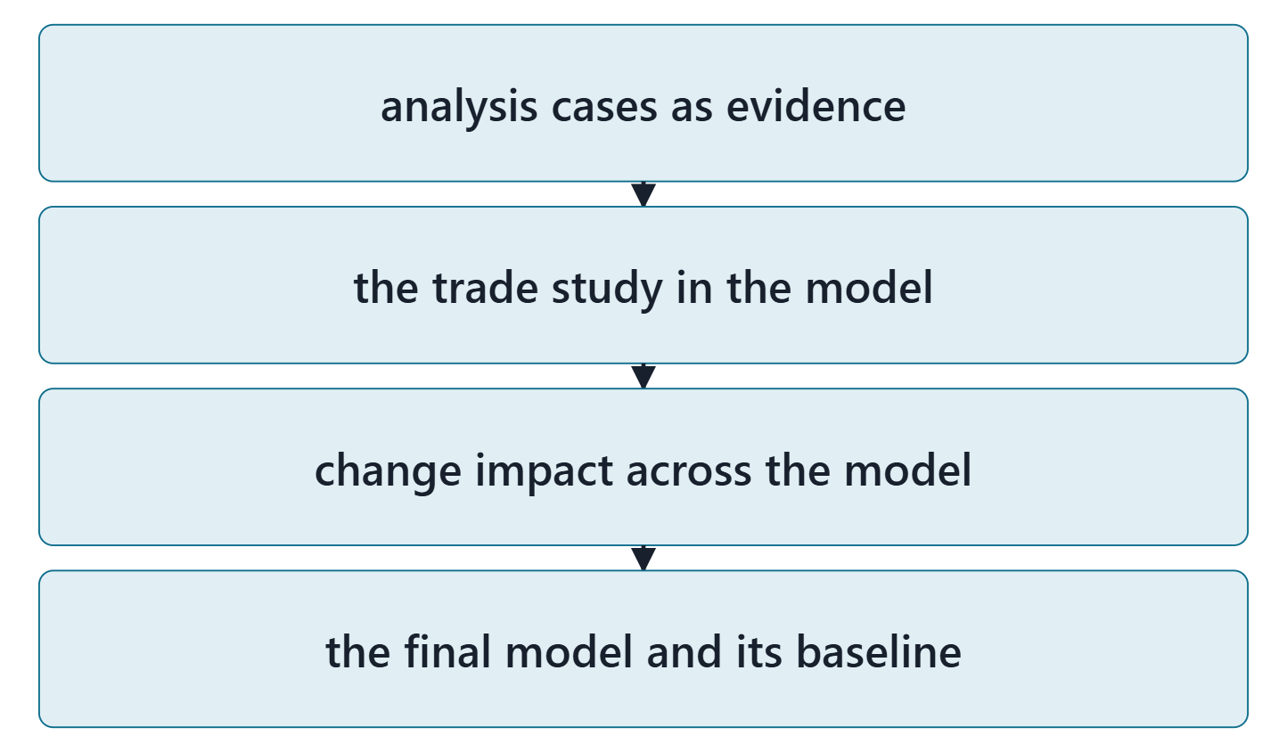
Bridge: Week 13, analysis and the trade study
Week 13: analysis cases, the trade study in the model
Week 14: the final model and its baseline
Figure. What Weeks 13 and 14 do with the verification model built this week. Course illustration, not SysML v2 graphical notation.

Slide 19
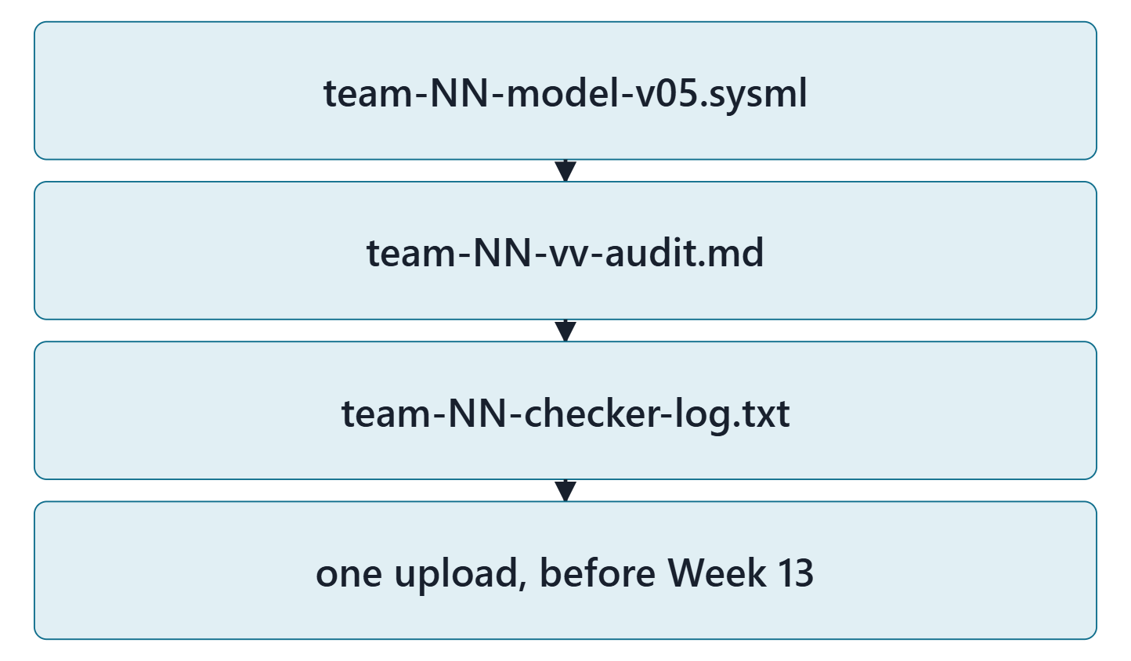
Lab L12: model v0.5 of your enterprise
Due before Week 13, Session 1, on the LMS; your own enterprise, never AeroLink
Your own enterprise, never AeroLink
Three files: team-NN-model-v05.sysml, team-NN-vv-audit.md, team-NN-checker-log.txt
Zero checker errors; every warning explained
Formative feedback before Week 13, Session 2
Figure. Lab L12 deliverables: three files, one upload (course convention). Course illustration, not SysML v2 graphical notation.

Slide 20
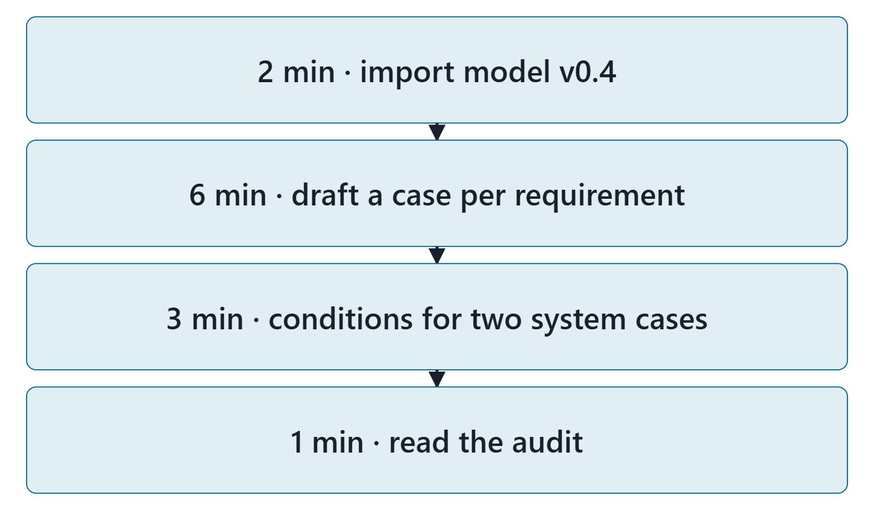
Team work: draft your verification cases
12 minutes, in teams, in the Week 12 lab tool
Import your Week 11 model (and your Week 6 file)
Draft a case for each requirement
Check each method and element
Write two cases’ pass and inconclusive conditions
Figure. In class: import, draft the cases, write two cases’ conditions, read the audit in the lab tool. Course illustration, not SysML v2 graphical notation.

Slide 21
Instructor checkpoint
Per team: two cases, one element, one condition
Show: two cases and the element each verifies
Read aloud: one pass condition and its inconclusive condition
Show: the exit card from Session 1
Note one fix to make before day 2

Slide 22
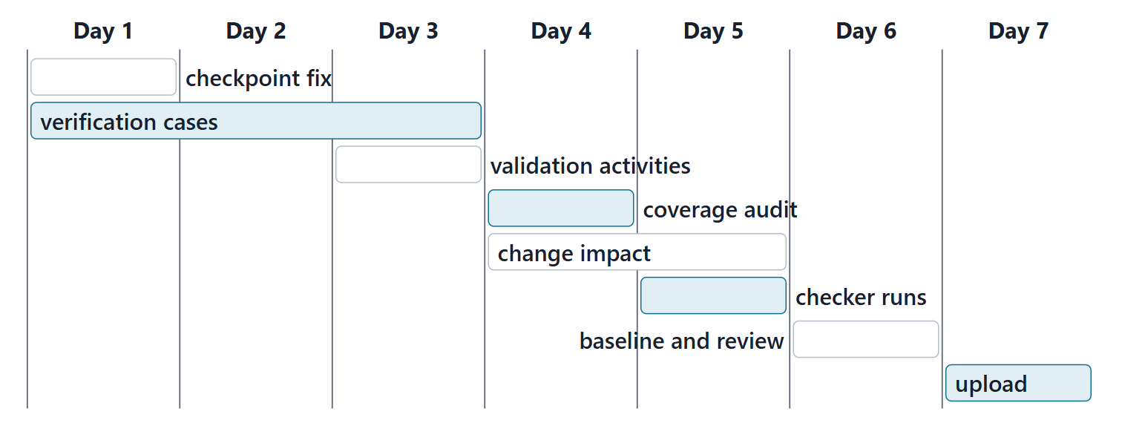
Close: the next seven days
Quiz Q12 and the applied exercise open today. Log your hours.
Figure. A suggested seven-day plan for Lab L12, with the lead role for each task (course convention). Course illustration, not SysML v2 graphical notation.

Slide 23
References and credits
R19 · SEBoK v2.14 (2026), “System Architecture Design Definition”, p.570, 576
R23a · SEBoK v2.14 (2026), “System Verification”, p.634–640
R23b · SEBoK v2.14 (2026), “System Validation”, p.646, 648–649, 651–652, 654–655
R30 · SEBoK v2.14 (2026), “Digital Engineering”, p.1394
R36 · SEBoK v2.14 (2026), “Configuration Baselines”, p.498–499, 502
R49 · OUSD(R&E) Systems Engineering Guidebook (2021/2022), “Verification Process”, p.149–150
R84 · OMG SysML v2.1 Beta 2, Part 1 (Release 2026-07), “7.23 Analysis Cases”, p.173–176
R88 · OMG Systems Modeling API and Services v1.1 Beta 2, “7.1 API Model”, p.35
R112 · SEBoK v2.14 (2026), “Traceability (glossary)”, p.1666
R115 · OMG SysML v2.1 Beta 2, Part 1 (Release 2026-07), “9.6 Requirement Derivation Domain Library”, p.581
R118 · SEBoK v2.14 (2026), “Configuration Management”, p.491, 493–494
CREDITS AND LICENSES
SEBoK v2.14: “This material is used under a Creative Commons Attribution-NonCommercial ShareAlike 3.0 Unported License from The Trustees of the Stevens Institute of Technology.” (SEBoK, “Bkcase Wiki:Copyright”, PDF p.31). Quotations are short and cited; no SEBoK figure or table is reproduced.
OUSD(R&E) Systems Engineering Guidebook: Distribution Statement A. Approved for public release. Distribution is unlimited.
Figures are original drawings for this course; none redraws a figure from the sources.
AeroLink Urban Mobility is a fictional teaching case: every number, name and statement about it is a teaching value.

