Slide 1
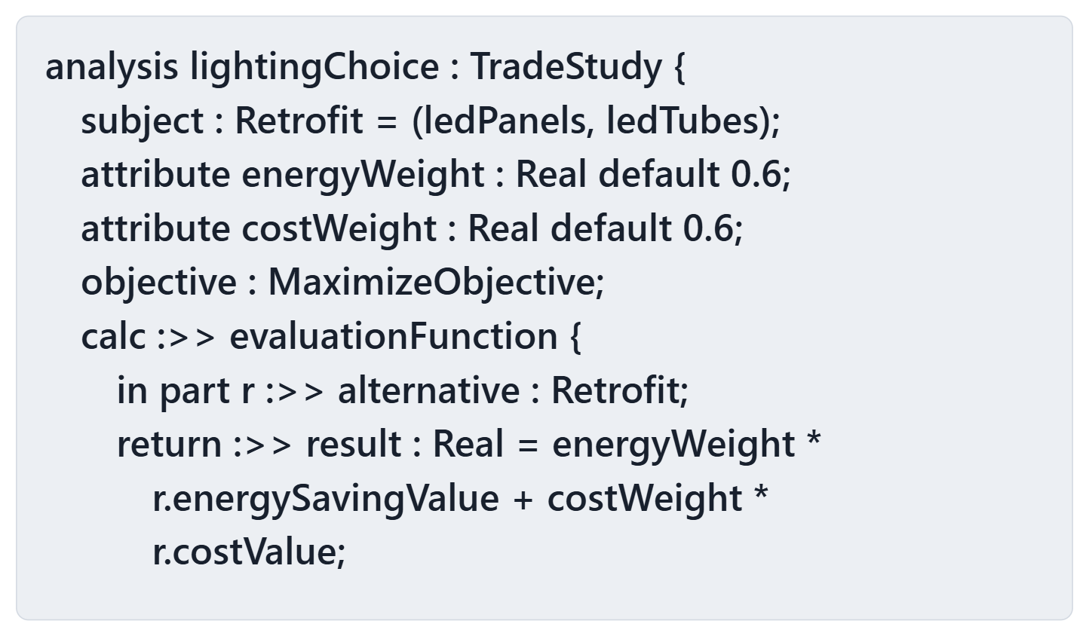
Warm-up: three statements about one trade
1 · The weights sum to one
2 · The checker would reject this trade
3 · A sensitivity check may redefine energyWeight
True or false? Write T or F for each
Figure. A library chooses between two lighting retrofits by a weighted sum (lines shortened for display). Course illustration, not SysML v2 graphical notation. (FICTIONAL)

Slide 2
Reveal: false, false, true
Statement | Answer | Why
The weights sum to one | False | 0.6 + 0.6 = 1.2
The checker would reject it | False | Recorded: PASS, no message
A sensitivity check may redefine energyWeight | True | Declared with default
Sources: R120 sl.74

Slide 3
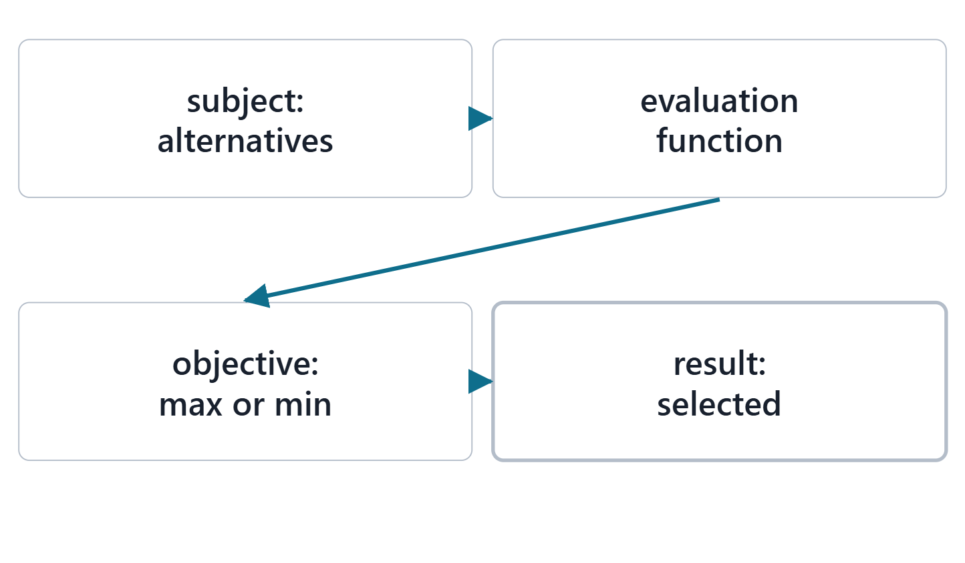
A trade-off analysis is a TradeStudy usage
A usage of the TradeStudy analysis case definition
Subject: the collection of alternatives
An evaluation function values each alternative
Objective: maximize or minimize; result: the selection
Figure. A trade study in SysML v2: the alternatives are the subject, an evaluation function values each, the objective picks the best, the result is the selected alternative. Course illustration, not SysML v2 graphical notation.
Sources: R84 p.172; R75 sl.95

Slide 4
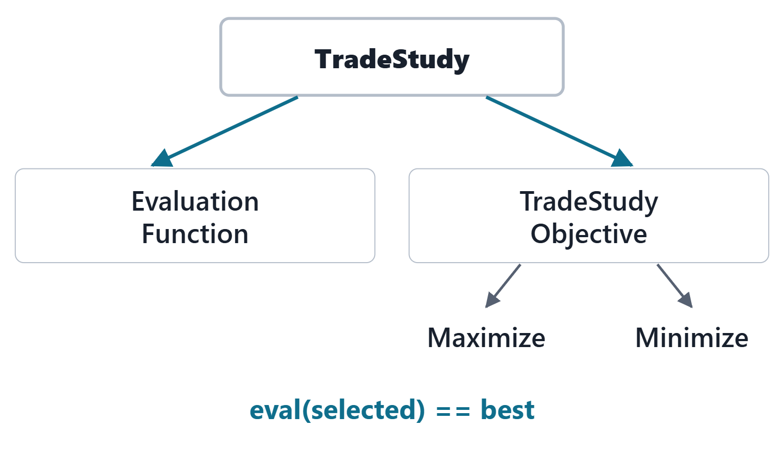
The TradeStudies library
EvaluationFunction: an alternative in, a scalar out
TradeStudyObjective: the selected alternative has the best value
MaximizeObjective and MinimizeObjective define best
TradeStudy: subject, evaluation function, objective, selection
Figure. The four declarations of the TradeStudies library and how a TradeStudy uses them. Course illustration, not SysML v2 graphical notation.
Sources: R121 p.571–574; R78 sl.152

Slide 5
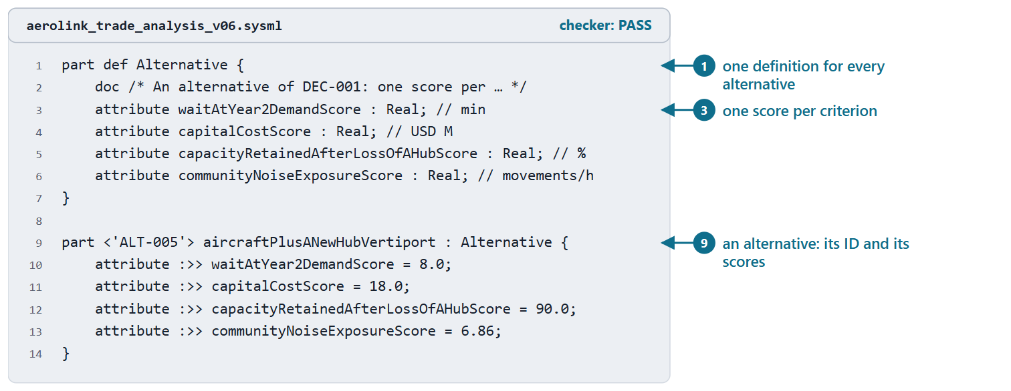
Worked example III: the alternatives as parts
One definition: one score attribute per criterion
Each alternative: a part usage with its ALT ID
six alternatives, the baseline among them
Scores in the criterion’s unit, from Week 3
Figure. AeroLink model v0.6: the alternative definition and one alternative with its scores. Checked: PASS. (FICTIONAL)
Sources: R84 p.172; R18 p.468

Slide 6
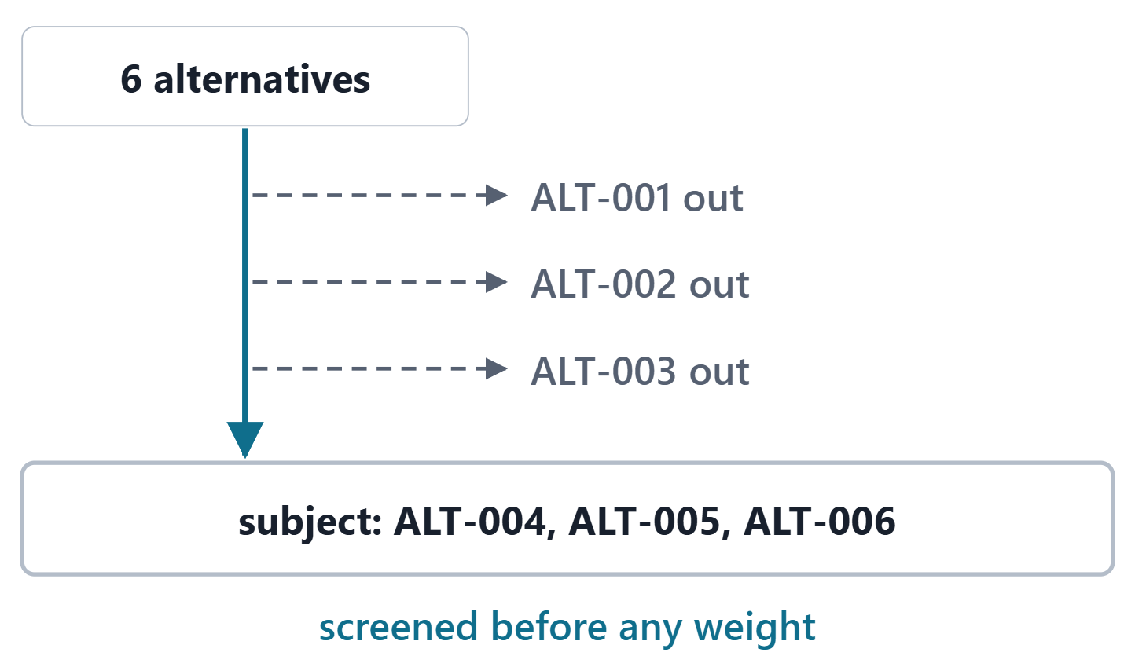
Screens: a requirement is not a weight
Screens apply before any weight
A walk-away point is a screen too
A requirement limit on a score is a screen
Left out of the subject, with the reason in the doc
Figure. Screens and walk-away points leave three of the six AeroLink alternatives out of the trade before any weight is applied (computed). Course illustration, not SysML v2 graphical notation. (FICTIONAL)
Sources: R18 p.465–466

Slide 7
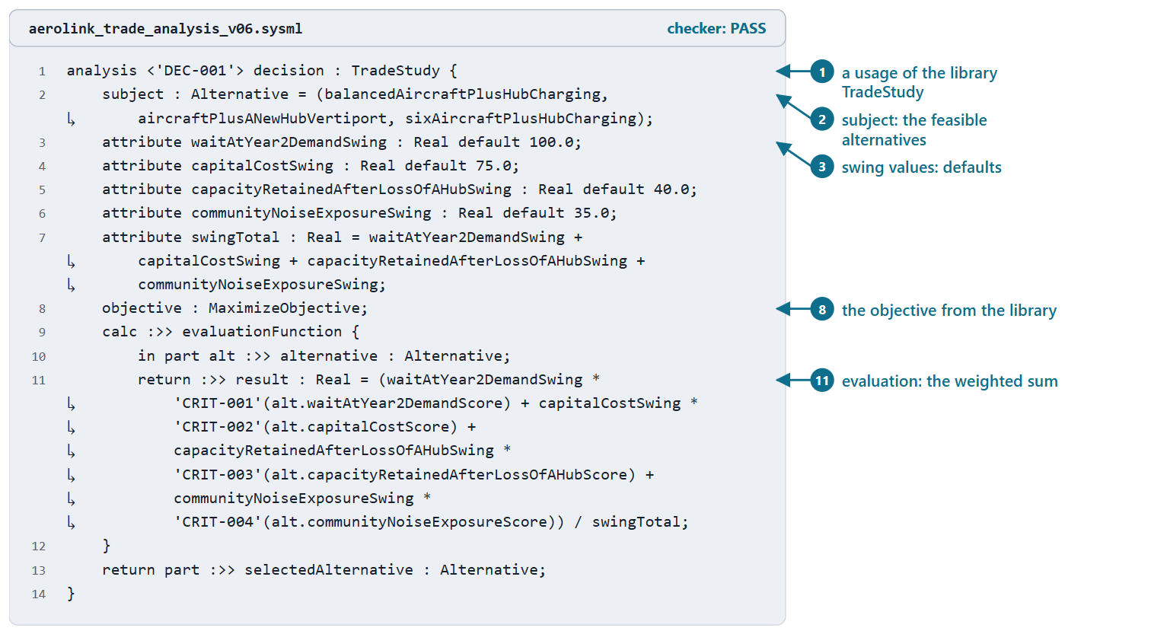
Worked example IV: DEC-001 as a TradeStudy
Subject: the feasible alternatives
Swing values as defaults; weights = swing ÷ sum
Evaluation: the weighted sum of the criteria’s values
Computed: ALT-004 0.670, ALT-005 0.624
Figure. AeroLink model v0.6: DEC-001 as a usage of TradeStudy, the weights as swing values over their sum. Checked: PASS. (FICTIONAL)
Sources: R84 p.172–173; R18 p.469

Slide 8
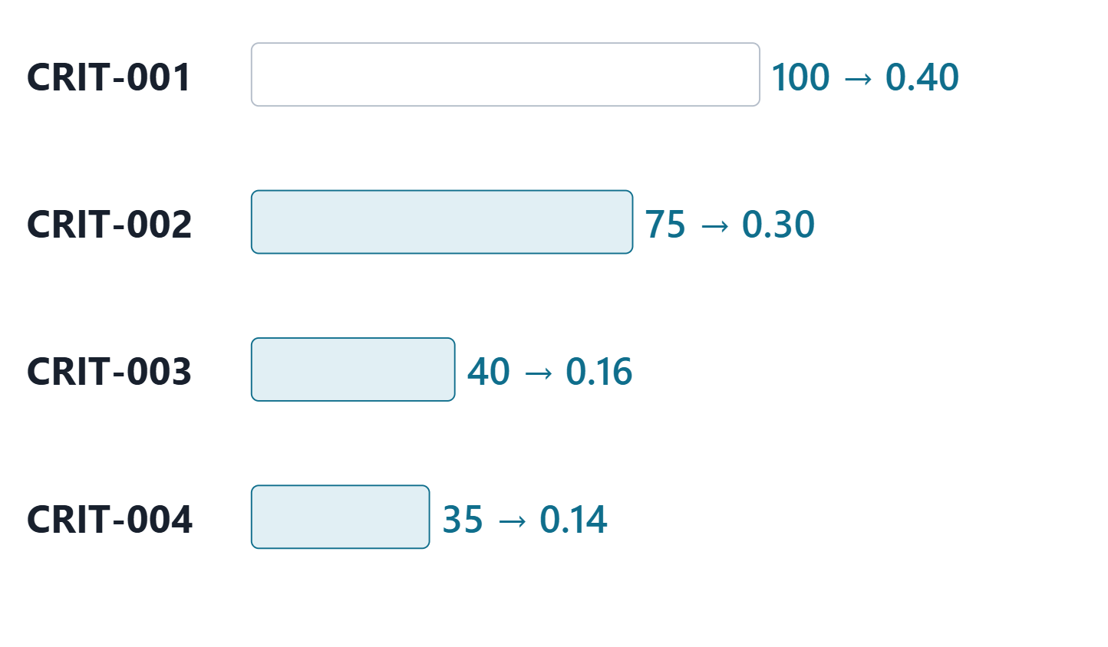
Swing weights and their elicitation
Weights depend on importance and on the range
The largest swing gets 100; others are judged against it
Normalized to sum to one
Record the rationale: the range swung
Figure. The AeroLink swing values and the weights they give (computed): the wait swing is the largest, the others are judged against it. Course illustration, not SysML v2 graphical notation. (FICTIONAL)
Sources: R18 p.466

Slide 9
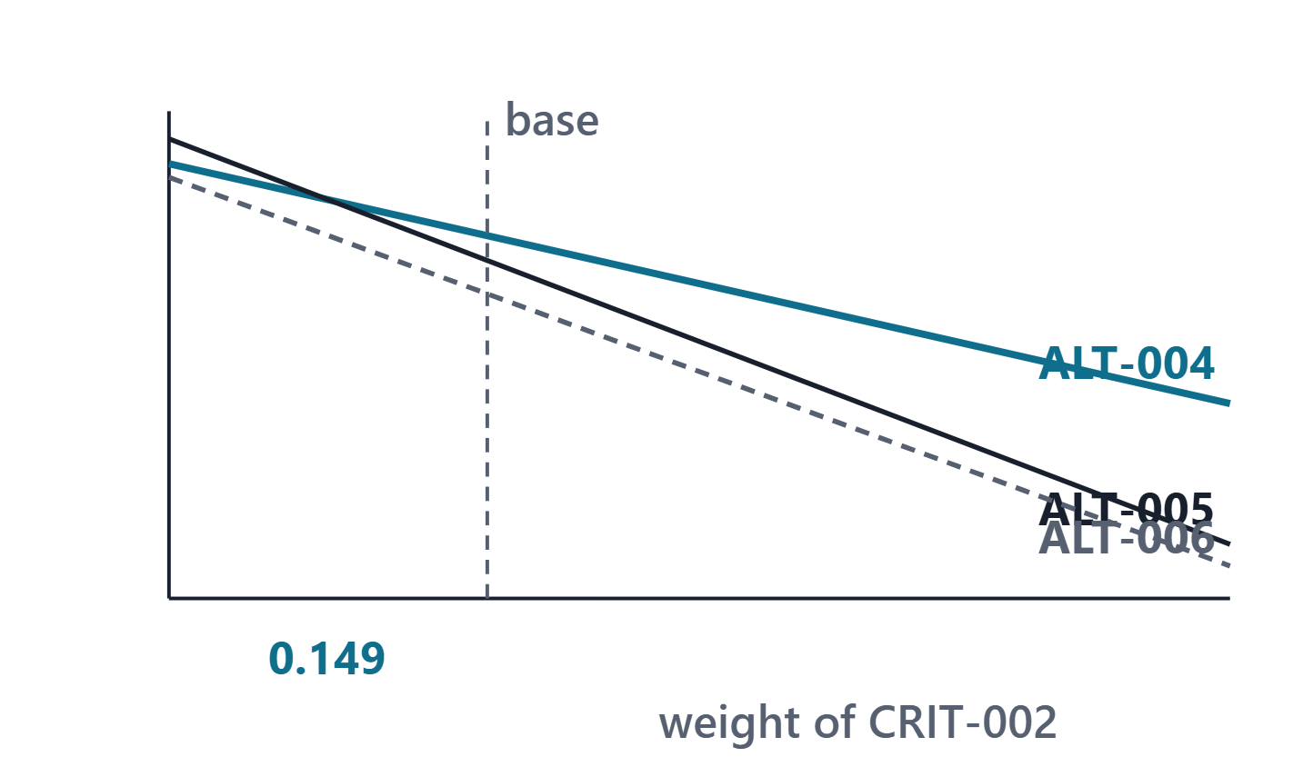
Sensitivity: one weight at a time
Move one weight; the others keep their ratios
The line diagram shows each total against that weight
A reversal point: where the leader changes
Close to the base weight: a fragile decision
Figure. Line diagram: each feasible alternative’s total as the weight of CRIT-002 runs from 0 to 1, the other weights keeping their ratios; the leader changes at 0.149 (computed). Course illustration, not SysML v2 graphical notation. (FICTIONAL)
Sources: R18 p.472; R34 p.612

Slide 10
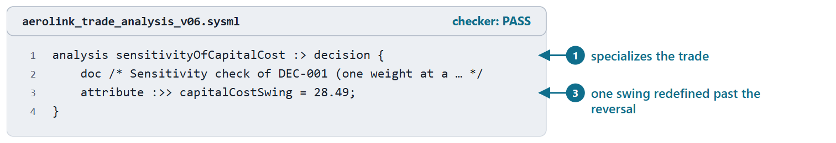
Worked example V: the sensitivity usage
A usage that specializes the trade
It redefines one swing value; the others keep theirs
Swing 28.49 gives weight 0.140: ALT-005 (computed)
It explores a judgment; it asserts nothing
Figure. AeroLink model v0.6: the sensitivity check of the capital weight, redefining one swing value past the reversal point. Checked: PASS. (FICTIONAL)
Sources: R120 sl.74; R18 p.472

Slide 11
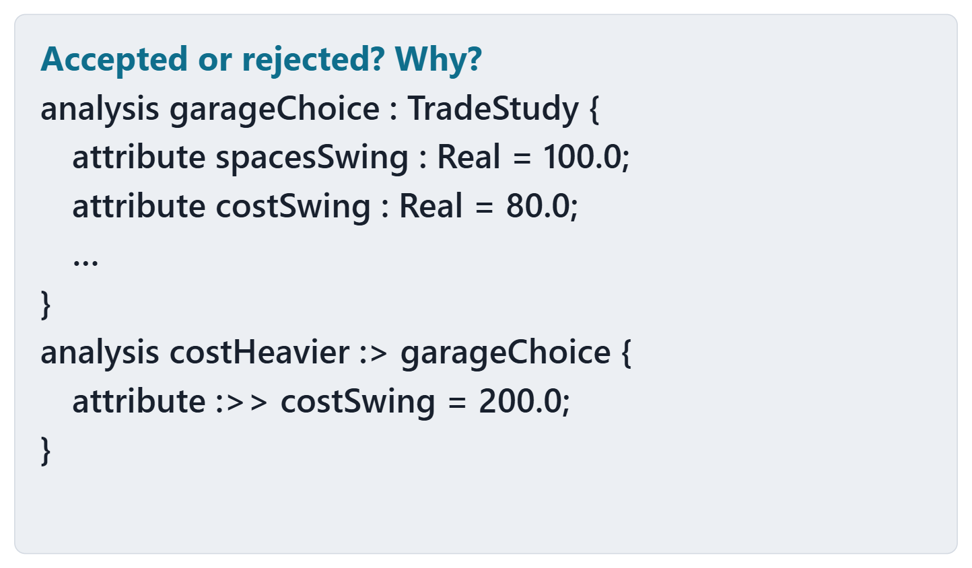
Predict: a sensitivity check on bound swings
Will the checker accept this file?
If not, which line, and why?
What one change would make the check work?
Figure. A parking-garage trade binds its swing values with =; a sensitivity check redefines one. Accepted or rejected? Course illustration, not SysML v2 graphical notation. (FICTIONAL)

Slide 12
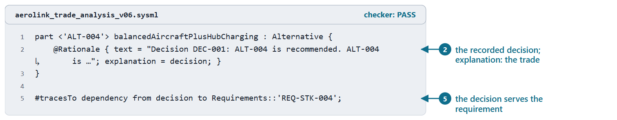
Documenting the decision and its rationale
Rationale: why, with conditions and residual risk
Its explanation refers to the trade study
What would change the decision
The decision traces to the requirement it serves
Figure. AeroLink model v0.6: the decision recorded on ALT-004 as Rationale metadata whose explanation is the trade study (text shortened for display). Checked: PASS. (FICTIONAL)
Sources: R114 p.555–556; R78 sl.148; R18 p.473

Slide 13
Model-based and document-based: the comparison
Alternative | Name | Model total
ALT-004 | Balanced: aircraft plus hub charging | 0.670
ALT-005 | Aircraft plus a new hub vertiport | 0.624
ALT-006 | Six aircraft plus hub charging | 0.563
Model v0.6 ranking (computed); Week 3 agrees.
Adds: traces, re-runnable sensitivity, the record
Not: better judgment, or computation by the checker
Sources: R43 p.109

Slide 14
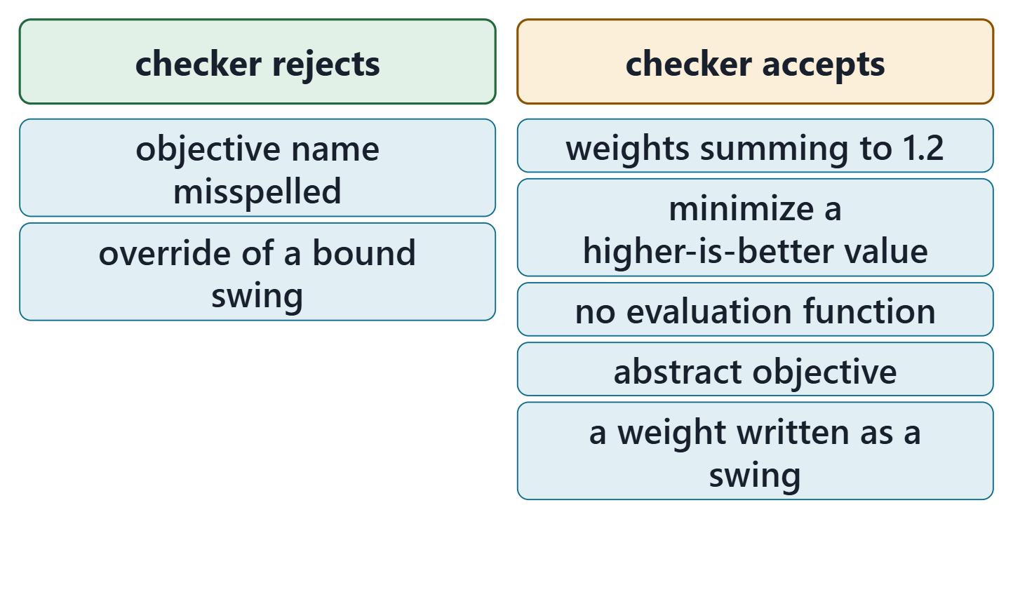
What the checker does with trade studies
The garage: rejected; a bound value cannot be overridden
Fix: declare the swings with default
Accepted silently: wrong direction, no evaluation, weights that do not sum to one
Every number still needs a tool and a reviewer
Figure. Recorded results of the course checker (release 2026-08) on 7 trade-study files: what it rejects and what it accepts without complaint. Course illustration, not SysML v2 graphical notation.
Sources: R120 sl.74; R121 p.573

Slide 15
Common errors in trade studies and analyses
A requirement weighted instead of screened
Anchors or objective in the wrong direction
Weights typed, or not summing to one
Swings bound, so no sensitivity check can run
A criterion traced to no stakeholder concern
A satisfy on an estimate; a number with no source
Sources: R18 p.465–466; R120 sl.74

Slide 16
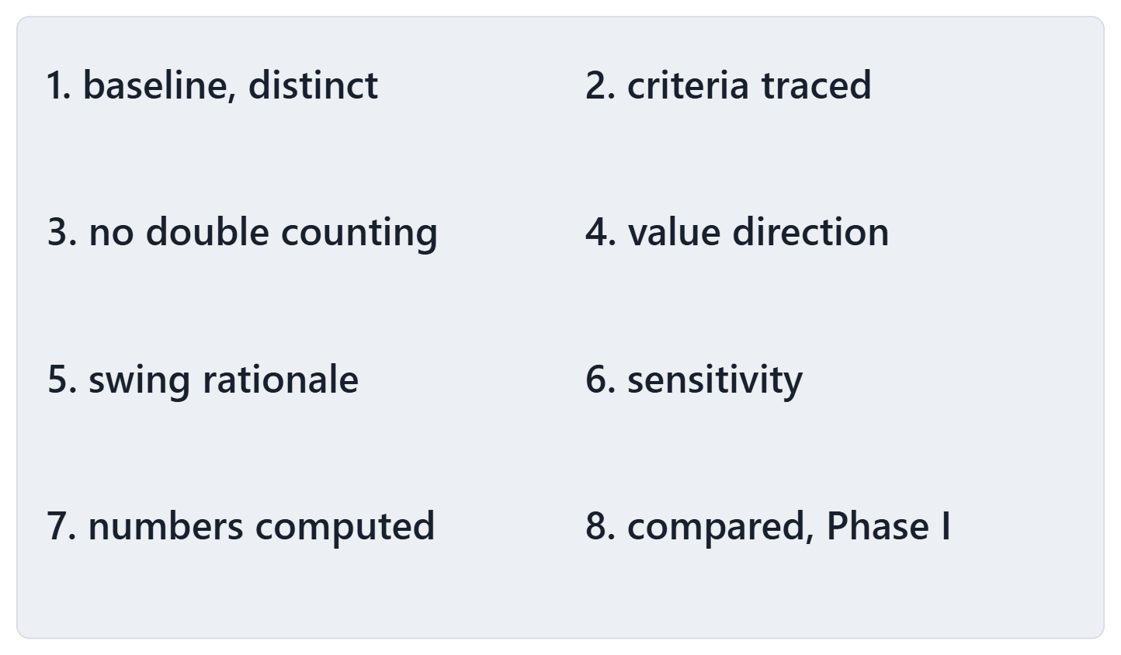
The trade review checklist
Baseline and genuinely different alternatives
Criteria traced; no double counting; limits as screens
Value functions and weights checked
Sensitivity, computed numbers, comparison with Phase I
Figure. The eight checks of the trade review checklist (course convention). Course illustration, not SysML v2 graphical notation.
Sources: R18 p.465–466; R18 p.472

Slide 17
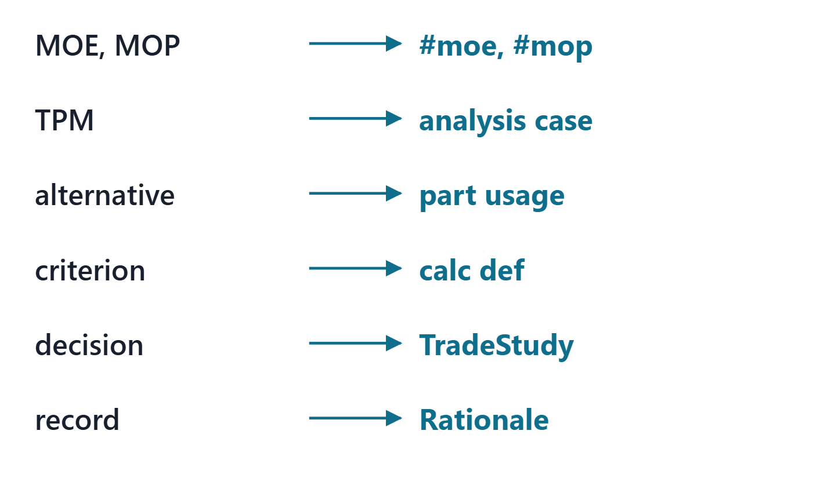
The Week 13 mapping, in one table
Measures: #moe and #mop attributes
Alternatives: parts of one definition
Criteria: calculation definitions
Decision: a TradeStudy usage; record: Rationale
Figure. The Week 13 mapping (course convention): each Phase I element and the model element it becomes. Course illustration, not SysML v2 graphical notation.
Sources: R124 p.561–562; R84 p.172

Slide 18
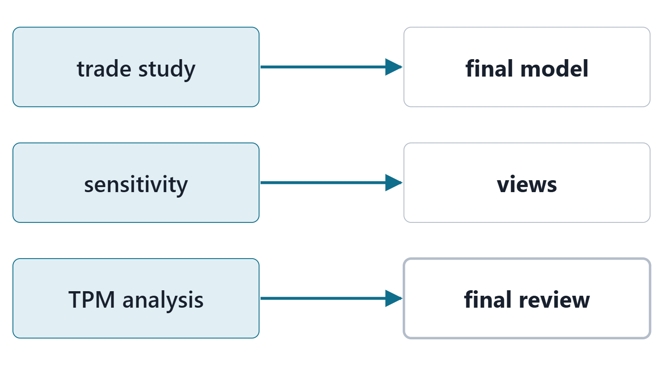
Bridge: Week 14, the final model and review
Week 14: the coherent model, views, the final review
The review asks for your decision and its rationale
Keep every ID stable; change through change control
Figure. Week 13’s outputs feed the Week 14 final model, its views and the final review. Course illustration, not SysML v2 graphical notation.

Slide 19
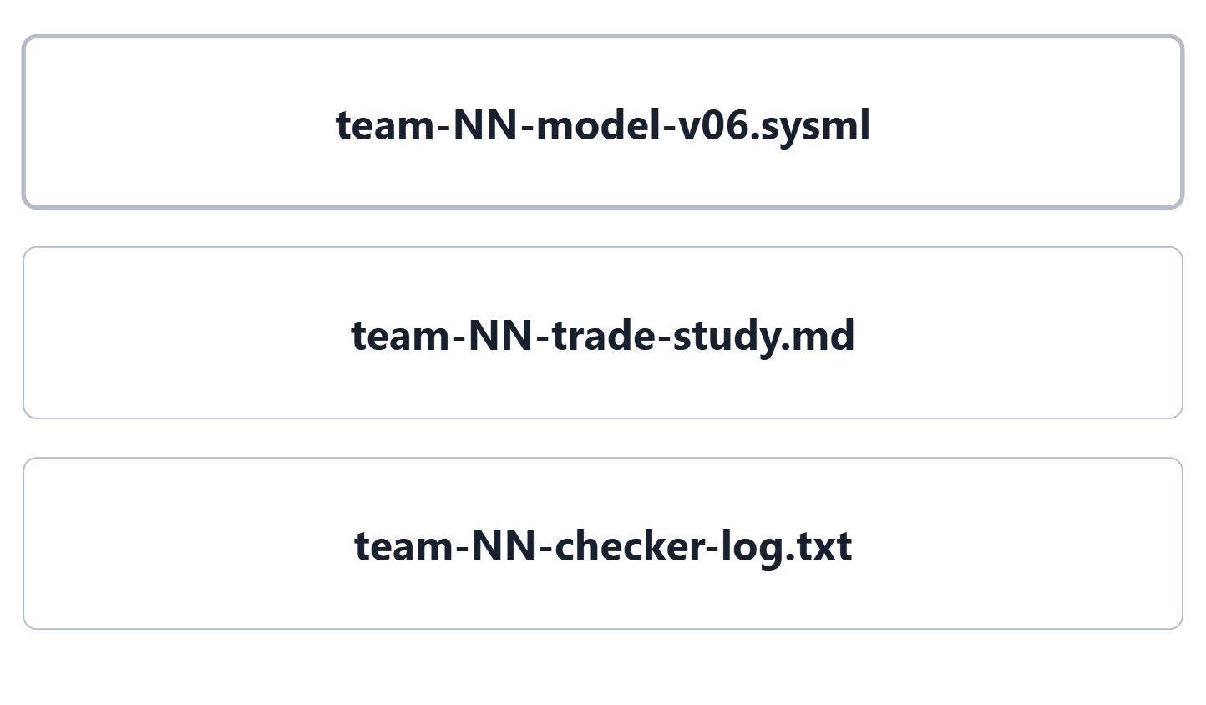
Lab L13: model v0.6 of your enterprise
Due before Week 14, Session 1, on the LMS; your own enterprise, never AeroLink
Your own enterprise, never AeroLink
Three files: team-NN-model-v06.sysml, team-NN-trade-study.md, team-NN-checker-log.txt
At least 3 alternatives, 4 criteria (three for a team of three)
Zero checker errors; every warning explained
Figure. The three files of Lab L13. Course illustration, not SysML v2 graphical notation.

Slide 20
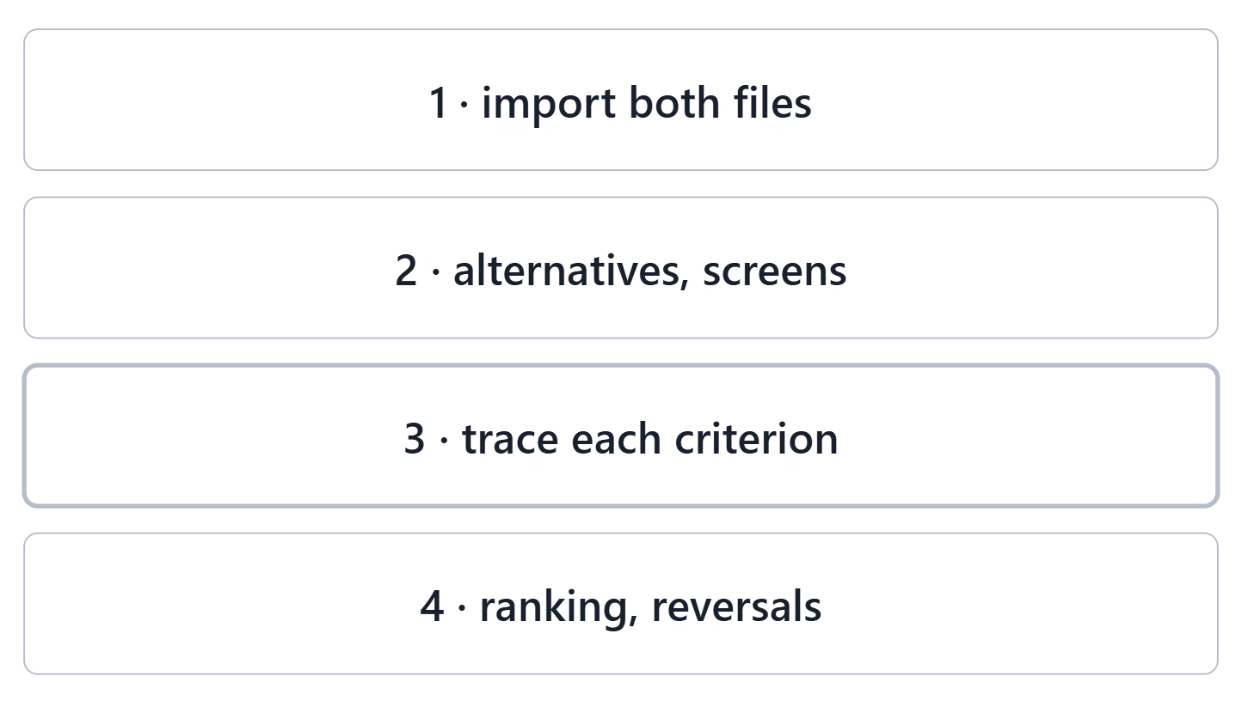
Team work: trace every criterion
Import model v0.5 and your Week 3 file
Check the alternatives and the screens
Trace each criterion; choose any requirement limit
Read the ranking and the reversal points
Figure. The in-class steps in the lab tool: import, check the alternatives and screens, trace the criteria, read the ranking. Course illustration, not SysML v2 graphical notation.

Slide 21
Checkpoint: one trace, one reversal point
One criterion and what it is derived from
Your top-ranked alternative and its total
The reversal point closest to its base weight
Instructor: two sentences of feedback per team

Slide 22
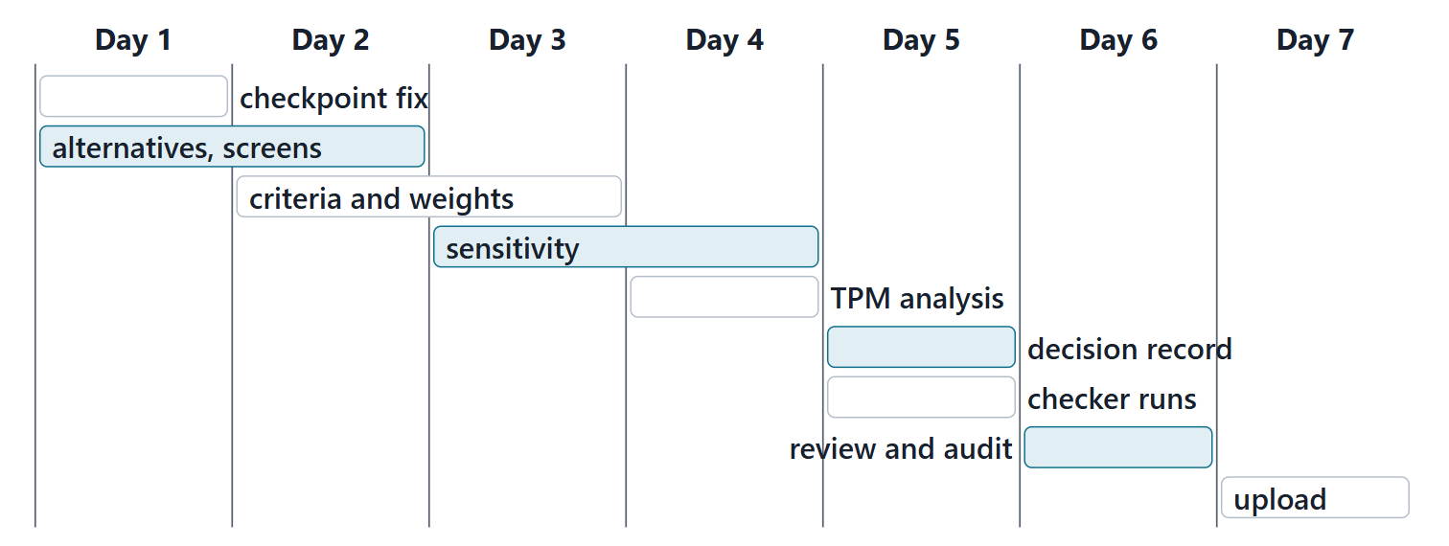
Close: the next seven days
Figure. A suggested seven-day plan for Lab L13, by task and lead role (course convention). Course illustration, not SysML v2 graphical notation.

Slide 23
References and credits
R18 · SEBoK v2.14 (2026), “Decision Management”, p.465–466, 468–469, 472–473
R34 · SEBoK v2.14 (2026), “System Analysis”, p.608–609, 612
R43 · OUSD(R&E) Systems Engineering Guidebook (2021/2022), “Decision Analysis Process”, p.109
R75 · Seidewitz, Intro to the SysML v2 Language: Textual Notation (Release 2026-08), “Analysis Case Definitions”, sl.92–95
R78 · Seidewitz, Intro to the SysML v2 Language: Textual Notation (Release 2026-08), “Standard View Definitions and Domain Libraries (metadata, analysis, cause and effect, requirements derivation)”, sl.148–149, 152
R84 · OMG SysML v2.1 Beta 2, Part 1 (Release 2026-07), “7.23 Analysis Cases”, p.170, 172–173
R114 · OMG SysML v2.1 Beta 2, Part 1 (Release 2026-07), “9.3.2 Modeling Metadata”, p.555–556
R120 · Seidewitz, Intro to the SysML v2 Language: Textual Notation (Release 2026-08), “Expressions and Feature Values”, sl.72, 74, 76, 79, 81, 83–84
R121 · OMG SysML v2.1 Beta 2, Part 1 (Release 2026-07), “9.4.5 Trade Studies”, p.571–574
R124 · OMG SysML v2.1 Beta 2, Part 1 (Release 2026-07), “9.3.4 Parameters of Interest Metadata”, p.561–562
CREDITS AND LICENSES
Introduction to the SysML v2 Language, Textual Notation (Release 2026-08): Copyright © 2019–2026 Model Driven Solutions, Inc. Licensed under the Creative Commons Attribution 4.0 International License (CC BY 4.0).
SEBoK v2.14: “This material is used under a Creative Commons Attribution-NonCommercial ShareAlike 3.0 Unported License from The Trustees of the Stevens Institute of Technology.” (SEBoK, “Bkcase Wiki:Copyright”, PDF p.31). Quotations are short and cited; no SEBoK figure or table is reproduced.
OUSD(R&E) Systems Engineering Guidebook: Distribution Statement A. Approved for public release. Distribution is unlimited.
Figures are original drawings for this course; none redraws a figure from the sources.
AeroLink Urban Mobility is a fictional teaching case: every number, name and statement about it is a teaching value.

