Slide 1
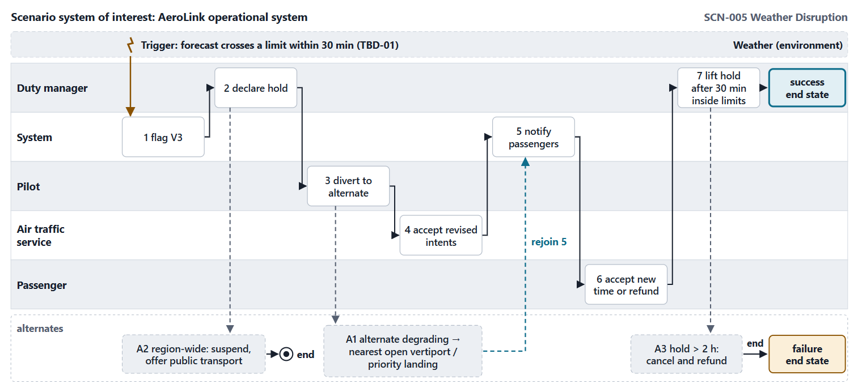
Warm-up: three questions on Session 1
1 · Is the weather an actor in SCN-005?
2 · Name one thing writing SCN-005 exposed
3 · Which capability does SCN-003 exercise?
Figure. SCN-005 from Session 1, as a memory aid for the warm-up.

Slide 2
Warm-up: the answers
1 · No: it has no goal and cannot be asked for help; it is the environment
2 · NEED-011, assumption A-008, or unknown U-001 (TBD-01)
3 · CAP-003, fleet charging management
Sources: R59 p.453

Slide 3
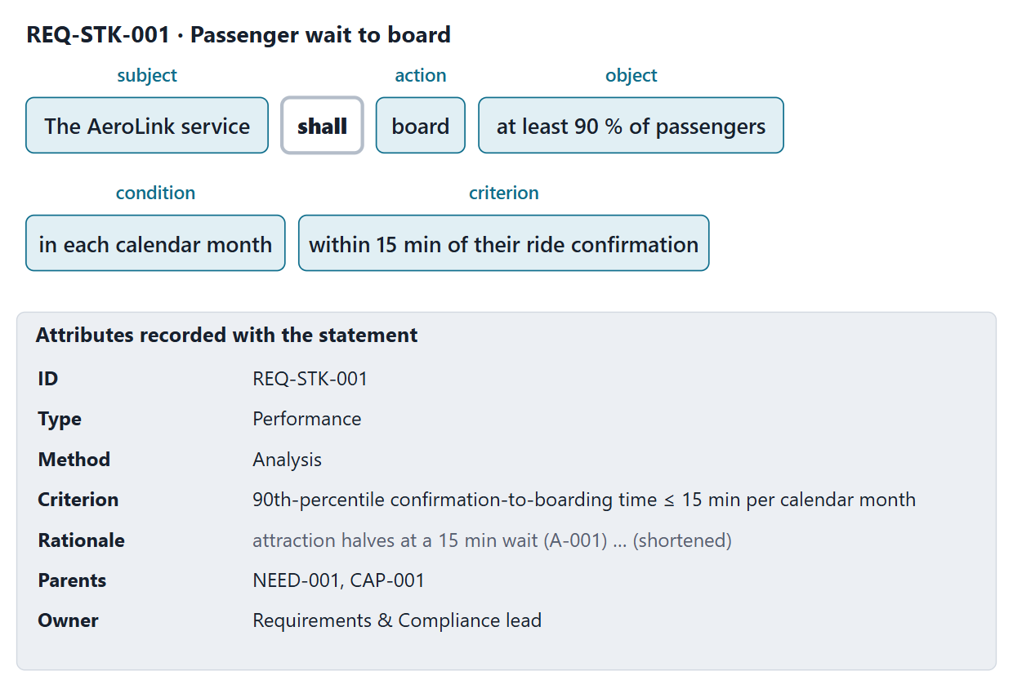
Anatomy of a requirement and its attributes
An agreed obligation to perform a function or have a quality, within constraints
“Shall” binds; “should” and “may” do not; “will” declares purpose
Attributes: rationale, parent, verification criteria, owner, priority …
Course minimum record: ID, name, statement, type, criterion or TBD, rationale, parent, method, owner
Figure. REQ-STK-001 dissected into its parts, with the attribute record that travels with it (FICTIONAL).
Sources: R13 p.558–559; R54 p.330

Slide 4
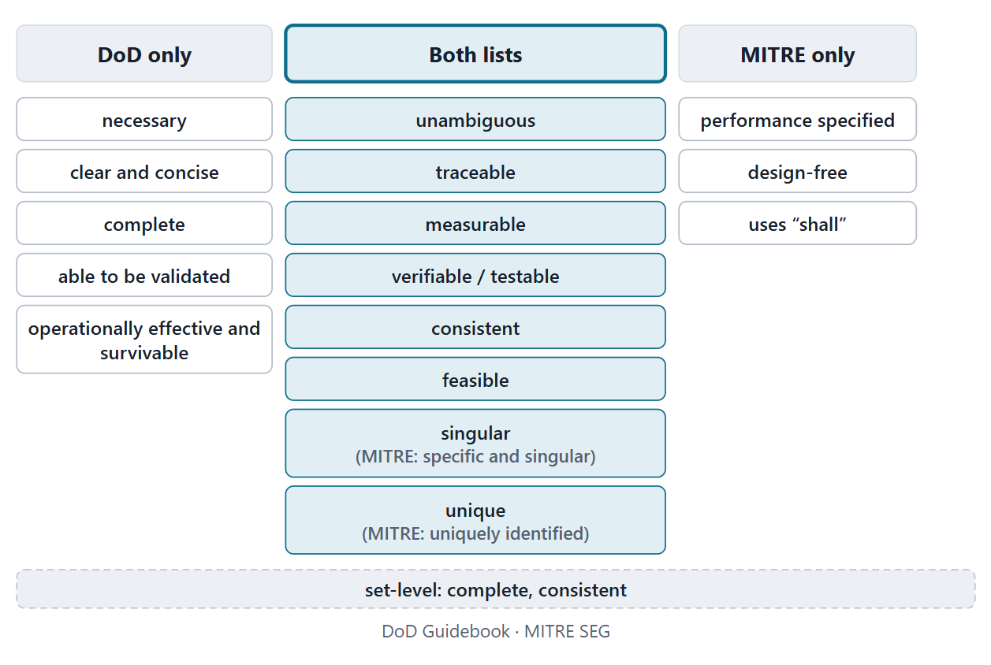
Characteristics of good requirements
The DoD and MITRE lists share eight characteristics
Complete and consistent are judged on the set
Checking against them is requirement verification
INCOSE’s guide, which SEBoK cites, is not in our collection
Figure. The DoD and MITRE lists of good-requirement characteristics: what both name, and what only one does.
Sources: R48b p.144; R54 p.329–330; R13 p.566

Slide 5
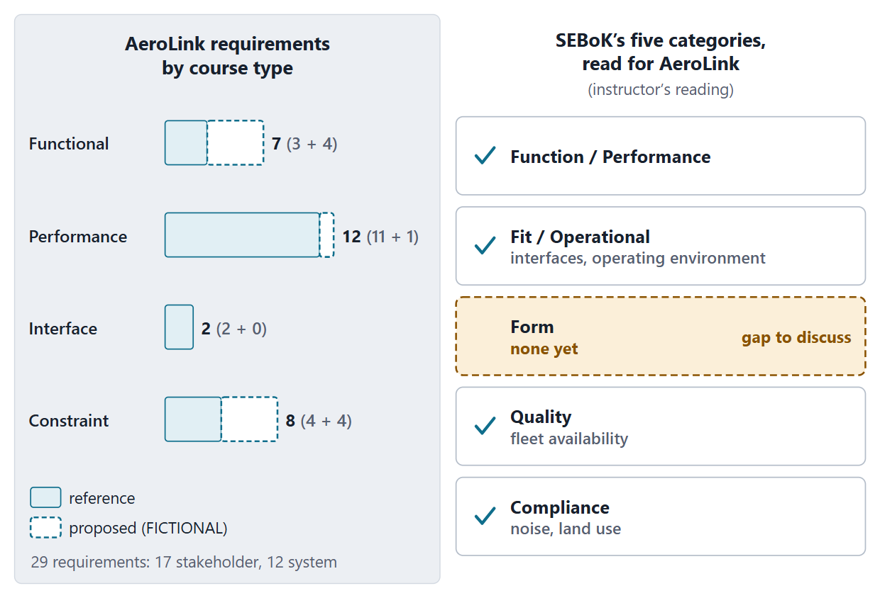
Types and categories: organizing a set so gaps show
SEBoK categories: function/performance, fit/operational, form, quality, compliance
A complete set addresses every category
MITRE: a function, a performance, a design constraint or an interface reference
Course types: functional, performance, interface, constraint
Figure. The 29 AeroLink requirements by course type, reference and proposed, and SEBoK’s five categories read for the set (instructor’s reading).
Sources: R13 p.560; R55 p.368–369

Slide 6
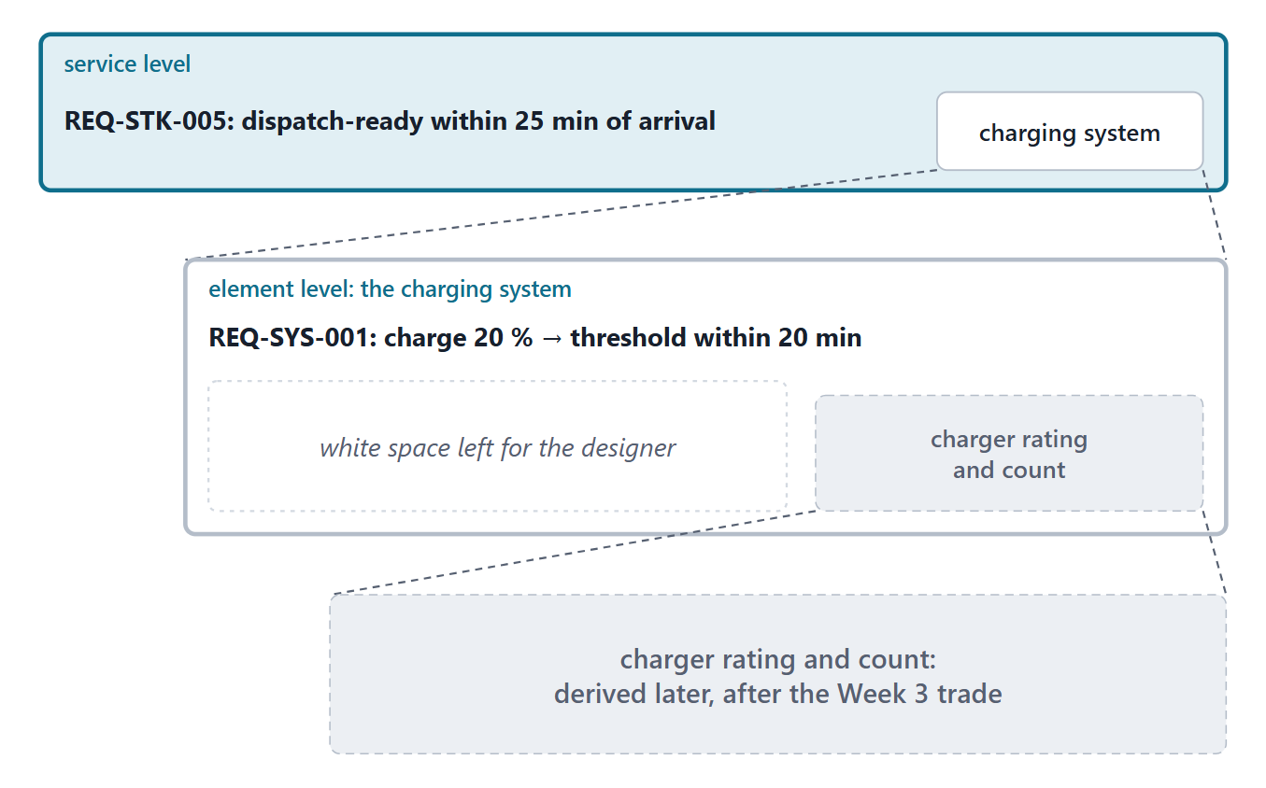
Level, white space and derived requirements
Give designers what they must know; leave white space
Too high: the designer guesses; too low: the design is constrained
Derived requirements come from solution decisions: keep them traceable
Write at the level of the system of interest
Figure. Three levels of the same turnaround: the service, the charging system, and the charger rating that is derived later (FICTIONAL).
Sources: R55 p.367; R55 p.371; R48 p.146; R13 p.558

Slide 7
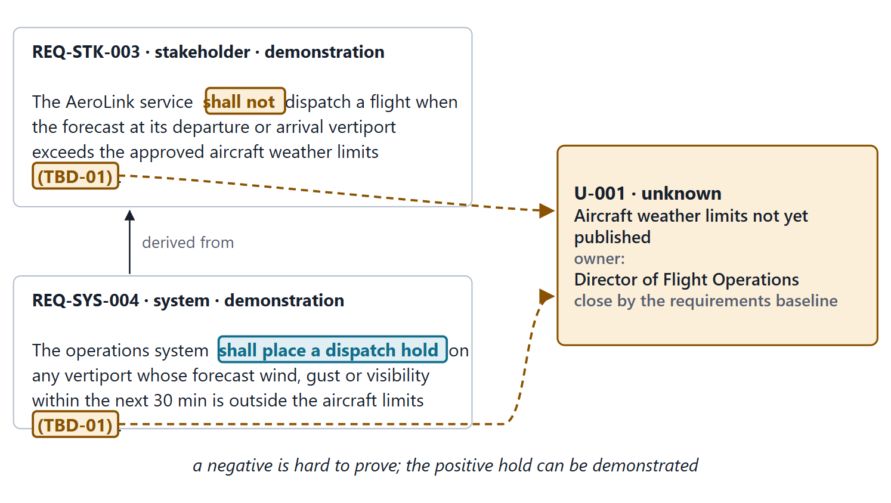
Negatives, ranges, thresholds and TBDs
Avoid “shall not”: a negative is hard to prove
Avoid “maximize” and “minimize”; use ranges, not single points
Threshold: must be met; objective: better has value up to it
TBD: value unknown; TBR: known, low confidence; each with an owner
Figure. A negative stakeholder requirement with a TBD, the unknown that tracks it, and the positive system requirement that answers it (FICTIONAL).
Sources: R55 p.370; R13 p.565

Slide 8
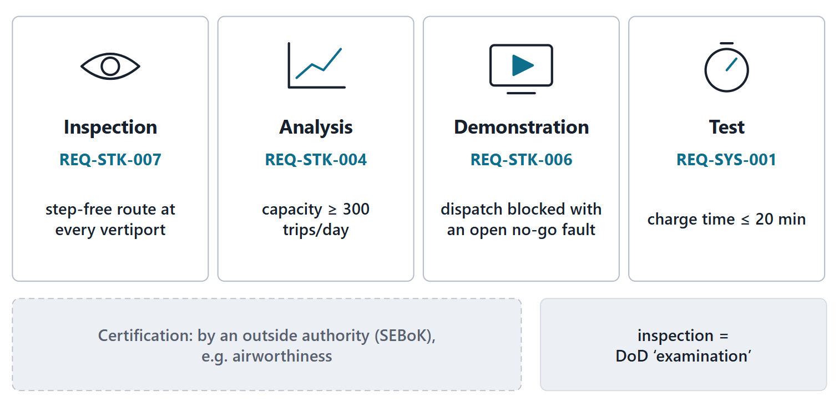
A verification method for every requirement
Every requirement needs a verification method
Inspection, analysis, demonstration, test
Certification: a fifth method, by an outside authority
Define the success criteria while writing
Figure. Four verification methods, each with one AeroLink requirement, and certification as a fifth method (FICTIONAL).
Sources: R55 p.370; R49 p.149–150; R16 p.769; R13 p.566

Slide 9
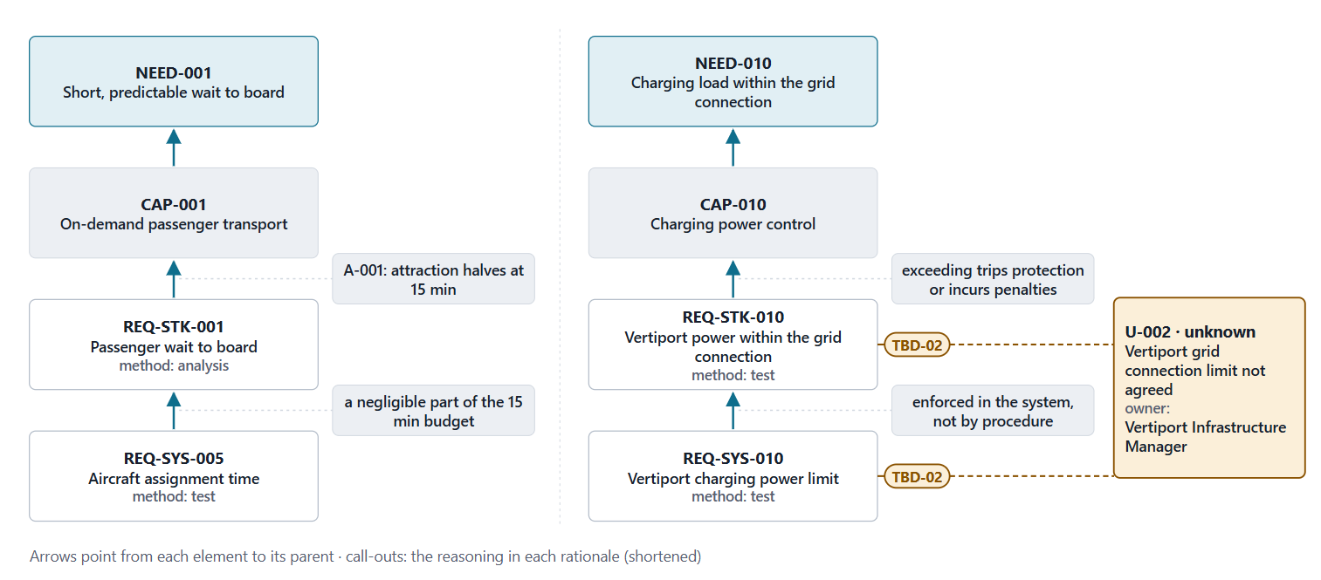
Worked example IV: two chains and the reasoning in the rationale
Figure. Two chains from need to system requirement. The rationale beside each arrow says why the requirement exists and where its value comes from (FICTIONAL).
Sources: R13 p.559; R13 p.565

Slide 10
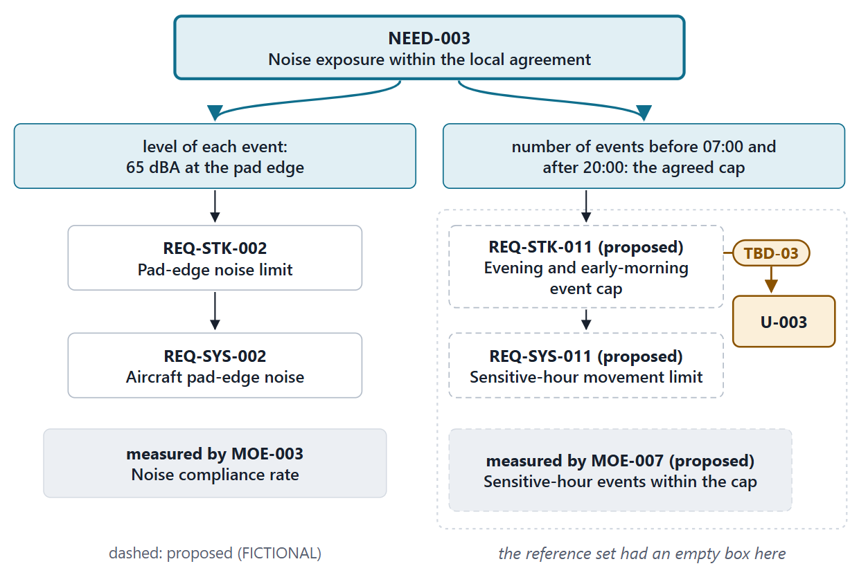
Worked example V: a Week 1 correction reaches the requirements
Corrected NEED-003: the loudness of each event and the number of evening and early-morning events
REQ-STK-002 covers loudness only
Proposed REQ-STK-011: the event cap (TBD-03)
It flows down: REQ-SYS-011, MOE-007, MOP-010
Figure. The corrected NEED-003 has two bounds; each needs its own requirements and measure. The second column is proposed (FICTIONAL).
Sources: R13 p.558–559

Slide 11
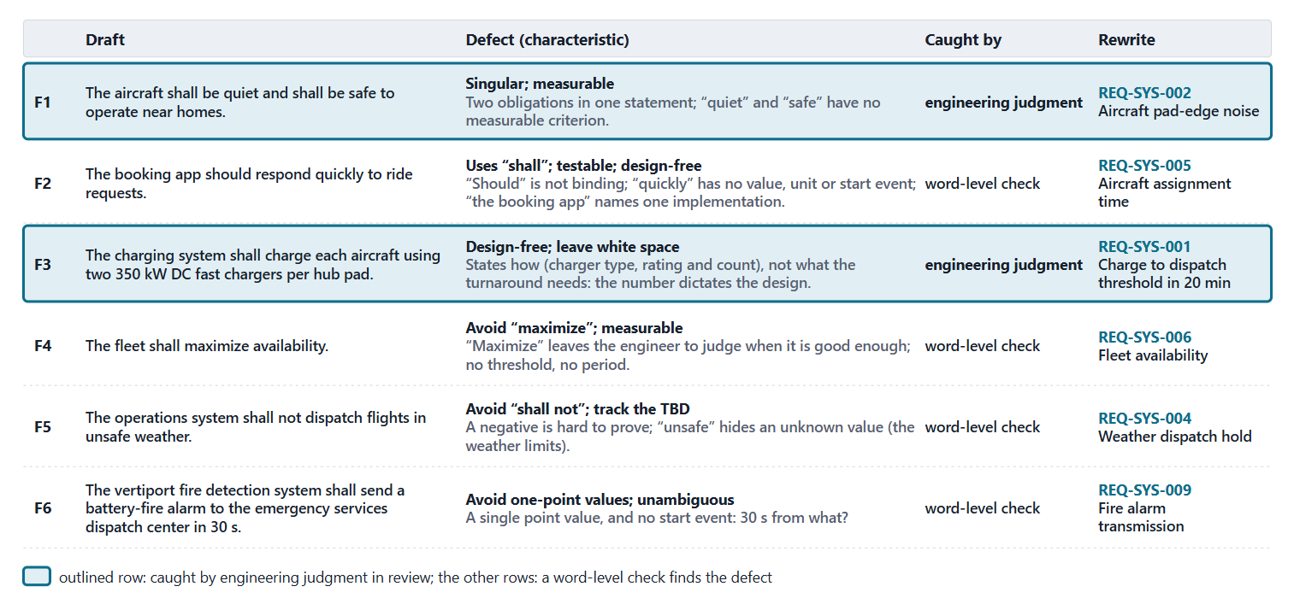
Worked example VI: critique and rewrite
Pairs diagnose two drafts each; then the reveal (FICTIONAL)
Figure. Six flawed drafts, the defect in each with its source, what finds it, and the rewrite (FICTIONAL).
Sources: R48b p.144; R54 p.329–330; R55 p.367; R55 p.370; R13 p.565–566

Slide 12
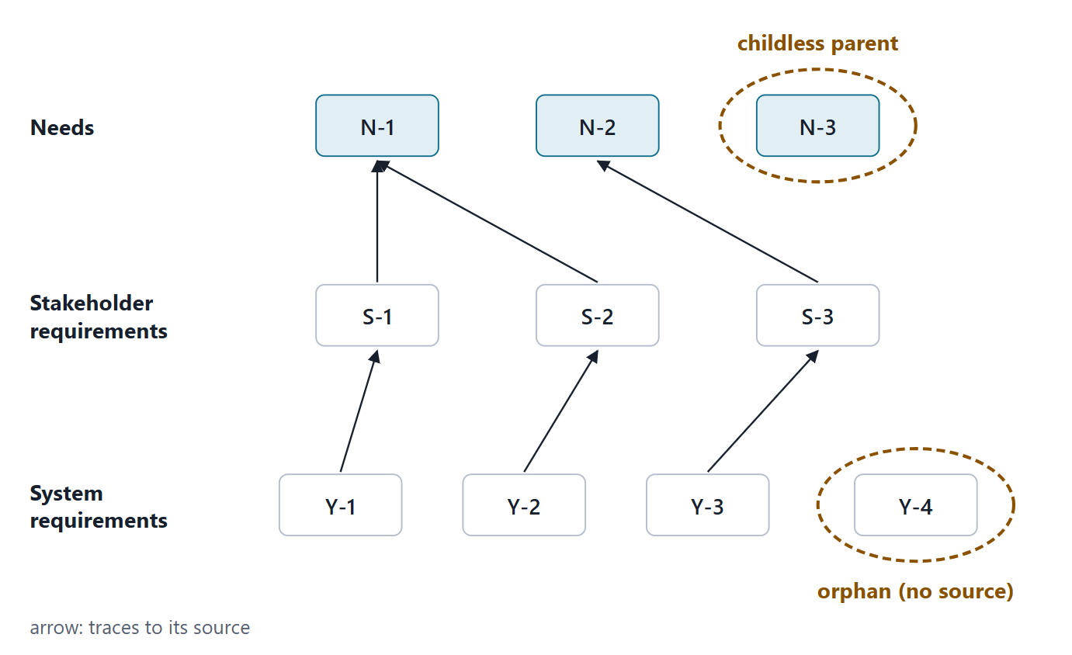
Bidirectional traceability: orphans and childless parents
Bottom-up: every derived requirement traces to its source
Bidirectional: no orphans below, no childless parents above
The traceability matrix records decomposition, derivation, allocation and rationale
Traceability supports the impact analysis of changes
Figure. A generic trace graph with one orphan requirement and one childless parent.
Sources: R45 p.118–119; R13 p.565; R14 p.478

Slide 13
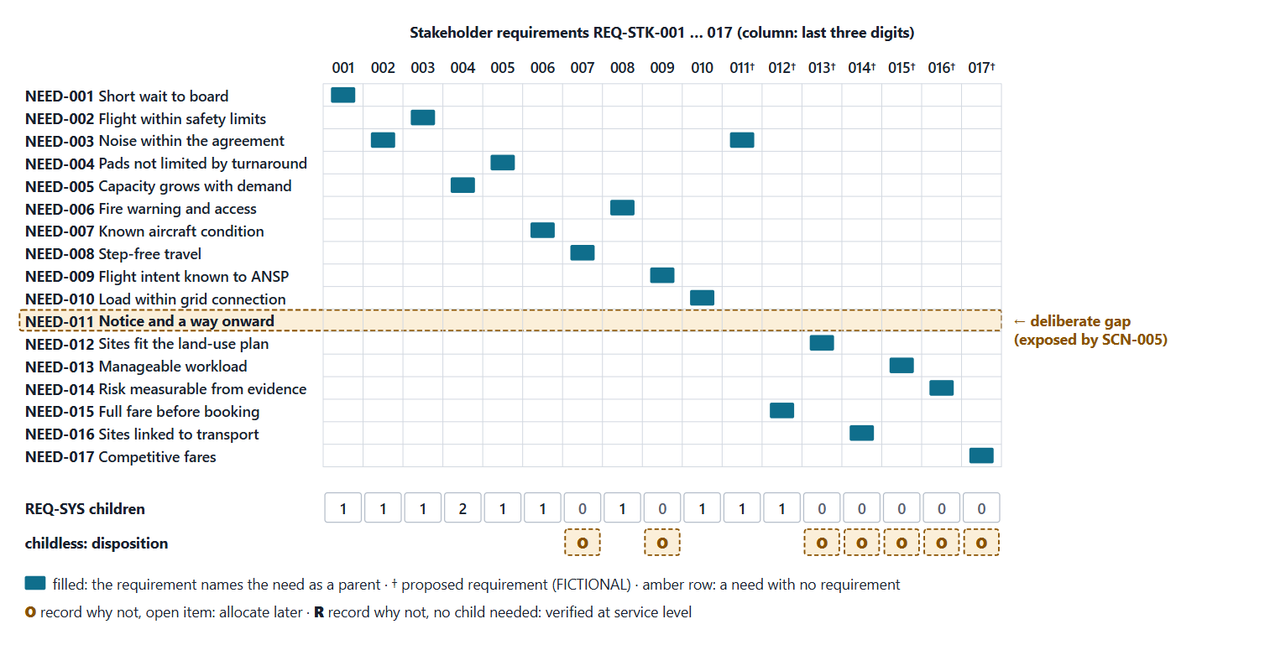
Worked example VII: auditing the AeroLink trace
Figure. Needs by stakeholder requirements, and stakeholder requirements by the number of system requirements under them. NEED-011 is the one deliberate gap; childless stakeholder requirements carry their disposition, record why not: O, an open item, or R, no child needed. Proposed columns are marked †. FICTIONAL.
Sources: R45 p.118

Slide 14
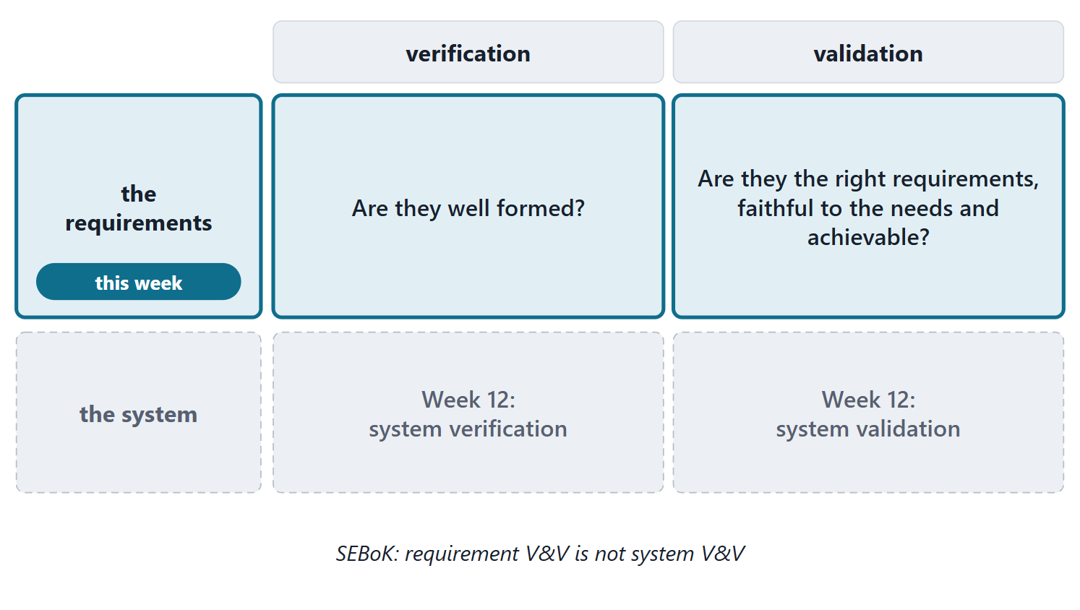
Requirement verification versus requirement validation
Requirement verification: are they well formed?
Requirement validation: are they the right ones, faithful to the needs and achievable?
Neither is system verification or validation
Methods: peer review; comparison with the characteristics and the needs
Figure. Verification and validation applied to the requirements this week, and to the system in Week 12.
Sources: R13 p.566

Slide 15
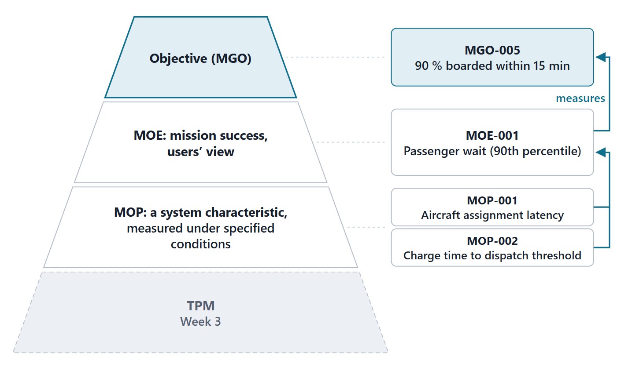
Measures of effectiveness and measures of performance
MOE: mission success under stated conditions, from the users’ viewpoint
MOP: a physical or functional characteristic, measured under stated conditions
KPP: a stakeholder-defined, minimal and critical measure
TPMs: Week 3, with technology and risk
Figure. From objective to measure: MOEs in the users’ terms, MOPs in the system’s, with TPMs left for Week 3.
Sources: R54 p.330–331; R10 p.544; R15 p.532

Slide 16
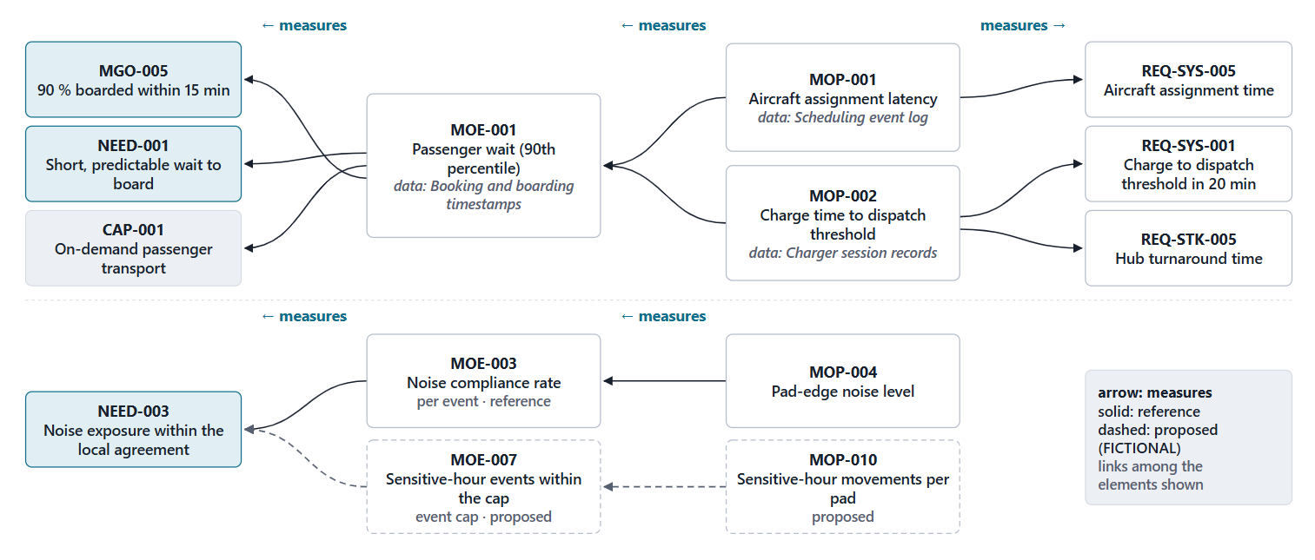
Worked example VIII: the AeroLink measures
Figure. How the AeroLink measures link objectives, needs and capabilities to requirements, with their data sources. Dashed items are proposed (FICTIONAL).

Slide 17
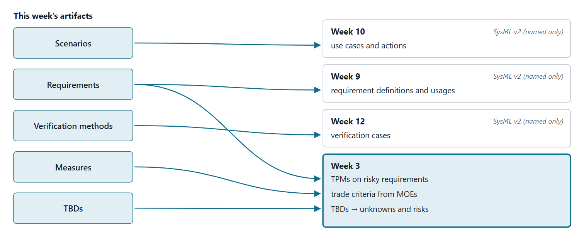
Where this goes: Weeks 3, 9, 10 and 12
Figure. This week’s artifacts and where each goes next. Phase II items are named only; no SysML syntax is taught this week.
Sources: R74 sl.86–91; R76 sl.100–107; R72 sl.30–47; R75 sl.96–97

Slide 18
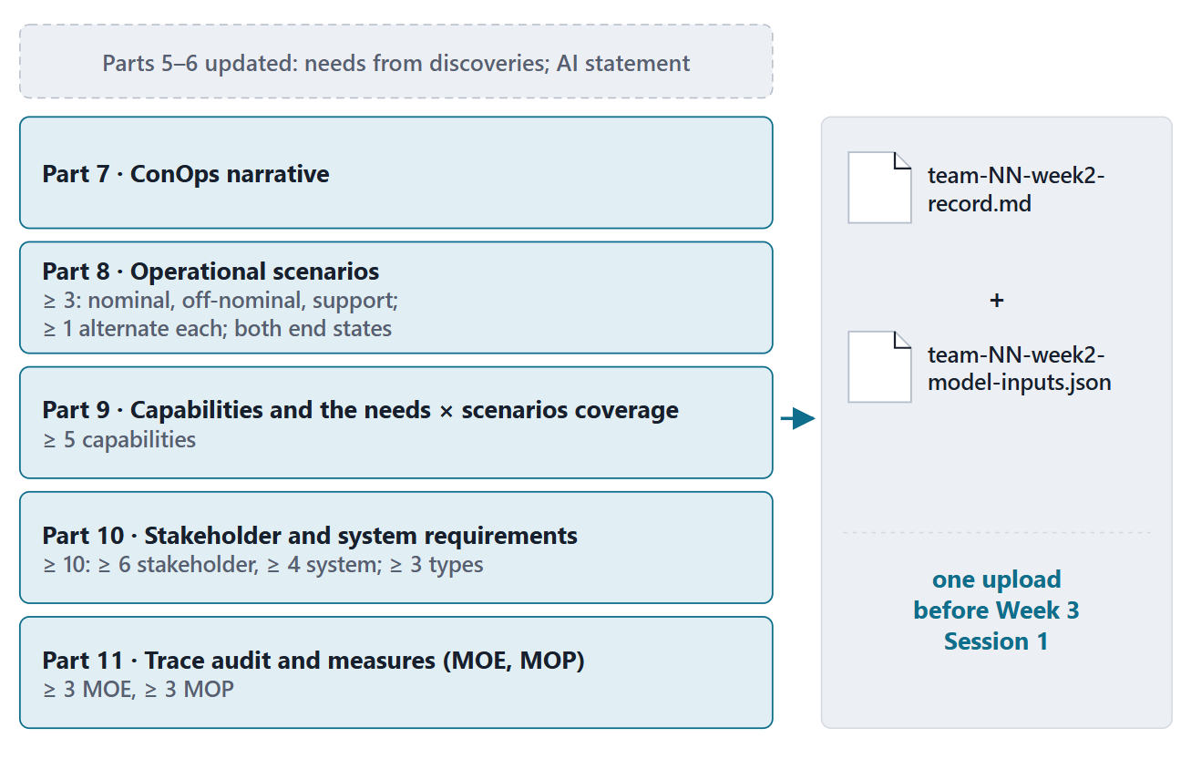
Lab L2: what you deliver, and by when
Due before Week 3 Session 1, on the LMS; your own enterprise, never AeroLink
Your own enterprise, never AeroLink
Import your Week 1 record; the lab tool extends it
Two files, one upload, before Week 3 Session 1
Formative; feedback before Week 3 Session 2
Figure. The Week 2 additions to the Team Record and their minimums for a team of four (course convention).

Slide 19
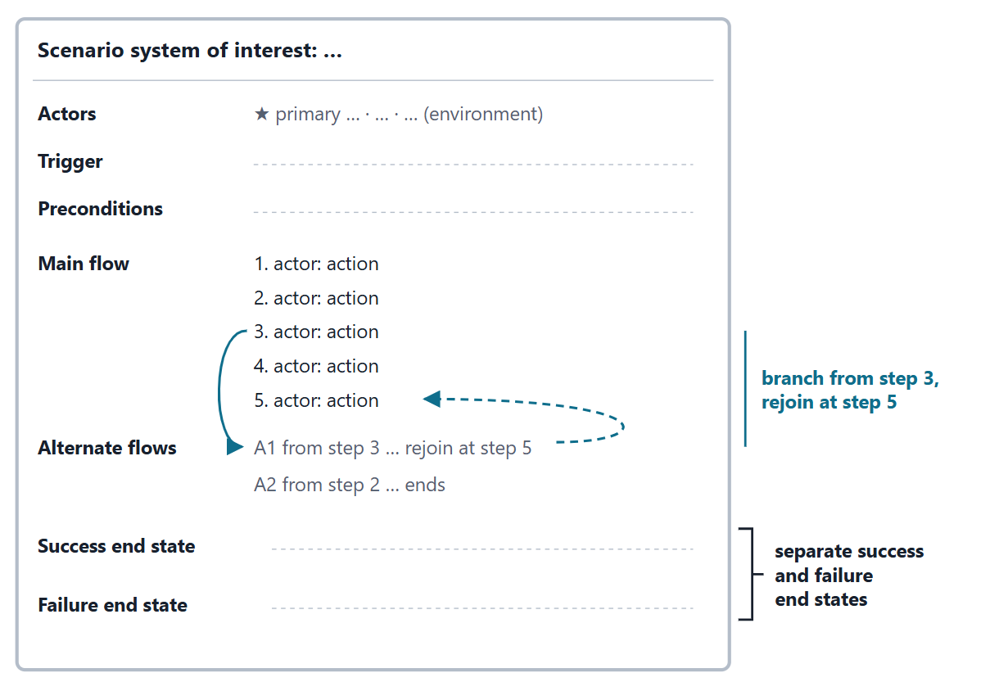
Team work: choose scenarios and owners
8 minutes, in teams; the off-nominal skeleton is needed for the clinic
Merge the members’ skeletons; choose at least three
One nominal, one off-nominal, one support
An owner for each scenario and each ID prefix
Write the off-nominal skeleton for the clinic
Figure. The scenario template from Session 1: teams fill the header, trigger, primary actor and failure end state for the clinic.
Sources: R59 p.453–454

Slide 20
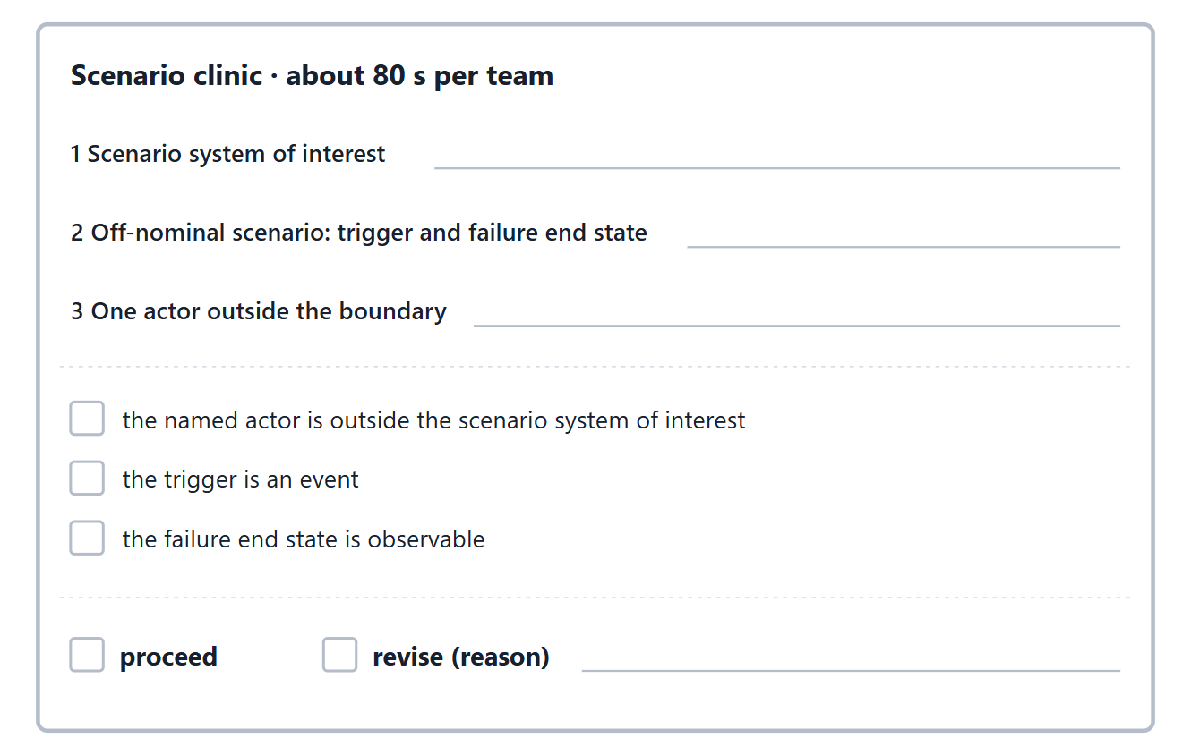
Instructor checkpoint: the scenario clinic
About 80 seconds per team; up to five teams in class, the rest decided within 48 h
State your scenario system of interest
Read your off-nominal trigger and failure end state
Name one actor outside the boundary
Decision: proceed, or revise with the reason
More than five teams: card on the LMS, decided within 48 h
Figure. The clinic card: three lines from the team, three checks and the instructor’s decision.
Sources: R59 p.453–455

Slide 21
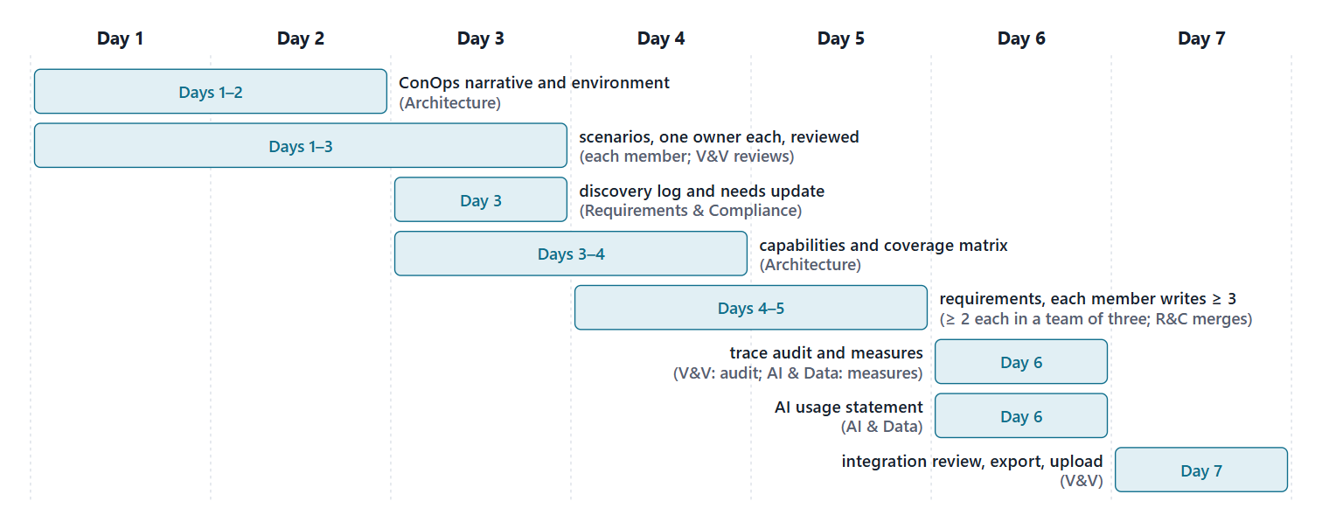
Close: the next seven days
Quiz Q2 and the applied exercise open today. Log your hours.
Figure. A suggested seven-day plan for Lab L2, with the lead role for each task (course convention).

Slide 22
References and credits
R10 · SEBoK v2.14 (2026), “Business or Mission Analysis”, p.544, 546
R13 · SEBoK v2.14 (2026), “System Requirements Definition”, p.557–562, 565–566
R14 · SEBoK v2.14 (2026), “Requirements Management”, p.478
R15 · SEBoK v2.14 (2026), “Measurement”, p.532
R16 · SEBoK v2.14 (2026), “Product Systems Engineering Special Activities”, p.769
R45 · OUSD(R&E) Systems Engineering Guidebook (2021/2022), “Requirements Management Process”, p.118–119
R48 · OUSD(R&E) Systems Engineering Guidebook (2021/2022), “Stakeholder Requirements Definition Process”, p.146
R48b · OUSD(R&E) Systems Engineering Guidebook (2021/2022), “Requirements Analysis Process”, p.142, 144
R49 · OUSD(R&E) Systems Engineering Guidebook (2021/2022), “Verification Process”, p.149–150
R54 · The MITRE Systems Engineering Guide (2014), “Analyzing and Defining Requirements”, p.329–331
R55 · The MITRE Systems Engineering Guide (2014), “Develop System-Level Technical Requirements”, p.367–371
R59 · The MITRE Systems Engineering Guide (2014), “Use Cases and Mission Threads”, p.452–456
R72 · Seidewitz, Intro to the SysML v2 Language: Textual Notation (Release 2026-08), “Action Definition”, sl.30–47
R74 · Seidewitz, Intro to the SysML v2 Language: Textual Notation (Release 2026-08), “Requirement Definitions”, sl.86–91
R75 · Seidewitz, Intro to the SysML v2 Language: Textual Notation (Release 2026-08), “Analysis Case Definitions”, sl.96–97
R76 · Seidewitz, Intro to the SysML v2 Language: Textual Notation (Release 2026-08), “Use Case Definition”, sl.100–107
CREDITS AND LICENSES
Introduction to the SysML v2 Language, Textual Notation (Release 2026-08): Copyright © 2019–2026 Model Driven Solutions, Inc. Licensed under the Creative Commons Attribution 4.0 International License (CC BY 4.0).
SEBoK v2.14: “This material is used under a Creative Commons Attribution-NonCommercial ShareAlike 3.0 Unported License from The Trustees of the Stevens Institute of Technology.” (SEBoK, “Bkcase Wiki:Copyright”, PDF p.31). Quotations are short and cited; no SEBoK figure or table is reproduced.
OUSD(R&E) Systems Engineering Guidebook: Distribution Statement A. Approved for public release. Distribution is unlimited.
The MITRE Systems Engineering Guide: © 2014 by The MITRE Corporation. All rights reserved. Approved for public release; distribution unlimited (Case Numbers 10-4072 and 12-1089). Quoted briefly with attribution.
Figures are original drawings for this course; none redraws a figure from the sources.
AeroLink Urban Mobility is a fictional teaching case: every number, name and statement about it is a teaching value.

