Slide 1
WEEK 7 · SESSION 2
Final Presentation
Session 2: Presenting and defending engineering decisions; the Phase I design review
First: how to present and defend a decision, and how to answer a finding
Then: the Phase I design review, team by team
Your reviewers have read your package and written their findings

Slide 2
A defendable decision is traceable, and states its limits
Traceable: every claim leads to an ID or an analysis
Defendable: the criteria, weights and sensitivity are shown
Actionable: it ends in a decision and an action plan
The decision maker decides; you make it decidable
KEY POINT
Reviewers judge how well you show the link from your design to its requirements.
Sources: R43 p.109; R43 p.110; R56 p.387

Slide 3
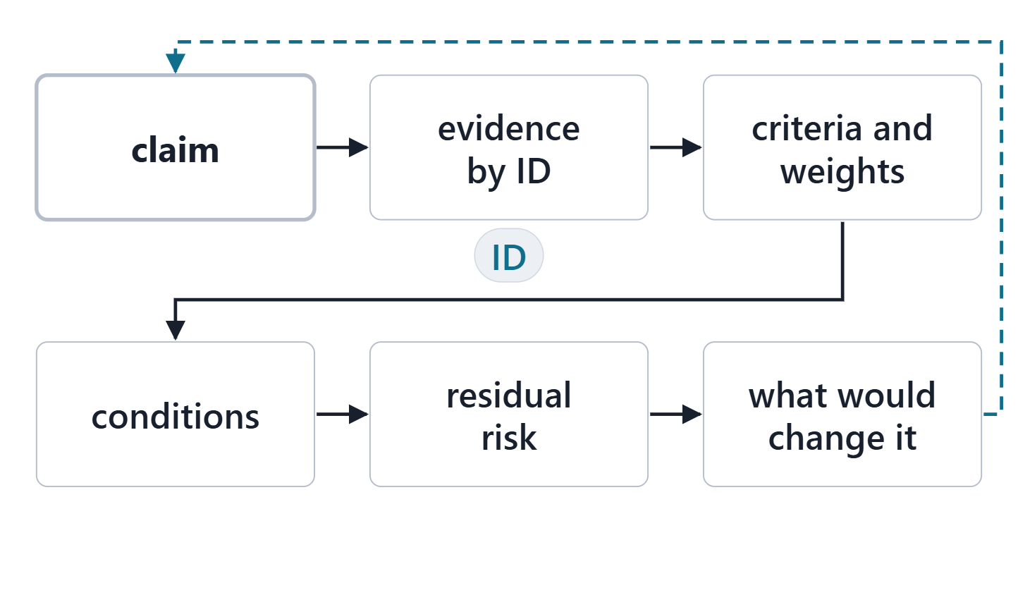
The structure of an engineering argument
Claim: the recommendation, in one sentence
Evidence: analysis and IDs, not adjectives
Criteria: what “better” meant, with weights
Conditions and residual risk: the limits
What would change it: the honest exit
Figure. An engineering argument in six links: the claim, its evidence, the criteria, the conditions, the residual risk and what would change it.
Sources: R43 p.110; R18 p.473

Slide 4
Defending the trade: AeroLink’s Year-2 decision
Claim: ALT-004, 4 aircraft and a fourth hub
Evidence: 320 trips/day by month 24; passes every screen
Criteria: 0.670 against 0.624 for ALT-005
3 alternatives survive the screens
4 conditions, from the sensitivity
4 residual risks, each with its R ID
4 stated exits: what would change it
Sources: R43 p.110

Slide 5
Defending a risk position and a roadmap
Risk: the handling chosen, its owner and its trigger
Accepting a risk is a decision: say why and who watches
Show the residual level, not only the treatment
Roadmap: each increment serves a named gap
Order by evidence: maturity, triggers, dependencies
Defend the timing with what starts it, not a date
Sources: R06c p.387; R105 p.531

Slide 6
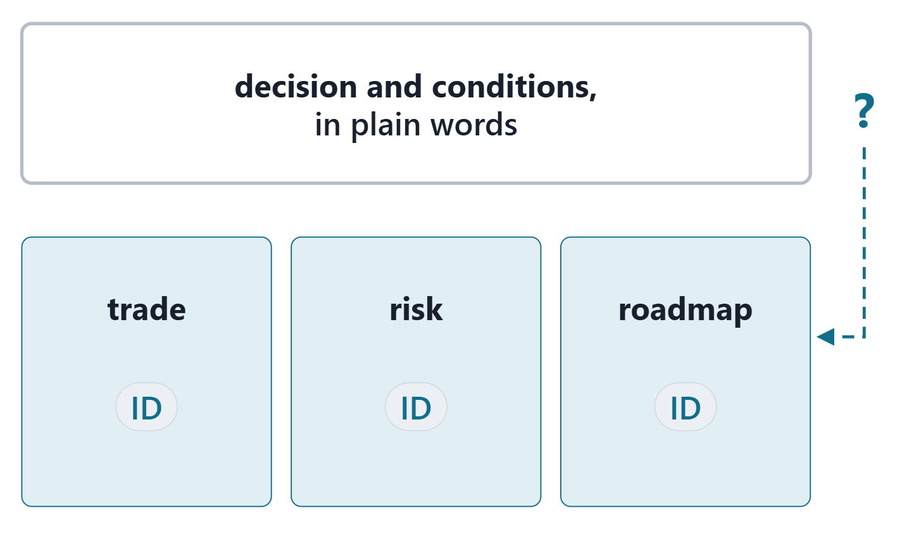
Briefing a mixed audience
Lead with the decision, in operational terms
One message per slide; IDs on the slide, jargon off it
Drill down on request, from summary to analysis
Figure. One briefing, two depths: the decision on top, the evidence one step below, reachable when asked.
Sources: R105 p.531; R43 p.110

Slide 7
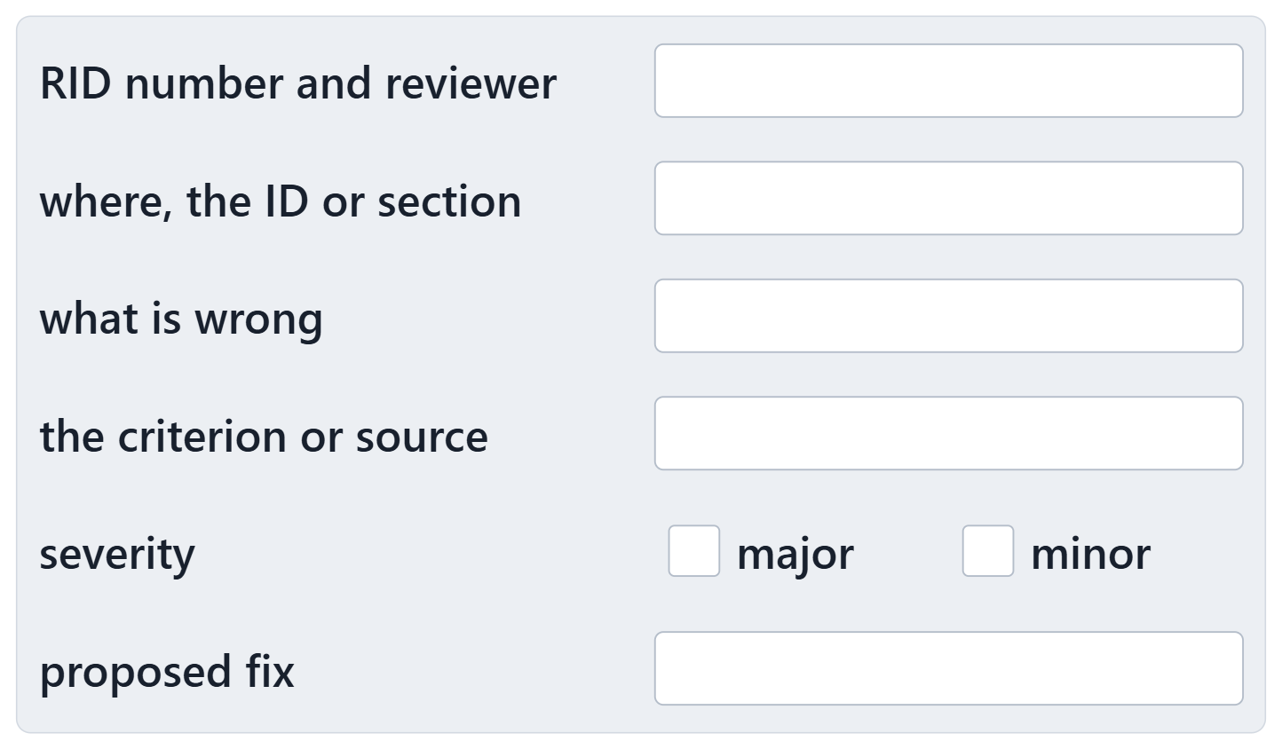
Review findings: the review item discrepancy (RID)
Where: the ID or section it concerns
What: what is wrong, against which criterion
Severity: major or minor
A proposed fix: what would close it
Course convention: the form on the Assessment page
Figure. The RID form: where, what and against which criterion, severity, and the proposed fix.
Sources: R06c p.388

Slide 8
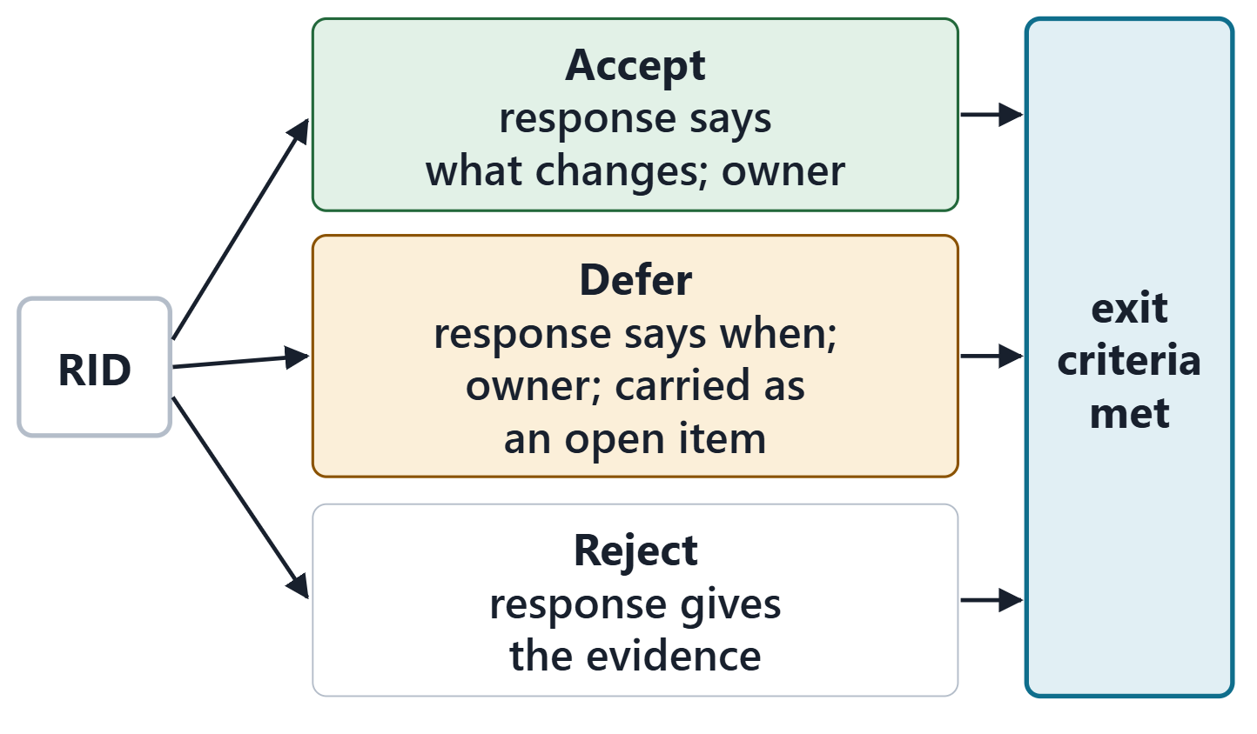
Answering findings: accept, defer or reject
Accept, defer or reject, each with a response
An accepted or deferred RID has an owner
Reject only with evidence: an ID, a decision, a computation
Exit when every RID is dispositioned
Figure. Every RID gets one of three dispositions, each with a response; accepted and deferred ones also get an owner.
Sources: R06c p.388

Slide 9
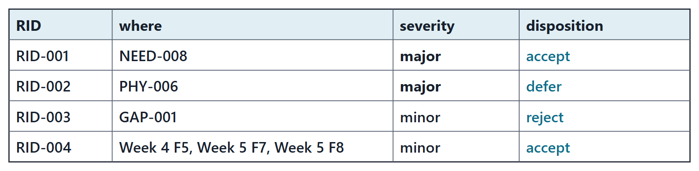
Worked example: four RIDs against the AeroLink package
RID-001 Accept: NEED-008: major
RID-002 Defer: PHY-006: major
RID-003 Reject: GAP-001: minor
RID-004 Accept: Week 4 F5, Week 5 F7, Week 5 F8: minor
Figure. 4 RIDs raised against AeroLink’s package and their dispositions: 2 accepted, 1 deferred, 1 rejected. (FICTIONAL)
Sources: R13 p.566; R13 p.565

Slide 10
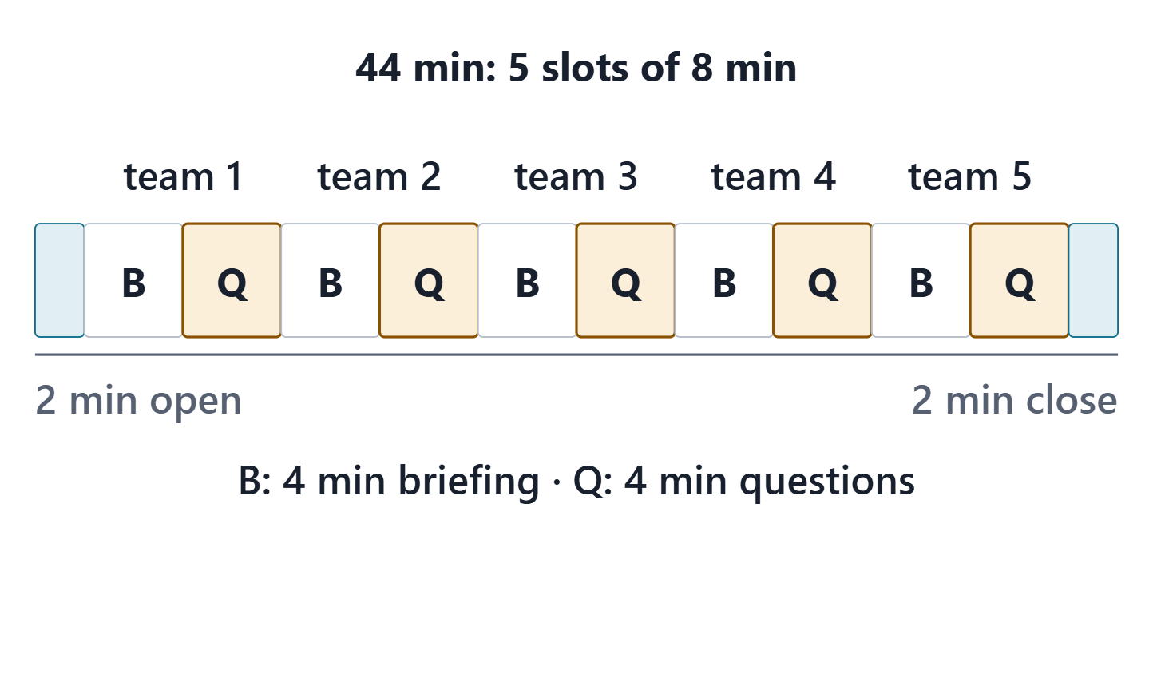
Opening the review: criteria, roles and timing
Criteria: the presentation rubric, known in advance
Owners present and answer for their sections
Five teams: 4 min briefing, 4 min questions
Four teams: 6 min briefing, 4 min questions
Figure. The review block for five teams: 8-minute slots of 4 minutes of briefing and 4 of questions on the RIDs.
Sources: R06c p.387

Slide 11
Team design reviews
Briefing: summary, one decision defended, one thread walked
Questions: the reviewers’ RIDs, answered by their owners
Recorder: each RID raised and the first answer
Next team ready while the questions run

Slide 12
Closing the review: what happens next
Dispositions of every RID: within 3 days
Accepted and deferred RIDs: owned
Close the package in the tool and export it again
Week 8 starts from the closed package
Sources: R06c p.388

Slide 13
References and credits
R06c · SEBoK v2.14 (2026), “Technical Reviews and Audits”, p.386–388
R13 · SEBoK v2.14 (2026), “System Requirements Definition”, p.565–566
R18 · SEBoK v2.14 (2026), “Decision Management”, p.473–474
R43 · OUSD(R&E) Systems Engineering Guidebook (2021/2022), “Decision Analysis Process”, p.109–110
R56 · The MITRE Systems Engineering Guide (2014), “Assess the Design”, p.387, 389
R105 · The MITRE Systems Engineering Guide (2014), “Technology Planning”, p.531
CREDITS AND LICENSES
SEBoK v2.14: “This material is used under a Creative Commons Attribution-NonCommercial ShareAlike 3.0 Unported License from The Trustees of the Stevens Institute of Technology.” (SEBoK, “Bkcase Wiki:Copyright”, PDF p.31). Quotations are short and cited; no SEBoK figure or table is reproduced.
OUSD(R&E) Systems Engineering Guidebook: Distribution Statement A. Approved for public release. Distribution is unlimited.
The MITRE Systems Engineering Guide: © 2014 by The MITRE Corporation. All rights reserved. Approved for public release; distribution unlimited (Case Numbers 10-4072 and 12-1089). Quoted briefly with attribution.
Figures are original drawings for this course; none redraws a figure from the sources.
AeroLink Urban Mobility is a fictional teaching case: every number, name and statement about it is a teaching value.

