Slide 1
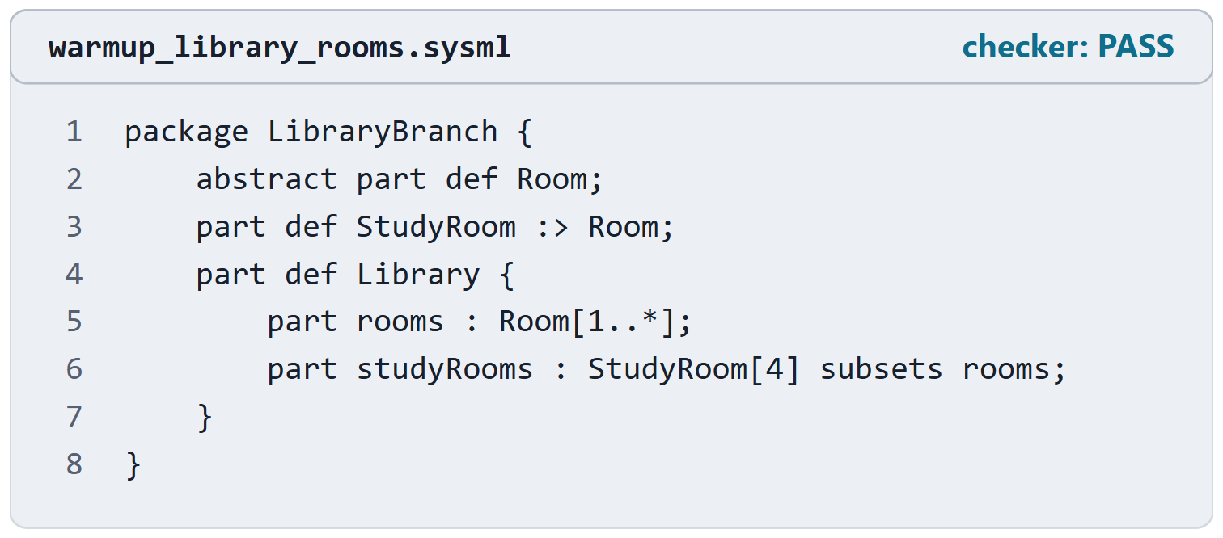
Warm-up: read this listing
Session 2: Packages, the toolchain, the import, stakeholders and concerns
Which line is a specialization?
Which line is a subsetting?
At least how many rooms does a library have?
ANSWERS
StudyRoom :> Room specializes; studyRooms … subsets rooms; at least four rooms, because the four study rooms are among the rooms.
Figure. An unseen listing: a branch library and its rooms. Checked with the course-designated checker (PASS).
Sources: R70 sl.10–11; R80 p.64

Slide 2
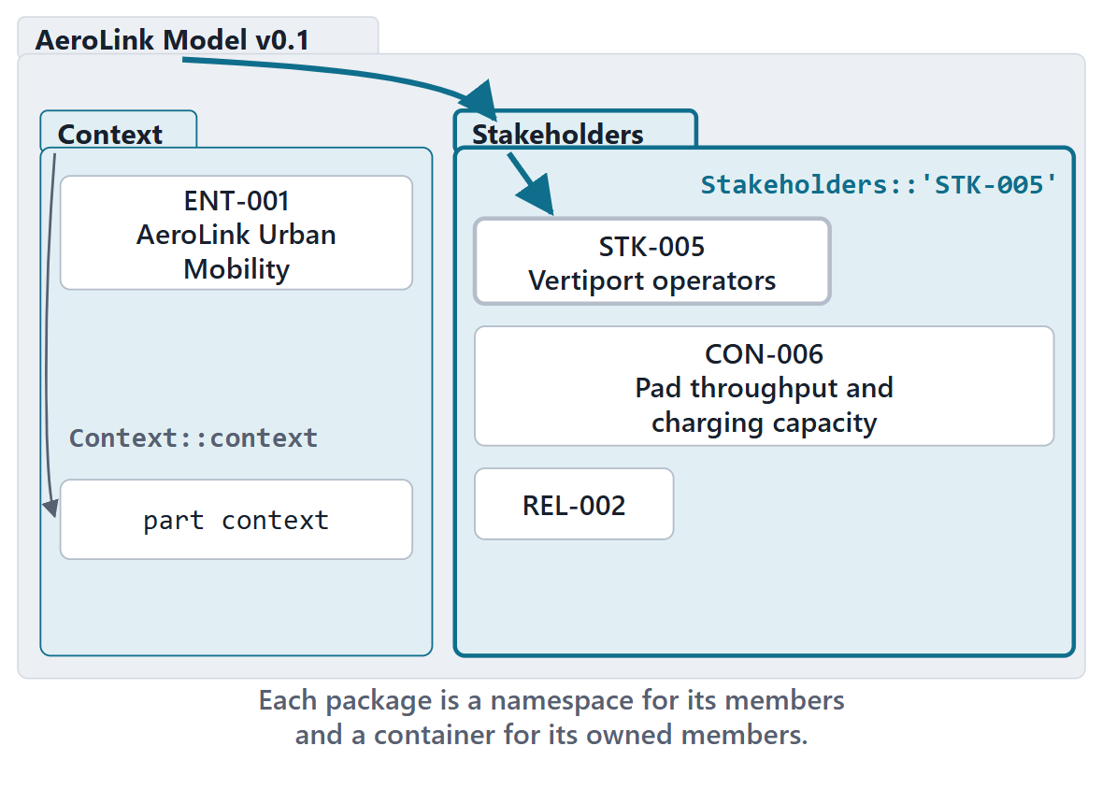
Packages, namespaces and qualified names
A namespace contains elements and names them
A package is a namespace used only to organize the model
Qualified name: names joined by ::
Definitions and usages are namespaces too
A name with spaces or special characters is quoted
Figure. A model organized in packages; a qualified name is the path of names from a package to a member.
Sources: R80 p.47; R80 p.56; R70 sl.5; R70 sl.9

Slide 3
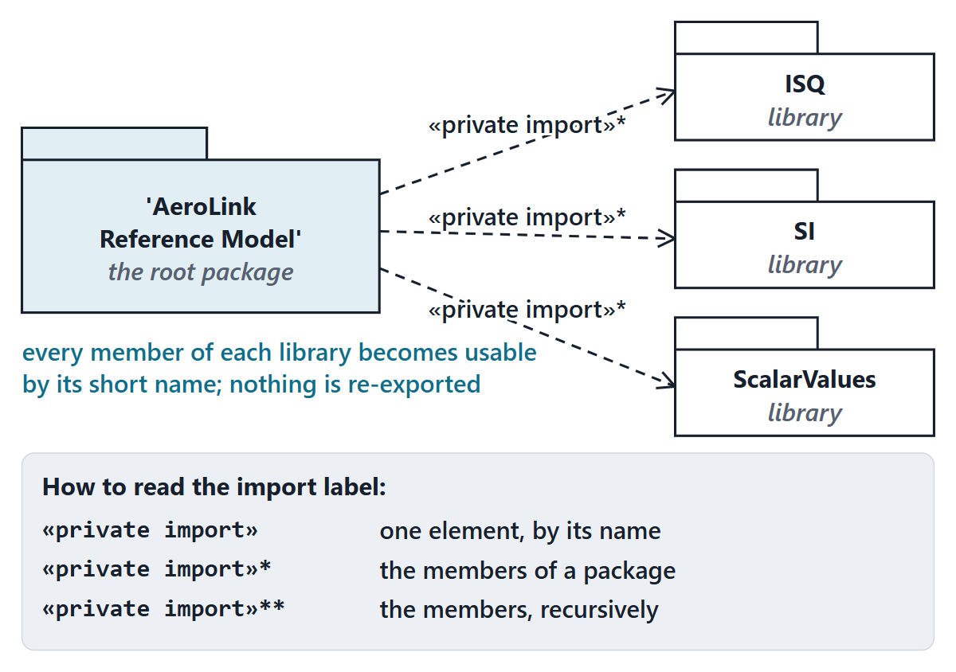
Imports and visibility
::* imports all members; ::** imports recursively
Show visibility on every import; private unless re-export is needed
An import owned by a root namespace must be private
Recorded result: an import without visibility fails
Figure. The AeroLink reference model’s root package imports the quantity, unit and scalar-value libraries privately, drawn in the graphical notation. Checked (PASS).
Sources: R70 sl.5–6; R80 p.60–61; R80 p.63

Slide 4
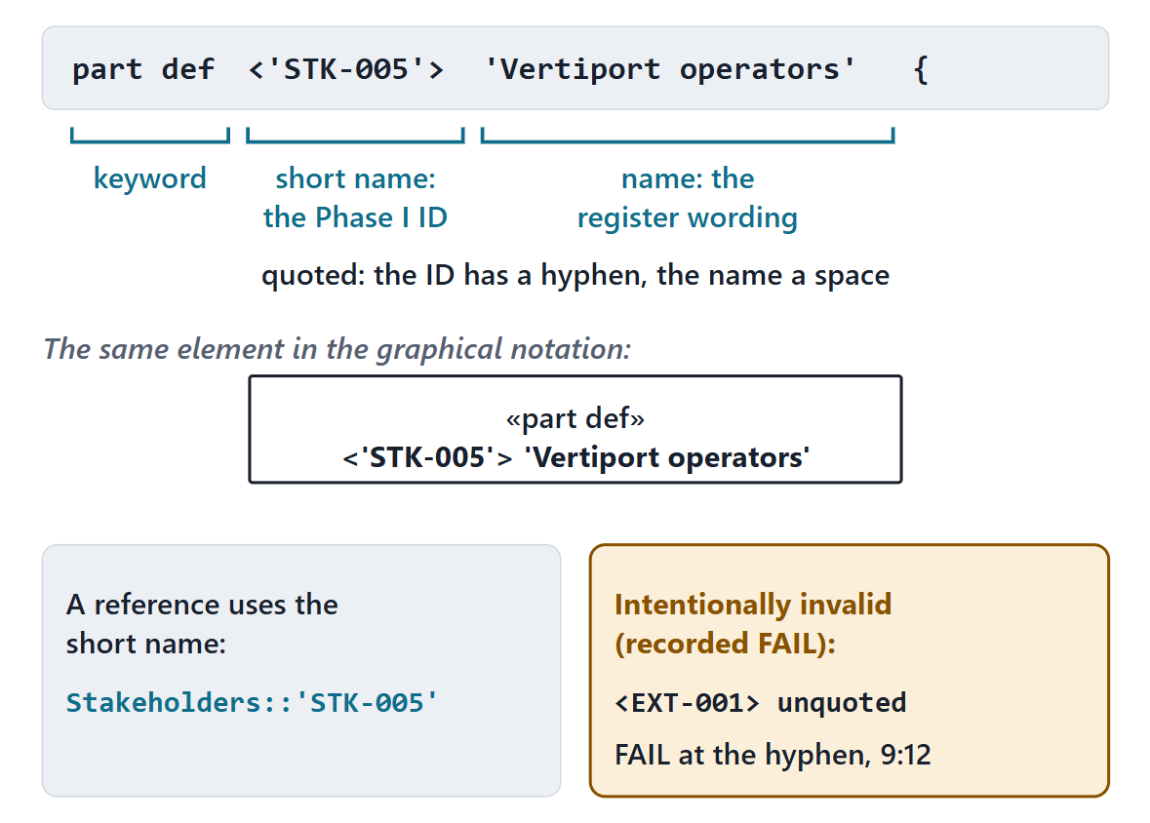
Names and short names: carrying the Phase I IDs
The tool keeps the element ID; the text cannot write it
Declaration order: short name in < >, then name
Basic names: letters, digits, underscore; others quoted
Course convention: each Phase I ID is a quoted short name
Figure. One AeroLink stakeholder declaration taken apart: keyword, short name (the Phase I ID) and name; the same element as a box; a reference by short name; and the recorded failure of an unquoted ID from the intentionally invalid tool-proof file. Checked (PASS; the invalid file FAIL, as intended).
Sources: R80 p.49–50; R90 sl.22

Slide 5
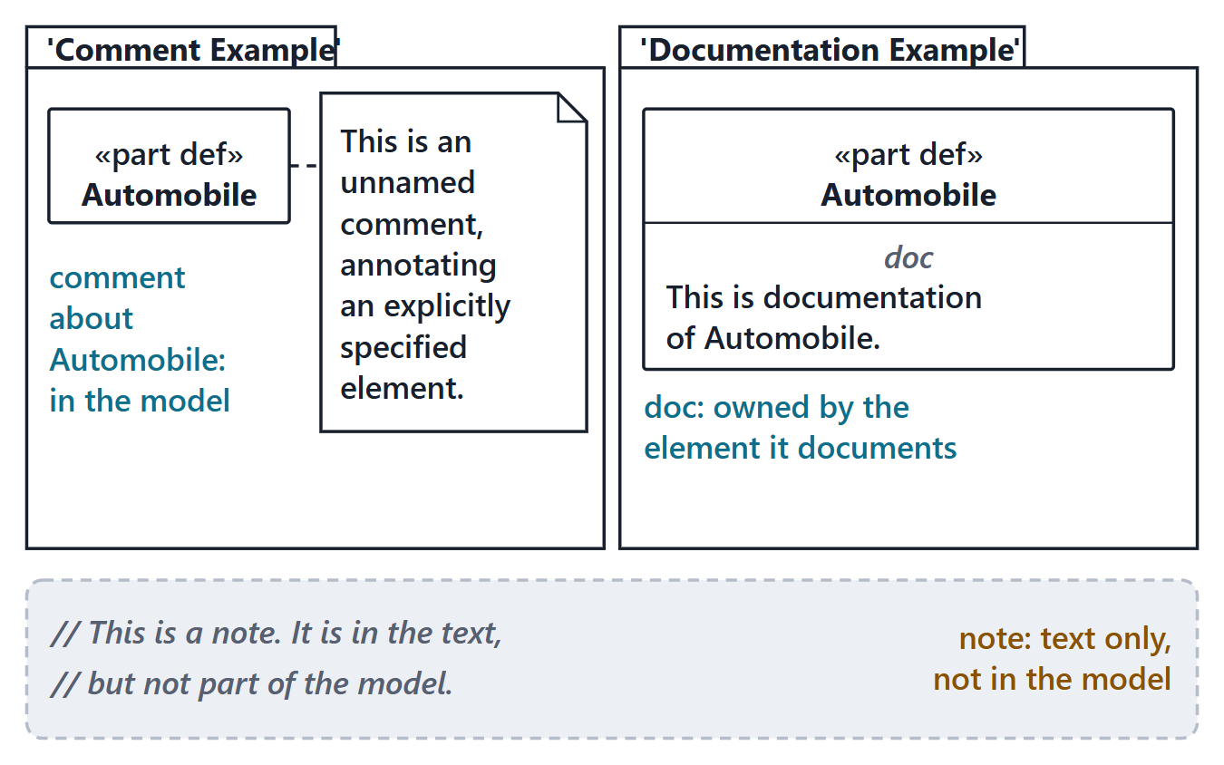
Comments, documentation and notes
/* … */ comment: part of the model
// … note: in the text, not in the model
doc /* … */: owned by the element it documents
Course convention: register text with no modeled attribute goes into doc
Figure. The training deck’s comment, documentation and note examples (slides 7–8) as a diagram: the comment and the doc are in the model; the note is text only. Checked (PASS).
Sources: R70 sl.7–8

Slide 6
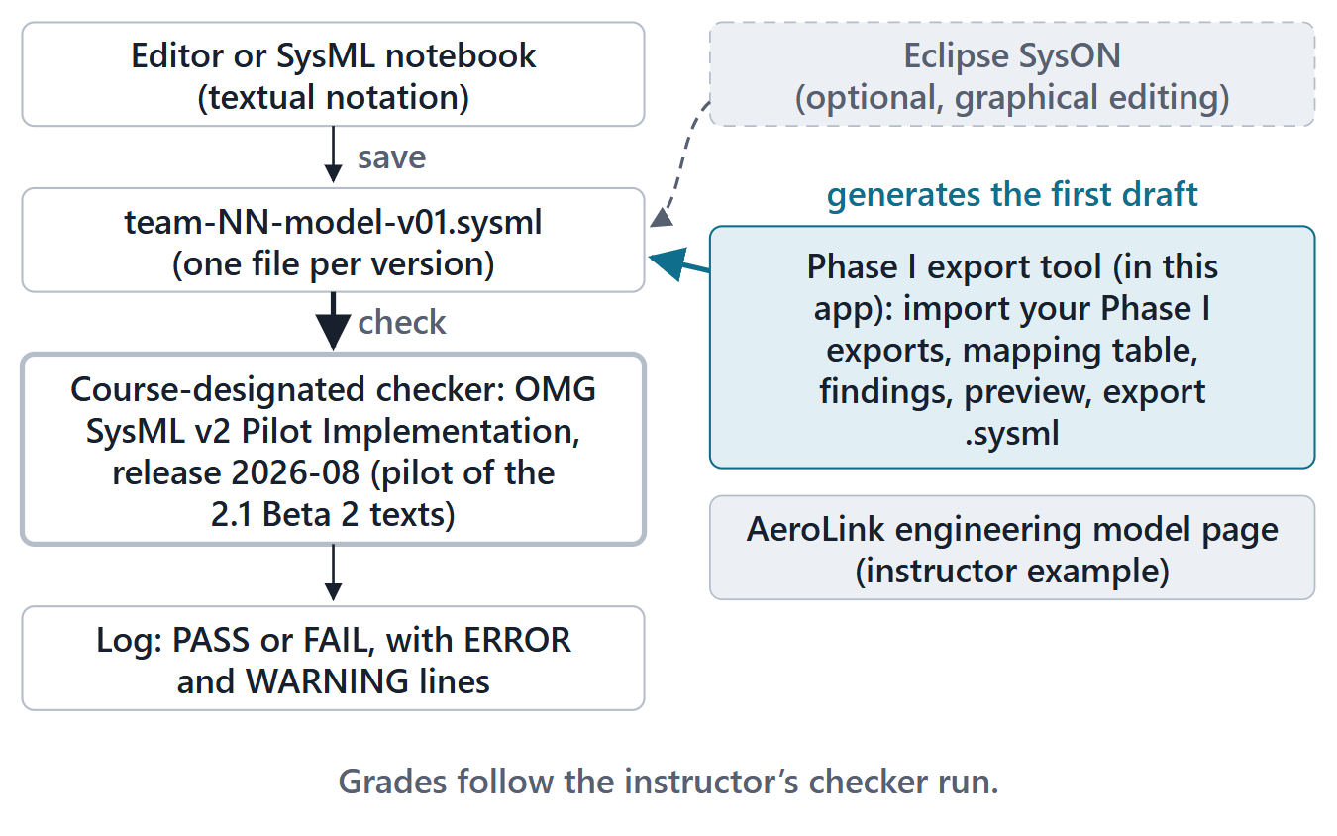
The course toolchain
What you type into, and what decides if it is valid
Write the textual notation; one file per model version
The course-designated checker decides validity
The Phase I export tool imports your record and drafts the skeleton
Graphical editing (SysON) is optional, never graded
Figure. The course toolchain (course convention): text in, checker decides validity, views and the Phase I export tool support the work.

Slide 7
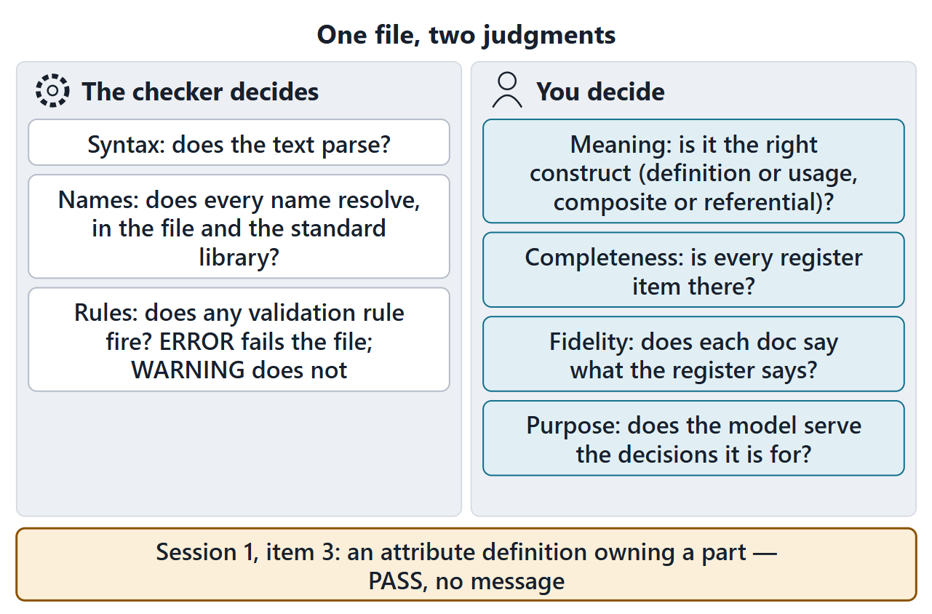
What the checker decides, and what it cannot
Checker: parses, resolves every name, runs its rules
An ERROR fails the file; a WARNING does not
It cannot judge meaning, completeness, fidelity or purpose
Recall: an attribute definition owning a part passed silently
Figure. Two columns: what the checker decides, and what only the team can decide.
Sources: R33b p.295–296

Slide 8
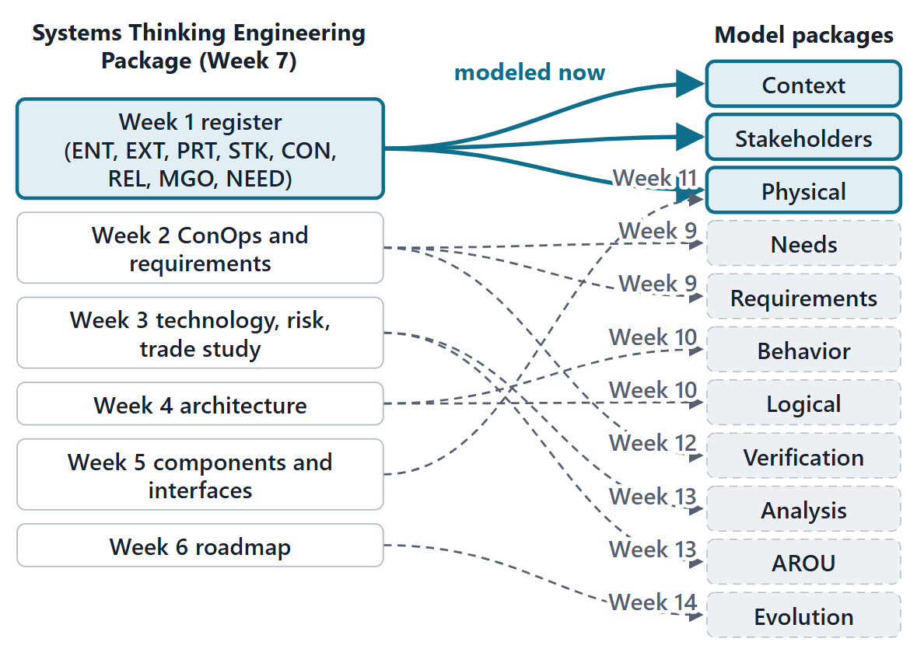
The import is a mapping, not a copy
Every artifact, by ID: a package and a construct, or a reason to wait
Week 8 models ENT, PRT, EXT, STK, CON, REL; it maps the rest
Nothing retyped from memory: the package is the source
Disagreements found while modeling are recorded, not silently fixed
Figure. Every artifact of the package gets a home in the model; the Week 1 stakeholder register is modeled now, the rest is mapped to the week that models it (course convention). AROU: Assumptions, Risks, Opportunities and Unknowns.
Sources: R28 p.374

Slide 9
The artifact-to-model mapping matrix
Course convention: which Phase II week models each Phase I ID kind
Modeled in | Phase I ID kinds
Week 8 (modeled now) | ENT, PRT, EXT, STK, CON, REL
Week 9 | MGO, NEED, REQ-STK, REQ-SYS
Week 10 | SCN, CAP, FN, LOG
Week 11 | INFO, PHY, IF
Week 12 | MOE, MOP, VER, TPM
Week 13 | TECH, A, U, R, O, ALT, CRIT, DEC
Week 14 | INC
Course mapping (convention)

Slide 10
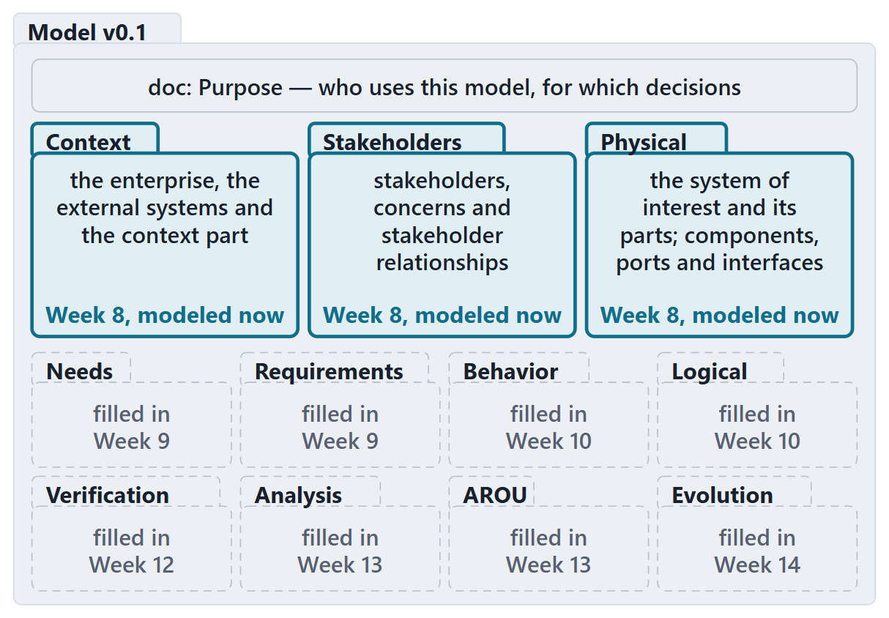
The model’s package structure
One root package; the purpose in its doc
11 course packages, mirroring the matrix
Every empty package says which week fills it
Private imports at the top
Figure. Model v0.1: the course packages, with the week that fills each (course convention).
Sources: R70 sl.6; R70 sl.8

Slide 11
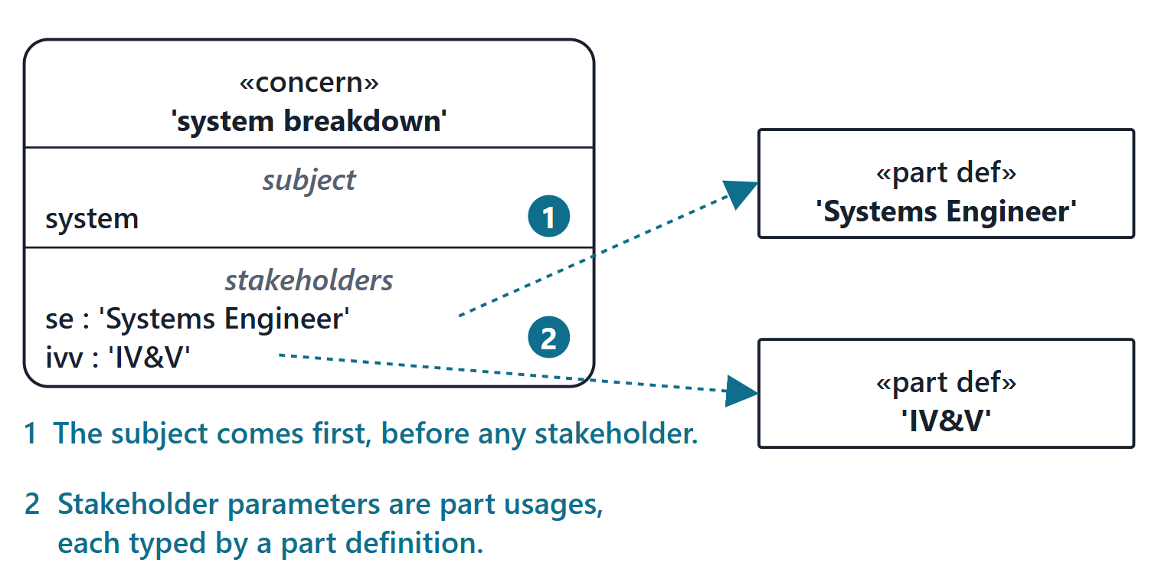
Stakeholders and concerns in SysML v2
STAKEHOLDER; CONCERN
A stakeholder is a person, organization or other entity with concerns to be addressed. A concern is a specific topic that one or more stakeholders desire to be addressed.
R77 · Seidewitz, Intro to the SysML v2 Language: Textual Notation (Release 2026-08), "Metadata", sl.115
Declared like a requirement, keyword concern
Figure. The training deck’s concern “system breakdown” (slide 115, adapted) in the graphical notation: the subject first, then two stakeholder parameters typed by part definitions. Checked (PASS).
Sources: R77 sl.115; R83 p.166–167

Slide 12
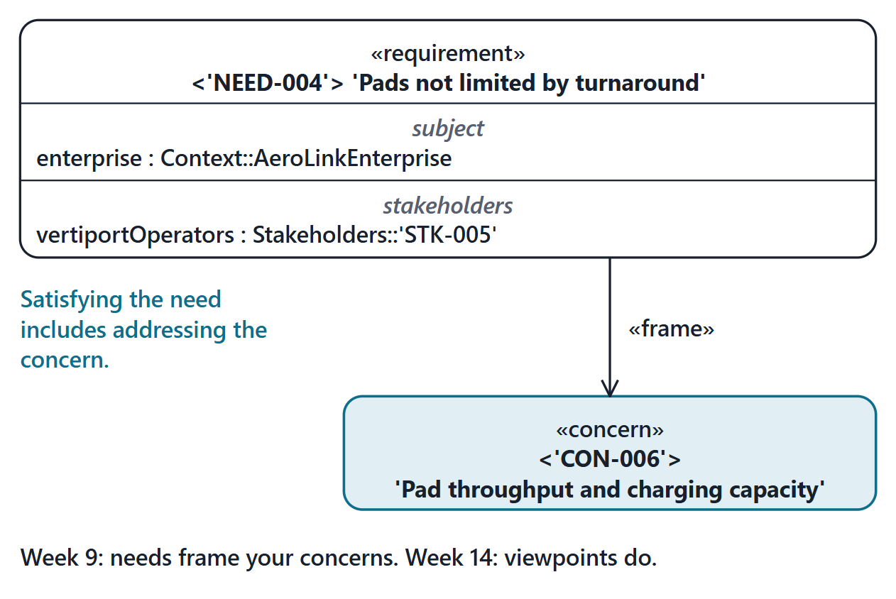
Where concerns go next: framed by needs and viewpoints
A requirement can frame a concern
A framed concern becomes a required constraint of its container
A viewpoint frames the concerns a view must address
Week 9: needs frame your concerns; Week 14: viewpoints do
Figure. From the AeroLink reference model: the need NEED-004 frames the Week 1 concern CON-006, in the graphical notation (the construct Week 9 teaches). Checked (PASS).
Sources: R83 p.167; R77 sl.116; R85 p.181

Slide 13
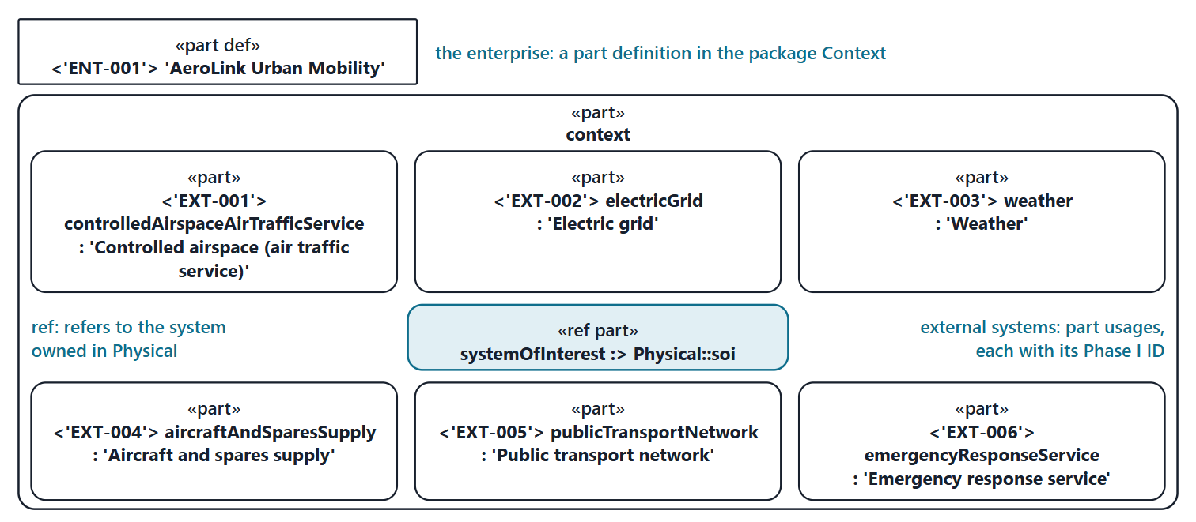
AeroLink worked example I: the context
Figure. The AeroLink context in the generated Week 8 model, in the graphical notation (FICTIONAL): the enterprise ENT-001 as a part definition; the context part, which refers to the system of interest and holds 6 external systems as part usages with their IDs, named as systems. Checked (PASS).
Sources: R80 p.64; R70 sl.9; R80 p.48–49

Slide 14
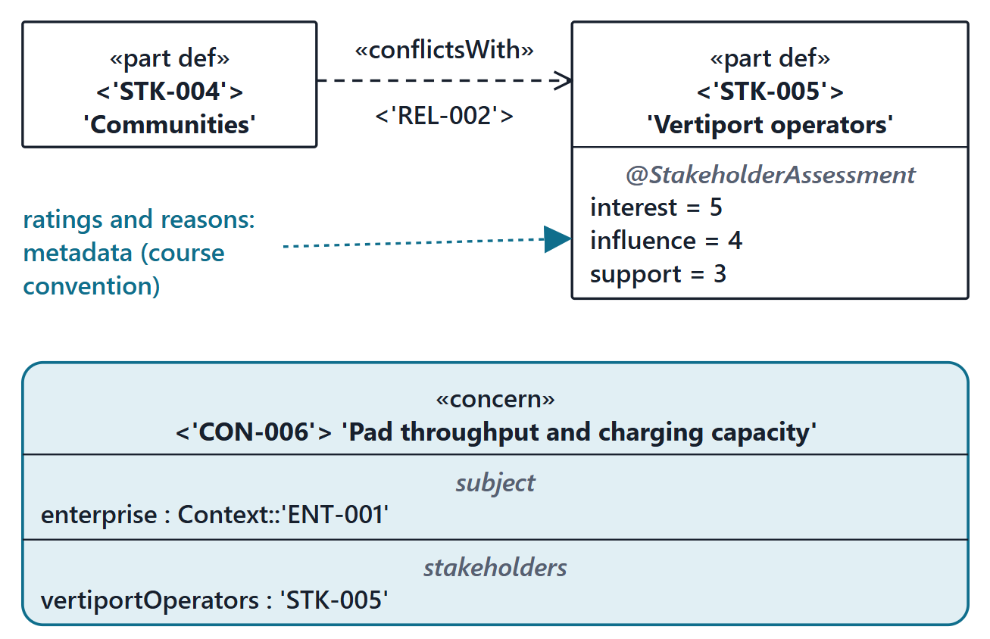
AeroLink worked example II: stakeholders and concerns
15 stakeholders as part definitions; 17 concerns
Ratings and reasons as metadata (course convention)
8 relationships as dependencies with a keyword
DIRECTION RULE
from A to B: A, the client, depends on B, the supplier. FAA regulates OEM: #regulatedBy from STK-011 to STK-002.
Figure. One stakeholder with its ratings, the conflict it is part of and one of its concerns, from the generated AeroLink model, in the graphical notation (FICTIONAL). Checked (PASS).
Sources: R77 sl.108–109; R80 p.50–51; R69 p.193; R83 p.166–167

Slide 15
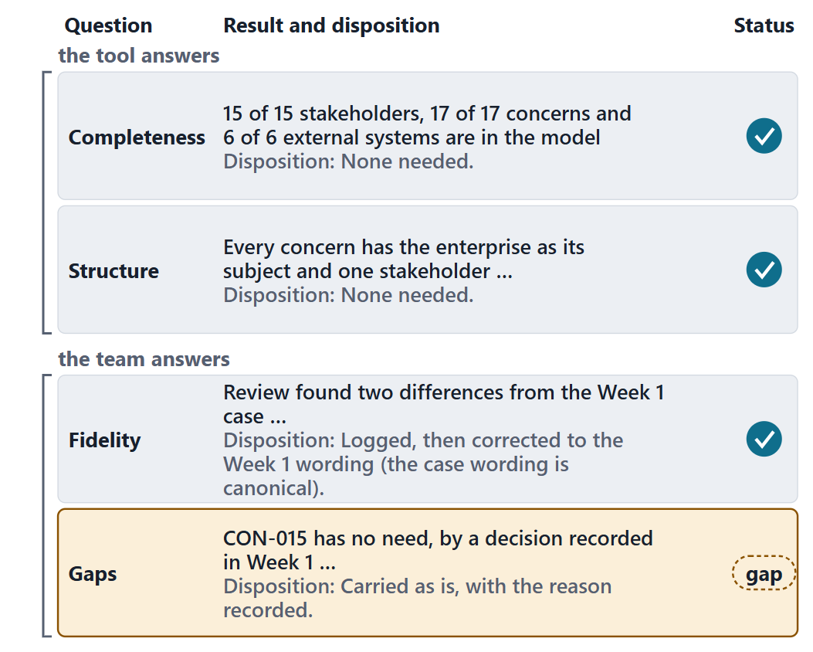
AeroLink worked example III: auditing the import
Completeness: 15/15 stakeholders, 17/17 concerns, 6/6 external systems
Structure: every concern has a subject and a stakeholder
Fidelity: differences logged, then corrected
Gaps: each with a recorded disposition
Figure. The four audit questions applied to the AeroLink import, with the result and the disposition of each (FICTIONAL).

Slide 16
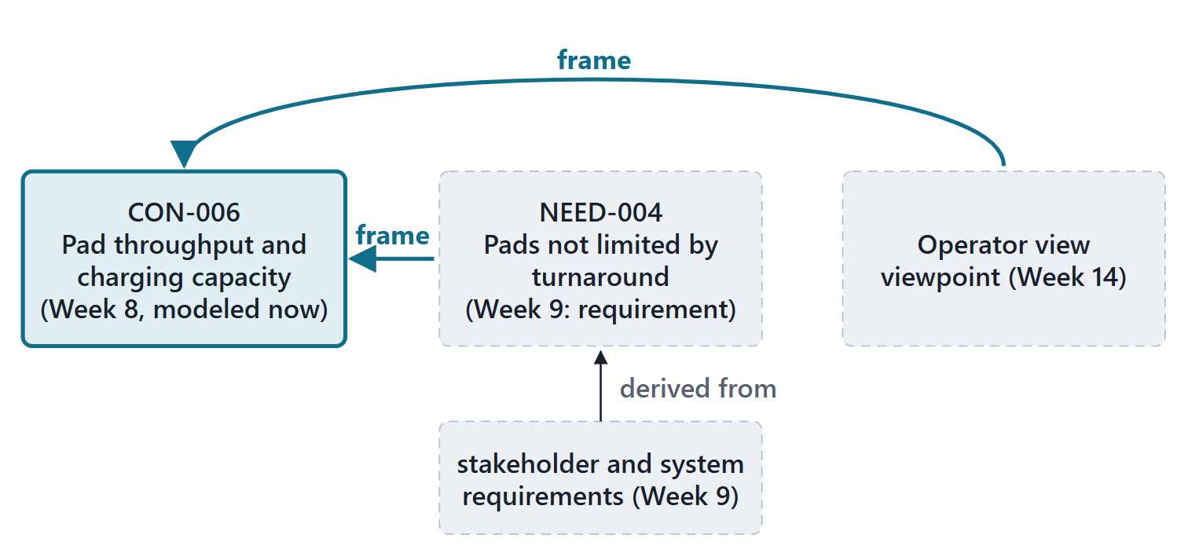
Bridge: Week 9
Figure. A concern modeled this week is framed by a need in Week 9 and by a viewpoint in Week 14.
Sources: R83 p.167

Slide 17
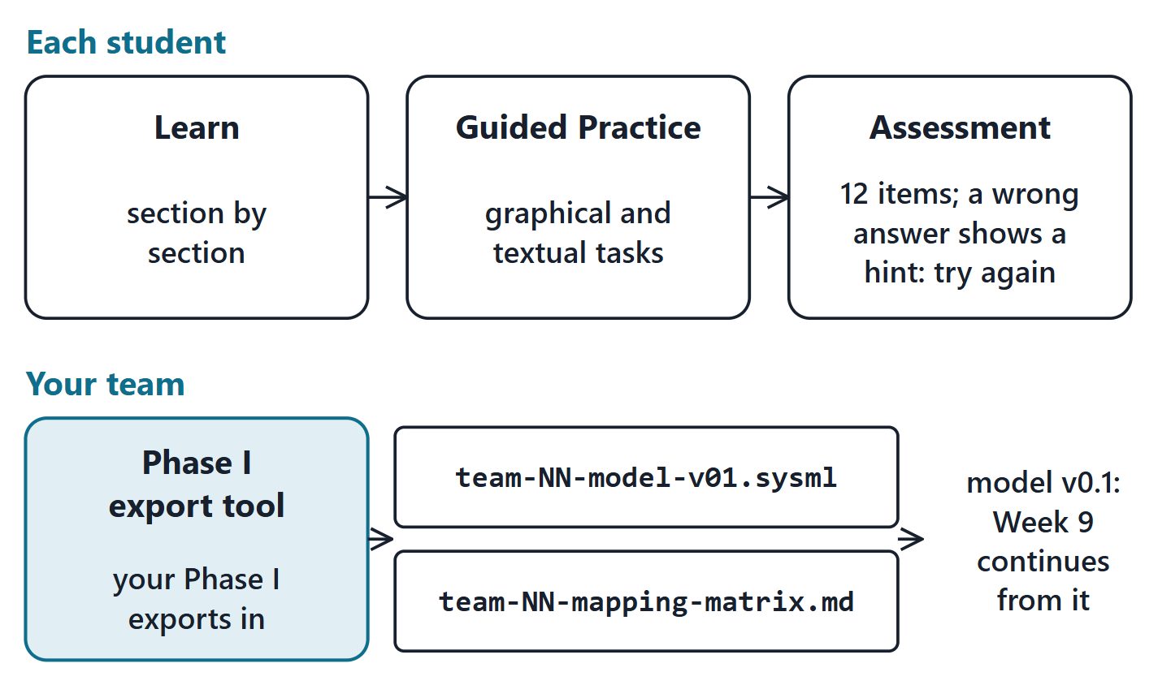
This week: Learn, Practice, Assessment, export
Due before Week 9 Session 1; your own enterprise, never AeroLink
Each of you: Learn, then Guided Practice
Assessment: 12 items, individual, formative
Your team: the Phase I export tool writes model v0.1 and the mapping matrix
Validity: the course checker, one installation per team
Figure. The Week 8 journey: each student works through Learn, Guided Practice and the Assessment; the team runs the Phase I export tool, which writes model v0.1 and the mapping matrix.

Slide 18
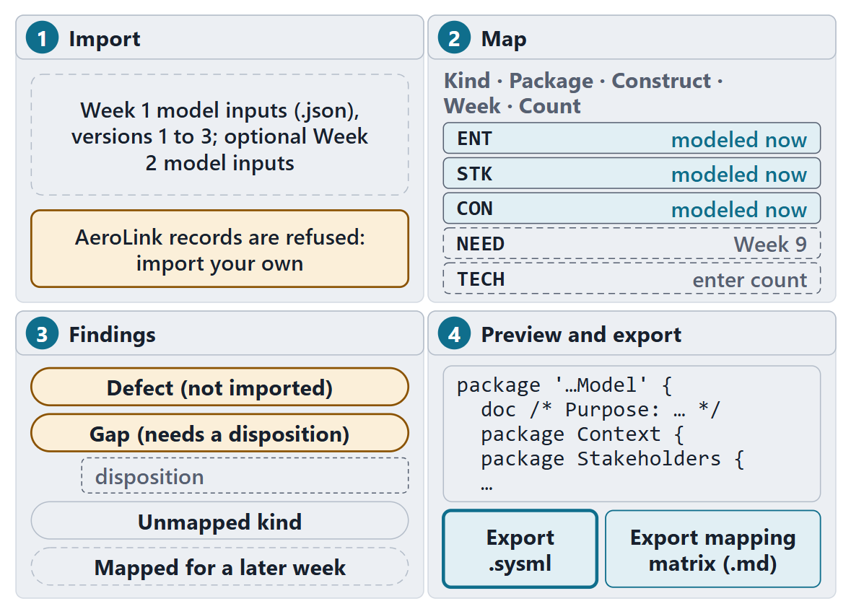
Team work: import, map and start the skeleton
12 minutes, in teams, in the Phase I export tool
Import your Week 1 export (and Week 2, if you have it)
Enter counts for the Weeks 3–6 kinds; decide any unmapped kind
Read every defect and gap; draft a disposition
Write the purpose; preview the skeleton
Figure. The Phase I export tool in four steps: import, map, review the findings, preview and export.

Slide 19
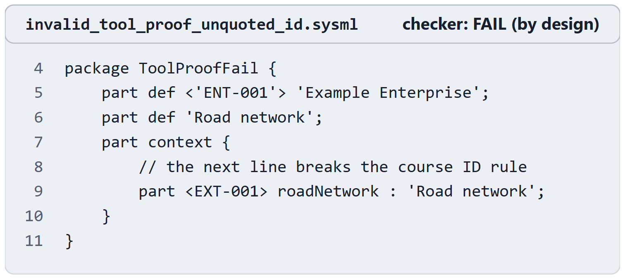
Checkpoint: prove the toolchain
Every member shows two outputs: the pass file and the fail file
Pass file: expect PASS, no message
Fail file: expect FAIL at the unquoted ID
Keep both outputs for the checker log
No working installation: team’s or lab machine today
Figure. The fail file of the tool proof, numbered as in the file (its three header comment lines are not shown): an unquoted ID on line 9. The checker must reject it. Checked (FAIL, as intended).
Sources: R80 p.49–50

Slide 20
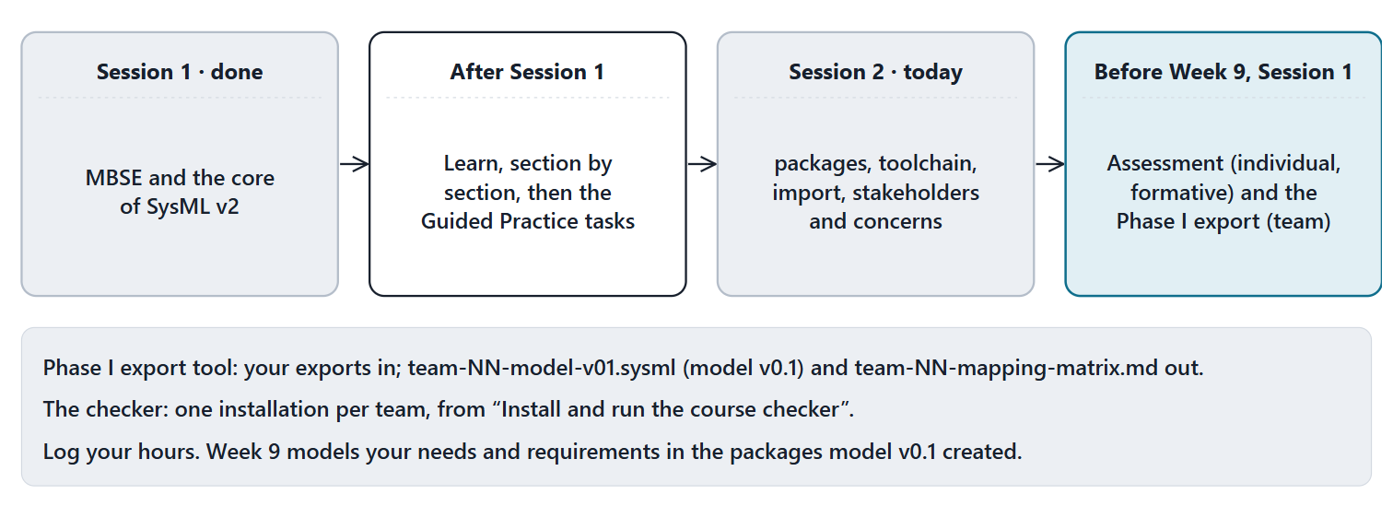
Close: from today to Week 9
Assessment (formative) and the Phase I export, both before Week 9 Session 1. Log your hours.
Figure. From today to Week 9: what is done, what comes next, and what is due before Week 9 Session 1.

Slide 21
References and credits
R28 · SEBoK v2.14 (2026), “Model-Based Systems Engineering (MBSE)”, p.370, 372–374
R33b · SEBoK v2.14 (2026), “Why Model?”, p.295–296
R69 · OMG SysML v2.1 Beta 2, Part 1 (Release 2026-07), “7.27 Metadata”, p.193
R70 · Seidewitz, Intro to the SysML v2 Language: Textual Notation (Release 2026-08), “Introduction to the SysML v2 Language”, sl.3–12, 15–16
R77 · Seidewitz, Intro to the SysML v2 Language: Textual Notation (Release 2026-08), “Metadata”, sl.108–109, 115–116
R80 · OMG SysML v2.1 Beta 2, Part 1 (Release 2026-07), “7.1 Language Overview”, p.47–51, 56, 60–61, 63–66, 72–73, 77
R83 · OMG SysML v2.1 Beta 2, Part 1 (Release 2026-07), “7.21 Requirements”, p.166–167
R85 · OMG SysML v2.1 Beta 2, Part 1 (Release 2026-07), “7.26 Views and Viewpoints”, p.181
R90 · Friedenthal, Intro to the SysML v2 Language: Graphical Notation (2023-03-07), “Systems Modeling Language”, sl.7–9, 12, 22
CREDITS AND LICENSES
Introduction to the SysML v2 Language, Textual Notation (Release 2026-08): Copyright © 2019–2026 Model Driven Solutions, Inc. Licensed under the Creative Commons Attribution 4.0 International License (CC BY 4.0).
SEBoK v2.14: “This material is used under a Creative Commons Attribution-NonCommercial ShareAlike 3.0 Unported License from The Trustees of the Stevens Institute of Technology.” (SEBoK, “Bkcase Wiki:Copyright”, PDF p.31). Quotations are short and cited; no SEBoK figure or table is reproduced.
Figures are original drawings for this course; none redraws a figure from the sources.
AeroLink Urban Mobility is a fictional teaching case: every number, name and statement about it is a teaching value.

