Slide 1
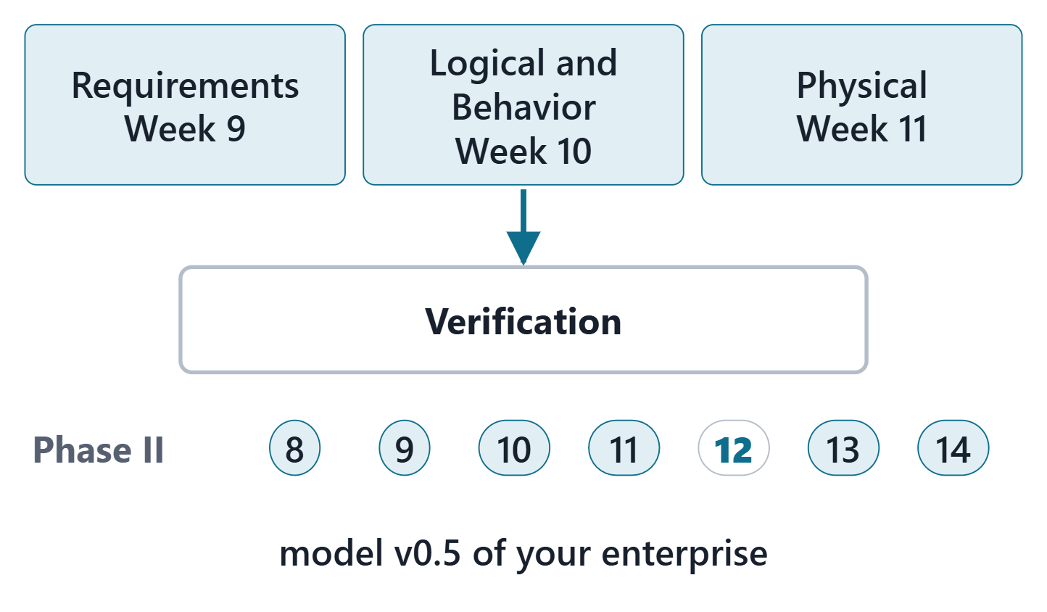
Digital Thread / V&V
Session 1: Verification, validation and verification cases
Today: verification, validation and verification cases
Session 2: the digital thread, coverage, change and baselines, the Lab L12 launch
Your output: model v0.5 of your own enterprise
Figure. Week 12 fills the Verification package of your model: Requirements was filled in Week 9, Logical and Behavior in Week 10, Physical in Week 11. Course illustration, not SysML v2 graphical notation.

Slide 2
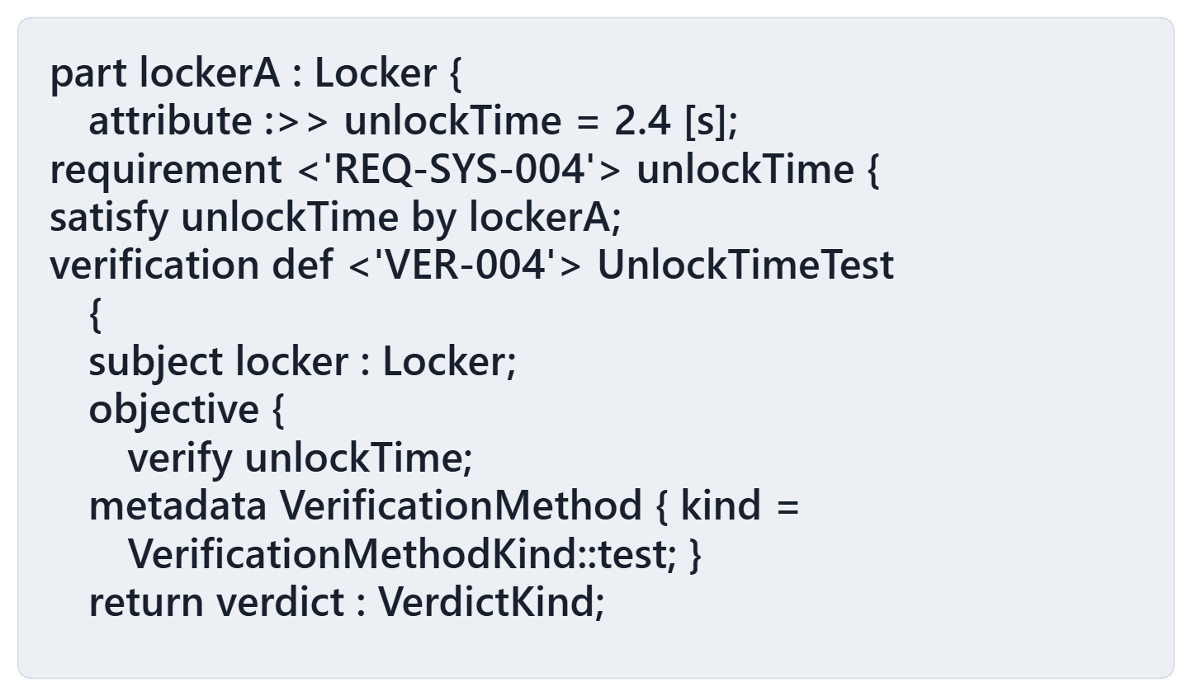
Driving question: the checker accepts this. What has been shown?
VOTE
The checker accepts this file. Which is true?
A · REQ-SYS-004 is verified
B · The design is shown to satisfy REQ-SYS-004
C · The model claims it and plans a test; nothing is shown yet
D · The checker rejects the file
Figure. A parcel locker with a design value, a requirement on its unlock time, a satisfy line and a verification case (lines shortened for display). Course illustration, not SysML v2 graphical notation.

Slide 3
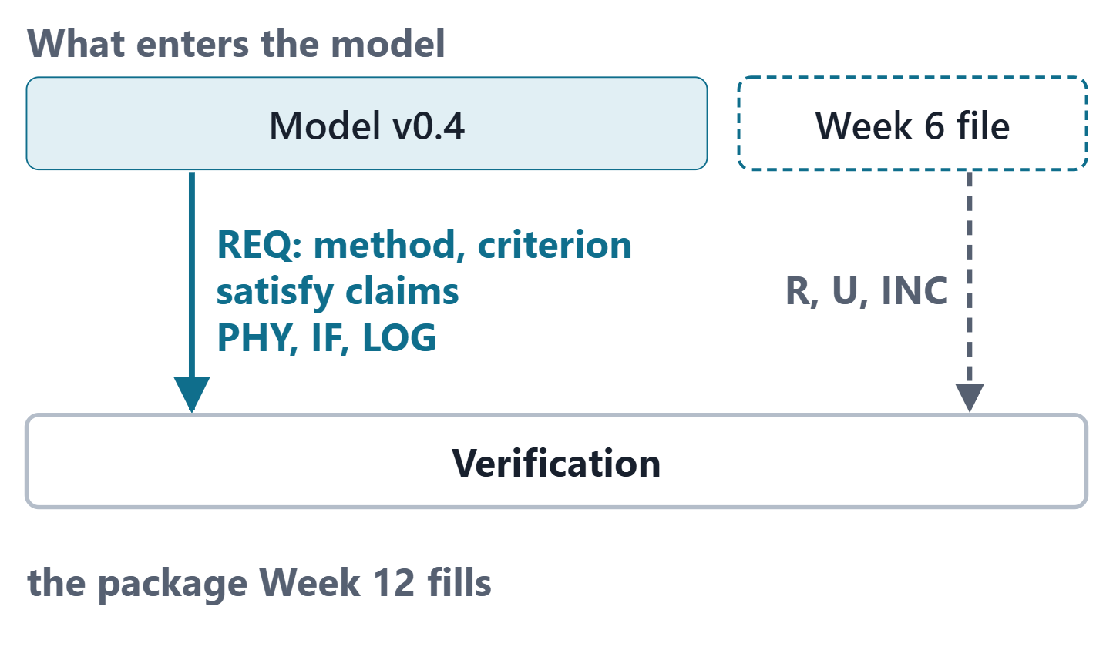
What Week 12 imports
Week 9: each requirement with a method and a success criterion
Weeks 10 and 11: functions, logical and physical parts, interfaces; the first satisfy claims
Optional Week 6 file: risks, unknowns, increments, interface change requests
Same IDs throughout
Figure. The sources of this week and the package they enter: model v0.4 with its requirements (method and criterion), satisfy claims and design elements, and the optional Week 6 file with risks, unknowns and increments. Course illustration, not SysML v2 graphical notation.

Slide 4
Verification and validation: two definitions
VERIFICATION (SEBOK)
“the confirmation, through the provision of objective evidence, that specified requirements have been fulfilled”
R23a · SEBoK v2.14 (2026), "System Verification", p.634
VALIDATION (SEBOK)
“the confirmation, through the provision of objective evidence, that the requirements for a specific intended use or application have been fulfilled”
R23b · SEBoK v2.14 (2026), "System Validation", p.646
Sources: R23a p.634; R23b p.646

Slide 5
Built right, or the right system?
 | Verification | Validation
Purpose | detect faults (supplier) | acquire confidence (end user)
Reference | system design | system and stakeholder requirements
Basic method | fine-tooth comb | traceability matrix
Order | first | second
After SEBoK’s table of differences (may vary with context)
KEY POINT
“Did you build the system correctly?” versus “Is it the right solution to the problem?” (DoD)
Sources: R23b p.648; R23a p.636; R49 p.149–150

Slide 6
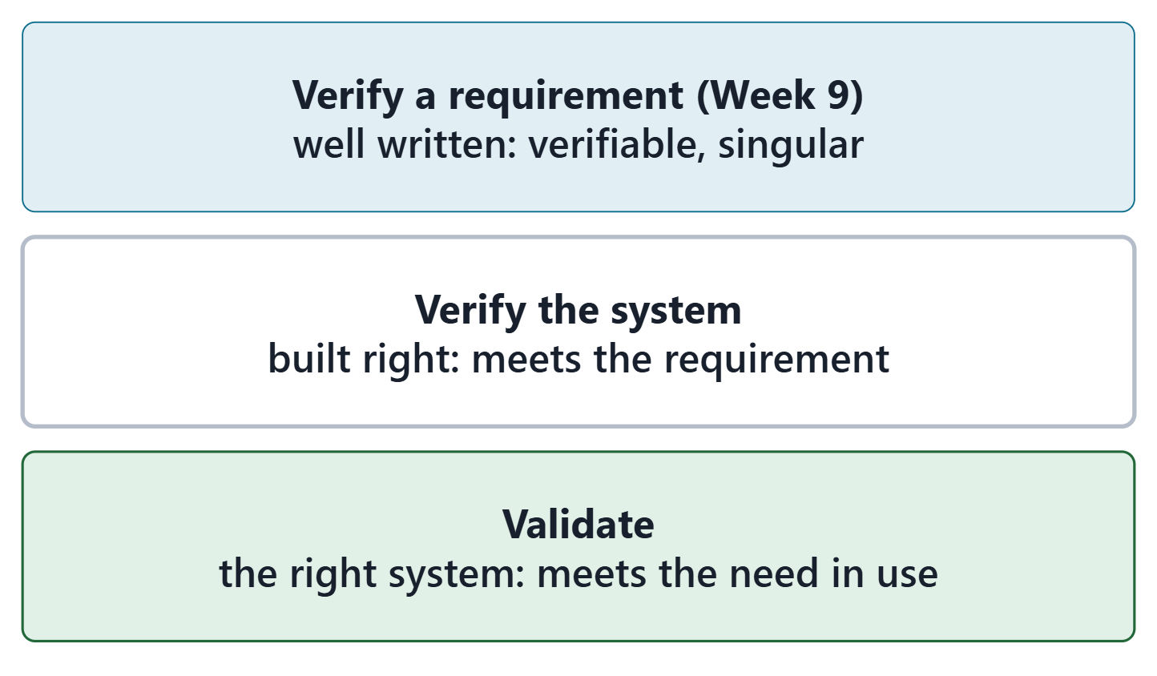
Three different checks
A requirement: checked against the characteristics of a good requirement
The system: checked against its requirements
The system in use: checked against the need
Verification cases do the second
Figure. Three checks with three references: the requirement against the characteristics of a good requirement, the system against the requirement, the system in use against the need. Course illustration, not SysML v2 graphical notation.
Sources: R23a p.635; R23b p.648

Slide 7
The four verification methods
Method | What it relies on | Library literal
Inspection | observation, simple measurement; no stimuli | inspect
Analysis | calculation, models, simulation; no intervention | analyze
Demonstration | observed operation, little or no instrumentation | demo
Test | controlled conditions; quantitative data | test
SEBoK and the DoD guidebook; the literals of VerificationMethodKind
Sources: R23a p.639; R49 p.149–150; R117 p.539–540

Slide 8
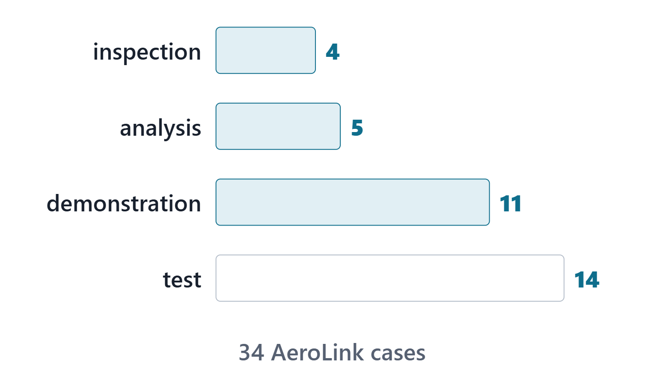
Choosing a method
What evidence does the criterion need: a number, an observation, a document?
When can it be had: design, integration, operation?
A strategy: a justified selection against risk
Pitfall: use only testing
Figure. The AeroLink verification cases of model v0.5 by method, counted from the generated model. Course illustration, not SysML v2 graphical notation.
Sources: R23a p.637; R23a p.640

Slide 9
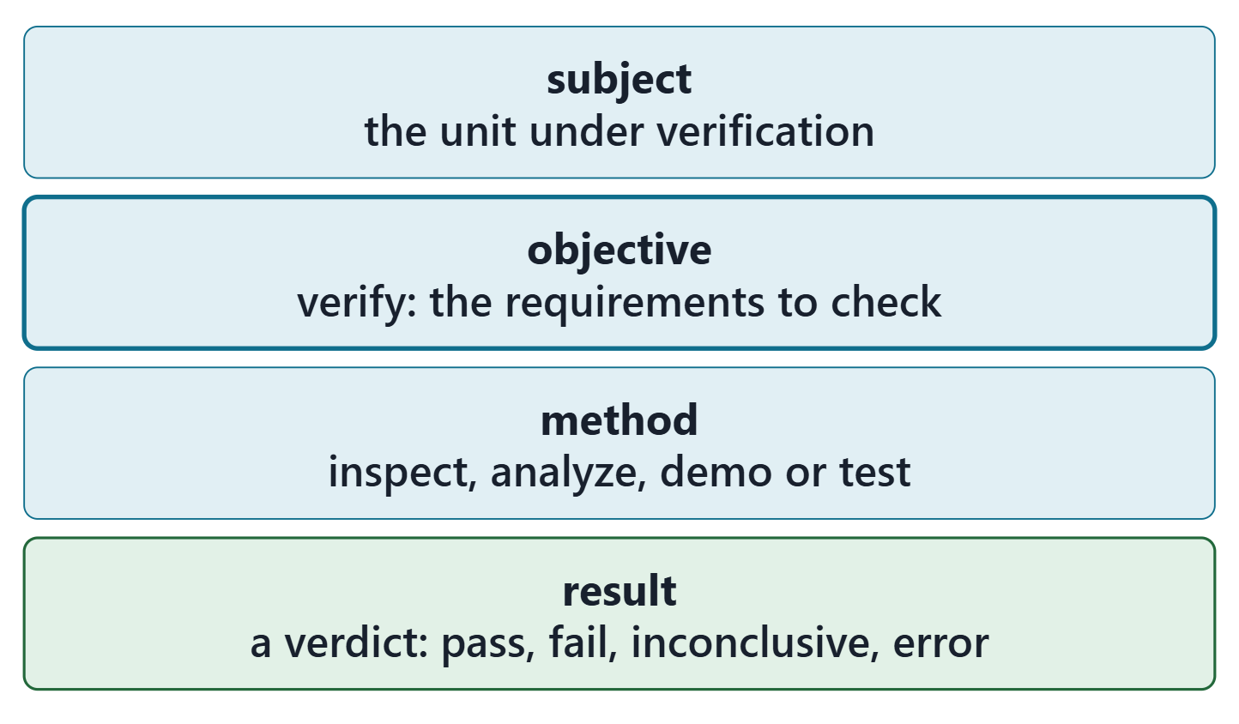
A verification case: subject, objective, verdict
VERIFICATION CASE DEFINITION (SYSML V2.1 BETA 2)
“a kind of case definition … whose result is a verdict on whether the subject of the case satisfies certain requirements”
R84 · OMG SysML v2.1 Beta 2, Part 1 (Release 2026-07), "7.23 Analysis Cases", p.173
Subject: the unit under verification
Objective: the requirements to verify
Result: pass, fail, inconclusive or error
Figure. The four parts of a SysML v2 verification case as the course uses them: the subject, the objective with its verified requirements, the method and the verdict. Course illustration, not SysML v2 graphical notation.
Sources: R84 p.173; R75 sl.96

Slide 10
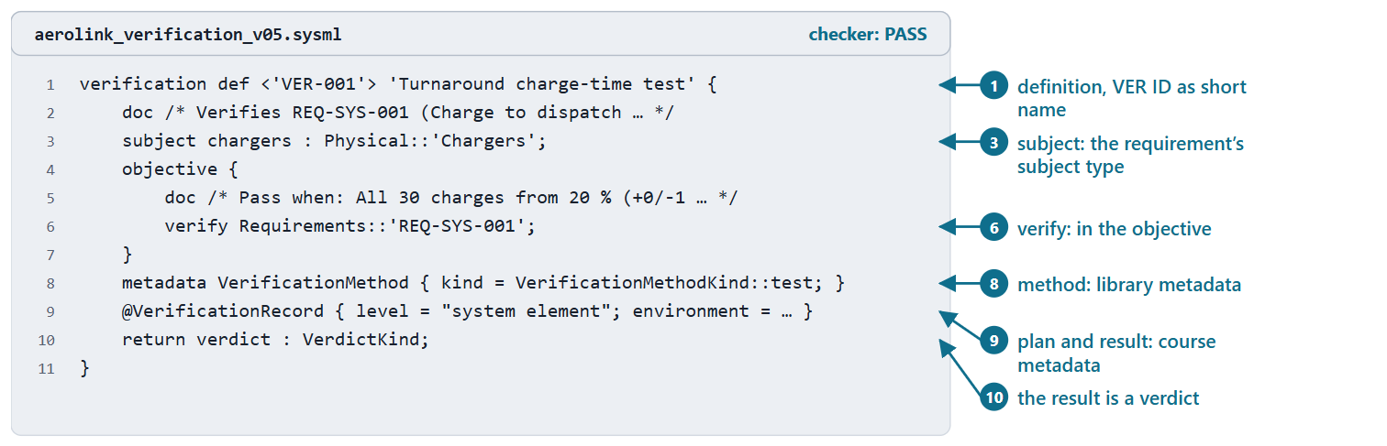
An AeroLink verification case in the textual notation
verification def, the objective, verify, return verdict: SysML v2
VerificationMethod: library metadata
Course conventions: the VER ID as short name; the subject typed by the requirement’s subject; the VerificationRecord
Figure. VER-001 in AeroLink model v0.5, with its long record line shortened. Checked: PASS. (FICTIONAL)
Sources: R84 p.174–176; R117 p.539

Slide 11
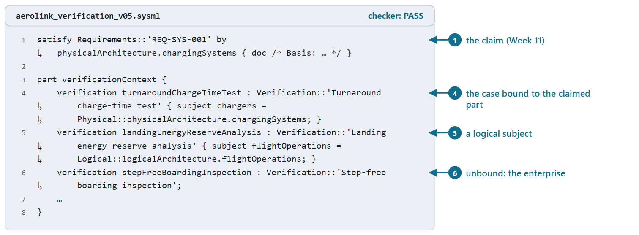
Binding the subject to the element under verification
The verified requirement is evaluated on the case’s subject
Course convention: one verification usage per case, in verificationContext
Bind the element the satisfy claim names; otherwise the part whose type is the requirement’s subject
A stakeholder requirement stays on the enterprise
Figure. A satisfy claim of Week 11 and three verification usages of AeroLink model v0.5: one bound to the claimed part, one to a logical part, one left on the enterprise (excerpt). Checked: PASS. (FICTIONAL)
Sources: R84 p.176; R75 sl.98

Slide 12
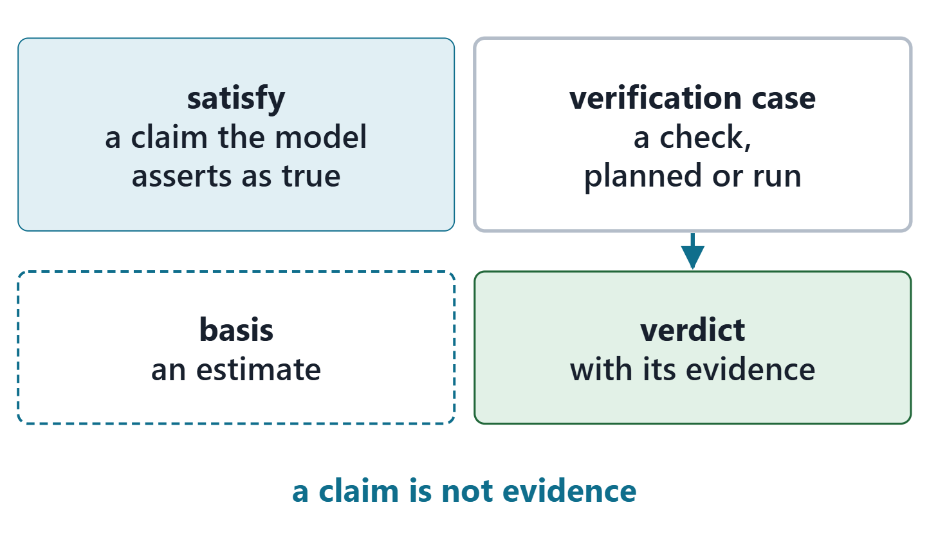
A claim is not evidence: satisfy and verify
satisfy: an assertion that the requirement is met when its subject is bound to the element
verify: the requirement a case checks
Evidence: a verdict from a run
The vote: C. Claimed and planned; nothing shown yet
Figure. A satisfy claim asserts that the requirement holds and rests on a basis; a verification case, once run, gives a verdict with its evidence. Course illustration, not SysML v2 graphical notation.
Sources: R83 p.168; R74 sl.91; R84 p.173

Slide 13
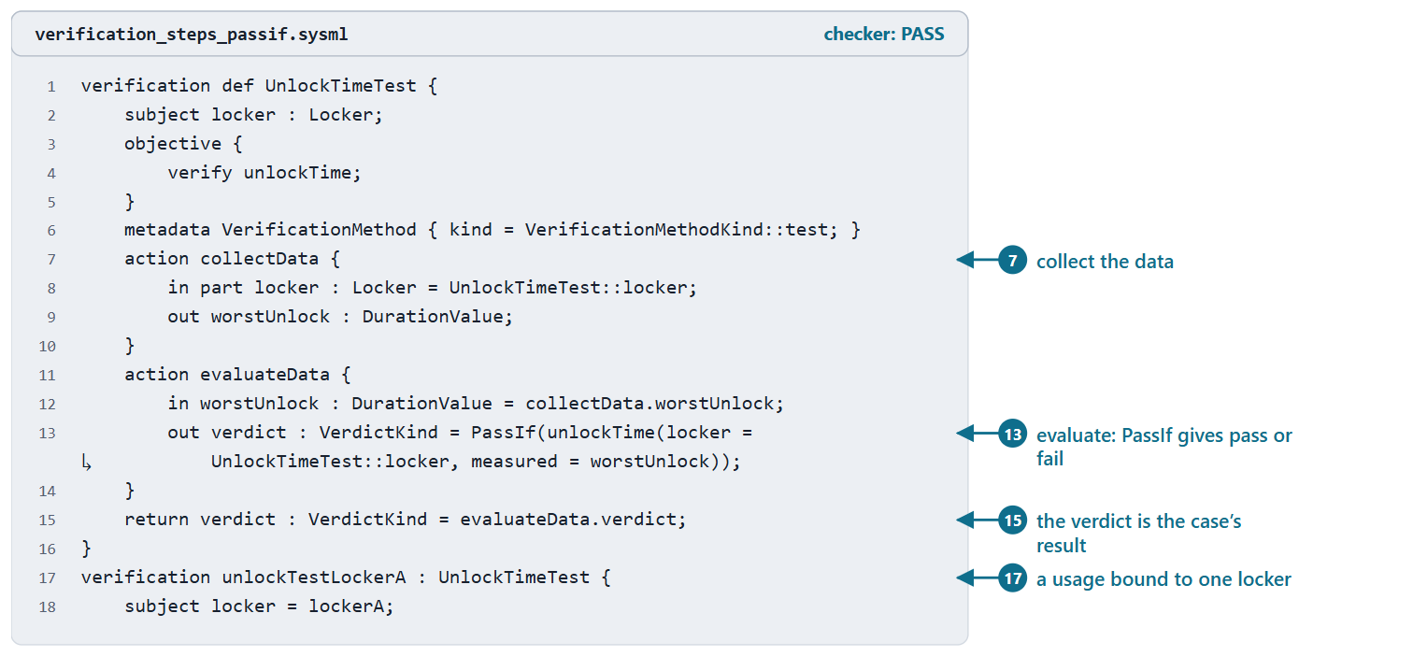
The steps of a case and its verdict
Collect data with a method; analyze it; evaluate it against the objective
PassIf: pass or fail from a Boolean
The steps are actions; a verification system can perform them
The course models plans, so most cases carry no steps yet
Figure. A parcel-locker verification case whose steps collect the worst unlock time and evaluate it with PassIf, and a usage bound to one locker. Checked: PASS. (FICTIONAL)
Sources: R84 p.174; R117 p.536–537; R75 sl.97–98

Slide 14
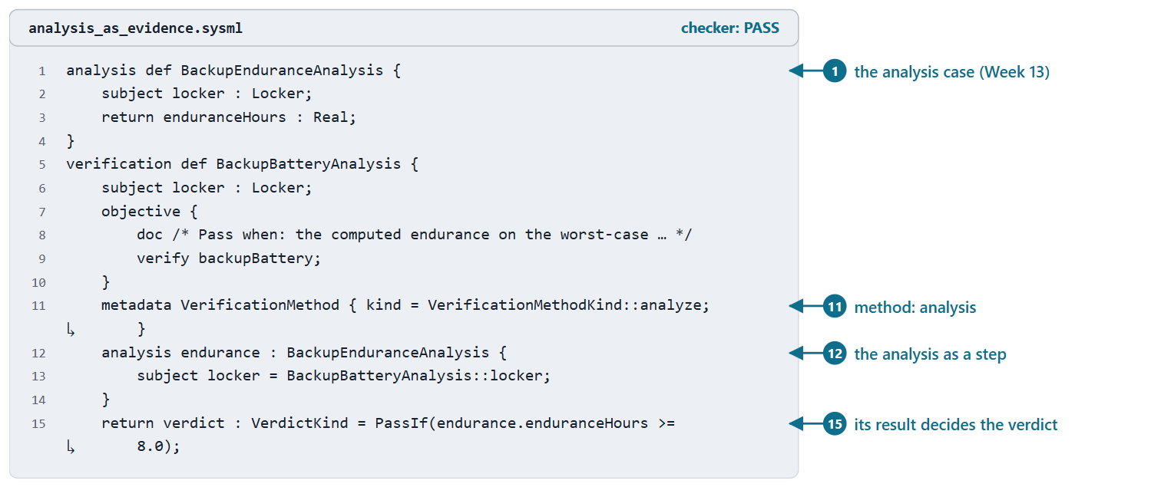
An analysis case as evidence
Method analysis: the evidence is a computed result
An analysis case computes it; PassIf turns it into a verdict
Analysis cases, constraints and trade studies: Week 13
Figure. An analysis case used as the evidence step of a verification case whose method is analysis; its result decides the verdict. Checked: PASS. (FICTIONAL)
Sources: R75 sl.92; R84 p.174

Slide 15
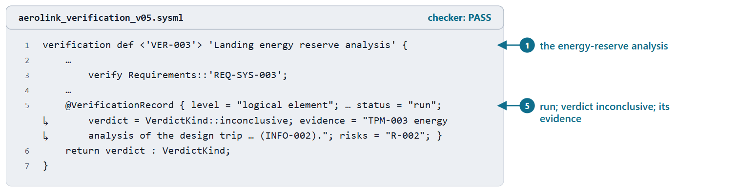
Four verdicts: pass, fail, inconclusive, error
Pass: determined to satisfy; fail: determined not to
Inconclusive: no determination could be made
Error: the verification itself went wrong
AeroLink VER-003: inconclusive, with its evidence
Figure. VER-003 in AeroLink model v0.5, the one case already run: its record line with the plan’s fields and part of the evidence left out (…). Checked: PASS. (FICTIONAL)
Sources: R84 p.173; R117 p.537

Slide 16
Write the pass and inconclusive conditions first
 | VER-001
Requirement criterion | Charge time from 20 % reserve to dispatch threshold <= 20 min
Pass when | All 30 charges from 20 % (+0/-1 %) state of charge reach the dispatch threshold in <= 20.0 min
Inconclusive when | fewer than 30 valid charges, or start state of charge outside tolerance
AeroLink model v0.5 (FICTIONAL)
Say in advance when the run cannot decide
Sources: R23a p.640; R23b p.655

Slide 17
Verification level by level
Each element is verified before it is integrated into the level above
Interfaces are checked as aggregates are integrated
No result is definitive until the system runs in its real environment
The record states the level: enterprise, system element, component, interface, logical element
Sources: R23b p.649; R23a p.635

Slide 18
Worked example: from REQ-SYS-001 to VER-001
1 Requirement: REQ-SYS-001: method test
2 Element: PHY-003, the part the satisfy claim names
3 Conditions: pass and inconclusive, from the criterion
4 Environment: Hub vertiport, ambient 0-35 C
5 Record: planned; risk and evidence when known
Sources: R84 p.173–176; R23a p.637

Slide 19
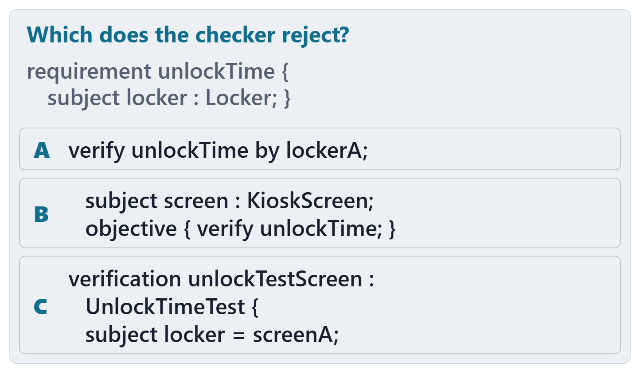
Predict: which does the checker reject?
PREDICT, 1 MIN
For A, B and C: rejected, warned about, or accepted without a message?
Write one word for each
For B and C: is the case right?
Figure. Three fragments of parcel-locker files around one requirement, shown without their checker results. Course illustration, not SysML v2 graphical notation.

Slide 20
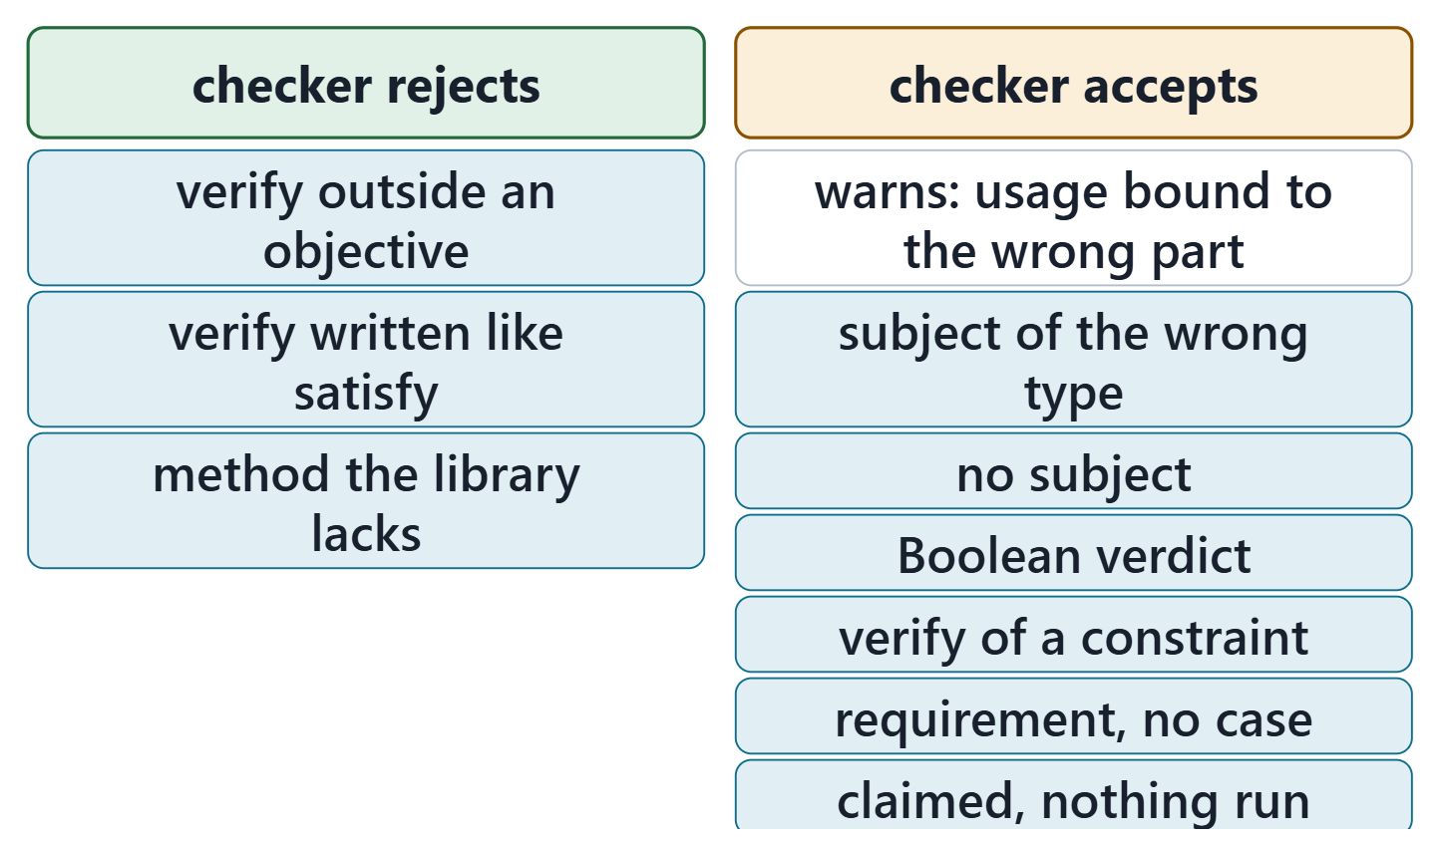
What the checker checks, and what it cannot
The predict card: A rejected, C warned about, B silent
Rejected: verify outside an objective, verify like satisfy, an unknown method
Not checked: a case’s subject type, verdict type, coverage, method fit, criterion, verdict truth
Zero errors is necessary, never sufficient
Figure. Recorded results of the course checker (release 2026-08) on 10 course files: what it rejects, and what it accepts, one of them with a warning. Course illustration, not SysML v2 graphical notation.
Sources: R84 p.176; R117 p.540

Slide 21
From cases to coverage
AeroLink model v0.5: 34 of 36 requirements have a case
34 cases: inspection 4, analysis 5, demonstration 11, test 14
One run; the others planned
Two requirements wait, each with a disposition
Sources: R23a p.638

Slide 22
Summary
Verification: against the specified requirements; validation: against the intended use
Choose the method from the evidence the criterion needs and the risk
A verification case: subject, objective with verify, method, verdict
A satisfy line is a claim; a run with evidence shows it
Sources: R23a p.634; R23b p.646; R84 p.173; R83 p.168

Slide 23
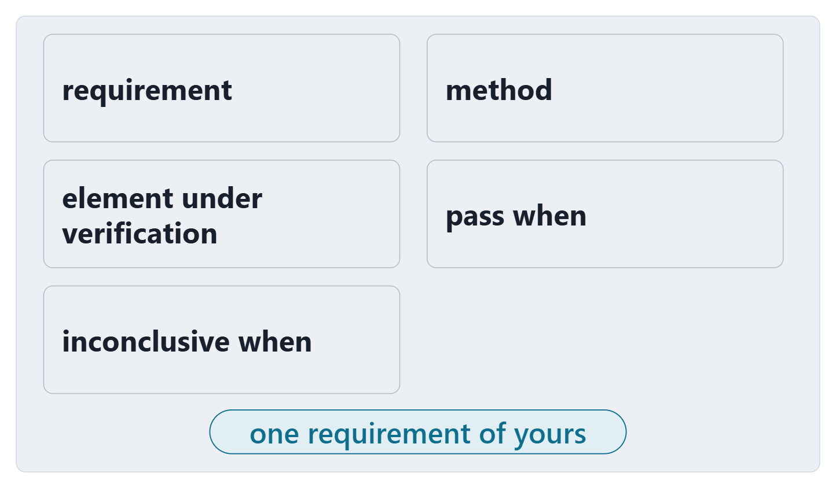
Exit: plan one case for one of your requirements
Pick one system requirement of your model v0.4
Method: keep the recorded one, or give a reason
Element under verification: the satisfying part, or the part of the subject type
Pass when; inconclusive when
Figure. The exit card: five fields to fill for one requirement of your team’s model. Course illustration, not SysML v2 graphical notation.

Slide 24
References and credits
R23a · SEBoK v2.14 (2026), “System Verification”, p.634–640
R23b · SEBoK v2.14 (2026), “System Validation”, p.646, 648–649, 651–652, 654–655
R49 · OUSD(R&E) Systems Engineering Guidebook (2021/2022), “Verification Process”, p.149–150
R74 · Seidewitz, Intro to the SysML v2 Language: Textual Notation (Release 2026-08), “Requirement Definitions”, sl.91
R75 · Seidewitz, Intro to the SysML v2 Language: Textual Notation (Release 2026-08), “Analysis Case Definitions”, sl.92, 96–98
R83 · OMG SysML v2.1 Beta 2, Part 1 (Release 2026-07), “7.21 Requirements”, p.168
R84 · OMG SysML v2.1 Beta 2, Part 1 (Release 2026-07), “7.23 Analysis Cases”, p.173–176
R117 · OMG SysML v2.1 Beta 2, Part 1 (Release 2026-07), “9.2.17 Verification Cases”, p.536–537, 539–540
CREDITS AND LICENSES
Introduction to the SysML v2 Language, Textual Notation (Release 2026-08): Copyright © 2019–2026 Model Driven Solutions, Inc. Licensed under the Creative Commons Attribution 4.0 International License (CC BY 4.0).
SEBoK v2.14: “This material is used under a Creative Commons Attribution-NonCommercial ShareAlike 3.0 Unported License from The Trustees of the Stevens Institute of Technology.” (SEBoK, “Bkcase Wiki:Copyright”, PDF p.31). Quotations are short and cited; no SEBoK figure or table is reproduced.
OUSD(R&E) Systems Engineering Guidebook: Distribution Statement A. Approved for public release. Distribution is unlimited.
Figures are original drawings for this course; none redraws a figure from the sources.
AeroLink Urban Mobility is a fictional teaching case: every number, name and statement about it is a teaching value.

