Slide 1
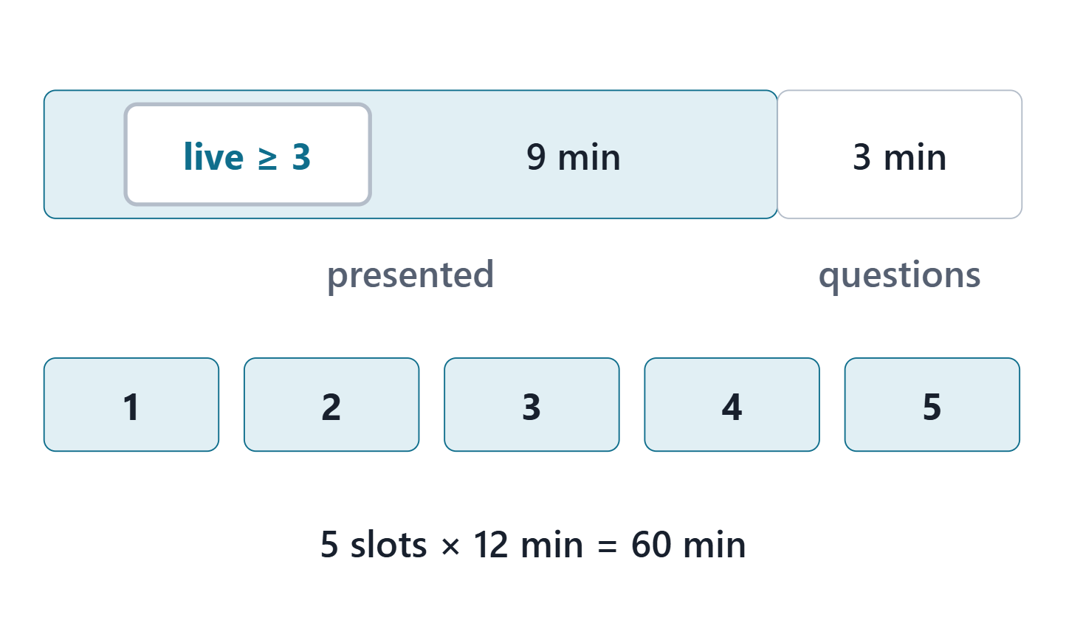
The final review
Order, timing and what the panel looks for
Live navigation of complete threads
The key decision and what would change it
Answers from the model, not from memory
Each member on their own elements
Figure. One review slot: 9 minutes presented, at least 3 of them live in the model, then 3 minutes of individual questions; 5 slots in all. Course illustration, not SysML v2 graphical notation.
Sources: R06c p.388

Slide 2
Team slot 1
12 minutes
Presentation: 9 min, at least 3 live in the model
Individual questions: 3 min, each on the member’s own elements
Audience: note one strength and one finding

Slide 3
Team slot 2
12 minutes
Presentation: 9 min, at least 3 live in the model
Individual questions: 3 min, each on the member’s own elements
Audience: note one strength and one finding

Slide 4
Team slot 3
12 minutes
Presentation: 9 min, at least 3 live in the model
Individual questions: 3 min, each on the member’s own elements
Audience: note one strength and one finding

Slide 5
Team slot 4
12 minutes
Presentation: 9 min, at least 3 live in the model
Individual questions: 3 min, each on the member’s own elements
Audience: note one strength and one finding

Slide 6
Team slot 5
12 minutes
Presentation: 9 min, at least 3 live in the model
Individual questions: 3 min, each on the member’s own elements
Audience: note one strength and one finding

Slide 7
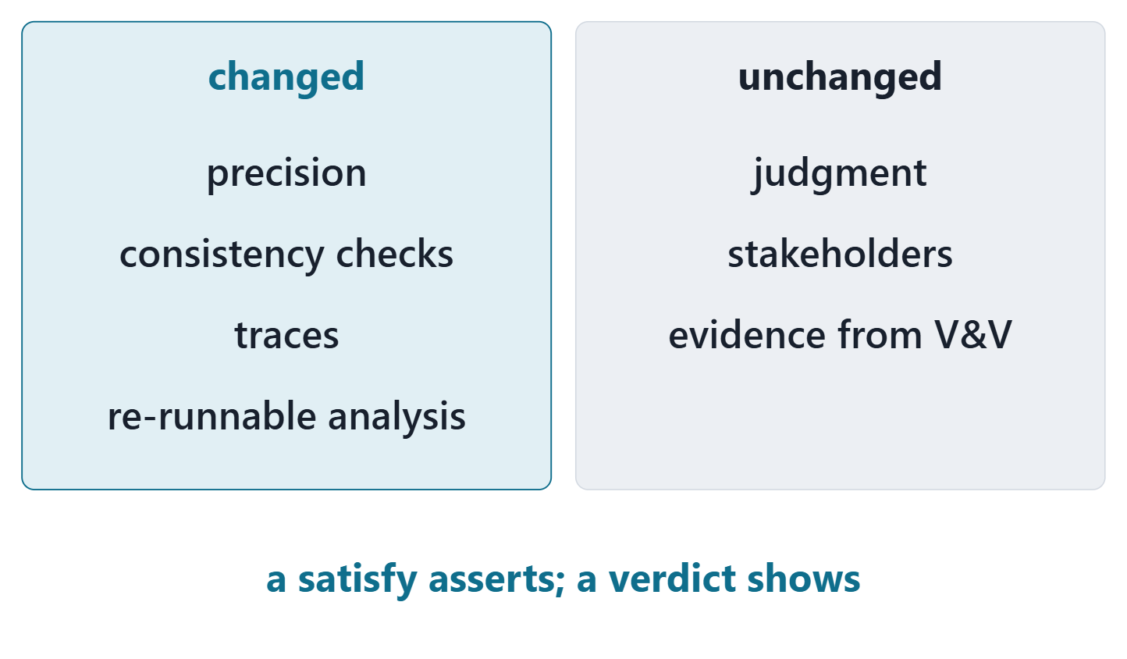
From document to model
Changed: precision, consistency checks, traces, re-runnable analysis
Unchanged: judgment, stakeholders, evidence from verification and validation
A model asserts; evidence shows
Figure. What the model changed and what it did not: precision, consistency checks, traces and re-runnable analysis on one side; judgment, stakeholders and evidence on the other. Course illustration, not SysML v2 graphical notation.
Sources: R29 p.1383–1384; R83 p.168

Slide 8
Next steps
Final model and review package: by the date on the course calendar
Panel findings: disposition each one in the package
Peer evaluation: within its window
Graduate students: the model-based adoption memo
Sources: R29 p.1383–1384

Slide 9
References and credits
R06c · SEBoK v2.14 (2026), “Technical Reviews and Audits”, p.386–388
R29 · SEBoK v2.14 (2026), “Transitioning Systems Engineering to a Model-based Discipline”, p.1383–1384
R83 · OMG SysML v2.1 Beta 2, Part 1 (Release 2026-07), “7.21 Requirements”, p.168
CREDITS AND LICENSES
SEBoK v2.14: “This material is used under a Creative Commons Attribution-NonCommercial ShareAlike 3.0 Unported License from The Trustees of the Stevens Institute of Technology.” (SEBoK, “Bkcase Wiki:Copyright”, PDF p.31). Quotations are short and cited; no SEBoK figure or table is reproduced.
Figures are original drawings for this course; none redraws a figure from the sources.
AeroLink Urban Mobility is a fictional teaching case: every number, name and statement about it is a teaching value.

